Slide 1
Biometrics
Lecture 4
Facial Recognition System
Lecturer: Dr. Joshua Okemwa

Slide 2
Expected learning outcomes
At the end of the lecture you will be able to:
Explore Facial Recognition System
Discuss the composition of Facial Recognition System
Evaluate the merits and demerits of Facial Recognition System

Slide 3
Areas of focus
The main areas of focus in this presentation include:
Facial Recognition System (FRS)
Reasons why FRS is preferred
How FRS works
Components of FRS
Merits and Demerits for Facial Recognition System

Slide 4
Facial Recognition System
A Facial Recognition System is an advanced technology designed to automatically identify or verify a person based on their facial features. It works by using computer algorithms and artificial intelligence (AI) to detect, analyze, and compare the unique patterns in a person’s face.

Slide 5
Cont…
Facial recognition is based on determining shape and size of jaw, chin, shape and location of the eyes, eyebrows, nose, lips, and cheekbones. 2D facial scanners start reading face geometry and recording it on the grid. The facial geometry is transferred to the database in terms of points. The comparison algorithms perform face matching and come up with the results.

Slide 6
Reasons as to why face recognition is preferred
It requires no physical interaction on behalf of the user.
It is accurate and allows for high enrolment and verification rates.
It does not require an expert to interpret the comparison result.
It can use your existing hardware infrastructure, existing cameras and image capture Devices will work with no problems
It is the only biometric that allow you to perform passive identification in a one to. Many environments (e.g.: identifying a terrorist in a busy Airport terminal

Slide 7
How it works
Image or Video Capture:
The system captures an image or video containing a face. This could be from a camera, smartphone, or security system. In live settings, the system continuously scans for faces.
Face Detection:
Once the image is captured, the system detects the face within the image. This step isolates the face from the background or other objects and ensures that only relevant data (the face) is processed further.

Slide 8
How it works
Feature Extraction:
The system analyzes specific facial features such as the distance between the eyes, the shape of the nose, the position of the cheekbones, jawline, and other distinguishable landmarks. These measurements create a unique set of data points, often referred to as a "faceprint" or "facial signature."

Slide 9
How it works
Matching and Comparison:
The facial data extracted is then compared to a database of stored faceprints. Depending on the application:
  Verification: The system checks if the face matches a specific individual (1:1 comparison). For example, verifying that the person unlocking a smartphone is the authorized user.
  Identification: The system scans the database to find any match (1: many comparison). This is commonly used in law enforcement or security systems.

Slide 10
How it works
Decision Making:
After comparing the faceprint with the database, the system either confirms a match or indicates no match was found. It then allows or denies access, flags a person, or triggers further action based on the context.

Slide 11
distinguishable landmarks on your face
When you look at your face in the mirror, certain distinguishable landmarks on your face—such as the distance between your eyes, the width of your nose, the shape of your cheekbones, and the contour of your jawline—are key in facial recognition. These landmarks are often referred to as nodal points in facial recognition technology.

Slide 12
distinguishable landmarks on your face
Nodal points are specific locations on your face that facial recognition software analyzes to create a unique "faceprint" or facial signature. While there are hundreds of distinguishable features, about 80 nodal points are generally used in most facial recognition systems.

Slide 13
points considered by th esoftware
These points help the software define your face's geometry and include factors like:
The distance between the eyes
The width of the nose
The depth of the eye sockets
The shape of the cheekbones
The length and width of the jawline

Slide 14
How the Software Uses Nodal Points:
The system measures these nodal points and converts them into a mathematical formula. This formula is unique to each individual, allowing the software to compare your face with others in a database for identification or verification purposes.
For instance, when you unlock your phone with face ID, the software quickly analyzes the nodal points of your face and compares them to the stored data. If the measurements match, access is granted.

Slide 15
cont…
These nodal points are key to how facial recognition systems identify and differentiate faces, even among billions of people.
Face detection applications use AI algorithms, ML, statistical analysis and image processing to find human faces within larger images and distinguish them from nonface objects such as landscapes, buildings and other human body parts. Before face detection begins, the analyzed media is preprocessed to improve its quality and remove images that might interfere with detection.

Slide 16
cont…
Face detection algorithms typically start by searching for human eyes, one of the easiest features to detect. They then try to detect facial landmarks, such as eyebrows, mouth, nose, nostrils and irises. Once the algorithm concludes that it has found a facial region, it does additional tests to confirm that it has detected a face.

Slide 17
cont.…
To ensure accuracy, the algorithms are trained on large data sets that incorporate hundreds of thousands of positive and negative images. The training improves the algorithms' ability to determine whether there are faces in an image and where they are.

Slide 18
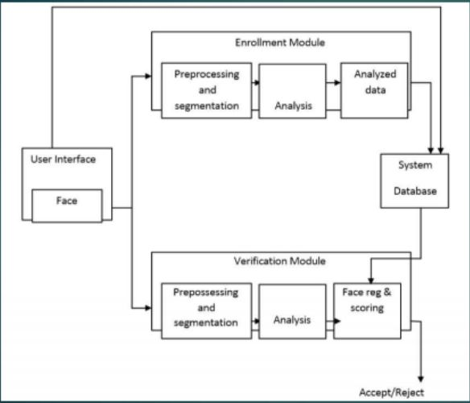
COMPONENTS OF FACE RECOGNITION SYSTEMS
source: slideshare.net
Author: Saghir Hussain

Slide 19
Explanation
Enrollment module : An automated mechanism that scans and captures a digital or an analog image of a living personal characteristics
Database : Another entity which handles compression, processing, storage and compression of the captured data with stored data
Identification module : The third interfaces with the application system

Slide 20
IMPLEMENTATION OF FACE RECOGNITION TECHNOLOGY
The implementation of face recognition technology includes the following three stages:
• Data acquisition
• Input processing
• Face image classification and decision making

Slide 21
explanation
Data acquisition
The input can be recorded video of the speaker or a still image. A sample of 1 sec duration consists of a 25 frame video sequence. More than one camera can be used to produce a 3D representation of the face.
Input processing
A pre-processing module locates the eye position and takes care of the surrounding lighting condition and colour variance.

Slide 22
Cont…
First the presence of faces or face in a scene must be detected. Once the face is detected, it must be localized.
Some facial recognition approaches use the whole face while others concentrate on facial components and/ or regions (such as lips, eyes etc). The appearance of the face can change considerably during speech and due to facial expressions.

Slide 23
explanation
Face image classification and decision making
Synergetic computer are used to classify optical and audio features, respectively. A synergetic computer is a set of algorithm that simulate synergetic phenomena. In training phase the BIOID creates a prototype called face print for each person.
A newly recorded pattern is pre-processed and compared with each face print stored in the database. As comparisons are made, the system assigns a value to the comparison using a scale of one to ten. If a score is above a predetermined threshold, a match is declared.

Slide 24
Face Bunch Graph
Face Bunch Graph (FBG) is a concept used in the context of face recognition systems, particularly in algorithms that deal with local feature analysis.
The FBG method focuses on representing a face based on its local features and their relationships, which can improve robustness in facial recognition, especially in varying lighting conditions or facial expressions.
By using a bunch of jets (local features) and organizing them in a graph structure, the system can efficiently recognize faces, even in challenging conditions.

Slide 25
Face Bunch Graph
FBG offers a more flexible and reliable recognition system compared to simpler holistic methods that analyze the entire face as a single unit.
A Face bunch graph is created from “70 nodal points” to obtain a general representation of face.
Given an image the face is matched to the Face bunch graph to find the same point.
These nodal points are measured to create a numerical code, a string of numbers that represents a face in the database. This code is called face print.
Only 14 to 22 nodal points are needed for faceit software to complete the recognition process.

Slide 26
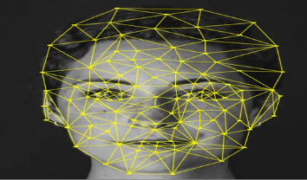
Diagram
Author: Md Khaled Hasan et al

Slide 27
benefits
• Convenience: Offers a fast and often hands-free way to verify identity.
• Security: Enhances security in places requiring high levels of protection.
• Automation: Reduces human error in identifying individuals.

Slide 28
challenges& Concerns
Privacy: Facial data is personal and sensitive. There are concerns about how the data is collected, stored, and used without consent.
Accuracy: Some systems may struggle with variations in lighting, angles, or identifying people from different ethnic backgrounds.
Bias: Studies have shown that some facial recognition systems can be less accurate for certain demographic groups, leading to concerns about fairness and discrimination.

Slide 29
Application
Security: Used in surveillance cameras to identify suspects or detect threats in public spaces like airports, train stations, or events.
Access Control: Allows authorized personnel to enter secure buildings or rooms, and it’s commonly used in smartphone unlocking.
Payments and Authentication: In some regions, facial recognition is used to authenticate online payments or access sensitive information.
Retail and Marketing: Brands use it to analyze customer demographics or personalize shopping experiences.

Slide 30
Review questions
Highlight reasons as to why you would prefer face recognition to fingerprint recognition
Mention a situation where face recognition wont work
In a paragraph, explain how face recognition system works
Explain THREE areas where you would encourage the use of face recognition systems
What is a face bunch graph
State any FOUR nodal points measured by a face recognition system
Highlight the roles of the different components of a face recognition system

Slide 31
References
Li, S. Z., & Jain, A. K. (Eds.). (2011). Handbook of face recognition (2nd ed.). Springer. https://doi.org/10.1007/978-0-85729-932-1
Wayman, J. L., Jain, A. K., Maltoni, D., & Maio, D. (Eds.). (2005). Biometric systems: Technology, design and performance evaluation. Springer.https://doi.org/10.1007/978-1-84628-064-1
Cappelli, R., Maio, D., & Maltoni, D. (2020). Challenges and solutions in face recognition systems: A review. Pattern Recognition Letters, 135, 65-73. https://doi.org/10.1016/j.patrec.2020.04.010

