Slide 1
Biometrics
Lecture 5
Hand Geometry
Lecturer: Dr. Joshua Okemwa

Slide 2
Expected learning outcomes
At the end of the lecture you will be able to:
Explore the hand geometry System
Discuss the features of hand geometry
Evaluate the applications of hand geometry

Slide 3
Areas of focus
The main areas of focus in this presentation include:
Hand geometry
Dimension of hand measurements
Features of hand geometry
Merits and Demerits of hand geometry
Application of hand geometry

Slide 4
Hand Geometry
Hand geometry refers to the method of biometric identification that uses the physical dimensions of a person’s hand to verify their identity. This includes measuring various features like the length, width, thickness, and shape of the fingers and the palm.

Slide 5
Cont…
Unlike fingerprint or iris recognition, which focuses on unique patterns, hand geometry relies on overall size and shape, which are distinct enough to differentiate between individuals but less precise than other biometric systems.

Slide 6
Cont…
While it is not as precise as fingerprint or iris recognition, it is highly practical and widely used in access control systems, time and attendance systems, and some security applications. Hand geometry biometrics measure and analyze the physical dimensions of a person’s hand, such as finger lengths, widths, thickness, and overall palm shape.

Slide 7
dimensions of the hand measured of the hand
Hand geometry focuses on the dimensions of the hand. It captures and measures the hand's features using a scanner that records characteristics such as:
Finger length and width: Each finger is measured in terms of length and width at various points.
Palm size and shape: The dimensions of the palm, including the width and height.
Finger placement and separation: The distances between the fingers and their relative position.
Thumb location: The position and orientation of the thumb relative to the rest of the hand.

Slide 8
Uniqueness of Hand Geometry
Hand geometry does not provide as high a level of uniqueness as fingerprints or retinal scans. However, the variation in hand dimensions from person to person is sufficient for identification purposes.
Hand geometry is more about the relative proportions of the hand rather than a specific unique pattern like fingerprints or iris patterns.

Slide 9
There are two Hand Geometry systems
Contact Based − a hand is placed on a scanner’s surface. This placement is positioned by five pins, which guide the candidate hand to position correctly for the camera.
Contact Less − In this approach neither pins nor platform are required for hand image acquisition.

Slide 10
Features of Hand Geometry
Robustness: Hand geometry works effectively even in environments where fingerprints might fail, such as in situations involving dirt, grease, or moisture. It is less affected by wear and tear compared to fingerprint recognition.
Low Sensitivity: It is relatively insensitive to small changes in hand structure over time, like minor cuts, swelling, or age-related variations.
Medium Accuracy: While less precise than fingerprints or iris scans, hand geometry is accurate enough for medium-security environments, such as workplaces or airports.

Slide 11
Data Captured by Hand Geometry Readers
The hand geometry reader scans the user’s hand when they place it on the reader’s surface, typically using pegs or a guide to ensure the hand is positioned consistently.
A digital camera captures an image of the hand, and a light source ensures proper visibility for measurement.
The image is processed by software that analyzes 90 to 100 unique points on the hand, including finger length, finger thickness, and palm shape.

Slide 12
How it works
Measurement Analysis:
The system extracts key measurements such as:
Finger lengths and thickness at multiple points.
Palm width and height.
Distance between fingers.

Slide 13
How it works
Template Creation:
The measurements are processed and turned into a biometric template, which is a numerical representation of the key hand geometry characteristics. This template is stored in a database for future comparison.
Verification or Identification:
When a person attempts to gain access or verify their identity, they place their hand on the reader. The system captures the new measurements and compares them against the stored template. If the measurements match within a certain threshold, the identity is confirmed.

Slide 14
where it is used
Access control
Used to accesss Health facilities, Daycare centers
Labaratories, prisons
Times & attendance
Personal Identification

Slide 15
Equipment needed to implement
To implement a hand geometry biometric system, several pieces of equipment are required to capture, process, and verify the physical characteristics of a person's hand. Here is a breakdown of the equipment typically needed for hand geometry recognition systems:

Slide 16
Equipment needed to implement
Hand Geometry Scanner (Hand Reader)
Computer/Processing Unit:
Biometric Software (Analysis and martching)
Database/ storage system
Userinterfce (optional)
Access control intergration (optional)
Communication Interface
Power Supply

Slide 17
Additional Considerations
Environment Setup:
Hand geometry readers need to be placed in well-designed environments. Adequate lighting and ergonomic placement of the reader are necessary for user comfort and accuracy.
Security Measures:
To ensure the privacy and security of biometric data, proper data encryption methods and firewall protections are needed, especially if the system is connected to a network.
Maintenance Tools:
Systems need regular cleaning and maintenance. Hand geometry readers can collect dust, dirt, or hand oils, which can affect performance over time. Regular calibration may also be needed for accurate readings.

Slide 18
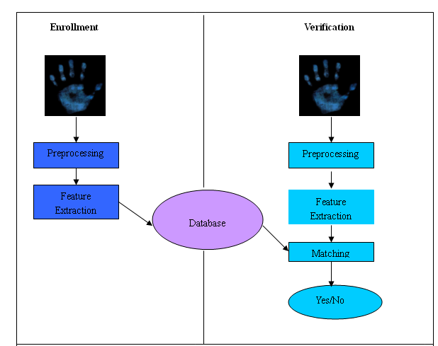
System demonstration
Source: slideshare.net
Author: Naghamallella

Slide 19
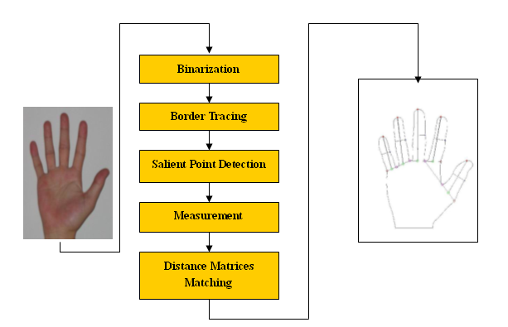
System demonstration
Source: slideplayer.com
Author: Shanon Hoover
A diagram for hand feature extraction and matching

Slide 20
Explanation
In hand geometry biometrics, binarization plays an important role during the image processing phase, specifically in the extraction and analysis of hand features. Binarization helps convert the captured image of a hand into a binary format, making it easier to differentiate the hand from the background, and to measure key geometric features like finger length, width, and palm shape.

Slide 21
Explanation
Binarization process involves:
Change input RGB image into gray-level image
Change the gray-level image into white-black image.
Due to illumination problems, Median filtering

Slide 22
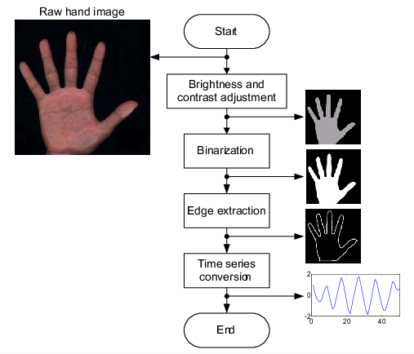
DIAGRAM
Author: V. Niennattrakul
C. Ratanamahatana

Slide 23
Explanation
Binarization is a critical preprocessing step in hand geometry biometrics. It simplifies the image by reducing it to black-and-white, making it easier for the system to measure and analyze the geometric features of the hand. The success of this step directly affects the accuracy and reliability of the biometric system, especially in terms of feature extraction and matching. Advanced techniques like adaptive thresholding help mitigate challenges such as uneven lighting and noise, ensuring more accurate results.

Slide 24
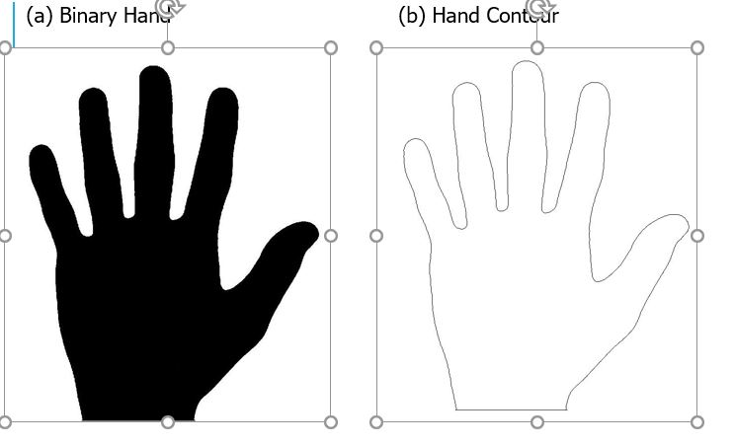
Diagram
Searching for the starting point using appropriate algorithms then record the coordinates of the border are recorded
Author: V. Niennattrakul,
C. Ratanamahatana

Slide 25
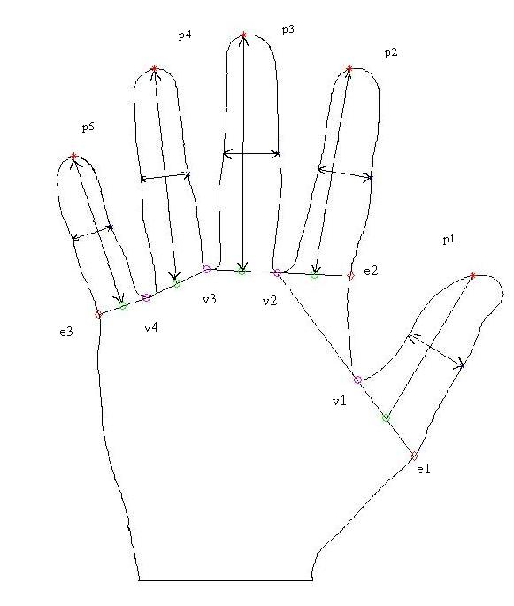
measurement
Generate a feature vector Vh, including 5 lengths of fingers, 10 widths
of fingers, and the width between v1 to v2.
Source: slideshare.net
Author: Naghamallella

Slide 26
comparison between biometric
BIOMETRIC TYPE | ACCURACY | EASE OF USE | USER ACCEPTANCE
Fingerprint | High | Medium | Low
Hand Geometry | Medium | High | Medium
Voice | Medium | High | High
Retina | High | Low | Low
Iris | Medium | Medium | Medium
Signature | Medium | Medium | High
Face | Low | High | High

Slide 27
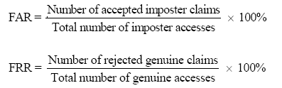
Performance Evaluation
FAR and FRR stands for false acceptance rate and false rejection rate, respectively. The FAR and FRR are defined as below:
Equal error rate (EER) where FAR = FRR.

Slide 28
advantages
User-Friendly:
Hand geometry readers are easy to use, requiring minimal training. Individuals just place their hand on a surface and wait for the scan to complete.
Low Intrusiveness:
Unlike fingerprint or retina scanning, hand geometry is considered less invasive, making it more comfortable for users in some applications.

Slide 29
cont…
Durability: The system is durable and can withstand adverse environmental conditions. It works effectively with hands that may be dirty, greasy, or slightly injured.
Stability Over Time: Hand geometry remains fairly stable over a person's lifetime, with only minor changes as a result of age. This allows the system to remain accurate for long-term use without frequent re-enrollment.
Speed: The technology is fast, with verification taking less than one second in most systems.

Slide 30
Disadvantages
Lower Uniqueness:
Hand geometry is not as distinctive as other biometric methods, like fingerprints or iris scans. This makes it less suitable for applications where high accuracy and uniqueness are critical.
Size and Bulk:
Hand geometry scanners are often larger and bulkier than fingerprint readers, making them less portable and harder to integrate into small devices.

Slide 31
Cont..
Hand-Related Issues:
Some users may have difficulties if they have hand injuries, deformities, or are missing fingers, which could affect the system's accuracy.
Limited Use for Large-Scale Identification:
Hand geometry is better suited for verification (one-to-one comparison) rather than identification (one-to-many), due to its limited uniqueness compared to other biometric technologies.

Slide 32
challenges& Concerns
Inflexibility in Positioning: Users need to position their hands correctly each time they interact with the scanner. Improper placement can lead to false rejections.
Changes in Hand Size: Weight fluctuations, swelling (e.g., due to injury or health conditions), and temporary hand deformities can affect the measurements and might require re-enrollment.
Technology Obsolescence: As more advanced biometric technologies like facial recognition and iris scanning become prevalent, hand geometry systems may face declining usage due to their relatively lower accuracy.

Slide 33
Application
Access Control: Hand geometry systems are often used in physical access control environments, such as securing entry points to buildings or restricted areas.
Time and Attendance Systems: In many organizations, hand geometry is used for tracking employee attendance.
Airport Security: Hand geometry recognition has been implemented in some airport security systems.

Slide 34
cont…
Healthcare Industry: Hospitals and healthcare facilities use hand geometry for staff verification and patient identification.
Educational Institutions: Some universities and schools use hand geometry for student attendance tracking and access to facilities such as libraries or examination halls. It ensures secure and accurate verification while maintaining convenience.

Slide 35
Review questions
Where can you use hand geometry . Give a reason for each place you identify
State three advantage of hand geometry
State three disadvantage of hand geometry
Compare hand geometry to Face recognition
Differentiate FAR from FRR

Slide 36
references
Singh, A. K., Agrawal, A. K., & Pal, C. B. (2019). Hand geometry verification system: A review. Proceedings of the International Conference on Ultra Modern Telecommunications & Workshops, St. Petersburg, Russia, 1-7. https://doi.org/10.1109/ICUMT.2009.5345652
Sidlauskas, D. (1998). Biometric identification using hand geometry measurements. Biometric Technology Today, 6(4), 10-12. https://doi.org/10.1016/S0969-4765(98)80154-7
Reillo, R. S., & Sanchez-Avila, C. (2001). Hand geometry and verification scores. Proceedings of the Workshop on Biometric Authentication, 66-69. https://doi.org/10.1007/3-540-44738-2_9

