Slide 1
Biometrics
Lecture 7
Iris Recognition System
Lecturer: Dr. Joshua Okemwa

Slide 2
Expected learning outcomes
At the end of the lecture you will be able to:
Understand the working of Iris Recognition System.
Discuss the features of Iris Recognition System.
Evaluate the challenges, recent developments and future trends.

Slide 3
Areas of focus
The main areas of focus in this presentation include:
Overview of Iris Recognition System (IRS)
Features of (IRS)
System demonstration
Advantages & Disadvantages of (IRS)
Challenges and concerns

Slide 4
Iris Recognition System
Iris recognition is a biometric identification system that uses unique patterns in the human iris to verify or identify individuals. It’s one of the most accurate biometric systems due to the complexity and stability of the iris structure, which remains consistent throughout a person's life.
Iris recognition refers to the process of identifying individuals based on the unique patterns present in their iris.

Slide 5
Iris Recognition System
Iris recognition system involves the use of techniques such as Gabor wavelet-based iris encoding and correlation filters to match iris images and produce a match score.
The iris is the colored, donut-shaped portion of the eye behind the cornea and surrounds the pupil. A person’s iris pattern is unique and remains unchanged throughout life.

Slide 6
Cont…
Iris recognition works on the basis of iris pattern in human eye. The iris is the pigmented elastic tissue that has adjustable circular opening in center. It controls the diameter of pupil. In adult humans, the texture of iris is stable throughout their lives.
The iris patterns of left and right eyes are different.

Slide 7
Cont…
The iris patterns and colors change from person to person.
It involves taking the picture of iris with a capable camera, storing it, and comparing the same with the candidate eyes using mathematical algorithms.
Note: The iris is covered by the cornea, the iris is well protected from damage, making it a suitable body part for biometric authentication.

Slide 8
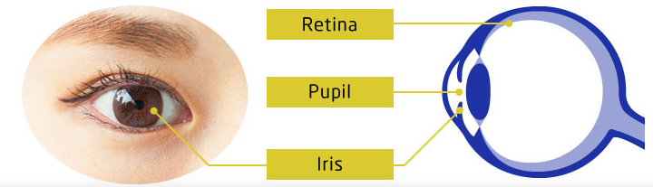
DIAGRAM
Source: nec.com

Slide 9
Explanation
Iris comes in a variety of colors, including brown (the most common), gray, blue, gray, hazel, violet, and pink. The iris has its own patterns which contribute to each person’s uniqueness. Iris recognition systems use a variety of methods to search the iris.

Slide 10
CONT…
Around 200 points on the iris such as rings, furrows, freckles, and other features will be reviewed. The information from each person is stored in a database and compared when a user wants to access the system.

Slide 11
FEATURES OF IRIS RECOGNITION
Highly accurate and fast, iris recognition boasts of having top-class precision among different types of biometric authentication technologies.
Remains unchanged throughout life. (This does not constitute a guarantee.)
Since the iris is different between the left and right eye, recognition can be performed separately by each eye.

Slide 12
CONT…
Possible to distinguish twins.
As long as the eyes are exposed, iris recognition can be used even when the subject is wearing a hat, mask, eyeglasses or gloves.
Because of using an infrared camera, recognition is available even at night or in the dark.
Without the need to touch the device, contactless authentication is possible, making it hygienic to use.

Slide 13
How it works
Image Acquisition: A camera, typically using infrared light, captures a high-quality image of the iris. Infrared illumination enhances the visibility of iris patterns while reducing glare and minimizing the effects of reflections from glasses or contact lenses.]
Preprocessing and Segmentation:
Segmentation: This process isolates the iris from other eye parts such as the eyelid, sclera (white part), and eyelashes. Accurate segmentation is crucial for reducing noise and extracting reliable features.

Slide 14
CONT
Normalization: The segmented iris is transformed into a standardized scale and orientation, accounting for variations in the distance and tilt between the eye and the camera.
Feature Extraction: Mathematical algorithms are applied to extract distinctive features from the iris. Techniques like Gabor filters or wavelet transforms convert the iris texture into a compact, high-dimensional vector, commonly referred to as an iris code. The code represents the unique patterns of furrows, ridges, and freckles found in the iris.

Slide 15
CONT
Matching: The generated iris code is compared against a database of previously stored iris codes. The system calculates the Hamming distance between two iris codes, which measures the similarity. If the distance is below a predefined threshold, the system concludes a match.

Slide 16
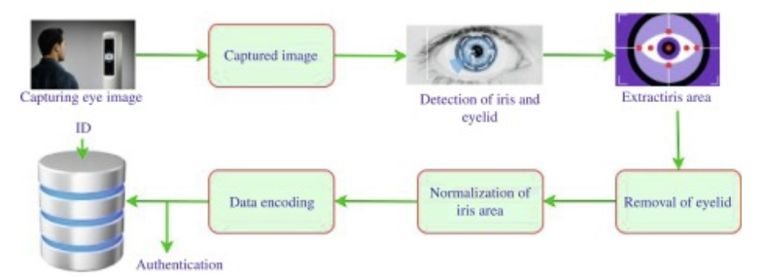
System demonstration
Source: sciencedirect.com
Author: Hala Fathee et al.

Slide 17
Explanation
The iris biometric system’s verification and enrollment processes are highly secure and precise, utilizing an individual's unique iris patterns for identification.
Enrollment establishes an individual's identity by capturing and storing their unique iris pattern in a secure database.
Verification confirms an individual’s identity by comparing a new scan of their iris to the stored template in the database.

Slide 18
cont….
The iris is an overt body that is available for remote assessment with the aid of a machine vision system to do automated iris recognition. Iris recognition technology combines computer vision, pattern recognition, statistical inference, and optics. The spatial patterns that are apparent in the human iris are highly distinctive to an individual.

Slide 19
advantages
Fast Processing Speed
Instant Verification: The system can match a captured iris image to stored data within seconds, making it suitable for time-sensitive situations, such as border control.
High Throughput: Many systems can process multiple people quickly, reducing queues and improving operational efficiency.
Enhanced Security
Difficult to Forge: The iris has complex patterns that are challenging to replicate, making it more secure against spoofing or identity theft.
Supports Multi-Layer Security: Iris recognition can be combined with other biometric systems (e.g., facial recognition or fingerprints) for even higher security, such as in multi-factor authentication.

Slide 20
Cont…
High Accuracy and Uniqueness
Unique Patterns: Each person’s iris has a unique pattern, even between the left and right eye, making it highly accurate for identity verification.
Low Error Rates: Iris recognition has lower false acceptance and rejection rates compared to other biometrics, minimizing identification errors.
Stability Over Time
Permanent Patterns: Iris patterns are stable from early childhood and do not change with age, illness, or environmental factors, unlike fingerprints or facial features.
Long-Term Reliability: This stability allows iris-based systems to offer consistent accuracy for years without needing re-enrollment.

Slide 21
cont…
Data Protection and Privacy
Encodes Patterns: Only encoded data or "templates" of the iris patterns are stored, not the actual image, which reduces privacy risks.
Compliance with Regulations: Many systems are designed to adhere to data protection laws, ensuring that user data remains secure and private.

Slide 22
Disadvantages
High Initial Costs
Expensive Technology: Iris recognition requires high-resolution cameras and sophisticated software, making it costlier than other biometric systems like fingerprinting.
Setup and Maintenance Costs: The infrastructure to install, maintain, and update iris scanners can be expensive, particularly for large-scale deployments in public or high-traffic areas.
Privacy and Ethical Concerns
Privacy Issues: The collection and storage of biometric data raise privacy concerns, especially as iris data is highly sensitive and unique to each individual.
Potential for Misuse: If not properly regulated, iris recognition could be misused for surveillance, raising ethical concerns about consent and personal privacy.

Slide 23
cont.…
Limitations in Certain Populations
Not Always Inclusive: Certain medical conditions (e.g., cataracts, glaucoma) or rare eye diseases can affect the clarity of the iris, leading to difficulties in capturing accurate data.
Age and Physical Limitations: Some groups, such as young children or the elderly, may have difficulty positioning themselves properly for the scan, reducing the system’s inclusivity.

Slide 24
challenges& Concerns
Image Quality Sensitivity: The accuracy of iris recognition depends heavily on the quality of the captured image. Poor lighting conditions, occlusion by eyelashes or glasses, and motion can affect performance.
Computational Demand: Iris recognition requires significant processing power due to the complexity of image processing and feature extraction techniques.
Environmental and Operational Issues: External conditions like lighting, distance, and positioning of the camera relative to the eye can affect system performance.

Slide 25
Application
Security and Access Control: Widely used in high-security environments such as airports, military facilities, and government buildings to ensure secure access.
Healthcare: Helps in patient identification and managing health records.
Mobile Authentication: Recently, iris recognition has been implemented in smartphones and other mobile devices for user authentication.

Slide 26
Recent Developments
Mobile and Contactless Iris Recognition: Efforts are being made to improve mobile iris recognition systems, making them contactless and more adaptable to real-world conditions.
Multimodal Systems: Iris recognition is often combined with other biometrics like fingerprints or facial recognition to enhance security and accuracy.

Slide 27
Future Trends
Enhanced Segmentation Algorithms: Research continues to improve segmentation techniques, especially in non-ideal scenarios such as variable lighting or off-angle gazes.
Lightweight and Fast Algorithms: Efforts are also underway to develop more efficient and faster iris recognition algorithms suitable for real-time applications on mobile or embedded devices.

Slide 28
cont....
Iris recognition is a robust and reliable biometric method due to the high uniqueness and stability of the iris. Despite some challenges, especially with image quality and computational demand, it remains a leading technology in security and identification systems, with continued advancements pushing its boundaries.

Slide 29
Review questions
Discuss the steps involved in iris recognitions processing?
Explain the segmentation and normalization stages in iris recognition.
Highlight the feature extraction techniques commonly used in iris recognition systems?
Explain how the matching algorithm in iris recognition work?
What are the advantages of using iris recognition over other biometric modalities?
Evaluate the potential vulnerabilities and limitations of iris recognition systems?

Slide 30
References
Daugman, J. G. (2004). How iris recognition works. IEEE Transactions on Circuits and Systems for Video Technology, 14(1), 21-30. https://doi.org/10.1109/TCSVT.2003.818350
Wildes, R. P. (1997). Iris recognition: An emerging biometric technology. Proceedings of the IEEE, 85(9), 1348-1363. https://doi.org/10.1109/5.628669

