Slide 1
Biometrics
Lecture 10
Other Biometrics Modalities
Lecturer: Dr. Joshua Okemwa

Slide 2
Areas of focus
The main areas of focus in this presentation include:
Overview of other biometric modalities
Introduction of behavioral modalities
Difference of DNA from other modalities
Application of Various modalities.

Slide 3
Other Biometric Modalities
In addition to well-known biometric modalities like fingerprints and facial recognition, several other biometric methods are gaining attention due to their unique and specialized applications. Here’s an overview of these alternative biometric modalities.

Slide 4
cont…
This other modalities include:
                Retinal scan system
                DNA Recognition System
                Gait recognition system
                Signature Recognition System
                Keystroke recognition system

Slide 5
Retinal Scanning System
Retina is the lining layer at the back of the eyeball that covers 65% of the eyeball’s inner surface. It contains photosensitive cells. Each person’s retina is unique due to the complex network of blood vessels that supply blood.
It is a reliable biometric as the retina pattern remains unchanged throughout the person’s life, barring the patterns of persons having diabetes, glaucoma, or some degenerative disorders.

Slide 6
cont…
In retinal scanning process, a person is asked to remove lenses or eyeglasses. A low-intensity infrared light beam is casted into a person’s eye for 10 to 15 seconds.
This infrared light is absorbed by the blood vessels forming a pattern of blood vessels during the scan. This pattern is then digitized and stored in the database.

Slide 7
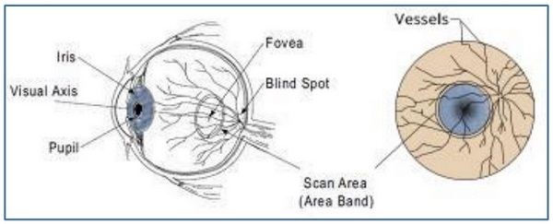
diagram
Source: Researchgate.net
Author: Kashif shaheed

Slide 8
Merits of retinal scan
High Accuracy: The retina’s vascular pattern is extremely complex and unique, providing a high level of precision in identification.
Stability Over Time: The retinal pattern remains relatively unchanged throughout a person's life, making it a stable biometric.
Security: Retinal scanning is highly secure, as it requires close-range scanning that is difficult to replicate or forge, providing robust protection for secure access applications.

Slide 9
Demerits of retinal scan
Costly Equipment: Retinal scanning requires specialized equipment that can be expensive to purchase and maintain.
User Discomfort: The scanning process requires close proximity to the scanning device, which some users may find intrusive or uncomfortable.
Health-Related Variability: Certain medical conditions, such as diabetes, glaucoma, or degenerative eye diseases, can alter retinal patterns, reducing the reliability of this biometric for affected individuals.

Slide 10
Application
High-Security Access Control: Due to its accuracy and security, retinal scanning is often used in high-stakes environments such as military installations, government facilities, and nuclear power plants.
Medical Identification: Some healthcare systems use retinal scanning for identifying patients, especially in specialized fields like ophthalmology, where records of the retina are already available.

Slide 11
cont…
3. Banking and Finance: Certain high-security banking operations or vault access controls may use retinal scanning to ensure that only authorized individuals can access sensitive areas or information.
4. Forensic Investigations: Retinal scanning can play a role in forensics, aiding in the accurate identification of individuals in criminal investigations or disaster victim identification.

Slide 12
summary
Retinal scanning’s high accuracy and reliability make it valuable in secure environments, but cost, scalability, and user comfort considerations limit its widespread adoption.

Slide 13
DNA Recognition System
Deoxyribo Neuclic Acid (DNA) is the genetic material found in humans.
Every human barring identical twins, is uniquely identifiable by the traits found in their DNA, which is located in the nucleus of the cell.
There are number of sources from which DNA patterns can be collected such as blood, saliva, nails, hair, etc.

Slide 14
cont…
DNA is organized in long double helix structure called chromosomes.
There are 23 pairs of chromosomes in humans. Out of the 46 total chromosomes, the offspring inherits 23 chromosomes from each biological parent. 99.7% of an offspring’s DNA is shared with their parents.
The remaining 0.3% DNA contains repetitive coding unique to an individual.

Slide 15
FUNDAMENTAL STEPS OF DNA PROFILING
Sample Collection: Gathering biological samples from individuals. Common sources include blood, saliva, hair, or skin cells.
DNA Extraction: Isolating DNA from the collected samples. This process involves breaking open cells and purifying the DNA from other cellular materials.
DNA Quantification: Measuring the amount of DNA extracted to ensure there's enough for analysis.
Polymerase Chain Reaction (PCR): Amplifying specific regions of DNA to generate sufficient quantities for analysis. PCR is a crucial step to target and replicate particular DNA sequences.

Slide 16
cont…
5.Electrophoresis: Separating the amplified DNA fragments by size using gel electrophoresis. An electric current is applied to a gel matrix, causing DNA fragments to migrate, allowing visualization of distinct patterns.
6.Analysis: Interpreting the resulting DNA profile. The unique patterns of DNA fragments are compared against reference samples or databases to identify individuals or determine genetic relationships.

Slide 17
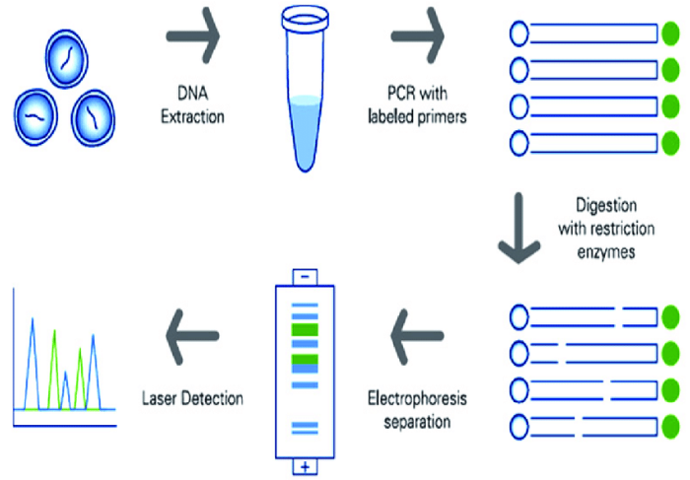
diagram
Source: Researchgate.net
Author: Nwawuba Stanley

Slide 18
DNA Biometrics differs from all others biometrics modalities
Uniqueness and Specificity: DNA is the most specific identifier, unique to each individual except identical twins.
Complexity: Analyzing DNA involves intricate procedures like extraction, amplification, and sequencing. In contrast, other biometrics mostly rely on pattern marching and image processing.
Stability: DNA remains constant throughout a person’s life. Other traits, such as facial features or voice, can change due to aging, health, or environmental factors.

Slide 19
cont…
4.Sample Types: DNA can be extracted from various biological materials (blood, saliva, hair), whereas other modalities require specific conditions for data capture.
5.Applications: DNA biometrics is widely used in forensic science, paternity tests, and genetic research due to its unmatched accuracy.
6.Data Protection: The handling and storage of DNA data require stringent security measures to prevent misuse, given its sensitive nature.

Slide 20
summary
DNA biometrics offers unparalleled accuracy and uniqueness but comes with higher complexity, ethical considerations, and the need for robust data protection. It's a powerhouse in identification but requires careful handling.

Slide 21
Behavioral Modalities
Behavioral biometrics pertains to the behavior exhibited by people or the manner in which people perform tasks such as walking, signing, and typing on the keyboard.
Behavioral biometrics modalities have higher variations as they primarily depend on the external factors such as fatigue, mood, etc.
This causes higher FAR and FRR as compared to solutions based on a physiological biometrics.

Slide 22
Behavioral Modalities
Behavioral biometrics modalities include the following:
                Gait recognition system
                Signature Recognition System
                Keystroke recognition system

Slide 23
Gait Recognition
Gait is the manner of a person’s walking. People show different traits while walking such as body posture, distance between two feet while walking, swaying, etc., which help to recognize them uniquely.
A gait recognition based on the analyzing the video images of candidate’s walk. The sample of candidate’s walk cycle is recorded by Video.

Slide 24
cont.…
The sample is then analyzed for position of joints such as knees and ankles, and the angles made between them while walking.
A respective mathematical model is created for every candidate person and stored in the database. At the time of verification, this model is compared with the live sample of the candidate walk to determine its identity.

Slide 25
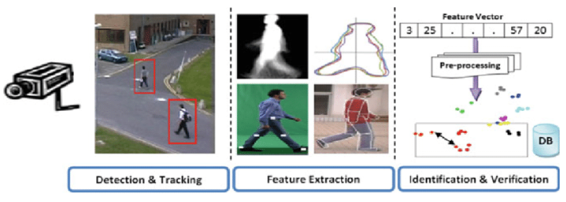
diagram
Source:
Researchgate.net
Author:
Imed Bouchrika

Slide 26
summary
Gait recognition is a behavioural biometric system that identifies individuals based on their unique walking patterns. It analyses parameters such as body movement, and walking speed captured through video footage
This makes it particularly useful for surveillance and security in public spaces
Gait recognition systems can operate at a distance, thus providing a reliable and convenient method for identifying individuals

Slide 27
Signature Recognition System
In this case, more emphasis is given on the behavioral patterns in which the signature is signed than the way a signature looks in terms of graphics.
The behavioral patterns include the changes in the timing of writing, pauses, pressure, direction of strokes, and speed during the course of signing. It could be easy to duplicate the graphical appearance of the signature but it is not easy to imitate the signature with the same behavior the person shows while signing

Slide 28
cont…
This technology consists of a pen and a specialized writing tablet, both connected to a computer for template comparison and verification.
A high quality tablet can capture the behavioral traits such as speed, pressure, and timing while signing.
During enrollment phase, the candidate must sign on the writing tablet multiple times for data acquisition.

Slide 29
cont…
The signature recognition algorithms then extracts the unique features such as timing, pressure, speed, direction of strokes, important points on the path of signature, and the size of signature.
The algorithm assigns different values of weights to those points.
At the time of identification, the candidate enters the live sample of the signature, which is compared with the signatures in the database.

Slide 30
unique properties of signature recognition system
Behavioral Biometrics: Unlike physiological biometrics (like fingerprints), signature recognition is based on behavioral traits, capturing the dynamic aspects of writing.
Dynamic and Static Recognition: Systems can analyze both the static image of the signature (shape, size, and angle) and the dynamic process (stroke order, pressure, speed).
NonIntrusive: Signature recognition is less invasive as it uses a familiar act of signing, requiring no physical or biometric scanning.

Slide 31
cont…
4.Change Over Time: Signatures can evolve with time or change due to various factors such as health or age, which adds complexity but also richness to the recognition process.
5.Forgery Detection: Advanced systems can detect even subtle differences between genuine signatures and forgeries by analyzing intricate writing dynamics.
6.Ease of Integration: Can be easily integrated into existing systems for document verification, banking, and legal purposes without the need for specialized hardware.

Slide 32
Constraints of Signature Recognition System
To acquire adequate amount of data, the signature should be small enough to fit on tablet and big enough to be able to deal with.
The quality of the writing tablet decides the robustness of signature recognition enrollment template.
The candidate must perform the verification processes in the same type of environment and conditions as they were at the time of enrollment. If there is a change, then the enrollment template and live sample template may differ from each other.

Slide 33
advantages
Signature recognition process has a high resistance to imposters as it is very difficult to imitate the behavior patterns associated with the signature.
It works very well in high amount business transactions.
It is a non-invasive tool.
We all use our signature in some sort of commerce, and thus there are virtually no privacy rights issues involved.
Even if the system is hacked and the template is stolen, it is easy to restore the template.

Slide 34
disadvantages
The live sample template is prone to change with respect to the changes in behavior while signing. For example, signing with a hand held in plaster.
User need to get accustomed of using signing tablet. Error rate is high till it happens.

Slide 35
Keystroke Recognition System
During the World War II, a technique known as Fist of the Sender was used by military intelligence to determine if the Morse code was sent by enemy or ally based on the rhythm of typing. These days, keystroke dynamics the easiest biometric solution to implement in terms of hardware.

Slide 36
CONT…
This biometric analyzes candidate’s typing pattern, the rhythm, and the speed of typing on a keyboard. The dwell time and flight time measurements are used in keystroke recognition.
Dwell time − It is the duration of time for which a key is pressed.
Flight time − It is the time elapsed between releasing a key and pressing the following key.

Slide 37
cont…
The candidates differ in the way they type on the keyboard as the time they take to find the right key, the flight time, and the dwelling time.
Their speed and rhythm of typing also varies according to their level of comfort with the keyboard.
There are two types of keystroke recognition:
Static − It is one time recognition at the start of interaction.
Continuous − It is throughout the course of interaction.

Slide 38
Merits
It needs no special hardware to track this biometric.
It is a quick and secure way of identification.
A person typing does not have to worry about being watched.
Users need no training for enrollment or entering their live samples

Slide 39
Demerits
The candidate’s typing rhythm can change between a number of days or within a day itself because of tiredness, sickness, influence of medicines or alcohol, change of keyboard, etc.
There are no known features dedicated solely to carry out discriminating information.

Slide 40
summary
Keystroke dynamics is non-intrusive, cost effective and can be implemented without additional hardware, making it a versatile tool for enhancing security across various domains.

Slide 41
References
Sharma, M., & Elmiligi, H. (2022). Behavioral Biometrics: Past, Present and Future. In M. Sarfraz (Ed.), Recent Advances in Biometrics1. IntechOpen. https://doi.org/10.5772/intechopen.102841
Rees, M. (2024). Behavioral Biometrics: A Complete Guide. Expert Insights. Retrieved from https://expertinsights.com/insights/a-guide-to-behavioral-biometrics/
IntechOpen. (2022). Behavioral Biometrics: Past, Present and Future. Retrieved from https://www.intechopen.com/chapters/80748

