Slide 1
Course
Lecture 1
Introduction to
basic principles in
Pharmacology
PHARMACOLOGY
Seth Mikaye

Slide 2
Pharmacology
Pharmakon = Drug, remedy, poison; Logos = Science
- Def: The study of drugs and their interactions with living systems.
- Entails study of drug absorption; distribution; metabolism and excretion.
- It deals with the discovery, development, and therapeutic applications of drugs.
DRUG: Def: Any subs (not food) able to diagnose, prevent or treat abnormal condition.
When introduced to the body, produces a non-nutritional physiological effects.
It (drug) does something to the body: Enhances, disrupts or silences it (body).

Slide 3
THE IDEAL DRUG
Safe
Selective
Effective
Wish List
Predictable, No adverse effects
No interaction
Cheap
Easy to administer
Reversible
N/B: Goal of Pharmacology? The drug to achieve max benefit for the patient with min harm.

Slide 4
WHAT DETERMINES THE STRENGTH OF A DRUG RESPONSE?
How much of the drug can we get at the desired site of action?
Dosage (amount) of medication
Route of administration
Timing in between doses
Unique patient individual differences
Pharmacokinetics: what the BODY does to the DRUG
Pharmacodynamics: what the DRUG does to the BODY

Slide 5
SUBDIVISIONS OF PHARMACOLOGY
Pharmacodynamics: The study of the biological and therapeutic effects of drugs (i.e, “what the drug does to the body”).
Pharmacokinetics: Study of the absorption, distribution metabolism and excretion (ADME) of drugs (“i.e what the body does to the drug”).
Pharmacotherapeutics: It deals with the proper selection (effective) and safe use of drugs for the prevention and treatment of disease.
Clinical Pharmacology: It’s the science that includes the study of effective use of drugs in humans.

Slide 6
Contd…
Chemotherapy: treatment of diseases by chemicals that kill the cells, especially those of microorganisms and neoplastic cells.
Toxicology: a branch of pharmacology which includes the study of adverse effects of drugs on the body. It deals with the symptoms, mechanisms, treatment and detection of poisoning caused by different chemical substances.
Pharmacoeconomics : deals with the cost of drugs. In this discipline the cost of one drug is compared with another for same use. The cheap drugs are preferred.
Pharmacogenetics: Branch of pharmacology dealing with the genetic variations that cause difference in drug response among individuals or population.

Slide 7
Contd…
Pharmacoepidemiology: deals with the effects of drugs on a large population. The effects may be good or harmful.
Comparative Pharmacology: deals with the comparison of one drug to another belonging to the same or another group
Posology: deals with the dosage of drugs. Example includes paracetamol given as one tablet of 500mg thrice a day.
Animal pharmacology: deals with the study of administering drugs and their effects in animals.

Slide 8
DRUG NOMENCLATURE
A drug generally has three categories of names:
(a) Chemical name
It describes the substance chemically, e.g. N-(4-hydroxyphenyl)ethanamide, for paracetamol
(b) Non-proprietary / official name / Approved name
Name in the official books accepted all over the world, e.g paracetamol
(c) Proprietary (Brand) name
''Panadol'' for Paracetamol

Slide 9
DRUG CATEGORY
1. Prescription drugs
Are used under only medical supervision and dispensed by an order of medical practitioner only
2. OTC drugs
Can be sold over the counter without prescription
3. Essential medicines
"those drugs that satisfy the health care needs of the majority of the population.
They should be available at all times in adequate amounts and appropriate dosage forms, at a price the community can afford."

Slide 10
4. Orphan drugs
Drugs for diagnosis/treatment/ prevention of a rare or orphan disease
Orphan disease: Fewer than 200,000 people – (National Cancer Institute).
Or drugs for more common disease (endemic regions) for which there is no reasonable expectation that the cost of developing and marketing it will be recovered from the sales of that drug.
Due to abandoned or "orphaned" studies due to insufficient funding or lack of interest in developing the drug.
Governments offer tax benefits and other incentives to pharmaceutical companies.
Eg. Ibrutinib, tafamidis…

Slide 11
SOURCES OF DRUGS
1. Minerals: Liquid paraffin, magnesium sulfate, magnesium trisilicate, kaolin, etc.
2. Animals: Insulin, thyroid extract, heparin and antitoxin sera, etc.
3. Plants: Morphine, digoxin, atropine, castor oil, etc.
4. Synthetic source: Aspirin, sulphonamide, paracetamol, zidovudine, etc.
5. Micro-organisms: Penicillin, streptomycin and many other antibiotics.
6. Genetic engineering: Human insulin, human growth hormone etc.
NOTE: Majority of drugs currently used - synthetic source.

Slide 12
IMPORTANT PHARMACOLOGICAL TERMS
Agonist: a drug capable of binding and activating a receptor, leading to a pharmacological response that could mimic an endogenous substance.
Antagonism: the opposition between two or more medications eg. morphine and Naloxone
Cumulative action: an increased effect caused by multiple doses of the same drug. Caused by buildup in the blood.
Potentiation: the enhancement of a drug’s effect by another drug.
  Eg. alcohol enhancing the effect barbiturates
Synergism: it is the combined action of two or more drugs, that is greater than the sum of the two drugs when acting separately.

Slide 13
Hypersensitivity: an inappropriate reaction to a drug which often results in an exaggerated immune response.
Idiosyncrasy: an abnormal reaction to a drug that is significantly peculiar to an individual.
Indication: refers to the condition (medical ) for which the drug has proven to be therapeutically beneficial.
Refractory: refers to the failure of a patient to respond as desired to a certain medication. It refers to a disease or condition that does not respond to treatment.

Slide 14
Therapeutic Action: the intended action of a drug given in an appropriate medical setting.
Therapeutic Threshold: the minimum amount of a drug that is required to evoke the desired response.
Therapeutic Index: refers to the difference between the therapeutic threshold and the amount of the drug considered to be toxic.
  Often referred to as the safety margin.

Slide 15
Tolerance: the diminished sensitivity or response to a drug that occurs when there is repeated use of the drug. Higher doses of the drug are required to achieve the desired effect. Usually leads to dependence.
Dependence : refers to the physical or psychological symptoms that occur, compelling someone to feel like they need to take a drug/substance to achieve an effect.
Untoward Effect: a side effect of a drug that is harmful to the patient.

Slide 16
Adverse events/effects/reactions: are unintended pharmacologic effects occurring when a medication is given correctly. Harmful and undesired. More severe and life threatening
Side effect: is a secondary unwanted effect (more predictable) that occurs during drug treatment. Side effects can be harmful of beneficial
Parenteral: any route of administration other than the digestive tract.

Slide 17
ROUTE OF DRUG ADMINISTRATION
Definition:- A route of administration in pharmacology is the path by which a drug is taken into the body
Classification
The various routes of administrations are classified into following categories:
1. Systemic Route
2. Local Route

Slide 18
1. Systemic route
From the alimentary tract:
(i) Sublingual/Buccal cavity: e.g. nitrates
(ii) Stomach: e.g. aspirin, alcohol
(iii) Intestine: e.g. most of non ionized and ionized drugs.
(iv) Rectum: e.g. rectal suppositories, bisacodyl laxatives.
2. Inhalation:
Via nebulized particles when sprayed as fine e.g. salmeterol spray and other volatile general anesthetics.

Slide 19
3. From the parenteral route (Injectables):
(i) Intradermal: Given into the layers of the skin e.g. B.C.G. vaccine
(ii) Subcutaneous: Non-irritant substances e.g. insulin
(iii) Intramuscular: e.g. multivitamins, streptomycin
(iv) Intravenous: Drugs directly given into a vein, e.g. furosemide, morphine, dopamine or as continuous infusion e.g. fluids during shock or dehydration.
(v) Intrathecal: Injected into subarachnoid space of spinal cord e.g. spinal anesthetics.

Slide 20
(vi) Intraperitonial: Injections given into the abdominal cavity e.g. infant saline, glucose.
(vii) Intra-articular: Injected directly into a joint e.g. hydrocortisone.
(Viii) Epidural: via vertebral interspace e.g, xylocaine
(Ix) Intracardiac: via heart muscles e.g, adrenaline
(x) Intra-arterial: via artery lumen e.g, radiopaque contrast media for coronary angiography, anticancer drugs
(xi) Intramedullary (intraossesous): Via tibia or sternum e.g, local anesthetic for bone marrow transplant

Slide 21
4. Transcutaneous route:
i) Iontophoresis: Galvanic current is used for bringing about the penetration of drugs into the deeper tissue e.g. salicylates.
Ii) Pellet & biodegradable implants: e.g, testosterone, contraceptives implants
iii) Jet injection: With help of high velocity jet produced through a micro fine orifice; No need of needle and therefore painless. e.g. mass inoculation programs.
iv) Adhesive units: A transdermal therapeutic system produce prolonged systemic effect e.g. scopolamine for motion sickness.

Slide 22
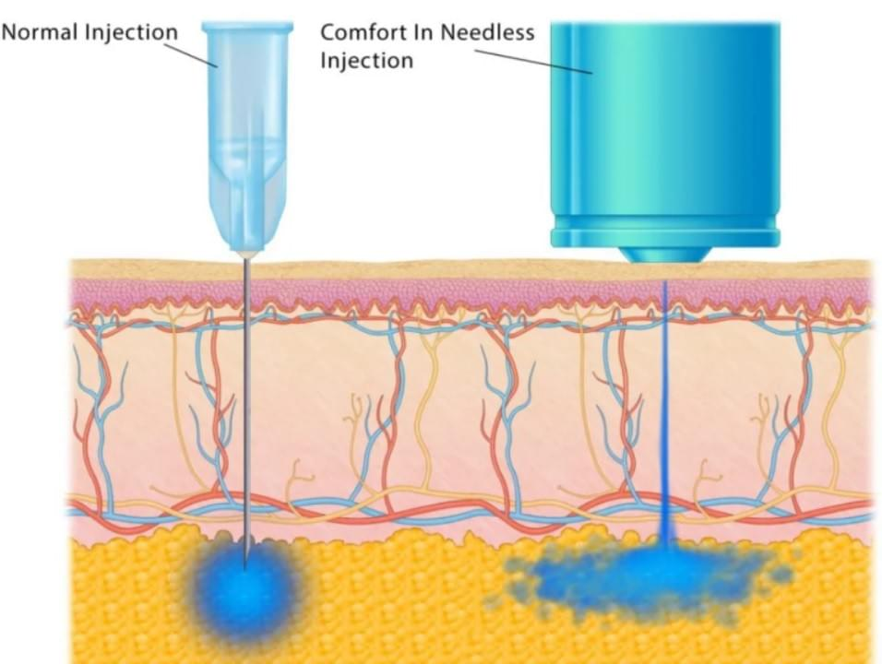
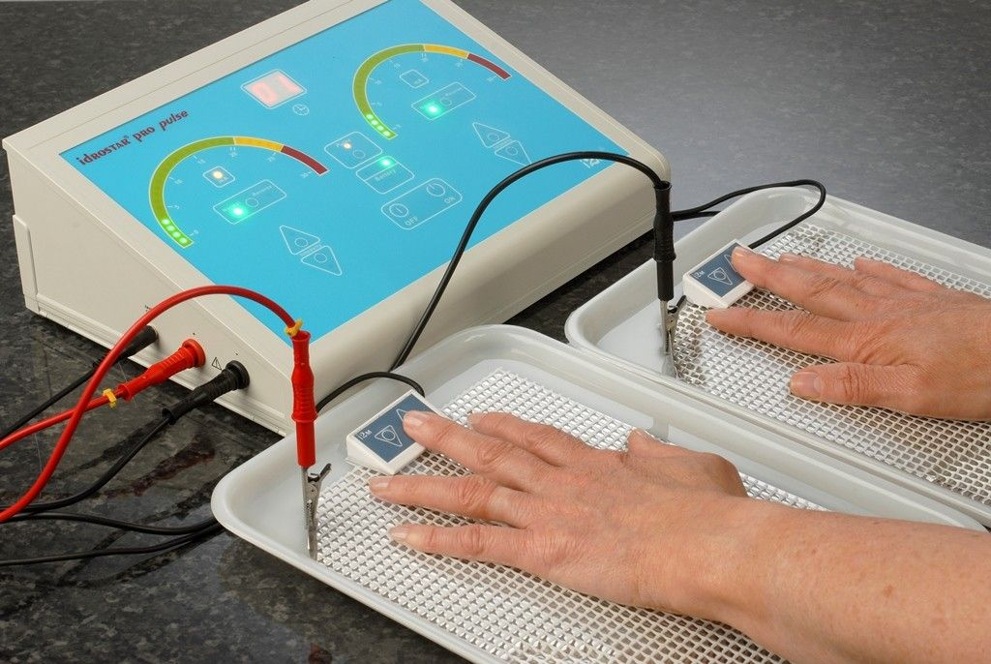
Jet inj. B. iontophoresis
Note source. (Health-D)
Note source. (The London Skin and Hair Clinic)

Slide 23
2. Topical/ local route:
Drug applied to the skin for local effect.
(i) Conjunctival, Nasal, Auditory mucosal: e.g chloramphenicol, gentamicin, ciprofloxacin, saline solutions
(ii) vaginal & urethral: pessaries, ointments, tablets, pencil-shaped bougies for urethra
(iii) Inunctions & dermal: rubbing drug into the skin e.g. nitroglycerin ointment in angina pectoris, or spray on the surface

Slide 24
Advantages & disadvantages of routes of administration
Advantages of Oral Route
Convenient - Can be self-administered, pain free, easy to take
Absorption - Takes place along the whole length of the gastro-intestinal tract
Cheap - Compared to most other parenteral routes

Slide 25
Disadvantages of Oral Route
• Sometimes inefficient - only part of the drug may be absorbed
• First-pass effect - drugs absorbed orally are initially transported to the liver via the portal vein
• Irritation to gastric mucosa - nausea and vomiting
• Destruction of drugs by gastric acid and digestive juices
• Effect too slow for emergencies
• Unpleasant taste of some drugs
• Unable to use in unconscious patient

Slide 26
Advantages of Sublingual and Buccal Route:
Rapid absorption
• Drug stability: - As in this route the drug does not go to the stomach, so it is not destroyed by the enzymes and acids present in the stomach so that it is stable.
• Avoid first-pass effect.

Slide 27
Disadvantages of Sublingual and Buccal Route
• Inconvenient: - In this route the drug is kept in the mouth
• Small Doses: - Small size to keep the drug in the mouth.
• Unpleasant taste of some drugs

Slide 28
Advantages of rectal/urethral/vaginal route
Convenient for unconscious patients.
Convenient for patient experiencing nauseous or vomiting
Disadvantages
May cause irritation
Absorption may be variable.

Slide 29
Intravascular:- drug is directly taken into the blood with the help of injection. Absorption phase is bypassed.
Advantages:-
1. Precise, accurate and almost immediate onset of action 2. Large quantities can be given, fairly pain free
3. Can be given to unconscious patients.
4. Quick action
5. Drugs having unpleasant taste can be given.

Slide 30
Disadvantages:-
1. Pain at the site of injection.
2. Greater risk of adverse effects
High concentration attained rapidly
Risk of embolism

Slide 31
Intramuscular:- In this route of administration, the drug is given into the muscles with the help of injection. Drug once reaches to the muscles, absorbs into the blood.
Advantages:
1. Very rapid absorption of drugs in aqueous solution
2. Depot and slow-release preparations
Disadvantages:
Pain at injection sites for certain drugs

Slide 32
Topical route: Drug applied to the skin for local effect.
Advantages:
1. Very low to no drug reaching systemic levels; therefore fewer or no side effects
2. Absence of drug–drug interactions
3. Ease of combinations of medications into one formulation for synergism
4. Higher concentration at the site of pain analgesics
5. User friendly, due to ease of application.

Slide 33
Disadvantages of topical route:
1. They sometimes can be time-consuming to apply.
2. The regimen could be complicated, especially if several different formulations are prescribed.
3. The applications could be messy or uncomfortable.

Slide 34
REFERENCES
Lippincott Illustrated Reviews: Pharmacology, ed.8 by Karen Whalen, Lippincott Home 2023.
Katzung's Basic and Clinical Pharmacology, 16th Edition by Todd W. Vanderah, McGraw Hill Medical, 2024.
Goodman and Gilman's the Pharmacological Basis of Therapeutics, 14th Edition by Laurence Brunton; Bjorn Knollmann, McGraw Hill Medical, 2024.

