Slide 1
Course
PHARMACOLOGY
Seth Mikaye
Lecture 2
Topic: Pharmacokinetics
“What the body does to the drug”

Slide 2
Pharmacokinetics
Refers to the movement of drug into, through, and out of the body.
Its the time course of a drug’s absorption, distribution, metabolism, and excretion (ADME).
It aims at understanding how drugs move throughout & interact with your body to provide safe & effective drug doses.
Knowledge of pharmacokinetic principles helps prescribers adjust dosage more accurately and effectively.
Application of pharmacokinetic principles to individualize pharmacotherapy is termed therapeutic drug monitoring (TDM), an important knowledge in optimization of therapy.

Slide 3
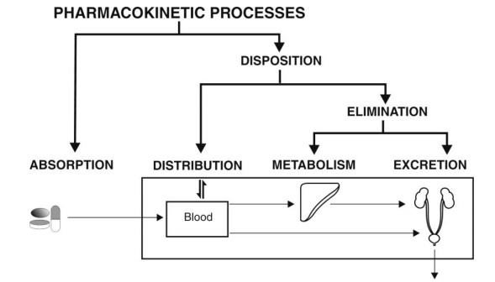
Diagram showing the process of Pharmacokinetics
Note source. (pharmacy180.com)- https://www.pharmacy180.com/media/imgph03/YGGahH1.jpg

Slide 4
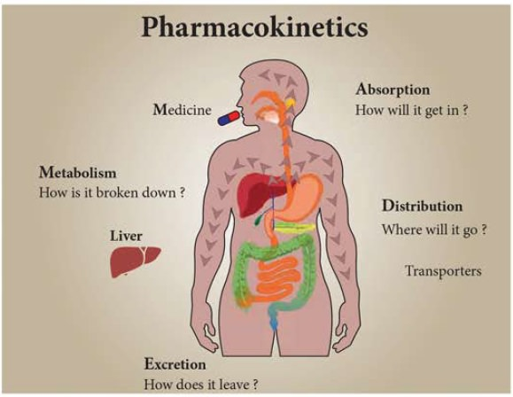
1. ABSORPTION
Absorption is the process by which the drug enters into the systemic circulation from the site of administration through biological barrier.
Necessary for the production of a therapeutic effect.
Most drugs undergo gastrointestinal absorption. This is extent to which drug is absorbed from gut lumen into portal circulation
Some bypasses absorption processes and enters into the circulation directly, e.g, I.V, intra-arterial injections.
Note source. (BrainKart.com) -https://img.brainkart.com/imagebk36/P02IdqO.jpg

Slide 5
Unless given IV, a drug must cross several semipermeable membranes before reaching systemic circulation.
Cell membranes are barriers that selectively inhibit the passage of drugs.
These membranes are composed majorly of a lipoidal matrix, which determines a membrane’s permeability features.
Drugs may cross cell membranes via the following process/mechanisms:
  1. Passive diffusion
  2. Facilitated passive diffusion
  3. Active transport
  4. Pinocytosis/endocytosis

Slide 6
Mechanisms of Drug Passage (absorption) across Membranes
Passive Diffusion: The drug diffuses across the membrane in the direction of its concentration gradient.
A more lipid soluble drug attains higher concentration in the membrane and diffuses quickly.
The un-ionized form is usually lipid soluble (lipophilic) and diffuses readily across cell membranes.
E.g, diazepam, fentanyl, sodium or potassium salts, morphine derivatives etc.

Slide 7
2. Active transport
Some drugs pass across the biological membrane against their concentration gradient with the help of carriers along with the expenditure of energy
Active transport seems to be limited to drugs structurally similar to endogenous substances (e.g. ions, vitamins, sugars, amino acids).
Such drugs are usually absorbed from specific sites in the small intestine, e.g. alpha methyl dopa, levodopa, 5-fluoro-uracil, 5 bromouracil.

Slide 8
3. Facilitated Diffusion
In this process, a carrier molecule in the membrane combines reversibly with the substrate molecule outside the cell membrane.
The carrier-substrate complex diffuses rapidly across the membrane, releasing the substrate at the interior surface.
The process does not require energy expenditure, and transport against a concentration gradient cannot occur, e.g. anti-cancer drugs, anti-viral drugs, certain vitamins etc.

Slide 9
4. Phagocytosis/Endocytosis/ Pinocytosis of drugs
▪ Cells have the ability to engulf either particles (phagocytosis) or droplets (pinocytosis).
▪ The cell membrane invaginates, encloses the fluid or particles, then fuses again, forming a vesicle that later detaches and moves to the cell interior.
Energy expenditure is required.
▪ The absorption of immunoglobulins through the gut mucosa of young calves depends on pinocytosis. E.g. insulin, vaccines

Slide 10
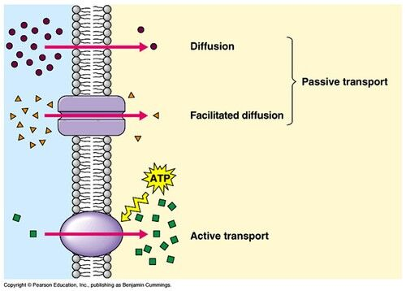
Mechanism of drug absorption
Note source. Pearson Education, Inc., publishing as Benjamin Cummings- https://ibb.co/LNJzvGy

Slide 11
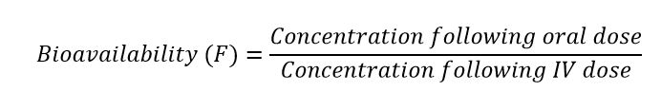
Drug BIOAVAILABILITY
Routes of administration other than I.V, may result in partial absorption and lower bioavailability.
Def: Bioavailability refers to the extent and rate at which the active concentration of drug or metabolite is available at the desired site of action.
Bioavailability of a drug: largely determined by the properties of the dosage form, which partly depend on its design and manufacture.
Differences in bioavailability among formulations of a given drug can have clinical significance; thus, knowing whether drug formulations are equivalent is essential.

Slide 12
First-pass effect/First-pass Metabolism/ Hepatic 1st pass effect/Pre-systemic metabolism
Is when an administered drug enters the liver and undergoes extensive biotransformation and thus decreasing the concentration rapidly before it reaches its target.
It happens most commonly when the drug is administered orally.
The drug then is absorbed in the GIT and enters the portal circulation before entering the systemic circulation.
The drug concentration is decreased, as a result.

Slide 13
Beneficial effect of first-pass effect
Some drugs take benefit of the liver biotransformation.
These drugs are administered as prodrugs and are converted from inactive to active form.
Prodrug: A prodrug is a pharmacologically inactive medication or compound that, after intake, is metabolized into a pharmacologically active drug.
E.g. Codeine is administered and demethylated (biotransformation in liver) into its active form Morphine.

Slide 14
DISTRIBUTION

Slide 15
DISTRIBUTION
Def: Reversible Transfer of a Drug between the Blood and the Extra Vascular Fluids and Tissues of the body (for example, fat, muscle, and brain tissue).
All of the fluid in the body (referred to as the total body water), in which a drug can be dissolved, can be roughly divided into three compartments:
intravascular (blood plasma, within blood vessels)- 3L or 4% of BW
interstitial/extravascular (fluid surrounding cells) – 9L or 13% of BW
intracellular (fluid within cells, i.e. cytosol) – 28L or 41% of BW

Slide 16
Factors affecting distribution
The distribution of drugs to body tissues and fluids is generally uneven because of several factors:
Physico-chemical properties of the drug: particle size of drug, lipid solubility etc.
Permeability across tissue barrier: presence of biological barriers.
Plasma protein binding with drug: Protein + drug ⇌ Protein-drug complex
Tissue binding with drug; binding with bones, liver, hair, fats etc.
PH
pka
Cardiac output and blood flow. Increased cardiac output increases the distribution

Slide 17
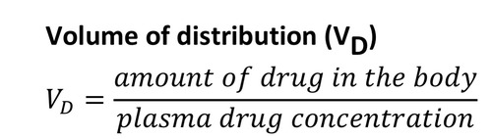
Volume of distribution
Fluid volume that is required to contain the entire drug in the body at the same concentration measured in the plasma.
Calculated by dividing the dose that ultimately gets into the systemic circulation by the plasma concentration.

Slide 18
EXAMPLE
If 50 mg of drug reaches circulation (total amount of drug ) And if plasma concentration is 0.5 mg/ml, calculate the volume of distribution.
Amount of drug in the body = 50 mg. plasma drug conc. = 0.5 mg/ml
Vd = 50mg/0.5mg/ml = 100 ml.
Which means you require 100 ml of fluid to accommodate a total of 50 mg of drug at concentration of 0.5 mg/ml.

Slide 19
Volume of distribution has nothing to do with the actual volume of the body or its fluid compartments but rather involves the distribution of the drug within the body.
Generally, drugs that are highly tissue-bound, have very little drug remain in the circulation; thus, plasma concentration is low and volume of distribution is high.
Drugs that remain in the circulation tend to have a low volume of distribution.

Slide 20
QUIZZ
For example, if the amount of drug in the body is 2000 mg and the plasma concentration is 2 μg/ml, what will be it’s volume of distribution?
A. 10L
B. 1000ml
C. 1000L
D. 100L

Slide 21
METABOLISM (BIOTRANSFORMATION)

Slide 22
Biotransformation: Chemical alteration of the drug in body that converts nonpolar or lipid soluble compounds to polar or lipid insoluble compounds.
• Consequences of biotransformation: Active drug converts to Inactive metabolite.
N/B: Although metabolism typically inactivates drugs, some drug metabolites are pharmacologically active (prodrug)
Sites of Drug Metabolism: The liver is the principal site of drug metabolism.
-Hepatic microsomal enzymes: found in the endoplasmic reticulum of hepatocytes.
-Hepatic non-microsomal enzymes: located in sites other than endoplasmic reticulum (microsomes), e.g, cytoplasm, mitochondria, etc.

Slide 23
Why Drug Biotransformation?
All chemical substances that are not nutrients for the body and enter the body through, ingestion, inhalation or absorption are called as xenobiotics (Greek: xenos = foreign) or exogenous compounds.
For effective absorption, a drug needs to be sufficiently lipid soluble.
But for excretion, only water-soluble agents undergo renal excretion (major route for exit of drugs from the body).
Whereas lipid soluble substances are passively reabsorbed from the renal tubules into the blood after glomerular filtration.

Slide 24
Biotransformation...
Normally: results in pharmacological inactivation of drugs, i.e. it results in formation of metabolites with little or no pharmacological activity; e.g. conversion of phenytoin to p-hydroxy phenytoin.
Occasionally: yields metabolites with equal activity; e.g. conversion of phenylbutazone to oxyphenbutazone.
Rarely: leads to toxicological activation of drugs, i.e. it results in formation of metabolites with high tissue reactivity; e.g. conversion of paracetamol to reactive metabolite (N-acetyl-P-benzoquinoneimine) that cause hepatic necrosis.

Slide 25
Drug Metabolizing Organs
Liver is the primary site for metabolism of almost all drugs (and other xenobiotics) because of its possession of large variety of enzymes.
Metabolism by organs other than liver (called as extrahepatic metabolism) is of minor importance since lower level of drug metabolizing enzymes are present in such tissues.
The decreasing order of drug metabolizing ability of various organs is:
Liver > Lungs > Kidneys > Intestine > Placenta > Adrenals > Skin Brain, testes, muscles, spleen, etc.

Slide 26
Metabolic enzymes: Cytochrome P- 450
Cytochrome P-450 (CYP450), a microsomal superfamily of isoenzymes that catalyzes the oxidation of many drugs is the most important enzyme.
CYP450 enzymes can be induced or inhibited by many drugs and substances resulting in drug interactions.
With aging, the liver’s capacity for metabolism through the CYP450 enzyme system is reduced by ≥ 30%.
Thus, drugs that are metabolized through this system reach higher levels and have prolonged half-lives in older people.
Because neonates have partially developed hepatic microsomal enzyme systems, they also have difficulty metabolizing many drugs.

Slide 27
Phase I metabolism
  Includes; oxidation, reduction, and hydrolysis reactions.
  Phase I reactions convert a parent drug to more polar (water soluble) active metabolites by unmasking or inserting a polar functional group (-OH, -COOH, -SH, -NH2)
  Thus, phase I reactions are also called as functionalization reactions.
  The resulting product of phase I reaction is susceptible to phase II reactions.
  Generally, geriatric patients have decreased phase I metabolism
  Drugs metabolized via phase I reactions have longer half-lives
  Geriatric patients metabolize drugs majorly by phase II reactions

Slide 28
Phase II metabolism
  Involves covalent attachment of small polar endogenous molecules such as glucuronic acid, sulphate, glycine, etc. to either unchanged drugs or phase I products having suitable functional groups viz. -OH, -COOH, -NH₂ and -SH to form highly water-soluble conjugates which are readily excreted.
  Thus, these reactions are called as conjugation reactions, since the outcome of such processes are generally products with increased molecular size (and altered physicochemical properties).
  Hence, phase II reactions are better known as true detoxification reactions.

Slide 29
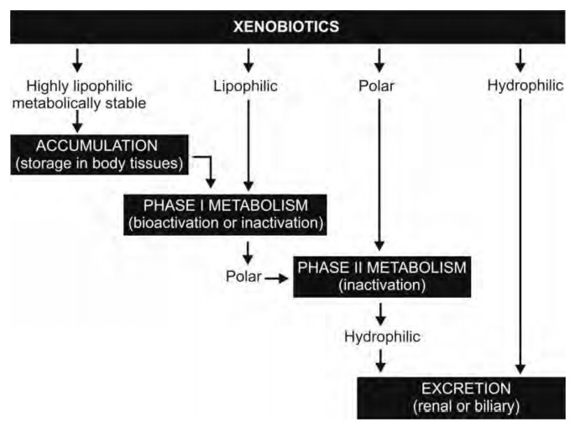
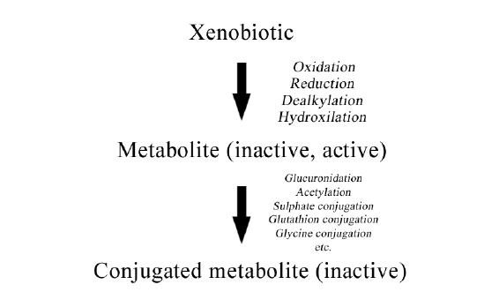
Phase I &II reaction - Summary
Note source. (Readings in Advanced Pharmacokinetics - Theory, Methods and Applications)-
https://ibb.co/Vg8NtRz
Note source. (Pharmacy180.com)- https://www.pharmacy180.com/media/imgph03/7auggpO.jpg

Slide 30
Microsomal Enzyme Induction
Certain drugs and chemicals tend to increase the synthesis of microsomal enzyme protein.
Different inducers are relatively selective for certain cytochrome P-450 enzyme families e.g. Phenobarbitone , rifampin, glucocorticoids induce CYP3A isoenzymes, Isoniazid and chronic alcohol consumption induce CYP2E1
Induction takes 4-14 days to reach its peak and is maintained till the inducing agent is present.
Although prominent in the liver, it may occur in placenta, intestines, lungs and kidneys, e.g CYP1A1 isoenzyme induced in the lungs of cigarette smokers.

Slide 31
Clinical significance of enzyme induction
Enzyme induction is normally associated with a reduction in the drug efficacy.
It reduces plasma half-life and duration of action of drugs.
It enhances drug tolerance.
It increases drug toxicity by enhancing concentration of metabolite, if metabolite is toxic.
It increases chances of drug interactions.

Slide 32
Examples of Clinically important enzyme inducers
Sr No | Enzyme inducer drug / substance | Drugs whose metabolism is increased
1 | Cigarette (Benzopyrene) | Benzodiazepines, paracetamol, propoxyphene, theophylline
2 | Ethanol | Barbiturates, phenytoin, warfarin, tolbutamide
3 | Barbiturates (phenobarbitone) | Phenytoin, warfarin, corticosteroids, phenothiazines, doxycycline, digitoxin, quinidine, calcium channel blockers, ℬ - blockers

Slide 33
Clinical significance of Enzyme Inhibition
Enzyme inhibitors are important for a variety of reasons:
They can be used to gain information about the shape on the enzyme active site and the amino acid residues in the active site.
They can be used to gain information about the chemical mechanism.
They can be used to gain information about the regulation or control of a metabolic pathway.
They can be very important in drug design.

Slide 34
Examples of Clinically significance enzyme inhibitors
inhibitors | substrates
Cimetidine, ciprofloxacin, isoniazid, macrolide antibiotics, paroxetine | Acetaminophen, amitriptyline, cyclobenzaprine, erythromycin, estradiol, naproxen, theophylline
Amiodarone, chloramphenicol, cimetidine, fluvoxamine, zafirlukast | Celecoxib, diclofenac, losartan, naproxen, piroxicam, torsemide, warfarin
Azole antifungals, fluvoxamine, omeprazole, topiramate | Amitriptyline, citalopram, diazepam, lansoprazole, phenobarbital, propranolol, topiramate

Slide 35
Role of Metabolism
In pediatric and elderly
New born have low glomerular filtration rate and tubular transport is immature, so the half life (t1/2) of the drug like streptomycin and penicillin are prolonged.
Hepatic drug metabolizing system is inadequate in new born e.g. chloramphenicol can produce gray baby syndrome (UDP-glucoronyl transferase).
In elderly the renal function progressively declines.
Reduction of hepatic microsomal activity and liver blood flow.
Incidence of adverse drug reactions is much higher in elderly.

Slide 36
4. EXCRETION

Slide 37
EXCRETION
Excretion of drugs refers to the transportation of unaltered/altered form of drug out of the body.
The major processes of excretion include renal excretion, hepatobiliary excretion and pulmonary excretion.
The minor routes of excretion are saliva, sweat, tears, breast milk, vaginal fluid, nails and hair.
The rate of excretion influences the duration of action of drug.
For drugs that are excreted slowly, their concentration in the body is maintained and the effects of the drug will continue for longer period.

Slide 38
Different routes of drug excretion
a) Renal excretion: A major part of excretion of chemicals is metabolically unchanged or changed. The excretion of drug by the kidney involves.
i) Glomerular filtration
ii) Active tubular secretion
iii) Passive tubular reabsorption.
The function of glomerular filtration and active tubular secretion is to remove drug out of the body, while tubular reabsorption tends to retain the drug.

Slide 39
i) Glomerular filtration: It is a process, which depends on (1) the concentration of drug in the plasma (2) molecular size, shape and charge of drug (3) glomerular filtration rate.
Only the drug which is NOT bound with the plasma proteins can pass through glomerulus. All the drugs which have low molecular weight can pass through glomerulus e.g. digoxin, ethambutol, etc.
In congestive cardiac failure, the glomerular filtration rate is reduced due to decrease in renal blood flow.

Slide 40
ii) Active tubular secretion:
The cells of the proximal convoluted tubule actively transport drugs from the plasma into the lumen of the tubule e.g. acetazolamide, benzyl penicillin, dopamine, pethidine, thiazides, histamine.

Slide 41
iii) Tubular reabsorption: The reabsorption of drug from the lumen of the distal convoluted tubules into plasma occurs either by simple diffusion or by active transport.
Acidic urine: the degree of ionization of basic drug increase and their reabsorption decreases.
Alkaline urine: the degree of ionization of acidic drug increases and the reabsorption decreases.
In alkaline urine, acidic drugs are more readily ionized. In acidic urine, alkaline drugs are more readily ionized.
Ionized substances (also referred to as polar) are more soluble in water so dissolve in the body fluids more readily for excretion.

Slide 42
b) Hepatobiliary excretion
Molecular weight more than 300 Dalton and polar drugs are excreted in the bile.
Excretion of drugs through bile provides a back up pathway when renal function is impaired.
After excretion of drug through bile into intestine, certain amount of drug is reabsorbed into portal vein leading to an enterohepatic cycling which can prolong the action of drug e.g. chloramphenicol, oral estrogen are secreted into bile and largely reabsorbed and have long duration of action.

Slide 43
c) Gastrointestinal excretion: When a drug is administered orally, a part of the drug is absorbed and excreted in the feces.
The drugs which do not undergo enterohepatic cycle after excretion into the bile are subsequently passed with stool e.g. aluminum hydroxide changes the stool into white color, ferrous sulfate changes the stool into black and rifampicin into orange red.
d) Pulmonary excretion: Drugs that are readily vaporized, such as many inhalation anesthetics and alcohols are excreted through lungs.

Slide 44
e) Sweat: A number of drugs are excreted into the sweat either by simple diffusion or active secretion e.g. rifampicin, metalloids like arsenic and other heavy metals.
f) Mammary excretion: Many drugs mostly weak basic drugs are accumulated in the breast milk.
e.g. ampicillin, aspirin, chlordiazepoxide, coffee, diazepam, furosemide, morphine, streptomycin etc.

Slide 45
Elimination Kinetics
First order elimination: occurs when a constant proportion of drug is eliminated per unit time.
2. Zero order: a constant amount of drug is eliminated per unit time.
For example 2.5mg of a drug maybe eliminated per hour, this rate of elimination is constant and is independent of the total drug concentration in the plasma.
Zero order kinetics are rare Elimination mechanisms

Slide 46
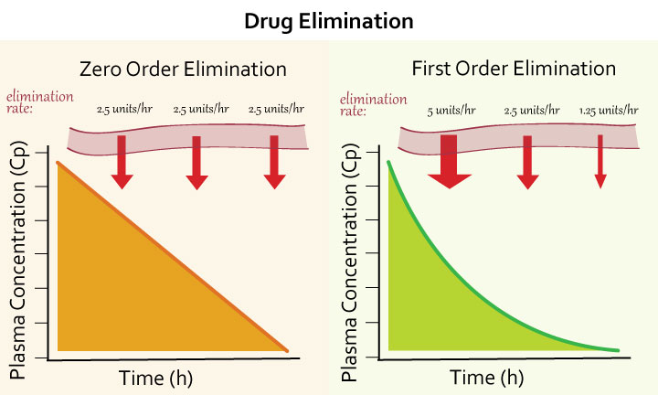
Note source. (Medbullets step1)- https://upload.medbullets.com/topic/107004/images/elimination-of-drugs.jpg

Slide 47
Half life
Half life (t1/2) of a drug is the time taken for the concentration of drug in the blood or plasma to decline to half of original value or the amount of drug in the body to be reduced by 50%.
A half-life value can be readily determined for most drugs by administering a dose of the drug to a subject, taking blood samples at various time intervals and then assaying the samples.
For example if a blood level of drug A is 8.6 mg/ml at 10 minutes and 4.3 mg/ml at 60 minutes, so the half – life of that drug is 50 minutes.

Slide 48
REFERENCES
Lippincott Illustrated Reviews: Pharmacology, ed.8 by Karen Whalen, Lippincott Home 2023.
Goodman and Gilman's the Pharmacological Basis of Therapeutics, 14th Edition by Laurence Brunton; Bjorn Knollmann, McGraw Hill Medical, 2024.
TH 2019 - 2025 pharmacy180.com; Developed by Therithal info. Website; www.Pharmacy180.com

