Slide 1
Course
Lecture 3
Topic: Pharmacodynamics
“What the drug does to the body”
PHARMACOLOGY
Seth Mikaye

Slide 2
PHARMACODYNAMCS - Introduction
Is concerned with the actions, interactions and the mechanisms of drugs on target cells to alter cellular function.
Drug action can be specific (involve receptors) or non-specific (not involving receptors).
Receptor mechanisms:
Receptors: are protein molecules (sites) present either on the cell surface or with-in the cell where a ligand (drug) can bind.
Drugs are capable of 'ligating' themselves to the receptor protein.

Slide 3
This binding initiates a conformational change in the receptor protein leading to a series of biochemical reactions inside the cell (‘signal transduction’).
Example of receptor specific; hormones, autacoids and most of the drugs produce their effects by binding with their specific receptors.
Example of receptor non-specific: Aluminum hydroxide and magnesium trisilicate (used peptic ulcer disease) act by non-receptor mechanism by neutralizing the gastric acid.

Slide 4
Many drugs are similar to or have similar chemical groups to the naturally occurring chemical and have the ability to bind onto a receptor.
Here one of two things can happen- either the receptor will respond or it will be blocked.
When a drug is able to stimulate a receptor, it is known as an agonist and therefore mimics the endogenous transmitter.
A drug, which is able to fit onto a receptor, is said to have affinity for that receptor.

Slide 5
Efficacy is the ability of a drug to produce an effect at a receptor. An agonist has both an affinity and efficacy whereas antagonist has affinity but not efficacy.
When the drug blocks a receptor, it is known as antagonist and therefore blocks the action of the endogenous transmitter (i.e. it will prevent the natural chemical from acting on the receptor).
However, as most drug binding is reversible, there will be competition between the drug and the natural stimulus to the receptor.

Slide 6
Drug – receptor reaction
The forces that attract the drug to its receptor are termed chemical bonds and they are:
(a) hydrogen bond
(b) ionic bond
(c) covalent bond
(d) Van der Waals force.
Covalent bond is the strongest bond and the drug-receptor complex is usually irreversible.

Slide 7
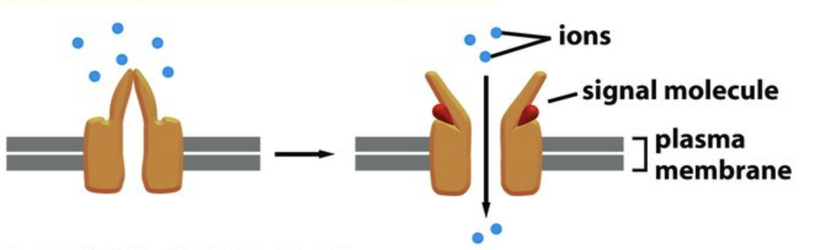
Types of receptors
1. Ion Channel-linked Receptors
Coupled directly to an ion channel. Activation opens the channel, making a cell membrane permeable to specific ions.
Upon binding a ligand, they change shape such that a channel is formed across the plasma membrane, allowing specific ions to pass through.
e.g, Nicotinic acetylcholine receptors; gamma –aminobutyric acid receptors (GABA), Na+ channels
Note source. (The cell)- https://personalpages.manchester.ac.uk/staff/j.gough/lectures/the_cell/signalling/figure15_16a.jpg

Slide 8
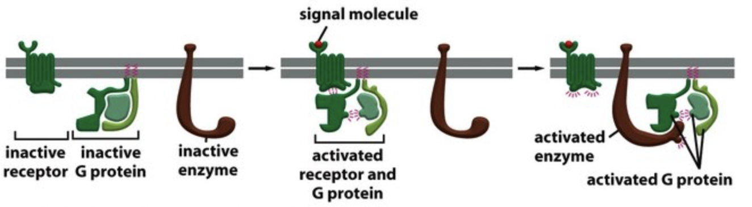
2. G-Protein Coupled receptors (GPCRs)
Binding of a signaling molecule to a GPCR results in G protein activation, which in turn triggers the production of a number of second messengers.
E.g, Muscarinic acetylcholine receptors, beta adrenoceptors, dopamine receptors, serotonin receptors, opioid receptors.
Note source. (The cell)- https://personalpages.manchester.ac.uk/staff/j.gough/lectures/the_cell/signalling/figure15_16b.jpg

Slide 9
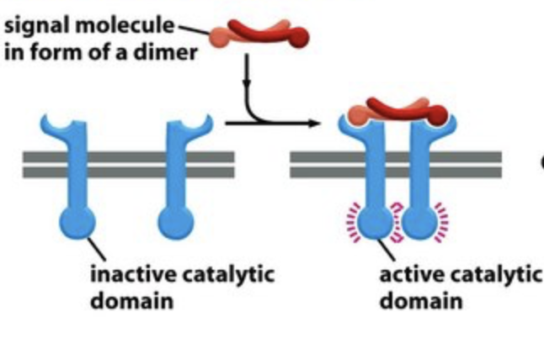
3. Kinase-linked receptors
Linked directly to an intracellular protein kinase that triggers a cascade of phosphorylation reactions.
e.g, insulin receptors
Note source. (The cell)- https://personalpages.manchester.ac.uk/staff/j.gough/lectures/the_cell/signalling/figure15_16c.jpg

Slide 10
4. Nuclear hormone receptors
Intracellularly located.
Binding of a ligand promotes or inhibits synthesis of new proteins, which may take hours or days to promote a biological effect.
It involves activation through binding of the hormone, and the receptor eventually binding to DNA and regulation of transcription occurs.
E.g, steroid hormone, thyroid hormone, vitamin D receptors.

Slide 11
Other targets
Enzymes: Inhibitors of cyclooxygenase such as aspirin, Inhibitors of angiotensin converting enzyme such as enalapril, Inhibitors of xanthine oxidase such as allopurinol.
Transporter proteins: Inhibitors of serotonin reuptake transporter such as fluoxetine
Cell adhesion proteins: β₂ integrins on leukocytes which are essential for effective immune responses, Cadherins such as E-cadherin required for endothelial cell-cell contact, and tissue morphogenesis during embryonic development.

Slide 12
Types of Agonist
Full Agonists: Ligands activate receptors to produce maximal response.
Partial agonists: Ligands partially increases the activity of the receptors but do not produce the maximal response like a full agonist, even when in excess amounts.
They have lower intrinsic activity at receptors.
Inverse agonists: Here, the ligands decreases the activity of an active receptor to their inactive state.
Note: An full agonist increases the activity of a receptor above its basal level, whereas an inverse agonist decreases the activity below the basal level.

Slide 13
Antagonist and its types
Antagonist: prevent receptor activation. Preventing activation has many effects.
Antagonists increase cellular function if they block the action of a substance that normally decreases cellular function, and vice versa.
Competitive antagonists: The antagonist substance competes with the agonist for the same orthosteric (binding) site for the receptor.
Non-competitive antagonists: The antagonist substance binds to a different site other than the orthosteric site for the receptor.

Slide 14
POTENCY vs EFFICACY

Slide 15
POTENCY vs EFFICACY
Potency denotes the amount/strength/conc. of drug needed to produce a given effect.
Efficacy: Refers to the relative ability of a drug to produce a maximum functional response.

Slide 16
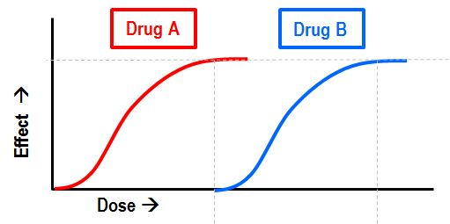
Potency
Both Drug A and Drug B achieve the same maximum effect, i.e. they have equal efficacy.
However, drug A achieves this effect at a lower dose.
Thus, Drug A has higher potency than Drug B.
Note source. (Deranged physiology) -https://www.derangedphysiology.com/main/sites/default/files/php/Pharmacodynamics/images/potency.JPG

Slide 17
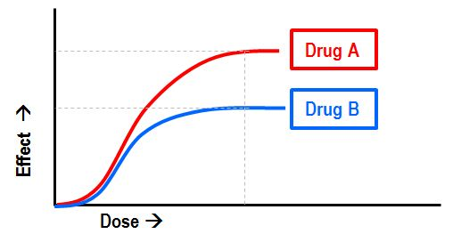
Efficacy
Here, Drug A achieves a higher maximum effect than Drug B, at the same dose.
Drug A is therefore said to be more efficacious.
Note source. (Deranged physiology)- https://www.derangedphysiology.com/main/sites/default/files/php/Pharmacodynamics/images/efficacy.JPG

Slide 18
Efficacy vs Potency
Here, both Drug A and Drug B achieve the same maximum effect, i.e. they have equal efficacy.
However, Drug A achieves this effect at a lower dose (i.e Drug A has higher potency than Drug B).
Note source. (Deranged physiology) -https://www.derangedphysiology.com/main/sites/default/files/php/Pharmacodynamics/images/potency.JPG

Slide 19
Summary
Potency refers to the concentration (EC50) or dose (ED50) of a drug required to produce 50% of that drug’s maximal effect.
Certainly, the more the ED 50 of a drug, the less the potency and the Less the ED50, the more the potency.
Efficacy (E_{max}) is the capacity of a drug to produce a maximum response. Also, it is known as maximal efficacy.
In other words, Efficacy is the ability of a drug to elicit a physiologic response when it interacts with a receptor

Slide 20
Relative potency
Relative potency is a variant where instead of using units to describe the dose required to achieve a certain endpoint, one ends up using a ratio of equivalent doses;
i.e. one might say that Drug A is 10 times more potent than Drug B because it achieves the same effect with 1/10th of the dose.

Slide 21
Efficacy vs Potency
Difference in estimation: Efficacy is estimated by comparing differences in the highest response at high drug concentrations or doses. On the other hand, Potency is estimated by comparing dose (e.g, ED50).
2. The Depending factors: Efficacy depends on the concentration at the site of action, the number of drug-receptor binding, the efficiency of the coupling of receptor activation to cellular responses.
Whereas, Potency of a drug depends on the affinity of the receptors to bind the drug and how effectively the drug-receptor interaction leads to clinical response

Slide 22
3. Decisive component: Efficacy is a decisive component used when choosing a drug among other drugs of the same kind.
While Potency is a decisive component to choose the dose of the drug.
4. Clinical effectiveness: The clinical effectiveness of a drug depends on its efficacy and do not necessarily depend on its potency
5. Which on is important: Certainly, a drug with greater efficacy than greater potency is more therapeutically beneficial.
Efficacy tells us how good a drug is at producing a desired effect

Slide 23
6. Case example:
Morphine produces an optimum level of analgesia which is not possible with any dose of aspirin. Hence, morphine has more efficacy than aspirin.
On the other hand, 500 mg of Paracetamol and 30 mg of morphine can be used as an analgesic. Here, a small dose of morphine requires to produce an analgesic effect. Thus, morphine is a more potent analgesic than Paracetamol.

Slide 24
Adverse Drug Reactions (ADRs)

Slide 25
Adverse drug reactions
An adverse drug reaction is “a response to a drug which is noxious, unintended and which occurs at doses normally used in man for prophylaxis, diagnosis, or therapy of disease or for the modification of physiologic function.” (WHO definition, 2005)
An adverse drug event is “any untoward medical occurrence that may present during treatment with a pharmaceutical product but which does not necessarily have a causal relationship with this treatment” (WHO definition, 2005)
In other words, the reaction is where the drug does something harmful, and an event is something harmful which potentially happens randomly and might be totally unrelated to the drug.

Slide 26
The basic requirements for an ADR is as follows:
The reaction is directly related to the drug
The drug was/is being used correctly and appropriately
The reaction is harmful
N/B: Prescribing errors, labelling confusion, misinterpretation, intentional overdoses do not fall under the definition of an adverse drug reaction, but adverse events.

Slide 27
Adverse drug reactions- CLASSIFICATION
Type A: Dose-related reactions (adverse effects at either normal dose or overdose), e.g. serotonin syndrome or anticholinergic effects of tricyclic drugs.
Type B: Non-dose-related reactions (i.e. any exposure is enough to trigger such a reaction), e.g. allergic or anaphylaxis reactions of penicillin.
Type C: Dose and time-related reactions, e.g. due to dose accumulation, or with prolonged use (e.g. adrenal suppression with corticosteroids)

Slide 28
Type D: Time related reactions, i.e. due to prolonged use in a drug which doesn't tend to accumulate (e.g. tardive dyskinesia from antipsychotics)
Type E: Withdrawal reactions, i.e. the undesired effects of ceasing the drug (for example, opiate withdrawal)
Type F: Unexpected failure of therapy, where a drug undesirably increases or decreases in efficacy. E.g. the decreased effect of antibiotics due to resistance.

Slide 29
Type A - ADR
Type A- ADR can further be classified as follows:
1. Side effects: Undesirable effects even with therapeutic doses of the drug. They are usually mild and manageable, e.g chlorpheniramine (piriton)- drowsiness.
2. Secondary effects: Indirect consequences of the main action of the drug, e.g. corticosteroids- weakening of body immunity, antibiotics –superinfections
3. Toxicity: Exaggerated forms of side effects due to overdose or prolonged use of drugs, e.g. gentamicin –nephrotoxicity, Paracetamol – hepatotoxicity

Slide 30
Type B - ADR
Type B- ADR can further be classified as follows:
1. Hypersensitivity (allergic) reactions: are an overreaction of the immune system to an antigen which would not normally trigger an immune response, e.g. skin rashes – penicillin
2. Genetically determined ADR: Individuals show different effects to a drug, from the majority population, e.g. Glucose-6-phosphate dehydrogenase (G6PD) deficient patients exposed to quinine, sulfa drugs – hemolysis causing anemia.

Slide 31
3. Idiosyncratic drug reactions: Idiosyncrasy is an abnormal reactivity to a chemical that is peculiar to a given individual. It could be: An abnormally exaggerated response, or an abnormal lack of response, e.g. chloramphenicol single dose – anemia, thiazide – erectile impotence.
N/B: once the problem is connected to genes, its no longer idiosyncratic reaction.

Slide 32
Types C,D,E - ADR
Types C, D, E- ADR can further be classified as follows:
Type C (Chronic effects) ADR: Associated with prolonged use of the drug, e.g. laxatives – colonic dysfunction
Type D (Delayed effects) ADR: Occurs years after treatment, and may also occur in their offspring, e.g. Alkylating agents causes secondary cancers (lung cancer) in Hodgkin's disease treatment and teratogenic effects.
Type E (End of treatment effects) ADR: Occurs when a drug is suddenly discontinued, e.g. rebound increase in B.P with abrupt stopping of propranolol.

Slide 33
REFERENCES
Lippincott Illustrated Reviews: Pharmacology, ed.8 by Karen Whalen, Lippincott Home 2023.
National Library Medicine: Nursing Pharmacology [Internet]. 2nd edition; by Ernstmeyer K, Christman E, editors. Eau Claire (WI): Chippewa Valley Technical College; 2023.
TH 2019 - 2025 pharmacy180.com; Developed by Therithal info. Website; www.Pharmacy180.com

