Slide 1
Course
Lecture 4
Topic: Pharmacodynamics (Contd…)
“What the drug does to the body”
PHARMACOLOGY
Seth Mikaye

Slide 2
THERAPEUTIC INDEX

Slide 3
Therapeutic index (TI) measurement of drug safety.
Its a ratio that compares the blood concentration at which a drug becomes toxic and the concentration at which the drug is effective.
It refers to the relationship between toxic and therapeutic dosing
Def: Therapeutic index of a drug is the ratio of the dose that produces toxicity to the dose that produces a clinically desirable or effective response.
                TI = TD50/ED50

Slide 4
  TD50/LD50- Toxic/lethal dose) = the dose of drug that causes a toxic response in 50% of the population
  ED50 (effective dose) = the dose of drug that is therapeutically effective in 50% of the population
A safer drug has a higher therapeutic index
  very large toxic/lethal dose, very small effective dose
A more dangerous drug has a lower therapeutic index
  may require regular monitoring of drug levels
  examples include: warfarin, lithium, digoxin, phenytoin, gentamicin, amphotericin5-fluoro-urocil, zidovudine

Slide 5
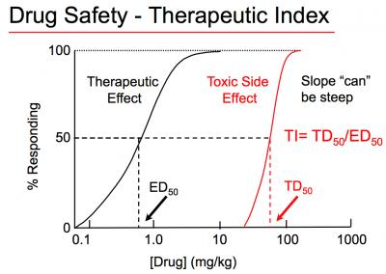
Therapeutic window (TW): is the range of drug concentrations in which a drug is effective
Image credits: Pharmacology Medbullets step 1.
Link:https://upload.medbullets.com/topic/107009/images/6e49bfae2c1b79c8cd7415fbdd8a23f0.media.400x284.jpg

Slide 6
Drug’s safety margin
TI = LD50 > ED50. TI must be >1 for drug to be usable ( TI > 1)
Digitalis has a TI of 2
Penicillin has TI of >100
If the TI is small (the difference between the two concentrations is very small), the drug must be dosed carefully and the person receiving the drug should be monitored closely for any signs of drug toxicity.
Therapeutic drug monitoring (TDM) is the clinical practice of measuring specific drugs at designated intervals to maintain a constant concentration in a patient's bloodstream, thereby optimizing individual dosage regimens.

Slide 7
TW concept is reflected in TI calculation
  TW = MTC/MEC
    Minimum effective concentration (MEC) is the minimum concentration that is required for drug effect
    Minimum toxic concentration (MTC) is the minimum concentration in which toxicity usually occurs
    If you have a low dose for the drug to start working (MEC) and a high dose at which the drug is toxic (MTC) you have a wide window in which the drug can safely be used (TW)

Slide 8
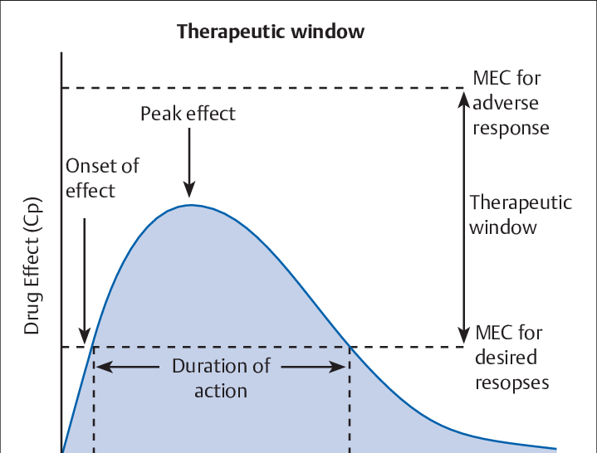
Therapeutic Window
Image credits: Anyimicrobial stewardship, by Vasudeva Murthy, Smitha Th, 2022.
Link: https://www.researchgate.net/publication/360041907

Slide 9
DOSAGE REGIMEN

Slide 10
DOSAGE REGIMEN
The dosage regimen is the frequency at which the drug doses are given.
For some drugs like analgesics single dose is efficient for optimal therapeutic effect.
However the duration of most illnesses are longer than the therapeutic effect produced by a single dose.
In such cases drugs are required to be taken on a repetitive bases over a period of time depending upon the nature of illness.

Slide 11
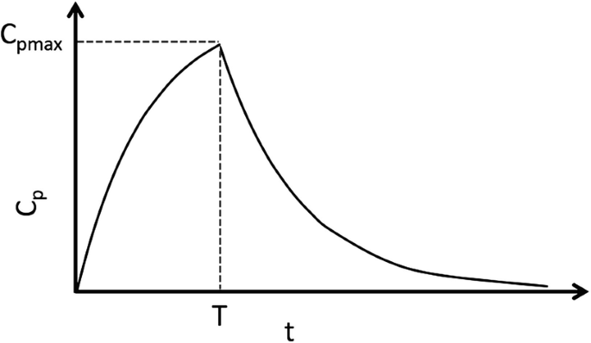
1. Single dosing
Only one dose of medication is given.
E.g. Albendazole, local anesthetics etc.
Note source: Talevi, A., Bellera, C.L. (2021). One-Compartment Pharmacokinetic Model. In: The ADME Encyclopedia. Springer, Cham. https://doi.org/10.1007/978-3-030-51519-5_58-1

Slide 12
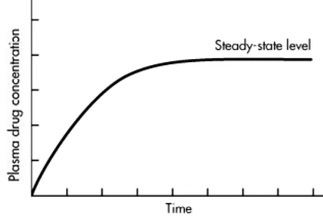
2. Continous infusion dosing
Administration of constant proportion of fluid into a blood vessel (infusion of a parenteral drug) over several hours (continuous drip) to days.
Eventually, a constant concentration will be reached, where the rate of elimination equals infusion rate.
This is called a steady state level and the dose required to maintain it is called maintenance dose
Image credit: ©2020-2024 PharmaEducation.Net.
Link: https://pharmaeducation.net/wp-content/uploads/2022/12/Plasma-Level–Time-Curve-of-controlled-release-sustained-release-dosage-forms-after-administration-of-a-single-dose.webp

Slide 13
3. Intermittent dosing
Certain dose of medication are administered at regular intervals.
If the next dose is administered before the previous dose is completely eliminated, the plasma concentration will progressively rise.
Fluctuations would occur through peaks and troughs.
Over time, the rate of elimination also increases until it matches the rate of administration.
At this stage, a steady state would have been reached.
In life threatening conditions, the steady state can be reached quickly by administering an initial loading dose

Slide 14
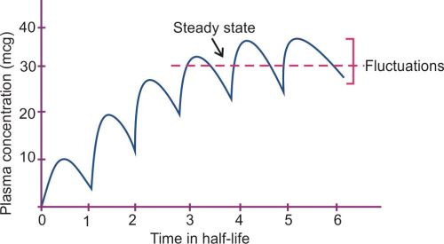
Intermittent dosing
Image credit: Pharmacology for Dental and Allied Health Sciences, by Udaykumar Padmaja, Author Affiliations, Father Muller Medical College, Mangaluru, Karnataka, India, 2017.

Slide 15
Drug safety and effectiveness
Factors modifying the dosage and action of drugs :

Slide 16
Individuals differ both in the degree and the character of the response that a drug may elicit.
Therefore, the desired therapeutic effect varies from person to person.
The important factors which influence the effect of a drug are:
1. Drug intolerance: It is inability of the individual to tolerate a drug. Also called as hyper-susceptibility. It is a quantitative deviation from the anticipated response to a given dose of a drug. E.g. sulfa drugs
2. Body Weight: The average dose is mentioned either in terms of mg per kg body weight.
However, excessively obese individuals, edema conditions, or dehydration nutritional factors, can sometimes alter drug metabolizing capacity and therefore, dosing expressed in this fashion may not apply in such cases.

Slide 17
3. Sex difference:
Special care should be exercised when drugs are administrated during:
a) Menstruation: Drugs producing pelvic congestion should be avoided during menstruation e.g. drastic purgatives.
b) Pregnancy: Drugs which may stimulate the uterine smooth muscle, are contraindicated during pregnancy.
Drugs capable of crossing the placenta and affecting the fetus can produce teratogenicity when they are used in pregnancy. Teratogenicity means congenital malformation.
  E.g. thalidomide, cyclophosphamide, methotrexate, tetracyclines, phenytoin, carbamazepine and progestogens.
c) Breast feeding: Most of the lipid soluble drugs get into breast milk and may harm the infant health. e.g. sulphonamides, tetracyclines, nalidixic acid, isoniazid, diazepam, lithium, Indomethacin, aspirin, etc.

Slide 18
4. Age:
The pharmacokinetics of many drugs changes with age. Moreover, the liver capacity to metabolize drugs is low and the renal function is less developed, hence children may not react to all drugs in the same fashion as young adults.
With a few exceptions, drugs are more active and more toxic in the new born than the adults.
The pediatric doses are expressed in terms of body weight (mg/kg per dose or day) or in terms of body surface area (mg/m² /day).
The body surface area can be calculated from the height and weight of the child.
Like children, old people also present problems in dosage adjustment and this may vary widely with different people.
Therefore, there should be dose adjustments for both pediatrics and geriatrics.

Slide 19
5. Disease state
Drug responses are affected by disease states because of changes in both pharmacokinetics and pharmacodynamics.
Some antimicrobial agents penetrate the cerebrospinal fluid well across the normal meninges while other antimicrobials penetrate well only when the meninges are inflamed (meningitis)
E.g. benzyl penicillin, streptomycin, gentamicin and cephalosporin
Similarly renal and pulmonary diseases may modify the metabolism of drugs like insulin or isoprenaline.
Excretion of drug is also impaired in chronic renal disease.

Slide 20
6. Drug tolerance:
A person's diminished response to a drug, which occurs when the drug is used repeatedly, so that either more medicine is needed or different medicine is needed.
Tachyphylaxis: an acute, sudden decrease in response to a drug after its administration. e.g. Ephedrine, amphetamine and nitroglycerine which produce tachyphylaxis on repeated administration.

Slide 21
7. Emotional factors.
The placebo response/effect is an example here.
Placebo: It is a Latin word meaning” I shall please” and it is a tablet looking exactly like the active treatment but containing no active component.
8. Repeated administration and drug cumulation
If a drug is excreted slowly, its administration may build up a sufficiently high concentration in the body to produce toxicity. e.g. digitalis, emetine.
To avoid cumulation: One must know if a drug is eliminated slowly or rapidly

Slide 22
9. Drug interactions:
Patients who receive a number of drugs at the same time, may develop a phenomenon which happens when the effects of one drug is modified by another drug(s).
A drug interaction may result in beneficial or harmful effects and may be classified into:
a) Pharmaceutical drug interactions:
Serious loss of potency and efficacy can occur from incompatibility between an infusion fluid and a drug that is added to it.
For example, diazepam if added to infusion fluid there will be a precipitate formation, leads to loss of therapeutic effect.

Slide 23
b) Pharmacokinetic drug interactions:
Interaction during absorption: Drugs may interact in the gastrointestinal tract resulting in either decreased or increased absorption.
e.g. Tetracycline +Calcium = Decreased absorption of tetracycline.
2) Interaction during distribution: A drug which is extensively bound to plasma protein can be displaced from its binding sites by another drug.
e.g.Quinidine displaces digoxin from binding sites in tissues and plasma and leads to digoxin toxicity.

Slide 24
3) Interactions during metabolism: Can be divided into two:
(i) Enzyme induction: Here, the metabolism of drugs is enhanced. For instance, if drug X is metabolized by the microsomal enzymes, then concurrent administration with a microsomal inducer (drug Y) will result in enhanced metabolism of drug A.
e.g. Warfarin (anticoagulant) + Barbiturate (enzyme inducer) = decreased anticoagulation.
Enzyme inducers: Rifampicin, phenytoin, sulfonamides, etc.
(ii) Enzyme inhibition: Here, metabolism of drugs is delayed/inhibited. For instance, if drug A is metabolized by the microsomal enzymes, then concurrent administration with a microsomal inhibitor (drug B) will result in decreased/delayed metabolism of drug A.
e.g. Warfarin + Metronidazole (enzyme inhibitor) = Hemorrhage.
Enzyme inhibitors: Disulfiram, isoniazid, allopurinol, cimetidine, etc.

Slide 25
4. Interactions during excretion: Some drugs interacts with others at the site of excretion i.e. in kidneys.
e.g. Penicillin (antibiotic) +Probenecid (antigout drug) = Increases the duration of action of penicillin (Both drugs excreted through tubular secretion).

Slide 26
c) Pharmacodynamics drug interactions:
(i) Drug Synergism: When the therapeutic effect of two drugs are greater than the effect of individual drugs. It is of two types:
(a) Additive effect: When the total pharmacological action of two or more drugs administered together is equivalent to the summation of their individual pharmacological actions.
  i.e. A + B = AB
e.g. Combination of ephedrine + aminophylline in the treatment of bronchial asthma.
(b) Potentiation effect: When the net effect of two drugs used together is greater than the sum of individual effects.
  i.e. AB > A + B
e.g. Trimethoprim + sulfamethoxazole

Slide 27
(ii) Drug Antagonism: Refers to the act of opposing actions of two drugs on the same physiological system.
a) Chemical antagonism: In this the biological activity of a drug can be reduced or abolished by a chemical reaction with another agent.
e.g. Antagonism between acids and alkalis.
b) Competitive antagonism: In this the agonist and antagonist compete for the same receptors .
  Competitive antagonism can be overcome by increasing the concentration of the agonist at the receptor site.
e.g. Acetylcholine and atropine antagonism at muscarinic receptors.
  naloxone is a competitive antagonists at all opioid receptors

Slide 28
c) Non competitive antagonism: An antagonist that prevents the biological response of an agonist without competing with the agonist on the same orthosteric site on the receptor. The antagonist inactivates the receptor (R)
e.g. Acetylcholine and papaverine on smooth muscle.
d) Physiological antagonism: A drug that produces the opposite physiological effect to that of an agonist, thereby opposing the action of that agonist.
e.g. Acetyl choline causes constriction where as adrenaline causes dilatation of pupil.
glucagon is a physiological antagonist of the actions of insulin and can be used to treat insulin-induced hypoglycemia.

Slide 29
Importance of drug antagonism
(i) Correcting adverse effects of drugs
(ii) Treating drug poisoning.
e.g. Morphine with naloxone, organophosphate compounds with atropine.
(iii) Predicting drug combinations which would reduce drug efficacy.

Slide 30
SECOND MESSENGER

Slide 31
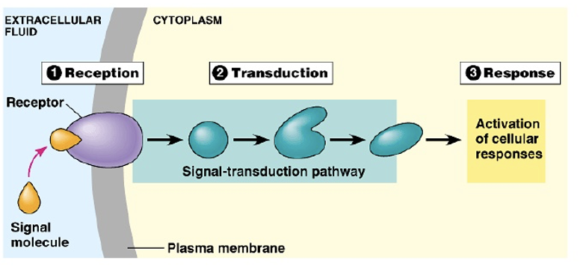
Cellular response to different signals, involves 3 main stages:
Reception
Transduction
Response
Image credit: Winnacunnet Biology, By Croteau Scales.
Link source: https://croteaubio.wordpress.com/wp-content/uploads/2011/12/cell-to-cell-communication-9-728.jpg

Slide 32
The “fight or flight” (e.g, from a growling dog) is our bodies’ mechanistic way of preparing for situations of heightened stress.
This mechanism is triggered by the release of the hormone epinephrine (adrenaline) by the adrenal glands.
When epinephrine binds to receptors on the cell-surface, it stimulates the production of the second messenger (cAMP) which then increases the production of stress hormone (cortisol).
When released into the bloodstream, cortisol triggers various cellular responses in various parts of the body, resulting in higher blood pressure and blood sugar levels.

Slide 33
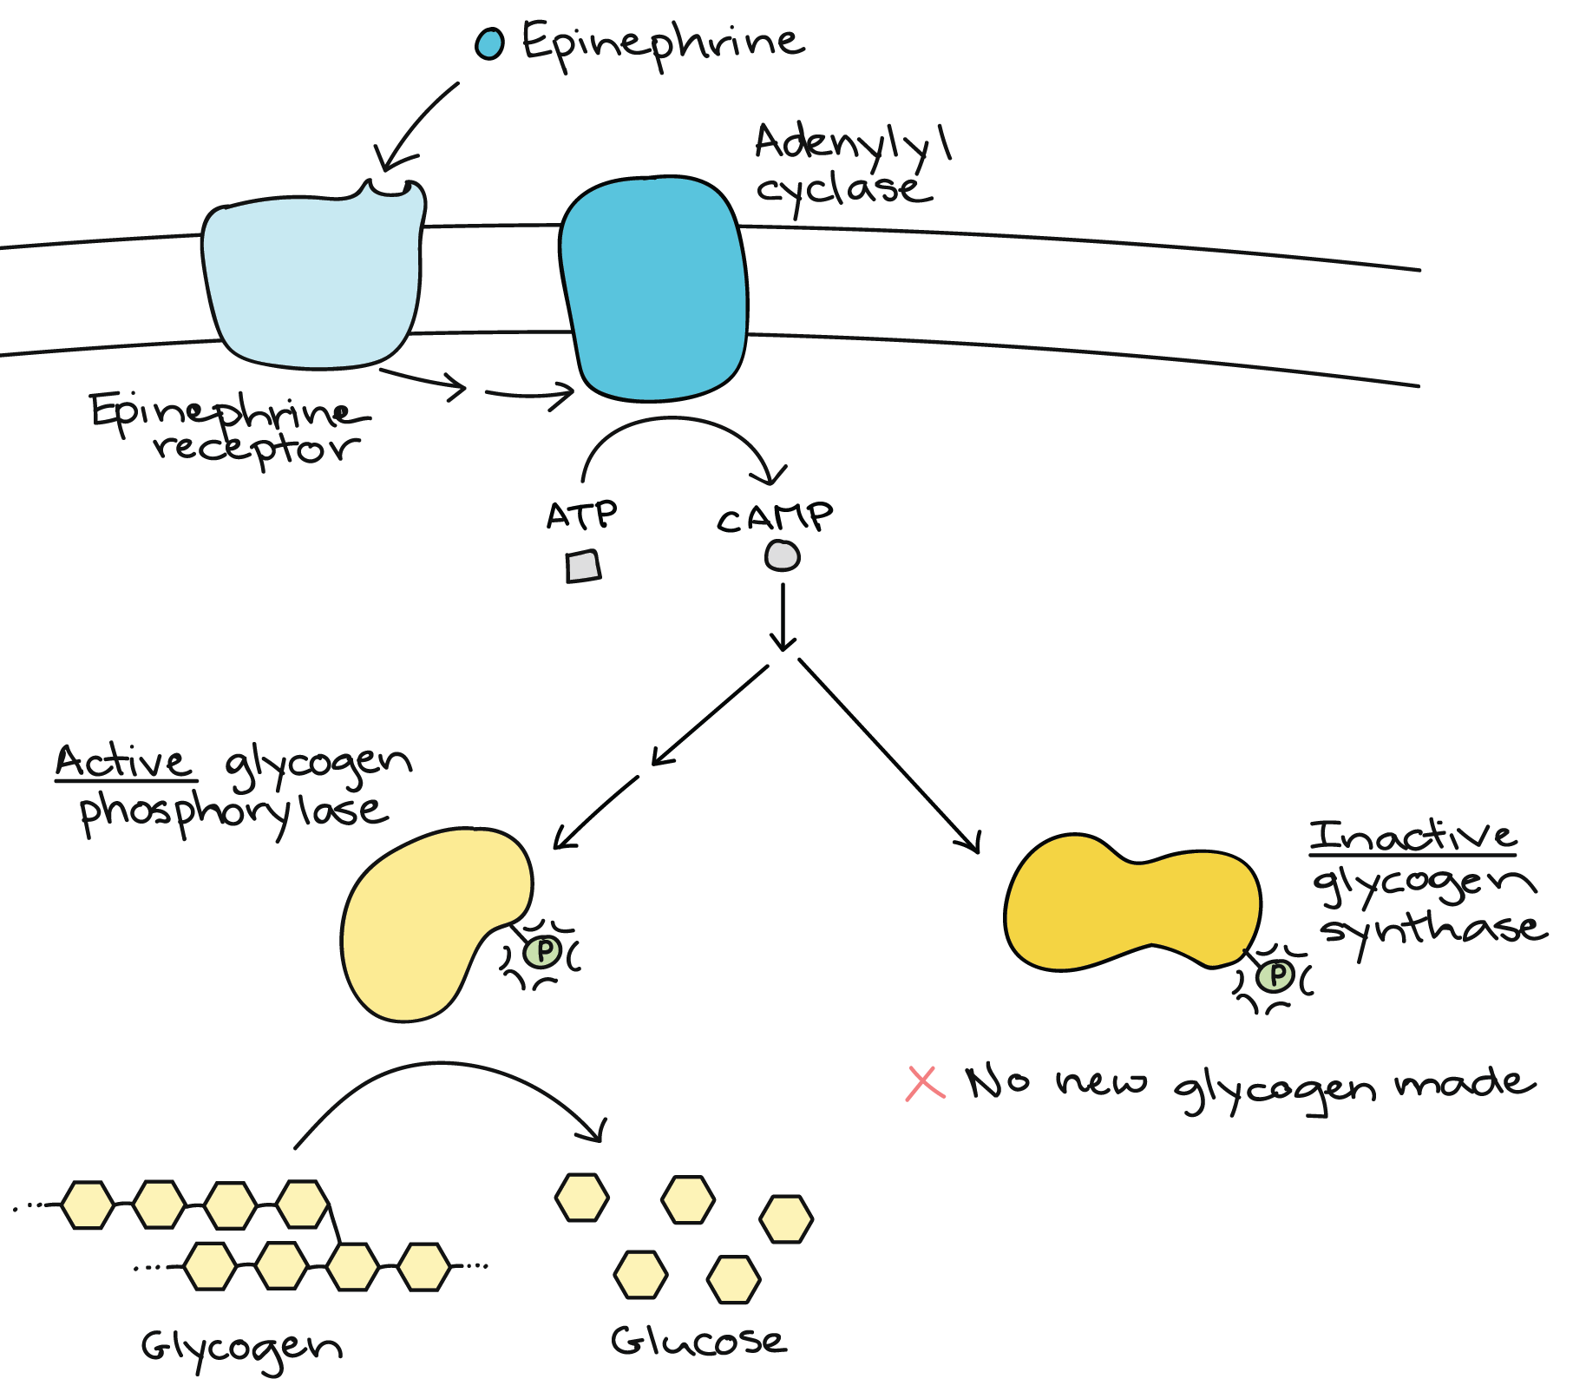
Example of a response to a signal
Image credit: Khan Academy.
Link sourcw: https://cdn.kastatic.org/ka-perseus-images/29d97104e7565901e86c0a4f300ab5856db69c93.png

Slide 34
Definition:
Second messengers are molecules that relay signals received at the cell surface of receptors.
E.g. the arrival of protein hormones, growth factors, etc. which eventually targets molecules in the cytoplasm and/or nucleus.
Additionally, they also serve to greatly amplify the strength of the signal.
Binding of a ligand to a single receptor at the cell surface may end up causing massive changes in the biochemical activities within the cell.

Slide 35
Types of second messengers
Hydrophobic based: Diacyglycerol, Phosphatidylinositol
Hydrophilic based: cAMP, cGMP, IP₃, Ca²⁺
Gases: NO, H₂S, CO

Slide 36
Cyclic Adenosine Mono-Phasphate (cAMP)
Hormones achieving effects through cAMP as a second messenger:
  adrenaline
  glucagon
  luteinizing hormone (LH)
cAMP is synthesized from ATP by the action of adenylyl cyclase.
Binding of the hormone to its receptor activates a G protein which, in turn, activates adenylyl cyclase, resulting in rise in cAMP which turns on the appropriate response in the as follows:
  Change of the molecular activities in the cytosol, often using
  Protein Kinase A (PKA) - a cAMP-dependent protein kinase that phosphorylates target proteins.
  Turning on a new pattern of gene transcription

Slide 37
Cyclic Guanosine Mono-Phosphate (cGMP)
cGMP is synthesized from the nucleotide GTP using the enzyme guanylyl cyclase. cGMP serves as the second messenger for:
  atrial natriuretic peptide (ANP)
  nitric oxide (NO)
  the response of the rods of the retina to light
The major effect of cGMP is mediated via;
Protein Kinase G (PKG) — a cGMP-dependent protein kinase that phosphorylates target proteins in the cell.

Slide 38
Inositol trisphosphate (IP₃) and diacylglycerol (DAG)
Peptide and protein hormones like vasopressin, thyroid-stimulating hormone (TSH), and angiotensin and neurotransmitters like GABA bind to G protein-coupled receptors (GPCRs) that activate the intracellular enzyme phospholipase C (PLC).
PLC hydrolyzes phospholipids — specifically phosphatidylinositol-4,5-bisphosphate (PIP₂) which is found in the inner layer of the plasma membrane, resulting into production of:
IP₃
DAG

Slide 39
  diacylglycerol (DAG): DAG remains in the inner layer of the plasma membrane. It recruits Protein Kinase C (PKC) — a calcium-dependent kinase that phosphorylates many other proteins that bring about the responses in the cell.
  inositol-1,4,5-trisphosphate (IP₃): This water soluble molecule diffuses through the cytosol and binds to receptors on the endoplasmic reticulum causing the release of calcium ions (Ca²⁺) into the cytosol. The rise in intracellular calcium triggers cellular response.

Slide 40
Calcium ions (Ca²⁺)
In response to many different signals, a rise in the concentration of Ca²⁺ in the cytosol triggers many types of events such as
muscle contraction
exocytosis, e.g.
  release of neurotransmitters at synapses, secretion of hormones like insulin
activation of T cells and B cells when binding antigen with their antigen receptors (TCRs and BCRs respectively)
adhesion of cells to the extracellular matrix (ECM)
apoptosis
a variety of biochemical changes mediated by PKC.

Slide 41
Normally, the level of calcium in the cell is very low (~100 nM). There are two main depots of Ca²⁺ for the cell:
  The extracellular fluid (ECF — made from blood), where the concentration is ~ 2 mM or 20,000 times higher than in the cytosol;
  the endoplasmic reticulum ("sarcoplasmic" reticulum in skeletal muscle).
However, its level in the cell can rise dramatically when channels in the plasma membrane open to allow it in from the extracellular fluid or from depots such as the endoplasmic reticulum and mitochondria.

Slide 42
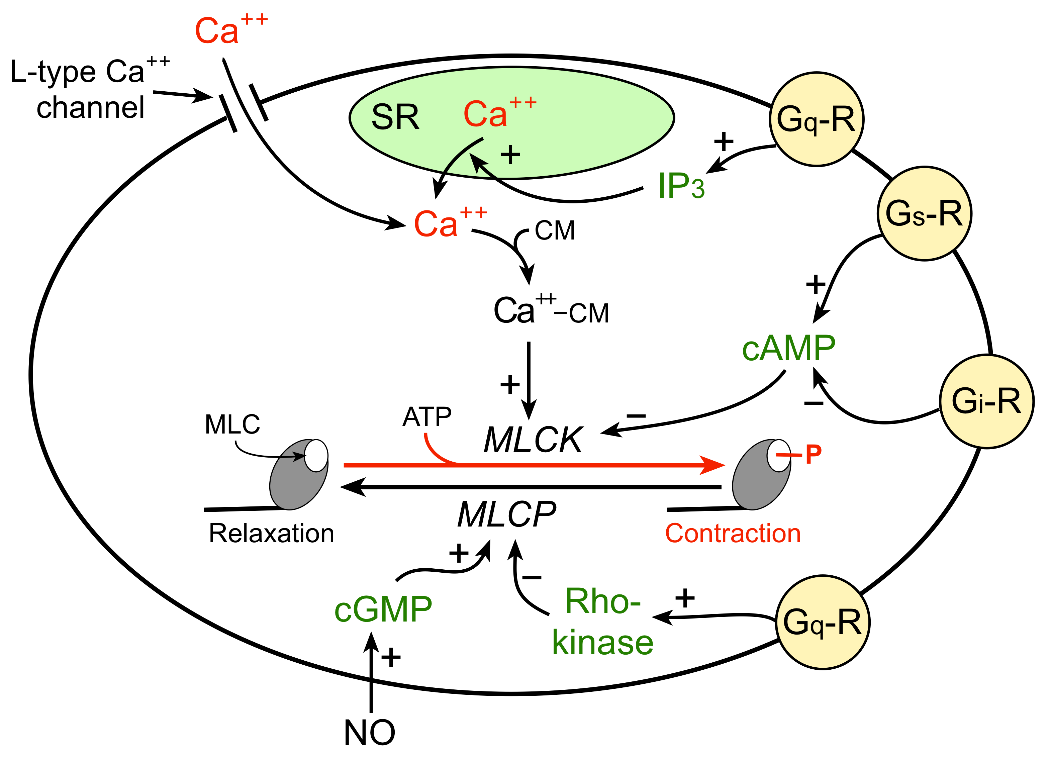
Second messenger pathway illustration
Cardiovascular Physiology Concepts, by Richard Klabunde; Published by Wolters Kluwer (2021).
https://cvphysiology.com/s9v2f-3r4p7/share/BP026%20VSM%20contraction.png

Slide 43
REFERENCES
Cardiovascular Physiology Concepts, 3rd Edition, by Richard E. Klabunde; Published by Wolters Kluwer (2021).
Reece, J. B., Urry, L. A., Cain, M. L., Wasserman, S. A., Minorsky, P. V., and Jackson, R. B. (2011). Cell communication. In Campbell biology (10th ed.). San Francisco, CA: Pearson, 223.
https://www.researchgate.net/publication/360041907
Shargel L. Yu A. B. C. & Wu-Pong S. (2012). Applied biopharmaceutics & pharmacokinetics (6th ed.). McGraw-Hill Medical.
Pharmacology for Dental and Allied Health Sciences, by Udaykumar Padmaja

