Slide 1
Course
Lecture 7
Topic:
Aminoglycosides &
Macrolides
PHARMACOLOGY
Seth Mikaye

Slide 2
Aminoglycosides

Slide 3
Introduction
Aminoglycosides are a group of natural and Semisynthetic antibiotics.
They provide coverage against aerobic gram-negative pathogens, including Pseudomonas.
They can also be used synergistically with inhibitors of bacterial cell wall synthesis (e.g., β lactams) for gram-positive pathogens.
There use is limited by serious side effects, including toxicity to the kidney and ear.
They majorly share similar antibacterial spectrum and toxic effect, and are bactericidal on nature.

Slide 4
History
Streptomycin - the first member of aminoglycoside antibiotics discovered in 1944 by Waksman and co-workers from a strain of Streptomyces griseus.
Neomycin - isolated in 1949
Kanamycin in 1957 and gentamicin in 1963.
Amikacin- first semi-synthetic aminoglycoside obtained via kanamycin chemical modification.
Produced from actinomycetes
Aminoglycosides prepared from Streptomyces carry the suffix — mycin.
Micromonospora have name ending with — micin.

Slide 5
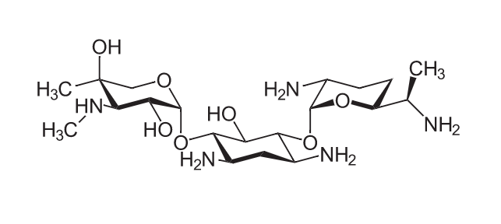
Chemistry
The aminoglycosides consist of two or more amino sugars joined in glycosidic linkages to a hexose (aminocyclitol) nucleus.
In streptomycin, the hexose molecule is 2-deoxystreptamine.
The presence of amino group in the structure imparts basic nature and the hydroxyl group on the sugars provide high water solubility (or poor lipid solubility) to the drugs.
Image credi: Wikipedia. https://upload.wikimedia.org/wikipedia/commons/thumb/d/d6/Streptomycin2.svg/800px-Streptomycin2.svg.png

Slide 6
Classification
A. Based on antibacterial spectrum
1. Narrow spectrum:
Streptomycin and dihydrostreptomycin.
Mainly active aerobic gram-negative bacteria (E.coli, Salmonella, pasturella spp. Brucella spp.) and also against Staphylococci, Actinomyces bovis and Laptospira spp.
Mycobacterium tuberculosis is also sensitive to streptomycin.

Slide 7
2. Broad spectrum:
Gentamicin, tobramycin, Amikacin, sisomicin and netilmicin.
Highly effective against a wide variety of aerobic (both gram positive and gram negative) bacteria including Pseudomonas aeruginosa.
Gentamicin is more potent than streptomycin (MIC 4-8 times lower), but it is ineffective against M. tuberculosis.
Amikacin and netilmicin are resistant to bacterial aminoglycoside inactivating enzymes and therefore have widest spectrum of activity including against organisms resistant to other aminoglycosides.

Slide 8
3. Extended spectrum:
Neomycin, framycetin, paromomycin and Kanamycin.
They have more spectra than streptomycin and effective against both aerobic gram-negative bacteria as well as against several gram-positive bacteria.
Clinically useful against gram-negative infections of E. coli, Salmonella, Klebsiella and Enterobacter.

Slide 9
B. Classification based on route of administration
1. Systemic aminoglycosides:
Streptomycin
Gentamicin
Kanamycin
Tobramycin
Amikacin
Sisomicin
Netilmicin
2. Topical aminoglycosides:
Neomycin
Framycetin

Slide 10
Sources of Aminoglycosides
Streptomycin: Streptomyces griseus;
Neomycin: S. Fradiae;
Kanamycin: S. kanamyceticus;
Gentamicin: Micromonospora Purpurea;
Tobramycin: S. tenebrarius;
Amikacin: Semisynthetic derivative of Kanamycin;
Sisomicin: Micromonospora inyoensis;
Netilmicin: Senmisynthetic derivative of sisomicin;
Framycetin: S. Lavendulae.

Slide 11
Pharmacokinetics
Absorption
Since it’s a sugar, its water soluble, and cannot be absorbed in GIT (its polar/hydrophilic). Usually given IV or IM
Distribution
Crosses the placenta
Does not cross the blood-brain barrier
Excretion
Clearance is correlated with renal function (↓ glomerular filtration leading to ↑ half-life).
Approximately 99% is unchanged in the urine.
Can be removed with hemodialysis

Slide 12
Common Properties of Aminoglycosides
All are used as sulphate salts that are highly water soluble (stable).
Poorly absorbed after oral administration.
They almost don’t penetrate the brain or Cerebrospinal fluid.
All are rapidly excreted unchanged through normal kidney by glomerular filtration.
They are almost exclusively used in the treatment of gram- negative bacterial infections.

Slide 13
All act by interference with the protein synthesis in susceptible bacteria.
They are bactericidal and more active at alkaline pH.
Partial cross resistance may be seen among them.
They have relatively narrow margin of safety.
All share common toxicities (ototoxicity and nephron-toxicity).

Slide 14
Mechanism of action
They generally have the same pattern of action which may be described in two main steps:
Transport of the aminoglycoside through the bacterial cell wall and cytoplasmic membrane.
Binding to ribosome resulting in inhibition of protein synthesis.

Slide 15
Step I
Transport of aminoglycoside into bacteria:
It is a multistep process.
They diffuse across the outer coat of gram-negative bacteria through porin channels.
Entry from the periplasmic space across the cytoplasmic membrane is carrier mediated which is linked to the electron transport chain.
Thus, penetration is dependent upon:
maintenance of a polarized membrane
Oxygen dependent active processes.

Slide 16
These processes are inactivated under anaerobic conditions; anaerobes are not sensitive and facultative anaerobes are more resistant when o₂ supply is deficient, e.g. inside big abscesses.
Penetration is also favored by high pH; aminoglycosides are 20 times more active in alkaline than in acidic medium.
Note: Bacterial cell wall inhibitors (β-lactams, Vancomycin) enhance entry of aminoglycosides and exhibit synergism.

Slide 17
Step II
Once inside the bacterial cell,
Aminoglycosides binds irreversibly to 30S ribosomes,
causing distortion of mRNA codon recognition resulting in misreading of the code:
Formation of non-function proteins: one or more wrong amino acids are entered in the peptide chain and /or peptides of abnormal length are produced.
2. Protein synthesis is terminated: by converting polysomes
to monosomes thereby hindering mRNA translation

Slide 18
Bactericidal action of Aminoglycoside
Protein synthesis inhibitors; tetracyclines, chloramphenicol & erythromycin are bacteriostatic.
Exposure to aminoglycosides; sensitive bacteria become more permeable. Ions, amino acids and proteins leak out causing death.
The cidal action of aminoglycosides is concentration dependent, i.e. rate of bacterial cell killing is directly related to the MIC.
They also exert a long and concentration dependent ‘post-antibiotic effect’.
Despite their short t1/2 (2- 4 hours), single injection of the total daily dose of aminoglycoside may be more effective and possibly less toxic than its conventional division into 2-3 doses.

Slide 19
MECHANISM OF RESISTANCE
Drug inactivation by conjugating enzymes
Decrease entry via porins
Decrease affinity binding to ribosomes

Slide 20
Clinical Uses
Streptomycin is widely used for the treatment of:
  Plague: which is a deadly infectious disease caused by enterobacteria; Yersinia pestis
  E-coli infection: causing mastitis (breast), metritis (uterus), enteritis (small intestine) and septicemia in all species.
  tuberculosis and vibriosis.
  Brucellosis (Mediterranean fever, rock fever or undulant fever) is a highly contagious zoonosis caused by ingestion of unsterilized milk or meat.
  Tularemia (rabbit fever, deer fly fever, and Ohara's fever) is caused by the bacterium; Francisella tularensis

Slide 21
Gentamicin; treatment of gram-negative septicemia (drug of choice), urinary tract, GI tract, respiratory tract and topically in eye/ear infections.
Framycetin; Due to ototoxicity and nephrotoxicity, they are rarely used systemically. May be used for the treatment of enteritis and topically for otitis externa in dogs.
Netilmicin; Is resistant to bacterial aminoglycoside inactivating enzymes and thus effective gentamicin resistant strains.

Slide 22
Neomycin; Not used systemically because of toxicity. Usually used for skin and eye infections.
Usually used alongside bacitracin, and polymyxin.
Amikacin; Broad spectrum.
        Resistant to bacterial aminoglycoside inactivating enzymes .
        Treat serious infection such as TB and nosocomial infections
Tobramycin; Same as Gentamicin. Its however better in treatment of Pseudomonas aeruginosa infections.
Paromomycin; Treat protozoas; amebiasis, giardiasis

Slide 23
Adverse reactions and Toxicity
The aminoglycosides produce toxic effect which is common to all but the relative intensity may differ.
The main toxicities are:
Ototoxicity
Nephrotoxicity
Neuromuscular blockade
Teratogenicity

Slide 24
GANTS can NOT kill anaerobes
G- gentamicin
A- amikacin
N- neomycin
T –tobramycin
S- streptomycin
N- nephrotoxicity & neuromuscular blockade
O- ototoxicity
T- teratogenicity

Slide 25
Ototoxicity
Most related to dose and duration of treatment
Involves progressive and irreversible damage of the sensory cells in the cochlea and vestibular apparatus of the internal ear.
Vestibular damage – vertigo, headache, vomiting, ataxia.
Cochlear damage -- auditory disturbances which may even lead to deafness.
Streptomycin and Gentamicin: prone to produce vestibular toxicity.
Neomycin and amikacin: mainly cochlear damage.
Netilmicin is less ototoxic and therefore preferred for long term use.
Other ototoxic drugs potentiates the ototoxicity of aminoglycosides

Slide 26
Neuromuscular blockade
High doses of aminoglycosides may cause neuromuscular blockade
This is due to chelation of calcium and reduction of Ach release from the motor nerve endings by aminoglycosides, resulting in skeletal muscle paralysis and respiratory arrest which may even lead to death.
Neomycin and streptomycin are more prone to cause this toxic effect than Kanamycin, Gentamicin or Amikacin.
Tobramycin is least toxic in this respect.
The blockade can be partially antagonized by IV calcium gluconate and neostigmine.

Slide 27
Nephrotoxicity
Damage of kidney tubules; common in patient with pre-existing kidney diseases.
Renal damage can be reversed by immediate discontinuation of drugs. Especially for Neomycin
Other side effects;
Contact dermatitis and sometime allergic reaction particularly to streptomycin is common.
Rapid IV injection: At high dose may cause CNS disturbances, even convulsions, respiratory arrest, fall in BP, collapse and death.

Slide 28
Contraindications and precautions
To be avoided during pregnancy (fetal toxicity), along with other ototoxic drugs (high ceiling diuretics, minocycline)
To be avoided with other nephrotoxic drugs such as;
amphotericin B, cephaloridine etc.

Slide 29
MACROLIDES

Slide 30
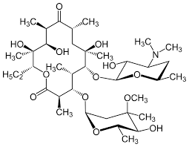
Macrolide antibiotics
The macrolides (macrocyclic lactones) are a group of bacteriostatic antibiotics that structurally consist of;
(a) a large lactone ring (which prompted the name macrolide),
(b) a ketone group
(c) a glycosidically linked amino sugar.
Image credit: Wikipedia. https://encrypted-tbn0.gstatic.com/images?q=tbn:ANd9GcQj3BVkYu96uZ5FomGZWvproKIh6t0ZgB2Wng&s

Slide 31
History
Erythromycin is the first member discovered in the 1950s.
Followed by oleandomycin, troleandomycin, spiramycin, josamycin, tilmicosin, and tylosin.
Roxithromycin, Clarithromycin and Azithromycin are the latest to be discovered.
Macrolides are mostly obtained from various species of Streptomyces soil-borne bacteria; while some are prepared semi-synthetically.

Slide 32
Common properties of Macrolides
All macrolide antibiotics are weak bases with pKa ranging from 6 to 9.
The basic nature of these antibiotics is due to the presence of dimethylamine group in their structures.
Due to their basic nature, they are concentrated in acidic fluids such as milk and prostatic fluid by process of ‘ion trapping'.

Slide 33
They exist as colourless crystalline substances that are poorly soluble in water and soluble in polar organic solvents.
Macrolides are often inactivated in basic (pH >10) as well as acidic (pH <4) environments.
Maximum activity is between pH 7.8 to 8.
They are lipid soluble but are often used in ester forms to enhance oral bioavailability and to improve oral tolerance.

Slide 34
Erythromycin
It was isolated from Streptomyces erythreus in 1952.
Since then, it has been widely employed, mainly as alternative to penicillin.
Water solubility of erythromycin is limited, and the solution remains stable only when kept in cold temperatures.
It is the prototype drug for this group.

Slide 35
Antibacterial spectrum
Effective against most aerobic and anaerobic gram-positive bacteria.
In general; are narrow spectrum antibiotics, not effective against gram-negative although some strains of Pasteurella, Haemophilus and Neisseria spp are moderately sensitive.
Also active against Mycoplasma, Chlamydia and Rickettsiae spp.
Tilmicosin; broad-spectrum macrolide with exceptionally high activity against Pasteurella haemolytica and P. multocida.
Erythromycin; effective in gram-positive bacteria since it accumulates more erythromycin than gram-negative bacteria.
Some of the members are also active against Mycobacterium.

Slide 36
Mechanism of action
Erythromycin is bacteriostatic at low conc but bactericidal (for certain bacteria) at high concentrations.
Bactericidal action depends on the organism concerned and its rate of multiplication.
The action of macrolides can be divided into two processes:
  passage of macrolides into bacterial cell and
  interaction of macrolides with bacterial ribosomes.

Slide 37
Step I : Passage of macrolides into bacterial cells :
Sensitive gram-positive bacteria accumulate erythromycin in the cell, by active transport which is responsible for their high susceptibility to this antibiotic.
Gram-positive bacteria accumulate about 100 times more antibiotics than do gram-negative organisms.
The non-ionised form of the macrocyclic antibiotic is considerably more permeable to bacterial cells, so the drugs show enhanced antimicrobial activity at alkaline pH.

Slide 38
Step II: Interaction of macrolides with bacterial ribosome:
Erythromycin acts by inhibiting bacterial protein synthesis.
It combines with 50S ribosome subunits and interferes with ‘translocation’.
After peptide bond formation between the newly attached amino acid and the nascent peptide chain at the acceptor (A) site, the elongated peptide is translocated back to the peptidyl (P) site, making the A site available for next aminoacyl tRNA attachment.
This is prevented by erythromycin and the ribosome fails to move along the mRNA to expose the next codon.
As an indirect consequence, peptide chain may be prematurely terminated: synthesis of larger proteins is specifically suppressed.

Slide 39
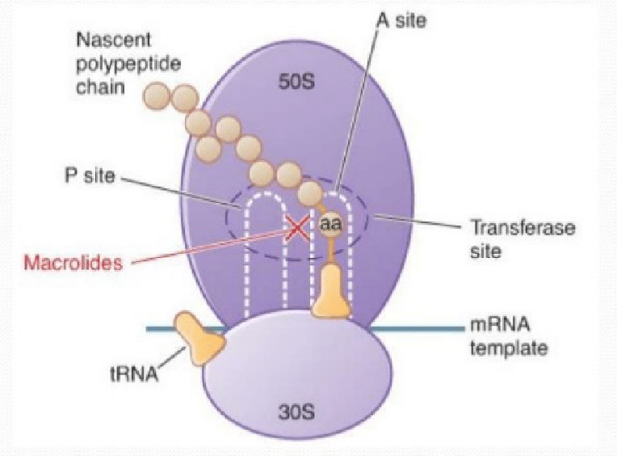
Mechanism of Action of Protein synthesis inhibitor (Macrolides) (Blondeau, 2004).

Slide 40
Bacterial Resistance in macrolides
The mechanisms involved in resistance are:
(I). Bacteria show less permeability to erythromycin
(II). Active macrolide efflux pumps
(III). Enterobacteriaceae produces erythromycin esterase which hydrolyzes the macrolides.
(IV). Changes in the 50S ribosome protein due to chromosomal mutations.

Slide 41
Pharmacokinetics
Erythromycin (basic) is unstable in acid.
To prevent the medicine from getting destroyed by gastric acid, enteric-coated tablets are administered.
Stearates and esters formulation are fairly acid-stable.
Macrolides do not cross Blood-Brain Barrier.
They penetrate poorly into the synovial fluid.
The liver metabolizes macrolides which is largely eliminated through the biliary excretion in its active form in feces.

Slide 42
Side Effects and Toxicity
In general, macrolides are least toxic antibiotic but tilmicosin is comparatively toxic.
They are irritants and may cause pain and swelling at the site of injections.
Erythromycin estolate salt is particularly hepatotoxic and may cause cholestatic jaundice.
Hypersensitivity reactions or skin reactions may occasionally be seen.

Slide 43
High doses may cause severe GI disturbances (vomiting, diarrhea, oedema of GI mucosa etc.).
Erythromycin can cause reversible deafness in high doses.
Cardiac arrhythmia, Q-T prolongation, ventral tachycardia, and death occur in patients who are administered with other arrhythmogenic drugs
DRUG INTERACTION:
Erythromycin is an enzyme inhibitor and may interact with theophylline, carbamazepine, cyclosporin, tacrolimus, warfarin, digoxin, terfenadine, astemazole, cisapride, lovastatin, triazolam, and disopyramide, thereby increasing their plasma concentration and possible toxicity

Slide 44
Uses
Patients allergic to penicillin
Respiratory tract infections
Atypical pneumonia caused by Mycoplasma pneumoniae
Bronchopneumonia
Bacterial enteritis
Urinary tract infections
Bacterial pyodermatitis
syphilis and gonorrhea
Whooping cough
Erythromycin is the preferred antibiotic to prevent and treat:
  dental infections
  Leptospirosis
  chlamydial infections
  streptococcal infections (pharyngitis, tonsillitis, scarlet fever)
  other staphylococcal infections.

Slide 45
Oleandomycin and Troleandomycin
Oleandomycin is obtained from Streptomyes antiboticus.
Troleandomycin is a derivative of oleandomycin.
Both drugs possess erythromycin like antibacterial spectrum and have special activity against Staphylococci and Streptococci.

Slide 46
NEWER MACROLIDES
To overcome the limitations of erythromycin viz.
narrow spectrum activity (extended spectrum)
poor tissue penetration
gastric acid liability
low oral bioavailability
short half life.

Slide 47
Some semisynthetic macrolides like roxithromycin, clarithromycin and azithromycin have been developed.
Their antibacterial spectrum is similar to that of erythromycin and some are more active against Mycoplasma and Chlamydia.
They are mainly used as an alternative to erythromycin for respiratory tract infection, pneumonia, skin, soft tissue and genital tract infections.
DRUG INTERACTION: Clarithromycin is an Enzyme inhibitor of rifabutin, carbamazepine, cisapride, astemizole, terfenadine, and theophylline
Clarithromycin & Erythromycin: fatal ventricular arrhythmias when they interact with astemizole, cisapride.

Slide 48
REFERENCES
Megan Block; Dana L. Blanchard; Aminoglycoside antibiotics. StatPearls Publishing LLC (2023)
Mechanism of Action of Protein synthesis inhibitor (Macrolides) (Blondeau, 2004).
Parth H. Patel; Muhammad F. Hashmi; Macrolide antibiotics. StatPearls Publishing LLC (2023)
Lippincott Illustrated Reviews: Pharmacology, ed.8 by Karen Whalen. Lippincott Home 2023.
Goodman and Gilman’s the Pharmacological Basis of Therapeutics, 14th Edition by Laurence Brunton; Bjorn Knollmann, McGraw Hill Medical, 2024.

