Slide 1
Course
Lecture 10
Topic:
Anti-viral drugs
Anti-retroviral drugs
PHARMACOLOGY
Seth Mikaye

Slide 2
ANTI-VIRAL DRUGS

Slide 3
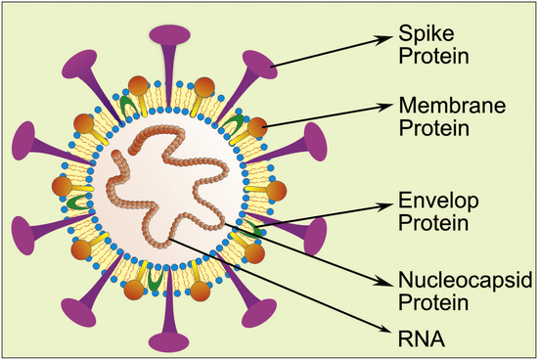
INTRODUCTION
A virus is a submicroscopic infectious agent that replicates only inside the living cells of an organism, infecting all life forms, from animals and plants to microorganisms, including bacteria.
Consists of a segment of nucleic acid (either DNA or RNA) surrounded by a protein coat.
Source:https://www.researchgate.net/publication/343013688/figure/fig5/AS:923983964823554@1597306352738

Slide 4
LIFE CYCLE OF A VIRUS
1. Virus attachment
2. Fusion of the viral membrane (envelope) with the host cell membrane
3. Uncoating
4. The HIV DNA is integrated into the host cell genome
5. Gene transcription
6. The viral mRNA is translated into proteins on host cell ribosomes.
7. The proteins assemble into immature virions
8. The virions undergo proteolytic cleavage, maturing into fully infective virions.

Slide 5
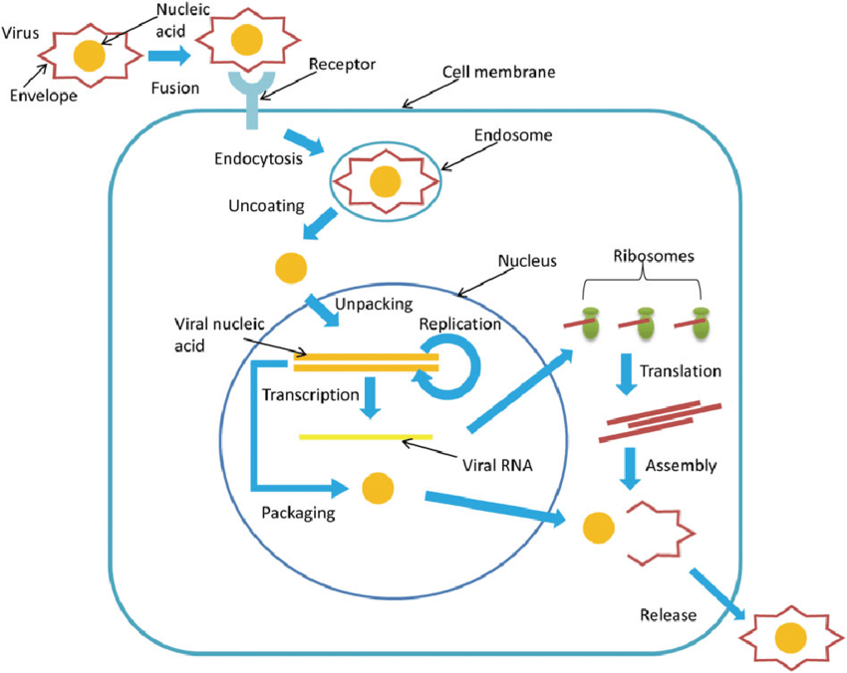
LIFE CYCLE OF A VIRUS
Image source: Qureshi, Abdi et al, doi:10.1002/rmv.1976. https://www.researchgate.net/publication/324534428_A_review_on_current_status_of_antiviral_siRNA

Slide 6
CLASSIFICATION OF ANTI-VIRAL DRUGS
I. Anti- Retroviral drugs
a) Nucleoside reverse transcriptase inhibitors (NRTIs): Lamivudine (3TC), Abacavir (ABC), Emtricitabine (FTC), Tenofovir DF (TDF), Zidovudine (AZT/ ZDV), stavudine (d4T),
b) Non-nucleoside reverse transcriptase inhibitors (NNRTIs) Efavirenz (EFV), Nevirapine (NVP) Etravirine (ETR) Rilpiverine (RPV)
c) Protease inhibitors: Atazanavir (ATV), Darunavir (DRV), Lopinavir (LPV), Ritonavir (RTV)

Slide 7
d) Inhibitor of virus entry/fusion with host cells: Enfuvirtide (T-20)
e) Integrase inhibitor : Raltegravir (RAL) Dolutegravir (DTG) Elvitegravir (ELV)
f) Chemokine receptor antagonist (CCR5): Maraviroc (MVC), aplaviroc, vicriviroc

Slide 8
II. Non- Antiretroviral drugs
A) Anti-Herpes drugs: Idoxuridine, Acyclovir, Valacyclovir, Famciclovir Ganciclovir, Foscarnet, Trifluridine, Cidoclovir, Fomivirsen
B) Anti-Influenza drugs: Amantadine, Rimantadine, Oseltamivir, Zanamivir
C) Anti-hepatitis virus/ nonselective antiviral drugs
i) Primarily for hepatitis B: Lamivudine, Adefovir diplivoxil, Tenofovir
ii) Primarily for hepatitis C: Ribavirin, Interferon α

Slide 9
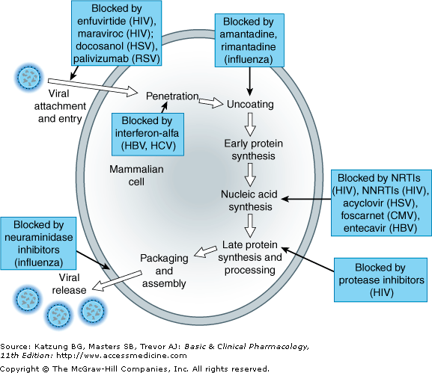
The major sites of antiviral drug action.

Slide 10
ANTIVIRAL DRUGS
The viral growth cycle | Selective inhibitors
1) Attachment 2) Penetration | Antiviral antibodies (gamma globulin)
3) Uncoating | Amantadine, rimantadine, Interferons
4) Early translation (early mRNA and protein synthesis) | fomivirsen
5) Transcription (viral genome replication) | Inhibitors of DNA-polymerase: Acyclovir, Gancyclovir, Famcyclovir, Cidofovir, Vidarabine, Idoxuridine, Trifluridine, Foscarnet In­hibitors of RNA-dependent DNA-polymerase: Zidovudine, Didanosine, Stavudine, Zalcitabine, Lamivudine, Foscarnet

Slide 11
6) Late translation (late mRNA an protein synthesis) | Ribavirin, Interferons
7) Posttranslational modifications (proteolytic cleavage) | Protease inhibitors: Saquinavir, Indinavir, Ritonavir
8) Assembly (packaging of viral nucleic acids) | Interferons, Rifampin
9) Release (virion is released from cell) | Antiviral antibodies, Cytotoxic T lymphocytes

Slide 12
GENERAL FEATURES OF ANTIVIRAL DRUGS
Most antiviral drugs are purine or pyrimidine analogs
Many antiviral drugs are prodrugs. They must be phosphorylated by viral or cellular enzymes in order to become active.
Antiviral drugs typically have a restricted spectrum of antiviral activity and inhibit a specific viral protein.
Single nucleotide changes leading to critical amino acid substitutions in a target protein often are sufficient to cause antiviral drug resistance.
Current agents inhibit active replication but do not eliminate nonreplicating or latent viruses so that viral growth may resume after drug removal. Effective host immune response remain essential for recovery from infection.

Slide 13
Antiviral drugs may have antiviral synergistic effects when given concomitantly
In other cases toxic synergistic effects preclude concurrent administration of two antiviral drugs (i.e. zidovudine and acyclovir, zidovudine and gancyclovir, etc.)
Clinical efficacy of antiviral drugs depends on achieving inhibitory concentrations within infected cells.

Slide 14
NON-ANTI-RETROVIRAL DRUGS
AMANTADINE AND ITS DERIVATIVES
Amantadine and rimantadine are tricyclic amines.
Mechanism of action
Inhibition of viral uncoating by:
a) Blockade of the viral membrane matrix protein M2, which function as an ion channel, which is needed to effect pH change.
b) Raising the pH of the endosome by amantadine helps prevent the uncoating process (an acidic pH inside the endosome is required for viral uncoating)

Slide 15
Antiviral spectrum and resistance
Influenza A virus (not B and C virus)
Resistant variants are selected rapidly during treatment (approximately in 30% of treated patients)
Other effects
Amantadine has antiparkinsonian effects. The mechanism of action is not clear but it may be related to:
a) the antimuscarinic properties of the drug
b) the stimulation of the synthesis and release of dopamine (and other catecholamines)

Slide 16
Pharmacokinetics and administration
F (oral): 50-90%
Distribution in all body tissues including CNS
Renal excretion: > 90%
Half lives: » 16 hours
Administration: oral

Slide 17
Adverse effects
Anorexia, nausea, vomiting ,stypsis, xerostomia, urinary retention, ataxia.
Nervousness ,insomnia, lightheadedness, difficulty concentrating
Delirium, hallucinations, seizures (with high doses)
Teratogenic effects in animals

Slide 18
Therapeutic uses
Treatment of influenza A (treatment within the first 48 hours after the exposure reduces the duration of symptoms and speeds functional recovery)
Prevention of influenza A (70-90% protective).
The drugs do not impair the immune response to influenza A vaccine.

Slide 19
RIBAVIRIN
Ribavirin is a purine nucleoside analog.
Mechanism of action
Inhibition of synthesis of guanosine-triphosphate which leads to inhibition of nucleic acid synthesis in general.
Specifically binds to the substrate-binding site of the IMPDH enzyme limiting access of the enzyme to its endogenous substrate (inosine-5-monophosphate) ultimately leading to the decreased synthesis and lower levels of GTP
Specific inhibition of viral mRNA synthesis

Slide 20
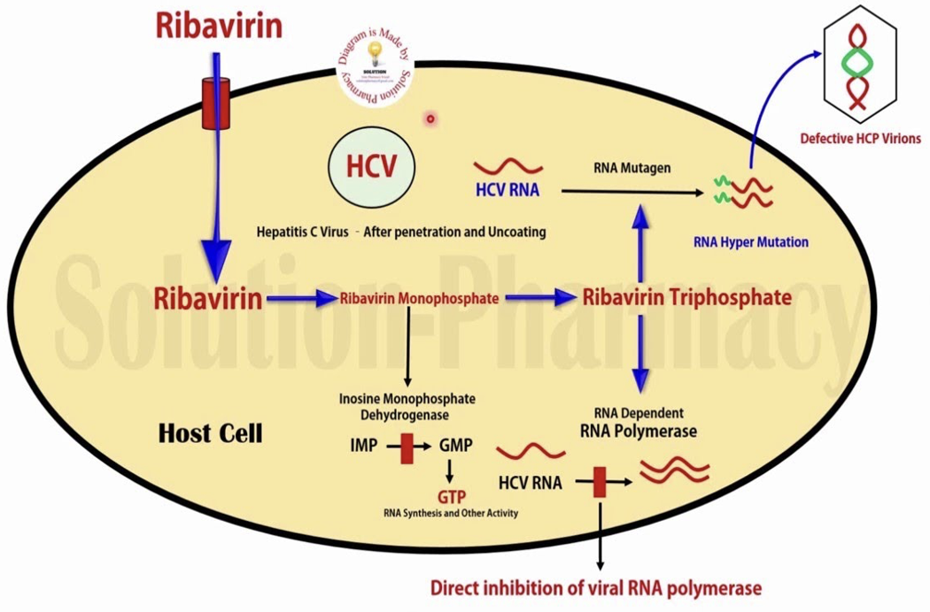
Source: Solution Pharmacy https://i.ytimg.com/vi/cx8QzDiyQTo/maxresdefault.jpg

Slide 21
Antiviral spectrum and resistance
Wide range of DNA and RNA viruses are susceptible, including influenza A, B and C viruses, parainfluenza viruses, measles virus, HSV-1, HSV-2, CMV, RSV
KEY
Cytomegalovirus (CMV)
Herpes Simplex Virus (HSV)
Varicella Zoster Virus (VZV)

Slide 22
Pharmacokinetics and administration
Bioavailability (oral): 50-90%
F(aerosol) < 5%
Distribution in all body tissues, except CNS
Renal excretion: » 35%
Half lives: » 30 hours
Administration: oral, IV, inhalation

Slide 23
Adverse effects
When given by aerosol: Conjunctival irritation, transient wheezing, reversible deterioration in pulmonary function.
When given orally or IV: Dose-dependent hemolytic anemia and bone marrow suppression
Headache, insomnia, mood alteration
Teratogenic effects in animals

Slide 24
Therapeutic uses
Ribavirin is the drug of choice for:
-RSV (Respiratory Syncytial Virus) bronchiolitis and pneumonia in hospitalized children (given by aerosol)
-Lassa fever (african rat virus)
Ribavirin is an alternative drug for:
-Influenza, parainfluenza, measles virus infection in immunocompromised patients

Slide 25
ACYCLOVIR AND CONGENERS
Acyclovir, gancyclovir, famcyclovir, pemcyclovir all are guanine nucleoside analogs.
Mechanism of action
All drugs are phosphorylated by a viral thymidine-kinase, then metabolized by host cell kinases to nucleotide analogs.
The analog inhibits viral DNA-polymerase
Only actively replicating viruses are inhibited

Slide 26
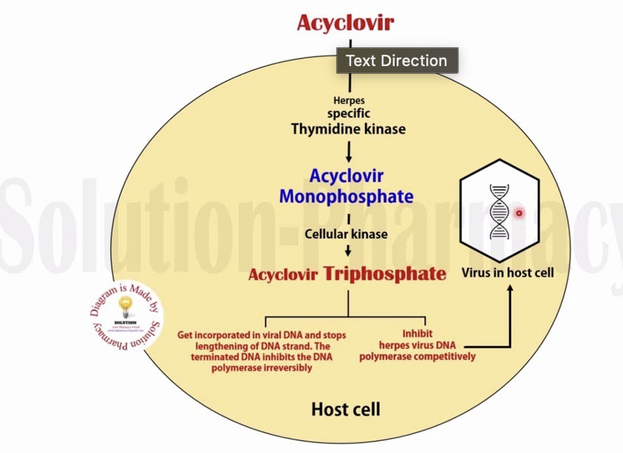
Source: Solution pharmacy. https://i.ytimg.com/vi/x3a6ox9Ngpk/maxresdefault.jpg

Slide 27
Antiviral spectrum and resistance
Acyclovir: HSV-1, HSV-2, VZV.
Gancyclovir: HSV-1, HSV-2, VZV, EBV, CMV.
Viral resistance may occur and may be due to:
a) decreased production of thymidine kinase
b) altered thymidine kinase substrate specificity
c) altered viral DNA polymerase

Slide 28
Pharmacokinetics and administration
F(oral): acyclovir 20-30%; gancyclovir < 10%
Distribution in all body tissues including CNS
(­CSF/plasma ratio » 0.5)
Renal excretion: > 80%
Half lives: 2-5 hours
Administration: topical, oral (acyclovir), IV (acyclovir, gancyclovir)

Slide 29
Adverse effects
Nausea and vomiting ,diarrhea (acyclovir PO)
Neurotoxicity (1-5% of patients) (headache, tremor, behavioral changes, delirium, seizures, coma) (acylovir and gancyclovir, high doses IV)
Nephrotoxicity (crystalluria, hematuria, renal insufficiency (acyclovir, high doses IV)
Myelosuppression (neutropenia, thrombocytopenia) (gancyclovir)
Teratogenic effects in animals

Slide 30
Therapeutic uses
Acyclovir is the drug of choice for:
Genital HSV infections
HSV encephalitis
HSV infections in immunocompromised patient
Gancyclovir is the drug of choice for:
CMV retinitis in immunocompromised patient
Prevention of CMV disease in transplant patients

Slide 31
IDOXURIDINE AND TRIFLURIDINE
Idoxuridine and trifluridine are pyrimidine nucleoside analogs.
Mechanism of action
The drugs are converted by cellular enzymes to their triphosphate analogs which inhibits viral (and, to a lesser extent, human) DNA synthesis.
Inhibits viral replication by substituting itself for thymidine in viral DNA. This in turn inhibits thymidylate phosphorylase and viral DNA polymerases from properly functioning.

Slide 32
Antiviral spectrum and resistance
Antiviral spectrum includes HSV-1, HSV-2 and VZV.
Prolonged treatment can select drug-resistant mutants.
Administration
Topically administered (eye, oral, genital mucosae)
Adverse effects
Pain, pruritus, edema involving the eye or lids.
Allergic reactions (rare)
Therapeutic uses
Ocular, oral, genital HSV infections

Slide 33
FOSCARNET
Foscarnet is an inorganic pyrophosphate analog
Mechanism of action
The drug directly inhibits viral DNA-polymerase and viral inverse transcriptase (it does not require phosphorylation for antiviral activity)
Antiviral spectrum and resistance
Antiviral spectrum of foscarnet includes HSV-1, HSV-2, VZV, CMV and HIV.
Resistance may be due to altered viral DNA polymerase
Cross-resistance between with other antiviral drugs is very rare.

Slide 34
Pharmacokinetics and administration
F(oral): 10-20%
Distribution in all body tissues including CNS (CSF/plasma ratiois 0.7)
Renal excretion: > 80%
Half life: 3-4 days
Administration: IV

Slide 35
Adverse effects
Hypocalcemia and hypomagnesemia (due to chelation of the drug with divalent cations) are common.
Neurotoxicity (headache, tremor, irritability, hallucinations, seizures)
Nephrotoxicity (acute tubular nephrosis, interstitial nephritis)
Therapeutic uses
HSV infections (due to thymidine kinase deficient strains which are acyclovir resistant)
HSV infections in immunocompromised patient
CMV retinitis (gancyclovir resistant)
CMV infections in immunocompromised patient

Slide 36
INTERFERONS
Interferons are inducible endogenous cytokines (glycoproteins)
Three major classes of human interferons (IFN) are:
IFN-alpha (human leukocyte IFN), induced by viruses
IFN-beta (human fibroblast IFN), induced by viruses
IFN-gamma (human immune IFN), induced by antigens

Slide 37
Mechanism of antiviral action
Induction of the following main enzymes:
1) a protein kinase which inhibits protein synthesis
2) an oligoadenylate synthase which leads to degradation of viral mRNA
3) a phosphodiesterase which can inhibit tRNA
The action of these enzymes leads to an inhibition of translation (late viral RNA and protein synthesis)

Slide 38
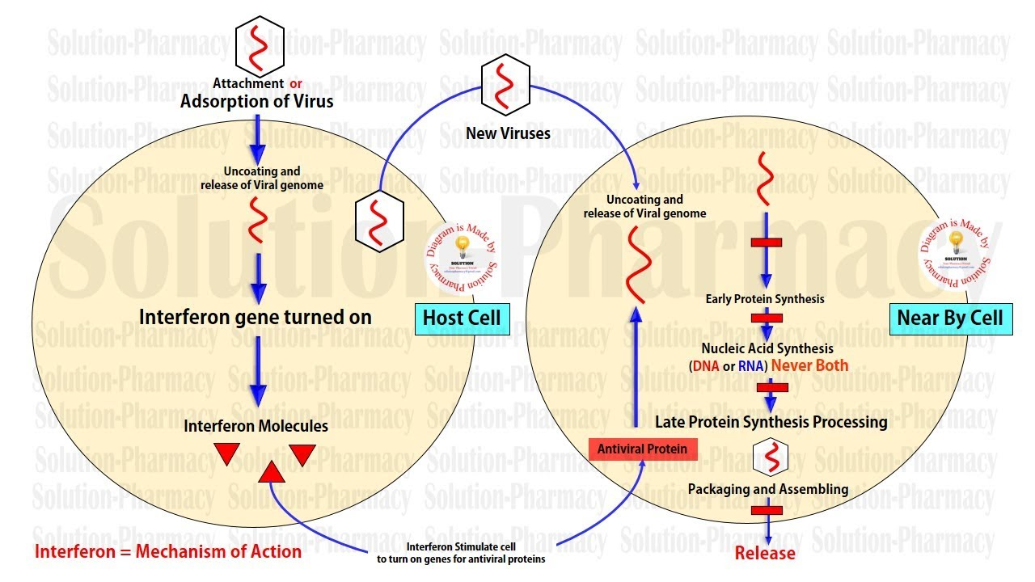
Source: Solution Pharmacy https://i.ytimg.com/vi/lFlUpDuL9rk/maxresdefault.jpg

Slide 39
Antiviral spectrum :Antiviral spectrum includes HBV, HCV, HDV, HSV, VZV, CMV and human papillomavirus (HPV).
Other effects
Interferons possess immunomodulating and antiproliferative actions and may inhibit the growth of certain cancer cells.
Pharmacokinetics
F(oral): < 1% ;
F(IM, SC): IFN-alpha > 80% ; IFN-beta » 40%
Distribution in all body tissues, except CNS and eye.
Half lives: 1-4 hours

Slide 40
Adverse effects
Acute flu-like syndrome (fever, headache, myalgia, arthralgia, nausea and vomiting)
Bone marrow suppression (granulocytopenia, thrombocytopenia)
Neurotoxicity (fatigue, sleepiness, confusion, seizures) (after high doses)
Cardiotoxicity (cardiac failure)(after high doses)
Hepatotoxicity (after high doses)
Interstitial nephritis (after high doses)
Hypersensitivity reactions (rare)
Impairment of fertility

Slide 41
Therapeutic uses
Chronic hepatitis B and C (improvement in 25-50% of patients. Administration usually last 4-6 months. Remission may be sustained, but complete disappearance is seen only in 30% of cases)
HZV infection in cancer patients (to prevent the dissemination of the infection)
CMV infections in renal transplant patients
Refractory condylomata acuminata (given by intralesional injection. Complete clearance is seen in 36-62% of patients)
Hairy cell leukemia (in combination with zidovudine)
AIDS related Kaposi’s sarcoma

Slide 42
ANTI-RETROVIRAL DRUGS

Slide 43
INTRODUCTION
There are now >30 antiretroviral medications available for the treatment of HIV.
These drugs have distinct sites of action in the HIV life cycle, and unique pharmacological properties that dictate how they can be used safely in the treatment of HIV.
Drug-drug interactions (DDIs) can occur because of alterations to several pharmacodynamic processes, including absorption and drug transport, but hepatic metabolism is clinically the most important.
The CD4 count normal range is 500 to 1500 cell/mm^3.

Slide 44
Nucleoside reverse transcriptase inhibitors (NRTIs)
Zidovudine, Stavudine, Lamivudine, Abacavir, Zalcitabine, Emtricitabine, Didanosine.
NRTIs are taken as prodrugs and must be taken into the host cell and phosphorylated before they become active
Mechanism of action: block reverse transcriptase (an HIV enzyme)
They act by incorporating themselves into the DNA of the virus (competing with natural nucleotides), thereby stopping the building process of transcription from RNA to DNA.
The resulting DNA is incomplete and cannot create a new virus.
Block the HIV replication, block the infection of new cells
No effect on already infected cells.

Slide 45
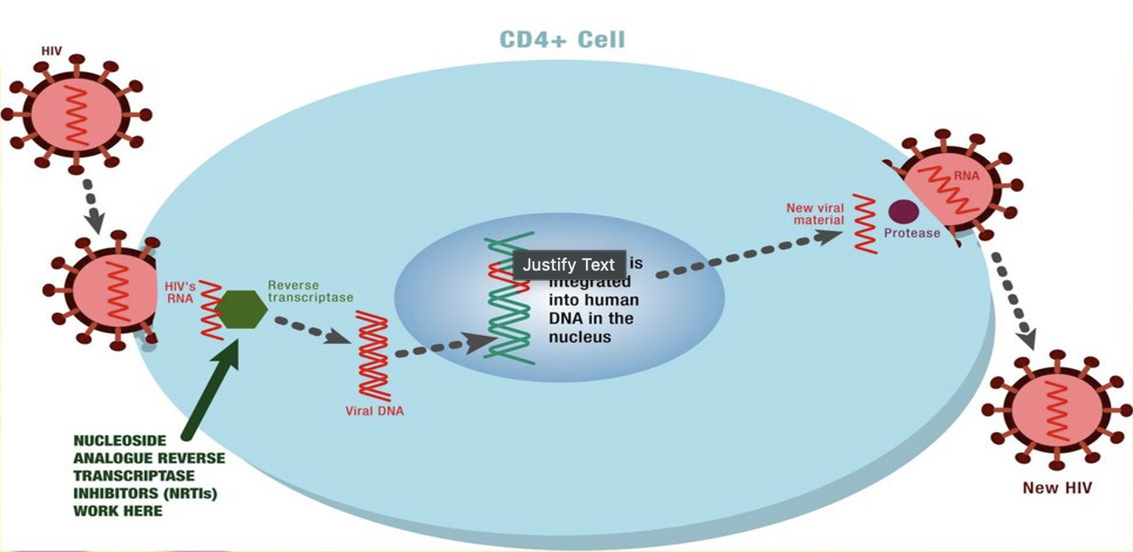
They inhibits the activity of HIV-1 reverse transcriptase (RT) via DNA chain termination after incorporation of the nucleotide analogue. It competes with the natural substrate dGTP and incorporates itself into viral DNA.
Source: IJMPR Review Article https://slideplayer.com/slide/12664591/76/images/8/Mechanism+of+action+of+NRTIs.jpg

Slide 46
Zidovudine (AZT, ZDV)
First antiviral drug used against HIV.
It is effective against HIV-1, HIV-2, and HTLV (human-T-lymphotropic virus) I and II.
In combination with one or more other ART agents, is approved for the treatment of HIV infection in adults and children and for post-exposure prophylaxis.
It is used alone or in combination for the prevention of prenatal and perinatal transmission to the baby by HIV-infected pregnant women.
Adverse effects: Headache, nausea, vomiting, anorexia, fatigue, confusion, insomnia, malaise, hepatitis, myopathy, myositis, bone marrow toxicity, anemia, neutropenia, and hematological abnormalities.

Slide 47
Stavudine (D4T)
It is active against HIV-1 and HIV-2.
It is approved for the therapy of HIV infection as part of a multidrug regimen and is also used for Postexposure prophylaxis.
Adverse effects:
Headache, diarrhoea, skin rash, nausea, vomiting, insomnia, anorexia, myalgia, peripheral neuropathy.
Lactic acidosis occurs more frequently with Stavudine than with other NRTIs.

Slide 48
Lamivudine (3TC)
It is active against HIV-1, HIV-2, and hepatitis B virus.
It is approved as part of a multidrug regimen for the therapy of HIV infection in adults and children and has been used for HIV postexposure prophylaxis.
Lamivudine is the best-tolerated NRTI.
Adverse effects:
Headache, malaise, fatigue, insomnia.

Slide 49
Abacavir (ABC)
It is indicated for the therapy of HIV-1 infection in adults and children. It is used as part of a multidrug regimen .
It is also used for Postexposure HIV infection prophylaxis.
Adverse effects:
Anorexia, nausea, vomiting, malaise, headache, and insomnia.
A potentially fatal hypersensitivity reaction develops in approximately 5% of patients.
Fever and rash are the most common symptoms of this reaction; malaise, respiratory symptoms, and gastrointestinal complaints may also occur.

Slide 50
Didanosine (DDI)
It is active against HIV-1, HIV-2, and HTLV-I.
It is approved as part of a multidrug regimen for the therapy of HIV infection and is also used as Postexposure HIV prophylaxis.
Adverse effects:
Diarrhea, abdominal pain, nausea, vomiting, anorexia and dose-related peripheral neuropathy, pancreatitis, hyperuricemia, bone marrow suppression, retinal depigmentation, and optical neuritis.

Slide 51
Non nucleoside reverse transcriptase inhibitors (NNRTIs)
Efavirenz, Nevirapine, Delaviridine.
All NNRTIs are active against HIV-1 reverse transcriptase only
Their use with NRTIs or protease inhibitors provide synergistic effects against HIV due to sequential block at two different steps required for viral replication.
The NNRTIs differ from the NRTIs in that they do not have a nucleoside structure and do not depend on phosphorylation for activity
Mechanism of action:
They act by stopping HIV production by binding directly onto reverse transcriptase (non-competitively) and preventing the conversion of RNA to DNA.

Slide 52
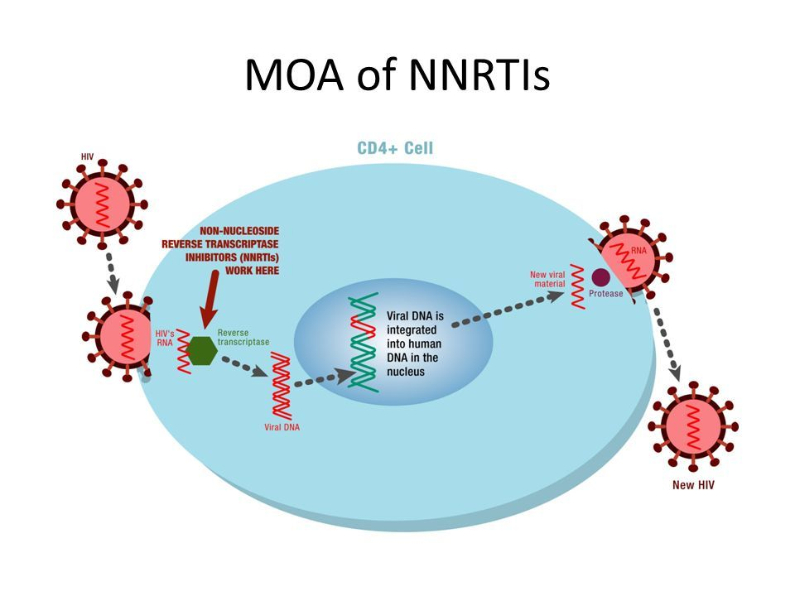
Source: IJMPR Review Article. ihttps://images.slideplayer.com/75/13970856/slides/slide_17.jpg

Slide 53
Efavirenz (EFV)
It is approved for the therapy of HIV infection of adults and children and is also used for Post-exposure prophylaxis.
It is the only NNRTI approved for once-daily dosing.
Adverse effects:
Rash, elevated liver enzymes and serum cholesterol also may occur.
CNS effects: dizziness, headache, insomnia, drowsiness, euphoria, agitation, impaired cognition, nightmares, vivid dreams, and hallucinations.
Efavirenz should be avoided during pregnancy because primate studies have shown it to be teratogenic at doses near therapeutic levels.

Slide 54
Nevirapine (NVP)
It is approved for the treatment of HIV infection in adults and children as part of a combination therapy.
During the first 12 weeks of treatment, patients must be closely monitored for the development of potentially fatal hepatic toxicity (i.e., hepatitis, hepatic necrosis, and hepatic failure) and skin reactions (i.e., Stevens-Johnson syndrome, toxic epidermal necrolysis, and hypersensitivity reactions).
Adverse effects:
Mild to moderate rash, fever, nausea, fatigue, headache, and elevated liver enzymes.

Slide 55
Protease inhibitors (PIs)
Mechanism of action:
HIV protease is a viral enzyme responsible for the cleavage of polyproteins into structural proteins and certain enzymes that are required for the final assembly of the new infectious virions.
Protease inhibitors act by binding to the viral protease, in this way preventing the correct cleavage of viral proteins.
Thus, they prevent HIV from being successfully assembled and released from the infected cells.

Slide 56
MOA: PIs prevent newly replicated, mature viruses from being formed and released into the blood to further infect other CD4 cells.
Therapeutic uses: • Combination therapy with PIs and other antiretroviral drugs significantly improve the clinical efficacy by blocking HIV replication at different stages in the intracellular life cycle.
Adverse effects: Diarrhea, nausea, abdominal discomfort Hyperglycemia, fat redistribution, hyperlipidemia Bleeding episodes in hemophilics

Slide 57
Saquinavir (SQV) is a potent inhibitor of HIV-1 and HIV-2 protease. • It is usually well tolerated and most frequently produces mild gastrointestinal side effects.
Ritonavir (RTV) is a potent inhibitor of HIV-1 and HIV-2 protease.
It is not well tolerated in higher doses.
It is mainly used in low doses to increase blood levels of other protease inhibitors and to extend their dosing interval.
Adverse effects:
Gastrointestinal side effects, altered taste sensation, paresthesias(tingling or numbness, skin) and hypertriglyceridemia.

Slide 58
Nelfinavir (NFV)
It is probably the most commonly used protease inhibitor because of its low incidence of serious adverse effects.
Adverse effects: Diarrhea and flatulence; these may resolve with continued use

Slide 59
Entry/Fusion inhibitors: Enfuvirtide
MOA
Enfuvirtide binds to the viral envelope glycoprotein and prevents the conformational changes required for the fusion of viral and cellular membranes.
Pharmacokinetics:
Oral bioavailability: Poor, Hence given S/C.
Distribution: PB 90% Plasma T1/2: 3-4 Hrs.

Slide 60
Therapeutic uses:
Used along with other antiretroviral drugs for the treatment of advanced HIV-1 infections (which is not managed despite other antiretroviral therapy)
Adverse effects:
Local reaction (nodule) at injection site, skin rash, eosinophilia, pneumonia like manifestation

Slide 61
Chemokine receptor antagonist (CCR5)
Maraviroc.
Maraviroc selectively binds to the human chemokine receptor CCR5 present on the membrane of CD4 cells (T-cells), preventing the interaction of HIV-1 gp120 and CCR5 necessary for CCR5-tropic HIV-1 to enter cells.
Attachment and entry of virus is inhibited
Used to treat a certain type of human immunodeficiency virus (HIV) infection in adults and children
Adverse reactions: •
Impaired immune surveillance, Increased risk of infection/ malignancy, Hepatotoxicity, Skin rashes

Slide 62
Integrase inhibitor : Raltegravir (RAL)
Inhibits the activity of HIV-1 integrase, which impedes the insertion of HIV-1 DNA into the host cell genome.
Integrase inhibitors rely on the fact that HIV needs integrase to replicate. These drugs stop HIV from being able to make integrase. Without the help of this enzyme, HIV can't take over CD4 cells to copy itself and the HIV life cycle is interrupted.
Active against both HIV 1 & 2 and causes improved CD4 cell count
Uses:
As a component of drug regimen along with other drugs in treatment experienced patients
Adverse effect: myopathy

Slide 63
REFERENCES
Qureshi A, Tantray VG, Kirmani AR, Ahangar AG. A review on current status of antiviral siRNA. Rev Med Virol. 2018;e1976. https://doi.org/10.1002/rmv.1976
Bertram G. Katzung, Todd W. Vanderah. Basic & Clinical Pharmacology, 16th Edition. 2024 by McGraw Hill.
Goodman and Gilman’s the Pharmacological Basis of Therapeutics, 14th Edition by Laurence Brunton; Bjorn Knollmann, McGraw Hill Medical, 2024.
Pankaj Basumatary et al., Evolution of anti-HIV drug: past, present, challenges, recent advancement & future promises. IJMPR Review Article, Volume 6, Issue 6. (2022)

Slide 64
Tyler R. Kemnic; Peter G. Gulick. HIV Antiretroviral Therapy. StatPearls Publishing LLC. 2022

