Slide 1
Course
Lecture 11
Topic:
Anti-Tubercular drugs
Anti-leprotic drugs
Anthelmintic drugs
PHARMACOLOGY
Seth Mikaye

Slide 2
ANTI-TUBERCULAR DRUGS

Slide 3
TUBERCULOSIS (TB) - HISTORY
A highly infectious disease caused by Mycobacterium tuberculosis believed to have originated from a common ancestor in East Africa 15000-20000 years ago.
Descriptions of tuberculosis were found in India and China about 3300 and 2300 years ago.
Skeletal deformities related to TB e.g. Pott’s deformities were found on Egyptian mummies 2400-3400 B.C.
It is well documented in ancient Greece as Phthisis or Consumption in Book I, of the Epidemics by Hippocrates.

Slide 4
Galen (Greek) identified symptoms of fever; sweating, blood-stained sputum and coughing, recommending fresh air, milk and soy beverages as effective treatments.
TB was widespread in Europe in the 5th century.
The contagious nature of TB was first provided by Girolamo Fracastoro in the 16th century.
Johann Schonlein in 1834 coined the term tuberculosis.

Slide 5
In 1865, Jean-Antoine Villemin showed TB was infectious by inoculating a rabbit with fluid from a person who had died of TB
Robert Koch successfully identified, isolated and cultured tubercle bacillus in animal serum and had his work published in the Society of Physiology in Berlin.
Clemens von Pirquet and Charles Mantoux developed TB skin test between 1907-1908.

Slide 6
The BCG vaccine was developed in 1921 by Albert Calmett and Jean-Marie Camille Guerin.
Selman Waksman, Elizabeth Bugie and Albert Schatz developed a TB antibiotic streptomycin in 1943.
Four drugs (Isoniazid, Pyrazinamide, Ethambutol & Rifampin) since 1951 have effectively treated Tuberculosis.

Slide 7
M. tuberculosis cell wall
Mycobacterium is derived from Greek word “Mycos” that means waxy appearance due to composition of their cell wall. More than 60% of the cell wall is lipid mainly mycolic acid.
Mycolic acids; long fatty acids covalently linked to the cell wall, provide structural integrity and make it highly impermeable, contributing to antibiotic resistance.
The cell wall of M. tuberculosis contains lipids and glycolipids that may impact virulence by affecting the host immune system.
It mainly affects the lungs, but can also spread to the CNS, circulatory system, and genitourinary system.

Slide 8
I. Classification based on Efficacy and clinical safety
1. First line drugs – drugs that exhibit high efficacy and clinical safety
All have a three letter and a single letter abbreviation
Ethambutol is EMB or E
Isoniazid is INH or H
Pyrazinamide is PZA or Z
Rifampicin is RMP or R
Streptomycin is STM or S

Slide 9
2. Second Line Drugs
They are found to be more toxic but may be used in certain resistance problems.
PASA (p-amino salicylic acid), Aminosalicylate sodium
Aminoglycosides e.g. kanamycin, Amikacin, Capreomycin
Fluroquinolones e.g. ciprofloxacin, levofloxacin, moxifloxacin, gatifloxacin
Thioamines e.g. prothionamide, ethionamide,
Miscellaneous drugs: cycloserine, linezolid, protamanid, delamanid, bedaquiline, clofazimine

Slide 10
3. Third Line Drugs
These are drugs that may be useful but are not on the WHO list.
Listed in this category because they are not very effective and also their efficacy has not been proven
e.g clarithromycin, rifabutin, amoxicillin/clavulanate,
Rifabutin is effective but not included in WHO list

Slide 11
Isoniazid (Isonicotinic acid hydrazide)
INH
Isoniazid is a pro-drug that is activated by an enzyme known as KatG.
When activated, it forms a covalent complex (adduct) with acyl carrier proteins (INH-A) and KasA, a beta ketoacyl carrier protein synthetase.
This inhibits the synthesis of mycolic acid, a key building block of the mycobacterial cell wall, leading to cell death due to loss of cell wall integrity.

Slide 12
CONTD... ISONIAZID
Bactericidal for actively growing tubercle bacilli.
INH inhibits the synthesis of mycolic acid which are unique fatty components of mycobacterial cell wall.
INH enters sensitive mycobacteria which converts it by a catalase-peroxidase enzyme into a reactive metabolites.
Adduct with NAD that inhibit InhA (Enol-acetyl-carrier-protein-reductase) and KasA (Acyl-carrier-protein-kinase).
Also adduct with NADPH, which inhibit Mycobacterial Dihydrofolate reductase resulting in interruption of DNA synthesis.

Slide 13
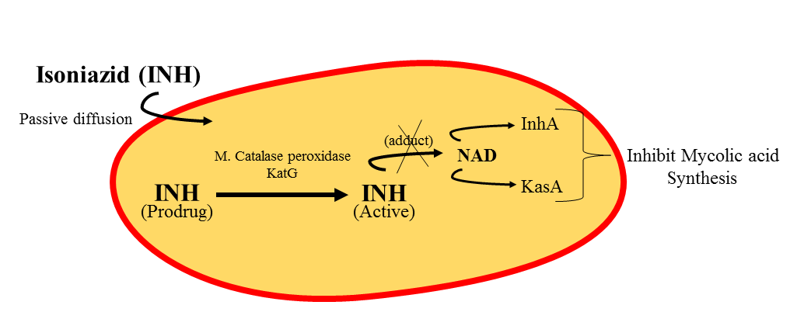
Image credit: Dash Smrutiranjan. Aleviate Now.
https://alleviatenow.in/wp-content/uploads/2022/09/Slide1.png

Slide 14
CONTD... ISONIAZID
Resistance:
Increase expression of InhA or by mutations that lower the enzyme’s affinity to NADH.
Pharmacokinetics:
INH completely absorbed orally.
Penetrate all the body tissue, tubular cavities, placenta, and meninges.
Extensively metabolized in liver, most important pathway being N-acetylation.
The acetylated metabolite is excreted in urine.

Slide 15
CONTD... ISONIAZID
The rate of INH acetylation show genetic variation.
i. Fast acetylator: (30-40% of population) t1/2 of INH 1hr.
Hepatotoxicity: due to increased metabolism and conc. of metabolites.
Also common in alcoholics and hepatitis patients.
Remedy: Stop drug upon symptom manifestation (fever, anorexia, abdominal pain, hematological changes, convulsions)
ii. Slow acetylator: (60-70% of population) t1/2 of INH 3hrs.
Isoniazid induced peripheral neuropathy is more common here.
Why? Accumulated INH inhibits pyridoxine phosphokinase which converts pyridoxine to its active form pyridoxal-5-phosphate.
Remedy: Prophylactic use of Vit B6.

Slide 16
Adverse effects - INH
Hepatitis: (chronic alcoholism induce CyP₂E₁ which generates the hepatotoxic metabolites), causing liver inflammation.
Hepatotoxicity due to dose related damage to liver cell.
Peripheral Neuritis: Due to interference with production of the active coenzyme pyridoxal phosphate from pyridoxine and its increased excretion in urine.
Prophylactic pyridoxine (10mg/day): Prevents neurotoxicity even with higher doses.
NOTE: Prophylactic pyridoxine must be given to diabetics, chronic alcoholics, malnourished, lactating and HIV infected patients.

Slide 17
Rifamycins: Rifampin, Rifapetine
Rifampicin is derived from the soil mold Streptomyces.
It shows broader antimicrobial action than Isoniazid.
It is never given as a single drugs in the treatment of tuberculosis.
Mechanism of action
They blocks transcription by interacting with β subunit (involved in the binding of RNA polymerase to DNA) of bacteria, thereby inhibiting mRNA synthesis by suppressing the initiation step.

Slide 18
Antimicrobial spectrum
Having bactericidal effect for both intra and extracellular mycobacteria, like M. tuberculosis, M. Kansasii.
Its also used for many gram +ve and gram –ve organisms.
Prophylactically used for Meningitis caused by meningococci or Haemophilus influenza.
Resistance
Resistance to rifampin can be caused by a mutation in the affinity of the bacterial DNA-dependent RNA polymerase for the drug.
Decreased permeability.

Slide 19
Pharmacokinetics
Well absorbed orally.
Distribution occurs to all body fluids and organs.
Bioavailability is nearly 70%.
Food decreases absorption, so rifampin is to be take in empty stomach.
Rifampin itself can induce the hepatic mixed-function oxidase, leading to a shortened half-life and numerous drug interaction.
Elimination via bile into the faces or via the urine (secretion should be orange-red color)

Slide 20
Adverse effects
Nausea, Vomiting, Flushing and Rashes are most common.
Cholestasis jaundice (Excessive bilirubin stored in the skin and excreted throughout urine) and occasionally hepatitis.
Flu symptoms: chills, fever, headache, malaise (feeling discomfort and illness), bone pain.
Urine color change to orange-red but is harmless.
Drug interaction
Rifampin induce metabolism of: Clofibrate, Digitoxin, Ketoconazole, Methadone, oral contraceptive ,warfarin, prednisone propranolol, quinidine, and sulfonylureas.

Slide 21
Pyrazinamide
Its exact mechanism of action is not known.
Research suggests it works by releasing pyrazinamidase which converts it to pyrazinoic acid (POA).
POA disrupts membrane energetics and inhibits membrane transport function in M. tuberculosis
POA may inhibit fatty acid synthase I, an enzyme involved in cell wall synthesis.
This interferes with the bacteriums ability to synthesize new fatty acids, required for growth and replication.
More active in acidic medium.

Slide 22
Adverse effect
Hepatotoxicity
Hyperuricemia (High uric acid level in the blood)
Abdominal distress: arthralgia (Pain in joint), flushing, rashes, fever and loss of diabetic control.

Slide 23
Ethambutol
Bacteriostatic and specific for most strains of M. tuberculosis and M. Kansasii.
Mechanism of action
The mycobacterial cell wall is composed of a peptidoglycan–arabinogalactan–mycolic acid structure.
Ethambutol disrupts formation of the tuberculous cell wall by blocking arabinosyl transferases.
These enzymes attach the arabinose residue of arabinogalactan to mycolic acid.

Slide 24
Pharmacokinetic
Absorbed on oral administration and Well distributed via-out the body.
Penetration into the CNS.
Both parent drugs and metabolites are excreted by glomerular filtration and tubular secretion.
Adverse effect
Loss of visual activity / color vision
Hyperuricemia

Slide 25
Streptomycin
Tuberculocidal, as it inhibits protein synthesis of mycobacterium in the ribosomes
It penetrate tubular cavities, but does not cross to the CSF, and has poor action in acidic medium.
Streptomycin is also considered as a second line drugs, because it more effective than first line agents and their toxicity often more serious.

Slide 26
Second line drugs
1. Cycloserine
Bacteriostatic
MOA
Inhibit the synthesis of cell wall by competing with two enzymes:
L-alanine racemase: Converts L-alanine to D-alanine
D-alanylalanine synthetase: Incorporates D-alanine into the
pentapeptide that forms peptidoglycan
Side effect
Neuropsychiatric manifestation, Suicidal tendencies, Convulsion, Psychosis, Nephrotoxicity

Slide 27
2. Ethionamide
It is structurally analogous to INH
Effective after oral administration.
Widely distributed in body, including CSF.
Whereas INH is activated by the catalase-peroxidase KatG, ETH is activated by the monooxygenase EthA.
side effect:
Psychosis
Hepatitis.

Slide 28
3. Para Amino Salicylic Acid (PASA)
Mycobacterium tuberculosis’s synthesis of folic acid is inhibited by PASA, a substance that binds more strongly to pteridine synthetase than PABA.
PAS is primarily metabolized by N-acetyltransferase
Salicylic acid is renally cleared, which can be increased by raising the urinary pH.
Medications like antacids can increase renal clearance as they raise urinary pH.

Slide 29
PASA
Side effect:
nausea, vomiting, diarrhea, abdominal pain, and.
allergic reactions including fever and itching.
MECHANISM OF RESISTANCE
Resistance may arise when this drug is used alone and even more likely in patients resistant to drugs, such as STM, INH, RMP & EMB,
Mutations in the dihydrofolate synthase enzyme, which is needed to bioactivate PAS, can cause PAS resistance.
Overexpression of the dfrA gene, which encodes the DHFR enzyme, can lead to PAS resistance.

Slide 30
DRUG | ADVERSE EFFECTS
ISONIAZID | Skin rash, hepatitis
RIFAMPIN | Abdominal pain, nausea, vomiting, hepatitis, thrombocytopenic purpurea
PYRAZINAMIDE | Hepatitis, arthralgia
STREPTOMYCIN | Renal damage, ototoxicity
ETHAMBUTOL | Ocular toxicity, retrobulbar neuritis
THIOACETAMIDE | Skin rash, exfoliate dermatitis
PASA | Nausea, vomiting, diarrhea, abdominal pain, allergic reactions including fever and itching.
KANAMYCIN | Auditory damage, nephrotoxicity, vertigo
ETHIONAMIDE | Abdominal pain, increased saliva, strange metallic taste in the mouth, loss of appetite, or sores in the mouth, hepatotoxicity
CYCLOSERINE | Anxiety, confusion, drowsiness, increased irritability, mental depression, muscle twitching or trembling, nightmares.

Slide 31
CONTRAINDICATIONS & Caution
Hepatic impairment: Should not be used in people with severe liver disease or hepatic impairment. Especially Isoniazid and Rifampicin
Renal impairment: Can cause kidney damage, and they should be used with caution in people with renal impairment. Eg Streptomycin
HIV infection: People with HIV infection may require different doses of anti-tubercular drugs or additional medications to treat TB (due to mal-absorptions, resistance, drug interactions etc)

Slide 32
Pregnancy and breastfeeding: Some anti-tubercular drugs can harm a developing fetus or be excreted in breast milk.
However, if a pregnant woman has active TB, anti-tubercular drugs should be used because the benefits of treatment outweigh the risks to the fetus.
Seizure disorders: Some anti-tubercular drugs can lower the seizure threshold and should be used with caution in people with seizure disorders (INH, cycloserine, fluoroquinolones)
Gout: Can increase uric acid levels and should be used with caution in people with gout. E.g. Pyrazinamide.

Slide 33
DRUG INTERACTIONS
Rifampin: It can reduce the effectiveness of hormonal contraceptives, anticoagulants, anticonvulsants, and immunosuppressants.
Isoniazid: Many drugs, including antacids, phenytoin, and several antidepressants, can interact with isoniazid. The effectiveness of isoniazid may be reduced as a result of certain interactions, or the risk of side effects may rise.
Pyrazinamide: Pyrazinamide can raise the risk of liver damage by interacting with other drugs, such as antacids and alcohol.
Ethambutol: Ethambutol's effectiveness can be lowered by interactions with other drugs, such as antacids.

Slide 34
ANTI-LEPROTIC DRUGS

Slide 35
HISTORY
It is believed to have originated on the Indian subcontinent.
The most ancient evidence of leprosy comes from a 4,000-year-old human skeleton uncovered in India in 2009.
The skeleton was found to have erosion patterns similar to those found in skeletons of lepers in Europe dating to the Middle Ages.
The history of leprosy is intertwined with religion, as many cultures throughout history associated the disease with punishment for sin or impurity.

Slide 36
In ancient times, leprosy was thought to be incurable and contagious, and people who contracted the disease were often banished from society and forced to live in isolation.
In 1200 CE an estimated 19,000 leprosy hospitals existed all over Europe.
It is estimated that there are around 200,000 new cases of leprosy each year, with the majority occurring in developing countries in Africa, Asia, and Latin America

Slide 37
CAUSING AGENTS
The causing agent of leprosy is the bacterium Mycobacterium leprae. Leprosy is also known as Hansen’s disease.
The bacterium is spread through respiratory droplets when an infected person coughs or sneezes.
It is not highly contagious, and most people who come into contact with the bacterium do not develop the disease.
However, some people are more susceptible to infection than others, and it is believed that genetics may play a role in determining susceptibility.
It primarily affects the nerves of the extremities, the skin, the lining of the nose, and the upper respiratory tract.

Slide 38
TYPES OF LEPROSY
  Tuberculoid (paucibacillary) leprosy:
    This type of leprosy is milder and less infectious.
    It is characterized by a small number of skin lesions that are well-defined, discolored, and numb.
    It can affect the nerves and cause loss of sensation, but generally not the muscles.
    The patient's immune response against the bacteria is vigorous, making this form of leprosy less severe.

Slide 39
  2. Lepromatous (multibacillary) leprosy:
    This type of leprosy is more severe and highly infectious.
    It is characterized by widespread skin lesions and thickened nerve bundles.
    The skin lesions are diffuse, poorly defined, and do not have any sensation.
    The immune response against the bacteria is weak, allowing the bacteria to multiply unchecked throughout the body.

Slide 40
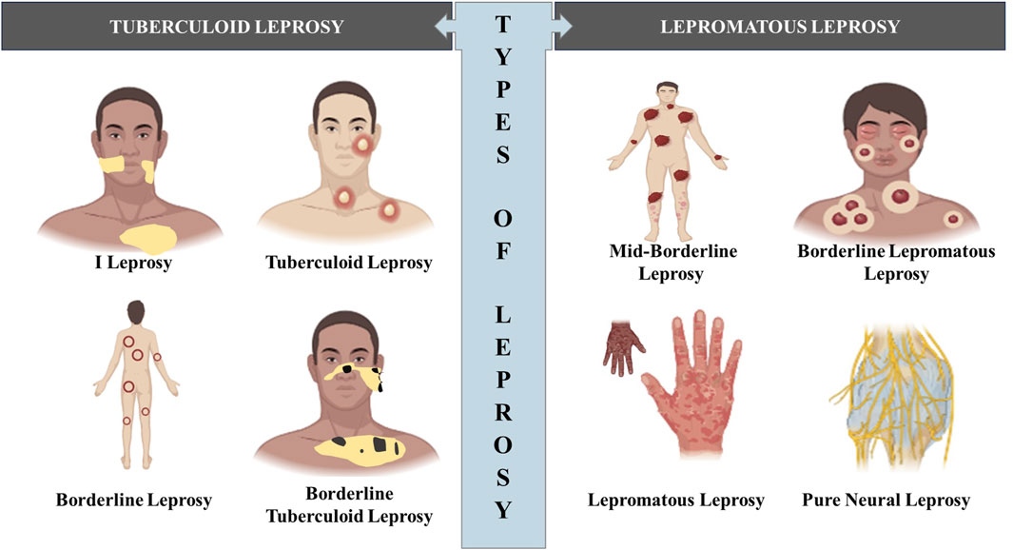
TYPES OF LEPROSY
Image source: Frontiers Pharmacology.
https://www.frontiersin.org/files/Articles/1361641/fphar-15-1361641-HTML-r1/image_m/fphar-15-1361641-g002.jpg

Slide 41
CLASSIFICATION OF
ANTI-LEPROTIC DRUGS
Sulfone: Dapsone (DDS)
Phenazine Derivative: Clofazimine
Antitubercular Drugs: Rifampin, Ethionamide
Other Antibiotics: Ofloxacin, Minocycline, Clarithromycin

Slide 42
1. DAPSONE
It is diamino diphenyl sulfone (DDS), the simplest, oldest, cheapest, most active and most commonly used member of its class.
All other sulfones are converted in the body to DDS; many have been used, but none is superior.
MODE OF ACTION
Dapsone is chemically related to sulfonamides and has the same mechanism of action, i.e. inhibition of PABA incorporation into folic acid; its antibacterial action is antagonized by PABA.
It is leprostatic.
Specificity for M. leprae may be due to difference in the affinity of its folate synthase. Doses of dapsone needed for the treatment of acute infections are too toxic, so not used.

Slide 43
Dapsone - MOA
Pteridine + PABA
Dihydropteroate synthetase
DAPSONE
Dihydropteroic acid
Dihydrofolate synthetase
Dihydrofolic acid
Dihydrofolate reductase
Tetrahydrofolic acid
Thymidines & purines
DNA & RNA

Slide 44
2. RIFAMPIN
It is an important anti-tubercular drug; also bactericidal to M. leprae.
Up to 99.99% M. leprae are killed in 3–7 days. However, it is not satisfactory if used alone—some bacilli persist even after prolonged treatment — resistance develops.
It has been included in the multidrug therapy of leprosy: shortens duration of treatment.
The 600 mg monthly dose used in leprosy is relatively nontoxic and does not induce metabolism of other drugs.
It should not be given to patients with hepatic or renal dysfunction.

Slide 45
MODE OF ACTION
It acts via the inhibition of DNA-dependent RNA polymerase.
DNA-dependent RNA polymerase is composed of an α-subunit dimer, and a β-subunit.
Rifampin interrupts the binding of the β-subunit with DNA, which uncouples the production of mRNA and results in the death of the organism.
This leads to a suppression of RNA synthesis and cell death; rapidly rendering leprotic patients noncontagious.

Slide 46
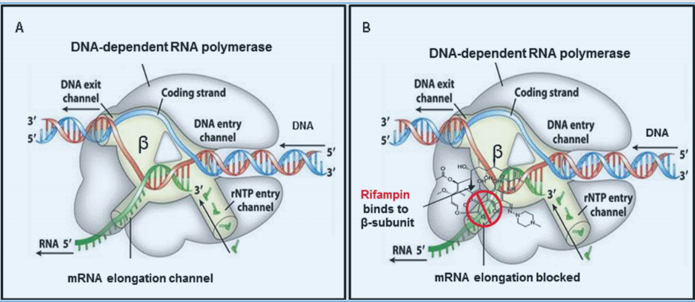
Image source: Emmanuelle Cambau, Diana Williams. The international textbook of leprosy.
https://internationaltextbookofleprosy.org/chapter/anti-leprosy-drugs-modes-action-and-mechanisms-resistance-mycobacterium-leprae

Slide 47
3. CLOFAZIMINE
It is a dye with leprostatic and anti-inflammatory properties; acts probably by interfering with guanine bases during DNA replivcation in M. leprae.
When used alone, resistance to clofazimine develops in 1–3 years.
Dapsone resistant M. leprae respond to clofazimine, but apparently after a lag period of about 2 months.
Clofazimine is orally active (40–70% absorbed).
It accumulates in many tissues, especially in fat, in crystalline form. However, entry in CSF is poor.

Slide 48
OTHER ANTIBIOTICS
Ciprofloxacin is not active against M. leprae, but ofloxacin, pefloxacin, gatifloxacin and sparfloxacin are highly active.
(a) Ofloxacin
Over 99.9% bacilli were found to be killed by 22 daily doses of ofloxacin monotherapy.
However, it is not included in the standard treatment protocols, but can be used in alternative regimens in case rifampin cannot be used, or to shorten the duration of treatment.

Slide 49
(b) Minocycline
Because of high lipophilicity, it is active against M. leprae.
Its antibacterial activity is much less than that of rifampin, but greater than that of clarithromycin.
(c) Clarithromycin
It is the only macrolide with significant activity against M. leprae.
However, it is less bactericidal than rifampin.
It is being included in alternative MDT (Multidrug treatment) regimens.

Slide 50
PHARMACOKINETICS - Rifampin
Absorption
Oral administration – slowly absorbed
High Bioavailabiliy
Half life extremely variable 10 to 50 hours
Distribution
About 70% protein bound
Plasma drug concentration greater than the minimum inhibitory concentration for M. Leprae in blood
Rifampicin is seen in saliva, CSF and breast milk
After absorption clofazimine circulates in protein bound form. Slow uneven distribution and prolonged retention in the tissue

Slide 51
Metabolism
Rifampicin regulates several hepatic microsomal drug metabolizing enzymes and induce metabolism of dapsone
Excretion
Urinary excretion
Excreted in feces, sebum and sweat

Slide 52
ADVERSE EFFECTS
DAPSONE | RIFAMPICIN | CLOFAZIMINE
Back, leg, or stomach pains | Muscle weakness | Heartburn
Difficulty breathing | Lack of coordination | Loss of appetite
Fever | Difficulty concentrating | Stomach pain
Skin rash | Itching | Blurry vision
Numbness, tingling, pain. | Watery or bloody stools | Increased urination
Unusual tiredness or weakness | Nausea, vomiting, loss of appetite | Bloody or black, tarry stools

Slide 53
CONTRAINDICATIONS
DAPSONE:
Dapsone should not be used if you have a sulfonamide antimicrobial allergy, severe cardiovascular disease, severe liver or kidney impairment, or pre-existing peripheral neuropathy.
You should also avoid using it if you have G6PD deficiency.
Deficit in methemoglobin reductase.

Slide 54
RIFAMPICIN:
Rifamycin hypersensitivity.
Simultaneous delivery of live bacterial vaccinations.
Rifampicin is not recommended for patients using atazanavir, darunavir, fosamprenavir, saquinavir, or tipranavir because it may induce significant drops in plasma concentrations of these antiviral medications, which could lead to viral resistance or loss of antiviral efficacy.

Slide 55
CLOFAZIMINE:
Unless absolutely required, clofazimine use should be avoided during pregnancy or lactation.
If liver or renal function is impaired, medication administration should be altered or stopped altogether.
To prevent hypokalemia, it should be administered with caution when used with diuretics.
Those with known hypersensitivity to clofazimine or any of its excipients should not take this medication.

Slide 56
ANTHELMINTIC DRUGS

Slide 57
Helminths
Helminths, also known as parasitic worms, are a diverse group of multicellular parasites that can infect humans and animals.
Helminth infections are usually acquired through contact with contaminated soil, water, or food.
There are several types of helminths, including:
Nematodes or Roundworms: ascariasis, hookworm infection, and filariasis.
Some penetrate to the blood, lymphatics and others to the tissues (filarial worms). Others are in the intestines; thus, they require use of drugs that are absorbed from the intestines

Slide 58
2) Cestodes or Tapeworms: taeniasis and cysticercosis. Cestodes attach to the intestinal tract
Unlike nematodes and trematodes, they do not enter the host tissues. As a result, tapeworm infections are more easily treated than infections caused by worms that penetrate the host tissues.
3) Trematodes or Flukes: schistosomiasis, lung and liver fluke infections. These are flatworms that can be found in freshwater snails and other aquatic animals.

Slide 59
CLASSIFICATION OF DRUGS
Benzimidazoles (BZs): Albendazole, Thiabendazole, Mebendazole, Flubendazole, Cyclobendazole, Dribendazole, Febendazole, Oxibendazole, Parbendazole
Imidazothiazoles: Tetramisole, Levamisole
Tetrahydropyrimidines: Pyrantel, Oxantel, Morantel
Macrocyclic lactones (MLs): Ivermectin, Abamectin, Doramectin, Eprinomectin, Selamectin, Moxidectin, Milbemycin, and Nemadectin.
Amino-acetonitrile derivatives (AADs): Monepantel
Cyclooctadepsipeptides: Emodepside, Tribendimidine

Slide 60
Spiroindoles: Derquantel
Quinolines and isoquinolines: Oxamniquine, Praziquantel
Piperazine derivatives: Piperazine citrate, Diethyl carbamazine
Vinyl pyrimidines: Pyrantel pamoate
Amides: Niclosamide
Organophosphorus: Metrifonate

Slide 61
Benzimidazoles
Albendazole has been used as a prototype drug.
Mode of Action
These drugs work by binding to the β-tubulin subunits of microtubules, essential for cell division & maintenance of cytoskeleton in nematodes. This results in the inhibition of microtubule assembly and disassembly, leading to a loss of cell division, decrease in motility and eventually death of the worm.
Additionally, they may also disrupt cellular transport/storage of glucose, leading to malnutrition and further debilitation of the parasites.

Slide 62
Pharmacokinetics of benzimidazoles:
Absorption: Albendazole is poorly absorbed from the gastrointestinal tract due to its low solubility in water. To increase its bioavailability, it is often administered with a fatty meal or with a lipid-based suspension.
Distribution: Rapidly metabolized in the liver to its active metabolite, albendazole sulfoxide. The drug & its metabolite have a high affinity for lipid-rich tissues, e.g, liver, lung, and brain, and can cross BBB.
Metabolism: Albendazole undergoes metabolism primarily by the cytochrome P450 enzyme system.

Slide 63
Elimination: Albendazole and its metabolites are primarily eliminated in the feces, with only a small amount excreted in the urine.
The drug has a half-life of approximately 8-12 hours.
USES:
Due to its broad-spectrum activity and low toxicity, benzimidazoles have been used to treat parasitic infections caused by nematodes, cestodes and trematodes.

Slide 64
Side effects of benzimidazoles.
Gastrointestinal disturbances: gastrointestinal disturbances, such as nausea, vomiting, abdominal pain, and diarrhea.
Headache, Dizziness, Allergic reactions:
Hepatic dysfunction: Prolonged use of benzimidazoles may lead to liver dysfunction or liver damage.
Hematologic effects: In rare cases, benzimidazoles can cause hematologic effects, such as leukopenia, thrombocytopenia, and agranulocytosis.
Neurological effects: seizures, tremors, and confusion.

Slide 65
Contraindications of benzimidazoles
Pregnancy: contraindicated during pregnancy, particularly during the first trimester. These drugs have been associated with fetal harm.
Breastfeeding: excreted in breast milk
Liver disease:
Blood disorders: may cause bone marrow suppression and blood disorders such as leukopenia, thrombocytopenia, agranulocytosis.
Seizure disorders: lower the seizure threshold and increase the risk of seizures in individuals with pre-existing seizure disorders.

Slide 66
REFERENCES
Timmins, G. S., & Deretic, V. (2006). Mechanisms of action of isoniazid. Molecular microbiology, 62(5), 1220-1227.
Chetty, S., Ramesh, M., Singh-Pillay, A., & Soliman, M. E. (2017). Recent advancements in the development of anti-tuberculosis drugs. Bioorganic & medicinal chemistry letters, 27(3), 370-386.
Dutta,Sanchari Sinha.(2019). History of Tuberculosis. [Retrieved from] https://www.news-medical.net/health/History-of-Tuberculosis.aspx﻿
Dr. Pramod B. (2015, September 22). Antileprotic drugs. Www.slideshare.net. https://www.slideshare.net/pramodbhalerao3/antileprotic-drugs-53049888

Slide 67
Leprosy - History. (n.d.). Encyclopedia Britannica. https://www.britannica.com/science/leprosy/History
Admin. (2016, February 11). 5.2 Anti-Leprosy Drugs: Modes of Action and Mechanisms of Resistance in Mycobacterium leprae. International Textbook of Leprosy. https://internationaltextbookofleprosy.org/chapter/anti-leprosy-drugs-modes-action-and-mechanisms-resistance-mycobacterium-leprae
Arundel, J. H., Boersema, J. H., Bruyning, C. F. A., Cross, J. H., Davis, A., De Muynck, A., ... & Sewell, M. M. H. (2012). Chemotherapy of gastrointestinal helminths (Vol. 77). Springer Science & Business Media.
McCarthy, J., Loukas, A., & Hotez, P. J. (2011). Chemotherapy of helminth infections. THERAPEUTICS, 1443
Campbell, W. C., & Rew, R. S. (Eds.). (2013). Chemotherapy of parasitic diseases. Springer Science & Business Media.

