Slide 1

Course: Computer Graphics and Design
Lecture 1: Introduction to
computer graphics and design.
Lecturer: Baya, Trevor.

Slide 2
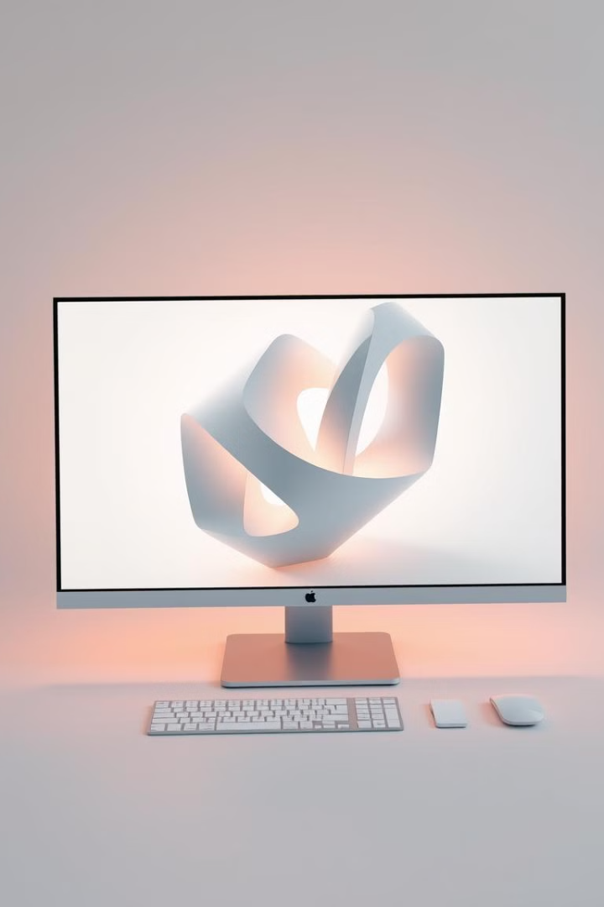
Learning outcomes
Define Basic Terms in Computer Graphics and Design
Students will be able to define fundamental terms such as pixels, resolution, raster graphics, vector graphics, aspect ratio, and opacity.
Differentiate Between Raster and Vector Graphics
Students will be able to explain the differences between raster and vector graphics, including their characteristics and typical uses.
Understand the Role of Aspect Ratio and Opacity in Design
Students will be able to describe the importance of aspect ratio and opacity in visual design and apply them appropriately in projects.
Explain Typography and Its Key Elements
Students will understand the basics of typography, including kerning, tracking, and font selection, and how these elements contribute to effective design.
Describe the Applications of Computer Graphics
Students will be able to identify the various applications of computer graphics in fields such as entertainment, medical imaging, CAD, virtual/augmented reality, and data visualization.
Identify Characteristics of a Good Computer Graphics Practitioner
Students will be able to list and explain the essential skills and qualities of a successful computer graphics and design professional, such as creativity, attention to detail, and technical proficiency.

Slide 3
Computer Graphics
And design
Computer Graphics refers to the creation, manipulation, and representation of visual content using computers. It encompasses both static images and dynamic animations, as well as interactive graphics used in video games, simulations, and virtual environments. Computer graphics are widely used in various fields such as entertainment, architecture, education, medical imaging, and data visualization.
The term can also refer to the technologies and software that enable the digital synthesis and manipulation of visual elements, including both raster (pixel-based) and vector (mathematics-based) graphics.

Slide 4
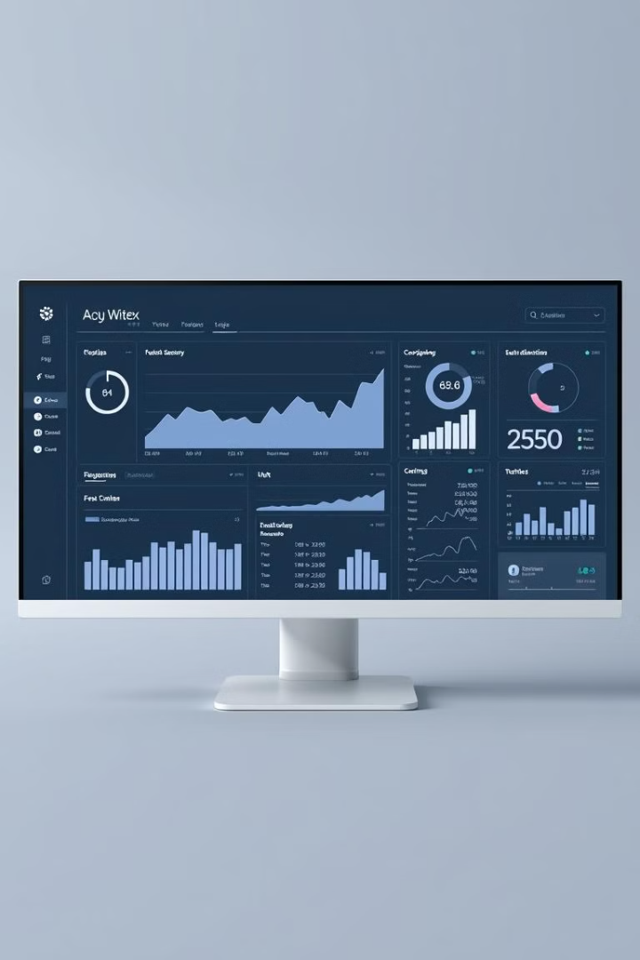
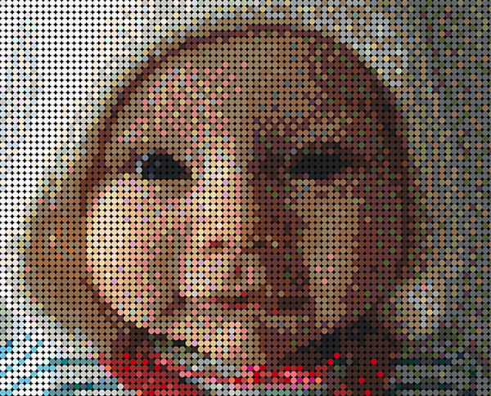
Common terminology of computer graphics and design
1
Pixel
A pixel (short for "picture element") is the smallest unit of a digital image or display.
Each pixel represents a single point of color in an image, and when combined with many other pixels, it forms a complete picture.
Pixels are arranged in a grid, and each one has a specific color value, which can be a combination of red, green, and blue (RGB) in digital images.
The more pixels in an image, the higher its resolution and the finer the details it can display.
In summary, a pixel is the building block of any digital image or screen.

Slide 5

Common terminology of computer graphics and design
2
Resolution
Definition: Resolution refers to the level of detail present in an image, typically measured by the number of pixels in a given dimension (width × height). It describes how many pixels or dots are used to display or print an image. A higher resolution means more pixels, resulting in finer detail and better image quality.
For example:
A resolution of 1920 × 1080 means there are 1920 pixels across the width and 1080 pixels along the height, often referred to as 1080p or Full HD.
In printing, resolution is measured in dots per inch (DPI), where higher DPI means more detailed prints.

Slide 6
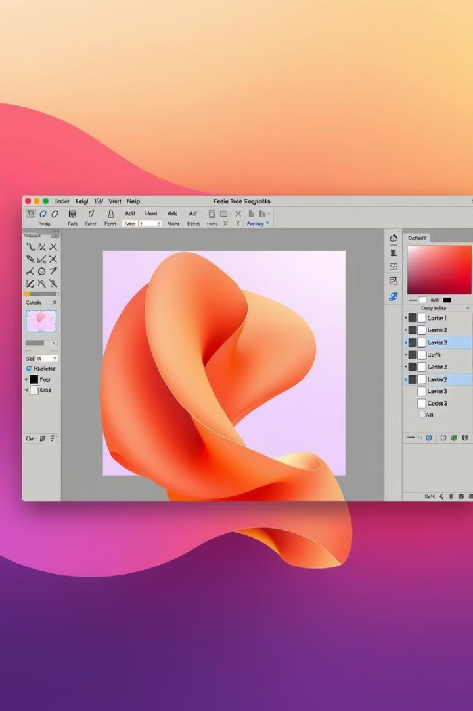
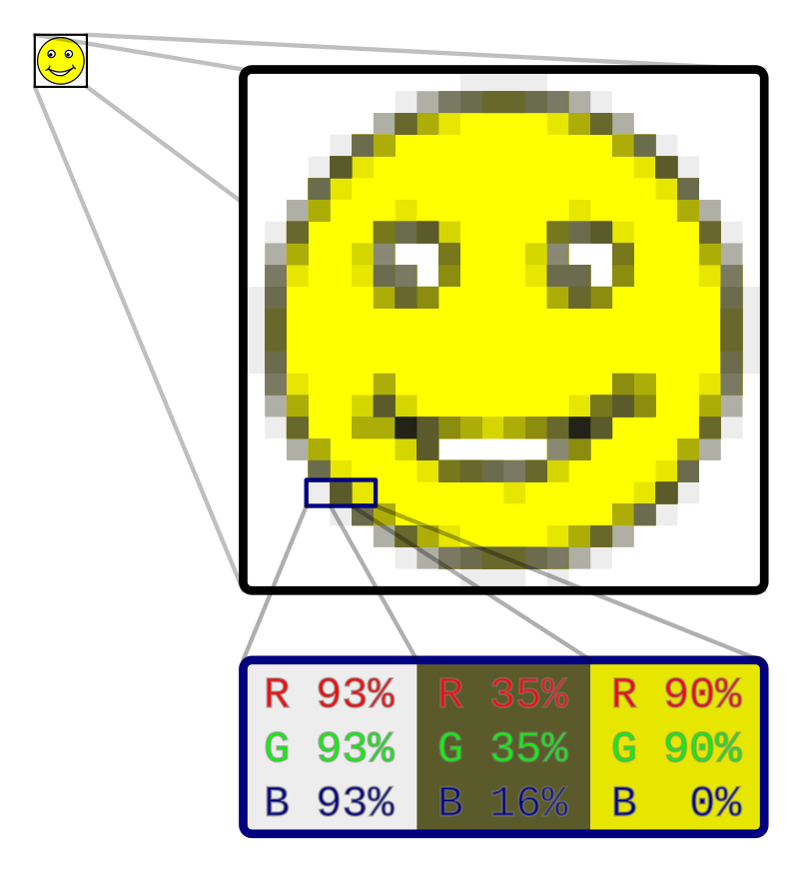
Common terminology of computer graphics and design
3
Raster Graphics
Raster Graphics refer to images composed of a grid of tiny, individual pixels, where each pixel holds a specific color value. These pixels collectively form the complete image, and the quality of the image is determined by the resolution—the number of pixels in the grid.
Since raster graphics are pixel-based, they are resolution-dependent, meaning that scaling the image up or down can result in a loss of quality, often leading to pixelation or blurring.
Examples of raster graphic formats include:
JPEG
PNG
GIF
BMP
Common uses include photographs, digital
artwork, and web images.

Slide 7
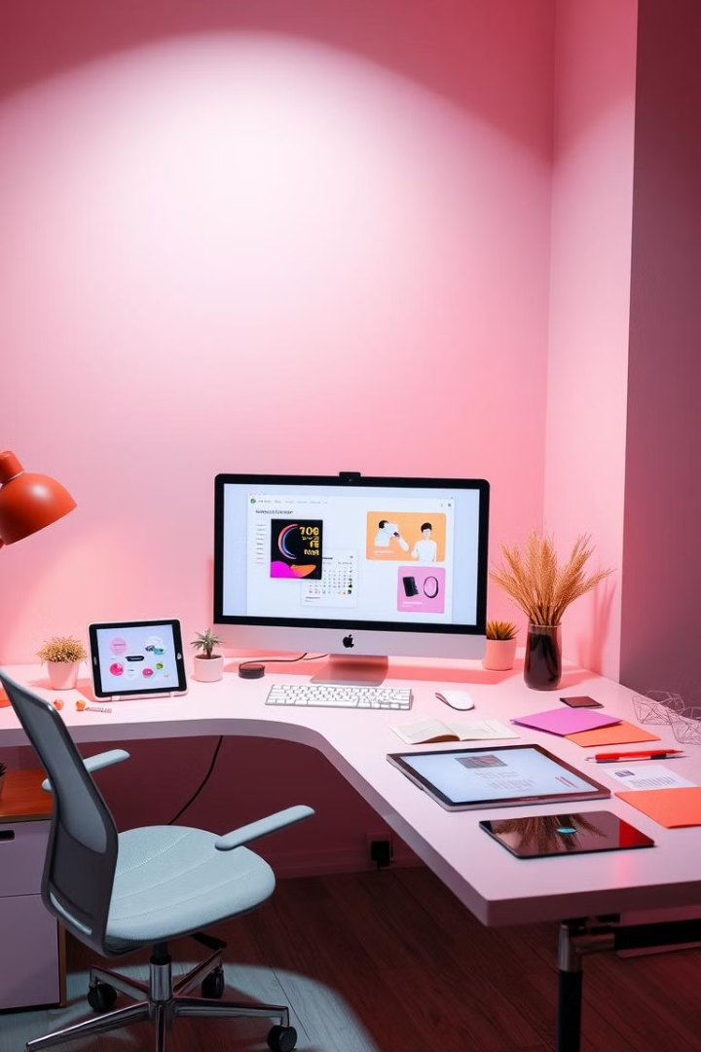
Common terminology of computer graphics and design
4
Vector graphics
Vector Graphics are images created using mathematical formulas to define shapes like lines, curves, and polygons. Instead of being made of pixels, vector graphics rely on points, paths, and geometric data to represent images. This allows vector graphics to be infinitely scalable without any loss of quality, making them ideal for designs that need to be resized frequently, such as logos, icons, and illustrations.
Key Features:
Resolution-independent: Can be scaled up or down without losing clarity.
Smaller file size: Generally lighter than raster images, especially for simple designs.
Editable: Elements can be manipulated easily, allowing for flexibility in design.
Examples of vector file formats include:
SVG (Scalable Vector Graphics)
EPS (Encapsulated PostScript)
AI (Adobe Illustrator)

Slide 8
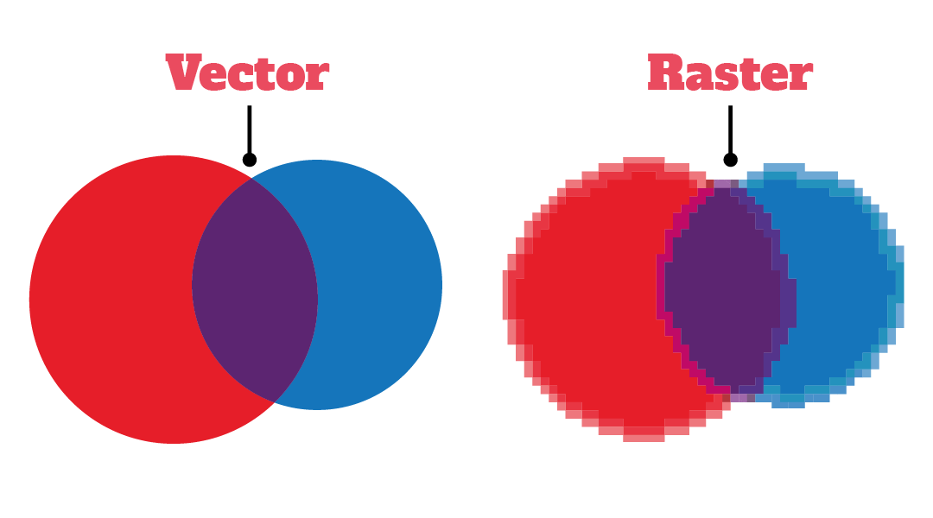
Difference between
Raster and Vector Graphics

Slide 9
Common terminology of computer graphics and design
5
Aspect ratio
Aspect ratio refers to the proportional relationship between the width and height of an image or screen. It is expressed as a ratio, such as 16:9 or 4:3, where the first number represents the width and the second represents the height. The aspect ratio affects how images or videos are displayed across different devices and platforms.
Key Features:
Maintains proportion: Ensures that images or videos are not distorted when scaled or displayed on different screens.
Common Formats: 16:9 (widescreen), 4:3 (standard TV), 1:1 (square).
Cinematic Usage: Aspect ratios like 21:9 are commonly used for films to provide a more immersive experience.
Examples of Common Aspect Ratios Include:
16:9 (HD video, modern TVs)
4:3 (older monitors, standard photography)
1:1 (social media posts, Instagram)

Slide 10
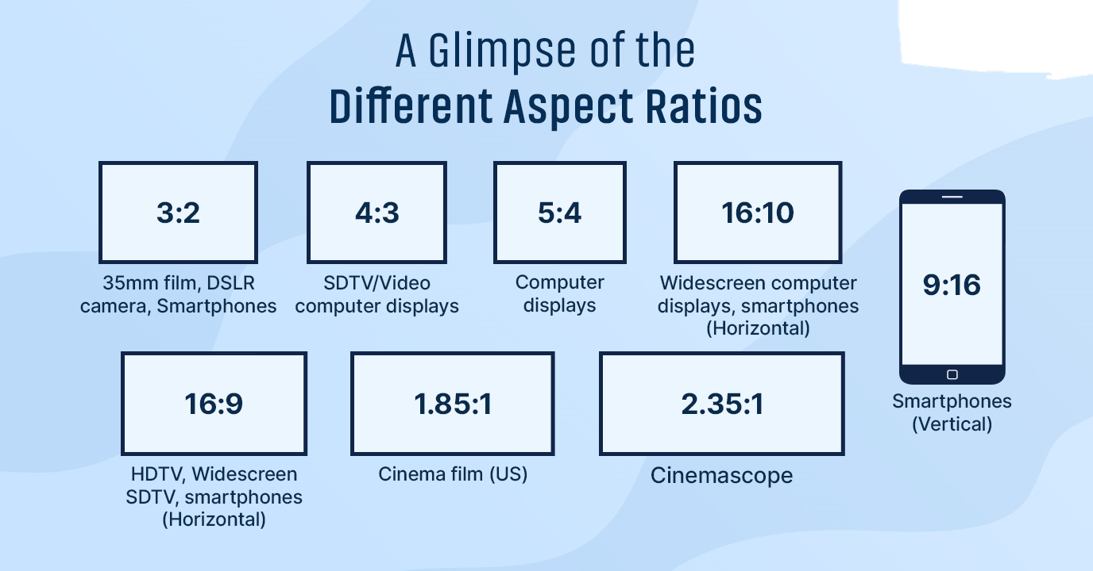

Slide 11
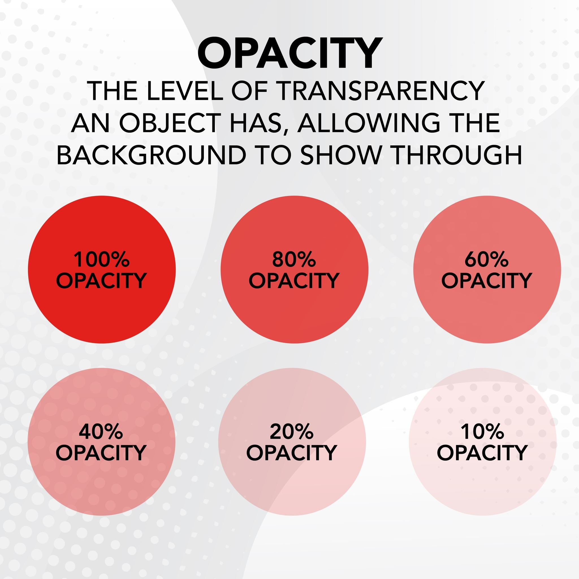
Common terminology of computer graphics and design
6
Opacity
Opacity refers to the degree of transparency of a design element, determining how much the background or lower layers are visible through the object. It is usually measured as a percentage, where 0% means fully transparent and 100% means fully opaque.
Key Features:
Adjustable Transparency: Used to create layered effects by blending different elements together.
Visual Depth: Adjusting opacity can add depth or a sense of hierarchy in a design.
Versatile Use: Commonly applied in UI/UX design, digital art, and overlays in images.
Examples of Usage Include:
50% opacity: Semi-transparent, showing both the object and part of the background.
100% opacity: Fully visible, with no transparency.
0% opacity: Fully transparent, invisible object.

Slide 12
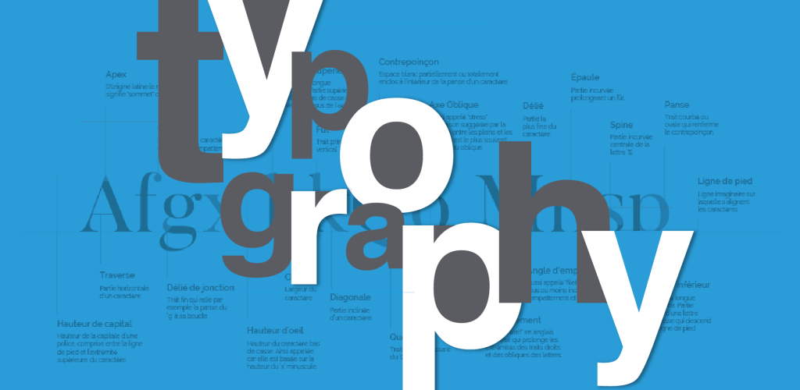
Common terminology of computer graphics and design
7
Typography
Typography is the art of arranging type in a visually appealing way to ensure readability and aesthetics in design. It involves choosing fonts, adjusting spacing, and using techniques like kerning and leading to balance the appearance of the text.
Key Features:
Font Choice: Different fonts (serif, sans-serif, display) create different moods and messages.
Spacing Adjustments: Includes kerning (space between characters) and line spacing (space between lines).
Readability: Proper typography makes content easy to read and enhances the visual structure of the design.
Examples of Common Typography Terms Include:
Serif Fonts: Times New Roman, Georgia (formal, traditional).
Sans-serif Fonts: Arial, Helvetica (modern, clean).
Display Fonts: Decorative fonts used for headings or titles.

Slide 13

Common terminology of computer graphics and design
8
Kerning
Kerning is the process of adjusting the space between individual characters in a word to improve visual balance and readability. It helps ensure that letters fit together naturally, preventing awkward spacing that can disrupt the design flow.
Key Features:
Improves Readability: Especially important in logos, titles, and headlines.
Visual Consistency: Ensures letters are evenly spaced for aesthetic purposes.
Customization: Designers can manually adjust kerning for optimal results.
Examples of Kerning in Practice Include:
Logos: Adjusting the space between letters to create a polished look.
Titles: Ensuring that letters in a headline appear evenly distributed.
Typography: Fine-tuning spacing for professional, clean text layouts.

Slide 14

Common terminology of computer graphics and design
9
Tracking
Tracking refers to the uniform adjustment of space between all characters in a block of text or a word, affecting the overall density of the text. Unlike kerning, which adjusts the space between individual character pairs, tracking alters the spacing across an entire word, line, or paragraph, making it either tighter or more spread out.
Key Features:
Consistency: Adjusts the spacing between all characters in a uniform manner, maintaining visual harmony.
Readability: Increasing tracking can improve readability for large blocks of text, while decreasing it can be useful for design-focused text like headlines.
Aesthetic Control: Useful for creating specific visual effects, such as tightening space in titles or spreading out letters in logos for dramatic emphasis.
Examples of Tracking in Practice Include:
Tight Tracking: Reducing space between letters for compact text in logos or display fonts.
Loose Tracking: Increasing space between letters in headlines or to create a modern, airy design.

Slide 15

Common terminology of computer graphics and design
10
Layers
Layers are individual elements in a design that can be stacked on top of each other to create a complex composition. Each layer can be edited independently without affecting the others, making it a fundamental tool in digital design software like Photoshop, Illustrator, and others.
Key Features:
Non-destructive Editing: Allows for adjustments and changes to specific elements without impacting the entire design.
Organization: Designers can group or organize layers to streamline their workflow.
Transparency Control: Individual layers can have different levels of opacity, blending, and effects.
Examples of Layer Usage Include:
Adjustment Layers: Used for color correction, brightness, or contrast without modifying the original content.
Text Layers: Separate layers for text elements, allowing for independent editing.

Slide 16
Common terminology of computer graphics and design
11
Negative Space
Negative space, also known as white space, is the area in a design that is left empty or unused around and between design elements like images, text, and graphics. It helps create balance and can direct the viewer's attention to key parts of the design.
Key Features:
Visual Breathing Room: Improves readability and reduces clutter in a design.
Focus on Key Elements: Draws attention to focal points by providing contrast between the elements and the surrounding space.
Aesthetic Appeal: Creates a minimalist, clean look that enhances visual clarity.
Examples of Negative Space Include:
Logos: Clever use of negative space to form hidden shapes (e.g., the FedEx logo’s hidden arrow).
Minimalist Design: Negative space is a hallmark of minimalist design, helping simplify and declutter the visual field.

Slide 17

Example of Negative Space

Slide 18
Common terminology of computer graphics and design
12
Hierarchy
Hierarchy in design refers to the arrangement and organization of visual elements to signify their importance. It guides the viewer's eye to the most important information first, and then through the rest of the design in a structured manner.
Key Features:
Size & Scale: Larger elements or text are typically seen as more important.
Color & Contrast: Bold or contrasting colors draw attention to specific elements.
Positioning: Items placed at the top or center of a layout are often perceived as more important.
Examples of Hierarchy in Design Include:
Headlines: Large, bold headlines at the top of the page to grab attention.
Calls to Action: Buttons or links in bright, standout colors to prompt user interaction.
Navigation Menus: Arranged to highlight the most important sections of a website.

Slide 19
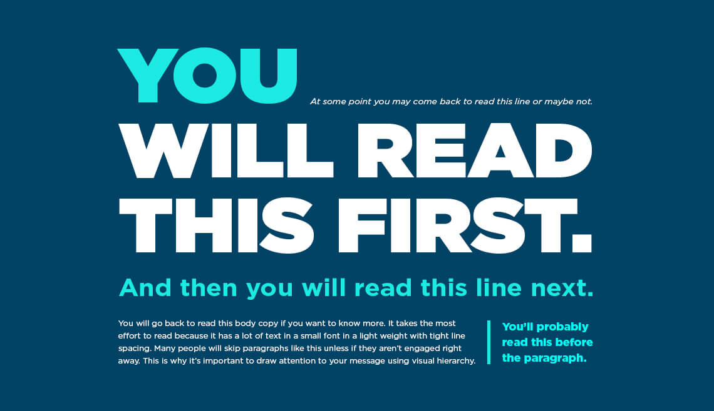
Example of Hierarchy

Slide 20
Common terminology of computer graphics and design
13
Alignment
Alignment refers to the arrangement of design elements in relation to one another along a common edge or axis. Proper alignment ensures that elements look cohesive and organized, which enhances the overall professionalism and readability of the design.
Key Features:
Visual Balance: Creates a sense of order and harmony by aligning elements consistently.
Improved Readability: Proper text alignment enhances readability, especially in body copy and headlines.
Consistency: Aligning elements helps create a structured, visually cohesive design.
Examples of Alignment in Design Include:
Left-aligned Text: Common in print and digital design for readability.
Center Alignment: Often used for formal layouts like invitations or certificates.
Grid Alignment: Ensures that all elements fit neatly into a grid for consistent spacing and proportion.

Slide 21
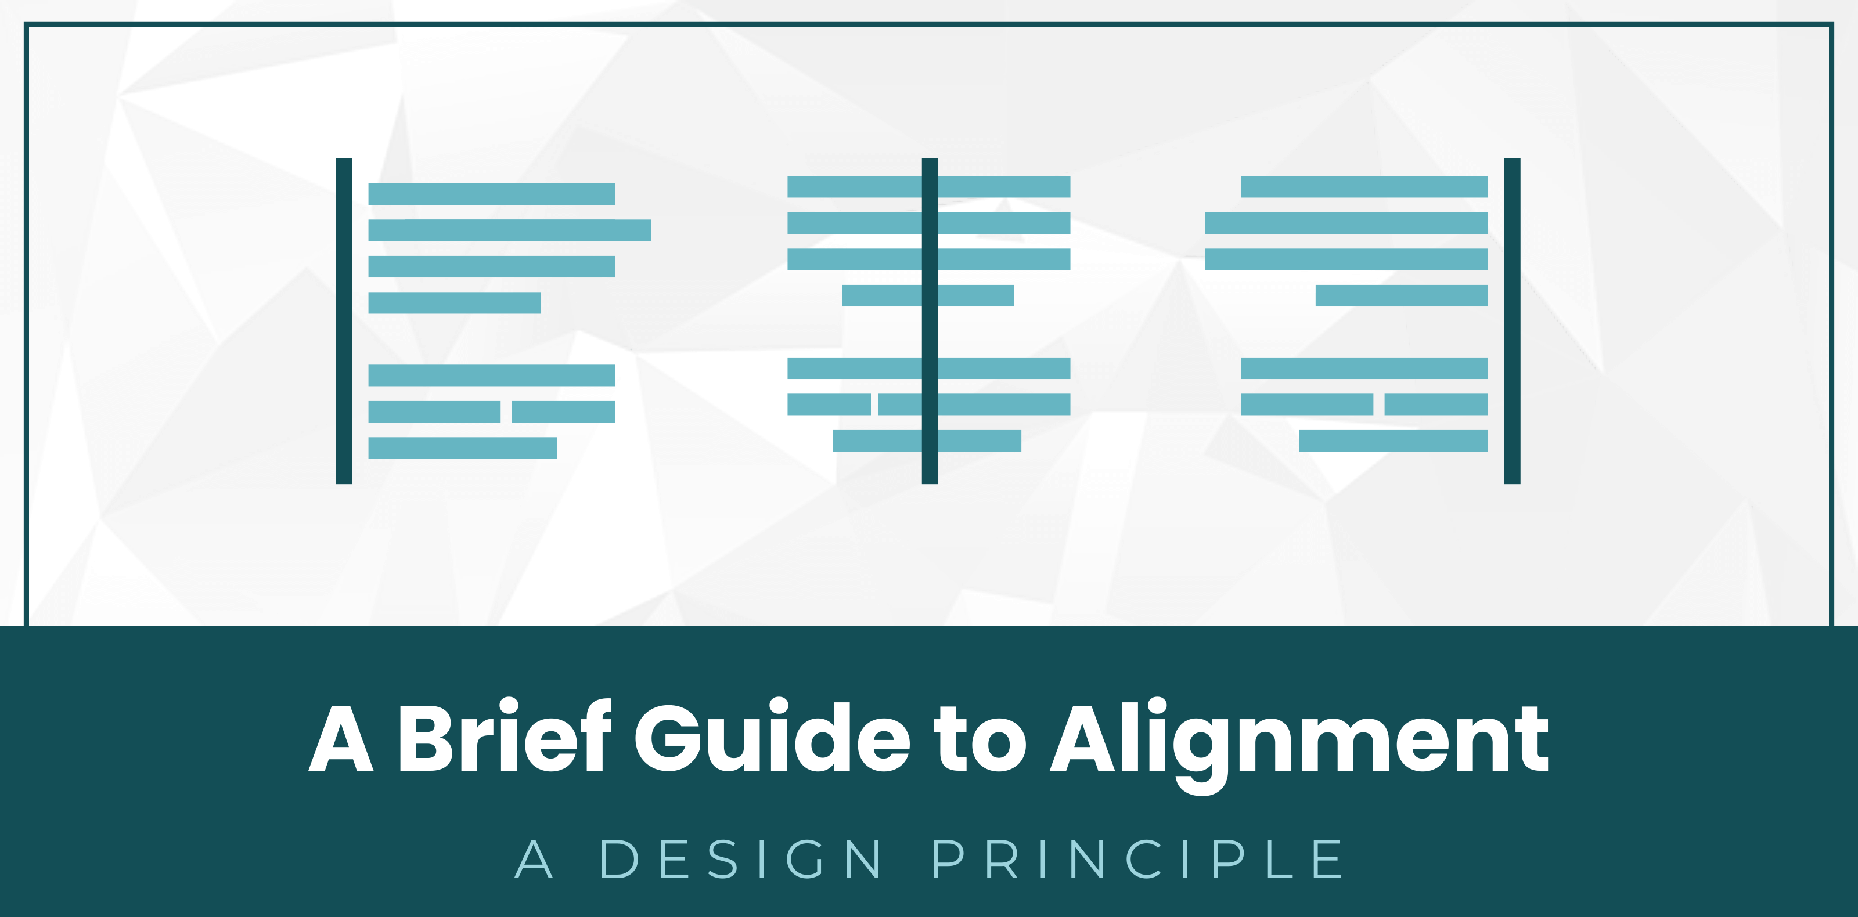
Example of Alignment

Slide 22
Common terminology of computer graphics and design
14
Grid
A grid is a framework of horizontal and vertical lines that helps designers align and organize content on a page or screen. It is commonly used in print and web design to maintain consistency, improve readability, and ensure a cohesive layout.
Key Features:
Consistent Layouts: Ensures elements are spaced and aligned consistently.
Flexibility: Grids can be adapted to suit different formats, including web, print, and mobile.
Foundation for Design: Provides a solid structure on which designers can place elements, ensuring visual balance.
Examples of Grid Usage Include:
Baseline Grid: Used to align text in print design, ensuring consistent typography.
Modular Grid: Ideal for layouts with a mix of text and images, such as magazines or catalogs.

Slide 23

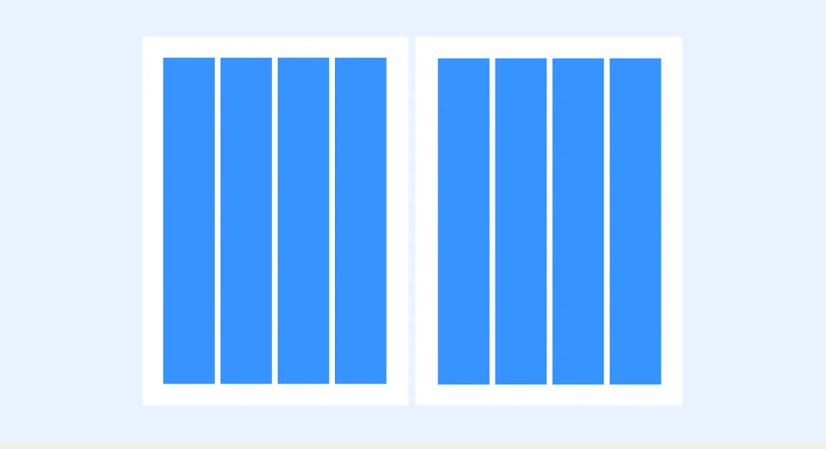
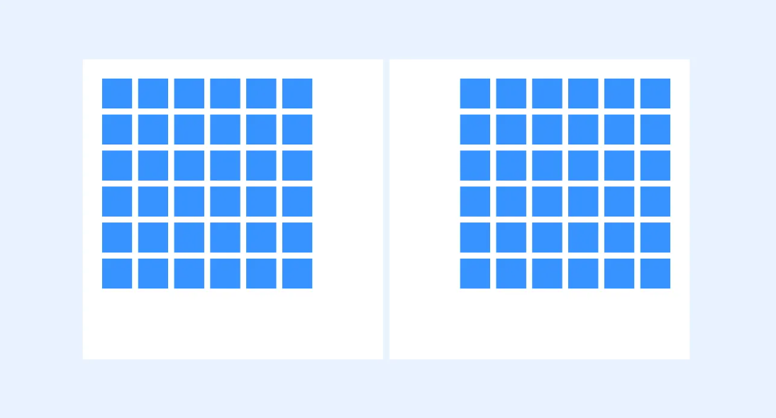
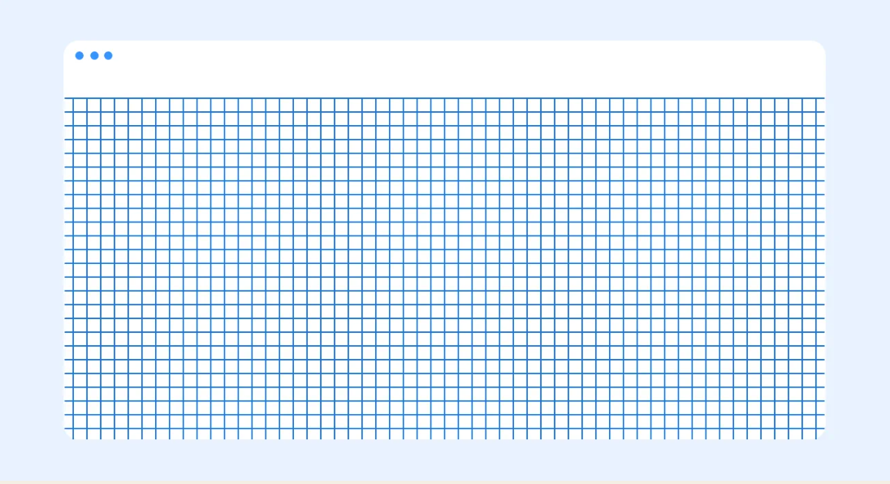
Example of Grids
Column
Grid
Baseline
Grid
Modular
Grid
Pixel
Grid

Slide 24

Application of Computer Graphics
1. Entertainment (Movies, Animation, and Games)
Explanation: Used for creating special effects, 2D and 3D animations, and realistic environments in movies and video games.
Software:
  Maya: Widely used in the film industry for 3D modeling and animation.
  Unreal Engine: Common in game development for real-time rendering and 3D environments.
  Blender: Open-source 3D animation tool used for films and games.

Slide 25

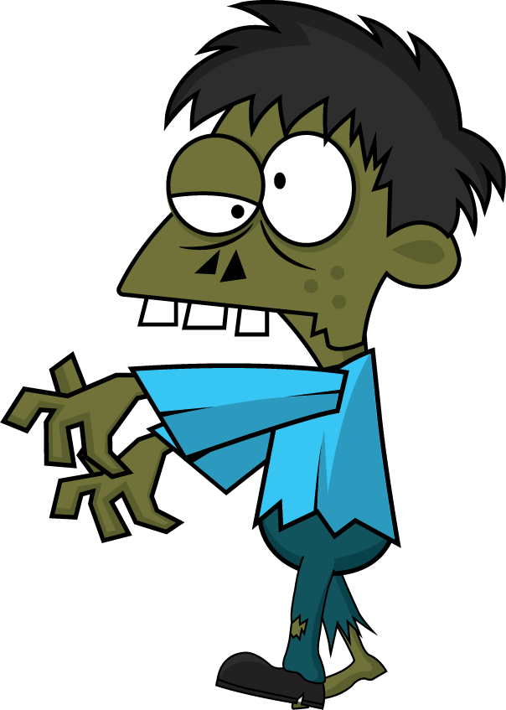
Different types of animation
3D Animation
2D Animation

Slide 26
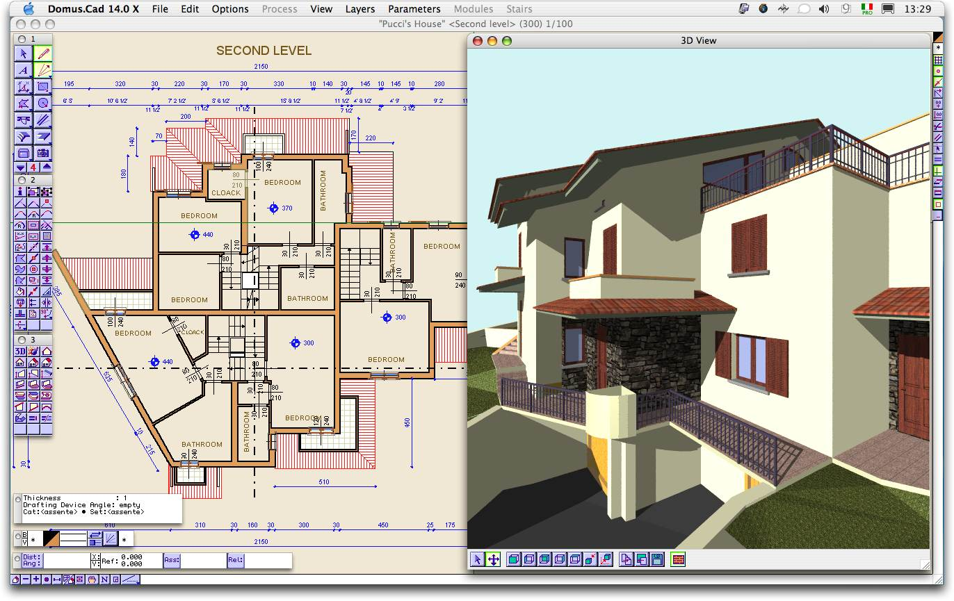
Application of Computer Graphics
2. Computer-Aided Design (CAD)
Explanation: Enables architects, engineers, and designers to create detailed models of products, buildings, and systems, allowing for simulation and optimization before manufacturing.
Software:
  AutoCAD: Used by architects and engineers for precision 2D and 3D design.
  SolidWorks: Popular for 3D CAD, especially in mechanical and product design.
  CATIA: Used in aerospace, automotive, and industrial design for complex 3D modeling.

Slide 27
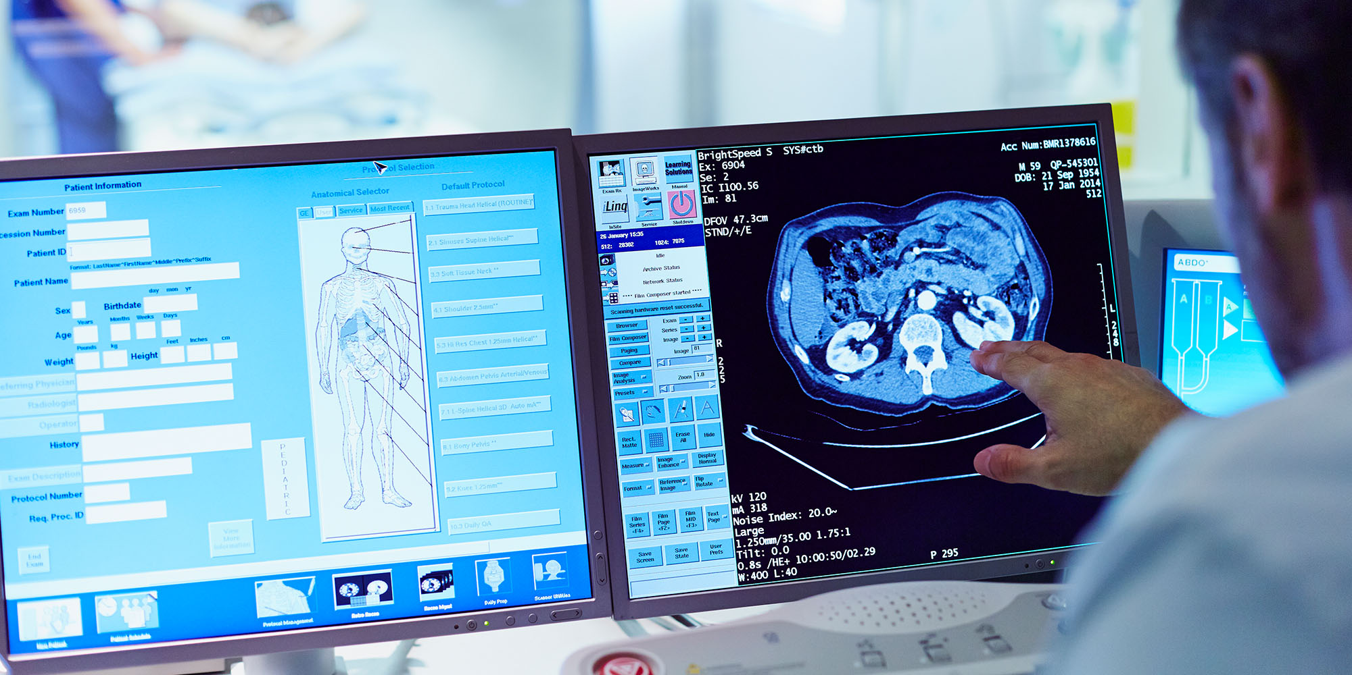
Application of Computer Graphics
3. Medical imaging
Explanation: Visualizes the inside of the human body, such as in MRI scans and CT scans, and enables 3D reconstructions of organs for diagnostic purposes.
Software:
  OsiriX: Specialized software for 3D medical image processing.
  Amira: Used for 3D visualization of CT/MRI scans in medical research.
  InVesalius: Free software for medical imaging reconstruction.

Slide 28
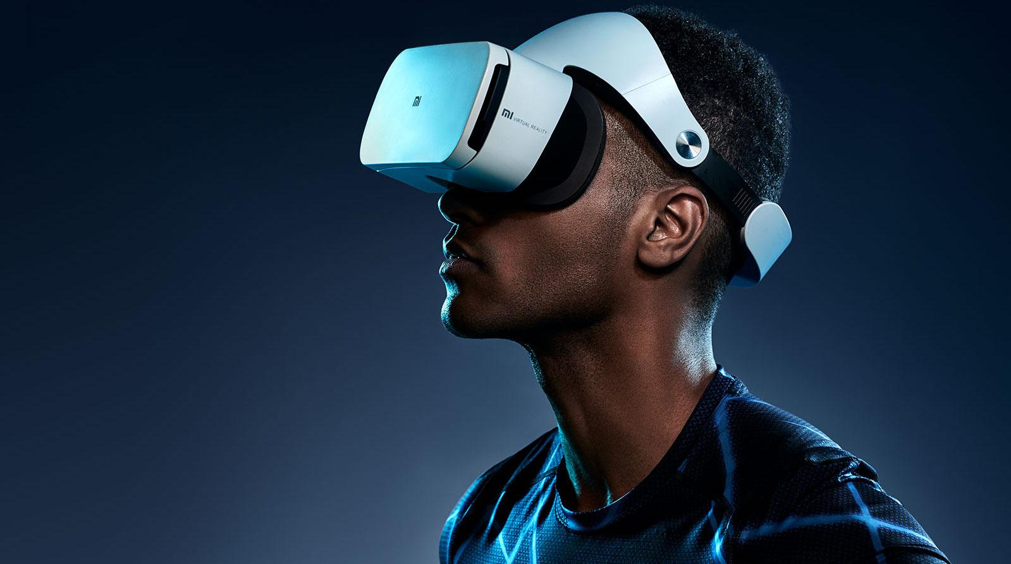
Application of Computer Graphics
4. Virtual Reality (VR) and Augmented Reality (AR)
Explanation: Creates immersive environments and interactive simulations for gaming, training, and education, with AR enhancing real-world views with digital overlays.
Software:
  Unity: A popular engine for developing VR and AR experiences.
  Vuforia: Widely used for AR application development.
  Oculus SDK: Provides tools for VR application creation, especially for Oculus devices.

Slide 29
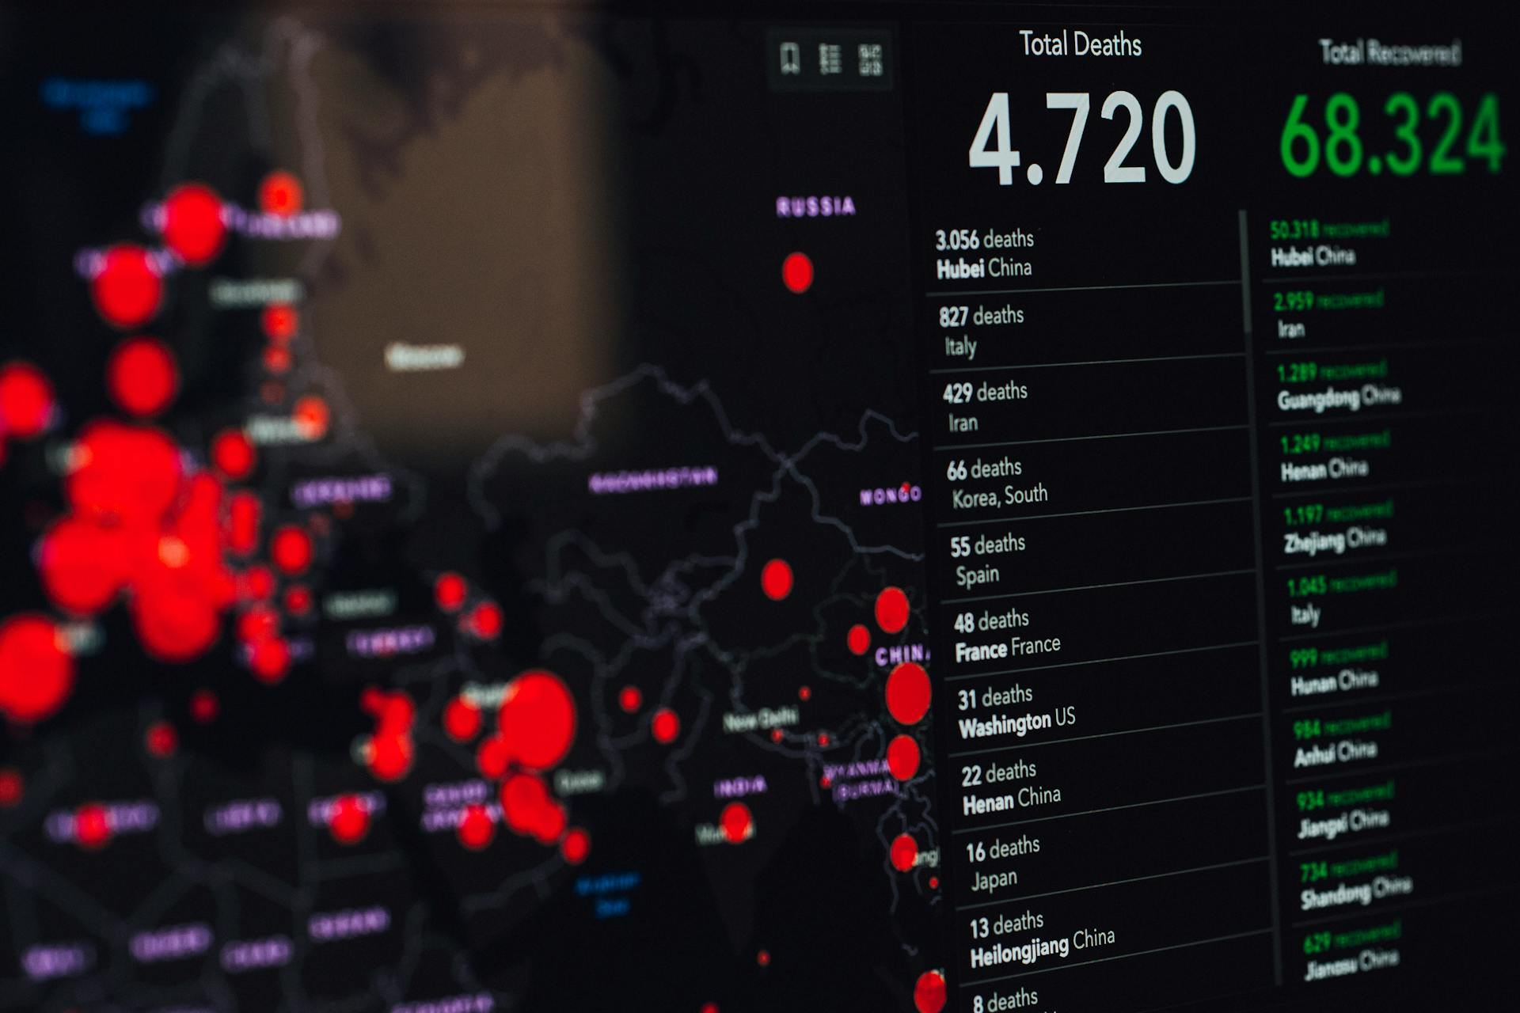
Application of Computer Graphics
5. Data Visualization
Explanation: Converts complex data into visual formats like graphs, charts, and 3D models, aiding in analysis of trends and patterns in finance, science, and business.
Software:
  Tableau: Used for interactive data visualizations and dashboards.
  Power BI: Microsoft tool for business intelligence and data visualization.
  D3.js: A JavaScript library for creating dynamic and interactive data visualizations.

Slide 30

Application of Computer Graphics
6. User Interface Design (UI)
Explanation: Graphics play a key role in designing intuitive, attractive interfaces for software, apps, and websites, enhancing user experience and functionality.
Software:
  Adobe XD: Tool for UI/UX design and prototyping.
  Figma: Popular for collaborative interface design and prototyping.
  Sketch: Commonly used in designing user interfaces for web and mobile apps.

Slide 31
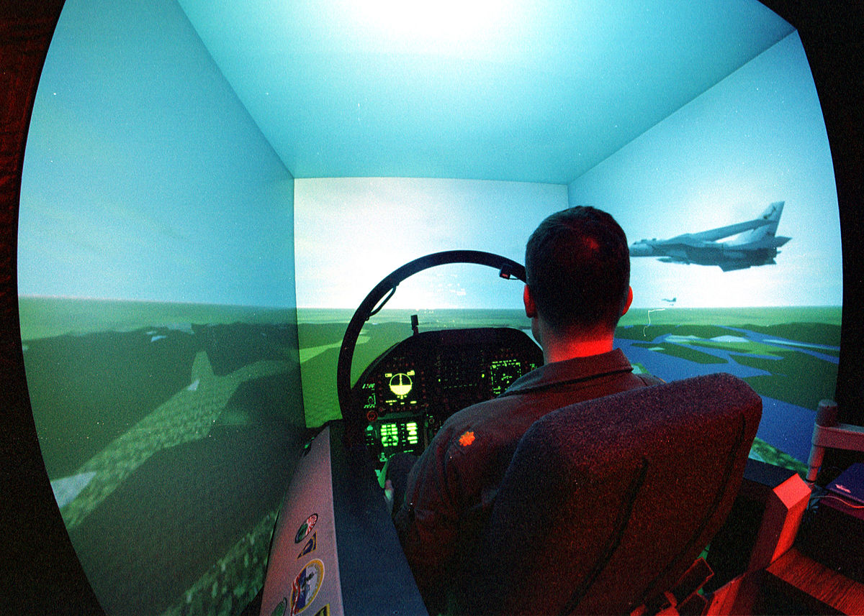
Application of Computer Graphics
7. Simulation and Training
Explanation: Realistic graphics are used in simulators for training pilots, doctors, and military personnel, providing a risk-free environment to practice complex tasks.
Software:
  FlightGear: Open-source flight simulation software.
  VBS3: Virtual Battlespace 3, used for military simulation and training.
  Ansys: Used for engineering simulation, including fluid dynamics and mechanical structures.

Slide 32
Getting Started in Computer Graphics
1
Learn the Basics
Understand fundamental concepts like rendering, shading, and animation, as well as supporting mathematics like linear algebra and geometry.
2
Choose Your Area
Decide whether to focus on 2D graphics, 3D graphics, animation, visual effects, or a combination of these areas.
3
Learn Programming
Develop proficiency in programming languages like Python, C++, and JavaScript, as well as graphics APIs like OpenGL and WebGL.

Slide 33

Characteristics of a good computer graphics
And design practitioner
Strong Technical Skills
1
Proficiency in Software: Mastery of tools like Adobe Photoshop, Illustrator, Blender, Maya, or AutoCAD, depending on the field of specialization.
Understanding of Graphics Fundamentals: In-depth knowledge of raster vs. vector graphics, resolution, color theory, typography, and 3D modeling concepts.
Knowledge of Programming (if required): Familiarity with graphics programming (e.g., OpenGL, DirectX) for game design or 3D rendering is essential for technical roles.

Slide 34
Characteristics of a good computer graphics
And design practitioner
Creativity and Innovation
2
Originality: Ability to generate unique ideas, designs, and concepts that stand out.
Problem-Solving: Using creativity to overcome design challenges and develop visual solutions that meet specific goals or requirements.
Adaptability: Ability to experiment with new tools, trends, and techniques to innovate in design projects.

Slide 35
Characteristics of a good computer graphics
And design practitioner
Attention to Detail
3
Precision in Design: Paying close attention to details such as alignment, spacing, color consistency, and overall visual balance.
Pixel-Perfect Execution: Ensuring that designs are polished and refined, avoiding errors or inconsistencies in final outputs.

Slide 36
Characteristics of a good computer graphics
And design practitioner
Good Communication Skills
4
Visual Communication: Ability to convey ideas and messages clearly through design elements, ensuring the design speaks to its audience effectively.
Collaboration: Comfortable working in teams, particularly in multidisciplinary environments (e.g., working with developers, animators, or marketers).
Client Interaction: Listening to client feedback and interpreting their needs into design solutions while clearly articulating design choices.

Slide 37
Characteristics of a good computer graphics
And design practitioner
Strong Time Management and Organization
5
Meeting Deadlines: Ability to deliver high-quality work within tight deadlines, often while juggling multiple projects.
Workflow Efficiency: Skilled in organizing files, layers, assets, and adhering to design specifications to streamline project completion.

Slide 38
Characteristics of a good computer graphics
And design practitioner
Adaptability to Technology and Trends
6
Keeping Up with Trends: Staying updated with the latest design trends, techniques, software updates, and industry best practices.
Learning New Tools: Willingness and ability to quickly learn and adapt to new software or technologies as they emerge.

Slide 39
Characteristics of a good computer graphics
And design practitioner
Understanding of User Experience (UX)
7
User-Centered Design: Knowledge of how users interact with digital products, ensuring the designs are not just visually appealing but also functional and intuitive.
Accessibility Awareness: Ensuring that designs are accessible to a wide audience, considering factors like readability, contrast, and usability.

Slide 40
Characteristics of a good computer graphics
And design practitioner
Critical Thinking and Analytical Skills
8
Design Strategy: Ability to analyze project requirements and translate them into effective visual strategies.
Feedback Interpretation: Constructively analyzing feedback from clients or peers to improve design work without taking criticism personally.

Slide 41
Characteristics of a good computer graphics
And design practitioner
Portfolio and Presentation Skills
9
Strong Portfolio: A well-rounded portfolio showcasing a range of skills and successful projects that demonstrate proficiency and creativity.
Presentation Skills: Confidence in presenting design ideas, rationale, and revisions to clients, teams, or stakeholders.

Slide 42
Characteristics of a good computer graphics
And design practitioner
Patience and Perseverance
10
Handling Revisions: Willingness to iterate on designs and handle feedback to refine and improve the final output.
Long-Term Vision: Ability to work on long, complex projects without losing focus or enthusiasm.

Slide 43
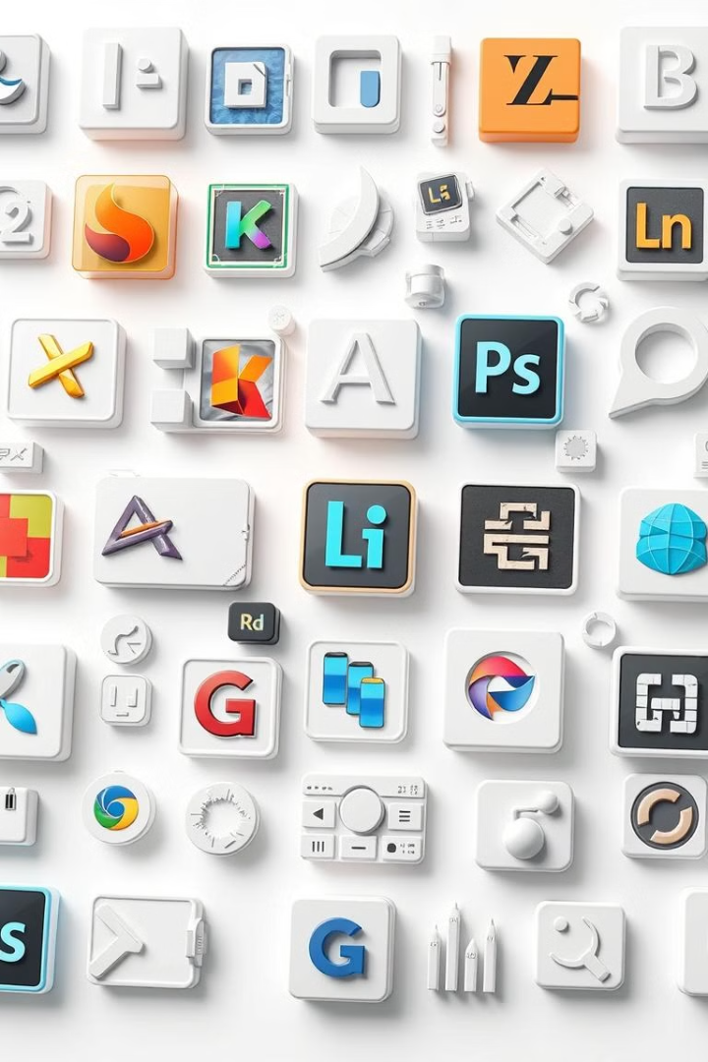


Common Software
2D Graphics Software
1
Used for creating, editing, and manipulating 2D images, illustrations, and digital art. Common in graphic design, web design, and digital painting.
3D Modeling and Animation Software
2
Used for creating and animating 3D models, objects,
and environments. Widely used in industries like film,
gaming, architecture, and engineering.
Rendering Software
3
Used to convert 3D models and scenes into 2D images, videos or animations by simulating lighting, textures, and effects.

Slide 44
Common Software
Game Engines
4
Provide a framework for creating interactive, real-time 3D environments and simulations, used in game development, VR, and AR
Computer-Aided Design (CAD) Software
5
Focused on precision design and modeling for engineering,
architecture, and manufacturing, helping professionals create
complex, detailed technical models.
Video Editing and Motion Graphics Software
6
Used for editing video, adding visual effects, and creating motion graphics and animations. Essential in film, television, and advertising.

Slide 45
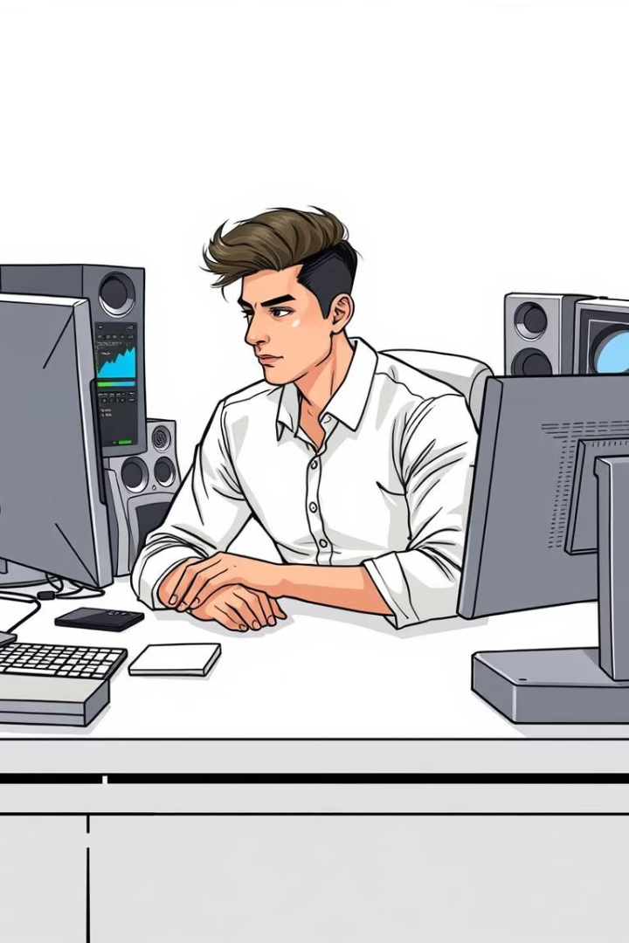
Building a Career in Computer Graphics
1
Study & Practice
Take online courses, read textbooks, and work on personal projects to continuously improve your skills.
2
Build a Portfolio
Showcase your best work online to demonstrate your abilities and creative vision to potential employers.
3
Apply for Jobs
Look for entry-level positions, freelance opportunities, and internships to gain valuable experience.

Slide 46
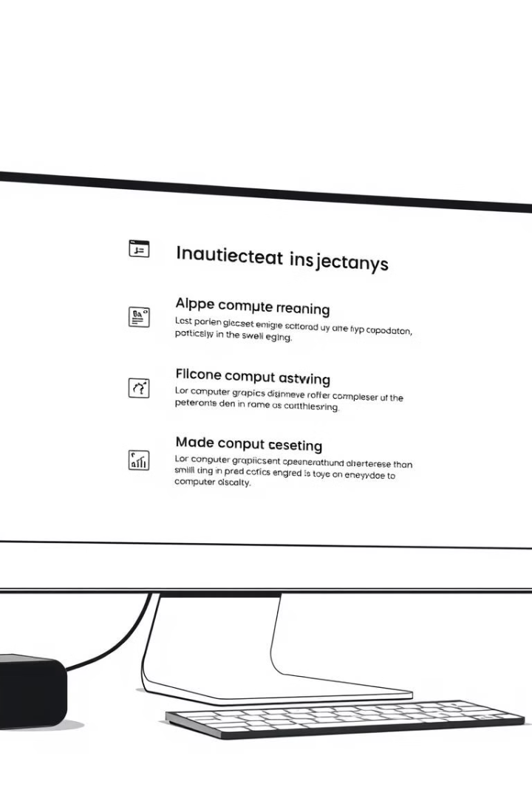
Conclusion
Computer graphics is a diverse and rapidly evolving field that plays a vital role in a wide range of industries, from entertainment to healthcare. By mastering the fundamentals, leveraging powerful tools and software, and staying up-to-date with emerging trends, you can unlock a world of creative and career opportunities in computer graphics.

Slide 47
References
"Digital Art Fundamentals," Robin Landa, Open Textbook Library, 2020.
"Introduction to Graphic Design," Richard Hollis, Open Library, 2013.
"The Elements of Graphic Design," Alex W. White, Internet Archive, 2011.
"Computer Graphics: Principles and Practice," John F. Hughes et al., MIT OpenCourseWare, 2006.

