Slide 1
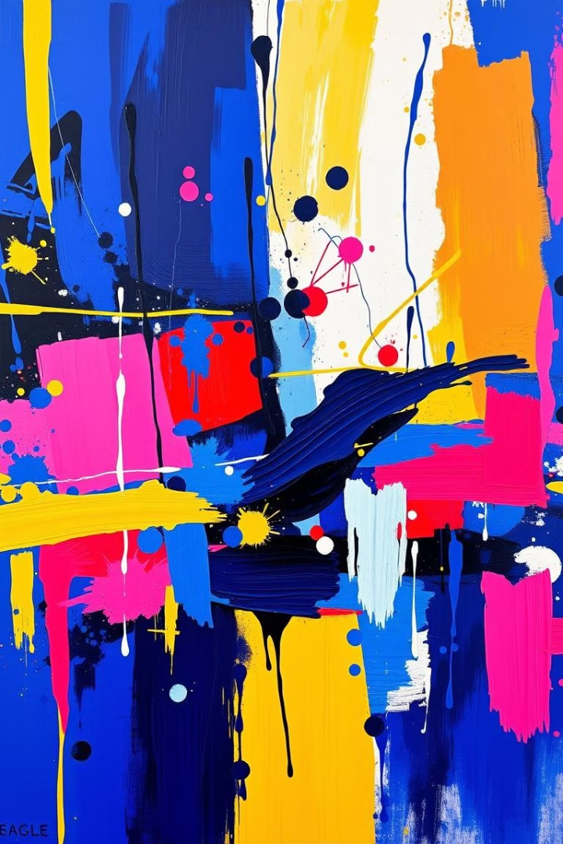
Computer Graphics and Design
Lecture 4
Color Theory in Design.
Lecturer: Baya, Trevor.

Slide 2

Learning Outcomes:
By the end of this lecture, students will:
Understand the basics of color theory and the color wheel.
Recognize the emotional and psychological effects of color.
Apply color harmonies to create balanced and visually appealing designs.
Use color effectively in branding, web design, and other design fields.
Avoid common color mistakes and use color purposefully to convey messages.

Slide 3
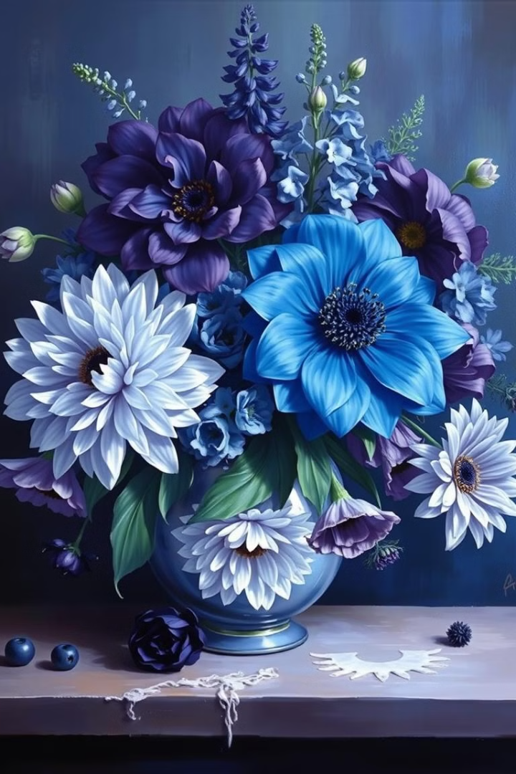
What is Color Theory?
Color theory is a set of principles and guidelines that explain how colors interact, combine, and are perceived. It serves as a foundation for artists, designers, and anyone working with color to create harmonious and visually appealing designs.
Color theory is rooted in both art and science, as it involves understanding the physics of light and color perception, as well as the emotional and psychological responses colors can evoke.
Color theory helps us understand the relationships between colors (e.g., complementary, analogous) and how to create harmonious or contrasting palettes. It covers how colors interact, how they are used to create emotions, and how to build visually appealing designs.

Slide 4
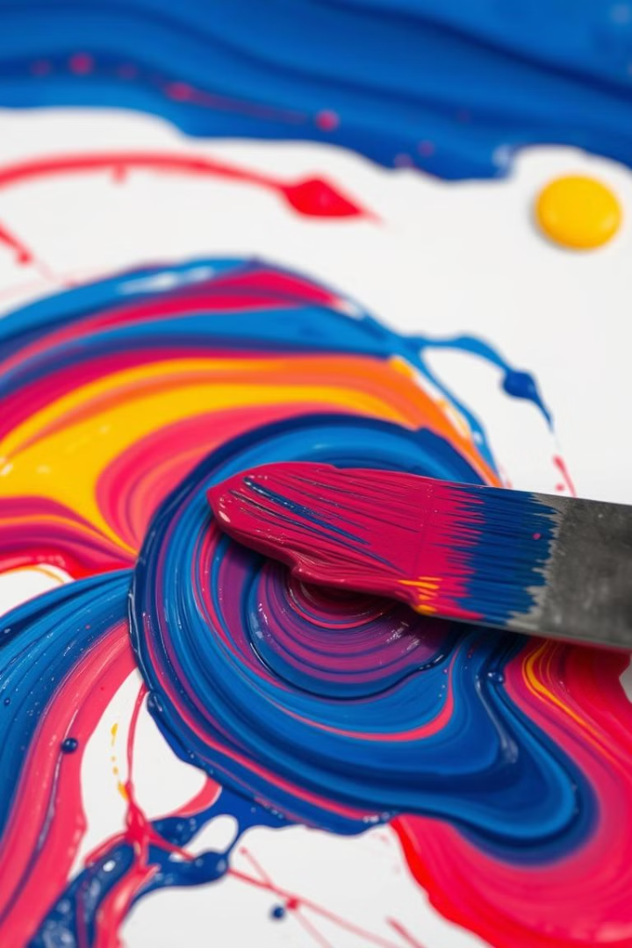
Why Color Matters in Design
1
Grabs Attention:
Color is one of the first things people notice in a design. It can attract attention and guide the viewer's eyes to important elements.
2
Evokes Emotions:
Colors evoke specific emotions and moods. Warm colors (red, yellow) are stimulating, while cool colors (blue, green) tend to be calming.
3
Conveys Meaning:
Colors can communicate ideas without words. For example, green is often associated with nature, health, or growth, while black can represent elegance or power.

Slide 5
Why Color Matters in Design
4
Improves Readability:
The right contrast between text and background enhances readability and accessibility in both print and digital designs.
5
Influences Decisions:
In marketing and advertising, color can impact how consumers perceive a brand and their purchasing decisions. For instance, red often creates a sense of urgency, making it effective in sale signage.
6

Slide 6
Key Points:
Color captures attention and makes your design stand out.
It creates emotional connections and impacts how your audience feels about your content.
Colors have inherent meaning and can communicate messages even without words.
The effective use of color improves user experience and visual clarity.
In marketing, the right color choices can influence consumer behavior and engagement.

Slide 7
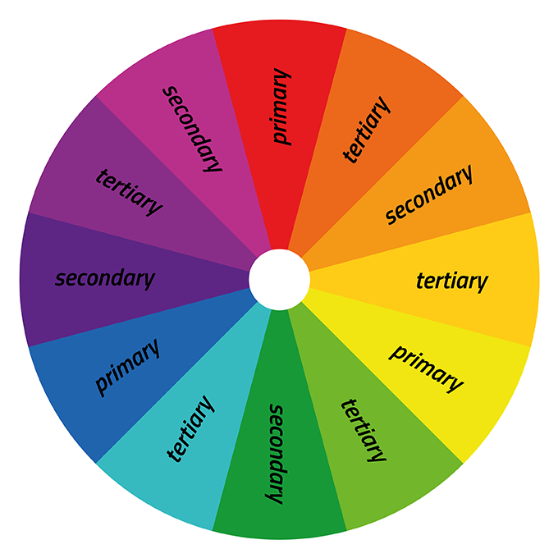
The Color Wheel Overview
The color wheel is a circular diagram that represents the relationships between colors in an organized and logical format. It is a key tool in color theory, used by artists, designers, and anyone working with color to understand how colors interact and how they can be combined to create harmonious designs.

Slide 8
Components of the Color Wheel
Primary Colors: The foundational colors that cannot be created by mixing other colors. In the traditional RYB (Red, Yellow, Blue) color model, the primary colors are:
  Red
  Yellow
  Blue

Slide 9
Components of the Color Wheel
Secondary Colors: These are the colors created by mixing two primary colors in equal proportions. They are located between the primary colors on the wheel.
  Red + Yellow = Orange
  Blue + Yellow = Green
  Red + Blue = Purple (Violet)

Slide 10
Components of the Color Wheel
Tertiary Colors: Tertiary colors are created by mixing a primary color with a neighboring secondary color. They fill in the gaps between the primary and secondary colors.
  Red + Orange = Red-Orange
  Yellow + Orange = Yellow-Orange
  Yellow + Green = Yellow-Green
  Blue + Green = Blue-Green
  Blue + Purple = Blue-Purple
  Red + Purple = Red-Purple

Slide 11
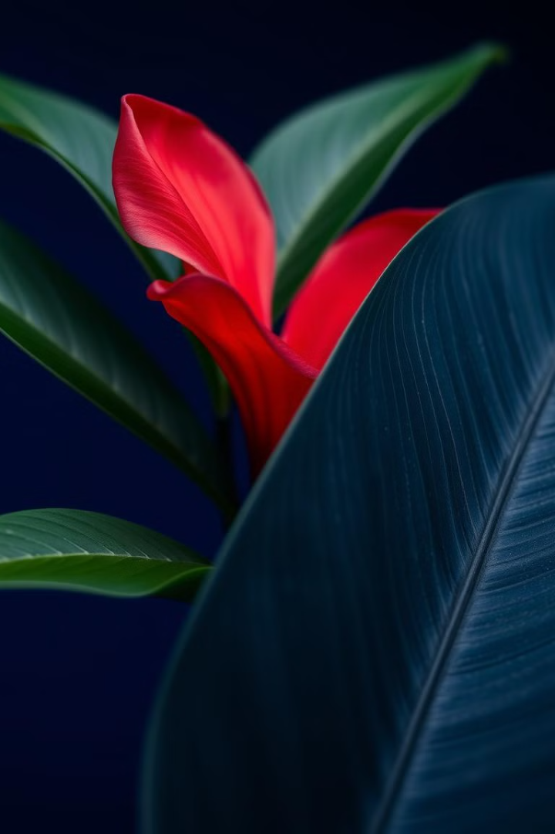
Role of Primary Colors in Traditional Color Theory
Building Secondary Colors: When two primary colors are mixed, they create secondary colors:
  Red + Yellow = Orange
  Blue + Yellow = Green
  Red + Blue = Purple (Violet)
These secondary colors form the basis for further color combinations and are located between the primary colors on the color wheel.
Creating Tertiary Colors: Tertiary colors are created by mixing a primary color with a neighboring secondary color. For example:
  Red + Orange = Red-Orange
  Blue + Green = Blue-Green
  Yellow + Green = Yellow-Green
These combinations result in a wider variety of colors and are placed on the color wheel between primary and secondary colors.
Analogous color schemes are harmonious and soothing, with less contrast than complementary schemes.

Slide 12
Role of Primary Colors in Traditional Color Theory
Emotional and Psychological Influence:
Primary colors in the traditional model have strong emotional and psychological connotations:
  Red: Often associated with energy, passion, excitement, and sometimes danger.
  Yellow: Linked to happiness, warmth, optimism, and creativity.
  Blue: Known for its calming, serene, and stable qualities, often evoking feelings of peace and trust.
Color Mixing for Artistic Expression:
In design, the ability to mix colors from the three primaries gives artists a powerful tool to create a wide range of hues, shades, tints, and tones. By understanding how primary colors interact, artists can control the brightness, intensity, and mood of their work.
  Tints: Created by adding white to a primary color, making it lighter (e.g., red + white = pink).
  Shades: Created by adding black to a primary color, making it darker (e.g., blue + black = navy).
  Tones: Created by adding gray to a primary color, reducing its saturation and making it more muted (e.g., yellow + gray = olive).

Slide 13
Summary of the Role of Primary Color Theory
Primary colors (red, yellow, blue) are the basic building blocks for creating all other colors in the RYB model.
They combine to form secondary colors (orange, green, purple) and tertiary colors (e.g., red-orange, blue-green).
Primary colors are essential for establishing color harmony, guiding the creation of balanced and aesthetically pleasing color schemes.
These colors influence emotions and psychology, making them powerful tools in artistic and design expression.
Understanding the mixing of primary colors allows for artistic flexibility in creating a broad range of hues, tints, shades, and tones.
In digital design (RGB), the primary colors are Red, Green, and Blue, which combine to create different shades of light.
Primary colors are central to how we create and understand color in art, and mastering their use is key to effective visual expression.

Slide 14
Secondary Colors
In traditional color theory, based on the RYB (Red, Yellow, Blue) model, secondary colors are the colors formed by mixing equal parts of two primary colors. There are three secondary colors in this model:
1. Orange: Created by: Mixing Red and Yellow.
Characteristics: Orange is a warm, vibrant color that evokes feelings of energy, enthusiasm, and warmth. It can also suggest creativity and playfulness.
2. Green: Created by: Mixing Blue and Yellow.
Characteristics: Green is often associated with nature, growth, and tranquility. It represents balance, renewal, and a sense of calm. Depending on the shade, it can also signify freshness and harmony.
3. Purple (Violet): Created by: Mixing Red and Blue.
Characteristics: Purple has historically been linked to royalty, luxury, and mystery. It can evoke creativity and spirituality, as well as convey sophistication or depth.

Slide 15
Role of Secondary Colors in Traditional Color Theory
Creating Tertiary Colors: Secondary colors serve as a base for creating tertiary colors when mixed with neighboring primary colors. For example:
  Red-Orange (Red + Orange)
  Yellow-Green (Yellow + Green)
Color Harmony: Secondary colors are essential for establishing harmonious and balanced color schemes. They are often used in analogous and complementary color schemes to add variety and complexity.
Visual Contrast: Because secondary colors are mixtures of two primary colors, they provide a moderate level of contrast when used alongside their constituent primary colors. This contrast can be used to create emphasis or highlight specific areas in art and design.
Psychological Impact: Secondary colors have distinct emotional and psychological impacts, which can vary based on their saturation and context. Understanding their effects helps artists and designers convey the right mood and message in their work.

Slide 16
Tertiary Colors
In traditional color theory, tertiary colors are created by mixing a primary color with a secondary color that is adjacent to it on the color wheel. These colors fill the gaps between primary and secondary colors, resulting in a more nuanced color spectrum. There are six tertiary colors in the RYB (Red, Yellow, Blue) model.
List of Tertiary Colors
Each tertiary color is named by combining the primary color with the secondary color it’s mixed with:
Red-Orange (Primary Red + Secondary Orange)
Yellow-Orange (Primary Yellow + Secondary Orange)
Yellow-Green (Primary Yellow + Secondary Green)
Blue-Green (Primary Blue + Secondary Green)
Blue-Purple (Primary Blue + Secondary Purple)
Red-Purple (Primary Red + Secondary Purple)

Slide 17
Role of Tertiary Colors in Traditional Color Theory
Expanded Color Palette: Tertiary colors provide more depth and variety to the color palette. By combining primary and secondary colors, artists and designers can create more complex, nuanced hues that allow for greater expression and subtlety in their work.
Color Harmony: Tertiary colors are important for creating analogous color schemes, where neighboring colors on the color wheel are used to create a harmonious and visually pleasing effect. For example, an analogous scheme could use Yellow, Yellow-Orange, and Orange.
Blending and Transition: Tertiary colors serve as transition colors between the bolder primary and secondary colors, helping to soften the contrast and create smoother color gradients. This can be especially useful in paintings or designs that require a sense of flow and continuity.
Emotional and Psychological Effects: Tertiary colors, like other colors, evoke specific emotions, but their impact can be more subtle than that of primary or secondary colors. For example:
Enhancing Visual Balance: Tertiary colors help balance compositions by offering intermediate hues that neither dominate nor fade into the background. Their ability to blend smoothly with both primary and secondary colors makes them versatile tools in creating well-balanced designs or artwork.

Slide 18
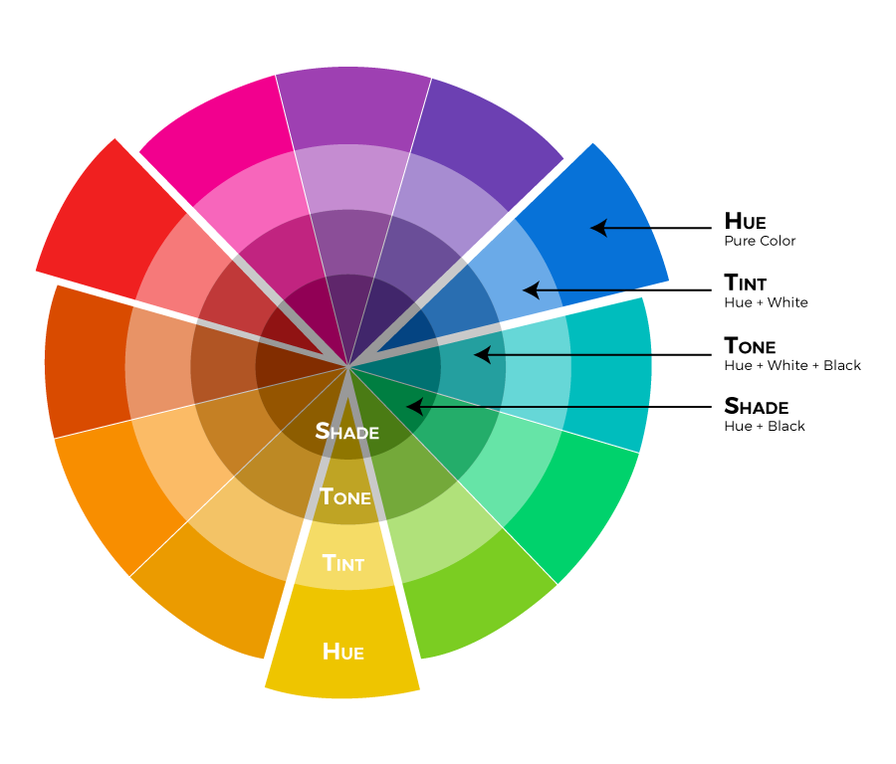
Properties of Color
In color theory, colors can be described by three key properties: hue, saturation, and value. Understanding these properties is crucial for artists, designers, and anyone working with color, as they help define how colors are perceived and used in various contexts. Here's an overview of each property:
1. Hue
Definition: Hue refers to the name of a color and is determined by the wavelength of light that the color reflects. It represents the pure spectrum colors like red, yellow, green, blue, etc. In essence, hue distinguishes one color from another.
Characteristics:
  Examples: Common hues include red, blue, yellow, green, orange, purple, etc.
  Placement on the Color Wheel: Hues are arranged in a circular format on the color wheel, with primary, secondary, and tertiary colors spaced evenly.
Importance:
  Hue is fundamental in identifying and categorizing colors. It serves as the starting point for discussions about color relationships and combinations.

Slide 19
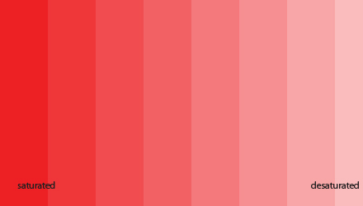
Properties of Color
2. Saturation
Definition: Saturation (also referred to as chroma or intensity) describes the purity or vividness of a color. It indicates how much gray is present in the color; a color with high saturation appears vivid and vibrant, while a color with low saturation looks more muted or washed out.
Characteristics:
  High Saturation: Colors that are bright and vivid, such as a bright red or vibrant blue. These colors have minimal gray added.
  Low Saturation: Colors that are duller or softer, such as pastel shades or muted tones. These colors have more gray mixed in.
Visual Representation:
  Saturation Scale: A highly saturated color appears on one end of the scale, while a desaturated (grayish) version of the same hue appears on the other end.
Importance:
  Saturation affects the emotional and psychological impact of colors. Highly saturated colors tend to be more attention-grabbing and energetic, while desaturated colors evoke calmness and subtlety.

Slide 20
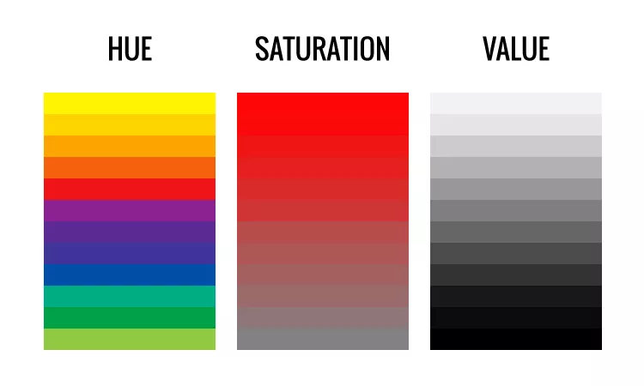
Properties of Color
3. Value
Definition: Value refers to the lightness or darkness of a color, which is determined by the amount of light that a color reflects. It helps in creating contrast and depth within compositions.
Characteristics:
  Light Value: Light colors, such as pastel shades, have high value. These colors are closer to white.
  Dark Value: Dark colors, such as navy or charcoal, have low value. These colors are closer to black.
Visual Representation:
  Value Scale: A gradient from white (high value) to black (low value), with various shades of gray in between, can represent the value of colors.
  Tint and Shade:
    Tint: A color mixed with white to lighten it (e.g., adding white to red creates pink).
    Shade: A color mixed with black to darken it (e.g., adding black to red creates burgundy).
Importance:
  Value is crucial for creating contrast and visual interest in artworks and designs. It influences the perception of form and space, allowing for techniques like shading and highlighting to be effectively utilized.

Slide 21
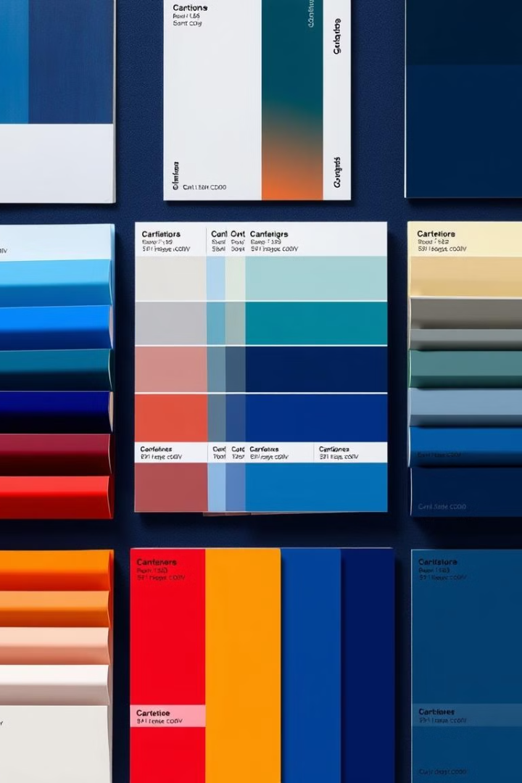




Color Harmonies Overview
Color harmonies, also known as color schemes, refer to the pleasing arrangements of colors that create visual interest and balance in artwork, design, and various visual compositions. By understanding color harmonies, artists and designers can evoke specific emotions, establish mood, and create visually appealing designs. Here’s an overview of some common color harmonies:
Monochromatic
Complementary
A monochromatic color scheme consists of variations (tints, shades, and tones) of a single color.
Complementary colors are pairs of colors that are directly opposite each other on the color wheel.
Analogous
Triadic
Analogous colors are groups of three colors that are next to each other on the color wheel.
Triadic color schemes consist of three colors that are evenly spaced around the color wheel.

Slide 22
Color Harmonies Overview
Color harmonies, also known as color schemes, refer to the pleasing arrangements of colors that create visual interest and balance in artwork, design, and various visual compositions. By understanding color harmonies, artists and designers can evoke specific emotions, establish mood, and create visually appealing designs. Here’s an overview of some common color harmonies:
Split-Complementary
Tetradic
This scheme uses one base color and the two colors adjacent to its complementary color.
This scheme consists of two complementary color pairs, forming a rectangle on the color wheel.

Slide 23
Color Harmonies Overview
Summary
Color harmonies are essential tools for artists and designers, providing a framework for creating visually appealing and emotionally impactful compositions. By understanding and applying these various color schemes, one can effectively manipulate color relationships to enhance visual storytelling and convey desired moods. Using color harmonies, creators can balance contrast and harmony, making their work more engaging and effective.

Slide 24
Detailed analysis of
color schemes and combinations

Slide 25
Complementary colors
Definition: Complementary colors are pairs of colors that are located directly opposite each other on the color wheel. When combined, these colors create a high contrast and vibrant effect. The concept of complementary colors is foundational in color theory, as it helps to understand color relationships and how they can be effectively used in art and design.
Characteristics of Complementary Colors
High Contrast:
  Complementary colors provide maximum contrast, making each color appear more vivid when placed next to each other. This can draw attention and create a dynamic visual effect.
Color Pairs:
  There are three primary pairs of complementary colors based on the traditional RYB (Red, Yellow, Blue) color wheel:
    Red and Green
    Blue and Orange
    Yellow and Purple
Visual Balance:
  When used together in a design or artwork, complementary colors can create visual balance. The tension between the two colors can make compositions more interesting and engaging.

Slide 26
Complementary colors
Usage of Complementary Colors in Design and Art
Creating Depth and Dimension:
  Artists use complementary colors to create depth. By placing a warm color (like red) next to its cool complement (like green), they can enhance the perception of three-dimensional space in a two-dimensional work.
Emphasizing Elements:
  Complementary colors can be used to highlight specific elements in a design or artwork. By placing complementary colors next to each other, you can draw attention to particular areas, making them stand out.
Creating Vibrancy:
  The juxtaposition of complementary colors can create a vibrant and lively aesthetic. This is often seen in graphic design, marketing materials, and artworks aimed at capturing attention.
Color Mixing:
  When mixed, complementary colors produce neutral tones, such as grays or browns. This can be useful for artists looking to tone down vibrant colors or create shadows and highlights.

Slide 27
Complementary colors
Psychological Effects of Complementary Colors
Dynamic Energy:
  The high contrast of complementary colors often conveys energy and excitement. This makes them effective for brands or products aiming to evoke enthusiasm.
Tension and Balance:
  The interplay between complementary colors can create a sense of tension, which can be visually stimulating. This dynamic can evoke emotions ranging from excitement to unease, depending on the context and usage.

Slide 28
Complementary colors
Considerations for Using Complementary Colors
Proportions:
  While complementary colors are striking, it's essential to consider their proportions in a design. Too much of one color can overwhelm the other, leading to a less balanced composition.
Context:
  The emotional response to complementary colors can vary based on cultural context and the surrounding colors. For example, red and green may evoke feelings of Christmas in some cultures, while in others, they may represent nature.
Saturation and Value:
  Adjusting the saturation and value of complementary colors can help create harmony. For instance, using a desaturated version of one color can soften the contrast, making the overall design feel more cohesive.
Conclusion
Complementary colors play a crucial role in color theory, offering artists and designers a powerful tool for creating visual interest, depth, and emotional impact in their work. By understanding how to effectively utilize complementary colors, one can enhance compositions and engage viewers in meaningful ways. Whether used to create vibrant artwork, effective marketing materials, or harmonious designs, complementary colors are fundamental in visual communication.

Slide 29
Analogous Colors
Definition: Analogous colors are groups of three or more colors that are next to each other on the color wheel. This color harmony is characterized by a shared hue, providing a sense of cohesion and balance in a composition. Because they are adjacent, analogous colors blend well together and create a serene, harmonious visual effect.
Characteristics of Analogous Colors
Color Relationships:
  Adjacent Colors: Typically, an analogous color scheme includes one dominant color and two neighboring colors. For example, if the dominant color is green, the adjacent colors might be yellow-green and blue-green.
  Shared Hues: Since these colors share a common hue, they are inherently related, making them pleasing to the eye.
Visual Cohesion:
  The colors work harmoniously together, creating a unified look. This cohesiveness can evoke feelings of calmness and tranquility.
  Because of their similarities, transitions between these colors can feel smooth and natural.
Vibrancy:
  Analogous colors can maintain vibrancy while creating a softer palette. This makes them suitable for a variety of designs, from serene landscapes to vibrant artworks.

Slide 30
Analogous Colors
Examples of Analogous Color Schemes
Warm Analogous:
  Red, Red-Orange, Orange: This palette feels energetic and inviting, perfect for designs that need to convey warmth and enthusiasm.
Cool Analogous:
  Blue, Blue-Green, Green: This combination offers a calming effect, ideal for designs that aim to evoke tranquility and relaxation.
Neutral Analogous:
  Gray, Beige, Taupe: These muted colors can create a sophisticated, understated palette that feels elegant and timeless.

Slide 31
Analogous Colors
Usage of Analogous Colors in Design and Art
Creating Mood:
  Calmness and Harmony: Analogous colors are often used to evoke a sense of peace and tranquility, making them popular in designs for spas, wellness centers, and nature-themed artwork.
  Energy and Warmth: Warm analogous colors can stimulate energy and excitement, suitable for marketing materials aimed at active or enthusiastic audiences.
Visual Flow:
  Because they blend well together, analogous colors can be used to guide the viewer’s eye through a composition. This makes them effective in creating a visual narrative in paintings or graphic designs.
Backgrounds and Foregrounds:
  Designers often use analogous colors in backgrounds to create a seamless transition that enhances the foreground elements. This approach can add depth and dimension to a design.
Subtlety and Depth:
  By varying the saturation and value of analogous colors, artists can create depth and interest without introducing high contrast. This technique is particularly useful in landscapes, portraits, and nature scenes.

Slide 32
Split Complementary Colors
Definition: Split complementary color schemes involve a base color and the two colors adjacent to its complementary color. This method maintains the contrast and vibrancy of complementary colors while providing a more nuanced and less jarring effect.
Characteristics of Split Complementary Colors
Composition:
  In a split complementary scheme, you select one color as the base and then choose the two colors that are directly next to its complementary color on the color wheel. For example:
    If blue is the base color, the split complementary colors would be red-orange and yellow-orange.
    If green is the base color, the split complementary colors would be red and purple.
Contrast and Balance:
  This scheme offers high contrast while avoiding the intense tension created by direct complementary colors. The inclusion of two colors provides a more balanced composition.
Visual Interest:
  By using three colors instead of two, split complementary schemes can add depth and complexity to a design, enhancing visual interest.

Slide 33
Split Complementary Colors
Usage of Split Complementary Colors in Design and Art
Creating Depth:
  Split complementary colors can be used to create depth in compositions by providing a strong focal point with the base color while using the adjacent colors to support it.
Dynamic and Harmonious Designs:
  This color scheme can create dynamic visual experiences while maintaining harmony. It’s particularly useful in graphic design, interior design, and fashion, where striking visuals are essential.
Flexible Color Choices:
  Using adjacent colors allows for a broader range of tones and shades, offering flexibility in how colors are utilized. Designers can experiment with saturation and value to achieve different effects.
Emphasis and Focal Points:
  The base color can be used for focal points or key elements, while the split complements can serve as secondary colors to enhance and support the overall design.

Slide 34
Split Complementary Colors
Considerations for Using Split Complementary Colors
Color Proportions:
  As with any color scheme, it’s important to consider the proportions of each color used. Typically, the base color is the most dominant, while the split complements should be used more sparingly to maintain balance.
Adjustment of Tones:
  Adjusting the saturation and brightness of the colors can help achieve a more cohesive look. For example, using a muted version of the split complements can soften the contrast and create a more harmonious feel.
Contextual Relevance:
  Consider the emotional and cultural implications of the colors used in a split complementary scheme, as they can vary across different audiences and contexts.
Conclusion
Split complementary colors are a versatile and effective color scheme that allows artists and designers to create vibrant yet balanced compositions. By understanding how to leverage the contrasting nature of a base color with its adjacent complements, creators can achieve depth, visual interest, and emotional engagement in their work. This color scheme is particularly useful for dynamic designs that require a sense of energy while maintaining harmony. Whether in art, design, or marketing, mastering split complementary colors can enhance the overall impact and effectiveness of visual communication.

Slide 35
Triadic Colors
Definition: A triadic color scheme consists of three colors that are evenly spaced around the color wheel. This approach provides a vibrant and harmonious balance, allowing for a rich visual experience while maintaining a sense of unity among the colors.
Characteristics of Triadic Colors
Even Spacing:
  The three colors in a triadic scheme are typically spaced 120 degrees apart on the color wheel. This uniform spacing creates a dynamic yet balanced composition.
High Contrast:
  Triadic colors offer significant contrast, making them visually stimulating. Each color enhances the others, leading to vibrant and energetic designs.
Vibrant Combinations:
  Because of the contrasting nature of triadic colors, they can create a lively aesthetic that captures attention and engages viewers.

Slide 36
Triadic Colors
Usage of Triadic Colors in Design and Art
Creating Balance:
  Triadic colors can establish a sense of balance in a composition. By distributing the colors evenly throughout the design, artists can create a harmonious look while still maintaining visual interest.
Dynamic Compositions:
  The vibrancy of triadic color schemes is particularly effective in creating dynamic artwork, posters, or branding that aims to attract attention.
Versatile Applications:
  Triadic color schemes can be used across various mediums, including painting, graphic design, interior design, and fashion. Their versatility allows for creative exploration while ensuring cohesion.
Focal Points:
  Artists and designers can use one of the triadic colors as the dominant color and the others as accents to create focal points, guiding the viewer’s eye through the composition.

Slide 37
Triadic Colors
Considerations for Using Triadic Colors
Proportions:
  Balance is key. Typically, one color should dominate, while the other two serve as support or accents. This helps to maintain focus without overwhelming the viewer.
Variations in Saturation and Value:
  Adjusting the saturation and brightness of the colors can help create a more cohesive look. For example, using pastel versions of the triadic colors can soften the overall effect, while using darker shades can create depth.
Cultural Context:
  Colors can have different meanings in different cultures. Understanding the cultural significance of the colors used in a triadic scheme can enhance the emotional impact of the design.
Conclusion
Triadic colors offer a vibrant and engaging way to create visually dynamic compositions. By leveraging the balance and contrast provided by evenly spaced colors, artists and designers can enhance their work with energy and harmony. This color scheme is versatile and can be applied across various creative fields, making it a valuable tool for effective visual communication. Mastering triadic color schemes can significantly elevate the impact and appeal of any artistic or design endeavor.

Slide 38
Tetradic Colors
Definition: A tetradic color scheme, also known as a double complementary color scheme, consists of four colors formed by two complementary color pairs. This scheme provides a rich variety of colors and offers a dynamic approach to color composition, making it one of the most versatile and complex color harmonies in color theory.
Characteristics of Tetradic Colors
Color Composition:
  A tetradic color scheme includes two complementary color pairs. For example, if the complementary pairs are red and green, and blue and orange, the tetradic scheme would consist of red, green, blue, and orange.
High Contrast:
  This scheme features a strong contrast due to the presence of two complementary color pairs. The combination of these contrasting colors can create a vibrant and energetic design.
Visual Complexity:
  With four colors in play, tetradic schemes can produce intricate and complex compositions. This complexity can add depth and interest to designs.

Slide 39
Tetradic Colors
Usage of Tetradic Colors in Design and Art
Creating Balance and Interest:
  The use of two complementary pairs allows for a balanced yet dynamic composition. Designers can distribute the colors in a way that leads the viewer’s eye around the design, maintaining interest.
Dynamic Visuals:
  Tetradic color schemes can create visually stimulating designs, making them ideal for branding, advertisements, and vibrant artworks that require attention.
Focal Points and Accents:
  Artists can use one or two colors as dominant colors while employing the other colors as accents. This helps to establish focal points while still incorporating a range of colors in the composition.
Exploration of Tones:
  The flexibility of a tetradic scheme allows artists and designers to explore a variety of tones, shades, and tints, enhancing depth and dimension within their work.

Slide 40
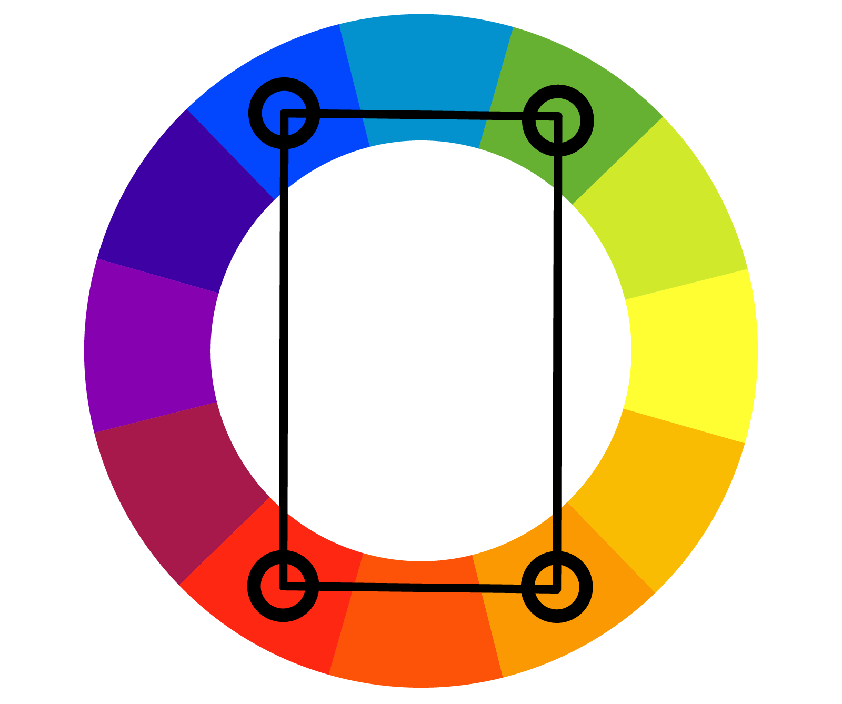
Tetradic Colors
Considerations for Using Tetradic Colors
Color Proportions:
  Achieving balance is crucial. It’s often best to use one or two colors as dominant and the other two as secondary or accent colors to avoid overwhelming the viewer.
Harmonizing with Neutrals:
  Incorporating neutral colors (like white, black, gray, or beige) can help balance the vibrancy of the tetradic scheme and provide breathing space within the design.
Saturation and Value Adjustments:
  Varying the saturation and value of each color can help create a more cohesive look. Softer, muted tones can lead to a more harmonious design, while bold colors can add excitement.
Contextual Relevance:
  Always consider the emotional and cultural significance of the colors used. The meaning of colors can change based on cultural context, so understanding the audience is essential for effective design.

Slide 41
Monochromatic Colors
Definition: A monochromatic color scheme consists of variations in lightness and saturation of a single hue. This approach focuses on one color, allowing artists and designers to create a cohesive and harmonious visual experience through shades, tints, and tones of that color.
Characteristics of Monochromatic Colors
Single Hue:
  The foundation of a monochromatic scheme is a single color, which is then manipulated through variations in value (lightness and darkness) and saturation (intensity or dullness).
Shades, Tints, and Tones:
  Shades: Created by adding black to the base color, resulting in darker variations.
  Tints: Created by adding white to the base color, resulting in lighter variations.
  Tones: Created by adding gray to the base color, resulting in more subdued variations.
Visual Harmony:
  Monochromatic schemes are inherently harmonious because they are derived from a single hue, leading to a cohesive and unified appearance. This can evoke feelings of serenity and calmness.

Slide 42
Monochromatic Colors
Usage of Monochromatic Colors in Design and Art
Creating Mood:
  Monochromatic schemes can effectively convey specific moods or themes. For example, a palette of soft pinks can create a romantic atmosphere, while darker shades of gray can evoke a more somber feeling.
Visual Depth and Dimension:
  By varying the shades, tints, and tones, artists can create depth and dimension in their work. This approach allows for intricate details and gradients without the distraction of multiple colors.
Branding and Identity:
  Many brands use monochromatic schemes to establish a strong visual identity. This approach can lead to recognizable branding while maintaining a sleek and professional appearance.
Focal Points:
  Within a monochromatic scheme, artists can create focal points by adjusting the saturation and value. A brighter or darker tone can stand out, drawing the viewer’s attention to specific elements.

Slide 43
Monochromatic Colors
Psychological Effects of Monochromatic Colors
Simplicity and Clarity:
  Monochromatic schemes can convey a sense of simplicity and clarity, making them effective in designs that aim to communicate a straightforward message.
Calmness and Unity:
  The cohesive nature of monochromatic colors often evokes feelings of calmness and unity. This can be particularly effective in spaces designed for relaxation, such as spas or homes.

Slide 44
Monochromatic Colors
Conclusion
Monochromatic color schemes provide a unique way to create visually compelling designs while maintaining harmony and unity. By exploring the shades, tints, and tones of a single hue, artists and designers can evoke a wide range of emotions, establish strong visual identities, and enhance the depth of their work. Understanding how to effectively utilize monochromatic colors can significantly elevate the impact and effectiveness of any artistic or design endeavor, making it a valuable technique in visual communication.

Slide 45
Summary of color Theory
Color theory is a framework that explains how colors interact with one another and how they can be combined to create visually appealing and harmonious compositions. It serves as a guide for artists, designers, and anyone working with color to understand the relationships between different hues and how these combinations affect perception and emotion.
At its foundation, color theory begins with the primary colors—red, blue, and yellow. These colors cannot be created by mixing others, but they serve as the base for creating all other colors. By blending primary colors together, we get the secondary colors—green, orange, and purple. Further mixing of primary and secondary colors results in tertiary colors, such as red-orange or blue-green, adding more complexity to the color palette.

Slide 46
References
References:
"Digital Art Fundamentals," Robin Landa, Open Textbook Library, 2020.
"Introduction to Graphic Design," Richard Hollis, Open Library, 2013.
"The Elements of Graphic Design," Alex W. White, Internet Archive, 2011.
"Computer Graphics: Principles and Practice," John F. Hughes et al., MIT OpenCourseWare, 2006.

