Slide 1

Computer Graphics and Design:
Lecture 6
Working with Layers and masks
Lecturer: Baya, Trevor

Slide 2
Learning Outcomes
By the end of this lecture, students will:
Understand the concept, purpose, and importance of layers and masks in Photoshop for non-destructive editing.
Demonstrate proficiency in creating, organizing, and managing different types of layers, including image, text, shape, and adjustment layers.
Apply layer masks to control the visibility and transparency of various parts of a layer.
Utilize adjustment layers for color correction, tonal adjustments, and creative effects while keeping the original content intact.
Explore blending modes, opacity settings, and their effects on layer interactions and overall image composition.
Implement clipping masks for targeted effects and seamless integration of visual elements.
Critically analyze how layers and masks contribute to a flexible and efficient workflow in complex projects.

Slide 3
Introduction to Layers and Masks
Layers and masks are fundamental components in Adobe Photoshop that allow for complex image editing, non-destructive changes, and detailed compositing. Layers work like transparent sheets that stack upon each other, enabling independent editing of different elements, while masks give control over the visibility of layer content without permanent changes. Mastering layers and masks is essential for anyone seeking to enhance their Photoshop skills and achieve professional-quality results.
Layers are the building blocks of Photoshop projects. Each layer functions as a separate piece of content within the overall composition, allowing for precise control, manipulation, and adjustment of images, graphics, or text.

Slide 4
Types of Layers
In Adobe Photoshop, layers are essential for organizing and editing your images. They allow you to work on different elements of a project independently and help maintain flexibility throughout your editing process. Here’s a breakdown of the various types of layers you can work with in Photoshop:
1. Background Layer
    Description: The base layer in a document, typically locked by default, which prevents transparency and edits.
    Usage: Ideal for traditional image editing. You can unlock it to add effects or adjustments.
2. Regular Layers
    Description: Standard layers that can contain images, shapes, or text. These layers can be edited, rearranged, and deleted freely.
    Usage: Used for most design tasks, allowing for blending, masking, and adjustments.

Slide 5
Types of Layers
3. Adjustment Layers
Description: Non-destructive layers that apply color and tonal adjustments to the layers below without permanently altering them.
Types:
  Brightness/Contrast
  Levels
  Curves
  Hue/Saturation
  Color Balance
  Black & White
  Gradient Map, etc.
Usage: To make adjustments like color correction, brightness, contrast, etc.
4. Layer Groups
Description: Folders that can contain multiple layers, allowing you to organize your workspace and manage complex projects.
Usage: Helps keep layers organized, especially in projects with many elements. You can collapse or expand groups for better workflow.

Slide 6
Types of Layers
5. Text Layers
    Description: Layers specifically for adding text. They retain their vector properties, allowing for scalable editing.
    Usage: Used for typography, titles, or any textual content. You can apply effects and styles just like regular layers.
6. Shape Layers
    Description: Layers that contain vector shapes created using the shape tools.
    Usage: Used for creating graphics, logos, or any designs needing scalable shapes. They can be filled with colors, gradients, or patterns.
7. Smart Objects
    Description: Layers that contain image data from raster or vector images, allowing for non-destructive transformations and edits.
    Usage: You can resize, rotate, and transform without losing quality. Useful for integrating graphics and maintaining high resolution.
8. Linked Layers
    Description: Layers that are linked together so that they can be moved or transformed simultaneously.
    Usage: Useful when you want to maintain a relative position between different elements.

Slide 7
Types of Layers
9. Fill Layers
Description: Special layers that fill an area with solid color, gradient, or pattern.
    Types:
    Solid Color: Fills the layer with a single color.
    Gradient: Fills the layer with a gradient transition between colors.
    Pattern: Fills the layer with a repeating pattern.
    Usage: Provides a quick way to add color or texture to a design.
10. Video Layers
    Description: Layers that contain video content, allowing for video editing and manipulation within Photoshop.
    Usage: Used for creating animations or editing video frames.
11. 3D Layers
    Description: Layers that contain 3D models and elements.
    Usage: Allows you to create and manipulate 3D graphics and effects.

Slide 8
Types of Layers
12. Masks
  Description: Special layers that control the visibility of the layer they're attached to by using black and white values (black hides, white reveals).
  Types:
  Layer Mask: Attaches to a layer for selective visibility.
  Clipping Mask: Uses the contents of one layer to mask another, allowing you to control the visibility of the layer based on the one above it.
Usage: To create complex compositions or to apply effects selectively
13. Adjustment Layer Masks
  Description: Similar to regular layer masks, but specifically for adjustment layers, allowing for selective adjustments.
  Usage: Apply adjustments only to certain parts of an image by painting on the mask.
14. Filter Layers
  Description: Layers that contain filters applied to the layer. They can be modified or removed non-destructively.
  Usage: To add effects like blur, sharpen, or stylize without altering the original layer.

Slide 9
Types of Layers
Summary
Understanding the different types of layers in Photoshop is crucial for efficient editing and design. By utilizing these layers effectively, you can maintain a flexible workflow, organize your projects better, and create more complex and visually appealing designs.

Slide 10
Working with Layers
Understanding how to manage and manipulate layers effectively is key to a streamlined Photoshop workflow.
Layer Organization
Grouping Layers: Grouping similar layers into folders helps keep the Layers panel organized, especially in projects with numerous elements. Groups can be named, collapsed, and manipulated as a unit.
Layer Naming: Renaming layers to reflect their content or function (e.g., "Background Image," "Logo," "Adjustment - Brightness") helps in navigating complex projects quickly.
Locking Layers: Layers can be locked to prevent accidental changes. Options include locking the entire layer, its position, or transparency. This is especially useful when working on large, multi-layer compositions.
Layer Ordering: The stacking order of layers affects visibility. Layers higher in the stack appear in front of lower layers. Adjusting the order can create depth and control overlapping elements.

Slide 11
Blending Modes
Blending modes in Photoshop are powerful tools that control how two layers interact with each other when combined. They affect how the colors and tones of the top layer blend with the layers below it. Here’s an overview of the main blending modes categories and how they work:
1. Normal Modes
Normal: The default mode, where the top layer covers the bottom layer without any blending.
Dissolve: Randomly replaces some pixels in the top layer with pixels from the underlying layers, creating a "grainy" or "dotted" effect.
2. Darken Modes
These modes darken the result by comparing the top and bottom layers.
Darken: Compares the colors of the top and bottom layers and keeps the darker pixels.
Multiply: Multiplies the base color by the blend color, resulting in darker colors. It's great for creating shadows.
Color Burn: Darkens the base color by increasing contrast. This mode is used to add intensity to shadows.
Linear Burn: Darkens the base color by reducing brightness. It's more intense than Multiply but less so than Color Burn.
Darker Color: Similar to Darken but doesn't work on individual RGB channels; instead, it compares the composite color.

Slide 12
Blending Modes
3. Lighten Modes
These modes lighten the result by comparing the top and bottom layers.
Lighten: Compares the colors of the top and bottom layers and keeps the lighter pixels.
Screen: The opposite of Multiply, it blends by inverting the colors, multiplying, and inverting the result. It creates a "lightening" effect.
Color Dodge: Brightens the base color by decreasing contrast, producing glowing effects.
Linear Dodge (Add): Brightens the base color by increasing brightness. It's more intense than Screen.
Lighter Color: Similar to Lighten but compares composite color instead of individual RGB values.

Slide 13
Blending Modes
5. Comparative Modes
These modes are used to compare the top and bottom layers.
Difference: Subtracts the blend color from the base color, or vice versa, depending on brightness.
Exclusion: Similar to Difference, but with lower contrast. It produces softer effects.
Subtract: Subtracts the blend color from the base color.
Divide: Divides the base color by the blend color.
6. Color Modes
These modes affect the color components (hue, saturation, and brightness) without affecting the details.
Hue: Uses the hue from the blend layer, while retaining the luminance and saturation of the base.
Saturation: Uses the saturation from the blend layer, while retaining the luminance and hue of the base.
Color: Uses the hue and saturation from the blend layer, while retaining the luminance of the base. Useful for colorizing.
Luminosity: Uses the luminance of the blend layer, while retaining the hue and saturation of the base.

Slide 14
Blending Modes
Tips for Using Blending Modes
Multiply is commonly used for creating shadows and darkening images.
Screen is ideal for lightening an image or adding highlights.
Overlay adds contrast, making it a popular choice for sharpening.
Color and Luminosity are great for color correction and toning.
Blending modes can be combined with layer opacity adjustments for even more nuanced effects, allowing for greater control over the final image appearance.
Opacity: Controls the transparency of a layer. Lowering the opacity makes the layer more see-through, allowing the layers below to show through. This is helpful for creating overlays and adjusting visual effects.

Slide 15
Layer Masks
Layer masks are used to hide or reveal parts of a layer without erasing the content. By manipulating the mask, you control which parts of a layer are visible or hidden. Masks are grayscale-based, where:
White Areas: Reveal the corresponding areas of the layer.
Black Areas: Conceal parts of the layer, making them fully transparent.
Gray Areas: Create partial transparency, allowing for soft transitions and feathered edges.
Using Layer Masks for Selective Editing
Non-Destructive Erasing: Instead of deleting parts of an image, layer masks allow users to paint with black to hide areas and white to reveal them, providing flexibility for future changes.
Gradient Masks: Using gradients on a mask creates smooth transitions between visible and hidden areas, which is ideal for blending images together.
Refining Masks: Tools such as the "Select and Mask" workspace help refine the edges of masks for precise selections, particularly useful for hair or fur.

Slide 16
Adjustment Layers and Clipping Masks
Adjustment layers in Photoshop are non-destructive layers that allow you to make color and tonal adjustments to your images without permanently altering the original layer. They enable you to easily experiment with different adjustments and refine your edits as needed. Here's a comprehensive overview of adjustment layers, their types, and how to use them:
Benefits of Using Adjustment Layers
Non-Destructive Editing: Adjustments can be modified or removed at any time without affecting the original image.
Layered Workflow: Allows you to stack multiple adjustments and control their order.
Masking: Each adjustment layer comes with a mask, enabling selective application of adjustments.
Easy to Modify: You can change the properties of an adjustment layer without starting over.

Slide 17
Types of Adjustment Layers
Brightness/Contrast
  Adjusts the brightness and contrast of the image.
  Ideal for quick tonal corrections.
Levels
  Provides control over the shadows, midtones, and highlights of an image using a histogram.
  You can set the input and output levels for better tonal range.
Curves
  Offers precise control over the tonal range by allowing you to adjust individual points on a curve.
  You can manipulate brightness and contrast with more flexibility than Levels.
Exposure
  Adjusts the exposure of an image, useful for correcting overexposed or underexposed photos.
  Offers sliders for adjusting exposure, offset, and gamma correction.

Slide 18
Types of Adjustment Layers
Hue/Saturation
  Modifies the hue, saturation, and lightness of the image.
  You can adjust all colors or target specific color ranges.
Color Balance
  Adjusts the balance of colors in the image using sliders for shadows, midtones, and highlights.
  Useful for correcting color casts or enhancing specific colors.
Selective Color
  Allows you to adjust the percentage of primary colors (Cyan, Magenta, Yellow, and Black) in each color range.
  Great for fine-tuning specific colors in an image.
Vibrance
  Adjusts the saturation of the less saturated colors more than the already saturated ones.
  Prevents over-saturation and is useful for enhancing skin tones.
Black & White
  Converts a color image to grayscale while allowing control over how each color is converted.
  You can adjust the intensity of specific colors in the conversion.

Slide 19
Types of Adjustment Layers
Photo Filter
  Applies a color filter to the image to simulate the effect of using colored filters in photography.
  You can adjust the density and choose from preset filters.
Gradient Map
  Maps a gradient to the tonal range of an image.
  Useful for artistic effects or color grading.
Invert
  Inverts the colors of the image, turning whites to blacks and vice versa.
  Creates a negative effect of the image.
Threshold
  Converts the image to a two-tone (black and white) version based on a threshold level.
  Useful for creating high-contrast images.

Slide 20
Tips for Using Adjustment Layers
Experiment with Different Adjustments: Use multiple adjustment layers to combine effects and achieve a more polished look.
Use Clipping Masks: If you want an adjustment layer to affect only the layer directly below it, right-click the adjustment layer and select Create Clipping Mask.
Save Presets: After creating a desired adjustment, you can save it as a preset for future use.
Adjustment layers are essential for achieving precise control over your image edits while maintaining flexibility in your workflow. They allow you to experiment and refine your adjustments without the fear of making irreversible changes to your original image.

Slide 21
Tips for Using Adjustment Layers
Clipping Masks
Clipping masks allow for the use of one layer’s content to define the visibility of another. This technique is often used for:
Applying Textures to Shapes: The texture layer is clipped to the shape below, making the texture visible only within the shape.
Targeted Adjustments: Clipping an adjustment layer to a specific image layer confines the effect to just that layer, without affecting other elements.

Slide 22
Practical Applications of Layers and Masks
Compositing: Combine multiple photos seamlessly by using masks for blending. For example, merging the sky from one image with the landscape from another.
Photo Retouching: Use masks to selectively adjust areas, such as brightening eyes, whitening teeth, or smoothing skin in portrait editing.
Digital Painting: Separate different parts of an illustration on different layers (e.g., background, midground, foreground) to make changes easily without disturbing other elements.
Graphic Design: Create complex compositions by layering text, shapes, and images, using masks to refine edges and blend elements together.

Slide 23
Types of Layers
Text Layers
Shape Layers
Smart Objects
Layers specifically for adding text. They retain their vector properties, allowing for scalable editing. Used for typography, titles, or any textual content.
Layers that contain vector shapes created using the shape tools. Used for creating graphics, logos, or any designs needing scalable shapes.
Layers that contain image data from raster or vector images, allowing for non-destructive transformations and edits. Useful for integrating graphics and maintaining high resolution.

Slide 24
More Layer Types
Linked Layers
Fill Layers
Video and 3D Layers
Layers that are linked together so that they can be moved or transformed simultaneously. Useful when you want to maintain a relative position between different elements.
Special layers that fill an area with solid color, gradient, or pattern. Provides a quick way to add color or texture to a design.
Layers that contain video content or 3D models and elements. Used for creating animations or editing video frames, or for creating and manipulating 3D graphics and effects.

Slide 25

Masks
Masks are special layers that control the visibility of the layer they're attached to by using black and white values (black hides, white reveals). Mastering masks is essential for anyone seeking to enhance their Photoshop skills and achieve professional-quality results.
Layer Mask
Attaches to a layer for selective visibility.
Clipping Mask
Uses the contents of one layer to mask another, allowing you to control the visibility of the layer based on the one above it.
Adjustment Layer Masks
Similar to regular layer masks, but specifically for adjustment layers, allowing for selective adjustments.
Filter Layers
Layers that contain filters applied to the layer. They can be modified or removed non-destructively.

Slide 26
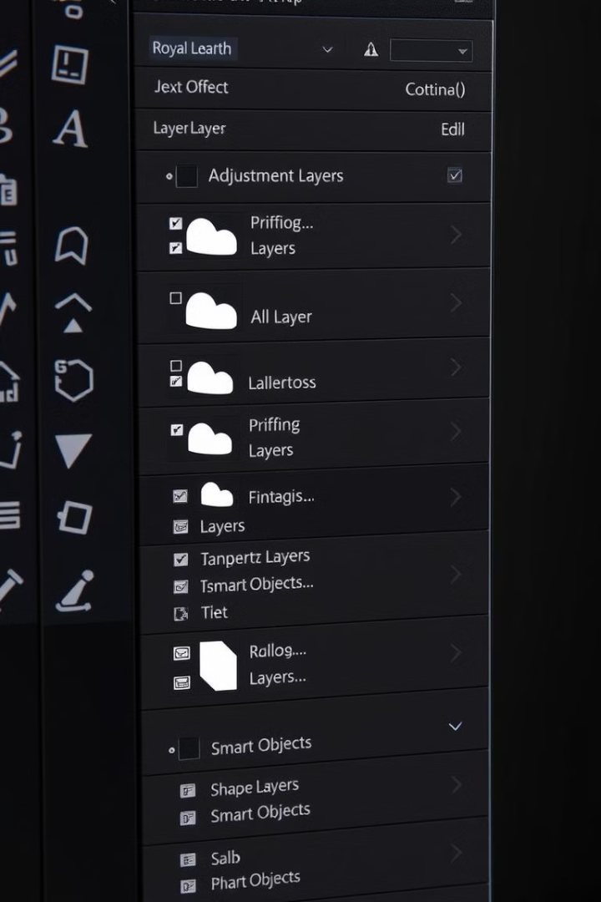
Working with Layers
Understanding how to manage and manipulate layers effectively is key to a streamlined Photoshop workflow. Grouping similar layers into folders helps keep the Layers panel organized, especially in projects with numerous elements.
1
Layer Naming
Renaming layers to reflect their content or function (e.g., "Background Image," "Logo," "Adjustment - Brightness") helps in navigating complex projects quickly.
2
Locking Layers
Layers can be locked to prevent accidental changes. Options include locking the entire layer, its position, or transparency.
3
Layer Ordering
The stacking order of layers affects visibility. Layers higher in the stack appear in front of lower layers. Adjusting the order can create depth and control overlapping elements.

Slide 27
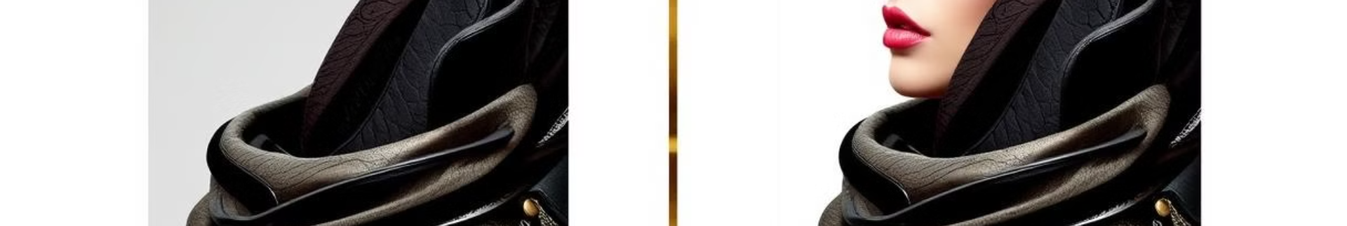
Blending Modes and Opacity
Blending modes in Photoshop are powerful tools that control how two layers interact with each other when combined. They affect how the colors and tones of the top layer blend with the layers below it.
Normal Modes
Darken Modes
Lighten Modes
Normal, Dissolve
Darken, Multiply, Color Burn, Linear Burn, Darker Color
Lighten, Screen, Color Dodge, Linear Dodge (Add), Lighter Color
Contrast Modes
Comparative Modes
Color Modes
Overlay, Soft Light, Hard Light, Vivid Light, Linear Light, Pin Light, Hard Mix
Difference, Exclusion, Subtract, Divide
Hue, Saturation, Color, Luminosity

Slide 28



Layer Masks
Layer masks are used to hide or reveal parts of a layer without erasing the content. By manipulating the mask, you control which parts of a layer are visible or hidden. Masks are grayscale-based, where white areas reveal the corresponding areas of the layer, black areas conceal parts of the layer, and gray areas create partial transparency.
Non-Destructive Erasing
Gradient Masks
Refining Masks
Instead of deleting parts of an image, layer masks allow users to paint with black to hide areas and white to reveal them, providing flexibility for future changes.
Using gradients on a mask creates smooth transitions between visible and hidden areas, which is ideal for blending images together.
Tools such as the "Select and Mask" workspace help refine the edges of masks for precise selections, particularly useful for hair or fur.

Slide 29





Adjustment Layers and Clipping Masks
Adjustment layers in Photoshop are non-destructive layers that allow you to make color and tonal adjustments to your images without permanently altering the original layer. They enable you to easily experiment with different adjustments and refine your edits as needed.
Non-Destructive Editing
Adjustments can be modified or removed at any time without affecting the original image.
Layered Workflow
Allows you to stack multiple adjustments and control their order.
Masking
Each adjustment layer comes with a mask, enabling selective application of adjustments.
Easy to Modify
You can change the properties of an adjustment layer without starting over.

Slide 30
References
"Digital Art Fundamentals," Robin Landa, Open Textbook Library, 2020.
"Introduction to Graphic Design," Richard Hollis, Open Library, 2013.
"The Elements of Graphic Design," Alex W. White, Internet Archive, 2011.
"Computer Graphics: Principles and Practice," John F. Hughes et al., MIT OpenCourseWare, 2006.

