Slide 1
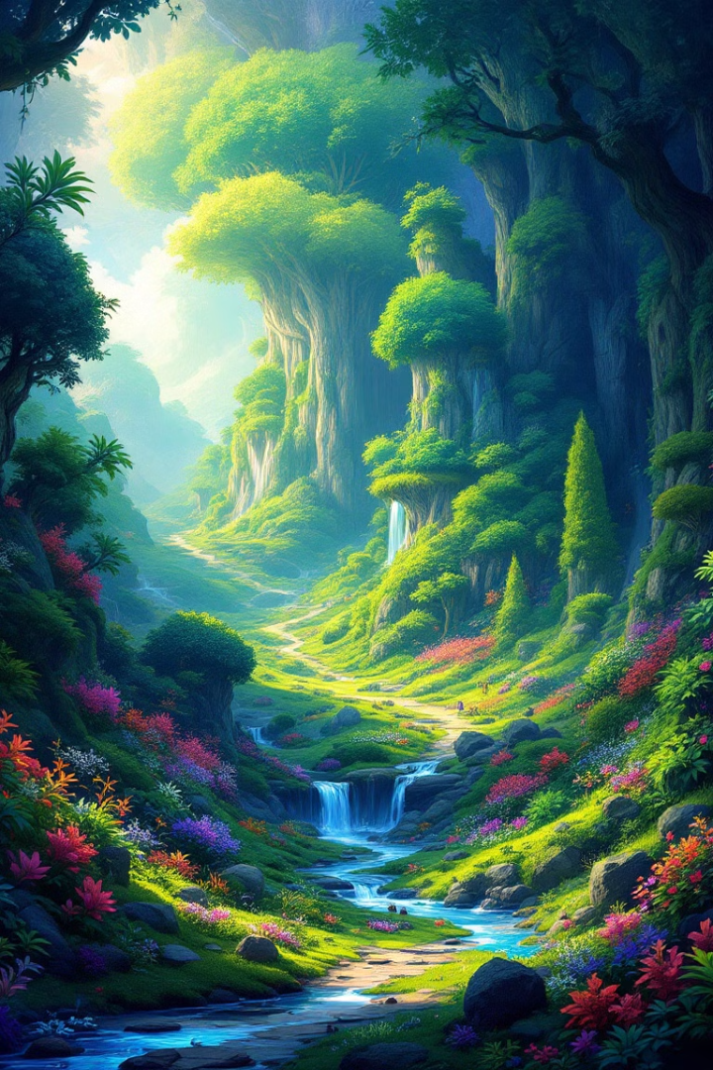
Computer Graphics and Design
Lecture 8
Digital Painting
Lecturer: Baya, Trevor

Slide 2

Lecturer learning outcomes
Understand the basics and advantages of digital painting compared to traditional methods.
Master Photoshop’s key digital painting tools, including brushes, layers, and blending modes.
Apply techniques like sketching, color blocking, and shading to create polished digital artwork.
Use graphics tablets effectively for precision and natural hand movements.
Create and use custom brushes and textures for unique effects.
Implement non-destructive editing workflows using Photoshop layers.
Recreate realistic lighting, shadows, and reflections in digital paintings.
Export and present completed artwork for digital or print use.

Slide 3
Introduction to Digital Painting in Photoshop
Digital painting is a modern art technique that involves creating artwork using digital tools such as graphic tablets, styluses, and software like Adobe Photoshop. Unlike traditional painting, which relies on physical mediums like oils, acrylics, or watercolors, digital painting allows artists to use virtual brushes, colors, and textures to mimic real-world techniques. This method offers significant advantages, including flexibility, ease of revision, and a wide range of creative possibilities.
In Photoshop, digital painting transforms the program from an image-editing tool into a canvas where artists can experiment with styles, colors, and brush strokes. Photoshop provides essential tools for artists to explore different techniques, from creating rough sketches to highly detailed, polished artwork.

Slide 4

Advantages of Digital Painting in Photoshop:
1
Non-Destructive Workflow:
2
Customizable
Brushes
Photoshop’s layer system enables artists to work non-destructively. Changes can be made on separate layers without affecting the original artwork.
Photoshop offers a vast range of brush types, from default brushes to custom ones that simulate traditional painting tools like pencils, oils, and watercolors.
3
Flexibility with Undo and History
Digital artists can experiment freely without fear of making permanent mistakes, thanks to Photoshop's history panel and undo feature.

Slide 5
Advantages of Digital Painting in Photoshop:
4
Blending Modes and Opacity Control
5
Efficiency
Layers and blending modes allow artists to experiment with transparency and light interaction, which are difficult to replicate in traditional media.
Tools like the smudge brush, blending tools, and adjustment layers can speed up processes like shading, color correction, and refinement, making complex art creation faster and more manageable.

Slide 6
Digital painting vs Traditional painting
Aspect | Digital Painting | Traditional Painting
Medium | Created using digital tools (software, tablets) | Uses physical materials (canvas, brushes, etc.
Tools Required | Graphics tablet, computer, stylus, software | Brushes, paints, canvas, palette, easel
Learning Curve | Steeper for software; easier to experiment | May require mastering techniques; hands-on skills
Undo/Redo Options | Easy to undo mistakes, multiple layers available | Difficult to correct mistakes, often permanent
Texture and Effects | Can simulate textures; endless possibilities | Real textures from materials; unique finishes
Cost | Initial investment in software and hardware | Ongoing costs for materials and supplies
Portability | Highly portable; can work anywhere with a device | Less portable; requires transport of materials
Reproducibility | Easy to duplicate and share online | Limited to physical reproduction methods
Style Variety | Wide range of styles easily achievable | Dependent on medium (oil, watercolor, acrylic)
Physical Presence | Lacks a physical form; exists digitally | Tangible artwork; can be framed and displayed
Community and Sharing | Online platforms for sharing and collaboration | Local galleries, exhibitions, and art shows
Environmental Impact | Less waste; depends on energy source | Uses physical materials that may harm the environment

Slide 7
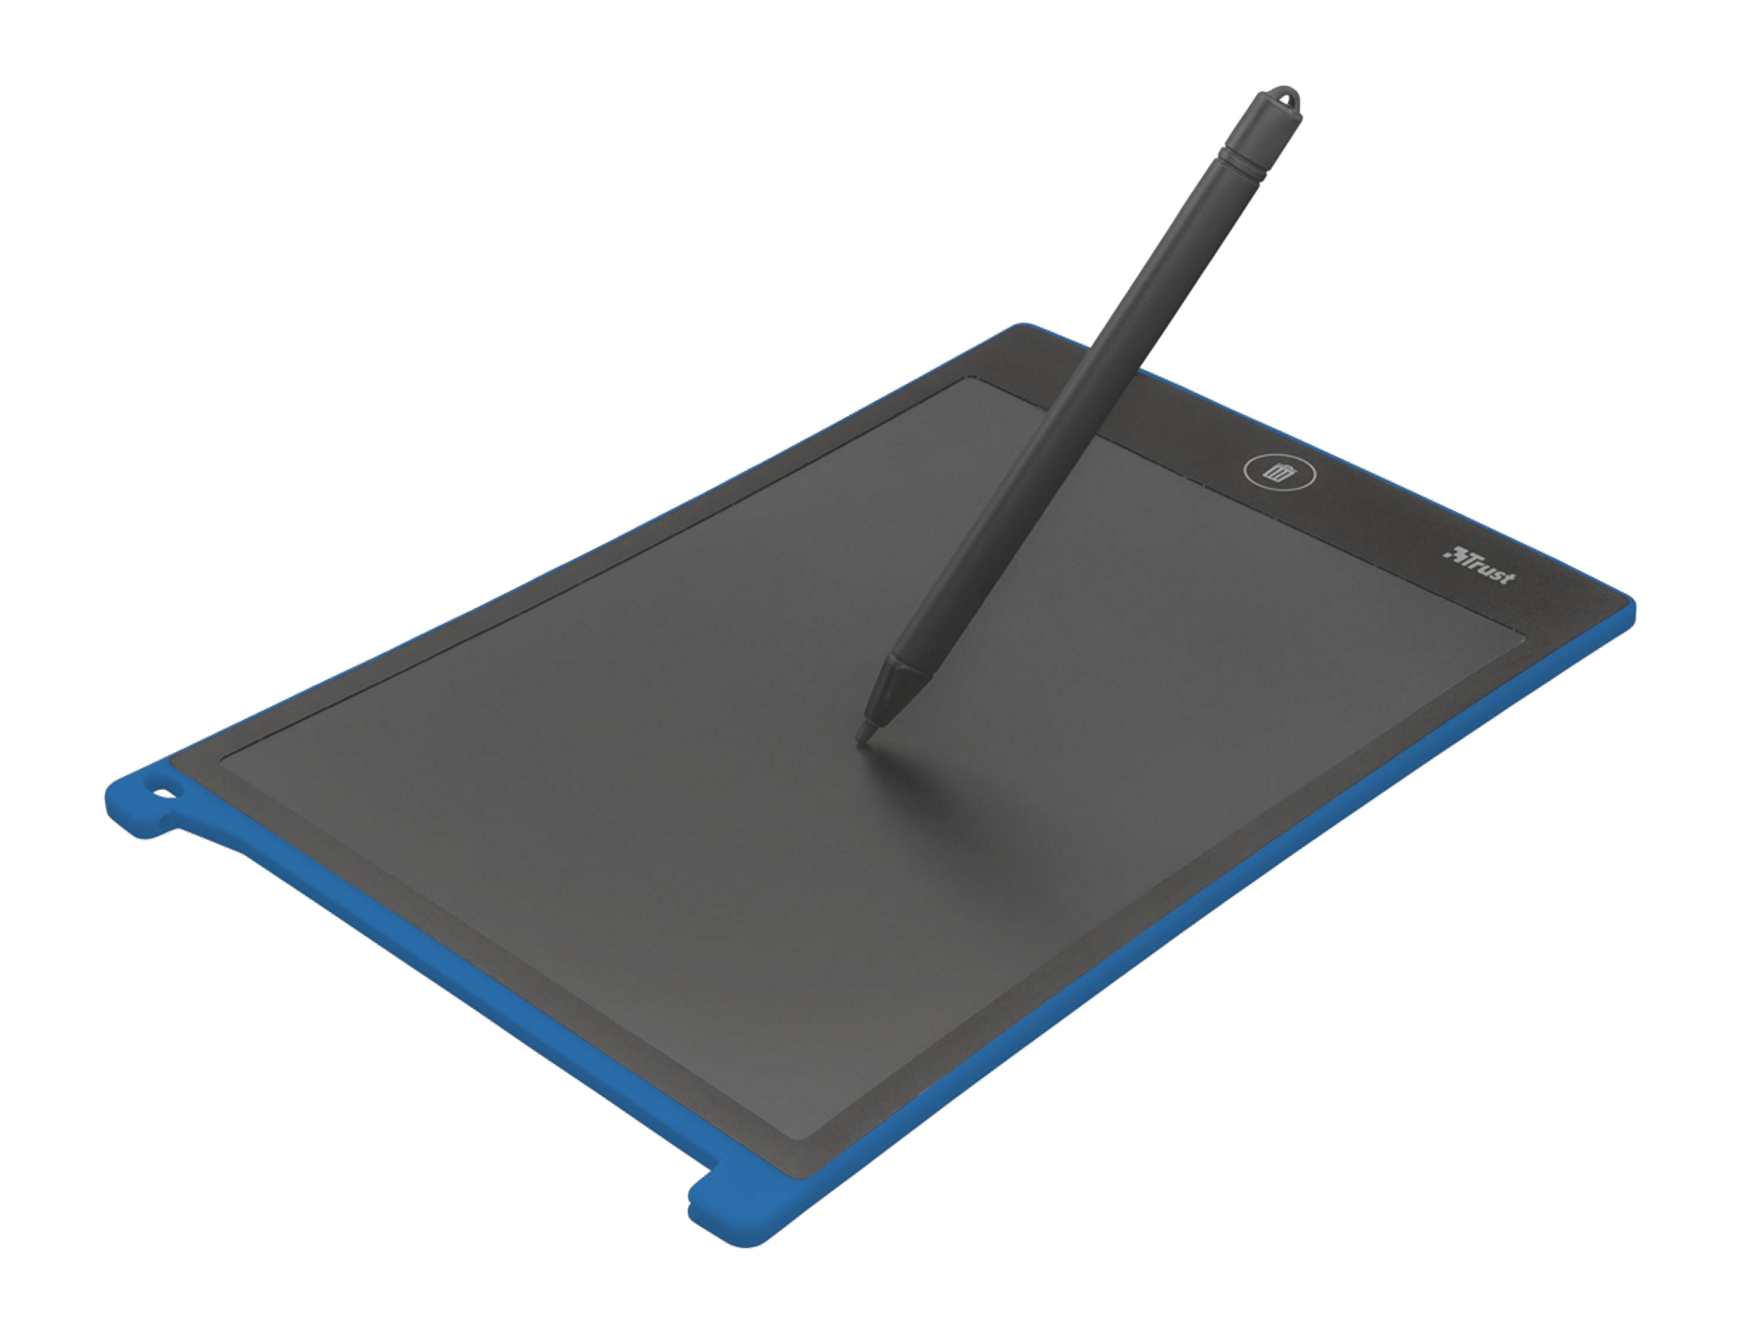
Why you need a graphics tablet for digital painting.
1. Pressure Sensitivity
Pen tablets provide pressure sensitivity, allowing you to control the thickness and opacity of your brush strokes based on how hard you press the stylus. This mimics the behavior of traditional drawing tools, like pencils or brushes, where harder pressure results in thicker lines and lighter pressure in finer lines. This sensitivity adds a level of precision and realism to your strokes that is difficult to achieve with a mouse.
2. Natural Hand Movements
Using a stylus on a pen tablet feels more natural than using a mouse, as it mimics the motion of traditional drawing or painting. This allows for greater fluidity in your strokes, leading to more organic and expressive artwork. The stylus is designed to fit comfortably in your hand, reducing strain and enabling longer working periods without discomfort.

Slide 8
Why you need a graphics tablet for digital painting.
3. Accuracy and Control
The stylus offers much finer control and precision over brush strokes compared to a mouse. This is particularly important in digital painting, where details and subtle variations in line work are essential. A pen tablet allows for intricate detailing, smooth curves, and accurate line control, all critical for professional-quality digital artwork.
4. Tilt Functionality
Many pen-tablets support tilt recognition, allowing the angle of the pen to affect the stroke in the same way tilting a pencil or brush would change the texture or line quality in traditional art. This feature helps achieve more natural shading and brushwork, adding depth and nuance to your digital painting.

Slide 9
Why you need a graphics tablet for digital painting.
5. Efficiency and Speed
With a pen tablet, your workflow becomes faster and more efficient. The pen’s responsiveness makes it easier to switch between quick broad strokes and intricate detailing without needing constant adjustments, like with a mouse. Additionally, customizable buttons on the tablet and stylus can be programmed for quick access to frequently used functions, improving productivity.
6. Ergonomics
Digital painting with a mouse can be uncomfortable for long sessions and can lead to repetitive strain injuries (RSIs) due to unnatural wrist movements. A pen tablet offers a more ergonomic experience, reducing the risk of strain and making long hours of work more comfortable.

Slide 10
Why you need a graphics tablet for digital painting.
7. Precision for Detailed Work
For tasks that require precise detail—like drawing fine lines, delicate shading, or intricate textures—a stylus provides a level of precision that simply isn’t possible with a mouse. This is crucial for professional-level digital paintings, where attention to small details is key.
In summary, a pen tablet is essential for digital painting because it offers pressure sensitivity, natural hand movements, precise control, and ergonomic advantages, all of which enhance the quality and efficiency of the artwork. It bridges the gap between traditional and digital art, making the process more intuitive and expressive.

Slide 11
The Brush Tool in Photoshop: An Overview
The Brush Tool is one of Photoshop’s most essential tools for digital painting and editing. It allows users to create freehand strokes in a variety of styles, making it a fundamental part of creating, blending, and detailing in artwork. Here's a detailed breakdown of how it works and its various settings.
The Brush Tool (shortcut: B) simulates a traditional paintbrush by allowing users to paint directly on the canvas in Photoshop. It can be used for a wide range of tasks, from painting and drawing to adding textures and shading. The versatility of the tool comes from its highly customizable settings, including brush size, hardness, opacity, and more.

Slide 12
Key Features of the Brush Tool
1. Brush Settings Panel
The Brush Settings Panel is where you can adjust how the brush behaves.
  Brush Tip Shape: Adjusts the size and shape of the brush. You can choose from round, square, textured, or custom shapes to create different effects.
  Size: Controls the diameter of the brush stroke. Smaller sizes produce finer details, while larger sizes are useful for broad strokes.
  Hardness: Adjusts the softness of the brush’s edges. A harder brush creates a sharp-edged line, while a softer one produces more feathered edges, ideal for blending.

Slide 13
Key Features of the Brush Tool
2. Opacity and Flow
Opacity: Controls the transparency of the brush strokes. An opacity setting of 100% results in fully opaque strokes, while lower values make strokes more transparent.
Flow: Determines how quickly paint is applied as you hold down the mouse or stylus. Lower flow settings allow for smoother, gradual application, which is useful for blending colors.

Slide 14
Key Features of the Brush Tool
3. Smoothing
The Smoothing feature allows you to create smoother, more precise strokes by reducing the shakiness in your brush movements. Photoshop automatically smooths the path of your strokes, which can be useful for drawing curved or controlled lines.
4. Blending Modes
The Brush Tool can be set to different Blending Modes (found in the top options bar) that change how the brush interacts with the colors already on the canvas. Some common modes include:
Normal: The default mode, where the brush applies color directly.
Multiply: Darkens the colors where the brush is applied, often used for shading.
Screen: Lightens the colors where the brush is applied, useful for highlights.

Slide 15
Using Custom Brushes
Photoshop offers a wide variety of default brushes, but you can also create or download custom brushes for specialized effects. Custom brushes allow for more texture, such as simulating natural media like charcoal, watercolor, or oil paint, and are essential for adding unique detail to digital paintings.
Creating a Custom Brush:
  Select an image or area you want to convert into a brush shape.
  Go to Edit > Define Brush Preset to save it as a new brush.
  You can now use this custom brush in your artwork and adjust its settings like any other brush.
Brush Presets:
  Photoshop includes a wide range of pre-made brush presets for different styles and textures.
  You can access them via the Brush Preset Picker in the top toolbar or through the Brush Settings panel.

Slide 16
Brush Dynamics
Brush dynamics add variability to your brush strokes based on the speed, pressure, and angle of your pen (if using a tablet). These settings are especially useful for achieving more natural, varied strokes.
Shape Dynamics: Changes the size, angle, and roundness of the brush tip based on the movement of the stylus.
Scattering: Spreads the brush strokes across an area, which is useful for creating textures like grass or foliage.
Dual Brush: Combines two different brushes to create more complex textures and effects.
Color Dynamics: Changes the hue, saturation, or brightness of the brush as you paint, giving the strokes a more varied, natural appearance.

Slide 17

Step-by-Step Guide for
Digital Painting.
1
Set Up Your Canvas
Creating a New Document
Open Photoshop and create a new document with dimensions like 1920x1080 pixels at a resolution of 300 ppi. Setting up your canvas correctly is essential because it establishes the workspace where your artwork will come to life. The right dimensions and resolution ensure that your painting is suitable for both digital display and high-quality prints.
Import the Reference Image
Drag your reference image into Photoshop or place it on a separate layer. Having a reference image is crucial as it serves as a visual guide throughout the painting process. It helps you understand the colors, lighting, and composition, ensuring that your painting remains consistent with the scene you wish to depict.

Slide 18
Step-by-Step Guide for
Digital Painting.
2
Start with a Rough Sketch
Select a Brush
Choose a basic round brush with medium hardness and lower opacity for sketching. This step is important as it allows you to create a loose outline of your landscape, giving you the freedom to experiment with shapes without committing to fine details too early.
Create a Sketch Layer
Add a new layer for your sketch, keeping it editable. This organization is vital because it allows you to toggle visibility and make adjustments easily, keeping your work structured and reducing the risk of losing progress.
Refine the Sketch
Block in major elements like the sun and clouds. Keeping the sketch loose at this stage is important to capture the overall composition without getting bogged down by details, allowing you to establish a clear foundation for your painting.

Slide 19
Step-by-Step Guide for
Digital Painting.
3
Block in the Basic Colors
Add Base Layers
Create a new layer for base colors and sample hues from your reference image. This foundational step is essential because it establishes the color palette for your painting, giving you a clear framework to work from and ensuring a cohesive look across your piece.
Use Big, Soft Brushes
Select a large, soft brush to blend colors smoothly. This technique is crucial for creating a gradient effect in the sunset sky, helping you achieve a harmonious transition between colors that evoke the beauty of a natural sunset.
Separate Layers for Key Elements
Organizing elements into separate layers helps maintain clarity and flexibility. This is important because it allows for easier adjustments later on, enabling you to work on individual components without affecting the entire composition.

Slide 20
Step-by-Step Guide for
Digital Painting.
4
Develop the Painting with Mid-Tones and Details
Refine the Sky and Sun
Blend the sky gradient smoothly and create a glowing effect for the sun. This step is crucial as it enhances the atmospheric quality of the painting, making the sunset feel alive and radiant, which is key to capturing the essence of the scene.
Add Clouds
Creating a new layer for clouds and focusing on their light and shadow adds depth. This step is important for realism, as clouds play a significant role in the overall mood of a sunset scene, influencing the light dynamics and color interactions.
Paint the Foreground and Shadows
Refining landforms with mid-tone colors and realistic shadows brings dimension to your artwork. This step is essential for grounding the painting, providing a sense of scale and perspective, and enhancing the overall composition.

Slide 21
Step-by-Step Guide for
Digital Painting.
5
Work on Lighting and Reflections
Create Sunlight Reflections
Painting reflections in water adds realism and depth to the scene. This technique is important as it mirrors the light dynamics present in nature, making your painting more believable and visually appealing.
Adjust Lighting with Adjustment Layers
Using adjustment layers allows for fine-tuning of brightness and color tones. This is crucial because it enables you to make non-destructive edits, ensuring that you can experiment without losing original details, leading to a more polished final product.

Slide 22
Step-by-Step Guide for
Digital Painting.
6
Add Fine Details and Textures
Refine Edges and Fine Details
Switch to a smaller brush for detailing objects like trees and rocks. This step is vital for adding realism and focus, drawing viewers’ eyes to key elements and enhancing the overall quality of the painting.
Texture the Ground and Sky
Using texture brushes adds realism to surfaces. This is important because texture plays a significant role in how viewers perceive your painting; realistic textures can create a more immersive experience.
Enhance Highlights
Adding subtle highlights emphasizes light sources and creates depth. This step is crucial for achieving a polished look, as highlights can bring attention to important areas and enhance the three-dimensionality of your artwork.

Slide 23
Step-by-Step Guide for
Digital Painting.
7
Final Touches
Blend and Soften Edges
Using the Smudge Tool or low-opacity brushes to soften transitions creates a seamless look. This is important for achieving a natural flow in the painting, especially in atmospheric elements like the sky and water.
Add Atmospheric Effects
Incorporating mist, haze, or glow enhances realism. This step is crucial as it contributes to the overall mood and depth of the scene, creating a more engaging visual experience.
Check Overall Balance
Zooming out to assess the painting helps identify areas needing attention. This is important for ensuring a harmonious composition, as it allows you to see the piece as a whole and make necessary adjustments.

Slide 24
Step-by-Step Guide for
Digital Painting.
8
Save and Export Your Artwork
Save as PSD
Saving your work as a PSD file preserves layers for future editing. This is essential for maintaining flexibility in your workflow, allowing you to revisit and modify your artwork without starting over.
Export as JPEG/PNG
Once satisfied, exporting the final painting in the appropriate format is crucial for sharing or printing. Choosing the right format ensures that your artwork retains its quality and is suitable for various applications, from digital sharing to physical displays.

Slide 25
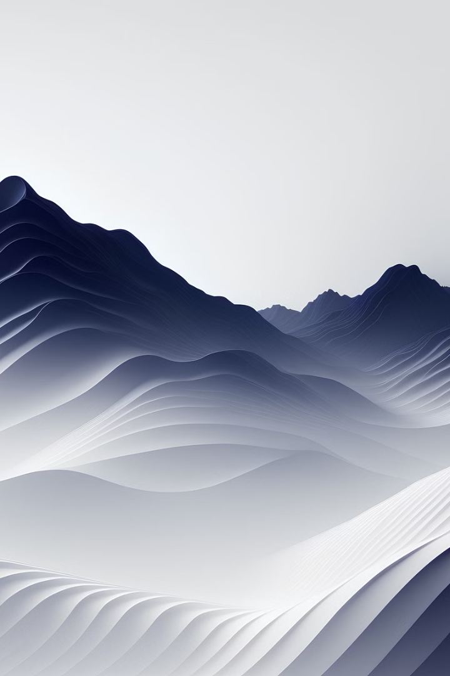
Layer Masking and Blending Modes
Non-Destructive Editing
Blending Modes Mastery
Utilize layer masks to make adjustments without permanently altering your underlying artwork.
Experiment with different blending modes to achieve unique color interactions and visual effects.
Compositing Techniques
Non-Destructive Workflow
Combine multiple elements and layers to create complex, layered digital paintings.
Develop a versatile, non-destructive workflow to maintain flexibility and creative control.

Slide 26



Perspective and Composition
Vanishing Points
Dynamic Composition
Spatial Awareness
Understand the principles of linear perspective and how to utilize vanishing points for realistic depth.
Explore techniques for creating captivating, visually engaging compositions that guide the viewer's eye.
Develop a keen eye for spatial relationships and proportions to achieve a sense of depth and scale.

Slide 27
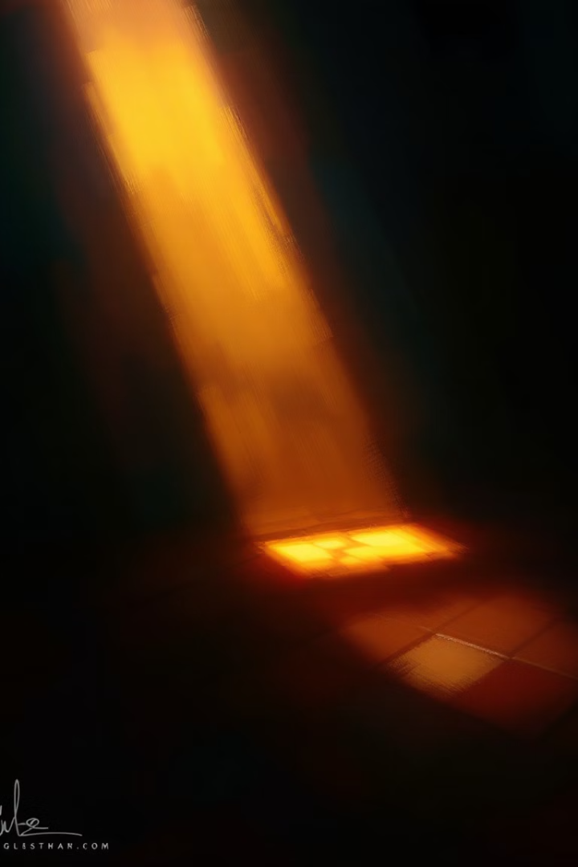




Lighting and Shading Techniques
Directional Lighting
Focal Point Emphasis
Learn to manipulate light sources to create dramatic, atmospheric lighting in your digital paintings.
Use strategic lighting and shading to draw the viewer's attention to the focal points of your artwork.
Reflections and Shadows
Mood and Atmosphere
Incorporate realistic reflections and shadows to add depth, dimensionality, and a sense of realism.
Experiment with lighting and shading to evoke specific moods and atmospheres in your digital paintings.

Slide 28
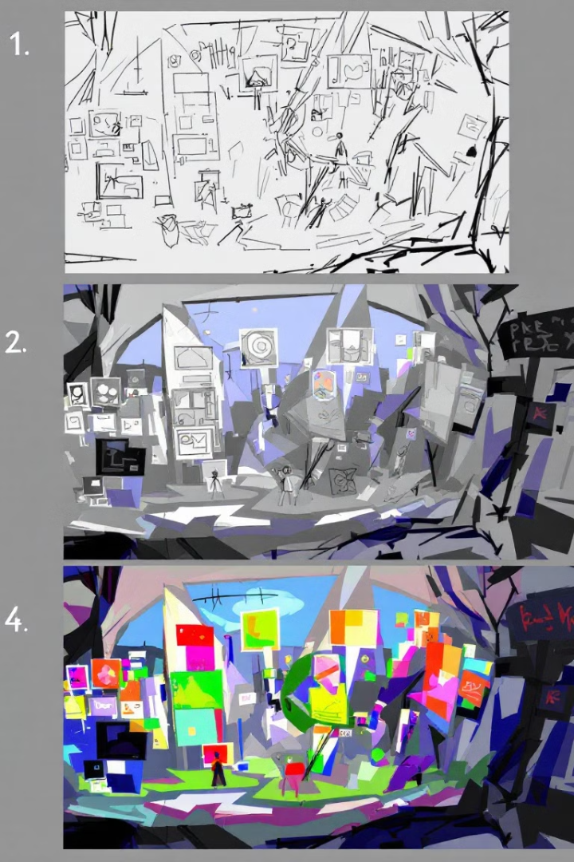
Digital Painting Workflow Summary
1
Concept Development
Start with a clear vision and brainstorm ideas to develop a strong conceptual foundation.
2
Sketching and Composition
Explore different compositions and refine the overall structure of your digital painting.
3
Color and Lighting Studies
Experiment with color palettes and lighting setups to establish the desired mood and atmosphere.
4
Painting and Refinement
Bring your digital painting to life through careful brushwork, layer management, and continuous refinement.

Slide 29
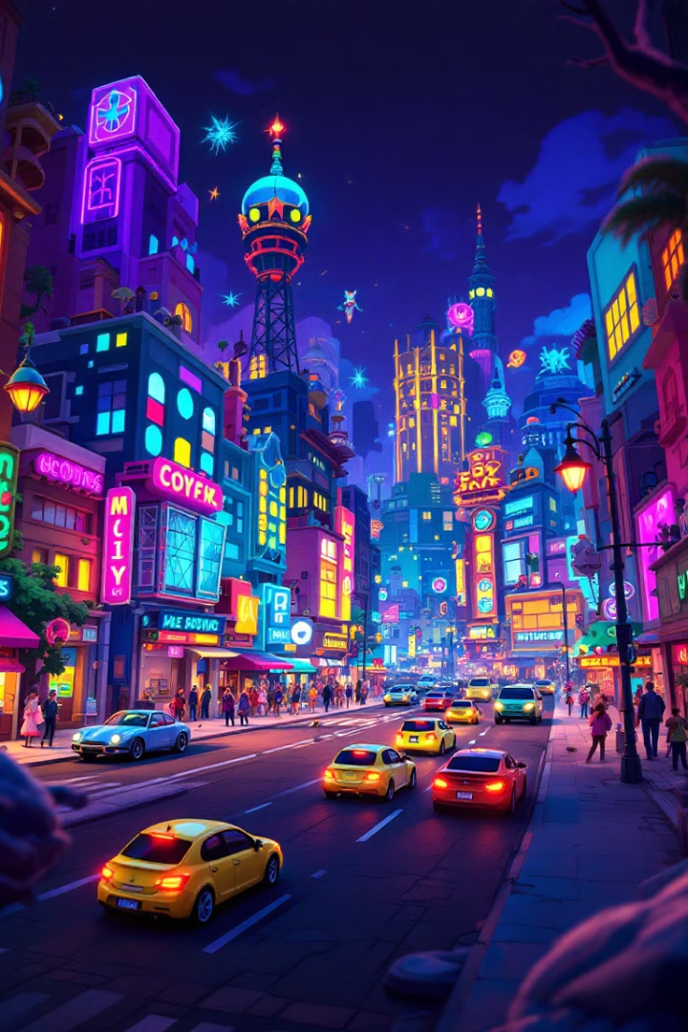
Advanced Techniques and Experimentation
Photoshop Scripting
Automate repetitive tasks and streamline your digital painting workflow.
3D Integration
Combine 2D digital painting with 3D elements for unique composite artworks.
Procedural Textures
Generate dynamic, procedural textures to add complexity and visual interest.
AI-Assisted Painting
Explore the potential of AI-powered tools to enhance and accelerate your digital painting process.

Slide 30
References
"Digital Art Fundamentals," Robin Landa, Open Textbook Library, 2020.
"Introduction to Graphic Design," Richard Hollis, Open Library, 2013.
"The Elements of Graphic Design," Alex W. White, Internet Archive, 2011.
"Computer Graphics: Principles and Practice," John F. Hughes et al., MIT OpenCourseWare, 2006.

