Slide 1
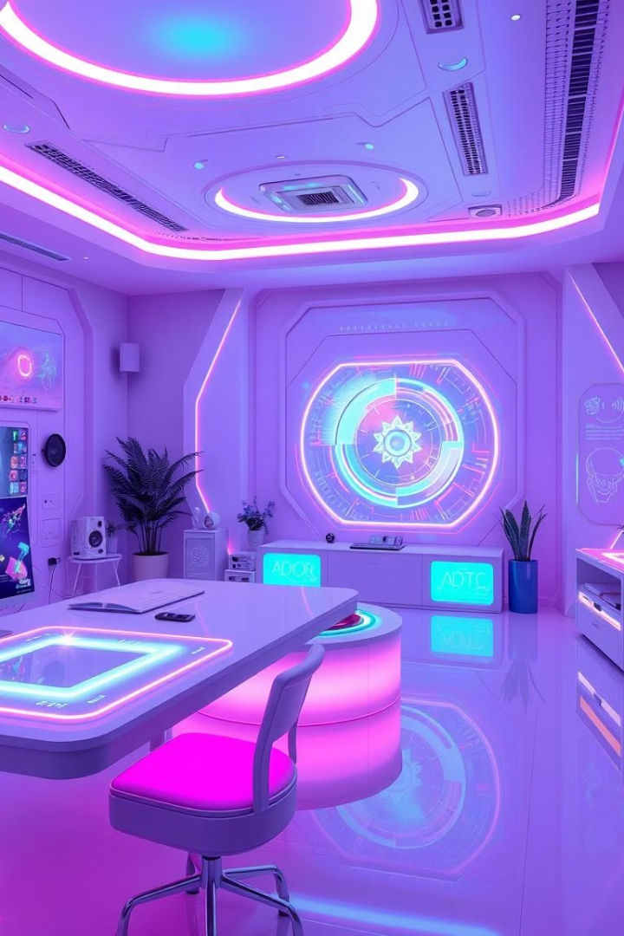
Computer Graphics and Design
Lecture 11
Artificial intelligence and Graphic Design
Lecturer: Baya, Trevor

Slide 2
Lecture learning outcomes
Define Artificial Intelligence (AI) and explain its fundamental components, including machine learning, natural language processing, computer vision, and robotics, as applied in design contexts.
Describe how AI is utilized in graphic design to automate repetitive tasks, enhance creative processes, and personalize user experiences.
Explain the concept and applications of generative design and how AI-driven tools assist in exploring design variations and optimizing for constraints such as material and cost.
Analyze AI-driven tools for image and video editing and identify how these tools simplify complex tasks (e.g., object removal, color correction) for enhanced productivity.
Evaluate the role of AI in user experience (UX) and personalization, highlighting how AI analyzes user data to create tailored and adaptive design elements.
Discuss the ethical and practical challenges associated with AI in design, including concerns about originality, bias, and the potential over-reliance on automation.
Identify key AI-based image generation and enhancement tools (e.g., DALL-E, Adobe Firefly) and compare their capabilities and applications in modern graphic design workflows.
Illustrate how AI influences augmented reality (AR) and virtual reality (VR) design, including AI’s role in creating interactive, immersive environments.
Reflect on the future implications of AI in graphic design, considering both advancements in technology and emerging ethical considerations.

Slide 3
This lecture explores the transformative impact of artificial intelligence on graphic design and visual arts. We'll examine how AI is revolutionizing creative processes, from automating repetitive tasks to generating entirely new visual concepts. Key topics include an overview of AI technology, its applications in design, notable AI tools for image generation and enhancement, and the ethical considerations surrounding AI-created art and designs.

Slide 4
What is Artificial Intelligence?
Artificial Intelligence (AI) is a field of computer science aimed at creating systems that can perform tasks requiring human-like intelligence, such as recognizing patterns, understanding language, making decisions, and even demonstrating creativity. Key aspects of AI include:
Machine Learning (ML), where systems learn from data to improve over time,
Natural Language Processing (NLP), which helps computers understand and generate human language,
Computer Vision for interpreting visual information, and
Robotics, enabling machines to act autonomously in the physical world.
AI can be classified into three types based on capability: Artificial Narrow Intelligence (ANI), specialized for specific tasks; Artificial General Intelligence (AGI), which would match human intelligence (still theoretical); and Artificial Superintelligence (ASI), a hypothetical form exceeding human intelligence.

Slide 5
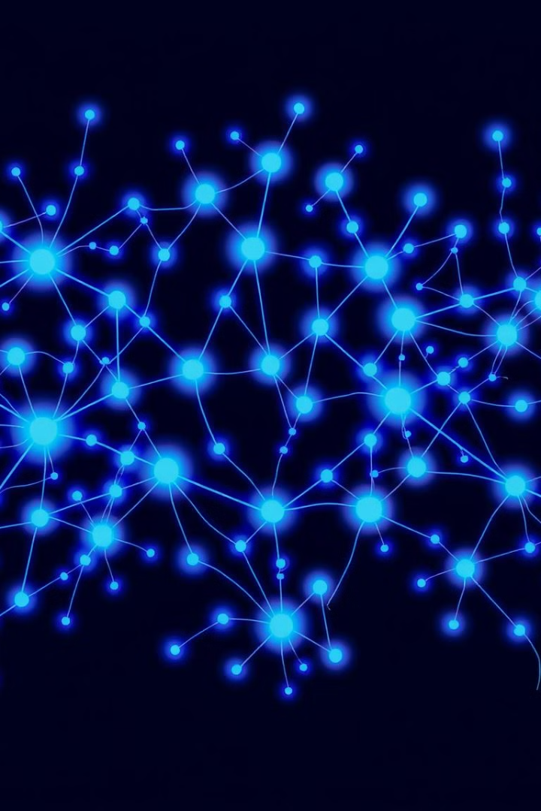
What is Artificial Intelligence?
1
Machine Learning
Systems that learn from data to improve over time
2
Natural Language Processing
Helps computers understand and generate human language
3
Computer Vision
Enables interpretation of visual information
4
Robotics
Allows machines to act autonomously in the physical world

Slide 6
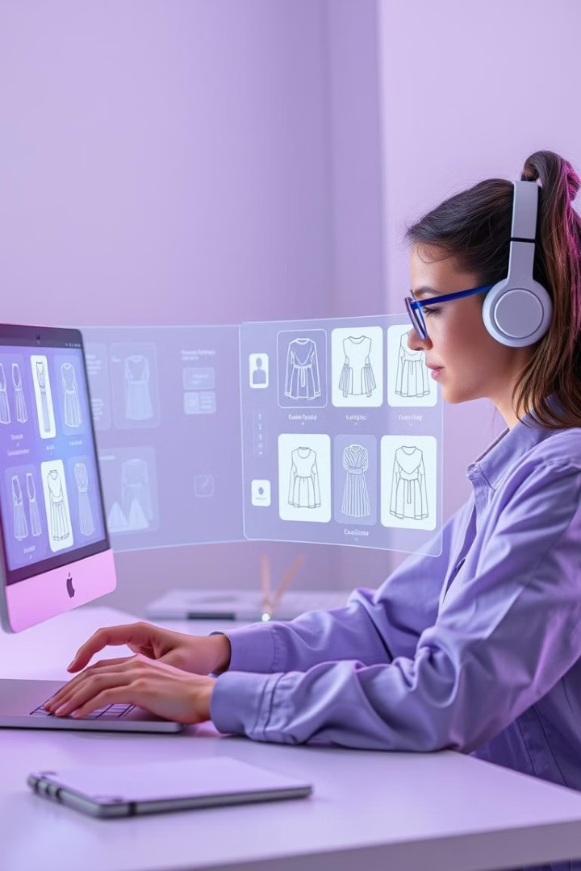
AI in Design: Core Areas
1
Automation of Repetitive Tasks
AI handles tedious work like resizing images and organizing assets
2
Generative Design
AI explores design options based on constraints and goals
3
Enhanced User Experience
AI enables personalization in digital products
4
Intelligent Image Editing
AI simplifies complex editing tasks

Slide 7
Introduction to AI in design
Artificial Intelligence (AI) in design is transforming how we create, optimize, and experience products, services, and environments. AI’s influence spans across fields like graphic design, product design, architecture, user experience (UX), and even fashion. By harnessing data-driven insights and automating repetitive tasks, AI is enabling designers to focus on creativity, experimentation, and human-centered design aspects, which were once heavily time-consuming.
Here’s a look at the core areas where AI is enhancing the design process:
1. Automation of Repetitive Tasks
AI can handle tedious and time-intensive tasks, such as resizing images, organizing assets, or generating variations of a design layout. Tools like Adobe's Sensei or Figma’s design plugins incorporate AI to reduce manual workload, allowing designers to focus on strategic decisions rather than repetitive edits.
2. Generative Design
Generative design, powered by AI, explores and creates a wide range of design options based on specified constraints and goals. AI algorithms can generate thousands of variations of a design, from furniture to architecture, by optimizing for factors like material cost, environmental impact, and structural integrity. For example, Autodesk’s Fusion 360 uses generative design to suggest solutions that a designer might not have initially considered, broadening creative potential.
3. Enhanced User Experience (UX) and Personalization
AI enables personalization in digital products, improving the user experience by adjusting content, design elements, and recommendations based on individual preferences. For instance, AI-driven algorithms analyze user interactions to provide personalized layout suggestions for websites or applications, creating a user-friendly experience tailored to individual needs.

Slide 8
4. Intelligent Image and Video Editing
AI-powered tools like Adobe Photoshop and Luminar Neo use machine learning to simplify tasks such as object removal, color correction, and background replacement. Designers can use these tools to achieve complex editing effects quickly. AI-driven image generation tools, like DALL-E or Midjourney, can create entirely new visual concepts based on text prompts, which can serve as inspiration or even directly inform a final design.
5. Data-Driven Insights for Better Design Decisions
AI can analyze massive datasets to provide insights into user behavior, preferences, and emerging trends. Designers can leverage these insights to create more informed and effective designs. Platforms like Google Analytics, for instance, use AI to provide user journey analytics that can guide UX and UI decisions.
6. Voice and Speech Interface Design
AI-driven Natural Language Processing (NLP) has opened up new possibilities for voice-activated design. Designers now create intuitive voice interfaces, like those for Amazon Alexa or Google Assistant, by understanding conversational AI, making user interactions more accessible and interactive.
7. Augmented Reality (AR) and Virtual Reality (VR)
AI enhances AR and VR experiences, which are crucial in immersive design. Through AI, virtual and augmented environments can become more interactive and adaptive, enabling real-time changes and responsive elements that enhance the user’s experience in fields like retail, gaming, and virtual showrooms.

Slide 9
Benefits and Challenges of AI in Design
While AI offers enormous benefits, it also presents challenges. A major benefit is the ability to iterate faster and explore a wider array of possibilities. However, designers often face concerns regarding the authenticity of their work, the over-reliance on automation, and potential biases in data-driven design. There’s a continuous dialogue around ethical considerations, especially in how AI-generated designs may unintentionally perpetuate stereotypes or miss cultural nuances.
AI is not replacing designers; rather, it is becoming a powerful collaborator, extending human capabilities. By freeing designers from repetitive tasks and expanding creative possibilities, AI is helping to shape the future of design, blending machine efficiency with human creativity. As AI tools evolve, the design industry is likely to see a richer, more nuanced integration of data, automation, and personalization into the creative process.

Slide 10
Image Generation Using AI: An In-Depth Exploration
Image generation using artificial intelligence (AI) has rapidly progressed over the past decade, enabling the creation of complex and highly realistic visuals from textual descriptions alone. Known as text-to-image synthesis, this process uses deep learning models, typically based on large neural networks, to generate images that correspond to given prompts. This paper explores the workings, applications, and available tools for text-to-image generation with a focus on leading AI models such as OpenAI's ChatGPT with DALL-E, Adobe Firefly, and other comparable tools.
1. Understanding Text-to-Image Generation
Text-to-image generation uses advanced machine learning algorithms that interpret natural language and translate it into visual content. This technology combines computer vision, which enables the model to "see" and generate visual elements, with natural language processing (NLP), which allows it to understand and interpret human language. These models are generally trained on vast datasets of images paired with descriptive text, allowing them to learn intricate patterns and associations between words and visual features.
The underlying architecture of most text-to-image models is the Generative Adversarial Network (GAN) or, more recently, the transformer-based architectures that have shown remarkable results in generative tasks. GANs involve a dual-network setup, with a generator creating images and a discriminator evaluating them for authenticity, iterating until the generated images are indistinguishable from real ones. Transformers, however, use attention mechanisms, making them better suited for sequential data like text and thus particularly effective for tasks that require understanding context and nuanced language.

Slide 11
Text-to-Image Generation
How It Works
Key Tools
Applications
AI models interpret text prompts and translate them into visual content using deep learning algorithms trained on vast image-text datasets.
Notable text-to-image AI tools include DALL-E, Midjourney, and Stable Diffusion, each with unique capabilities for generating images from text descriptions.
Used in digital art creation, content production, concept development, and rapid prototyping across various creative industries.

Slide 12
Notable AI Tools for Text-to-Image Generation
Below are some of the most prominent tools in the field of text-to-image synthesis, each with unique capabilities and applications.
a. OpenAI’s ChatGPT with DALL-E Integration
One of the most well-known names in the generative AI space, OpenAI has developed DALL-E, a powerful text-to-image model that has now been integrated into ChatGPT. This integration allows users to generate images directly from the ChatGPT interface using natural language prompts, providing a streamlined experience for both casual and professional users.
Key Features:
Prompt-Based Generation: DALL-E accepts detailed prompts to create specific visuals, making it suitable for tasks ranging from creating conceptual art to generating realistic images for content creation.
Inpainting Capabilities: One notable feature is inpainting, which allows users to edit specific parts of an image. By providing new prompts, users can modify parts of the image, effectively transforming details without starting from scratch.
Bias Mitigation and Safety: DALL-E includes safeguards to filter out harmful or biased content, making it safer for use in public and professional environments.
Applications: ChatGPT with DALL-E is widely used for generating digital art, creating marketing content, and facilitating design workflows. Its image customization features make it ideal for iterative design, where users can progressively refine images.

Slide 13
b. Adobe Firefly (firefly.adobe.com)
Adobe Firefly, launched as part of Adobe's suite of creative tools, focuses on producing high-quality images with professional design elements. Firefly is designed to integrate seamlessly with other Adobe products like Photoshop and Illustrator, allowing users to refine AI-generated images with Adobe’s editing tools.
Key Features:
Intuitive User Interface: Firefly’s interface is designed with creatives in mind, making it accessible to users with minimal AI experience while still offering advanced customization.
Image Style Customization: Firefly allows users to specify artistic styles, including photorealistic, illustrative, and abstract, among others. It also includes filters and effects tailored for professional design.
Integration with Adobe Ecosystem: Firefly’s integration with Adobe’s ecosystem allows for smooth transitions between image generation and post-processing. Users can take generated images directly into Photoshop, where they can make detailed edits to enhance or manipulate the image further.
Applications: Firefly is particularly beneficial for graphic designers, marketers, and creative professionals who need high-quality visuals that match specific brand aesthetics. Its style customization options make it versatile for both digital advertising and traditional media design.

Slide 14
Content-Aware Generative Fill: As a specialized form of image generation, content-aware generative fill allows for contextually accurate editing by filling, extending, or modifying parts of an image in a seamless, visually consistent manner. Using sophisticated models such as deep neural networks and diffusion techniques, generative fill synthesizes new elements that match the original image’s composition, lighting, and textures. This technique, exemplified by tools like Adobe Photoshop’s generative fill and DALL-E’s outpainting, has broad applications in photography, design, and content creation, offering both efficiency and creative flexibility. With just a few clicks or prompts, users can now remove unwanted objects, expand backgrounds, and even create imaginative composites from partial images. This subtopic not only illustrates how AI enhances image manipulation but also raises considerations around authenticity and responsible use.

Slide 15
c. Midjourney
Midjourney is a highly popular AI tool that operates primarily through Discord, allowing users to submit prompts and receive generated images directly within the chat platform. Known for its distinct style and artistic quality, Midjourney excels at creating visually captivating images with intricate detail.
Key Features:
Unique Artistic Style: Midjourney has become popular for its ability to create images with a high level of visual appeal, often leaning toward artistic and surreal styles.
Prompt-Specific Customization: Users can provide highly detailed prompts that guide the model toward specific visual outputs, allowing for a high degree of creative control.
Community-Based Platform: Operating within Discord, Midjourney fosters a collaborative environment where users can share prompts, images, and inspiration, building a community of creatives.
Applications: Midjourney is favored by digital artists, illustrators, and content creators who value aesthetically engaging visuals. Its high-quality output makes it popular for use in concept art, digital illustration, and even virtual worlds.

Slide 16
d. Stable Diffusion
Stable Diffusion, an open-source model developed by Stability AI, is one of the most customizable text-to-image tools available, allowing users to download the model and modify it to fit specific needs. This open-source approach has made Stable Diffusion a popular choice among developers and researchers.
Key Features:
Open-Source Flexibility: Stable Diffusion is available to download and run on local systems, giving users complete control over the model and its applications.
Fine-Tuning Capabilities: Users can fine-tune the model with specific datasets, enabling more specialized applications such as medical imaging or architectural visualization.
Efficient Computational Requirements: Compared to many other models, Stable Diffusion can be run on more modest hardware, making it accessible to a wider range of users.
Applications: Stable Diffusion is widely used in industries where specific customization is needed, such as gaming, animation, and virtual reality. Its open-source nature also makes it a valuable tool for academic research in computer vision and AI.

Slide 17
e. Google’s Imagen
Google’s Imagen is a text-to-image model focused on generating high-fidelity images that are both photorealistic and contextually accurate. Although not as widely accessible as other tools, Imagen has shown impressive results in research settings, especially for highly detailed image generation.
Key Features:
Photorealism: Imagen prioritizes realistic rendering of objects, people, and environments, making it ideal for applications that demand high visual fidelity.
Advanced NLP Integration: Built by Google, Imagen benefits from state-of-the-art natural language processing, enabling it to handle complex and nuanced prompts.
Research-Focused: As of now, Imagen is primarily used for research and not readily accessible to the general public, though Google has demonstrated its capabilities through various projects.
Applications: Imagen has applications in media, content production, and academic research, particularly for tasks that require extremely realistic visuals.

Slide 18
3. Comparative Analysis of Text-to-Image Tools
Each text-to-image tool discussed offers unique advantages and limitations, often geared toward different user needs. For example:
Accessibility and Ease of Use: Adobe Firefly and ChatGPT with DALL-E provide user-friendly interfaces, making them accessible to creative professionals with minimal technical experience. Midjourney also ranks highly in accessibility but is limited by its Discord-based operation.
Customization and Control: Stable Diffusion excels in customization due to its open-source model, making it ideal for specialized applications. Firefly also provides significant control, particularly for designers already embedded in the Adobe ecosystem.
Image Fidelity and Style: For highly realistic visuals, Google’s Imagen and Adobe Firefly are top contenders, while Midjourney stands out for its distinctive artistic style that favors conceptual and surreal art.

Slide 19
4. Ethical and Practical Considerations
While text-to-image generation offers remarkable capabilities, it raises ethical and practical concerns. Models can inadvertently replicate biases found in their training data, potentially generating inappropriate or harmful content. Additionally, questions around copyright and ownership arise, particularly when AI-generated images are used in commercial contexts. Tools like DALL-E and Firefly have implemented filters and safeguards, but these challenges remain complex and ongoing.
5. Future Directions in Text-to-Image AI
The future of text-to-image generation is likely to see further advancements in realism, customization, and ethical handling of generated content. Increased computational efficiency and reduced bias are key areas of research, along with integration into wider applications like augmented reality (AR) and virtual reality (VR). As models become more accessible and refined, text-to-image AI will continue to transform creative industries, media production, and beyond.
Conclusion
Text-to-image generation represents a significant leap in AI’s ability to interpret and visualize human language, with applications that span various industries. Tools like ChatGPT with DALL-E, Adobe Firefly, Midjourney, and Stable Diffusion each offer unique features tailored to different professional needs, from high-quality design to customizable open-source applications. As the technology progresses, ongoing advancements and ethical considerations will shape how these tools are implemented and regulated, ultimately broadening the creative horizons for individuals and industries worldwide.

Slide 20
Logo Generation Using AI
Logo generation using artificial intelligence (AI) represents a pivotal development in graphic design, providing businesses and individuals with the means to create professional and unique brand symbols. Using sophisticated algorithms, AI-driven tools can interpret text prompts, style preferences, and brand guidelines to deliver logos that align with brand identity. This paper delves into the technology behind AI-based logo generation, focusing on leading tools such as Looka, Canva, Tailor Brands, and others, highlighting their features, applications, and limitations.

Slide 21
1. Understanding AI-Based Logo Generation
AI-based logo generation involves machine learning algorithms trained on vast datasets of logos and brand designs. These algorithms learn patterns associated with design principles, including color theory, typography, symmetry, and composition. Through natural language processing (NLP), many AI logo tools can interpret user prompts to tailor logos to a brand’s desired look and feel. By analyzing input, such as industry type, preferred colors, and style, the AI system suggests unique logos that capture the brand’s essence.
Logo generation often relies on one of two types of models: rule-based systems and generative models. Rule-based systems use pre-defined design templates and customize them based on input parameters. Generative models, like those built on GANs (Generative Adversarial Networks), allow for more unique designs by synthesizing new logos rather than simply modifying templates.

Slide 22
2. Notable AI Tools for Logo Generation
Here we explore popular AI-driven logo generators that have established themselves in the design market, each with a distinct approach and audience.
a. Looka (looka.com)
Looka is a leading AI-driven logo design tool that utilizes machine learning to generate personalized logos based on user preferences. Users input brand details and style preferences, and Looka’s algorithms create a variety of logo options based on these inputs.
Key Features:
Customizable Brand Kit: In addition to logo creation, Looka provides an entire brand kit, including color schemes, social media assets, and website templates, making it a comprehensive solution for brand identity.
Interactive Design Process: Looka allows users to choose style preferences, colors, and icon types, ensuring that the AI generates logos aligned with the brand's personality.
High-Resolution Downloads: Users can download high-quality versions of their logos in multiple formats, suitable for various applications such as print, digital, and merchandising.
Applications: Looka is widely used by small businesses, startups, and entrepreneurs looking for affordable branding solutions without hiring a professional designer. It’s ideal for those who need a complete brand kit and a high level of customization.

Slide 23
2. Notable AI Tools for Logo Generation
b. Canva (canva.com)
Canva, though primarily known as an online design platform, has a built-in logo maker that leverages AI to provide logo templates and customizable design elements. Canva’s logo tool combines AI with a template-based approach, allowing users to modify designs with ease.
Key Features:
Extensive Template Library: Canva offers a wide array of logo templates tailored to different industries and aesthetics, making it easy to start from a template and make modifications.
AI-Enhanced Recommendations: Canva’s AI suggests design elements and color schemes based on user selections, creating a personalized design experience.
Integration with Canva’s Design Suite: Once a logo is created, it can be seamlessly integrated with Canva’s suite of tools for creating branded content like social media posts, presentations, and business cards.
Applications: Canva is popular among freelancers, bloggers, and small businesses who need quick, professional designs without complex customization. Its easy-to-use interface and extensive library make it ideal for non-designers looking to create logos and other branded materials.

Slide 24
2. Notable AI Tools for Logo Generation
c. Tailor Brands (tailorbrands.com)
Tailor Brands is a comprehensive branding platform that uses AI to create logos and a full suite of brand assets, from social media posts to business cards. By inputting brand details, users receive a tailored logo that can be adjusted to suit specific preferences.
Key Features:
Brand Personality Assessment: Tailor Brands uses a brand personality quiz that helps its AI understand the essence of the brand, translating this into a logo and a cohesive brand identity.
Multiple Logo Styles: Tailor Brands generates logos in a variety of styles—icon-based, text-based, or combination marks—allowing users to choose a style that best represents their brand.
Branding Toolkit: Users get access to a toolkit that includes social media graphics, branded presentations, and website design, making Tailor Brands a versatile option for brand-building.
Applications: Tailor Brands is popular with new businesses and entrepreneurs who need a fast, affordable way to establish a full brand identity. Its brand personality assessment also helps users who may not be sure about their brand’s visual direction.

Slide 25
2. Notable AI Tools for Logo Generation
d. Wix Logo Maker (wix.com/logo/maker)
Wix Logo Maker combines AI and design flexibility to generate customizable logos for businesses. It’s part of the larger Wix platform, known for its website-building capabilities, making it ideal for users who want a seamless design-to-website experience.
Key Features:
Personalized Logo Suggestions: Wix’s AI asks questions about the brand’s personality, industry, and style preferences, then generates multiple logo options for users to choose from.
Website Integration: Since Wix specializes in website building, users can directly integrate their logos into a website built on the Wix platform.
Design Customization Tools: Users can edit colors, fonts, icons, and layouts to create a unique logo that aligns with their brand vision.
Applications: Wix Logo Maker is especially useful for small businesses, bloggers, and startups that want an integrated branding and website solution. Its direct integration with the Wix website platform provides an all-in-one branding experience.

Slide 26
2. Notable AI Tools for Logo Generation
e. LogoMaker (logomaker.com)
LogoMaker is a user-friendly AI tool that provides a streamlined experience for creating simple and professional logos. Its focus on simplicity and affordability makes it accessible to users who need a quick logo solution.
Key Features:
Extensive Icon Library: LogoMaker has a vast library of icons that users can incorporate into their logos, providing a high level of customization within the icon-based design framework.
Customizable Templates: While LogoMaker’s designs are template-driven, users can adjust colors, fonts, and layout to create unique logo designs.
High-Quality Outputs: LogoMaker offers high-resolution downloads suitable for both digital and print use, ensuring logos look professional across different mediums.
Applications: LogoMaker is well-suited for individuals, small businesses, and entrepreneurs needing basic logos without advanced customization. It’s an ideal choice for quick, budget-friendly branding.

Slide 27
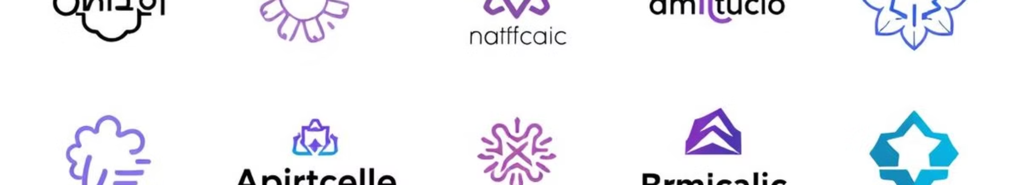
AI-Powered Logo Generation summary
Looka
Canva
Generates personalized logos based on user preferences and provides comprehensive brand kits
Offers AI-enhanced logo templates and design recommendations
Tailor Brands
Wix Logo Maker
Creates logos and brand assets using AI-driven brand personality assessment
Integrates AI logo generation with website building capabilities

Slide 28
3. Comparative Analysis of AI-Based Logo Generators
Each AI-based logo generator has unique strengths, making some more suitable for specific needs than others.
Customization and Flexibility: Tools like Looka and Tailor Brands provide users with significant customization, allowing them to create logos that are highly personalized. In contrast, LogoMaker and Canva are more template-driven, offering less flexibility but faster results.
Comprehensive Branding Kits: Looka and Tailor Brands go beyond logo creation, offering full branding kits that include color palettes, typography guidelines, and social media assets. This makes them ideal for users seeking an all-encompassing brand identity.
Ease of Use: Canva and Wix Logo Maker stand out for their user-friendly interfaces and extensive libraries, appealing to non-designers who want professional-looking logos without a steep learning curve.

Slide 29
4. Ethical and Practical Considerations
AI-generated logos raise certain ethical and practical questions, particularly regarding originality, quality, and copyright. Since these models are trained on large datasets of pre-existing designs, questions arise regarding the ownership and uniqueness of AI-generated logos. For instance, if a logo closely resembles an existing brand’s logo, it could result in trademark issues. Furthermore, the use of AI in design can lead to homogenization in branding, where distinctiveness—a critical element of effective logos—is diminished due to reliance on similar AI-driven design principles.
To address these concerns, many AI logo tools provide customization options to help users create more unique and identifiable logos. Nevertheless, businesses using AI-generated logos must be mindful of potential legal implications and may consider having their logos reviewed or refined by a professional designer.

Slide 30
5. Future Directions in AI-Based Logo Generation
The future of AI logo generation is likely to involve greater customization, enhanced ethical safeguards, and advanced personalization features. As machine learning models continue to improve, AI tools may provide even more intricate designs tailored to niche industries and specific brand attributes. We may also see more collaborative tools that combine AI with human designers, giving users the ability to refine AI-generated logos with professional oversight. Further research in explainable AI (XAI) could lead to transparency in design decisions, offering users insights into why certain design choices were made by the AI.
Another anticipated development is in real-time customization, where AI-powered logo tools might allow users to make iterative changes directly in augmented reality environments, providing a dynamic design process that can adapt to users’ preferences instantly.
Conclusion
AI-based logo generation offers a valuable solution for businesses and individuals seeking efficient, affordable, and professional branding. Tools like Looka, Canva, Tailor Brands, and Wix Logo Maker each offer distinct advantages, from full-brand kits to integrated web solutions. While these tools democratize access to logo design, users should remain cautious of ethical and legal implications surrounding originality and copyright. With continued advancements, AI-driven logo design will likely become even more sophisticated, customizable, and essential in shaping brand identities for companies of all sizes.

Slide 31
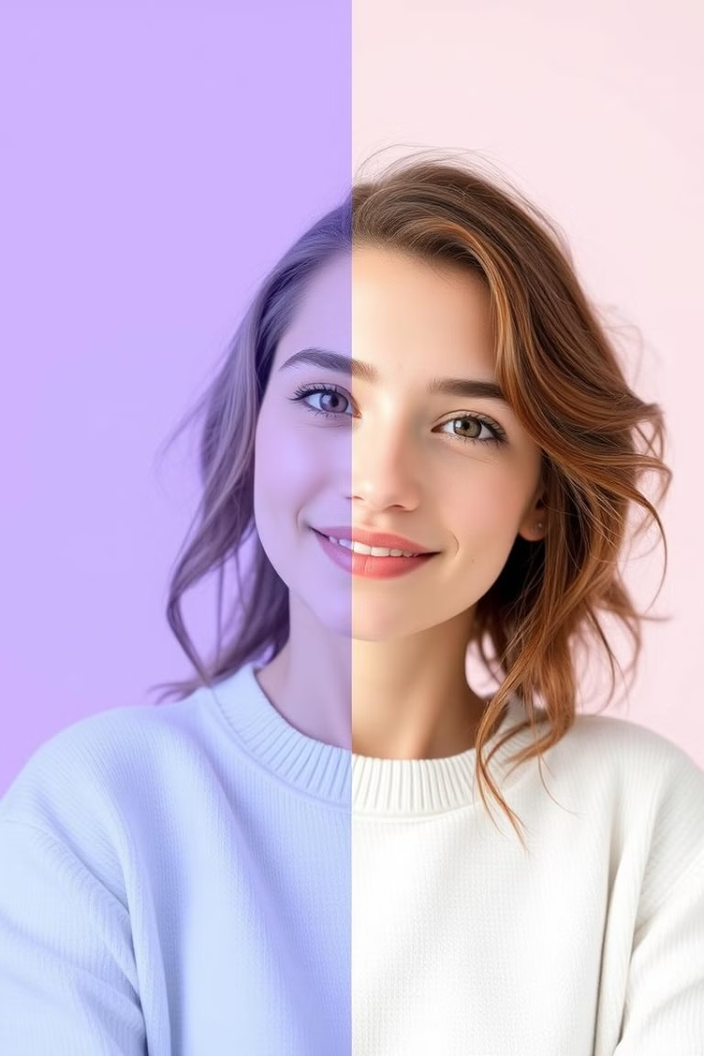



AI Image Enhancement Tools
Adobe Enhance
Integrated in Lightroom and Photoshop, offers AI-powered upscaling and noise reduction
Topaz Labs
Suite of specialized AI tools for upscaling, denoising, and sharpening images
Remini
Mobile app for enhancing low-quality or old photos using AI

Slide 32
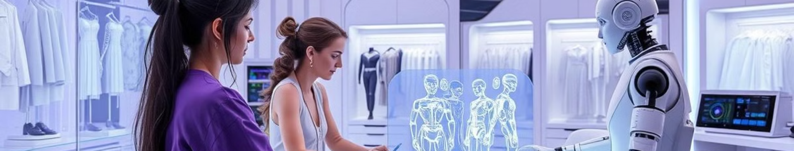
Image Enhancement Using AI: A Comprehensive Overview
Image enhancement is one of the most impactful applications of artificial intelligence (AI) in digital imaging, empowering both professionals and casual users to improve image quality, clarity, and aesthetic appeal. AI-driven image enhancement involves using deep learning techniques to adjust and refine image elements, such as brightness, contrast, sharpness, and color balance. This paper provides an in-depth exploration of the technology behind AI-based image enhancement, with an examination of key tools and models, including Adobe Enhance, Topaz Labs, and Google’s DeepLab, as well as the potential applications and ethical considerations surrounding this field.
1. Understanding AI-Based Image Enhancement
AI-based image enhancement refers to the use of machine learning models to automatically improve the quality of images. These models are typically trained on large datasets of high-quality images, allowing them to learn and replicate characteristics associated with clear, well-balanced visuals. By recognizing patterns in noise, sharpness, texture, and lighting, AI models can intelligently modify images to enhance clarity, correct defects, and, in some cases, reconstruct lost details.
Most AI image enhancement models rely on either Convolutional Neural Networks (CNNs) or Generative Adversarial Networks (GANs):
CNNs excel in feature extraction, making them ideal for tasks like denoising, super-resolution, and color correction.
GANs, with their generator-discriminator framework, allow for complex transformations by generating realistic enhancements and validating them against the original, yielding results that are often visually indistinguishable from actual high-quality images.

Slide 33
2. Notable AI Tools for Image Enhancement
a. Adobe Enhance (part of Adobe Lightroom and Photoshop)
Adobe’s Enhance feature, integrated within Lightroom and Photoshop, is a powerful AI-driven tool that automatically improves image quality using Adobe’s Sensei AI platform. This feature allows users to upscale images, reduce noise, and increase detail, making it a go-to for photographers and creatives.
Key Features:
Super-Resolution: Adobe Enhance uses machine learning to increase image resolution by up to 4x, allowing for larger prints or crops without quality loss.
Noise Reduction: Adobe’s AI model can effectively reduce image noise while preserving detail, particularly useful for low-light or high-ISO images.
Automatic Lens Corrections: Enhance can detect and correct lens-based distortions, such as vignetting or chromatic aberration, resulting in cleaner, more polished images.
Applications: Adobe Enhance is widely used by photographers and digital artists who need high-quality images for professional use, such as in advertising, editorial work, and fine art photography.

Slide 34
2. Notable AI Tools for Image Enhancement
b. Topaz Labs (Topaz Gigapixel AI, Denoise AI, and Sharpen AI)
Topaz Labs offers a suite of AI-powered tools designed specifically for image enhancement, including Gigapixel AI for upscaling, Denoise AI for noise reduction, and Sharpen AI for focus correction. Each tool addresses a different aspect of image enhancement, allowing users to optimize various elements of their images.
Key Features:
Gigapixel AI: This tool uses AI to upscale images up to 6x, enhancing resolution while preserving or even adding detail.
Denoise AI: A specialized denoising tool that reduces noise in photos, particularly effective for high-ISO images without blurring fine details.
Sharpen AI: Sharpen AI corrects motion blur, focus errors, and soft edges, enhancing clarity and creating a sharper, more detailed image.
Applications: Topaz Labs tools are popular among photographers, graphic designers, and digital artists who require precise, high-quality enhancements for prints, media, and publication.

Slide 35
2. Notable AI Tools for Image Enhancement
c. Google DeepLab
Google’s DeepLab is a deep learning model focused on image segmentation, which is often a preliminary step in image enhancement and editing. While DeepLab is primarily a research tool, its segmentation capabilities are used in Google Photos’ AI-driven enhancement features, which allow for selective improvements based on identified objects and regions within an image.
Key Features:
Image Segmentation: DeepLab can isolate objects, people, and backgrounds, allowing for targeted enhancements on specific parts of an image.
Smart Portrait Editing: By identifying foreground and background areas, Google Photos can apply portrait mode effects, blur backgrounds, and enhance facial features.
Selective Color Adjustments: Segmentation enables targeted adjustments to color and lighting, making it easy to apply changes only to specific regions of an image.
Applications: Google DeepLab and its implementation in Google Photos make image enhancement accessible to the average user, providing tools to refine portraits, landscapes, and general photos for personal and social media use.

Slide 36
2. Notable AI Tools for Image Enhancement
d. Let’s Enhance (letsenhance.io)
Let’s Enhance is an online AI image enhancement tool that offers super-resolution upscaling, color correction, and noise reduction through an intuitive web-based platform. Designed for ease of use, it’s accessible to both professional and non-professional users who need quick, high-quality enhancements.
Key Features:
Resolution Upscaling: Let’s Enhance allows users to increase resolution by up to 4x without losing detail, making it ideal for web images or low-resolution photos.
Color and Tone Adjustment: The tool uses AI to enhance colors and adjust tones automatically, often improving the overall aesthetic of the image.
Batch Processing: Users can upload multiple images and apply enhancements in bulk, saving time for those who need to process large volumes of images.
Applications: Let’s Enhance is widely used by e-commerce professionals, content creators, and small businesses needing high-quality visuals for websites, social media, and marketing without extensive graphic design expertise.

Slide 37
2. Notable AI Tools for Image Enhancement
e. Remini (reminiapp.com)
Remini is a mobile app that specializes in enhancing low-quality or old photos using AI. Known for its user-friendly interface, Remini can quickly turn blurry, pixelated, or faded images into sharp, clear visuals, making it especially popular among smartphone users.
Key Features:
Face and Detail Restoration: Remini’s AI can improve clarity, enhance facial features, and restore fine details, making it suitable for old photos or low-resolution selfies.
Photo Enhancer: Remini enhances brightness, contrast, and sharpness, producing vibrant images from dull or blurry originals.
Video Enhancement: Beyond photos, Remini offers a video enhancement feature that improves the quality of video footage, making it clearer and more detailed.
Applications: Remini is used primarily by casual users who want to enhance personal photos for social media, digital albums, and even printed memories. Its intuitive design and mobile format make it widely accessible for everyday users.

Slide 38
3. Comparative Analysis of AI-Based Image Enhancement Tools
Each of these tools offers specific features tailored to different use cases, target audiences, and levels of expertise.
Professional Quality and Control: Adobe Enhance and Topaz Labs offer the highest control over image quality and are preferred by professional photographers and graphic designers. Their extensive features allow for precise, customized enhancements.
Accessibility and Ease of Use: Let’s Enhance and Remini provide a more accessible approach for users without design experience. They simplify complex enhancements with intuitive interfaces, making high-quality results possible for casual users.
Specialized Features: Tools like Google DeepLab and Remini specialize in unique features such as image segmentation and face restoration, enabling selective and highly targeted enhancements.

Slide 39
4. Ethical and Practical Considerations
AI-driven image enhancement presents several ethical and practical concerns, particularly around issues of authenticity, privacy, and bias. Enhanced images may lead to concerns about misrepresentation, especially in social media, advertising, and journalism. The potential for over-enhancing images can distort reality, particularly when used to modify facial features or body proportions, raising concerns about body image and societal standards.
Privacy is also a critical issue, as tools that recognize and enhance faces can potentially be used for unauthorized surveillance or identification. To mitigate these issues, some tools incorporate privacy protections, while others offer user controls to limit AI’s impact on sensitive features.

Slide 40
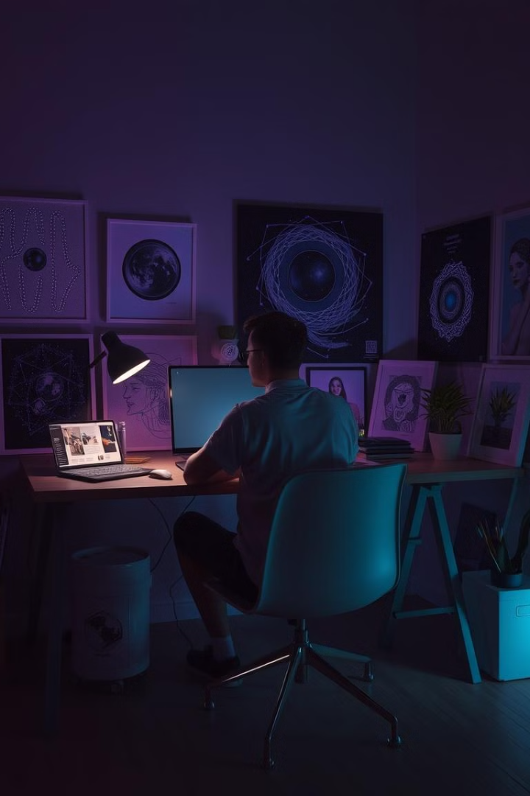
Challenges and Ethical Considerations
Authenticity
Concerns about misrepresentation in AI-enhanced images
Privacy
Potential misuse of AI recognition capabilities
Bias
AI models may perpetuate societal biases in generated content
Copyright
Unclear ownership of AI-generated designs

Slide 41
Future of AI in Graphic Design
5. Future Directions in AI-Based Image Enhancement
The future of AI-based image enhancement is likely to include advancements in both functionality and ethical considerations. AI models are expected to improve in terms of real-time enhancement, where users can see changes as they make adjustments, making the editing process more interactive and responsive. Furthermore, as generative models improve, AI may eventually be able to reconstruct missing parts of images with near-perfect accuracy, a feature useful for archival preservation and restoration.
Ethically, the industry may adopt guidelines to ensure transparency in AI-enhanced media, particularly in fields such as journalism, fashion, and advertising. Development of explainable AI (XAI) models that allow users to understand the enhancements made can help maintain trust and accountability. Additionally, future AI tools may include more built-in safeguards against bias and manipulation, making image enhancement both powerful and ethically sound.

Slide 42
Future of AI in Graphic Design
1
Advanced Personalization
2
Collaborative AI
AI will enable more tailored and context-aware designs
Tools that combine AI capabilities with human creativity and oversight
3
Ethical AI
4
Immersive Design
Development of more transparent and unbiased AI models
AI integration in AR/VR for dynamic, responsive designs

Slide 43
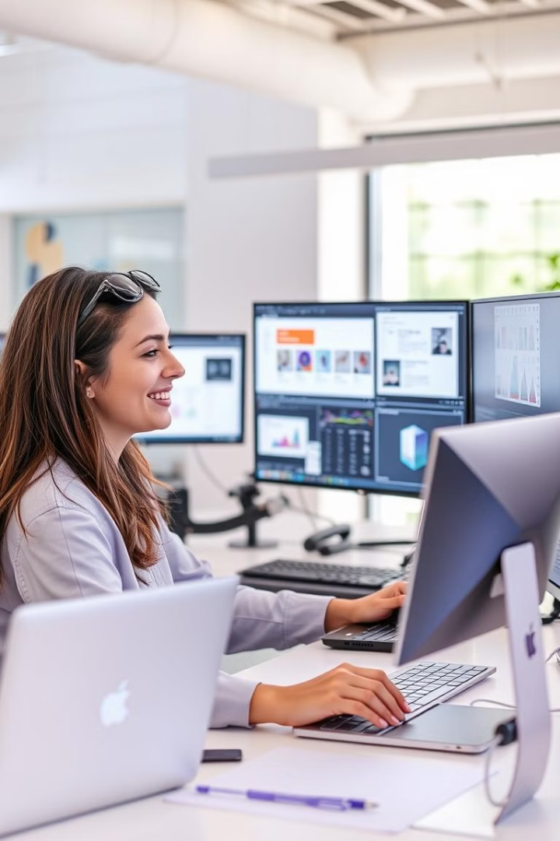




Benefits of AI in Design
Efficiency
AI automates time-consuming tasks, allowing designers to focus on creativity
Exploration
Generative AI enables rapid iteration and exploration of diverse design concepts
Personalization
AI facilitates creation of tailored designs and user experiences
Accessibility
AI tools make professional-quality design more accessible to non-experts

Slide 44
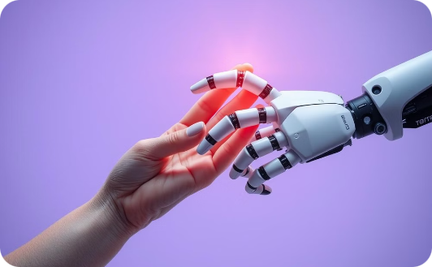

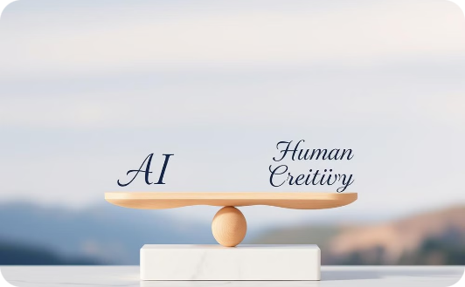
Conclusion: Embracing AI in Design
AI-based image enhancement provides revolutionary capabilities for improving image quality, from upscaling and denoising to targeted adjustments and selective color enhancements. Tools like Adobe Enhance, Topaz Labs, and Remini cater to diverse needs, from professional photographers requiring precise control to casual users seeking quick fixes. However, the ethical implications of AI-enhanced images must be considered carefully, as over-enhancement or unauthorized alteration can lead to issues around authenticity and privacy. With continued advancements in AI, image enhancement will likely become even more sophisticated, providing both powerful capabilities and responsible safeguards for users across all domains.
Collaboration
New Horizons
Balance
AI is becoming a powerful collaborator in design, extending human capabilities rather than replacing designers
AI is opening up new possibilities in design, enabling more efficient, personalized, and innovative creative processes
The future of design lies in finding the right balance between AI capabilities and human creativity and ethical considerations

Slide 45
References:
"Digital Art Fundamentals," Robin Landa, Open Textbook Library, 2020.
"Introduction to Graphic Design," Richard Hollis, Open Library, 2013.
"The Elements of Graphic Design," Alex W. White, Internet Archive, 2011.
"Computer Graphics: Principles and Practice," John F. Hughes et al., MIT OpenCourseWare, 2006.

