Slide 1
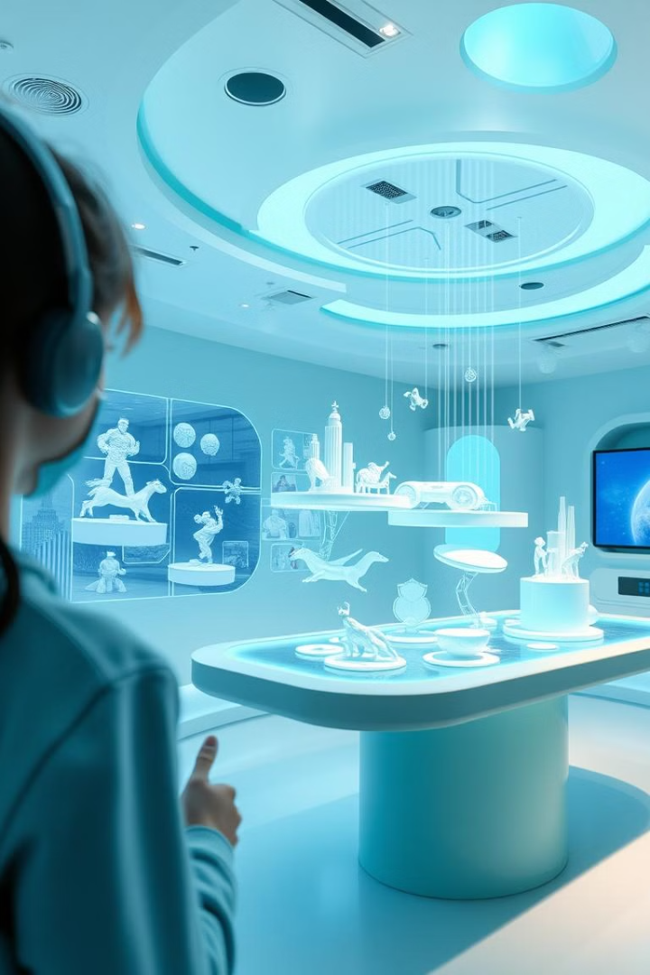
Computer Graphics and Design
Lecture 12
Digital manipulation of environments
Lecturer: Baya, Trevor.

Slide 2
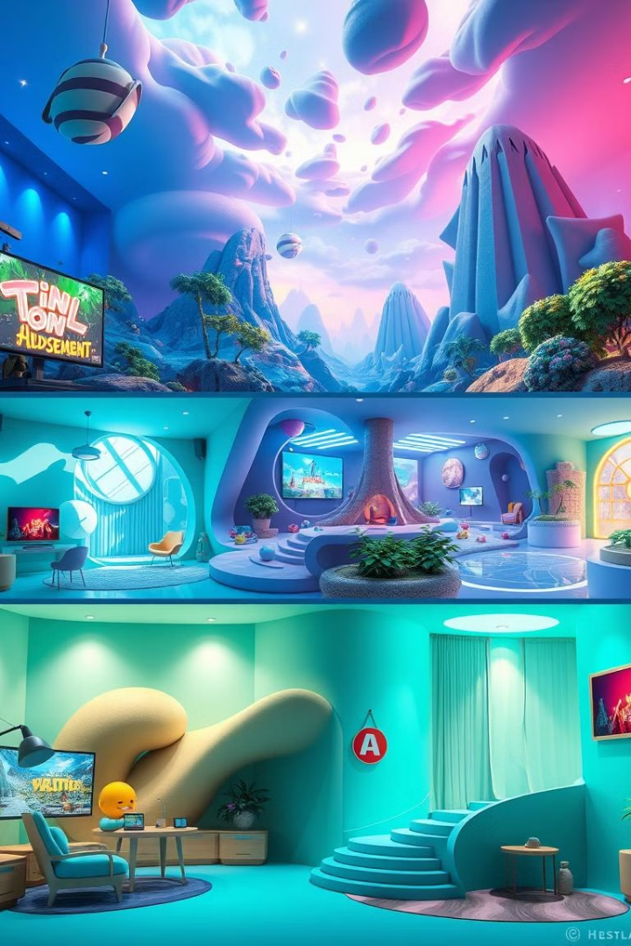
Lecture learning outcomes
Explain the Importance of Environment Design
  Articulate how digital environments contribute to storytelling, user immersion, and engagement across industries like gaming, film, VR/AR, architecture, and education.
Describe the Principles of Visual Language in Environment Design
  Identify elements that create a cohesive visual style and atmosphere, including color schemes, architectural choices, and stylistic consistency.
Apply Worldbuilding and Narrative Techniques in Environment Design
  Analyze how environment details, like object placement and structural wear, convey a space's history, purpose, and atmosphere, adding depth to the narrative.
Demonstrate Layout and Composition Skills for Virtual Environments
  Use composition principles and layout techniques to direct viewer focus and create navigable, immersive digital spaces.
Utilize Lighting and Rendering Techniques to Enhance Realism
  Apply lighting techniques, including dynamic and baked lighting, to set mood, simulate natural conditions, and improve visual appeal in rendered environments.
Integrate Post-Processing Effects for Enhanced Visuals
  Describe and use post-processing effects, such as color grading, bloom, and depth of field, to refine the final aesthetic and cinematic quality of digital scenes.

Slide 3
Lecture learning outcomes
Optimize Environments for Real-Time Applications
  Explain optimization strategies (e.g., LOD, occlusion culling, texture atlases) to ensure performance efficiency in environments used for games and VR/AR experiences.
Evaluate the Role of Interactivity and Animation in Immersive Design
  Understand how interactive elements and environmental animations enhance realism and user engagement, particularly in gaming and VR applications.
Select Appropriate Software Tools for Environment Design
  Identify and utilize key software for modeling, texturing, and rendering in environment design, including industry-standard tools such as Unreal Engine, Unity, and SpeedTree.
Designing and manipulating environments in computer graphics and design combines artistry, technical knowledge, and a deep understanding of how to create immersive worlds. Whether for video games, animated films, architectural visualization, or virtual reality experiences, environment design requires balancing realism and creativity.
The topic of Digital manipulation of environments in computer graphics is crucial because it lies at the heart of creating immersive, engaging, and visually compelling digital worlds. Environment design principles are applied across numerous industries and creative fields, each benefiting from designers who understand how to build spaces that convey mood, support storytelling, and enhance user experiences.

Slide 4
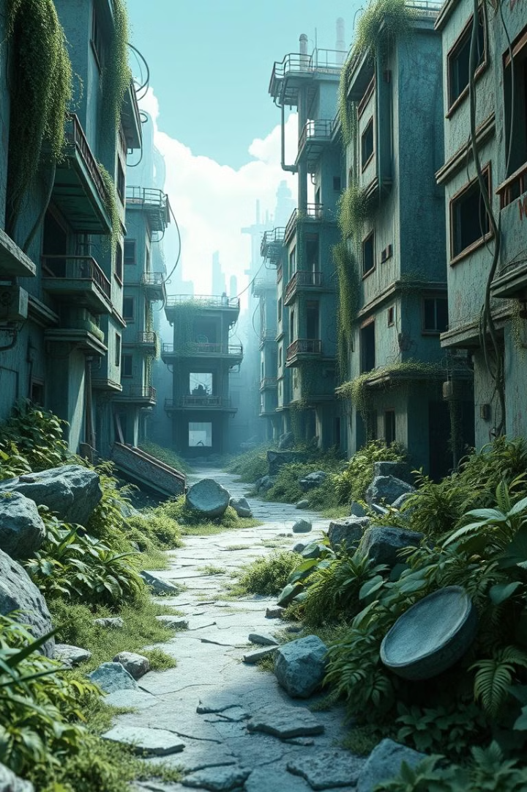
Applications
1. Video Games
  Immersion and Engagement: In video games, environments are not just backgrounds; they are interactive spaces where players explore, solve puzzles, and experience the game’s story. Well-designed environments enhance immersion, making players feel like part of a living, breathing world.
  Gameplay and Navigation: Environment designers help direct players, guiding their exploration and subtly indicating goals through visual cues like lighting, colors, and layout. A clear, well-thought-out environment supports intuitive navigation and enhances player satisfaction.
  Worldbuilding and Storytelling: In games, environments contribute significantly to storytelling. For instance, ruins and overgrown vegetation might tell players that an area has been abandoned for years, creating a narrative layer without dialogue.
2. Animation and Film
  Setting and Atmosphere: In animation and film, environments set the tone and provide visual context. They support the story by helping the audience understand the world in which the characters live, whether it’s a fantasy kingdom, a futuristic metropolis, or a quiet rural town.
  Visual Storytelling: Environments add layers of meaning to a scene. For example, a character’s messy room or a bleak, empty landscape can reflect their emotional state or challenges. This technique enhances the story’s impact and allows for subtle storytelling.
  Visual Continuity and Style: In animated films especially, environment designers create cohesive worlds by aligning the visuals of different locations with the film’s unique aesthetic. This builds continuity and helps viewers become immersed in a consistent style.

Slide 5
Applications
3. Virtual Reality (VR) and Augmented Reality (AR)
User Immersion and Presence: VR and AR environments need to be especially well-designed to make users feel as if they are truly within the space. Realistic, detailed environments with careful attention to scale, textures, and lighting enhance the sense of presence.
Interactive Experiences: In VR, users interact directly with their environment, so the design must accommodate realistic movement, interaction points, and 3D audio cues. Environments in AR applications also need to blend seamlessly with the real world, maintaining believability and functionality.
Training and Simulations: VR is used in training simulations across fields like healthcare, military, and aviation. Environment design here is vital to creating accurate, realistic settings that mimic real-world scenarios, allowing users to practice skills safely and effectively.
4. Architectural Visualization and Real Estate
Conceptualizing and Selling Designs: Environment design is essential in creating lifelike, 3D visualizations of buildings, interiors, and outdoor spaces. Clients, investors, and stakeholders can explore and understand architectural designs before they are built.
Interior and Landscape Planning: Environment design also includes accurately representing furniture, lighting, vegetation, and landscaping. This helps clients visualize the spatial arrangement and how various elements will come together in the completed space.
Virtual Tours and Showrooms: In real estate, virtual environments allow potential buyers to “walk through” a property remotely, gaining a realistic feel for the space. This is especially valuable for selling properties under construction or those located far away.

Slide 6
Applications
5. Product Design and Marketing
Contextual Product Visualization: In product marketing, placing products in a visually appealing environment can enhance their attractiveness. For example, a designer might place a piece of furniture within a 3D-rendered room to help customers visualize it in their own homes.
Interactive Marketing Campaigns: Designers create engaging virtual environments for immersive ad campaigns and product launches. For example, a brand may use a virtual showroom where customers can explore products in a dynamic, branded space.
Augmented Reality (AR) Product Previews: AR applications let customers preview products in real-life settings. For example, a customer could view how a new car would look in their driveway or how a sofa would fit in their living room, enhancing the shopping experience.
6. Education and Cultural Preservation
Historical and Cultural Reconstructions: Environment design helps recreate historical sites or cultural locations that no longer exist, allowing students, researchers, and the public to explore these spaces virtually. This is particularly valuable in archaeology and history education.
Immersive Educational Tools: Designers create interactive environments for educational simulations, where students can learn by exploring realistic settings. For instance, medical students may use VR to “walk through” the human body, learning about anatomy interactively.
Museum Exhibits and Interactive Displays: Museums use digital environments for interactive exhibits, allowing visitors to experience historical events or explore faraway locations. Environment design in this context provides engaging, memorable learning experiences.

Slide 7
Applications
7. Advertising and Experiential Marketing
Branded Virtual Spaces: In advertising, companies use environment design to create virtual branded spaces that people can explore as part of an interactive campaign. These spaces reinforce brand identity and create lasting connections with consumers.
Experiential Events and Immersive Pop-Ups: Brands often create temporary physical or virtual environments where people can interact with products in a unique setting. Environment designers play a key role in building immersive, experiential spaces that reflect the brand’s essence.
3D and Interactive Ad Experiences: With the growth of 3D ads and web-based interactive experiences, environment designers help create ad spaces that people can explore, whether for a game, movie, or retail campaign.
8. Artificial Intelligence and Machine Learning Applications
Training AI with Realistic Environments: In machine learning, AI models are often trained in virtual environments to teach them to recognize and interact with objects. For example, self-driving cars are tested in virtual simulations before being tested in real life.
Digital Twins and Simulations: Environment design is essential in creating digital twins—virtual replicas of physical spaces. These digital twins are used to simulate and analyze real-world conditions, making them valuable for city planning, manufacturing, and environmental management.

Slide 8
Applications
9. Science and Research
Simulating Natural Environments for Environmental Studies: Scientists use digital environments to simulate ecosystems, urban landscapes, or climate conditions to study the effects of changes in these settings.
Space Exploration and Virtual Training: Environment design helps create realistic simulations of alien planets, Mars habitats, or space stations, used for astronaut training, research, and public education on space exploration.
Why Environment Design Is Important
Visual Communication: Environments are powerful communication tools. They convey emotions, tell stories, and shape how people understand a scene.
Enhanced User Experience: In interactive fields, environment design enhances usability, guiding users and supporting intended interactions.
Engagement and Immersion: Environments create memorable, impactful experiences. Whether in a game or an ad, a well-designed environment holds users' attention.
Flexibility Across Industries: Skills in environment design apply to countless fields, from entertainment to education, making it a versatile, valuable field.
Overall, the knowledge and application of environment design principles empower designers to create spaces that are visually captivating, contextually relevant, and functionally optimized for their specific purpose.

Slide 9
Key areas in designing environments digitally.
1. Concept and Ideation
Research and References: Artists gather visual references and inspiration, often based on real-world environments, cultures, or historical settings. This informs the world’s design language, atmosphere, and architecture.
  Understanding the Project’s Needs: Designers start by examining the purpose and requirements of the environment. Is it for a fantasy game, a realistic historical simulation, or a futuristic sci-fi film? This purpose defines the overall direction.
  Gathering Real-World References: Artists study real-life locations, architecture, natural landscapes, and cultural artifacts to find visual and structural inspiration. For instance, if designing an ancient city, they might reference ruins, historical texts, and paintings.
  Analyzing Art and Design Styles: If the project has a specific visual style, such as stylized, hyper-realistic, or abstract, artists gather references that embody that look. Different stylistic choices impact color palettes, shapes, and even the level of deta
Mood Boards: A collection of images, colors, and styles to capture the environment’s intended look and feel, establishing a visual direction for the team.
    Creating Mood Boards: Mood boards help artists visually convey the intended look and feel of the environment. They compile images of color schemes, textures, lighting, architecture, and natural elements.
    Defining Visual Language and Aesthetics: The mood board clarifies the visual language, or the consistent style and tone that the environment should have. For example, a gothic environment may emphasize darker, colder colors and heavy, ornate architecture, while a jungle scene might feature vibrant colors, dense foliage, and dynamic lighting.
    Color Schemes and Palettes: Early color planning is crucial. Warm colors can create a welcoming or intense atmosphere, while cooler tones might make a scene feel serene or ominous. Artists often explore several palettes to find the best fit for the setting and mood.

Slide 10
Key areas in designing environments digitally.
Concept and Ideation
Storytelling and Worldbuilding: The environment should convey a story, with its design choices hinting at its history, purpose, and the culture of its inhabitants. Artists consider narrative elements to enhance immersion and detail.
    Defining the Environment’s History and Purpose: A compelling environment has a backstory, even if subtle. Artists imagine who built or inhabited the space, what events occurred there, and how time has affected it. This influences everything from architecture to wear and tear on objects.
    Character of the Environment: Every environment has a personality. A post-apocalyptic city might look abandoned, overgrown, and derelict, while a high-tech laboratory would be sterile and orderly. These characteristics give the viewer clues about the environment’s background.
    Narrative Elements in Design Choices: Objects and features within the environment can reveal parts of the story without words. For instance, a broken sword embedded in the ground might suggest a past battle, or a scattering of books and papers might imply abandonment.

Slide 11
Key areas in designing environments digitally.
2. Layout and Composition
Blocking Out Shapes: Using basic shapes to define the major forms and layout of the environment helps to plan space effectively before diving into detail.
Composition Principles: Composition guides how viewers experience the scene. Artists use lines, shapes, and colors to direct attention and create visual harmony.
Focal Points and Pathways: A well-designed environment has points of interest and visual cues to guide viewers or players through the space intuitively.
3. Modeling and Texturing
3D Modeling: Environments are constructed using 3D software (e.g., Blender, Maya, 3ds Max), where artists create the assets and structures. Organic shapes (like rocks or plants) might be sculpted in programs like ZBrush.
Textures and Materials: Textures add realism by simulating surface details. Artists use programs like Substance Painter or Photoshop to create texture maps, including color, normal, and roughness maps.
UV Mapping: UV mapping unwraps 3D models so that textures can be accurately applied. Seamless and optimized UVs are crucial for high-quality texturing.

Slide 12
Key areas in designing environments digitally.
4. Lighting and Rendering
Lighting for Atmosphere: Lighting plays a central role in setting mood and time of day. Artists adjust colors, intensity, and shadows to achieve effects like warm, natural sunlight or eerie, low-lit scenes.
Dynamic vs. Static Lighting: Depending on the use (game or film), lighting may be baked (static) or dynamic. Games often mix both to balance realism and performance.
Rendering Techniques: Ray tracing and global illumination simulate how light interacts with objects to produce realistic shadows, reflections, and ambient occlusion.
In environment design, lighting and rendering are crucial components that bring a scene to life, affecting its realism, mood, and overall aesthetic. Lighting determines how viewers perceive space, depth, and texture, while rendering translates the scene into a final image or sequence that can be used in film, games, or other media. Here’s an in-depth look at the roles of lighting and rendering, key techniques, and how they contribute to effective environment design.
Lighting for Atmosphere and Mood
Setting the Tone: Lighting is one of the most powerful tools for setting the mood of an environment. For example, bright, warm lighting can create a welcoming, cozy atmosphere, while dark, cold lighting can make a scene feel tense or ominous.
Color Temperature and Hue: The color of the light affects the emotional tone of the scene. Warm light (yellow/orange) tends to feel inviting and comforting, while cooler light (blue) often feels calm or even eerie. Adjusting these colors based on the scene’s context adds emotional depth.
Time of Day and Weather Effects: Natural lighting changes throughout the day. Morning light tends to be softer and warmer, while midday light is bright and harsh. Weather effects like fog, rain, or clouds diffuse the light, creating a softer, more muted scene, often adding a layer of moodiness or mystery.

Slide 13
Key areas in designing environments digitally.
4. Lighting and Rendering
Types of Lighting and Their Uses
Key Light: The primary light source, usually the brightest in the scene, which defines the main direction of lighting and casts the strongest shadows. It typically draws attention to the focal points and primary elements of the environment.
Fill Light: A softer, secondary light that reduces shadows created by the key light, providing more balanced illumination across the scene and preventing overly dark areas. It adds depth without detracting from the main light source.
Back Light/Rim Light: Placed behind or to the side of objects, rim lighting outlines the edges of objects, helping them stand out from the background. This is particularly useful for creating a sense of depth and separation.
Ambient Light: A soft, diffuse light that illuminates the entire scene without a specific source, simulating the light that bounces off surfaces. Ambient lighting is often used to provide a base level of illumination and set an underlying tone for the scene.

Slide 14
Key areas in designing environments digitally.
4. Lighting and Rendering
Lighting Techniques and Approaches
Global Illumination (GI): This advanced lighting model simulates how light bounces off surfaces to illuminate other objects, creating a more realistic and natural lighting effect. GI is crucial in scenes where indirect light is significant, like a room with sunlight streaming through a window.
Ray Tracing: Ray tracing calculates how light interacts with surfaces, producing realistic shadows, reflections, and refractions. Though computationally intensive, ray tracing is widely used in films and is becoming more feasible in real-time applications like games, thanks to advanced hardware.
Baked vs. Dynamic Lighting: Baked lighting pre-calculates light and shadow information, “baking” it into the scene for efficiency. This is used for static scenes or elements that don’t need to change. Dynamic lighting, by contrast, is calculated in real-time, allowing for moving light sources or changing environments, ideal for games.
Volumetric Lighting: Volumetric lighting simulates the way light interacts with particles like fog or dust, creating visible light rays or “god rays.” This technique is especially effective in scenes with mist, smoke, or dappled forest light, adding a sense of mystery or awe.

Slide 15
Key areas in designing environments digitally.
4. Lighting and Rendering
Shadows and Their Impact on Realism
Hard vs. Soft Shadows: Hard shadows, with sharp edges, usually result from a strong, direct light source like the sun. Soft shadows, which have blurred edges, occur when light is diffused or scattered, such as on a cloudy day. Using the right type of shadow adds realism and context.
Shadow Color and Opacity: Shadows are rarely pure black in real life; they carry subtle color from nearby objects and surfaces. Artists use slight color variations in shadows to add depth and realism, especially in outdoor scenes where light interacts with nature.
Ambient Occlusion (AO): AO is a technique used to enhance contact shadows where two surfaces meet. By darkening areas with limited light exposure, such as the corners of rooms or the undersides of objects, AO adds depth and makes the environment look more realistic.
Rendering Techniques and Styles
Realistic Rendering: This style aims to mimic real-world lighting and materials. Using high-quality textures, global illumination, and accurate lighting, realistic rendering is common in films, VR, and architectural visualization, where true-to-life visuals are desired.
Stylized Rendering: Often used in games and animated films, stylized rendering may exaggerate or simplify lighting and colors to achieve a particular look, such as a cartoonish or painterly effect. This technique is more about conveying a specific mood or art style than achieving realism.
Cel Shading: This technique gives 3D objects a flat, 2D look by using bold outlines and flat shading. Popular in certain types of animation and video games, cel shading creates a distinct, graphic novel-like style.
Path Tracing: A type of ray tracing that simulates even more complex light paths and interactions with surfaces, path tracing achieves highly realistic lighting but is even more computationally intensive than ray tracing. It’s often used in visual effects for film but is being explored in real-time applications with advanced GPUs.

Slide 16
Key areas in designing environments digitally.
4. Lighting and Rendering
Post-Processing Effects in Rendering
Color Grading and Correction: In post-processing, designers adjust colors, contrast, and saturation to enhance the final look. Color grading can help reinforce the mood, such as adding a blue tint to create a cold, dystopian feeling or a warm tint to evoke a sunny, inviting scene.
Bloom and Glow: This effect simulates the way light scatters when it interacts with bright areas, creating a soft glow around light sources. Bloom adds a sense of realism to bright lights, like neon signs or sunlight reflecting off water.
Depth of Field (DoF): DoF blurs areas outside the focal plane, mimicking the way real-world cameras focus on a subject. By blurring background or foreground elements, designers can direct attention to key areas in the scene.
Motion Blur: Motion blur simulates the blurring effect that occurs when an object moves quickly relative to the camera. This effect is commonly used in action scenes and adds dynamism to fast-moving elements.
Render Optimization for Real-Time Applications
Level of Detail (LOD): To maintain performance in real-time applications like games, artists use LOD techniques, where detailed models are replaced with simpler versions as they move farther from the viewer. This reduces the load on the graphics processor without sacrificing visual quality.
Optimized Shadows and Reflections: Instead of rendering full, complex shadows and reflections, designers often use simplified techniques like screen-space reflections and baked shadows for elements farther from the camera.
Efficient Use of Textures and Lighting: To ensure smooth performance, environment designers often use texture atlases, trim sheets, and tiling textures, as well as baked lighting for static objects. These techniques reduce processing demands while still maintaining a visually appealing scene.

Slide 17
Key areas in designing environments digitally.
5. Details and Set Dressing
Asset Placement: The environment is populated with objects and assets to bring it to life—furniture, plants, debris, and props that add layers of believability and story.
Attention to Detail: Small details like wear on surfaces, debris, and dirt make environments feel “lived in.”
Vegetation and Foliage: Using vegetation carefully enhances the natural elements of outdoor scenes. Tools like SpeedTree or built-in Unreal/Unity foliage systems assist in creating lifelike plants and trees.
6. Optimization and Performance
Optimization and Performance are vital considerations in environment design, particularly in real-time applications like video games, virtual reality (VR), augmented reality (AR), and interactive simulations. The goal is to create visually compelling environments that run smoothly on target hardware without sacrificing the user experience. Effective optimization ensures that the visuals maintain high quality while keeping the frame rate stable and reducing memory and computational load. Here’s a breakdown of key optimization techniques and their impact on performance:

Slide 18
Key areas in designing environments digitally.
6. Optimization and Performance
Geometry Optimization
Level of Detail (LOD): LOD is a technique where different versions of a model are created with varying levels of complexity (low to high polygon counts). As an object moves farther from the camera, a lower-detail version of the model is displayed, reducing the computational load. This technique is particularly useful for open-world environments where many objects may be on-screen at different distances.
Polygon Count Reduction: Artists optimize models by minimizing unnecessary polygons, especially for small or distant objects where high detail is not visible. Efficient use of geometry preserves visual quality while reducing the load on the graphics processor.
Occlusion Culling: This technique removes objects from the rendering pipeline that are not visible to the camera (such as objects hidden behind other objects). Occlusion culling reduces the number of draw calls and improves performance in complex scenes.
Texture Optimization
Texture Atlases and Trim Sheets: Instead of using multiple separate textures, a texture atlas combines several textures into a single image file. Trim sheets are a variation used to map repeating patterns or trim elements across multiple objects. These techniques reduce memory usage and draw calls, improving rendering speed.
Texture Resolution Reduction: Reducing the resolution of textures that are less visible (such as background elements or small props) decreases memory usage. High-resolution textures are only used where they are most visible, such as for large objects close to the camera.
Mipmapping: Mipmaps are pre-calculated, smaller versions of textures that display on distant objects, reducing texture detail where it is not needed. Mipmapping decreases aliasing and helps prevent textures from taking up excessive memory in distant views.

Slide 19
Key areas in designing environments digitally.
6. Optimization and Performance
Material and Shader Optimization
Simplified Shaders for Non-Essential Objects: Complex shaders can have significant performance costs, especially when they include multiple textures, reflections, or transparency effects. Simplified or combined shaders are used for objects where high-quality shading isn’t necessary, such as background elements.
Shader LOD: Similar to geometry LOD, shader LOD applies varying levels of shader complexity based on distance. For example, distant objects may not need complex lighting or shading effects like reflections, which can be omitted to improve performance.
Optimizing Transparency: Transparent surfaces, such as glass, water, or foliage, are computationally expensive to render because they require additional processing to blend with backgrounds. Limiting transparency and carefully placing transparent objects in the scene can reduce performance issues.
Lighting and Shadow Optimization
Baked Lighting: In static environments or for static objects, lighting can be “baked” into textures, meaning light information is pre-calculated and stored as part of the texture map. Baked lighting reduces the need for real-time calculations, freeing up resources for other tasks. This is often used for interior spaces or stable outdoor scenes.
Light LOD and Distance-Based Lighting: Real-time lights (dynamic lights) are only used where absolutely necessary, often with distance-based fading so that light sources disappear or reduce intensity at greater distances. This saves on computation without impacting visual quality at far distances.
Shadow Culling and Optimized Shadow Maps: Shadow culling ensures that only visible shadows are rendered. Lower resolution shadow maps can be used for distant objects, and shadow maps for closer objects are updated more frequently, optimizing memory usage and render time.

Slide 20
Key areas in designing environments digitally.
6. Optimization and Performance
Efficient Use of Draw Calls
Batching and Instancing: Batching combines similar objects into a single draw call, reducing the number of separate rendering requests the GPU has to process. Instancing duplicates the same object multiple times, which is useful for environments with many identical elements (e.g., trees or rocks) without significantly increasing memory use.
Reducing Overdraw: Overdraw occurs when multiple layers of pixels are rendered on top of each other, which can slow down performance. Techniques such as layering the scene from front to back and avoiding overlapping transparent textures help reduce overdraw, making the rendering pipeline more efficient.
Physics Optimization
Efficient Collision Detection: Physics calculations can be computationally expensive, especially in scenes with many objects. Simplifying collision shapes (using bounding boxes or spheres instead of detailed models) for objects that don’t require precise collision detection can reduce processing time.
Using Static Physics Objects: Static objects that don’t need to move or interact with other elements are excluded from ongoing physics calculations, reducing unnecessary computations. This is common for parts of the environment that serve as background or scenery.
Limiting Real-Time Physics Effects: Real-time physics, like cloth simulation or fluid dynamics, are restricted to objects where they are essential to gameplay or visual fidelity. Pre-simulated animations or simplified physics can achieve similar effects with less impact on performance.

Slide 21
Key areas in designing environments digitally.
6. Optimization and Performance
Optimizing for Specific Platforms
Targeting Platform-Specific Constraints: Different platforms (e.g., console, PC, mobile) have varying performance capabilities. Designers often create multiple versions of assets and effects for different platforms, adjusting quality based on hardware limitations. For example, mobile games may use lower-poly models, lower-resolution textures, and simplified shaders.
Dynamic Quality Scaling: Dynamic quality scaling adjusts graphics settings (like resolution or shader quality) in real-time based on the device’s performance to maintain a stable frame rate. This ensures a consistent experience on both high- and low-end devices without requiring separate builds.
Post-Processing Optimization
Selective Post-Processing Effects: Post-processing effects like bloom, depth of field, motion blur, and color correction are computationally expensive. By limiting these effects to where they are visually necessary, designers avoid excessive performance costs.
Reducing Depth of Field and Motion Blur: Effects like depth of field and motion blur can add realism but are used sparingly, especially in performance-constrained applications. Alternatives like simpler blur effects or selective DoF are used to achieve similar results with less processing.
Optimized Ambient Occlusion and Bloom: Ambient occlusion adds depth by simulating how light interacts in crevices and between objects, while bloom adds a soft glow to bright areas. Using simplified versions or lower-quality settings of these effects in the distance or on less important objects conserves resources.

Slide 22
Key areas in designing environments digitally.
6. Optimization and Performance
Memory Management and Asset Streaming
Asset Streaming: In large environments, only the assets near the camera are loaded into memory, while distant assets are loaded as needed. This is common in open-world games, where streaming assets based on camera proximity reduces memory usage and load times.
Texture Streaming and Mipmaps: Texture streaming loads high-resolution textures only when needed, such as when objects are close to the camera. Mipmaps are used to scale textures down at a distance, ensuring that memory is used efficiently without sacrificing detail up close.
Memory Pooling and Recycling: By reusing and recycling objects or assets (especially in scenes with many repeating elements), designers prevent excessive memory allocation, minimizing lag and improving overall stability.
Testing and Profiling for Optimization
Performance Profiling: Designers use profiling tools to measure frame rates, memory usage, and GPU/CPU load, identifying bottlenecks and areas for improvement. This feedback helps optimize specific aspects of the scene, such as adjusting complex shaders, simplifying models, or reducing high-density textures.
Stress Testing: By simulating the maximum number of objects, effects, and interactions a scene might encounter, stress testing reveals potential performance issues. It helps developers set quality limits and ensures the environment remains stable under different conditions.
Iterative Optimization and Fine-Tuning: Continuous testing and iterative improvements allow designers to balance visual quality and performance, making gradual adjustments to find the best possible settings for the target platform.

Slide 23
Key areas in designing environments digitally.
6. Optimization and Performance
Why Optimization and Performance Matter in Environment Design
Maintaining Frame Rate: For real-time applications, a consistent frame rate (typically 30+ fps for consoles and 60+ fps for PC/VR) is critical for smooth gameplay and user comfort. Poor frame rates can lead to discomfort in VR and frustrate players or viewers in interactive applications.
User Experience: Optimized environments load faster, run more smoothly, and feel more immersive. Users are less likely to notice stuttering, lag, or other technical issues, allowing them to engage fully with the content.
Device Compatibility: Optimization allows designers to reach a broader audience, making it possible for environments to run on various devices without requiring the latest, most powerful hardware.
Efficient Resource Usage: Optimized environments use less memory and processing power, reducing power consumption, especially in mobile and VR applications where battery life is a concern.
Conclusion
Optimizing performance in environment design is essential to balancing visual quality with technical efficiency. By applying these optimization techniques, designers can create rich, immersive environments that run smoothly across platforms and provide the best possible experience for users. Through careful planning, testing, and fine-tuning, optimized environment design becomes both an art and a science, contributing to more engaging, accessible, and reliable digital experiences.

Slide 24
Key areas in designing environments digitally.
7. Post-Processing and Effects
Post-Processing and Effects are essential in refining the final look and feel of an environment, adding cinematic qualities and enhancing immersion. In environment design for games, films, or interactive applications, post-processing effects can create mood, guide viewer focus, and give the scene a polished and cohesive look. These effects are applied after the initial rendering of the scene and include techniques like color grading, bloom, motion blur, and more. Here’s a closer look at the various types of post-processing and effects, their purposes, and how they’re implemented.
Color Grading and Color Correction
Purpose: Color grading enhances the mood, tone, and overall visual style of a scene. It adjusts the colors, contrast, brightness, and saturation to create a unified look.
Techniques: Designers often apply LUTs (Look-Up Tables) to achieve consistent color grading across scenes, similar to filters used in photography. They might use warm tones for a sunny, inviting scene or cooler tones for a dark, eerie setting.
Application: Color correction is especially useful for achieving visual consistency across multiple shots, scenes, or environments, helping viewers or players feel immersed in a cohesive world.
Bloom and Glow
Purpose: Bloom simulates the way bright light sources bleed into their surroundings, creating a soft glow around them. This adds realism and a cinematic feel, particularly for intense light sources like the sun, neon lights, or reflective surfaces.
Techniques: Bloom intensity is carefully controlled to avoid overwhelming the scene. Sometimes, designers add subtle lens dirt overlays to enhance the effect when light shines directly into the virtual “camera.”
Application: Bloom is used in scenes with high-intensity lights to evoke a dreamy or ethereal look and is popular in sci-fi or fantasy settings to give environments a surreal, vibrant quality.

Slide 25
Key areas in designing environments digitally.
7. Post-Processing and Effects
Depth of Field (DoF)
Purpose: Depth of field mimics the way cameras focus on a subject, blurring background or foreground elements to direct viewer attention. It gives the scene a sense of depth and dimensionality.
Techniques: Artists can adjust the focal plane and range, blurring parts of the scene based on their distance from the “camera.” This effect works well in first-person games or cinematic sequences.
Application: Depth of field is commonly used in close-up shots to focus on character details or specific objects, or in landscape scenes to create a soft, distant background.
Motion Blur
Purpose: Motion blur replicates the blurring effect seen in real-world cameras when objects move quickly. It adds dynamism to fast-moving scenes or elements, making motion feel smoother and more natural.
Techniques: Motion blur can be applied to the entire frame (global motion blur) or selectively to objects in motion (object-based motion blur). Its intensity is adjusted based on the speed of movement, ensuring it enhances rather than detracts from visibility.
Application: Motion blur is widely used in action scenes or sequences involving rapid camera movement to emphasize speed, add realism, and smooth out frame transitions.
Ambient Occlusion (AO)
Purpose: Ambient occlusion adds depth to a scene by simulating the way light behaves in tight or enclosed spaces. It darkens areas where objects meet or where light is occluded, such as in crevices or under objects.
Techniques: Different types of AO exist, including Screen-Space Ambient Occlusion (SSAO) and Ray-Traced Ambient Occlusion (RTAO). SSAO is faster but less precise, while RTAO produces more realistic results but is computationally intensive.
Application: AO is used to enhance realism by adding subtle shadows, giving objects and surfaces a more grounded and connected appearance in the environment.

Slide 26
Key areas in designing environments digitally.
7. Post-Processing and Effects
Screen-Space Reflections (SSR)
Purpose: Screen-space reflections simulate reflective surfaces by reflecting parts of the screen within a specific view, enhancing realism, particularly in environments with water, glass, or metallic surfaces.
Techniques: SSR is typically faster than ray-traced reflections but has limitations, such as only reflecting objects visible on-screen. Designers adjust the reflection intensity, quality, and coverage to balance performance with visual fidelity.
Application: SSR is commonly applied in urban scenes with wet or reflective surfaces, like rain-soaked streets or shiny floors, to increase realism without significantly impacting performance.
Lens Flare and Light Shafts (God Rays)
Lens Flare: This effect mimics the way light scatters in real camera lenses, creating flare patterns when the viewer looks directly at a bright light source. Lens flares are often seen in sci-fi or futuristic environments, adding a cinematic effect.
Light Shafts/God Rays: God rays simulate beams of light passing through particles like fog, smoke, or dust, creating a striking, volumetric effect. This effect is used to emphasize lighting from a single source, such as sunlight streaming through trees or a window.
Application: Lens flares and god rays add drama and depth to a scene, making it feel more immersive and atmospheric. They are common in outdoor scenes with direct sunlight or in cinematic sequences that aim to convey intensity or grandeur.
Volumetric Lighting and Fog
Purpose: Volumetric lighting and fog simulate the scattering of light through particles in the atmosphere, creating depth, ambiance, and mystery in a scene.
Techniques: Volumetric lighting calculates how light interacts with particles in the air, while fog is typically applied as a volumetric effect that fades objects based on distance from the camera. Artists can control density, color, and falloff to achieve various atmospheric effects.
Application: These effects are used in scenes with low visibility, like dense forests, caves, or smoky interiors, adding realism, atmosphere, and a sense of immersion.

Slide 27
Key areas in designing environments digitally.
7. Post-Processing and Effects
Chromatic Aberration
Purpose: Chromatic aberration mimics a lens artifact that separates colors at the edge of the frame, creating a subtle RGB “fringe” effect. It adds a sense of imperfection and realism.
Techniques: Artists apply chromatic aberration to specific areas or around the edges of the screen to avoid distracting viewers. It’s often used in combination with other effects to enhance cinematic quality.
Application: Chromatic aberration is popular in sci-fi, horror, and thriller genres, giving environments a surreal or distorted look that heightens tension and immersion.
Vignette
Purpose: Vignette darkens the edges of the screen, subtly focusing attention toward the center and creating a sense of intimacy or isolation.
Techniques: Artists control the intensity, shape, and size of the vignette to achieve the desired effect without drawing too much attention. A strong vignette can create a feeling of closeness or claustrophobia.
Application: Vignette is often used in first-person games, horror settings, and cinematic sequences to direct focus and create a sense of enclosure or mystery.
Anti-Aliasing (AA)
Purpose: Anti-aliasing smooths out the jagged edges on diagonal lines, making objects appear smoother and less pixelated, which is especially important for high-resolution displays.
Techniques: Various methods of anti-aliasing exist, such as FXAA (Fast Approximate Anti-Aliasing), MSAA (Multi-Sample Anti-Aliasing), and TAA (Temporal Anti-Aliasing). TAA is particularly popular in modern games due to its ability to smooth motion across frames.
Application: Anti-aliasing is essential for achieving a polished look and preventing visual artifacts, especially in scenes with detailed geometry and high contrast.

Slide 28
Key areas in designing environments digitally.
7. Post-Processing and Effects
Noise and Film Grain
Purpose: Adding noise or film grain introduces a subtle texture to the scene, emulating the look of older film or analog media. It’s commonly used for stylistic or nostalgic purposes.
Techniques: Designers adjust the grain intensity to achieve a natural look without overwhelming the scene, often pairing it with color grading for a vintage or gritty appearance.
Application: Film grain is used in horror or post-apocalyptic settings to evoke tension or realism and is common in scenes that aim for a cinematic or retro aesthetic.
Screen Effects (Distortion, Edge Detection)
Distortion Effects: Distortion simulates lens effects like fisheye, ripple, or heatwave effects. These are often applied in specific scenes or on elements like water surfaces or heat-emitting objects.
Edge Detection: This effect enhances or outlines edges, creating a unique stylized look (often used in cel-shaded or comic-style visuals). Edge detection can be applied to achieve stylized or illustrative visual styles.
Application: Distortion and edge effects are often used in specific scenarios, like underwater or “dream” sequences, to make environments feel unusual or surreal.

Slide 29
Key areas in designing environments digitally.
8. Interactivity and Animation (For Games and VR)
Interactive Elements: Environments for games and VR often incorporate interactive features like destructible objects, doors, or light switches, adding engagement.
Environmental Animation: Moving elements (like trees swaying, waterfalls, or animals) make the environment feel alive and responsive.
Sound Design: Ambient sound adds another layer to the environment. Sounds like rustling leaves, distant water, or birdsong create an immersive experience.
9. Environment Design Tools and Software
3D Modeling Software: Blender, Maya, and 3ds Max are common for asset creation and modeling.
Texturing Tools: Substance Painter, Substance Designer, and Photoshop.
Game Engines: Unity, Unreal Engine, and CryEngine are popular for interactive environments, allowing for lighting, interactivity, and animation.
Other Tools: Programs like Quixel Megascans offer high-quality scanned assets, while tools like SpeedTree help create complex foliage.
10. Final Touches and Polish
Playtesting and Adjustments: In interactive media, designers test the environment to ensure playability and enjoyment. Adjustments are made to fix any issues or enhance visuals.
Artistic Touches: Final touches, like color grading and adjusting composition, ensure that the environment aligns with the overall style and aesthetic of the project.
Environment design is a complex, iterative process that merges art with technology, creating virtual spaces that captivate and transport viewers.

Slide 30
Visual Language in Environment Design
Color Schemes
Architectural Choices
Stylistic Consistency
Colors set mood and atmosphere. Warm tones create welcoming environments, while cool tones evoke calm or eeriness.
Architecture defines space and era. Gothic structures create different feelings than modern minimalist designs.
Maintaining a cohesive style throughout the environment ensures immersion and believability.

Slide 31
Importance of Environment Design
1
Storytelling
Environments convey narrative and atmosphere, enhancing user immersion across industries.
2
User Engagement
Well-designed environments captivate audiences in games, films, and VR experiences.
3
Industry Applications
Environment design is crucial in gaming, film, VR/AR, architecture, and education.

Slide 32
Worldbuilding and Narrative Techniques
1
Object Placement
Strategically placed objects tell stories about the environment's inhabitants and history.
2
Structural Wear
Adding wear and tear to structures conveys age and lived-in qualities.
3
Environmental Storytelling
Subtle details in the environment can hint at past events or future possibilities.

Slide 33
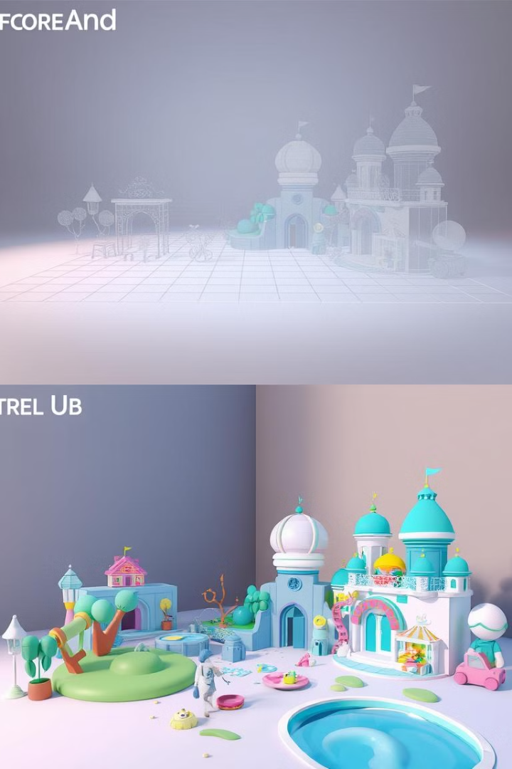



Layout and Composition
Blocking Out Shapes
Start with basic shapes to define major forms and layout.
Composition Principles
Use lines, shapes, and colors to guide viewer attention and create harmony.
Focal Points
Create points of interest to guide viewers through the space intuitively.

Slide 34
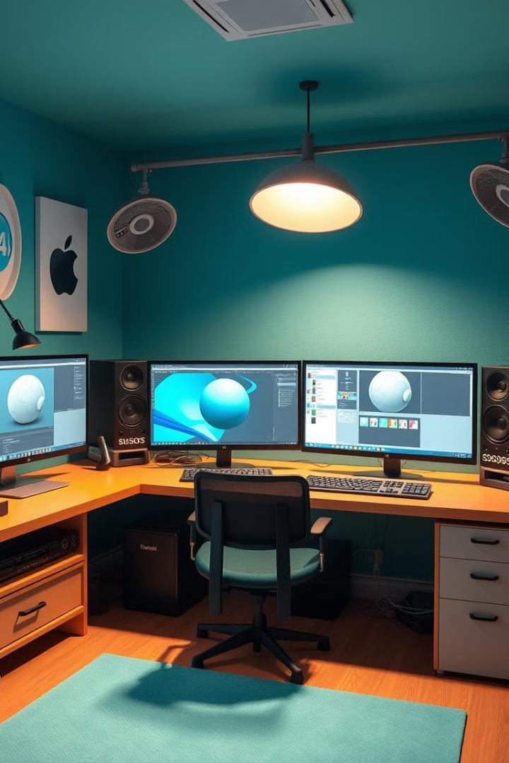
Modeling and Texturing
3D Modeling
Blender, Maya, 3ds Max
Texturing
Substance Painter, Designer, Photoshop
UV Mapping
Essential for accurate texture application

Slide 35
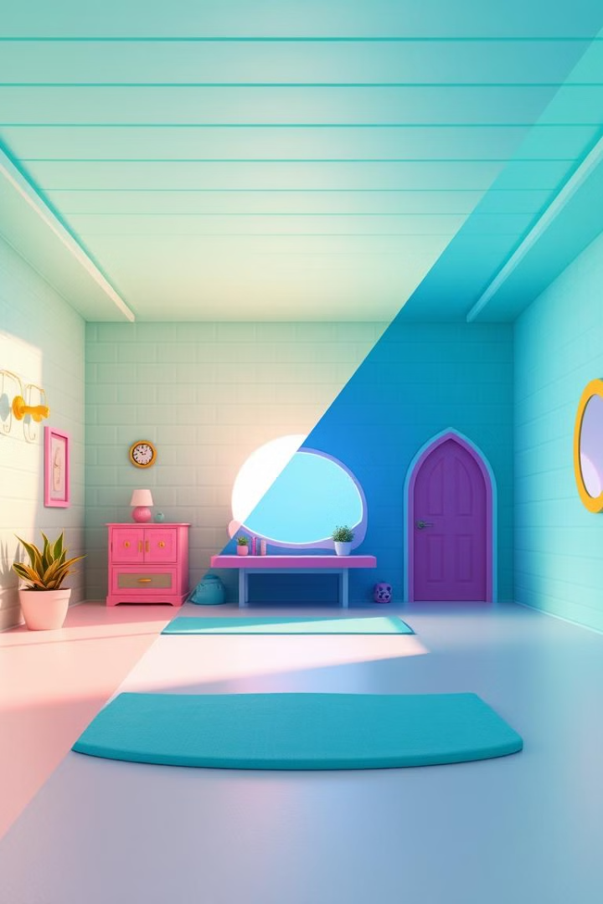
Lighting and Rendering
Lighting for Atmosphere
Lighting sets mood and time of day, crucial for environment ambiance.
Dynamic vs. Static Lighting
Choose between baked (static) or real-time (dynamic) lighting based on project needs.
Rendering Techniques
Use ray tracing and global illumination for realistic light interactions.

Slide 36
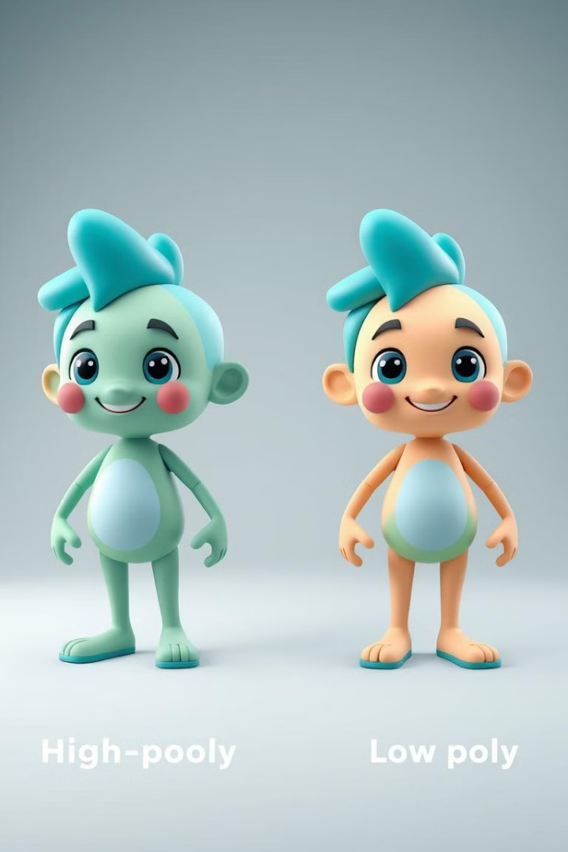



Optimization and Performance
Level of Detail (LOD)
Use simplified models for distant objects to improve performance.
Asset Optimization
Optimize textures and geometry to reduce memory usage and improve frame rates.
Occlusion Culling
Render only visible objects to reduce unnecessary processing.

Slide 37
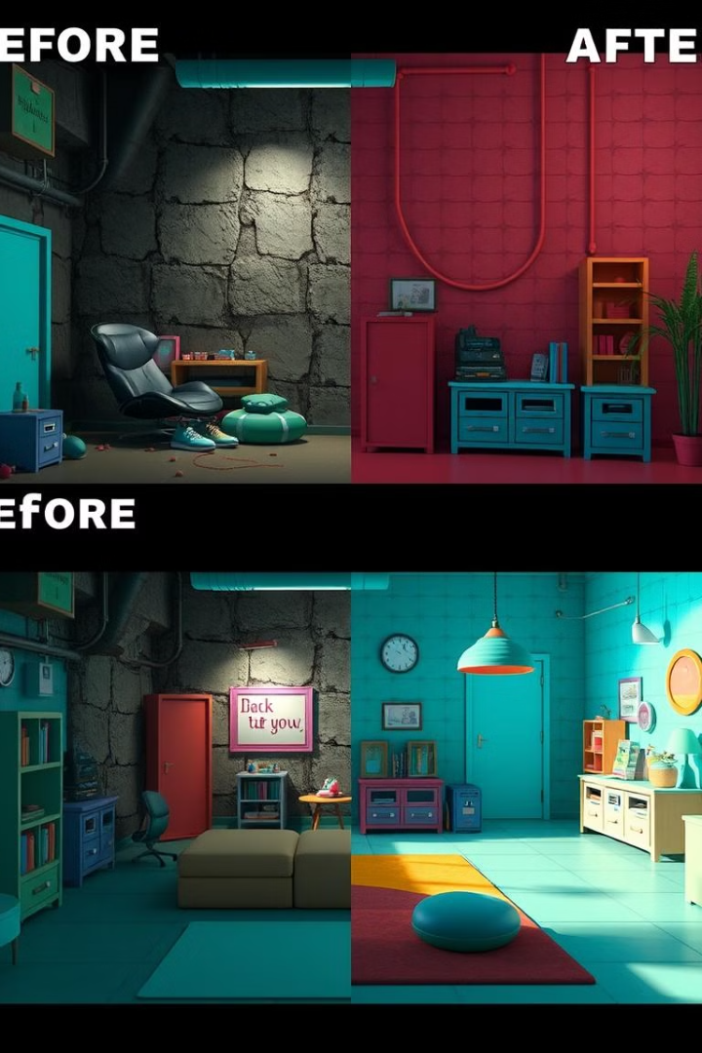
Post-Processing and Effects
1
Color Grading
Adjust colors to enhance mood and create a cohesive visual style.
2
Bloom and Depth of Field
Add realism and focus viewer attention with these cinematic effects.
3
Ambient Occlusion
Enhance depth by simulating how light behaves in tight spaces.

Slide 38
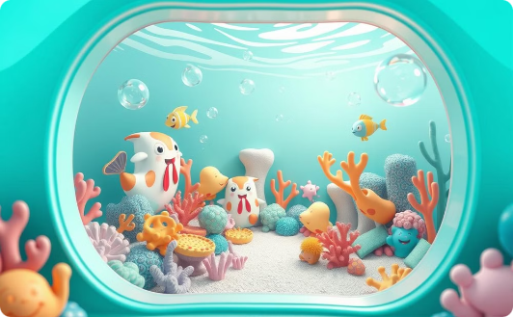
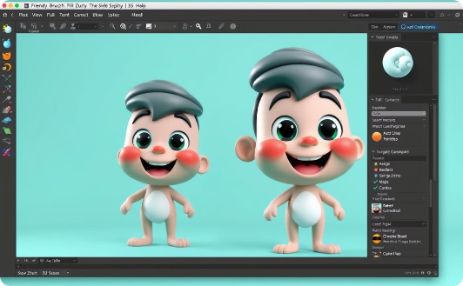

Environment Design Tools
Game Engines
Sculpting Tools
Specialized Software
Unity and Unreal Engine are popular for interactive environments.
ZBrush and Mudbox allow for detailed asset creation.
Tools like SpeedTree help create complex foliage efficiently.

Slide 39
References:
"Digital Art Fundamentals," Robin Landa, Open Textbook Library, 2020.
"Introduction to Graphic Design," Richard Hollis, Open Library, 2013.
"The Elements of Graphic Design," Alex W. White, Internet Archive, 2011.
"Computer Graphics: Principles and Practice," John F. Hughes et al., MIT OpenCourseWare, 2006.

