Slide 1
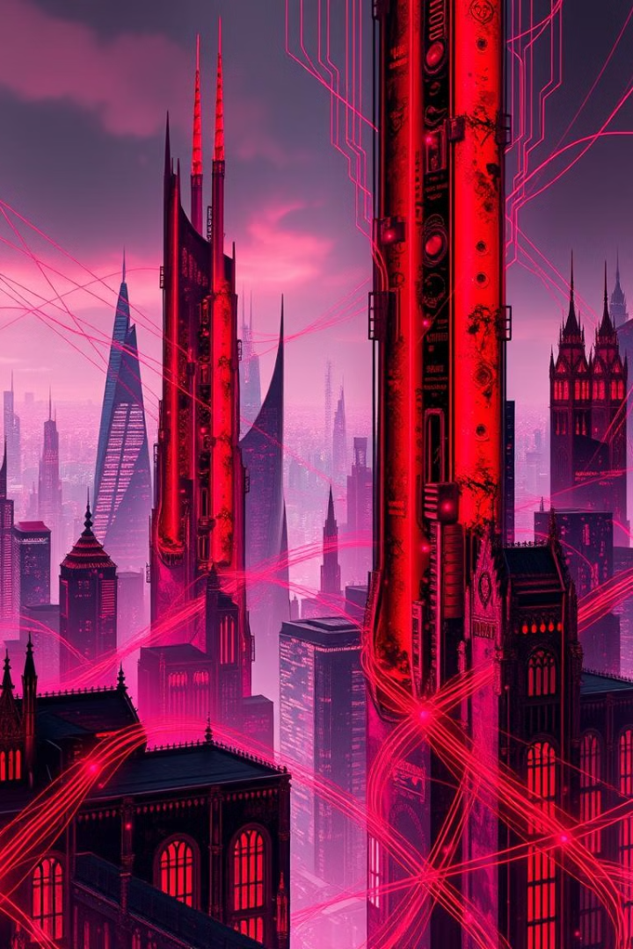
Computer Graphics and Design
Lecture 13
Computer graphics and design summary and review
Lecturer: Baya, Trevor.

Slide 2
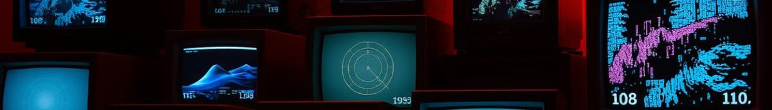
Lecture learning outcomes
Review Fundamental Concepts: Summarize key concepts in computer graphics and design, including 2D and 3D graphics, rendering, and animation principles.
Historical Development: Recall significant milestones in the evolution of computer graphics from early line drawings to advanced CGI and virtual/augmented reality applications.
Identify Core Technologies: Identify essential technologies in computer graphics, such as graphics hardware, modeling software, and rendering techniques.
Apply Common Terminology: Demonstrate understanding of common terminology and principles in computer graphics, including aspects of design, color theory, and terminology related to rendering and modeling.
Evaluate Applications of Computer Graphics: Analyze the applications of computer graphics across various industries, such as entertainment, scientific visualization, and virtual simulations.
Utilize Principles and Elements of Design: Apply the fundamental elements and principles of design—balance, contrast, emphasis, and rhythm—in creating visually appealing graphics.
Understand Photoshop Tools and Techniques: Summarize essential Photoshop tools and functionalities, including layers, masks, and advanced photo manipulation techniques.

Slide 3
Introduction to Computer Graphics
Computer graphics is a vital field that integrates technology and creativity, enabling the visualization of information and the creation of images through computational means. This paper provides a comprehensive overview of computer graphics, detailing its historical development, core concepts, key technologies, and its diverse applications across various industries.
1. Historical Development
The origins of computer graphics can be traced back to the 1960s when researchers began exploring ways to visually represent data using computers. Early graphical displays were limited to simple line drawings, which eventually evolved into more complex raster graphics and vector graphics. Key milestones include the development of the first computer-generated imagery (CGI) in films during the 1970s and the introduction of graphical user interfaces (GUIs) in personal computing in the 1980s. The field has since expanded dramatically, influenced by advancements in hardware, software, and graphics algorithms.

Slide 4
Core Concepts in Computer Graphics
2D Graphics
3D Graphics
Involves creation and manipulation of images on a two-dimensional plane. Key techniques include rasterization, vectorization, and image rendering. 2D graphics are fundamental for digital art, user interfaces, and web design.
Encompasses creation of three-dimensional representations using modeling techniques like polygonal modeling, spline modeling, and NURBS. 3D graphics require consideration of perspective, shading, and lighting to create realistic images.

Slide 5
Introduction to Computer Graphics
2. Core Concepts
Computer graphics can be categorized into two main types: 2D graphics and 3D graphics.
2D Graphics involve the creation and manipulation of images on a two-dimensional plane. Techniques such as rasterization, vectorization, and image rendering are fundamental to producing 2D images.
3D Graphics encompass the creation of three-dimensional representations of objects using modeling techniques, which include polygonal modeling, spline modeling, and NURBS (Non-Uniform Rational B-Splines). 3D graphics require additional considerations such as perspective projection, shading, and lighting to create realistic images.
3. Key Technologies
Several key technologies underlie the field of computer graphics:
Graphics Hardware: Modern graphics processing units (GPUs) are designed specifically for rendering images, capable of performing parallel processing to enhance performance and efficiency.
Rendering Techniques: Algorithms such as ray tracing and rasterization are crucial for converting 3D models into 2D images. Ray tracing simulates the way light interacts with objects, producing highly realistic images, while rasterization converts 3D data into pixels on a screen.
Modeling Software: Programs like Blender, Maya, and 3ds Max enable artists and designers to create detailed 3D models and animations, integrating various tools for texturing, rigging, and animation.

Slide 6
Introduction to Computer Graphics
4. Applications
Computer graphics find applications in numerous fields:
Entertainment: In film and video games, computer graphics are essential for creating immersive environments and character animations. Techniques such as motion capture and CGI have transformed the entertainment industry.
Simulations: Industries like aviation and medicine utilize computer graphics for simulation training, allowing users to engage with realistic scenarios in a controlled environment.
Scientific Visualization: Researchers employ computer graphics to visualize complex data sets, making it easier to interpret results and communicate findings effectively.
Virtual and Augmented Reality: These technologies leverage computer graphics to create immersive experiences that blend real-world and digital content.
5. Conclusion
Computer graphics is a dynamic and continually evolving field that significantly impacts various industries. Its ability to visually communicate information and create compelling experiences underscores its importance in the modern world. As technology advances, the potential applications of computer graphics will expand further, paving the way for innovative solutions and creative expressions.

Slide 7
Common Terminology in Computer Graphics and Design
Understanding the common terminology in computer graphics and design is essential for effective communication among professionals in the field. This paper aims to define and explain key terms used in computer graphics, including concepts related to rendering, modeling, and design processes. By familiarizing oneself with this vocabulary, individuals can better grasp the intricacies of graphic design and the technologies involved in creating visual content.
1. Basic Concepts
Pixel: The smallest unit of a digital image, representing a single point in a raster image. Pixels combine to form the overall image, with each pixel containing information about color and brightness.
Resolution: Refers to the number of pixels in an image, usually expressed as width × height (e.g., 1920 × 1080). Higher resolution images have more pixels and can display finer details.
Aspect Ratio: The ratio of the width of an image to its height. Common aspect ratios include 16:9 for widescreen formats and 4:3 for standard displays. Maintaining the correct aspect ratio is crucial for avoiding distortion in visual presentations.

Slide 8
Common Terminology in Computer Graphics and Design
2. Graphics Types
Raster Graphics: Images composed of a grid of pixels. They are resolution-dependent, meaning they lose quality when scaled. Common formats include JPEG, PNG, and GIF.
Vector Graphics: Images created using mathematical equations to define shapes. Unlike raster graphics, vector graphics are resolution-independent and can be scaled without loss of quality. Common formats include SVG and EPS.
3D Model: A mathematical representation of a three-dimensional object, defined by vertices, edges, and faces. 3D models are used in various applications, including gaming, simulations, and animations.

Slide 9
Common Terminology in Computer Graphics and Design
3. Rendering Techniques
Rendering: The process of generating a 2D image from a 3D model by calculating lighting, shading, and texture details. Rendering can be done in real-time (as in video games) or offline (as in animated films).
Ray Tracing: A rendering technique that simulates the way light interacts with objects by tracing rays from the viewer’s perspective back to light sources. This technique produces highly realistic images but is computationally intensive.
Shading: The process of adding color, brightness, and texture to a surface in a rendered image. Common shading techniques include flat shading, Gouraud shading, and Phong shading.

Slide 10
Common Terminology in Computer Graphics and Design
4. Design Terminology
Typography: The art and technique of arranging type to make written language legible, readable, and visually appealing. It involves choosing font styles, sizes, spacing, and alignment.
Composition: The arrangement of visual elements within a design. Good composition guides the viewer’s eye and creates a balanced, aesthetically pleasing image.
Color Theory: A set of principles used to understand how colors interact, including concepts such as complementary colors, analogous colors, and color harmony. Color theory is essential for effective design and visual communication.
5. Animation and Motion Graphics
Frame Rate: The number of individual frames displayed per second in a video or animation. Common frame rates include 24 fps for film and 30 fps for television. Higher frame rates result in smoother motion.
Keyframe: A frame in an animation that marks the start or end point of a smooth transition. Keyframes are used to define motion and properties (like position, scale, and rotation) over time.
Tweening: The process of generating intermediate frames between two keyframes to create the illusion of smooth motion. This can be done automatically by software or manually by the animator.

Slide 11
Common Terminology in Computer Graphics and Design
6. Conclusion
Familiarity with the common terminology in computer graphics and design is vital for professionals and enthusiasts alike. A solid understanding of these terms enhances communication, collaboration, and creativity within the field. As technology advances, the vocabulary may evolve, but these foundational terms will continue to underpin the discipline.

Slide 12
Elements of Design
The elements of design serve as the fundamental building blocks in creating effective visual compositions across various mediums, including graphic design, web design, and fine arts. This paper explores the primary elements of design—line, shape, color, texture, space, form, and value—elaborating on their individual characteristics and collective impact on visual communication.
1. Line
Definition: A line is a one-dimensional mark that connects two points. It can vary in width, length, and direction, playing a crucial role in guiding the viewer’s eye across a composition.
Types of Lines:
Straight Lines: Often convey stability and order.
Curved Lines: Suggest movement and fluidity, creating a more dynamic composition.
Diagonal Lines: Indicate action or tension, leading the viewer’s attention.
Application: Lines can define shapes, create patterns, and direct movement within a design. They establish the framework for more complex elements and influence the overall mood of a piece.

Slide 13
Elements of Design
2. Shape
Definition: A shape is a two-dimensional area defined by boundaries, such as lines or color changes. Shapes can be geometric (squares, circles) or organic (free-form, irregular).
Types of Shapes:
Geometric Shapes: Characterized by precise and uniform measurements, conveying a sense of order.
Organic Shapes: Derived from nature, these shapes are often more fluid and less predictable, evoking a sense of softness.
Application: Shapes are used to create visual interest, organize content, and define areas within a design. They can represent objects, symbols, and ideas, impacting the viewer's perception.

Slide 14
Elements of Design
3. Color
Definition: Color is the aspect of design that involves hue, saturation, and brightness. It has the power to evoke emotions, convey messages, and enhance aesthetics.
Color Properties:
Hue: The name of the color (e.g., red, blue).
Saturation: The intensity or purity of a color; highly saturated colors are vivid, while desaturated colors appear muted.
Value: The lightness or darkness of a color, influencing the overall contrast in a design.
Application: Color theory plays a crucial role in design, guiding choices about color combinations, contrasts, and harmonies to achieve desired effects and communicate effectively.

Slide 15
Elements of Design
4. Texture
Definition: Texture refers to the surface quality of an object, which can be perceived visually or through touch. It adds depth and interest to a design.
Types of Texture:
Tactile Texture: The physical feel of a surface (smooth, rough).
Visual Texture: An illusion of texture created through techniques such as patterns or shading.
Application: Texture can enhance the sensory experience of a design, contributing to its overall appeal and helping to establish a mood or atmosphere.

Slide 16
Elements of Design
5. Space
Definition: Space refers to the area around, between, and within objects. It is a crucial element that can influence composition, balance, and focus in design.
Types of Space:
Positive Space: The areas occupied by objects or shapes in a design.
Negative Space: The empty space around and between objects, which can create a sense of balance and highlight the positive space.
Application: Effective use of space can lead to clarity and emphasis in design, helping to create a hierarchy of information and guiding the viewer’s eye.

Slide 17
Elements of Design
7. Value
Definition: Value refers to the lightness or darkness of a color, affecting the contrast and depth within a design. It plays a critical role in establishing mood and dimension.
Application: Value can be used to create emphasis, direct attention, and enhance the three-dimensionality of shapes and forms. High contrast between light and dark areas can produce dramatic effects, while subtle variations can evoke softness.
8. Conclusion
The elements of design are integral to effective visual communication and composition. Mastering these elements allows designers to create compelling visuals that engage audiences, convey messages, and enhance user experiences. As design continues to evolve with technology, these foundational principles remain crucial for artists and designers alike.

Slide 18
Principles of Design
The principles of design are essential guidelines that dictate how the elements of design work together to create visually appealing and effective compositions. This paper discusses the key principles of design—balance, contrast, emphasis, movement, pattern, rhythm, and unity—and how they influence the creation of visual artworks and designs across various mediums.
1. Balance
Definition: Balance refers to the distribution of visual weight in a composition, providing a sense of stability and equilibrium. It can be achieved through symmetrical, asymmetrical, or radial arrangements.
Symmetrical Balance: Occurs when elements are arranged equally on either side of a central axis, creating a mirror-like effect. This type of balance often conveys formality and order.
Asymmetrical Balance: Involves an uneven distribution of elements that achieves harmony through contrast and visual interest. This type of balance is dynamic and can evoke movement and energy.
Radial Balance: Features elements arranged around a central point, leading the viewer's eye outward. This approach is common in designs like mandalas and certain logos.
Application: Effective balance helps guide the viewer’s perception, providing stability and focus in a design.

Slide 19
Principles of Design
2. Contrast
Definition: Contrast is the juxtaposition of differing elements, such as color, size, shape, or texture, to create visual interest and highlight important areas within a composition.
Types of Contrast:
Color Contrast: Involves using complementary colors or different shades to draw attention and create visual excitement.
Size Contrast: Emphasizes differences in scale to create hierarchy, with larger elements attracting more attention than smaller ones.
Texture Contrast: Combines various textures to enhance depth and tactile quality.
Application: Utilizing contrast effectively can lead to greater readability and engagement, ensuring that key elements stand out.

Slide 20
Principles of Design
3. Emphasis
Definition: Emphasis is the principle that focuses the viewer's attention on a specific part of a design. It establishes a focal point, guiding the viewer’s eye to where it is most needed.
Methods of Creating Emphasis:
Contrast: Using differences in color, size, or shape to highlight a specific area.
Placement: Positioning an element strategically within the composition, such as at the center or along a leading line.
Isolation: Surrounding a focal point with negative space to draw attention.
Application: Effective emphasis ensures that essential information is communicated clearly and is easily identifiable by the viewer.

Slide 21
Principles of Design
4. Movement
Definition: Movement refers to the way a viewer's eye is directed through a composition, guiding them from one element to another. This principle can create a sense of action or flow.
Techniques for Creating Movement:
Lines: Leading lines can guide the viewer’s eye toward focal points or create pathways through the composition.
Repetition: Repeated elements can create rhythm and lead the viewer through the design.
Directional Cues: The use of arrows or shapes can provide clear pathways for the viewer to follow.
Application: Incorporating movement effectively can enhance storytelling and engage viewers, making a design more dynamic and interactive.

Slide 22
Principles of Design
5. Pattern
Definition: Pattern involves the repetition of visual elements, creating a cohesive and structured design. Patterns can be used to add interest and texture to a composition.
Types of Patterns:
Regular Patterns: Consistent repetition of elements at fixed intervals, providing order.
Irregular Patterns: Varied repetition that creates a more dynamic and organic feel.
Application: Patterns can serve decorative purposes or help organize information, contributing to the overall aesthetic of a design.

Slide 23
Principles of Design
6. Rhythm
Definition: Rhythm is the repetition of elements to create a sense of organized movement within a design. It can evoke feelings and establish visual harmony.
Types of Rhythm:
Regular Rhythm: Consistent spacing and repetition create a predictable flow.
Flowing Rhythm: Smooth transitions between elements, often using curves and lines to guide the viewer’s eye.
Progressive Rhythm: A gradual change in elements, such as size or color, that leads the viewer through the composition.
Application: Incorporating rhythm enhances the visual experience, making designs feel cohesive and inviting.

Slide 24
Principles of Design
7. Unity
Definition: Unity refers to the harmony among the various elements within a design, creating a sense of wholeness. It ensures that all components work together to convey a singular message or theme.
Methods for Achieving Unity:
Proximity: Grouping related elements together to create connections and coherence.
Repetition: Using consistent colors, shapes, or textures to unify disparate elements.
Alignment: Organizing elements along common axes or pathways to establish relationships.
Application: Unity fosters a clear visual message and ensures that the design is perceived as a single entity, rather than a collection of unrelated parts.

Slide 25
Principles of Design
8. Conclusion
The principles of design are foundational guidelines that inform the creation of effective and aesthetically pleasing compositions. By understanding and applying these principles—balance, contrast, emphasis, movement, pattern, rhythm, and unity—designers can craft visuals that engage viewers, communicate messages, and evoke emotions. Mastery of these principles is essential for any designer aiming to create impactful work in various fields.

Slide 26
Color Theory in Design
Color theory is a crucial aspect of design that explores how colors interact, the psychological effects of colors, and the principles of color mixing. This paper delves into the fundamental concepts of color theory, including color models, color harmonies, the emotional impact of colors, and practical applications in design. Understanding these principles enables designers to create visually compelling and effective compositions that resonate with their audience.
1. Understanding Color
Definition: Color is perceived through light and is defined by three primary properties: hue, saturation, and value.
Hue: The actual color itself (e.g., red, blue, green) and is what we commonly refer to when we talk about color.
Saturation: The intensity or purity of a color; a highly saturated color appears vivid, while a desaturated color looks washed out or gray.
Value: The lightness or darkness of a color, affecting how it interacts with other colors in a composition.

Slide 27
Color Theory in Design
2. Color Models
Color models provide a systematic way to understand and reproduce colors. The most common models used in design include:
RGB (Red, Green, Blue): An additive color model used primarily in digital displays, where colors are created by combining varying intensities of red, green, and blue light. This model is fundamental for web design and digital media.
CMYK (Cyan, Magenta, Yellow, Black): A subtractive color model used in color printing. In this model, colors are produced by subtracting varying percentages of the four inks from white light. CMYK is crucial for print design, as it closely reflects how colors appear on paper.
HSB (Hue, Saturation, Brightness): A color model that represents color more intuitively for designers, focusing on the way humans perceive colors. HSB allows for easy manipulation of color attributes to achieve desired effects.

Slide 28
Color Theory in Design
3. Color Wheel and Color Harmonies
The color wheel is a visual representation of colors arranged in a circular format, showcasing the relationships between different hues. Key concepts related to the color wheel include:
Primary Colors: Red, blue, and yellow; these colors cannot be created by mixing other colors and serve as the foundation for color mixing.
Secondary Colors: Green, orange, and purple; these are formed by mixing equal parts of two primary colors.
Tertiary Colors: Colors created by mixing primary and secondary colors (e.g., red-orange, blue-green).

Slide 29
Color Theory in Design
Color Harmonies: These are combinations of colors that create a visually pleasing effect. Common color harmonies include:
Complementary Colors: Colors that are opposite each other on the color wheel (e.g., red and green). They create high contrast and are often used to draw attention.
Analogous Colors: Colors that are next to each other on the color wheel (e.g., blue, blue-green, and green). These harmonies provide a serene and comfortable design.
Triadic Colors: A combination of three colors that are evenly spaced around the color wheel (e.g., red, yellow, and blue). This scheme offers vibrant contrast while maintaining harmony.
Monochromatic Colors: Variations of a single hue, including different saturations and values. This scheme creates a cohesive and sophisticated look.

Slide 30
Color Theory in Design
4. Psychological Impact of Color
Colors evoke specific emotions and associations, which can significantly influence how a design is perceived. Some general associations include:
Red: Energy, passion, urgency; often used to grab attention (e.g., in sales).
Blue: Trust, calm, stability; commonly used in corporate branding and healthcare.
Green: Nature, growth, tranquility; associated with environmental and wellness themes.
Yellow: Optimism, cheerfulness; can convey happiness but can be overwhelming in large amounts.
Purple: Luxury, creativity, mystery; often associated with premium products and artistic themes.
Black: Elegance, sophistication; widely used in high-end branding but can also convey negativity.
Application in Design: Understanding the emotional responses to color can guide designers in selecting color palettes that align with the intended message and target audience.

Slide 31
Color Theory in Design
5. Practical Applications of Color Theory in Design
Color theory plays a vital role in various design disciplines, including:
Branding: Colors are critical in establishing brand identity and recognition. Companies strategically choose color schemes that reflect their values and resonate with their target audience.
User Interface Design: Color enhances usability and accessibility, guiding users through applications and websites. Effective color choices improve readability and highlight important elements.
Advertising and Marketing: Colors are used to evoke emotions and encourage consumer behavior. Understanding color psychology helps in crafting compelling advertisements that capture attention and drive sales.
Art and Illustration: Artists utilize color theory to convey moods and narratives within their work. Mastering color relationships enhances visual storytelling.
6. Conclusion
Color theory is a foundational component of effective design that encompasses the science and art of color use. By understanding color properties, models, harmonies, and psychological impacts, designers can create compositions that are not only visually appealing but also resonate with their audience. As technology continues to evolve, the principles of color theory will remain integral to the practice of design across various mediums.

Slide 32
Photoshop Interface, Tools, and Working with Layers and Masks
Adobe Photoshop is a powerful tool for image editing and graphic design, providing users with a comprehensive interface and a wide range of tools to manipulate digital images. This paper discusses the essential components of the Photoshop interface, explores the primary tools available, and delves into the functionalities of layers and masks. Understanding these elements is crucial for leveraging Photoshop's capabilities effectively and enhancing the creative process.

Slide 33
Photoshop Interface, Tools, and Working with Layers and Masks
1. The Photoshop Interface
The Photoshop interface is designed to provide users with a flexible and customizable workspace tailored to their workflow. Key components include:
Menu Bar: Located at the top, it contains various menus (File, Edit, Image, Layer, etc.) that provide access to commands and tools.
Options Bar: Directly below the Menu Bar, this context-sensitive bar changes based on the selected tool, providing options specific to that tool (e.g., brush size, opacity).
Toolbox: Typically located on the left side of the interface, it contains essential tools for selection, painting, editing, and navigation. Users can customize the toolbox to display their most frequently used tools.
Panels: Located on the right side, panels provide additional functionality and information. Common panels include Layers, Adjustments, and History. Users can open, close, and rearrange panels according to their preferences.
Document Window: The central area where the image is displayed. Users can have multiple document windows open simultaneously, allowing for easy comparison and editing.

Slide 34
Photoshop Interface, Tools, and Working with Layers and Masks
2. Essential Tools in Photoshop
Photoshop offers a vast array of tools for different tasks. Key tools include:
Selection Tools: Used to select specific areas of an image for editing. This category includes the Rectangular Marquee Tool, Lasso Tool, and Quick Selection Tool.
Brush Tool: Allows users to paint or edit images using customizable brushes. The brush settings can be adjusted for size, hardness, opacity, and flow.
Eraser Tool: Used to remove parts of an image or layer. It can be adjusted to different brush settings, similar to the Brush Tool.
Clone Stamp Tool: This tool duplicates a selected area of an image, allowing for seamless repairs or additions.
Text Tool: Enables users to add and edit text within an image. The text can be customized for font, size, color, and style.
Shape Tools: Used to create vector shapes and paths. Common shapes include rectangles, ellipses, and polygons.
Zoom Tool: Allows users to zoom in and out of an image for detailed editing.

Slide 35
Photoshop Interface, Tools, and Working with Layers and Masks
3. Working with Layers
Layers are a fundamental aspect of Photoshop, allowing users to work non-destructively and maintain flexibility in their editing process.
Understanding Layers: A layer is like a transparent sheet that can hold various content types (images, text, shapes) independently of other layers. Changes made to one layer do not affect others, enabling complex compositions.
Layer Types:
  Background Layer: The bottom layer in the layer stack, typically locked by default. It cannot be transparent and serves as the foundation for a project.
  Image Layer: Contains raster images. Users can apply adjustments, filters, and effects.
  Adjustment Layer: Non-destructive layers that apply color and tonal adjustments without altering the original image layer.
  Text Layer: Created when text is added; it remains editable and can be manipulated like other layers.
Layer Styles: Users can apply various styles, such as drop shadows, glows, and gradients, to enhance the appearance of layers.
Layer Groups: Layers can be grouped together for better organization, making it easier to manage complex projects.

Slide 36
Photoshop Interface, Tools, and Working with Layers and Masks
4. Masks in Photoshop
Masks are a powerful feature in Photoshop that allow for selective editing of images and layers. They enable users to control which parts of a layer are visible or hidden without permanently altering the image.
Types of Masks:
  Layer Masks: Used to hide or reveal parts of a layer. A white mask reveals the entire layer, while a black mask hides it. Shades of gray can create partial transparency, allowing for smooth transitions.
  Clipping Masks: Allow one layer to control the visibility of another layer. The base layer’s shape determines which parts of the upper layer are visible.
Creating and Editing Masks:
  Creating a Layer Mask: Select a layer and click the Layer Mask icon in the Layers panel. The mask thumbnail appears next to the layer thumbnail.
  Painting on Masks: Use the Brush Tool to paint on the mask. Painting with black hides parts of the layer, while painting with white reveals them.
  Mask Properties: Users can adjust the mask’s properties (feather, density) to create smooth transitions or sharper edges.
5. Conclusion
Understanding the Photoshop interface, tools, and the functionalities of layers and masks is essential for effective image editing and graphic design. The interface is designed to enhance workflow, while tools provide the versatility needed for various tasks. Layers and masks facilitate non-destructive editing, allowing designers and photographers to explore creative possibilities without permanently altering their images. Mastery of these components equips users to leverage Photoshop’s powerful capabilities, enhancing their creative projects.

Slide 37
Advanced Photo Manipulation Techniques
Abstract
Advanced photo manipulation techniques allow designers and photographers to create stunning visual compositions that go beyond traditional image editing. This paper explores various sophisticated methods, including blending techniques, composite creation, retouching, and the use of advanced tools and effects in software like Adobe Photoshop. Understanding these techniques enables professionals to enhance their creative work and produce compelling imagery for various applications.
1. Introduction to Photo Manipulation
Photo manipulation involves altering or enhancing photographs using digital tools to achieve artistic effects or create entirely new images. With the advancement of technology, photo manipulation has become a critical skill in fields such as advertising, marketing, digital art, and photography. Mastering advanced techniques can significantly improve the quality and impact of visual compositions.
2. Blending Techniques
Blending techniques are essential for seamlessly integrating multiple images or elements into a single composition. Key methods include:
Layer Blending Modes: Photoshop provides various blending modes (e.g., Multiply, Screen, Overlay) that affect how layers interact with each other. Understanding these modes allows for creative combinations of colors, textures, and lighting effects.
Gradient Masks: Using gradient masks helps create smooth transitions between layers. By applying a gradient to a mask, users can control the visibility of different parts of a layer, allowing for a more natural blend.
Double Exposure: This technique involves overlaying two images to create a single, cohesive image that combines elements from both. Adjusting opacity and using layer masks helps achieve the desired effect.

Slide 38
3. Composite Creation
Creating composites involves merging multiple images to form a single, unified piece. Techniques for effective compositing include:
Cutouts and Selections: Precise selections are critical for isolating subjects from their backgrounds. Advanced selection tools like the Pen Tool, Select and Mask feature, and the Quick Selection Tool can help achieve clean cutouts.
Perspective Matching: When combining images, it is essential to match their perspectives to create a believable composite. Adjusting the size and orientation of elements can help maintain consistent perspective.
Lighting and Shadow Integration: To ensure a composite appears realistic, it is vital to match the lighting and shadows of the elements involved. Using tools like the Brush Tool with low opacity to paint shadows and highlights can create depth and realism.

Slide 39
4. Advanced Retouching Techniques
Retouching is a crucial aspect of photo manipulation, allowing for the enhancement of images while preserving their natural qualities. Advanced techniques include:
Frequency Separation: This technique allows for independent adjustments of texture and color in an image. By separating high-frequency details (textures) from low-frequency tones (colors), users can retouch skin, remove blemishes, and enhance details without affecting overall image quality.
Dodge and Burn: This method involves selectively lightening (dodging) or darkening (burning) specific areas of an image to create depth, contrast, and highlight details. It can enhance facial features, textures, and three-dimensionality in a photo.
Non-Destructive Editing: Using adjustment layers and smart objects allows users to edit photos without permanently changing the original image. This flexibility enables designers to experiment freely and revert changes easily.

Slide 40
5. Textures and Effects
Adding textures and effects can significantly enhance the visual impact of a manipulated image. Techniques include:
Texture Overlays: Applying texture overlays can add depth and interest to an image. By using blending modes and adjusting opacity, users can create subtle or dramatic effects.
Lens Flare and Light Effects: Utilizing lens flares, bokeh effects, or light leaks can create a sense of atmosphere and add a creative flair to images. Custom brushes or pre-made overlays can achieve these effects effectively.
Creative Filters: Advanced filters in Photoshop (such as Gaussian Blur, Motion Blur, and Smart Filters) can enhance images or create artistic effects. Users can experiment with these filters to achieve unique looks.

Slide 41
6. Utilizing Advanced Tools
Several advanced tools in Photoshop enhance photo manipulation capabilities:
Smart Objects: Allow for non-destructive transformations and enable users to apply filters that can be edited later without losing quality.
Adjustment Layers: Provide flexible control over color and tonal adjustments without affecting the original image. Users can apply effects like Curves, Levels, and Color Balance to enhance their compositions.
Content-Aware Fill and Healing Brush: These tools help in removing unwanted elements from images while maintaining the surrounding context. They can be particularly useful in retouching and restoration tasks.

Slide 42
7. Conclusion
Mastering advanced photo manipulation techniques empowers designers and photographers to create striking visual narratives and enhance their artistic expression. Techniques such as blending, compositing, retouching, and the use of advanced tools can significantly improve the quality of images and broaden creative possibilities. As technology continues to evolve, proficiency in these techniques will remain essential for producing professional-grade digital artwork and photography.

Slide 43

Key Technologies in Computer Graphics
1
Graphics Hardware
Modern graphics processing units (GPUs) are designed specifically for rendering images, capable of performing parallel processing to enhance performance and efficiency.
2
Rendering Techniques
Algorithms such as ray tracing and rasterization are crucial for converting 3D models into 2D images. Ray tracing simulates light interactions for realism, while rasterization converts 3D data into pixels efficiently.
3
Modeling Software
Programs like Blender, Maya, and 3ds Max enable artists and designers to create detailed 3D models and animations, integrating various tools for texturing, rigging, and animation.

Slide 44
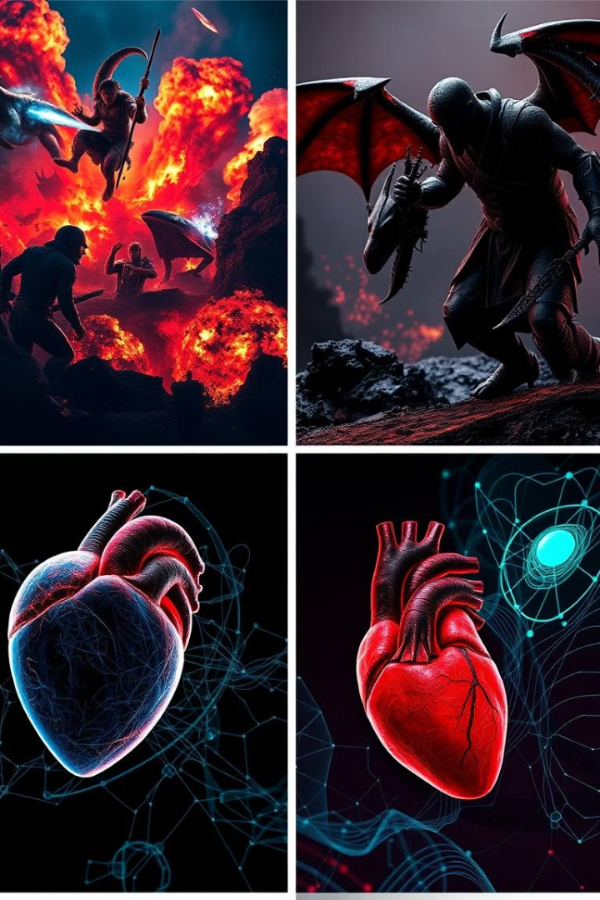
Applications of Computer Graphics
Entertainment
In film and video games, computer graphics create immersive environments and character animations. Techniques like motion capture and CGI have transformed the industry.
Simulations
Industries like aviation and medicine use computer graphics for simulation training, allowing users to engage with realistic scenarios in controlled environments.
Scientific Visualization
Researchers employ computer graphics to visualize complex data sets, making it easier to interpret results and communicate findings effectively.
Virtual and Augmented Reality
These technologies leverage computer graphics to create immersive experiences that blend real-world and digital content.

Slide 45
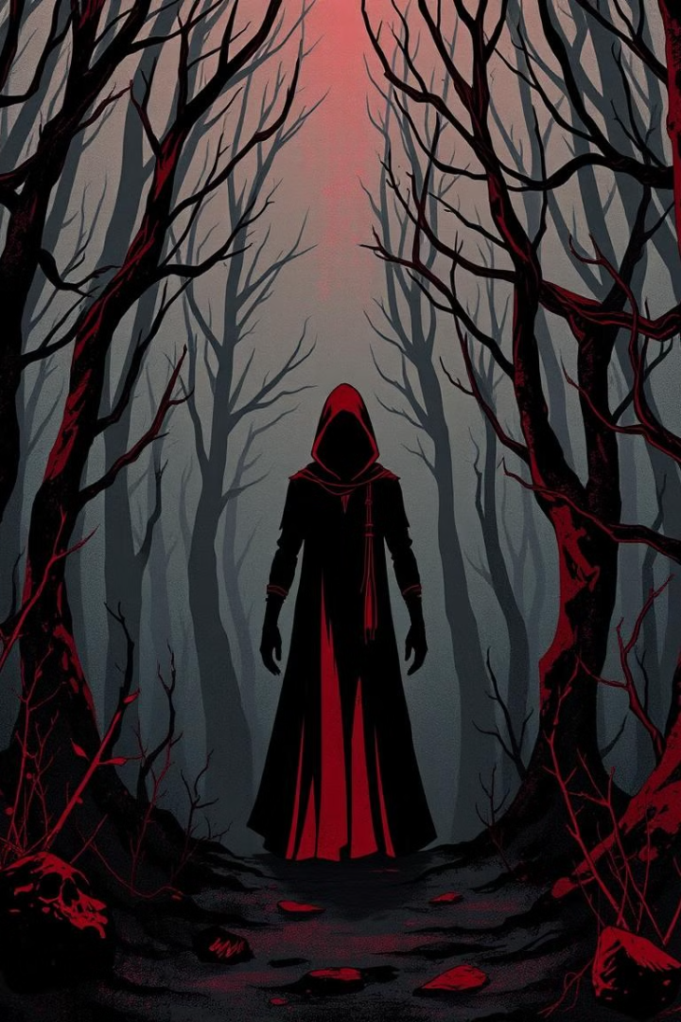




Elements of Design
Line
One-dimensional marks connecting points, guiding the viewer's eye and creating structure.
Shape
Two-dimensional areas defined by boundaries, creating visual interest and organization.
Color
Aspect involving hue, saturation, and brightness, evoking emotions and enhancing aesthetics.
Texture
Surface quality perceived visually or through touch, adding depth and interest to designs.

Slide 46
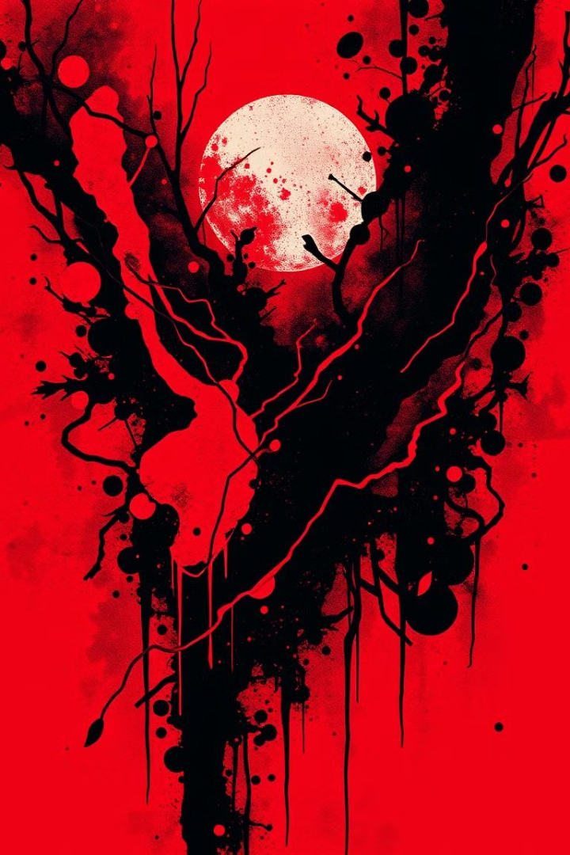


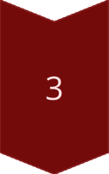
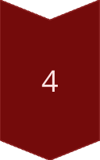
Principles of Design
Balance
Distribution of visual weight for stability and equilibrium. Can be symmetrical, asymmetrical, or radial.
Contrast
Juxtaposition of differing elements to create visual interest and highlight important areas.
Emphasis
Focusing viewer attention on specific parts of a design, establishing a focal point.
Unity
Harmony among various elements, creating a sense of wholeness in the design.

Slide 47
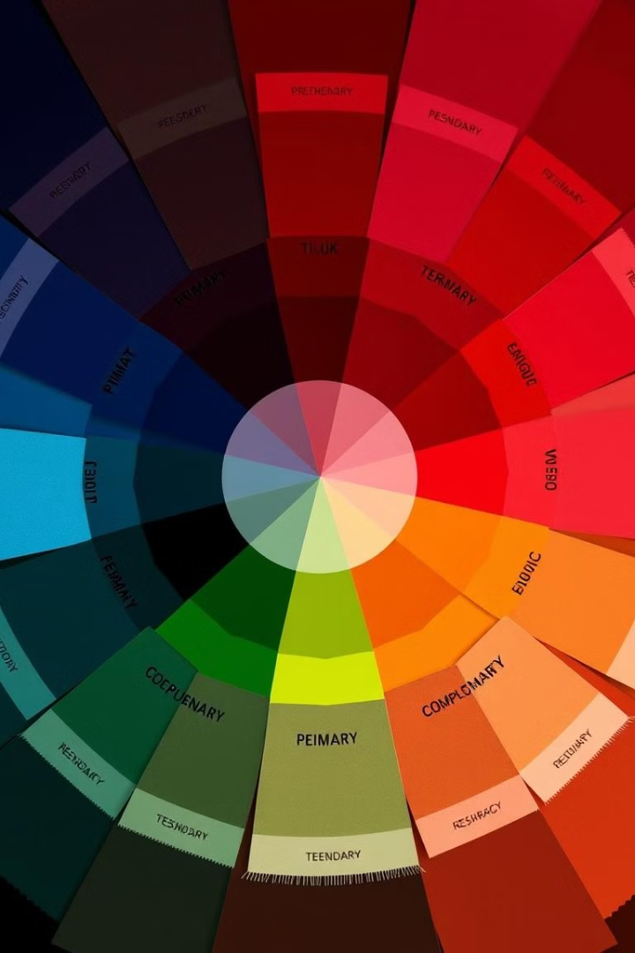
Color Theory in Design
Color Model
Description
Application
RGB
Additive model using red, green, blue
Digital displays, web design
CMYK
Subtractive model using cyan, magenta, yellow, black
Print design
HSB
Hue, Saturation, Brightness model
Intuitive color manipulation

Slide 48
Photoshop Interface and Tools
Interface Components
Essential Tools
Working with Layers
Selection Tools, Brush Tool, Eraser Tool, Clone Stamp Tool, Text Tool, Shape Tools, Zoom Tool
Layer types: Background, Image, Adjustment, Text. Layer styles and groups for organization.
Menu Bar, Options Bar, Toolbox, Panels, Document Window

Slide 49
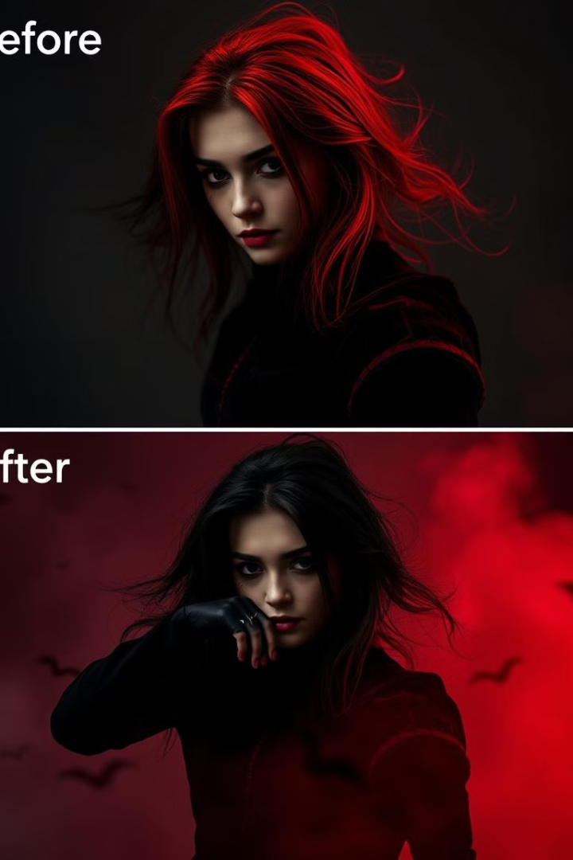
Advanced Photo Manipulation Techniques
1
Blending Techniques
Layer blending modes, gradient masks, and double exposure for seamless integration of elements.
2
Composite Creation
Precise selections, perspective matching, and lighting/shadow integration for realistic composites.
3
Advanced Retouching
Frequency separation, dodge and burn techniques, and non-destructive editing for enhancing images.
4
Textures and Effects
Texture overlays, lens flares, light effects, and creative filters for adding depth and atmosphere.

Slide 50
References:
"Digital Art Fundamentals," Robin Landa, Open Textbook Library, 2020.
"Introduction to Graphic Design," Richard Hollis, Open Library, 2013.
"The Elements of Graphic Design," Alex W. White, Internet Archive, 2011.
"Computer Graphics: Principles and Practice," John F. Hughes et al., MIT OpenCourseWare, 2006.

