Slide 1
Managerial Economics
Lecture 1
Introduction to Managerial Economics
Lecturer: Dr Daniel Kungu Njau

Slide 2
Lecture Learning Outcome
At the end of the lecture, you will be able to:
Understand the importance of managerial economics in analysing business practices and aligning business strategies.
Understand the difference between accounting profit and economic profit and how economic profit influences the value of the firm.
Understanding agency conflicts between owners and management and how monitoring can be employed to reduce these conflicts

Slide 3
Presentation Outline
Part I: Introduction to Managerial Economics
Part II: A Recap of Microeconomics
Part III: Practical examples and Applications
Part IV: Summary

Slide 4
Part I:
Managerial Decision Making
A firm’s managers allocate the limited resources available to them to achieve the firm’s objectives. The objectives vary for different managers within a firm but each managerial task is constrained by resource scarcity.
At any moment in time, a pro duction manager has to use the existing factory and a marketing manager has a limited marketing budget. Such resource limitations can change over time, but man agers always face constraints

Slide 5
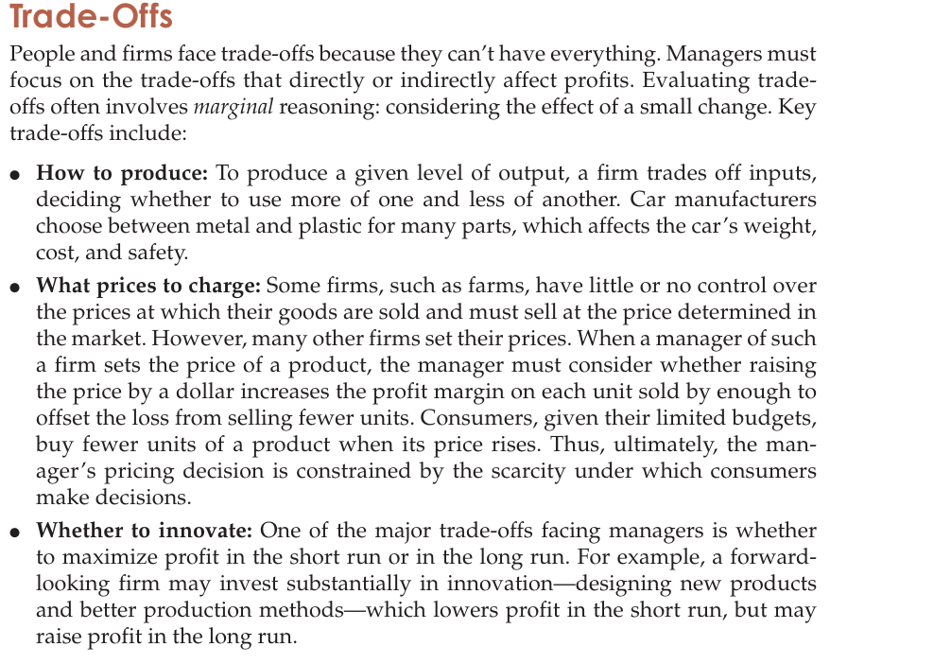

Slide 6
A Dive Into Micro Economics Concepts

Slide 7
Demand Function, What Is It Good for?

Slide 8
Deriving the Demand Curve and Analysing Its Properties

Slide 9
How can we derive the demand function from the optimal consumption in the supermarket?

Slide 10


Typical, Textbook (Real-Life?) Demand Curve
p
Q
p
Q
Source: Own Authored

Slide 11
Demand Function, What Is It Good for?

Slide 12
Deriving the Demand Curve and Analysing Its Properties

Slide 13
How can we derive the demand function from the optimal consumption in the supermarket?

Slide 14
Price Changes to Demand Curve
Pink Lady apples
Source: Own Authored
Granny Smith apples

Slide 15
Price Changes to Demand Curve
P_{Pink}
Pink Lady apples
Source: Own Authored
Kilos of Pink Lady apples demanded
Granny Smith apples

Slide 16
Price Changes to Demand Curve
P_{Pink}
5
4
Pink Lady apples
10
Kilos of Pink Lady apples demanded
Source: Own Authored
Granny Smith apples

Slide 17
Price Changes to Demand Curve
P_{Pink}
5
4
10
Kilos of Pink Lady apples demanded
Source: Own Authored

Slide 18
Price Changes to Demand Curve
P_{Pink}
5
4
Source: Own Authored
10
Kilos of Pink Lady apples demanded

Slide 19
Ronny’s Demand Curve for
Pink Lady Apples
P_{Pink}
Source: Own Authored
Kilos of Pink Lady apples demanded

Slide 20
Properties of demand curves
Demand is derived when holding fixed prices of other products as well as income and tastes.
Are demand curves always downward-sloping?
  Giffen goods
  Income and substitution effects of price changes
Elasticities
  “By what percentage does demand decrease when the price increases by 10%?”

Slide 21
Deriving the Demand Curve and Analysing Its Properties

Slide 22
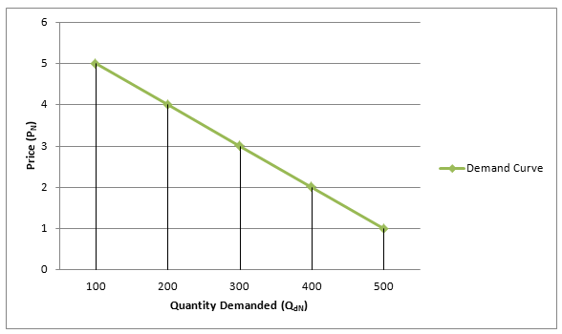
The Demand Curve
How do we know what it should look like?
  Theory: We can come up with explanations of what it should look like.
  Empirics: We can use data to measure the demand function.

Slide 23
Economic Principles
Rationality: people decide what to do by weighing all of the known pros and cons of the different options and picking the best option
Equilibrium: a situation in which everyone is simultaneously optimising, i.e. when no individual thinks he/she has another course of available action that is better for them

Slide 24
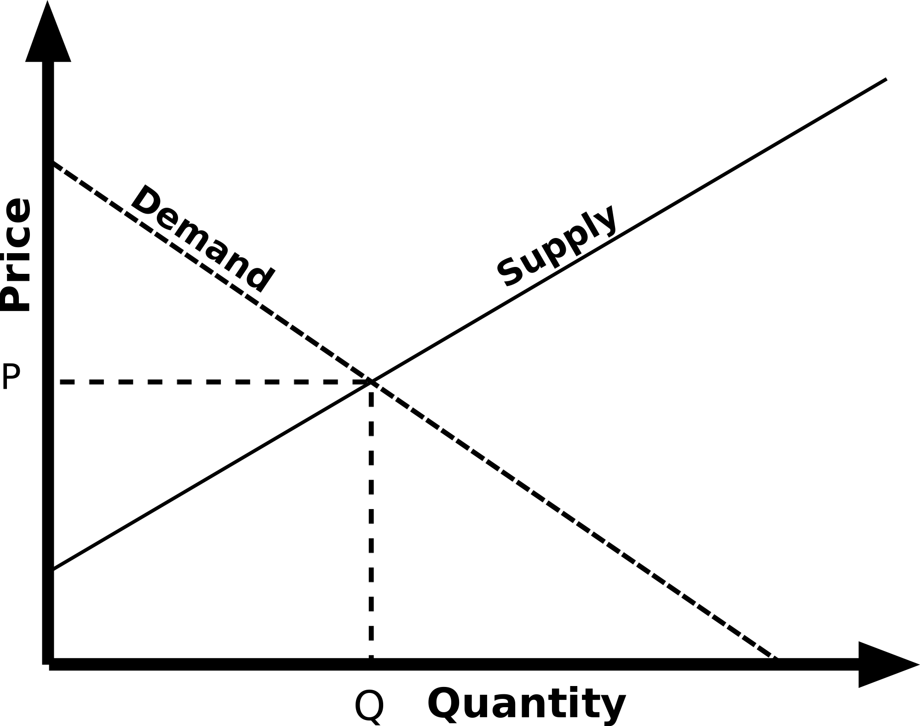
Rationality and Equilibrium in the Market
Source: Own Authored

Slide 25
Rationality and Equilibrium in the Market
The demand function results from the optimising behaviour of consumers.
Source: Own Authored

Slide 26
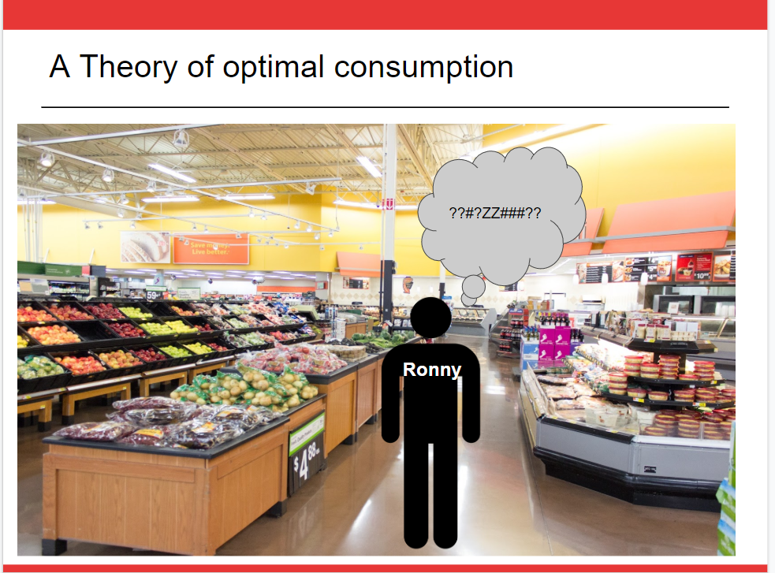
Rationality and Equilibrium in the Market
Source: Own Authored

Slide 27
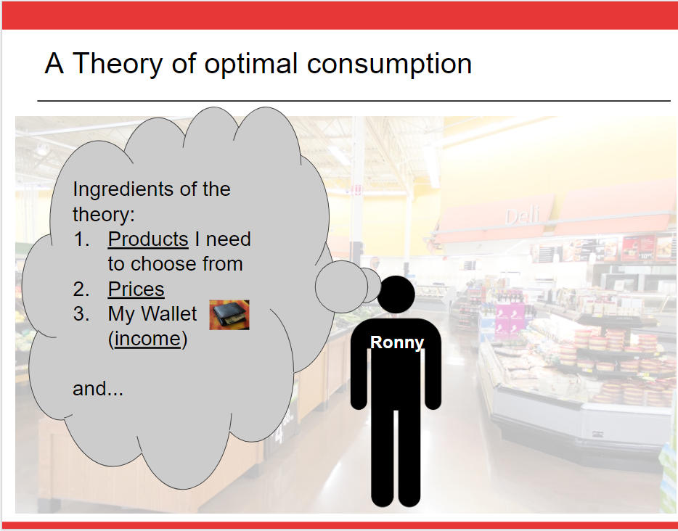
Rationality and Equilibrium in the Market
Source: Own Authored

Slide 28
Demand: important concepts
Consumption bundles
Preferences/utility
Budget line
Lines of equal preferences—indifference curves
Rationality/optimal consumption
Elasticities
Consumer surplus
Individual to market demand

Slide 29
Sample Case in Managerial Economics
The Dental Practice
Cost minimization
Strategic decisions and competition
Pricing decisions

Slide 30
Accounting Profit versus Economic Profit
One of the main goals of managerial economics is to assist managers to make decisions that will generate the most profits and revenues for their businesses in light of existing constraints. The profit is considered to be the holy grail because it shows the ability of the firm to meets its cost obligations from its revenue streams.
Generally, as long as good profits are being made then the business is able to comfortably proceed on a going concern. In order to understand these concepts better we should draw a distinction between various economic terms such as resources economic costs and equity while considering their implication on the firm.

Slide 31
Agency Conflicts in Business
As previously stated, when a firm grows in size it may require additional expertise from a manager who is hired expressly by the business owners to manage their affairs of the business. Conflicts arises between the shareholders and managers because of different horizon goals.
The business owners are primarily interested in the long-term growth of the firm, while managers may tend to focus on shorter time durations in order to maximize their compensation. For example, think of a manager whose compensation is pegged on revenues or units sold.

Slide 32
Managerial Economics and Agency Conflict
Studying managerial economics is important in understanding these types of conflicts as well as techniques on how to resolve them.
A classic case is the corporate control mechanism where the business owner willingly accepts to incur monitoring costs, such as constitution of directors to supervise managerial decisions and ensure these decisions are in the best interest and long-term growth of the firm.

Slide 33
Demand: What Have We Learned So Far?
The demand curve captures the quantity of goods demanded when:
  Prices of other goods, tastes, and income are fixed.
The market demand is the horizontal summation of the individual demands.
Coming up in the next block:
      Consumer surplus: The demand curve can be used (under some conditions) to infer the welfare of consumers.
      Demand elasticity: It is a useful measure capturing the slope and the point of consumption on the demand curve.

Slide 34
END OF LECTURE 1
THANK YOU

Slide 35
LIST OF REFERENCES
Brian T, ShorFroeb, L. M., McCann, M., & Ward, M. R. (2014). Managerial Economics; A Problem Solving Approach, Third Edition. In Angewandte Chemie International Edition, 6(11), 951–952.
Connelly, B. L., Certo, S. T., Ireland, R. D., & Reutzel, C. R. (2011). Signaling theory: A review and assessment. Journal of Management, 37(1), 39–67. https://doi.org/10.1177/0149206310388419
Thomas, C. R., Maurice, S. C., Viera Valencia, L. F., & Garcia Giraldo, D. (2016). Managerial economics : foundations of business analysis and strategy. In Angewandte Chemie International Edition, 6(11), 951–952. (Vol. 2).

