Slide 1
Managerial Economics
Lecture 2
Theory of Individual Behaviour
Lecturer: Dr Daniel Kungu Njau

Slide 2
Lecture Learning Outcome
At the end of the lecture, you will be able to:
Learn more about demand functions and how to distinguish between a change in demand from a change in quantity demanded
Develop a deeper understanding on the demand function and the demand schedule
Grasps the managerial concepts relating to determinants of demand in influencing the demand of a product
Understand and apply the practical aspects of changes in the determinants of demand

Slide 3
Presentation Outline
Part I: Introduction to Theory of Consumer Behavior
Part II: Exceptions to the Law of Demand
Part III: Direct Demand Functions and Inverse Demand Function
Part IV: Practical Applications for Determinants of Demand

Slide 4
Part I:
Introduction to Theory of Consumer Behavior
For our manager to be considered successful we must be able to accurately predict various production levels for goods and services and match these with the probable price levels. For example, let’s have a hypothetical example of a company like Samsung. He imagined that the company needs to make microchips for its smartphones

Slide 5
Introduction to Theory of Consumer Behavior
Samsung has to plan the production of its chip’s weeks and months in advance in anticipation of these chips being used to make smartphones to fulfill consumers smartphone demand all over the world.
In case Samsung decides to produce a lot of chips then this takes up a lot of resources which could have been used in other key departments in the company.
Additionally, the demand for smartphones may not be as high as initially envisaged.
On the flip side if Samsung produces few chips, in order to probably save some money and avoid tied up funds, it runs the risk of running out of this key smartphone component which leaves it vulnerable and unable to fulfill consumers demand for smartphone which leads to a loss of market and lost consumer confidence which is hard to regain.

Slide 6
Introduction to Theory of Consumer Behavior
Therefore, Samsung needs to carefully balance its chip production to ensure that it produces not too much and also not too little.
These are the kinds of managerial economic decisions relating to consumer behaviour that managers need to continuously think about.

Slide 7
A Deep Elaboration of the General Demand Function
Demand is defined as the amount of goods or services that consumers in a market are willing and able to pay for at a point of time.
Therefore, the quantity demanded is the amount of goods or surfaces consumers are willing and able to purchase at a point of time. In this content demand and quantity demand are used interchangeably.
For further elaboration demand functions can be broken down into three types.

Slide 8
General Demand Functions
This function shows how quantity demanded is related to a product price in addition to other factors which affect demand.
Price is considered to be the most important factor affecting demand in addition to other factors that we will discuss such as income levels, taste and preferences, availability of substitutes etc.

Slide 9
General Demand Functions
The main other key variables that influence quantitative demanded over a good or a service are as follows;
the own price of the good or service,
the income levels of consumers,
prices of related goods and services (also known as substitutes or complements),
tastes and preferences patterns of consumers,
the future expected price of the product in the future, and the number of consumers in the market.

Slide 10
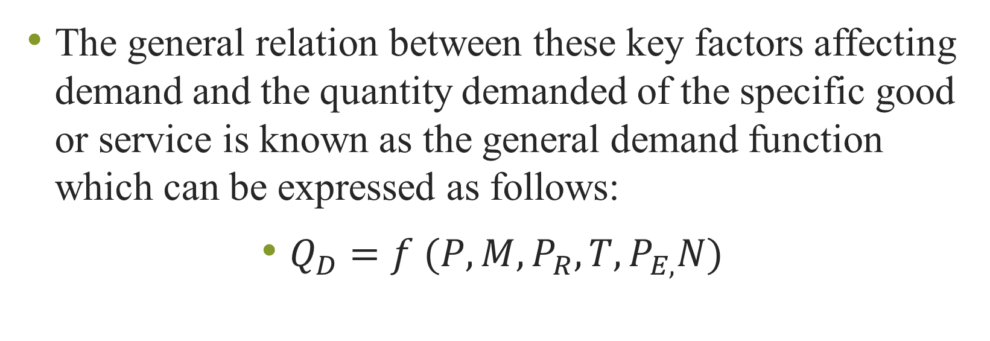
General Demand Functions
The general relation between these key factors affecting demand and the quantity demanded of the specific good or service is known as the general demand function which can be expressed as follows:
$Q_{D}=f (P,M,P_{R},T,P_{E,}N)$

Slide 11
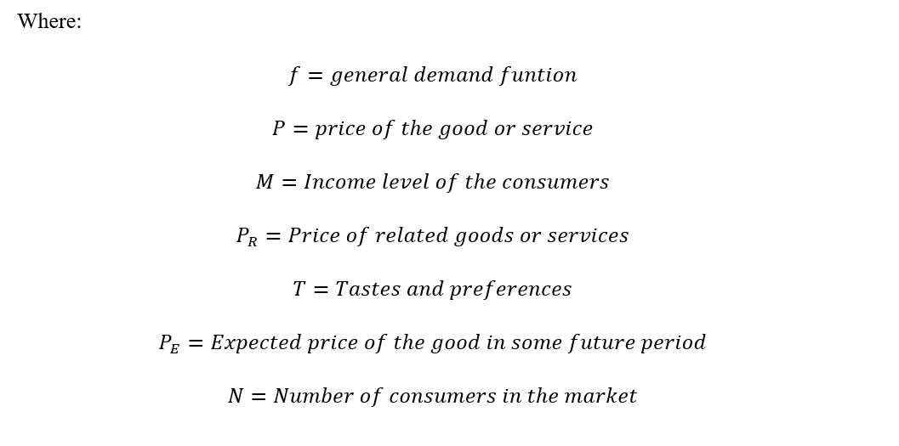
General Demand Functions

Slide 12
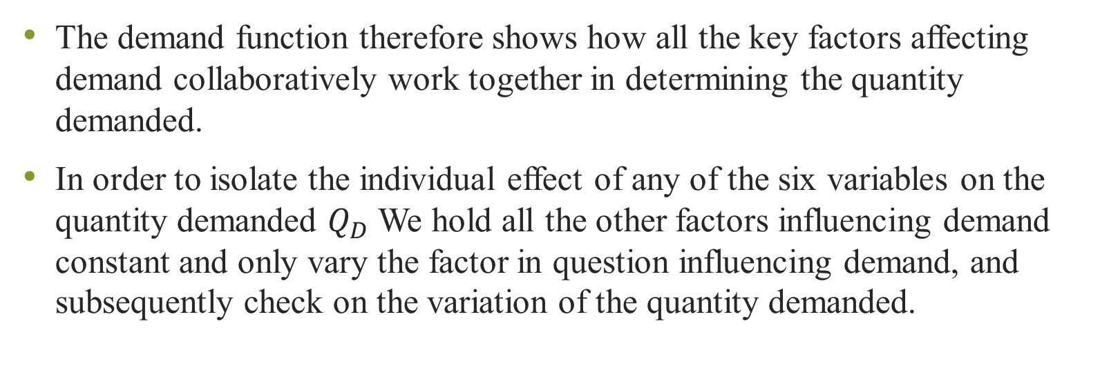
General Demand Functions
The demand function therefore shows how all the key factors affecting demand collaboratively work together in determining the quantity demanded.
In order to isolate the individual effect of any of the six variables on the quantity demanded $Q_{D}$ We hold all the other factors influencing demand constant and only vary the factor in question influencing demand, and subsequently check on the variation of the quantity demanded.

Slide 13
General Demand Functions
For example, we would obviously expect that when the price of a normal good goes down when the quantity demanded will go up because consumers can now afford more of the commodity.
The relationship between the price and quantitative demanded is therefore one of the most important key variables affecting demand.

Slide 14
Summary
End of Part I

Slide 15
Part II: Exception to the Law of Demand
The law demand simply states that there is an inverse relationship between price and quantity demanded with price being the most important and independent variable.
When the price is going up the quantity demanded is falling and vice versa. However, it is critical to note that this only applies to a normal good end to a rational consumer.
There are other exceptional types of goods that will exhibit different relationship when prices.

Slide 16
Exception to the Law of Demand:
The Case of Inferior Goods
A good or service is considered to be inferior if an increase in consumers income will lead to a drop in the quantity demanded of that particular good holding all the other factors constant.
An inferior goodwill typically be the one that consumers will continue buying if they are income constrained but will quickly abandon the product, for a much more quality product, if they have a high level of disposable income.

Slide 17
Exception to the Law of Demand:
The Case of Close Substitute Goods
Two goods are considered substitutes if an increase in the price of one good results to an increase of the quantity demanded of the related good.
For example, if the price of a certain good goes up then you would expect consumers to demand more of the related good as they shift from the high priced good to the more affordable related good.
A good case would be flying between two cities which are close to each other and using a fast train. We would expect that if the train tickets become more expensive, then more consumers would choose the flying option because it’s cheaper. Another good example would be phones from different manufacturers.

Slide 18
Exception to the Law of Demand:
The Case of Close Complements
Two goods are considered complements if an increase in the price of one good results to a decrease in the quantity demanded of another related good.
This shows that the price of one good directly affects the quantitative demanded of the related good. A good example would be fuel prices and quantity demanded for cars.
We would expect that if fuel prices go up, then the quantity demanded for cars to go down as find it more expensive to own cars, and they start sourcing for cheaper alternative transportation.
As a general rule goods are considered to be complements if they are naturally consumed jointly. For example, tires and rims, smartphone and data costs, shoe polish and shoes etc.

Slide 19
Summary
End of Part II

Slide 20
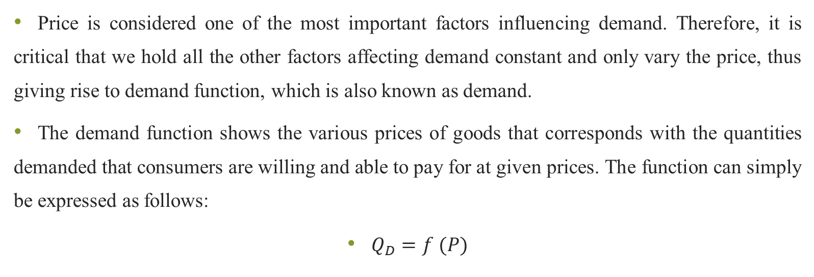
Part III: Direct Demand Functions
Price is considered one of the most important factors influencing demand. Therefore, it is critical that we hold all the other factors affecting demand constant and only vary the price, thus giving rise to demand function, which is also known as demand.
The demand function shows the various prices of goods that corresponds with the quantities demanded that consumers are willing and able to pay for at given prices. The function can simply be expressed as follows:
$Q_{D}=f (P)$

Slide 21
Direct Demand Functions
This means that the quantity demanded of the product is simply influenced by the price holding all the other factors that affect quantity demanded constant. Simply, the demand function expresses quantity demanded as a function of the price only.
The various points showing the quantities demanded at various price points once plotted together gives rise to the demand schedule. The demand schedule is graph or a line showing a list of possible product prices and the corresponding quantities demanded.

Slide 22
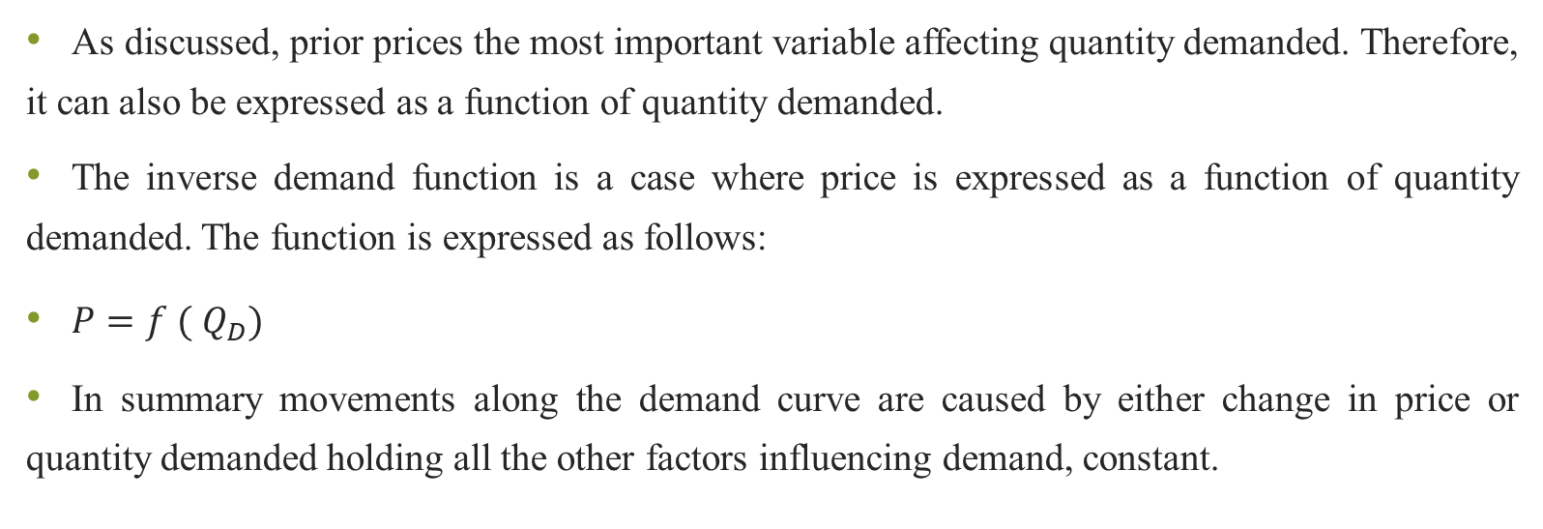
Inverse Demand Functions
As discussed, prior prices the most important variable affecting quantity demanded. Therefore, it can also be expressed as a function of quantity demanded.
The inverse demand function is a case where price is expressed as a function of quantity demanded. The function is expressed as follows:
$P=f ( Q_{D})$
In summary movements along the demand curve are caused by either change in price or quantity demanded holding all the other factors influencing demand, constant.

Slide 23
Summary
End of Part III

Slide 24
Part IV: Practical Applications of Changes in Determinants of Demand
In this section we shall discuss each of the variables affecting demand and its overall effect on the demand holding all the other factors affecting demand constant in each case.
We will have a practical hypothetical example and we can choose airline pricing for a deeper illustration. In each of the scenarios will be discussing either a rightward shift or a leftward shift in the demand curve

Slide 25
Practical Applications of Changes in Determinants of Demand:
Changes in Income
Consumers change of income can either increase or decrease.
If consumers income increases then we would expect that in our hypothetical example about airline travel these consumers will likely purchase more tickets as they fly around for business or pleasure. This will be represented by a rightward shift of the demand curve.

Slide 26
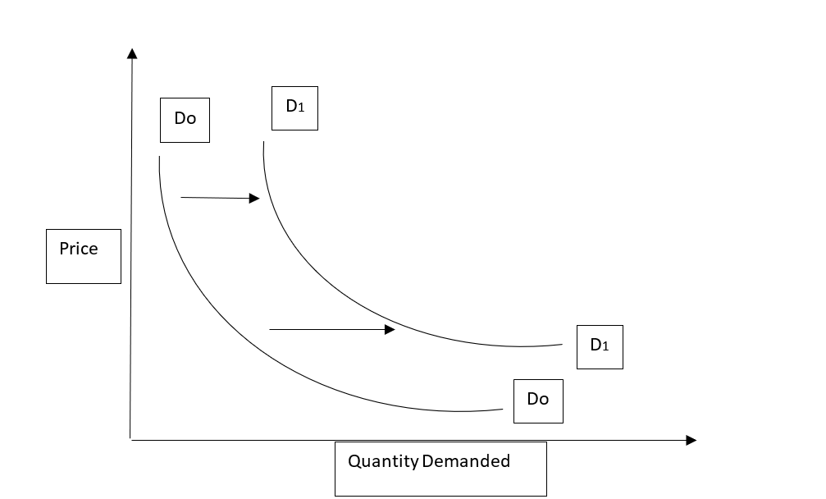
Practical Applications of Changes in Determinants of Demand:
Changes in Income
Figure 1
Source: Authors Illustration

Slide 27
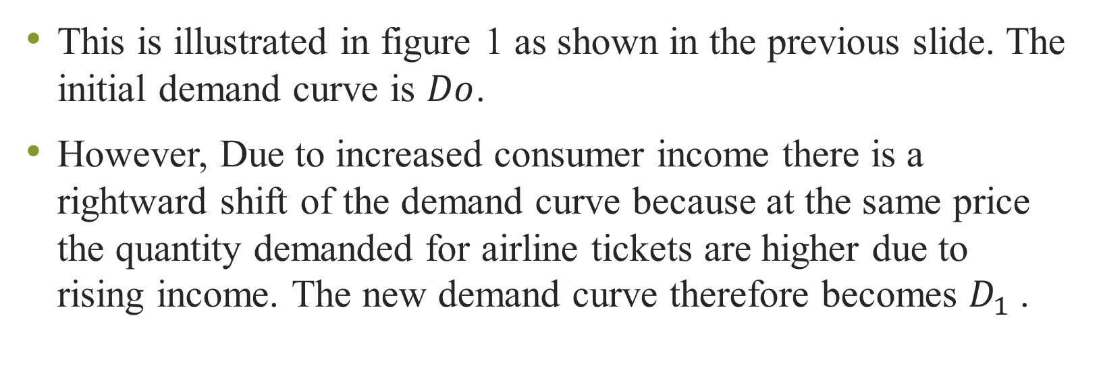
Practical Applications of Changes in Determinants of Demand:
Changes in Income
This is illustrated in figure 1 as shown in the previous slide. The initial demand curve is $Do$.
However, Due to increased consumer income there is a rightward shift of the demand curve because at the same price the quantity demanded for airline tickets are higher due to rising income. The new demand curve therefore becomes $D_{1}$.

Slide 28
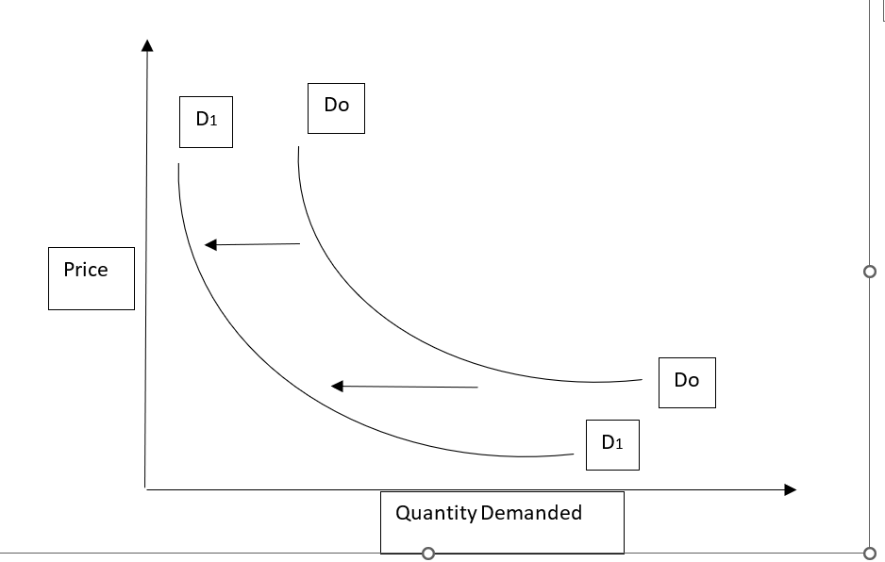
Practical Applications of Changes in Determinants of Demand:
Changes in Income
Figure 2
Source: Authors Illustration

Slide 29
Practical Applications of Changes in Determinants of Demand:
Changes in Income
The opposite will happen if their income falls and they reduce their expenditure in terms of airline travel. This will be shown as a leftward shift in the demand curve.
This is illustrated in figure 2 as shown in the previous slide.

Slide 30
Practical Applications of Changes in Determinants of Demand:
Changes in Price of Related Goods
Let’s imagine that airlines have competitors like they usually do. If airline A and B are competitors and airline A chooses to increase its flight tickets, then we would expect the quantity demanded of tickets for airline B to be much higher because some of the customers for airline A will opt out of paying the higher ticket prices A and choose to fly with airline B.
For illustration purposes, It is expected that the demand curve for airline A will be similar to Figure 2 and The demand curve for price tickets for airline B Will be similar to Figure 1.

Slide 31
Practical Applications of Changes in Determinants of Demand:
Changes in Price of Related Goods
This is the main reason why when companies decide to adjust their prices, they are always keeping in mind what will be the reaction of the competitors because this will ultimately affect the quantity demanded of their products.
Unless A is offering premium services which its special clientele is willing and able to pay for, ordinarily, they have to ensure that their pricing is similar to the one in the market. Otherwise, they are likely to lose business to their competitors.

Slide 32
Practical Applications of Changes in Determinants of Demand:
Changes in Tastes and Preferences
Consumers usually have a preference of one good or service from another. If we hold all the other factors affecting demand constant then we would expect that different consumer tastes and preferences will likely influence their demand for the good or service in question.
For example, assuming that price in other factors affecting demand is constant then we would expect that if airline a has exemplary customer service, great food, on time arrivals and departures, Airline A would be on paper, the more attractive option compared to airline B and its demand curve would be similar to that one for Figure 1.

Slide 33
Practical Applications of Changes in Determinants of Demand:
Changes in Future Price Expectations of Consumers
Future price expectation plays a key role in influencing the demand of a good or a service. Using our example of airline ticket pricing, if consumers for airline A are expecting the future airline tickets to be high in the future, then the consumers are likely to demand more tickets and actually buy them in the present moment, to take full advantage of the lower prevailing prices, before they climb higher in the future.

Slide 34
Practical Applications of Changes in Determinants of Demand:
Changes in Future Price Expectations of Consumers
Let’s imagine that the busy summer travel is coming up, and the airline announces that prices will go up in the coming weeks.
Rational consumers who are planning to fly in the near future will likely purchase their tickets weeks in advance to take advantage of the lower prices. The prevailing demand curve will likely be similar to that of figure 1 in the present circumstances.
On the flip side, if airline ticket prices are falling, rational consumers would likely hold on purchasing new tickets so that they take advantage of expected much lower fees in the future. The prevailing demand curve will be similar to that of figure 2 in the present.

Slide 35
Practical Applications of Changes in Determinants of Demand:
Changes in the Number of Buyers
The number of buyers for a good or service, heavily influences the level of demand prevailing for the product. It is expected that where there are many buyers, The demand will be quite high and this will push the prices up as many buyers express willingness and ability to buy the good or service in question.
For our case of airline tickets, If there is a sudden influx of travellers traveling between two cities or more, prices are likely going to go up Because of the prevailing high level of demand. Airline A and B are likely to increase their prices to take advantage of the prevailing high levels of demand with prices likely to fall in the future when demand eases off.

Slide 36
Summary
End of Part IV

Slide 37
REFERENCES
Brian T, ShorFroeb, L. M., McCann, M., & Ward, M. R. (2014). Managerial Economics; A Problem Solving Approach, Third Edition. In Angewandte Chemie International Edition, 6(11), 951–952.
Connelly, B. L., Certo, S. T., Ireland, R. D., & Reutzel, C. R. (2011). Signaling theory: A review and assessment. Journal of Management, 37(1), 39–67. https://doi.org/10.1177/0149206310388419
Thomas, C. R., Maurice, S. C., Viera Valencia, L. F., & Garcia Giraldo, D. (2016). Managerial economics : foundations of business analysis and strategy. In Angewandte Chemie International Edition, 6(11), 951–952. (Vol. 2).

Slide 38
Thank You
End of Lecture 2

