Slide 1
Managerial Economics
Lecture 3
Supply Side Economics
Lecturer: Dr Daniel Kungu Njau

Slide 2
Lecture Learning Outcome
At the end of the lecture, you will be able to:
Understand why producers are likely to supply more at higher prices
Appreciate why in the short run it is critical to make decisions whether to continue production and by how much
Be able to distinguish the difference between fixed and variable costs
Understand the general supply function

Slide 3
Lecture Learning Outcome
Develop a deeper understanding of the impact of technology in production
Understand the causes of shifts in the supply schedule
Apply the concepts determinants of supply

Slide 4
Presentation Outline
Part I: Introduction to Supply Side Economics
Part II: Time Horizons and Costs Discussion
Part III: Supply Functions and Shifts in Supply
Part IV: Practical Applications for Determinants of Supply

Slide 5
Part I:
Introduction to Supply Side Economics
During the COVID pandemic which struck in 2020, numerous businesses were faced with the difficult decision on whether to shut down or to continue operations under the then prevailing difficult economic circumstances.
Production of goods and services had come to a halt in light of supply chain issues and lack of consumer demand. This problem was particularly acute in the transport and services sectors where demand for these services were almost zero as lockdowns were imposed around the world.

Slide 6
Introduction to Supply Side Economics
Economic downturns therefore force businesses to make key decisions about whether to continue production and how much to produce and for whom to produce.
The decision on whether to continue production is heavily dependent on the tutorial revenue and total cost that a firm is able to generate from its operations. How much to produce is heavily dependent on the marginal revenue and marginal cost derived from incremental increase in production levels.

Slide 7
Introduction to Supply Side Economics
Supply side economics are therefore critical for firms to make decisions on rents and wages or whether to continue hiring or not or even whether it is worthwhile to continue business operations. These key questions therefore constitute the basis for discussion in this chapter.
In summary supply closely mirrors demand. Supply can be considered to be the natural response to the demand forces prevailing in the market.

Slide 8
Introduction to Supply Side Economics
The amount of goods or services offered for sale in a market during a given period of time Is therefore referred to as the quantity supplied.
This quantity is heavily dependent on a large number of variables.
The most critical major variables are; the price of the good itself, the price of inputs used in production,
The price of goods related in production,
The level of available technology,
The expectations of the producers concerning the future price of the good and the number of competing firms or the amount of productive capacity in the industry.

Slide 9
Summary
End of Part I

Slide 10
Part II:
Time Horizons and Costs Discussion
The time horizon is one of the most important considerations for businesses to make in deciding whether to continue production and the extent to how much the business will produce a good or a service.
The short run time horizon, Is the time in which a producer cannot be able to at least adjust one of the inputs used in production.
Generally, in the short run time horizon businesses are unable to change existing circumstances such as employment contracts or investment horizons due to contractual commitments.

Slide 11
Time Horizons and Costs Discussion
However, after a certain lapse of time a business can be able now to adjust some of these inputs in production and in the long run every input is considered to be variable.
In the long run time horizon producers can be able to adjust all the factors of production and similarly if there are profits to be made, the market will attract more players and barriers to entry can be overcome.
This also means that a firm can be able to invest in more productive labour and take advantage of improved technological efficiencies to enhance production. However, all of these is not possible in the short run.

Slide 12
Fixed and Variable Costs
In order for a business to decide on the most optimal rate of production the business needs to know exactly the cost of production of an additional unit of a good or service.
Therefore, it is critical for decisions relating to fixed and variable cost to be considered as costs are the main drivers and determinants of the levels of production.
It is also critical to note that costs can either be classified as fixed or variable only in the short run because in the long run all costs are variable.

Slide 13
Fixed and Variable Costs
A fixed cost is the one that does not change with the level of activity or the prevailing production rate in the short run. A good example would be rent or fixed wages which do not vary in the short run with the level of production.
Variable costs are those which change with the level of activity or the current production rate. They refer to the cost of inputs which change with the production rate. Examples include production-based compensation such as bonuses and overtime, payment to suppliers, equipment lease, etc.

Slide 14
Fixed and Variable Costs
For illustration purposes let’s imagine a small restaurant that incurs various costs when producing meals for its clients. The various costs can be summarized in Table 1.
A quick glance of the table can easily help us identify which costs remain fixed and the ones that vary which are variable and vary with the level of activity.

Slide 15
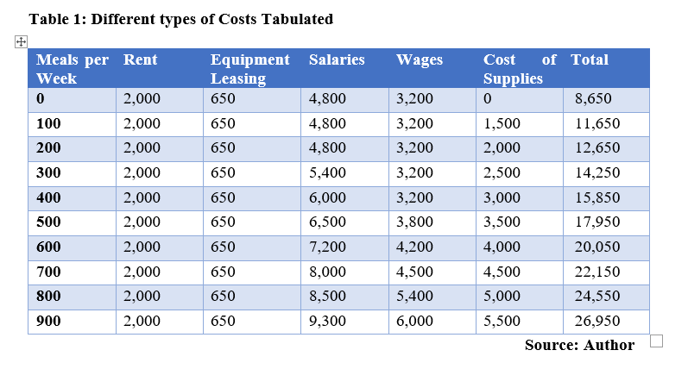
Fixed and Variable Costs
Table:

Slide 16
Summary
End of Part II

Slide 17
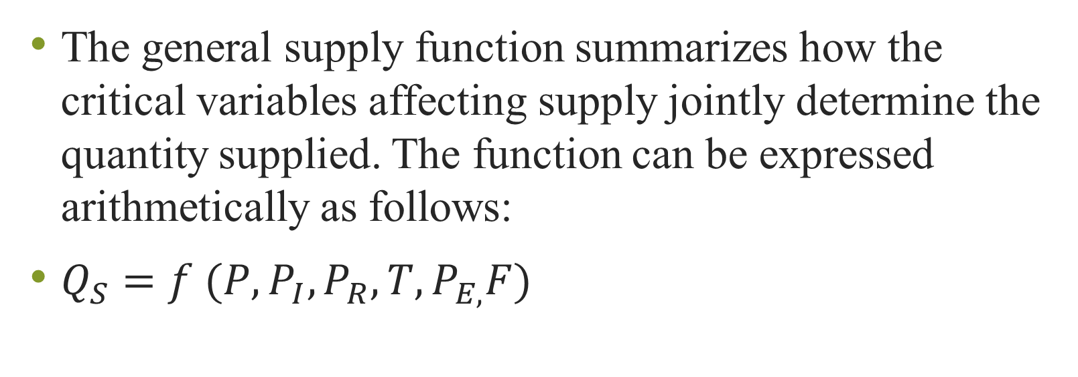
Part III:
The General Supply Function
The general supply function summarizes how the critical variables affecting supply jointly determine the quantity supplied. The function can be expressed arithmetically as follows:
$Q_{S}=f (P,P_{I},P_{R},T,P_{E,}F)$

Slide 18
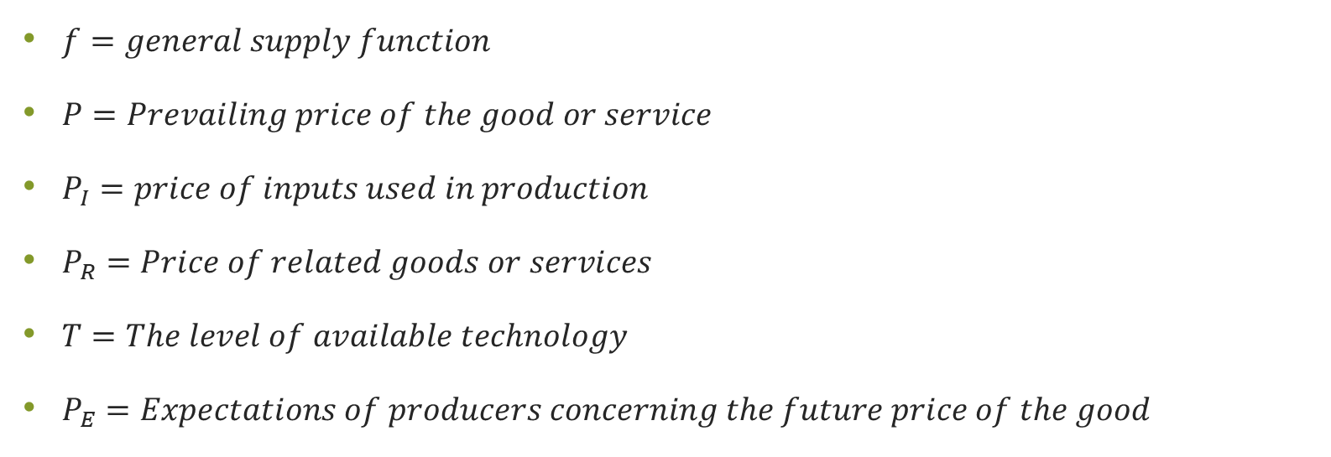
The General Supply Function
$f=general supply function$
$P=Prevailing price of the good or service$
$P_{I}=price of inputs used in production$
$P_{R}=Price of related goods or services$
$T=The level of available technology$
$P_{E}=Expectations of producers concerning the future price of the good$

Slide 19
The General Supply Function
Similar to demand the price of the good old service being produced is the most important determinant of the quantity supplied. The price in this case refers to how much the consumers are willing and able to pay for the product being produced.
The next variable of consideration is the price of inputs used in production. Without a doubt the prices of labour or capital used in the production of the good or service contributes immensely to the overall cost of that product. The higher the cost of inputs the higher will be the total cost of production. The next variable in consideration is the price of substitutes used in production which is discussed in depth in the next sub heading.

Slide 20
The General Supply Function
In summary we would expect a positive relationship between all the variables affecting supply and quantity supplied with the exception of the price of the substitute in production which has a negative and inverse relationship with the quantity supplied.

Slide 21
Substitutes in Production
Let’s imagine that a producer is producing two goods which are similar and can act as substitutes. Produces aimed at producing a good which fetches the highest price in the market. They are willing to devote more resources and inputs into the production of the good with the highest level of profits since its worthwhile investment.
For example, if a former produces chicken and beef for sale, and the market price for beef becomes substantially higher than that of chicken, we can expect the farmers to devote more inputs and resources into production of beef because it is more profitable than that of chicken. So, in this case beef is substituting chicken in the production process.

Slide 22
Substitutes in Production
Substitutes in production therefore refers to a case where between two competing goods, one could increase in price relative to the price of another good and causes the producers to focus on increasing production on the higher priced good and devote less resources to the less priced good.

Slide 23
Complements in Production
Goods are considered to be complements in production if the increase in the price of one good result the producers increasing the quantity supplied of the related good. For example, computer chips are critical in producing technologically advanced computers.
If the price of computer chips reduces due to an increase in the availability of raw materials for making chips, we can expect that producers will be able to produce more computers and sell them at a more favourable price in order to increase their revenue margins. In our case the computer chips and the computers are considered to be complements in production.

Slide 24
Complements in Production
Complements in production can therefore be defined as related goods or services where an increase in the price of one good relative to the price of another good results in producers increasing the production of both goods.
In our prior case the computer manufacturer is likely to increase the chips being manufactured as well as the overall number of computers assembled.

Slide 25
Impact of Technology in Production
Common knowledge dictates that advances in technology are critical in enhancing production efficiency.
For example, when you think about the evolution of farming, modern methods of farming are considered to be more technologically advanced and result in higher level of food production compared to more traditional methods of farming.

Slide 26
Impact of Technology in Production
Technology can be considered to be the current state of knowledge applied to combine resources to produce goods and services. As a general rule, advances in technology It results in higher levels of production and efficiency.
Technology can simply be defined as the current state of knowledge available which is employed in combining resources to produce goods and services. We can expect that with increased levels of technology particularly those relating to mass production, holding all the other factors influencing supply constant, At the same price, higher levels of production will be experienced.

Slide 27
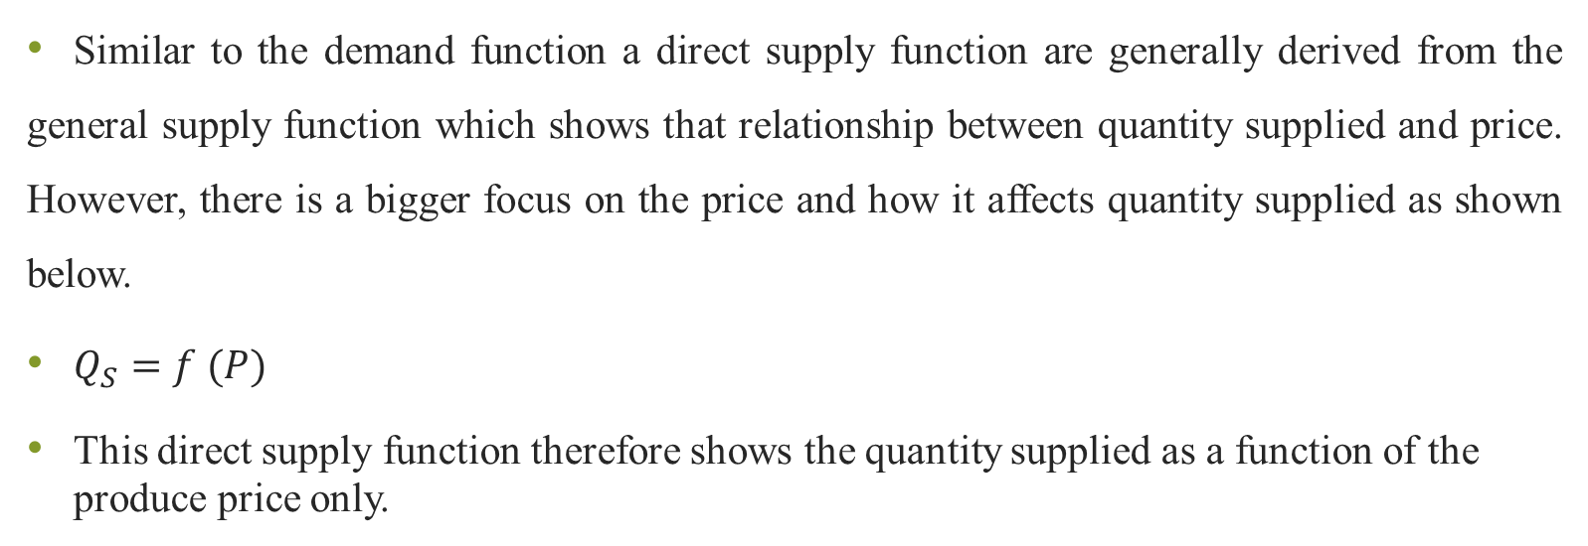
The Direct Supply Function
Similar to the demand function a direct supply function are generally derived from the general supply function which shows that relationship between quantity supplied and price. However, there is a bigger focus on the price and how it affects quantity supplied as shown below.
$Q_{S}=f (P)$
This direct supply function therefore shows the quantity supplied as a function of the produce price only.

Slide 28
The Direct Supply Function
From this function a graph can be derived showing what will be the quantity supplied, at different prevailing price levels for the goods in question, holding all the other determinants of supply constant.
The different points showing what is the quantity supplied at different levels, when plotted together resorts to a supply schedule. Similar to a demand schedule, Movements along the supply schedule are primarily caused by changes in the price of the good or service holding all the other variables affecting supply constant.

Slide 29
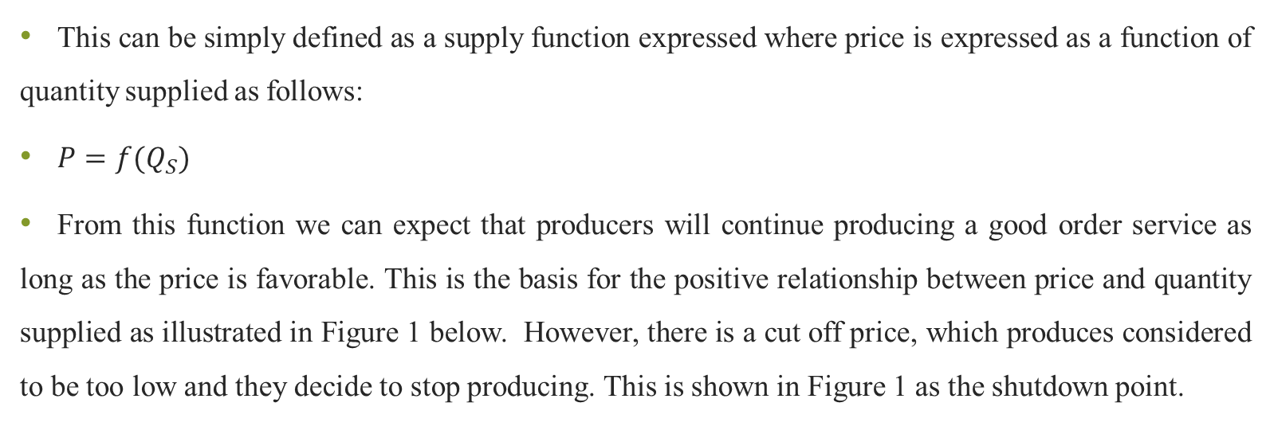
Inverse Supply Function
This can be simply defined as a supply function expressed where price is expressed as a function of quantity supplied as follows:
$P=f(Q_{S})$
From this function we can expect that producers will continue producing a good order service as long as the price is favorable. This is the basis for the positive relationship between price and quantity supplied as illustrated in Figure 1 below. However, there is a cut off price, which produces considered to be too low and they decide to stop producing. This is shown in Figure 1 as the shutdown point.

Slide 30
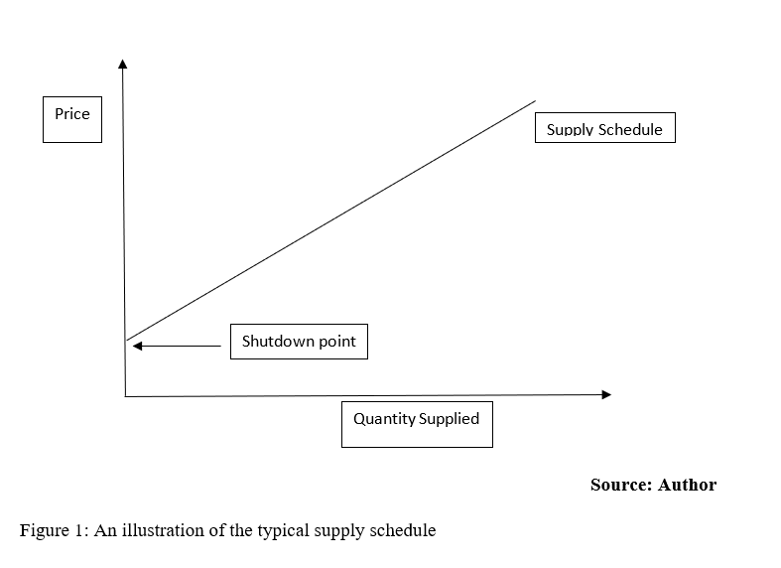
Inverse Supply Function

Slide 31
Shifts in Supply
Based on our previous discussions, a movement along the supply schedule is caused by a change in the price of the good or services holding all the other determinants of supply constant. A shift can either be based on increase in supply or decrease in supply.
An increase in supply is a change in the supply function that causes an increase in quantity supplied at every price and is reflected by a rightward shift in the supply curve. This is illustrated in figure 2.
A decrease in supply is a change in the supply function that causes a decrease in the quantity supplied at every price level and is usually depicted by a leftward shift in the supply curve. This is illustrated in figure 3.

Slide 32
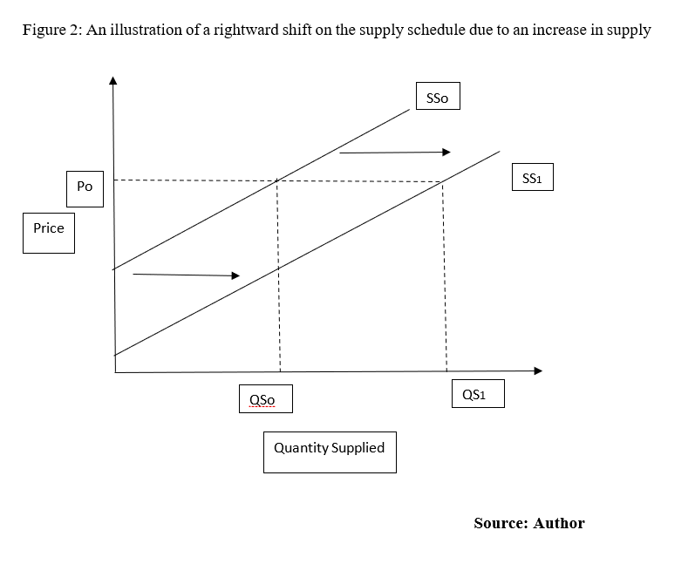
An Illustration of a Rightward Shift in Supply

Slide 33
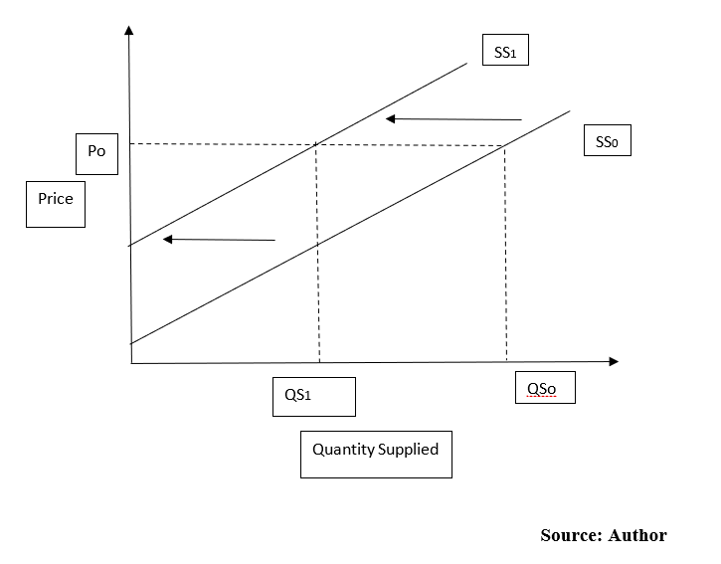
An Illustration of a Leftward Shift in Supply

Slide 34
Summary
End of Part III

Slide 35
Part IV:
Practical Application of Supply Shifts in Practice
In this section we will elaborate on a hypothetical example of Samsung making its smartphones and also making decisions about how much to produce given the available level of technology and the market demand.
We shall examine different scenarios and hypothetically discuss the possible impact on the quantity supplied of smartphones in the market.

Slide 36

Changes in Input Prices ${(P}_{I})$
Let’s imagine that Samsung makes its phones from microchips which are made from silicon.
If the price of silicon is a raw material drops due to possible discoveries in various minds around the world, then we would expect the cost of making phones to drop ensuring that at the same smartphone market price,
The manufacturer will be able to supply more of the smartphones, thus increasing their supply in the market. This can be illustrated by a rightward shift in the supply curve similar to that one in Figure 2.

Slide 37

Changes in the Price of Goods Related in Production ${(P}_{R})$
Let’s have another hypothetical example where Samsung is using its microchips to make smart TVs and smartphones.
If we imagine that there is a higher demand for smart TV compared to smartphones, and the manufacturer stands to gain a larger profit margin from making smart TVs compared to smartphones, it is likely that the manufacturer may devote more microchips to making TVs rather than to the manufacture of smartphones.

Slide 38
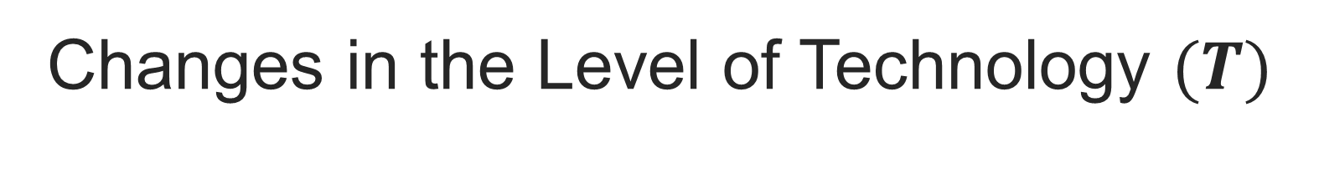
Changes in the Level of Technology $(T)$
Technology ultimately results to high levels of production because it makes it possible to produce more using in light of constrained factors of production.
This generally results to a rightward shift in the supply curve showing that at the same prevailing prices can be able to produce more of the commodity.
Using our example of the phone manufacturer if new technology emerges that can be able to condense more artificial intelligence in smaller microchips, then the phone maker will be able to produce better versions of smartphones at equally competitive prices.

Slide 39
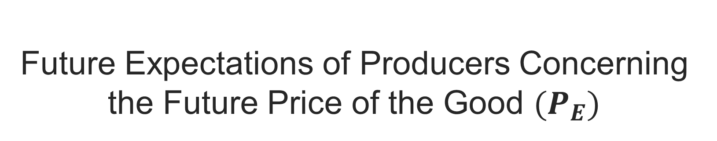
Future Expectations of Producers Concerning the Future Price of the Good ${(P}_{E})$
The future price expectations also do impact the quantity supplied. For example, if there is a new proposed law that proposes to put tariffs on imported silicon, keeping in mind that silicon is the raw materials used for making microchips.
It can be reasonably be expected that smartphones will become more expensive in the future and the manufacturer might want to ramp up production in the near future before the proposed tariffs kick in and make the microchips more expensive.

Slide 40
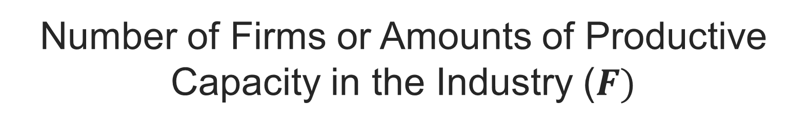
Number of Firms or Amounts of Productive Capacity in the Industry ($F)$
It can be reasonably be expected that where there is a large number of suppliers of smartphones, competition will be stiff among the firms, The supply will be more at given level of prices which will subsequently ensure that there is no shortage of smartphones in the market.

Slide 41
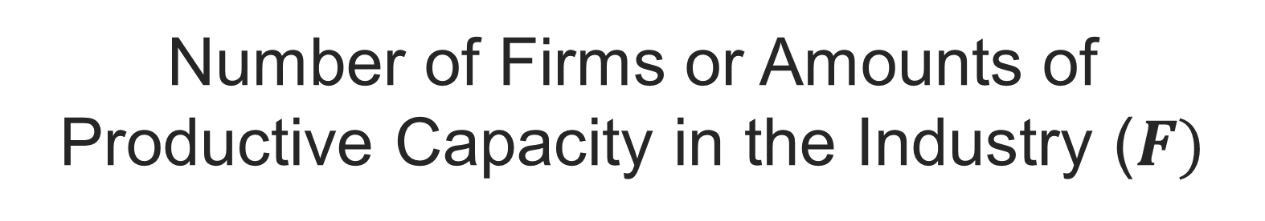
Number of Firms or Amounts of Productive Capacity in the Industry ($F)$
Phone manufacturers will therefore have to distinguish themselves by using other techniques apart from the price. In the near future overall phone prices are likely to drop due to stiff competition between the manufacturers until the prices are too low such that some firms cannot cope and they drop out of the market.

Slide 42
Summary
End of Part IV

Slide 43
REFERENCES
Brian T, ShorFroeb, L. M., McCann, M., & Ward, M. R. (2014). Managerial Economics; A Problem Solving Approach, Third Edition. In Angewandte Chemie International Edition, 6(11), 951–952.
Connelly, B. L., Certo, S. T., Ireland, R. D., & Reutzel, C. R. (2011). Signaling theory: A review and assessment. Journal of Management, 37(1), 39–67. https://doi.org/10.1177/0149206310388419
Thomas, C. R., Maurice, S. C., Viera Valencia, L. F., & Garcia Giraldo, D. (2016). Managerial economics : foundations of business analysis and strategy. In Angewandte Chemie International Edition, 6(11), 951–952. (Vol. 2).

Slide 44
Thank You
End of Lecture 3

