Slide 1
Managerial Economics
Lecture 4
Costs Concepts
Lecturer: Dr Daniel Kungu Njau

Slide 2
Lecture Learning Outcomes (1)
At the end of the lecture, you will be able to:
Understand meaning of cost in economic analysis and irrelevance in managerial decision making
Appreciate The different type of costs and the distinction between economic and accounting approaches of looking at costs
Grasp the importance of marching costs with relevant timeframes and distinguish between short and long run costs.

Slide 3
Lecture Learning Outcome (2)
Build an understanding of cost functions and their estimations

Slide 4
Presentation Outline
Part I: Introduction and Classification of Costs
Part II: Short Run Costs
Part III: Cost Curves and Mathematical Derivations

Slide 5
Part I:
Introduction and Classification of Costs

Slide 6
Introduction to Costs
Costs are extremely necessary in the production of a good or service. That is the reason why we have to pay for a good or a service, because there are costs incurred to produce it. There is usually a long chain from the producer to the retailer until a product is available to the consumer.
At each stage along this chain volume is added and costs are incurred. The costs stick the form of labour, capital and technology or any other resource that has been sacrificed to avail that product. Costs represents a sacrifice that has been made in form of time comfort and opportunity so that the producer can receive an income to compensate for this loss.

Slide 7
Introduction to Costs
Cost may be defined as a sacrifice which has already been made or has potential to kind of future with an objective to achieve a specified goal.
Cost has an implication on the value of assets, either making them to increase or decrease. Furthermore, Cost is heavily influenced by the cost of production which is largely the main determinant of a cost of a good or service.
Firms usually try to manage their costs through marginal efficiency and increasing productivity.

Slide 8
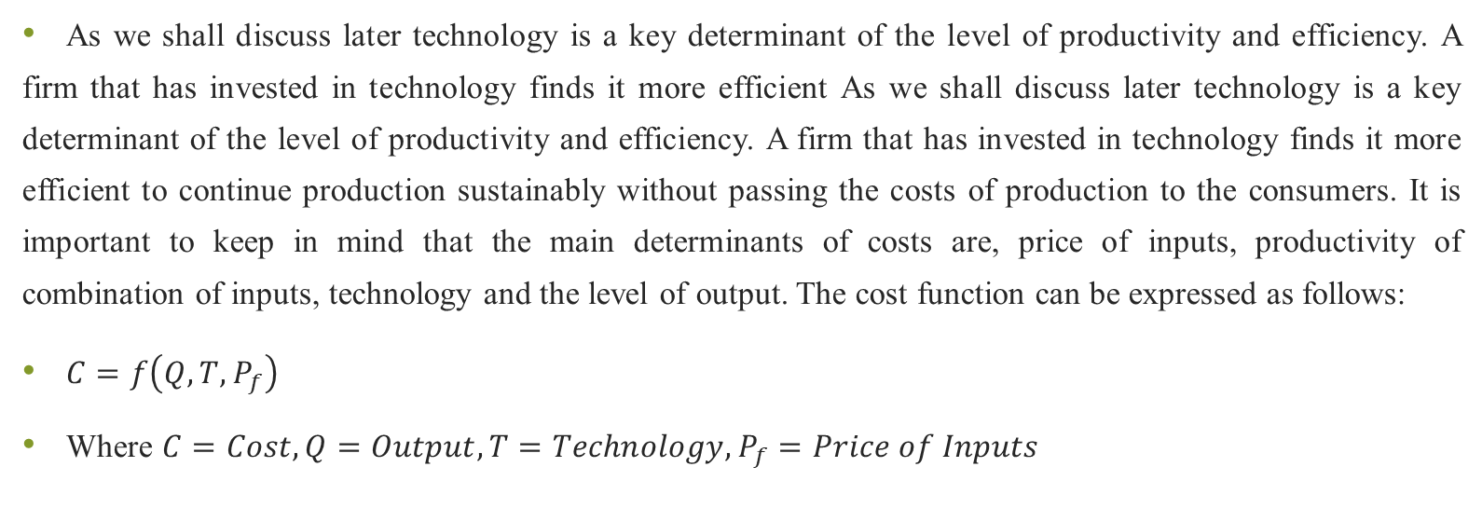
Introduction to Costs
As we shall discuss later technology is a key determinant of the level of productivity and efficiency. A firm that has invested in technology finds it more efficient As we shall discuss later technology is a key determinant of the level of productivity and efficiency. A firm that has invested in technology finds it more efficient to continue production sustainably without passing the costs of production to the consumers. It is important to keep in mind that the main determinants of costs are, price of inputs, productivity of combination of inputs, technology and the level of output. The cost function can be expressed as follows:
$C=f\left(Q,T, P_{f}\right)$
Where $C=Cost, Q=Output, T=Technology, P_{f}=Price of Inputs$

Slide 9
Classification of Managerial costs
A firm usually in cars an array of costs in order to produce a good or a service. Some costs can be expressed in monetary terms such as interests on loan, insurance, rent, taxes etc. However other costs are much more of economic theory and are measured on an estimation basis in order to aid in decision making. These include; social costs, implicit costs, opportunity costs, sunk costs etc. The various classification of costs are as follows:

Slide 10
Accounting Costs and Real Costs
On one hand, accounting costs are those that are recorded in the financial records and include all costs that have been identified, measured and accounted for. These include a firm’s typical costs such as raw materials, wages, salaries, interest on loans, capital costs, overheads etc.
They involve either a payment that has been done or a cost that has been incurred and the obligation will be settled at a future date.

Slide 11
Accounting Costs and Real Costs
On the other hand, real costs are a sum of all costs and sacrifices made in acquiring or selling a good or a service. For example, an entrepreneur usually makes huge sacrifices in family time when establishing a start up and running it.
It is difficult to estimate the actual amount of sacrifice made in monetary terms yet the sacrifice is necessary for the firm to grow. Real costs are therefore had to quantify in money terms, Yet the sacrifice in terms of them, is clearly visible. Real costs are difficult to account and therefore are not featured in the financial record. However, top management compensation is mostly based on the real cost sacrifice executives make in achieving a firm’s goal.

Slide 12
Implicit Costs and Explicit Costs
These are costs that do not involve actual payment of cash or reduction in assets. However, they are still incurred in the production process when the firm makes sacrifices by opting to produce a good in place of another.
For example, an entrepreneur who devotes his time and energy to the firm typically receives no salary during the early days of the startup firm. Yet the entrepreneur is still devoting his own energy to the production of a good or service and this sacrifice is considered worthwhile for consideration for managerial economists as it contributes to the overall cost of the service or good being produced.

Slide 13
Implicit Costs and Explicit Costs
Explicit costs are those which are quantifiable and are captured in the financial records. They can also be considered to be visible costs that involve payment of money by a firm to the parties who have provided a good or service to the firm.

Slide 14
Social Costs and Replacement Costs
Social costs are those incurred by the society in general as a result of the firm’s actions. For example, A company which owns a fleet of heavy trucks for cargo transportation, usually pollutes the environment through emissions from its diesel engines.
Members of the society who breathe the polluted air can be considered to be paying a cost, yet they may not be deriving an actual benefit from the transportation company. Companies are being required to ensure that they keep social costs as minimal as possible in order to reduce the burden towards the society and continue producing as sustainably as possible.

Slide 15
Social Costs and Replacement Costs
Another good example is in the airline industry where standards now require airlines to report the actual carbon footprints of flying passengers from one destination to another. Firms may also engage in activities That give back to the society as a form of compensation of the social cost they have imposed on the environment.
A good example would be corporate social responsibility (CSR) where companies endeavour to do social good as a form of payback to the society. CSR activities may involve; school fees support, environmental clean ups, safety campaigns, promotion of green economy etc.

Slide 16
Social Costs and Replacement Costs
Replacement costs are those in card in replacing an asset or maintaining its value after depletion of its economic life. Our farm is able to produce a good or service through utilization of its assets.
Therefore, these assets need to be maintained at their optimal value through replacement or maintenance under cost of maintaining these assets in their proper value is considered to be the replacement cost. The same cost would apply when a firm incurs labour cost such as training in order to enhance employee productivity.

Slide 17
Historical and Future Cost
In acquisition of an asset, which will be used to produce a good order service, then the historical cost becomes the cost of acquisition of those assets. In economic terms historical costs are considered to be, sunk costs, which are not relevant for decision making. A sunk cost is a past cost that has been incurred and is considered irrelevant for decision making.
Future costs are considered to be relevant for decision making because they represent an actual obligation to be incurred in the future.

Slide 18
Historical and Future Cost
Managers usually plan for these costs through formulating budgets and projection of cost estimates in order to adequately plan and prepare to cater them in the future.
The ability of a farm to continue as ongoing concern is highly dependent on its ability to cater for its future costs. A good example will be planning for future capital expenditure or exploring the feasibility of a project idea.

Slide 19
Direct and Indirect Costs
Direct costs are those which can be attributed to a particular activity that has occurred. Practical examples would be raw materials, direct labour costs, direct overheads etc. These costs are considered to be the prime cost in the production of a good or a service and are therefore unavoidable. It is therefore easy and direct to estimate the direct cost per unit of a good or service produced.

Slide 20
Direct and Indirect Costs
For indirect costs, they cannot be attributed directly to the good or service but are still necessary for revenues to be made. A good example would be the advertising cost for a good or a service. It is difficult to measure how effective the advertising has been in selling a product yet this expenditure is still necessary for sales to happen. The total cost of indirect cost that can be attributed to a good or service can only be approximately estimated.

Slide 21
Controllable and Uncontrollable Costs
Controllable cost is those which are within the control of management and management decisions can easily influence them. A good example would be the amount of compensation to be paid to new hires or any bonus to be calculated based on performance of the firm paid to workers. Controllable costs are therefore the main focus of management when the embark on the task of ensuring that the costs incurred are sustainable.
Uncontrollable costs on the flip side are those that management cannot be able to influence through their decisions. A practical example would be compensation of workers Which is determined by the government or the price of raw materials that has been set by the suppliers.

Slide 22
Production and Selling Costs
Production and selling cost are those which are incurred in the production of a good or service. A particular example would be the total production cost is the sum of direct and indirect costs. Estimation of this cost is critical in order to calculate the margin applicable in the sale of a product of a good or service. Selling costs are those which are incurred in order to make a sale. These include advertising or commissions paid to sales personnel.

Slide 23
End of Part I

Slide 24
Part II:
Short Run Costs

Slide 25
Short Run Costs
As discussed in prior chapters, classification of cost based on time is one of the most critical aspects of managerial economics. In the short term some of the production costs are variable well a majority of them are fixed. Variable costs are considered to be necessary for decision making because management has control over them in the short run compared to the fixed costs.

Slide 26
Fixed Costs
These are costs which do not vary with the level of output. When a firm begins business for the first time it has to incur considerable cost in the acquisition of assets that will be used for producing a good or a service. The cost incurred in acquiring machinery fitting equipment and related equipment are considered to be fixed and do not necessarily influence the level of production in subsequent periods. Initially long-term contracts such as rent or lease can be considered to be fixed costs.

Slide 27
Variable Costs
Variable costs are those which vary with the level of activity. For example, in an airline business, the cost of jet fuel can be considered to be a variable cost since it varies with the flight distance. Similar costs such as raw materials and wages are key variable costs.

Slide 28
Part III: Cost Curves and Mathematical Derivations

Slide 29
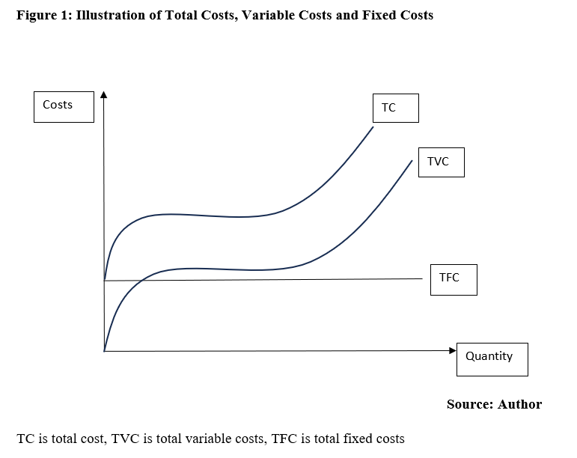
TC,VC and FC

Slide 30
Relationship TC,TVC and TFC
TFC is A straight line because it does not vary with the level of activity. Generally, we can expect variable cost curve to be a straight line though in practice it is not. This can be attributed to the law of variable proportions which states that with increasing levels of production, we can expect the TVC cost per unit to fall. The variable cost per volume of output is therefore expected to decrease per unit on extra production of a unit. A practical example is transportation of large amounts of people using a bus or a train. If the bus is full, the cost per unit of an individual is much lower compared to a bus which is half full. TC is the aggregate of TVC and TFC.

Slide 31
Average and Marginal Cost Functions
The average cost is the cost per unit of output. This average can be derived from the sum of TC, or TVC or TFC divided by the number of units of production. AFC is fixed cost per unit of output, AVC is variable cost per unit and AC is the total cost per unit of output.
Marginal cost, a critical cost concept, is the change in total cost due to a unit changing output. Since the fixed component of cost cannot be altered, MC is virtually the change in variable cost per unit, due to a change in output. It can also be referred to as a rate of change in the total cost.

Slide 32
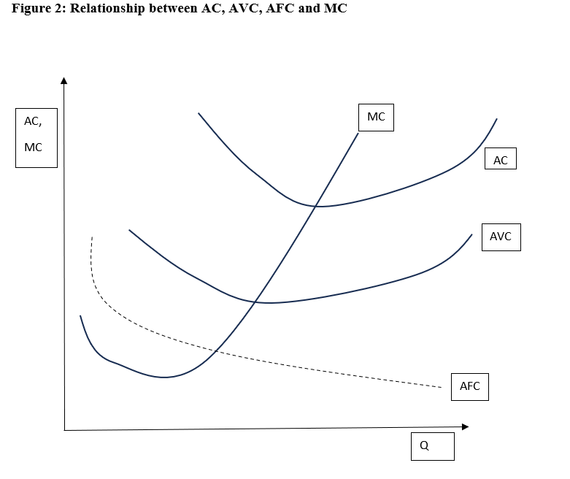
Relationship AC, AFC, AVC and MC

Slide 33
Relationship AC, AFC, AVC and MC
In Figure 2, the AFC curve is slowly declining because as the number of units of output increases the unit of output per each unit falls down. The AVC and AC curve are both U shaped. This can be explained by the law of variable proportions which is also known as the law of diminishing returns. AC is the sum of both AFC and AVC. When AFC and AVC fall, then AC also declines respectively. AVC reaches a minimum and starts rising.

Slide 34
Relationship AC, AFC, AVC and MC
MC is the variable cost per unit change in output. The MC curve is closely interlinked with changes in the AVC. When average costs decline, MC lies below the AC, when AC are constant, MC is equal to AC. MC passes through the minimum points of AVC. When AC rises, the MC curve is above it.

Slide 35
Relationship AC, AFC, AVC and MC
The relationship between, AC, AFC, AVC, and MC can be summarized as follows:
AVC and MC decline as TVC us increasing at a decreasing rate.
MV reaches a minimum output at which TVC reaches the inflection point.
For outputs above the minimum of the AVC, both AVC and MC increase, with MC rising at a faster rate.
MC is equal to AC when AC is minimum.
Neither TVC nor AVC nor MC can be negative.

Slide 36
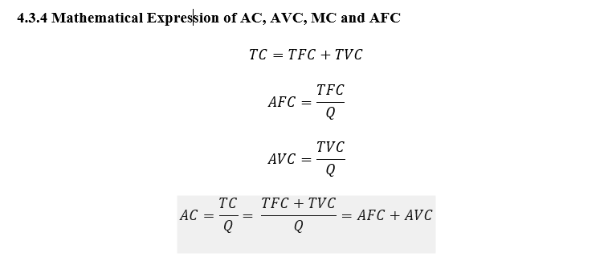
AC,AVC, MC and AFC

Slide 37
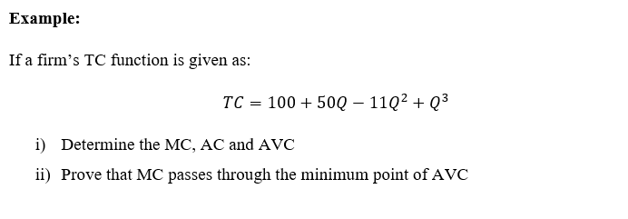
MC,AC,AVC

Slide 38
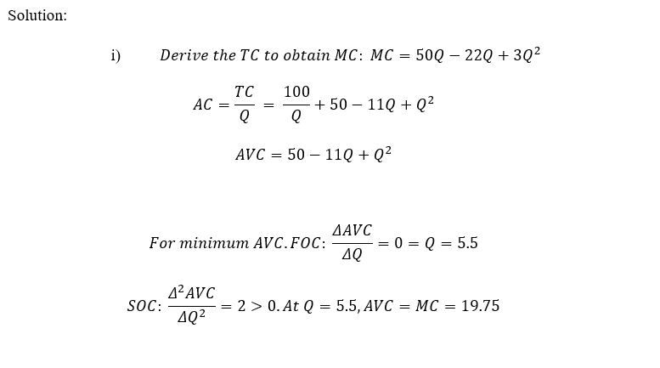
Solution

Slide 39
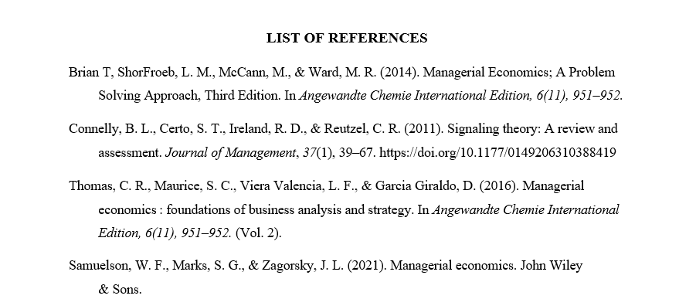
REFERENCES

Slide 40
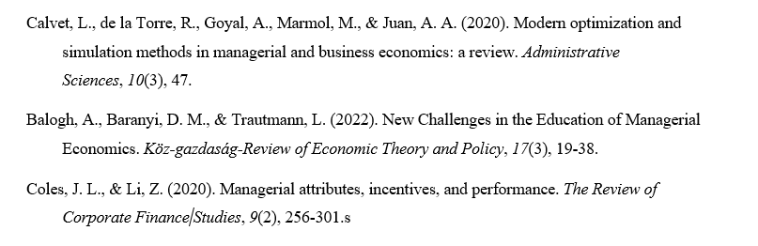
REFERENCES

Slide 41
Thank You
End of Lecture 4

