Slide 1
Managerial Economics
Lecture 5
Revenue and Elasticities of Demand
Lecturer: Dr Daniel Kungu Njau

Slide 2
Lecture Learning Outcomes
At the end of the lecture, you will be able to:
Understand the main concepts of revenue as applicable in Managerial Economics
Understand the relationship between marginal revenue and average revenue curves
Build an understanding of the relationship between cost, revenue, profit and break-even analysis
Comprehend the concepts of economies of scale and scope

Slide 3
Presentation Outline
Part I: Concepts of Revenue
Part II: Break Even Analysis
Part III: Economies of Scale

Slide 4
Part I:
Concepts of Revenue

Slide 5
Introduction to Revenue Concepts
The main basis for production is to sacrifice resources in order to gain revenue. Profit is earned when the sacrifice made is lower than the revenues to be generated from business activities. Therefore, the main basis for incurring a cost is so that a profit can be made.
Revenue can therefore be defined as the income or funds received by producers from the sale of goods and services to their clients. As the general rule the revenue should be higher than the cost for the business to continue going as of going concern. If the cost is higher, this can only be tolerated for a limited period of time with the expectations that future revenues will be much higher than the initial costs incurred.

Slide 6
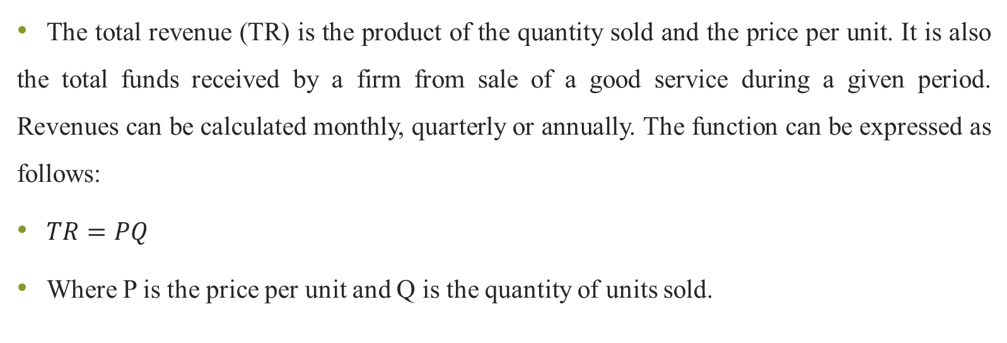
Total Revenue
The total revenue (TR) is the product of the quantity sold and the price per unit. It is also the total funds received by a firm from sale of a good service during a given period. Revenues can be calculated monthly, quarterly or annually. The function can be expressed as follows:
$TR=PQ$
Where P is the price per unit and Q is the quantity of units sold.

Slide 7
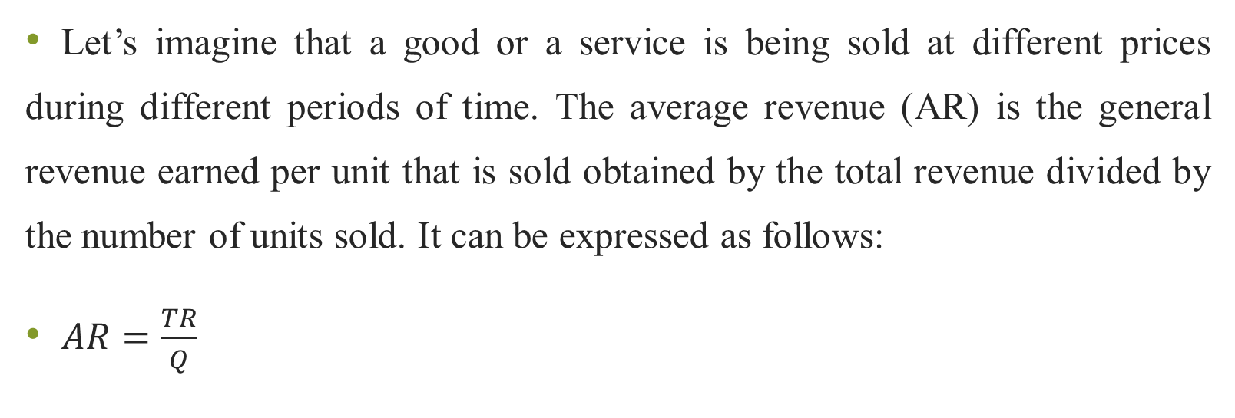
Average Revenue
Let’s imagine that a good or a service is being sold at different prices during different periods of time. The average revenue (AR) is the general revenue earned per unit that is sold obtained by the total revenue divided by the number of units sold. It can be expressed as follows:
$AR=\frac{TR}{Q}$

Slide 8
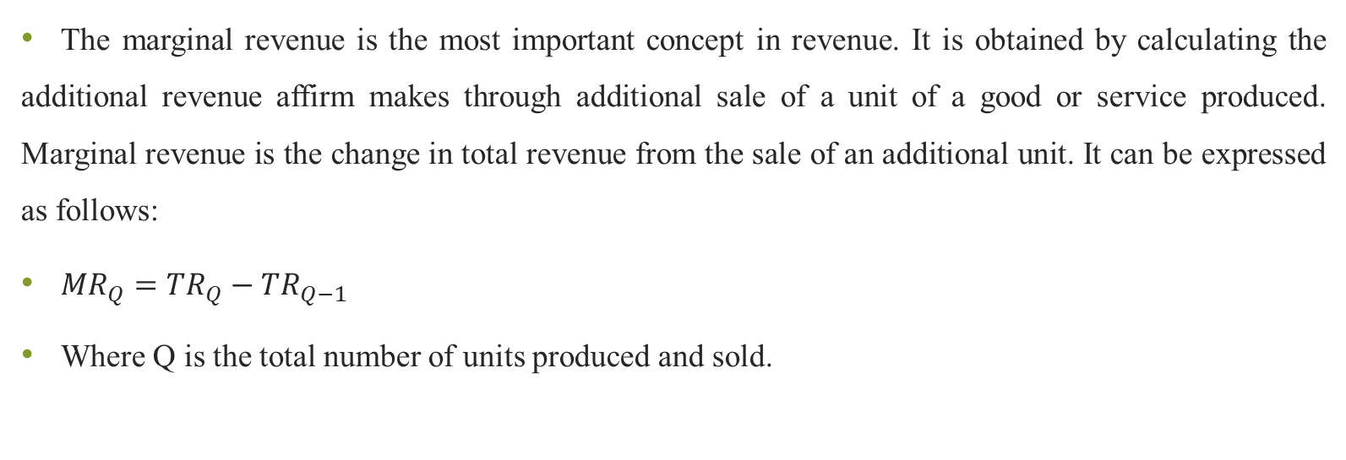
Marginal Revenue
The marginal revenue is the most important concept in revenue. It is obtained by calculating the additional revenue affirm makes through additional sale of a unit of a good or service produced. Marginal revenue is the change in total revenue from the sale of an additional unit. It can be expressed as follows:
${MR}_{Q}={TR}_{Q}−{TR}_{Q−1}$
Where Q is the total number of units produced and sold.

Slide 9
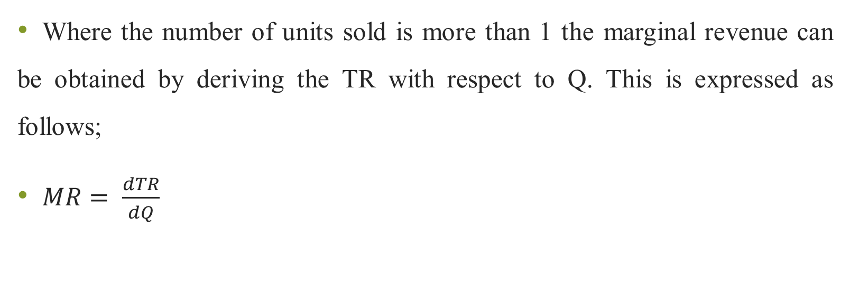
Marginal Revenue
Where the number of units sold is more than 1 the marginal revenue can be obtained by deriving the TR with respect to Q. This is expressed as follows;
$MR= \frac{dTR}{dQ}$

Slide 10
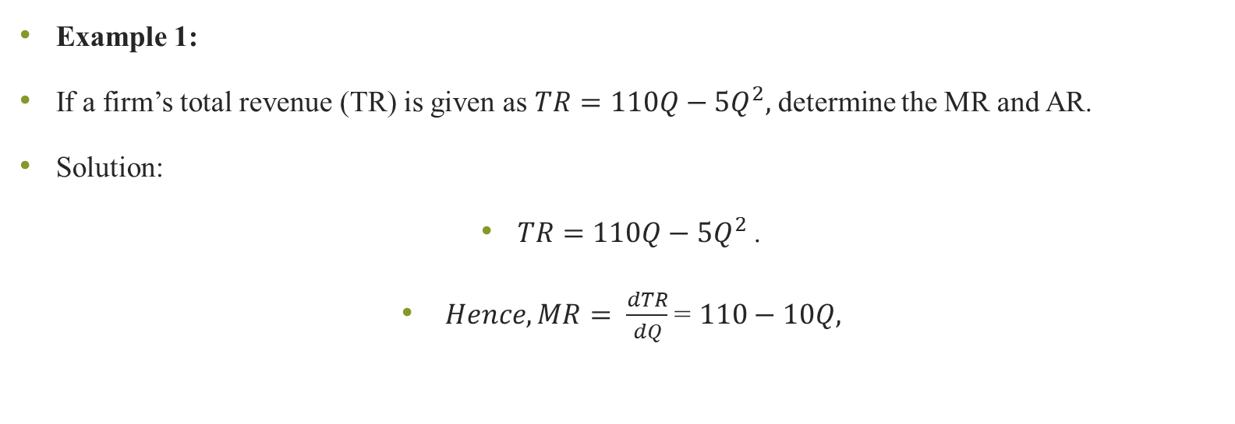
Practical Example
Example 1:
If a firm’s total revenue (TR) is given as $TR=110Q−{5Q}^{2},$ determine the MR and AR.
Solution:
$TR=110Q−{5Q}^{2}$.
$Hence, MR= \frac{dTR}{dQ}$ = $110−10Q,$

Slide 11
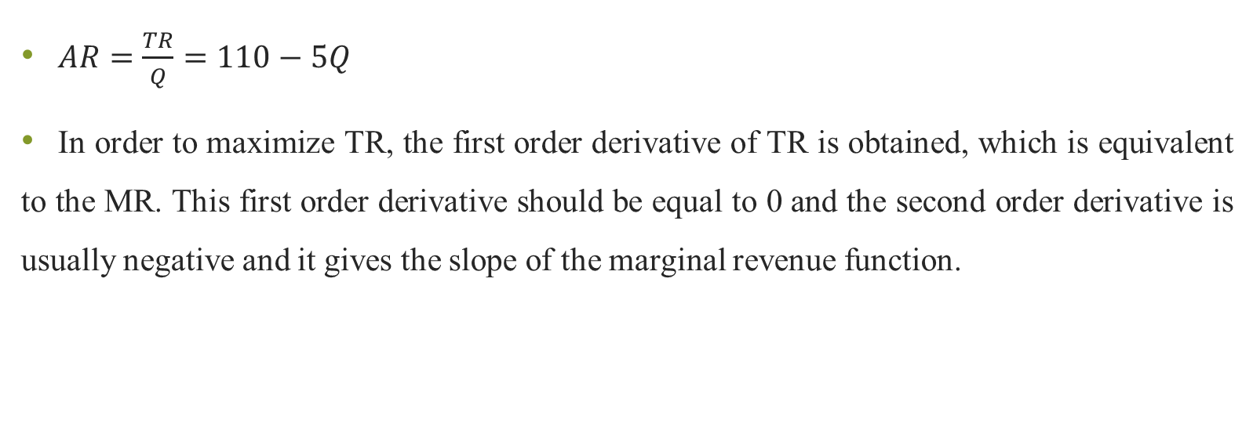
Practical Example
$AR=\frac{TR}{Q}=110−5Q$
In order to maximize TR, the first order derivative of TR is obtained, which is equivalent to the MR. This first order derivative should be equal to 0 and the second order derivative is usually negative and it gives the slope of the marginal revenue function.

Slide 12
Illustration of the Relationship TR and MR
P
Revenue
TR
MR
Quantity

Slide 13
Illustration of the Relationship TR and MR
In figure 2 the TR will be zero when nothing is sold. The MR is therefore the slope of the TR. The TR is also the sum of all MR for all the units sold.

Slide 14
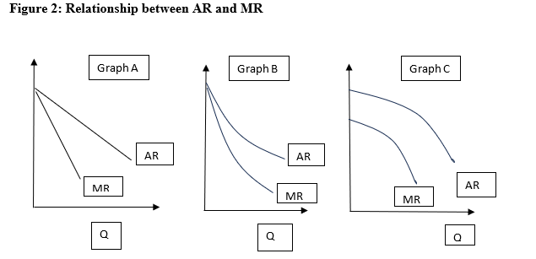
The link between Marginal Revenue and Average Revenue Curves
As discussed earlier, AR is the revenue earned per unit of output sold. The AR curve can be a straight line and it can also be convex or concave to the origin as shown in Figure 2.

Slide 15
The link between Marginal Revenue and Average Revenue Curves
Figure 2 illustrates the relationship between AR and MR. When AR is a straight line, as illustrated in graph A, MR lies midway to AR. When AR is convex to the origin as illustrated in graph B, MR will lie less than midway to AR. When AR is concave to the origin as illustrated in Graph C, MR will lie more than midway to AR.

Slide 16
End of Part I
Part II
Cost, Revenue and Profit
Break Even Analysis

Slide 17
Link between Cost, Revenue and Profit
The profit function shows an array of different outputs for which the firm makes a profit. In economics there is also the concept of supernormal profits. Profit is the necessary amount for which revenues should exceed the costs to ensure the firm continues as a going concern. Supernormal profits are earned on any profit which is above the normal profit. This is the point at which the slope of the MR > MC. Assuming a firm is rational production will continue until the point where the slope of the MR = MC.

Slide 18
Historical and Future Cost
Managers usually plan for these costs through formulating budgets and projection of cost estimates in order to adequately plan and prepare to cater them in the future.
The ability of a farm to continue as ongoing concern is highly dependent on its ability to cater for its future costs. A good example will be planning for future capital expenditure or exploring the feasibility of a project idea.

Slide 19
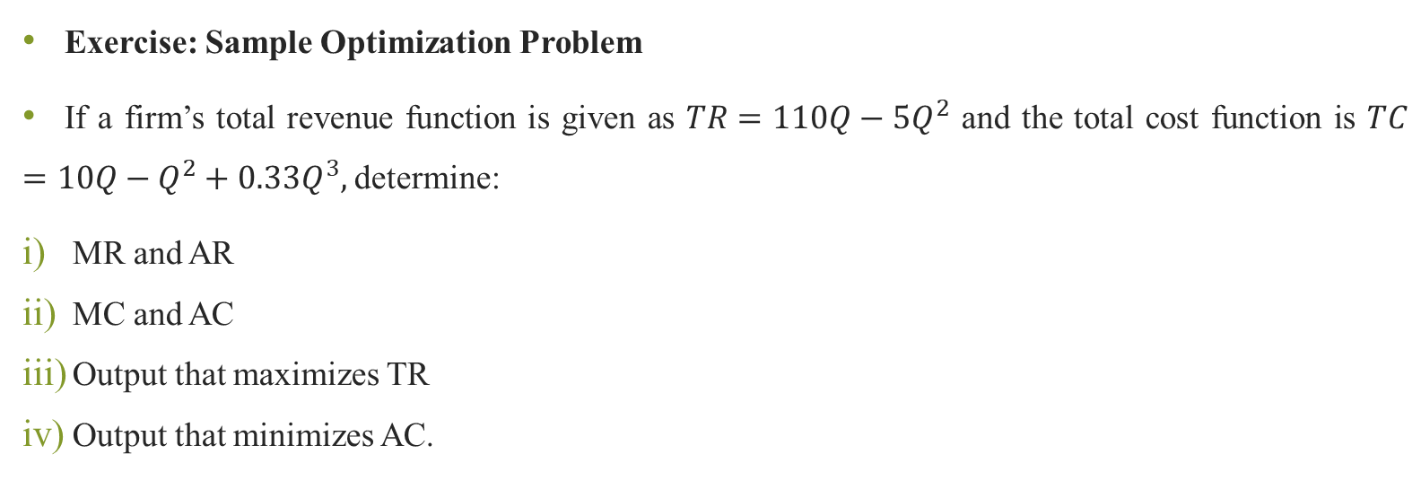
Practical Problem
Exercise: Sample Optimization Problem
If a firm’s total revenue function is given as $TR=110Q−5Q^{2}$ and the total cost function is $TC=10Q−Q^{2}+0.33Q^{3},$determine:
MR and AR
MC and AC
Output that maximizes TR
Output that minimizes AC.

Slide 20
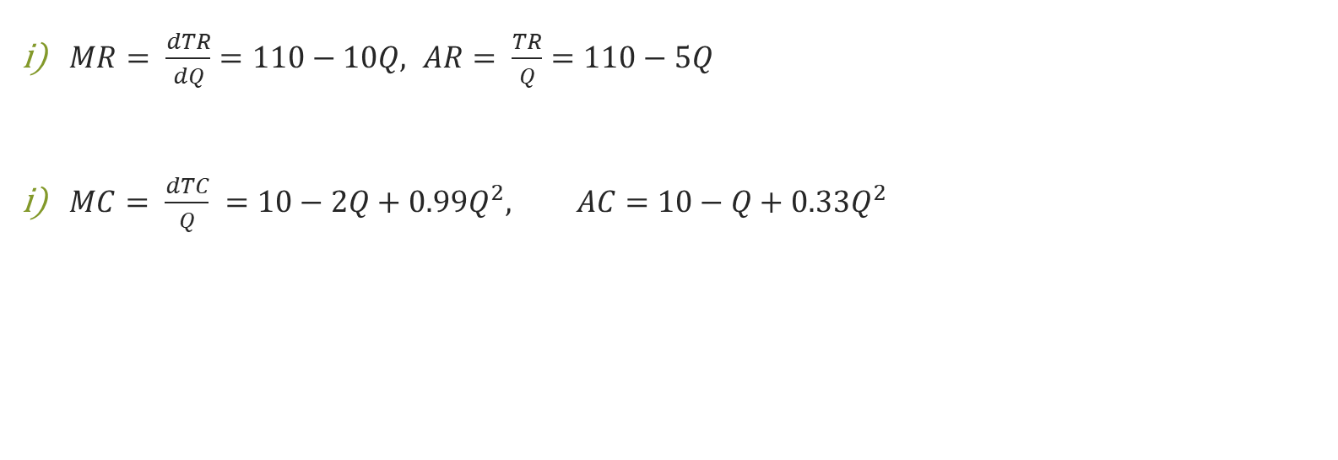
Practical Solution
$MR= \frac{dTR}{dQ}=110−10Q, AR= \frac{TR}{Q}=110−5Q$
$MC= \frac{dTC}{Q} =10−2Q+{0.99Q}^{2}, AC=10−Q+{0.33Q}^{2}$

Slide 21
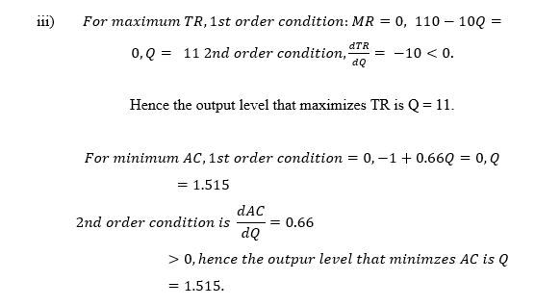
Practical Solution

Slide 22
Part II:
Break Even Analysis

Slide 23
Introduction to Break Even Analysis
This is an important application of cost and revenue analysis used in business to determine the point at which firm can make a decision to continue producing or to stop production because it is not profitable.
The analysis examines the relations between total revenue, total costs and profits at different levels of production for the firm.

Slide 24
Introduction to Break Even Analysis
These are costs which do not vary with the level of output. When a firm begins business for the first time it has to incur considerable cost in the acquisition of assets that will be used for producing a good or a service.
The cost incurred in acquiring machinery fitting equipment and related equipment are considered to be fixed and do not necessarily influence the level of production in subsequent periods. Initially long-term contracts such as rent or lease can be considered to be fixed costs.

Slide 25
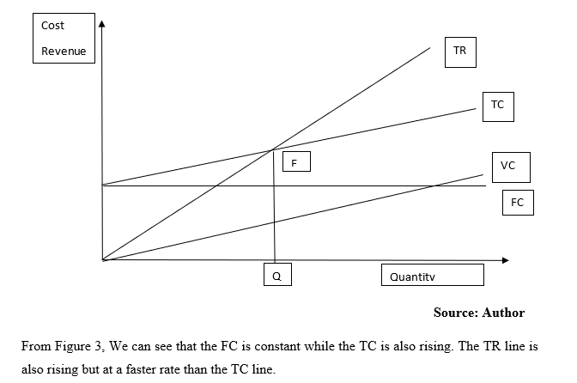
An Illustration of Break-Even Point

Slide 26
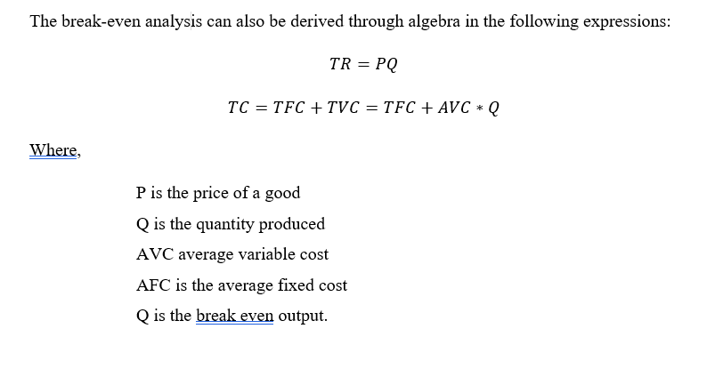
Algebraic Method

Slide 27
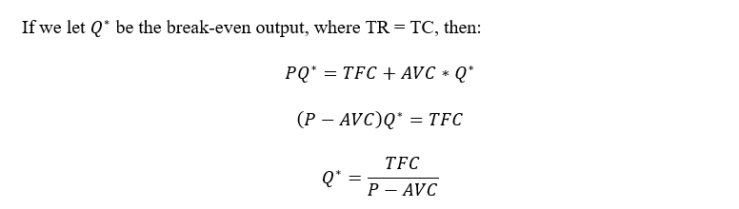
Algebraic Method

Slide 28
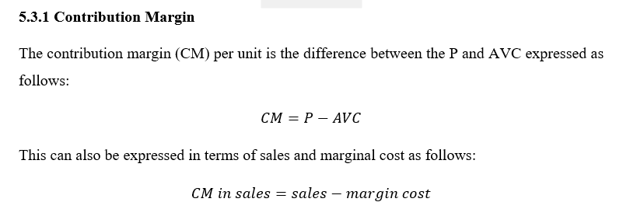
Contribution Margin

Slide 29
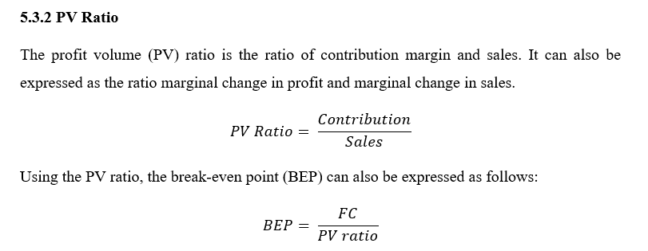
PV Ratio

Slide 30
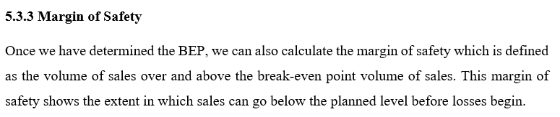
Margin of Safety

Slide 31
Limitation of Break-even Analysis
Although break even analysis is widely used in management its practical application has some assumptions and limitations which impair its robustness. These are:
BEP analysis does not stick into account possible changes in costs of a given time horizon.
BEP analysis does not account for varying levels of the selling price.
BEP analysis assumes that every service or good produced is subsequently sold.
BEP analysis does not account for changes in market conditions.

Slide 32
Economies of Scale
In economics. economies of scale usually kick in when the level of production has reached a point where the cost per unit of production becomes more economical and actually falls down because of mass production. It is therefore easier and much more sustainable for firms to innovate and produce in bulk compared to producing in small quantities.
Economies of scale therefore refer to the lower of cost of production by opting for mass production. When a firm reaches higher economies of scale it has been able to sufficiently recover its setup and production costs, and has also automated the production process.

Slide 33
Internal Economies of Scale
Internal economies of scale are those which are generated within the firm through the strategy it adopts in carrying out production. They are critical in ensuring the cost of production is sustainable. These are highlighted as follows:
Increased high levels of specialization, when a firm grows bigger more cars can be higher to take on specialist and repetitive tasks. This is an advantage because a worker can be able to specialize and become more efficient in performing a role, which means less time and greater levels of efficiency.

Slide 34
Internal Economies of Scale
Reliance on automation, Simplifying and making some of the processes automatic reduces the amount of labor and time spent in production and ensures consistency in the goods or services being produced. This means that higher levels of output can be achieved at much lower costs resulting in economies of scale.
Increased managerial economic role, The management can be able to specialize in overall supervision and management as opposed to a startup where the entrepreneur performs all the roles, some of which they may not be good at.
Reliance on financial economies of scale, a firm which is much bigger can be able to negotiate loans at competitive interest rates and also negotiate better terms from creditors. The additional savings made results in enhanced economies of scale.

Slide 35
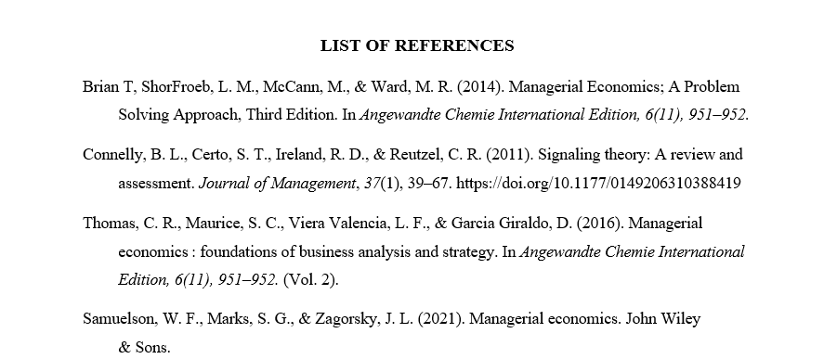
REFERENCES

Slide 36
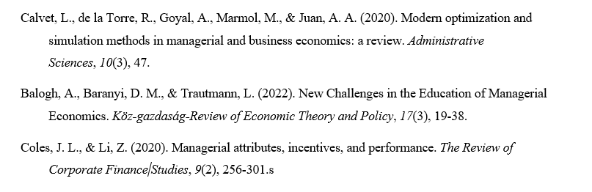
REFERENCES

Slide 37
Thank You
End of Lecture 5

