Slide 1
Managerial Economics
Lecture 6
Production Analysis
Lecturer: Dr Daniel Kungu Njau

Slide 2
Lecture Learning Outcome
At the end of the lecture, you will be able to:
Understand the economic analysis of a firm’s technology.
Develop an understanding of the distinction between short run and long run production functions.
Develop a grasp of the law of variable proportions and returns of scale
Introduce the concepts of isoquant and technical substitution

Slide 3
Presentation Outline
Part I: Production Analysis and Factors of Production
Part II: Production Function

Slide 4
Part I:
Introduction to Production Analysis
Production is a key aspect of everyday life. Many of the objects that make life comfortable are a byproduct of production by firms or individuals. Think of a product like a plane or a car a phone or a TV, all these items offer life conveniences and make our everyday life easier and better.
We normally don’t think so much about these objects, yet without them life may not be as enjoyable as it is and we would need to put a lot more effort to just achieve a particular simple task.

Slide 5
Part I:
Introduction to Production Analysis
These goods together with other many services that we enjoy Are a byproduct of production which generally involves combination of labor and capital using entrepreneurial knowledge, to come up with a final good or service that customers are willing and able to pay for.
Therefore, knowledge of production together with the economics of production is critical by managers in order to make optimal decisions.

Slide 6
Types of Inputs
Inputs generally refer to the raw materials labour and technology that has to be combined together to produce a good or a service. Managers have to decide the most optimal combination in light of constraints.
Inputs are usually scarce in nature and have to be utilized and combined carefully in order to generate some returns for the shareholders and to make the best use of them. The inputs we’re going to discuss are technology, capital and labour.

Slide 7
Types of Inputs
Additionally, inputs can be fixed or variable depending on whether we are examining the short run or long run period.
Variable inputs are those that vary in the short run period, such as, raw materials and unskilled labour. Fixed inputs are those that do not change in the short run. Examples include, land, machines, technology etc.

Slide 8
Types of Inputs
As discussed, prior technology is one of the most important drivers or catalyst in the production process. It determines the rate and quality of outputs. For example, during a car manufacturing process, increasing levels of automation results in faster production of cars at lower cost, with more consistent quality.
That’s the main reason why companies continue to invest in research and development with the aim of harnessing the power of technology to continue optimizing their production process. A good example is a company like Amazon which is continually optimizing its delivery process.

Slide 9
Factors of Production
These refer to the factors that are employed in the production process. Generally, they can be categorized as land, labour, capital and enterprise. These are discussed shortly as follows.

Slide 10
Land
Land is a fixed factor of production supplied by nature. It includes all natural resources available in the earth such as minerals, sunlight, water, forests etc.
The economic reward extracted from land is rent. Traditionally land has been one of the most important factors of production. However, in modern times other factors such as labour and capital are becoming more critical since lands supply is limited.

Slide 11
Labour
It normally refers to the mentor and human effort that goes into the production process. Luba is regarded as one of the most important factors of production because no production can take place without it.
Even with high levels of automation, both skilled and unskilled labour is still required. Skilled labour is considered to be more expensive because of the time required train and become proficient in carrying out a specific task.

Slide 12
Capital
Capital is another key component and a contributor to the factor of production. Capital can be summarized to be a gift of nature and also a large proportion of it is still produced by human labour.
Capital can also be categorized into two main categories. There is physical and human capital. Physical capital consists of resources such as machines, buildings, equipment, value adding goods etc. Human capital consists of special skills and knowledge that skilled people do have and is usually acquired through training experience and education. It generally helps to increase the value of goods and services produced.

Slide 13
Enterprise
Entrepreneurs are responsible for collecting coordinating and utilizing all the factors of production and therefore they are a key component in the production chain. This ability to assemble and utilize factors of production can be defined as enterprise.
Entrepreneurs usually take a risk by deciding to produce a good of service and risking the use of resources while uncertain of whether their product will have a demand in the market. The reward for these risk is profit and it’s the residual income after the entrepreneur has been able to meet all the business costs.

Slide 14
Production Function
The production function shows the technical relationship between factors of production and the output over a given period of time. For simplicity purposes, only capital and labour are used, since they are the most important factors of production.
Generally, a farm has to decide on the optimal mix between capital and labour needed to produce a good or a service. The main aim is to ensure that production is technically efficient and the utilization of both capital and labour is optimized in the process.

Slide 15
Production Function
The production function therefore is heavily dependent on the time period, a given level of technology and the relationship between capital and labour. In practice most production functions are expressed in form of capital and labour and one of the variables is held constant for the purposes of analysis.
In the short run we can expect that a firm can only be able to vary one factor of production, that is either capital or labour.

Slide 16
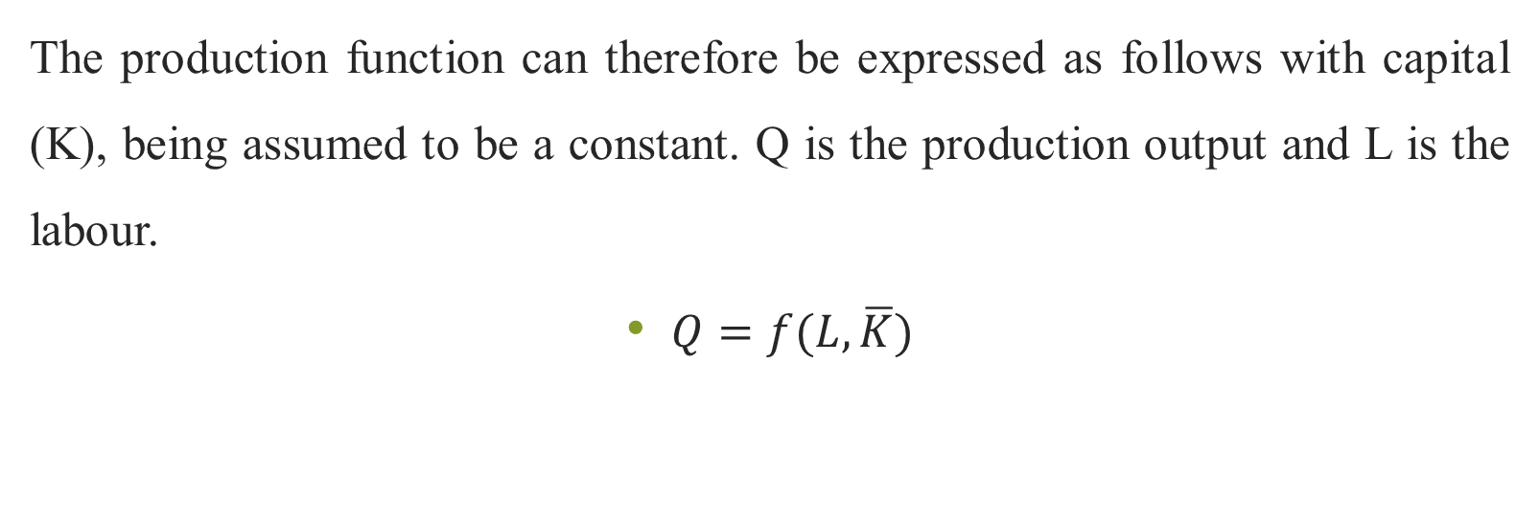
Production Function
The production function can therefore be expressed as follows with capital (K), being assumed to be a constant. Q is the production output and L is the labour.
$Q=f(L, \overline{K})$

Slide 17
Production Function
One key assumption of this function is that capital and labour can be substituted for each other. Additionally, as the units of the variable inputs are increased the proportion of views between the variable input and the fixed input continuously changes and this is explained by the curve curve of the production function.

Slide 18
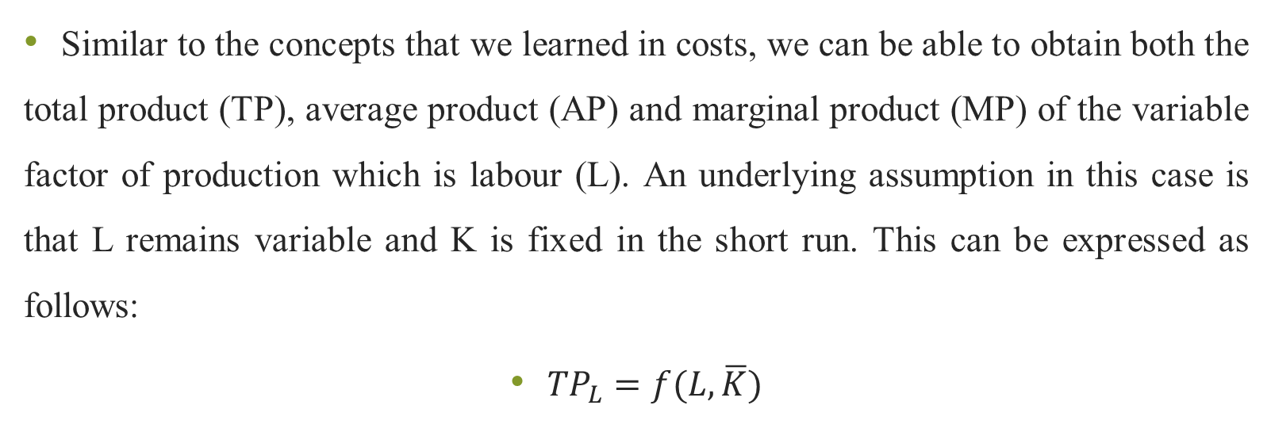
Production Function
Similar to the concepts that we learned in costs, we can be able to obtain both the total product (TP), average product (AP) and marginal product (MP) of the variable factor of production which is labour (L). An underlying assumption in this case is that L remains variable and K is fixed in the short run. This can be expressed as follows:
${TP}_{L}=f(L, \overline{K})$

Slide 19
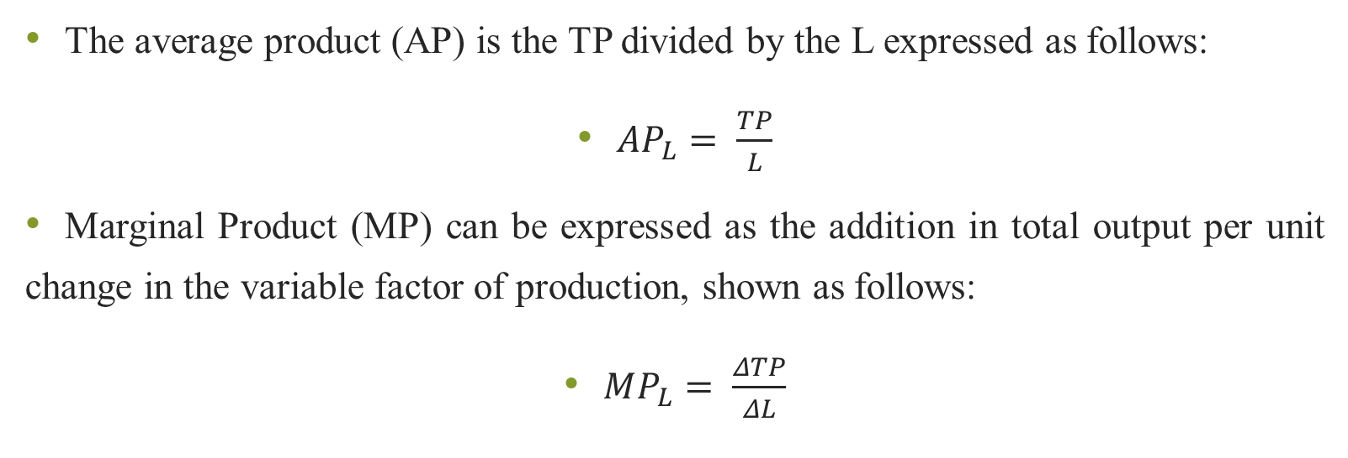
Production Function
The average product (AP) is the TP divided by the L expressed as follows:
${AP}_{L}= \frac{TP}{L}$
Marginal Product (MP) can be expressed as the addition in total output per unit change in the variable factor of production, shown as follows:
$MP_{L}= \frac{ΔTP}{ΔL}$

Slide 20
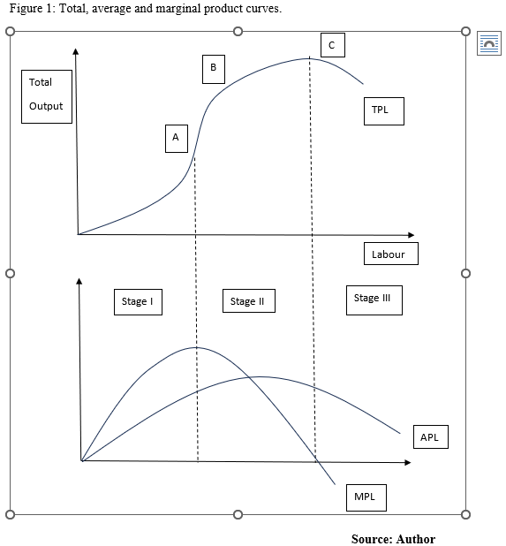

Slide 21
Increasing Returns
In the first stage of production when capital and labour are initially employed, we can expect that any additional inputs employed results in the total output increasing more than proportionally. The marginal product at this initial stage is continuously rising.
The firm has an incentive to continue adding the factors of production at this stage because of the increasing levels of returns, and the potential of further additional returns. This increasing return to the variable factor stage is shown in stage I of figure 1.

Slide 22
Diminishing Returns
In this stage II as shown in figure 1, The total output increases but by less than the proportionate increase in the labour input. The use of increasing amounts of the variable factor, which is labour in this case, beyond a certain point results in diminishing marginal returns of the total output.
The marginal product is therefore falling in stage II resulting in diminishing returns to the variable factor. THE TP is also increasing but at a decreasing rate. Both AP and MP are still positive but declining at a given rate.

Slide 23
Negative Returns
At this stage, the MP falls below 0 and the TP therefore begins to fall. This is shown in Stage III of figure I. This shows that inefficiencies have kicked in and adding more factors of production does not increase the total product. Generally, the firm should not operate at this stage.

Slide 24
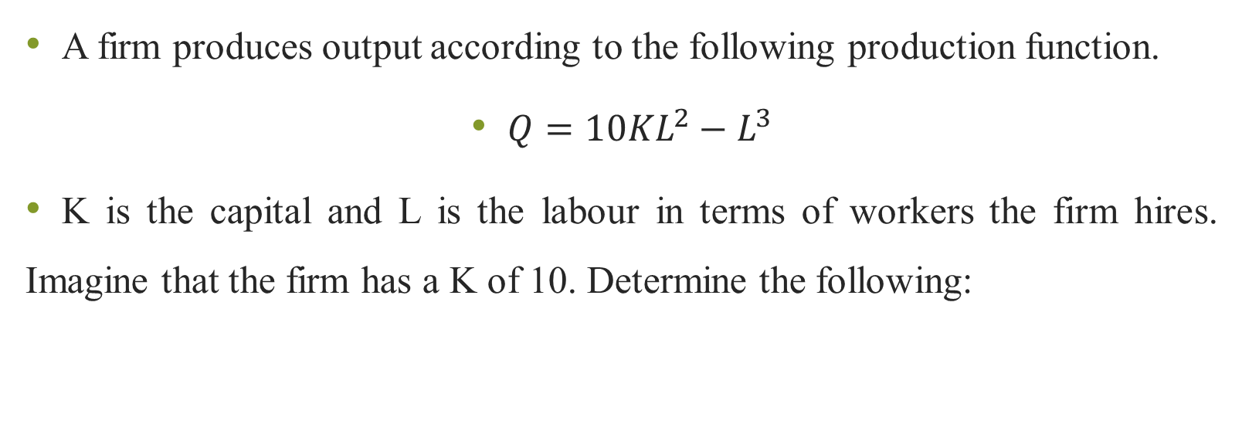
Practical Example
A firm produces output according to the following production function.
$Q=10{KL}^{2}−L^{3}$
K is the capital and L is the labour in terms of workers the firm hires. Imagine that the firm has a K of 10. Determine the following:

Slide 25
Practical Example
Calculate the marginal product and average product of labour
Determine the level of labour when diminishing marginal returns kick in
What is the level of labour at which the average product of labour is at its highest point?

Slide 26
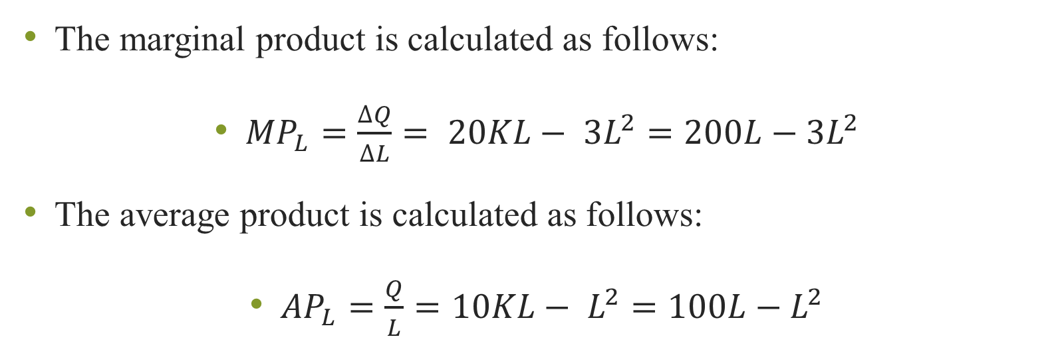
Solution
The marginal product is calculated as follows:
${MP}_{L}=\frac{∆Q}{∆L}= 20KL− {3L}^{2}=200L−{3L}^{2}$
The average product is calculated as follows:
${AP}_{L}=\frac{Q}{L}=10KL− L^{2}=100L−L^{2}$

Slide 27
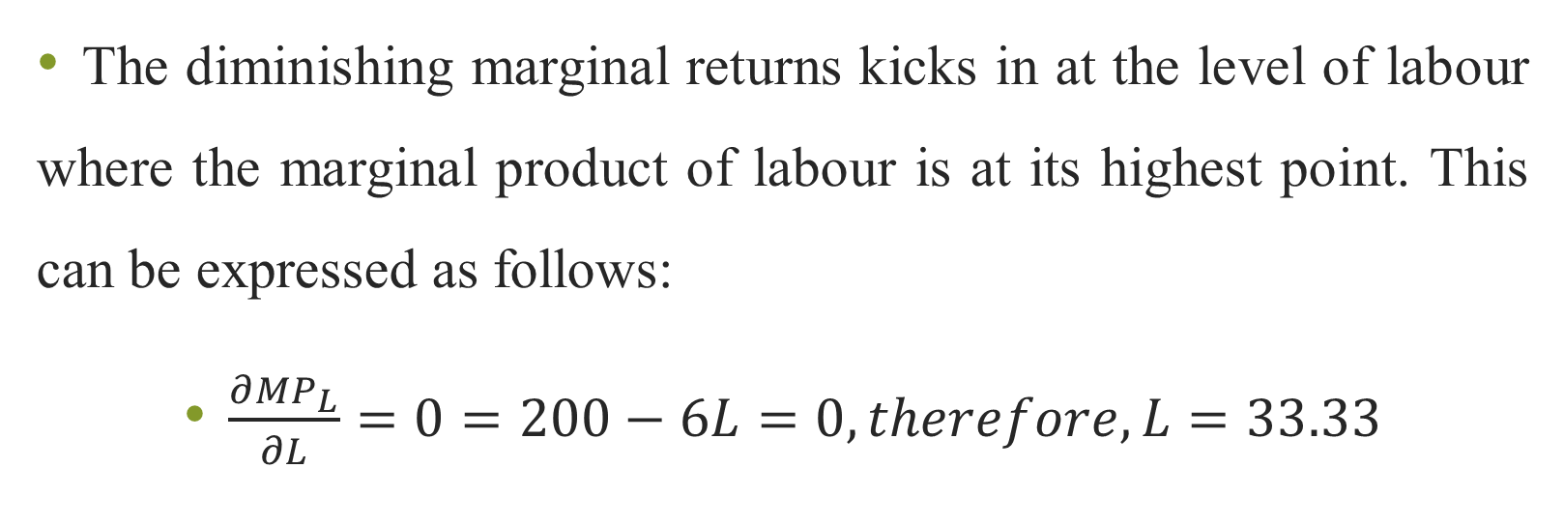
Solution
The diminishing marginal returns kicks in at the level of labour where the marginal product of labour is at its highest point. This can be expressed as follows:
$\frac{∂{MP}_{L}}{∂L}=0=200−6L=0, therefore, L=33.33$

Slide 28
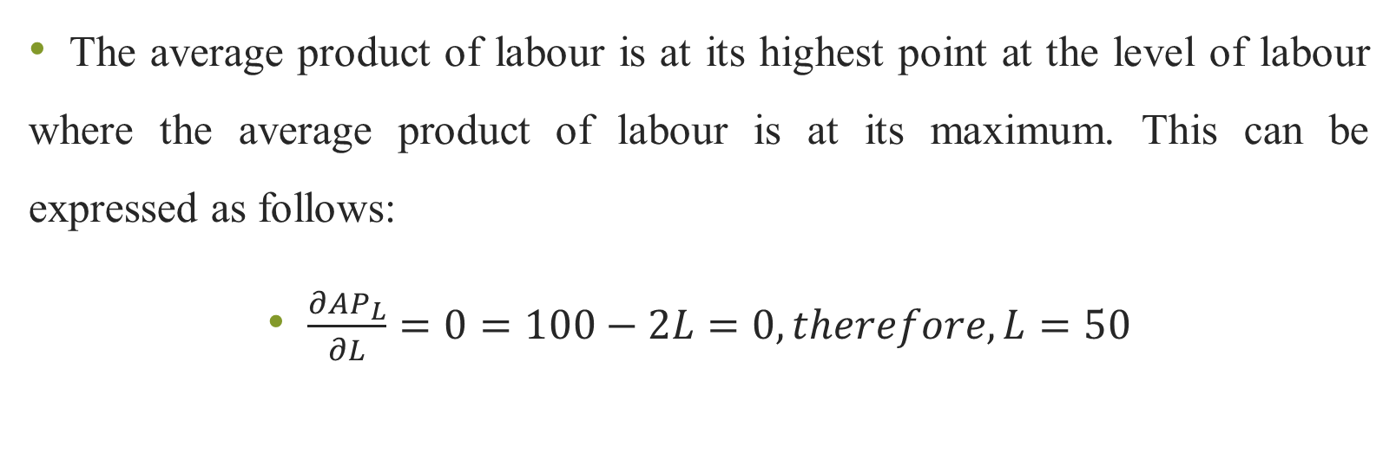
Solution
The average product of labour is at its highest point at the level of labour where the average product of labour is at its maximum. This can be expressed as follows:
$\frac{∂{AP}_{L}}{∂L}=0=100−2L=0, therefore, L=50$

Slide 29
Characteristics of Isoquants
An isoquant is a curve that shows various combinations of capital and labour that produces the same level of output. Isoquants have unique characteristics that will be discussed in the following section.

Slide 30
Downward Sloping
Isoquants are downward sloping because their shape illustrates the ability of capital to be substituted for labour and vice versa. The firm has to continuously evaluate the most optimal mix of capital and labour that will produce the desired output. This is illustrated in figure 2.

Slide 31
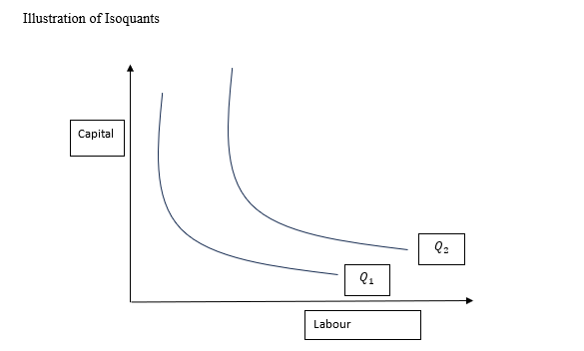
Isoquants: An Illustration

Slide 32
Non-Intersection of Isoquants
Since isoquants represent the same level of output but with different units of inputs, an intersection of two isoquants would imply that a single input combination produces two levels of output. This implication illustrates their parallel shape as shown in figure 2.

Slide 33
Convex to the origin
Since isoquants show the substitution between capital and labour, it reaches a point where employment of either capital and labour becomes more and more difficult to substitute one for the other. For example, if the firm chooses to use a lot of labour and less capital because capital is more expensive, it reaches a point where at least a minimum level of capital must be employed. In this case there is a limit to which the farm can continue substituting capital for labour. This is illustrated in Figure 2.

Slide 34
Isoquants: An Illustration

Slide 35
Higher Isoquant is equal to Higher Output
Isoquants also represent the highest level of prevailing efficiency that capital and labour can be combined efficiently. Higher isoquants represent additional units of capital and labour respectively as shown by Q1 and Q2 in figure 2.

Slide 36
Marginal Rate of Technical Substitution (MRTS)
The MRTS shows the substitution between capital and labour. It also represents the slope of the isoquant. It measures the reduction of one input which is compensated by increase in the substitute input in order to maintain the same level of production. For instance, if labour is much cheaper compared to capital a form may decide to employ more labour and less capital.

Slide 37
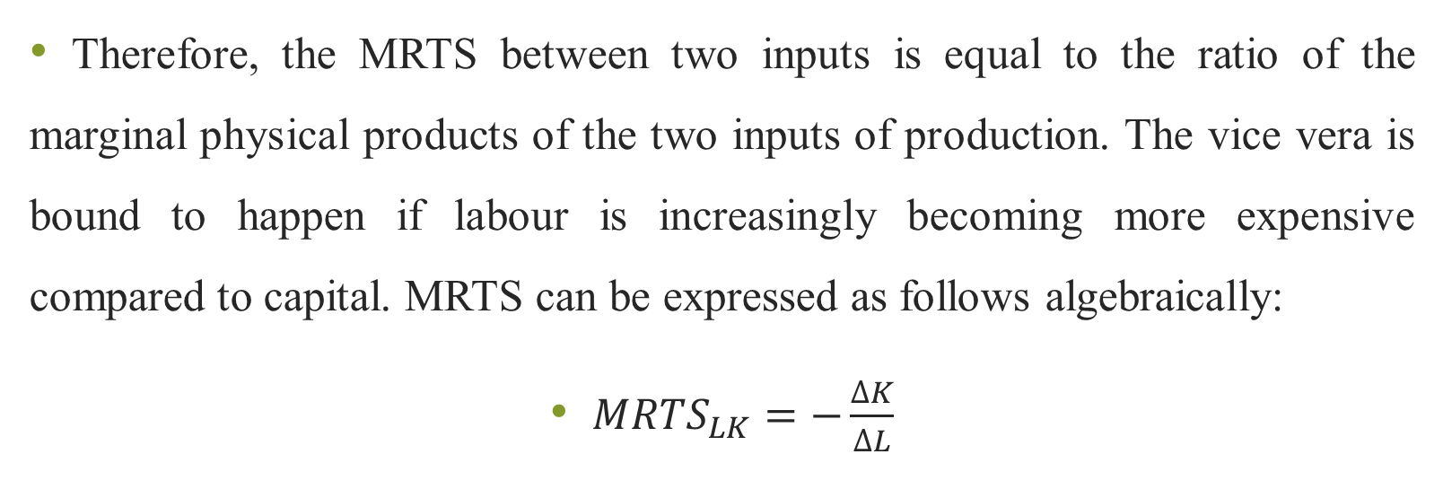
Marginal Rate of Technical Substitution (MRTS)
Therefore, the MRTS between two inputs is equal to the ratio of the marginal physical products of the two inputs of production. The vice vera is bound to happen if labour is increasingly becoming more expensive compared to capital. MRTS can be expressed as follows algebraically:
${MRTS}_{LK}=−\frac{∆K}{∆L}$

Slide 38
List of References
Brian T, ShorFroeb, L. M., McCann, M., & Ward, M. R. (2014). Managerial Economics; A Problem Solving Approach, Third Edition. In Angewandte Chemie International Edition, 6(11), 951–952.
Connelly, B. L., Certo, S. T., Ireland, R. D., & Reutzel, C. R. (2011). Signaling theory: A review and assessment. Journal of Management, 37(1), 39–67. https://doi.org/10.1177/0149206310388419
Thomas, C. R., Maurice, S. C., Viera Valencia, L. F., & Garcia Giraldo, D. (2016). Managerial economics : foundations of business analysis and strategy. In Angewandte Chemie International Edition, 6(11), 951–952. (Vol. 2).

Slide 39
List of References
Calvet, L., de la Torre, R., Goyal, A., Marmol, M., & Juan, A. A. (2020). Modern optimization and simulation methods in managerial and business economics: a review. Administrative Sciences, 10(3), 47.
Balogh, A., Baranyi, D. M., & Trautmann, L. (2022). New Challenges in the Education of Managerial Economics. Köz-gazdaság-Review of Economic Theory and Policy, 17(3), 19-38.
Coles, J. L., & Li, Z. (2020). Managerial attributes, incentives, and performance. The Review of Corporate Finance Studies, 9(2), 256-301.s

Slide 40
REFERENCES
Brian T, ShorFroeb, L. M., McCann, M., & Ward, M. R. (2014). Managerial Economics; A Problem Solving Approach, Third Edition. In Angewandte Chemie International Edition, 6(11), 951–952.
Connelly, B. L., Certo, S. T., Ireland, R. D., & Reutzel, C. R. (2011). Signaling theory: A review and assessment. Journal of Management, 37(1), 39–67. https://doi.org/10.1177/0149206310388419
Thomas, C. R., Maurice, S. C., Viera Valencia, L. F., & Garcia Giraldo, D. (2016). Managerial economics : foundations of business analysis and strategy. In Angewandte Chemie International Edition, 6(11), 951–952. (Vol. 2).

Slide 41
Thank You
End of Lecture 6

