Slide 1
Managerial Economics
Lecture 7
Perfect Competition
Lecturer: Dr Daniel Kungu Njau

Slide 2
Lecture Learning Outcome
At the end of the lecture, you will be able to:
Grasp the concepts around the different market structures.
Appreciate the nature of a perfectly competitive market.

Slide 3
Lecture Learning Outcome
Understand the market demand and firms demand under perfect competition.
Determine the pricing and output decisions of a perfectly competitive firm in the short run and long run.

Slide 4
Presentation Outline
Part I: Nature and Characteristics of Markets and Perfectly Competitive Market
Part II: General Market Demand and Firms Under Perfect Competition

Slide 5
Part I:
Nature and Characteristics of Markets and Perfectly Competitive Market

Slide 6
Part I:
Introduction to Markets
Understanding market dynamics is one of the most important critical concepts in economics. A market is an institutional relationship between sellers and buyers.
Through mutual interaction, buyers and sellers reach a mutually agreeable price. The interaction can be in person or thorough virtual means like telephone or the internet.

Slide 7
Introduction to Markets
A market is therefore key in determining the price at which a particular commodity will be bought or sold at.

Slide 8
Market Characteristics:
It is critical to understand what a market is and its unique characteristics.
Market morphology therefore describes the key market structures and characteristics of these structures and help us to understand more about the markets. Based on these, markets can be defined based on the following characteristics.

Slide 9
1. Nature of Competition
This generally refers to the distribution, size and number of sellers in the market. A possible market is one with a large number of sellers where each individual seller is small.
Think about a large shopping mall with various types of shops in it. Alternatively, there is also a market with one large player without any competitors. This normally applies to large utility firms for water or electricity which are a monopoly.

Slide 10
2. Nature of Product
This refers to whether a product is differentiated or homogeneous. A market where sellers produce a similar product can be treated as homogenous while the one where products are different among different sellers is considered differentiated.
Homogenous goods can also be treated as perfect substitutes while differentiated goods may differ in packaging, size, quality etc.

Slide 11
3. Freedom of Entry or Exit
Some markets are difficult to enter because they are specialized. Would be potential players face financial restrictions, legal hurdles and technological constraints.
For example, establishing a new telecommunication company is not easy because of the technological constraints, financial hurdles and regulatory hurdles a company has to face.

Slide 12
3. Freedom of Entry or Exit
These hurdles create a small group of players in the short run but this can be mitigated in the long run as companies find innovative ways of overcoming these barriers to entry.

Slide 13
4. Size and Number of Buyers
A typical market consists of two main parties; buyers and sellers. A market can also be defined in terms of number of buyers.
A typical market will consist of many small individual buyers but their total sum number is large.

Slide 14
4. Size and Number of Buyers
A market with many sellers and buyers is considered to be evenly balanced between the two.
However, in an exceptional case where the number of buyers is small but their individual size is big, it can be considered to be a buyers’ market since the market is controlled by buyers’ preferences.

Slide 15
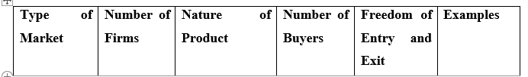
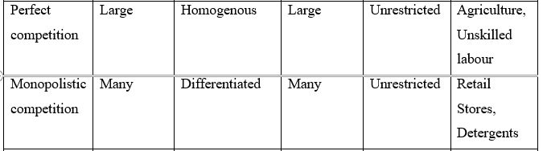
An Illustration of Market Characteristics

Slide 16
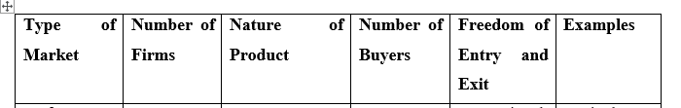
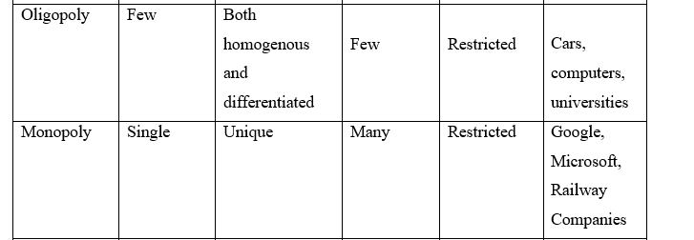
An Illustration of Market Characteristics

Slide 17
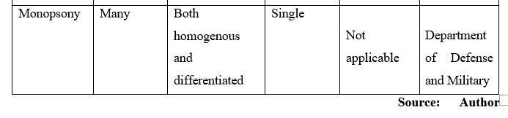
An Illustration of Market Characteristics

Slide 18
Definition: Perfect Competition
Perfect competition is the most common type of market that exists in the world today.
In a number of markets, the buyers and sellers are usually quite many with none of these controlling the market. The exit or entry of either does not have an impact on the market and remains unnoticeable.

Slide 19
Characteristics I:
Prescence of Large Number of Buyers and Sellers
Generally, there are many suppliers in the market each being of small stature, relative to the overall size of the market.
The market has numerous players such that the exit or entry of either a buyer or seller does not impact on the overall composition of the market. Any movement among the players does not exert influence on the market.

Slide 20
Characteristics II:
Homogenous Products
When products being sold in the market are identical or similar in nature, buyers are unable to discern the product of one buyer firm from another.
This normally applies to generic and unbranded products.

Slide 21
Characteristics II:
Homogenous Products
Therefore, buyers are indifferent to the different products sold by various sellers and will just consider the price and convenience of purchasing the product.
For homogenous products, they can be considered to be substitutes.

Slide 22
Characteristics III:
Freedom of Entry and Exit
In a typical competitive market, there is no barrier to entry and exit. New firms can easily enter the market and old ones can exit.
As long as there is a profit to be made, it will continue attracting players into the market while losses and downturns will push players out of the same market.

Slide 23
Characteristics III:
Freedom of Entry and Exit
Information asymmetries, where one party takes advantage of the other due to lack of access to information theoretically do not exist.

Slide 24
Characteristics IV:
Perfectly Elastic Curve
We can that the demand curve of a perfectly competitive firm to be perfectly elastic.
If a firm decides to charge a higher price than the existing market price, its demand will certainly be zero.

Slide 25
Characteristics IV:
Perfectly Elastic Curve
This is attributable to buyers who are sensitive to price changes and given that there are many sellers, buyers will opt for a seller whose price is competitive.
We can expect the demand curve to be a straight line for a perfectly elastic demand curve.

Slide 26
Characteristics V:
Perfect Mobility of Factors of Production
Another underlying assumption in perfect competition is the perfect mobility of factors of production.
This assumes that resources are free to move from one firm to the other. Resources will be allocated on the basis of returns with resources being channelled to the most viable alternative.

Slide 27
Characteristics VI:
Lack of Government Intervention
In an ideal perfect competition market, there is complete absence of government intervention in the market. There are no taxes, subsidies or regulation to influence the prices in the market.
The market has a free reign and the forces of demand and supply are left to act uninterrupted.

Slide 28
Characteristics VII:
The firm is a price taker
In a perfectly competitive market where no single firm is large enough to influence the market price, a single firm therefore becomes the price taker.
It has no choice rather than to take the price that is offered by the market and subsequently, it has to conform to the forces of supply and demand as dictated by the market.

Slide 29
Part II:
General Market Demand and Firms Under Perfect Competition

Slide 30
Demand and Revenue of a Firm
For a firm under perfect competition, the concepts of revenue and cost can be expressed in terms of price and quantity.
Under the assumption of rationality, we can assume that all firms aim to maximize profits. Additionally, since firms in a competitive market are price takers, then for them to make more profit, they can only adjust the quantity they sell.

Slide 31
Demand and Revenue of a Firm
Therefore, we can safely assume that TR depends on the quantity sold only. The TR is the product of the price and quantity sold. Hence, the Marginal Revenue (MR) can be expressed as follows:

Slide 32
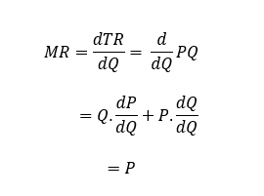
Demand and Revenue of a Firm

Slide 33

Demand and Revenue of a Firm
Under perfect competition, firms are price takers and can only supply as much as they want at the existing price in the market. This is expressed as follows:

Slide 34
Revenue, Cost and Profit Curves
To investigate how much each firm wants to sell, or how much each firm is willing to offer at the prevailing price, we employ the concepts of costs.
As illustrated in Figure 1 (next slide), TR is the total revenue curve which slopes upwards. The total cost (TC) curve in the short run follows the law of variable proportions that we learnt in the previous lecture. Subsequently, profit is derived as the difference between TR and TC.

Slide 35
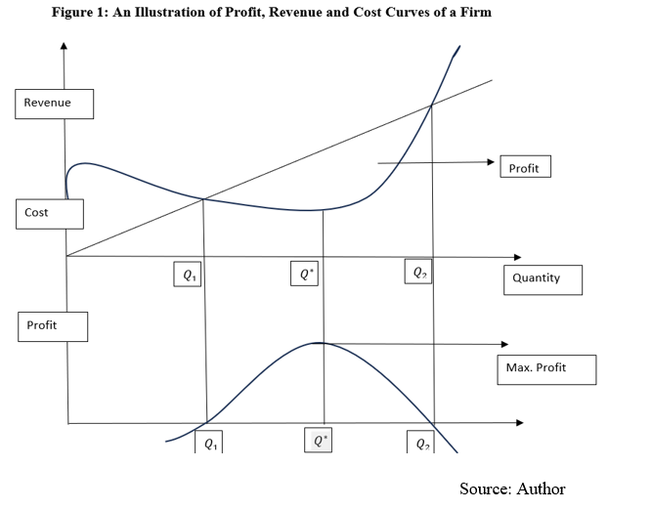
Revenue, Cost and Profit Curves

Slide 36
Revenue, Cost and Profit Curves
We can observe that in Figure 1, the profit curve starts on the negative axis, implying that as the firms begins operations before reaching point Q1 it starts by making losses.
This can be explained by the fact that the firm is yet to reach break even point.

Slide 37
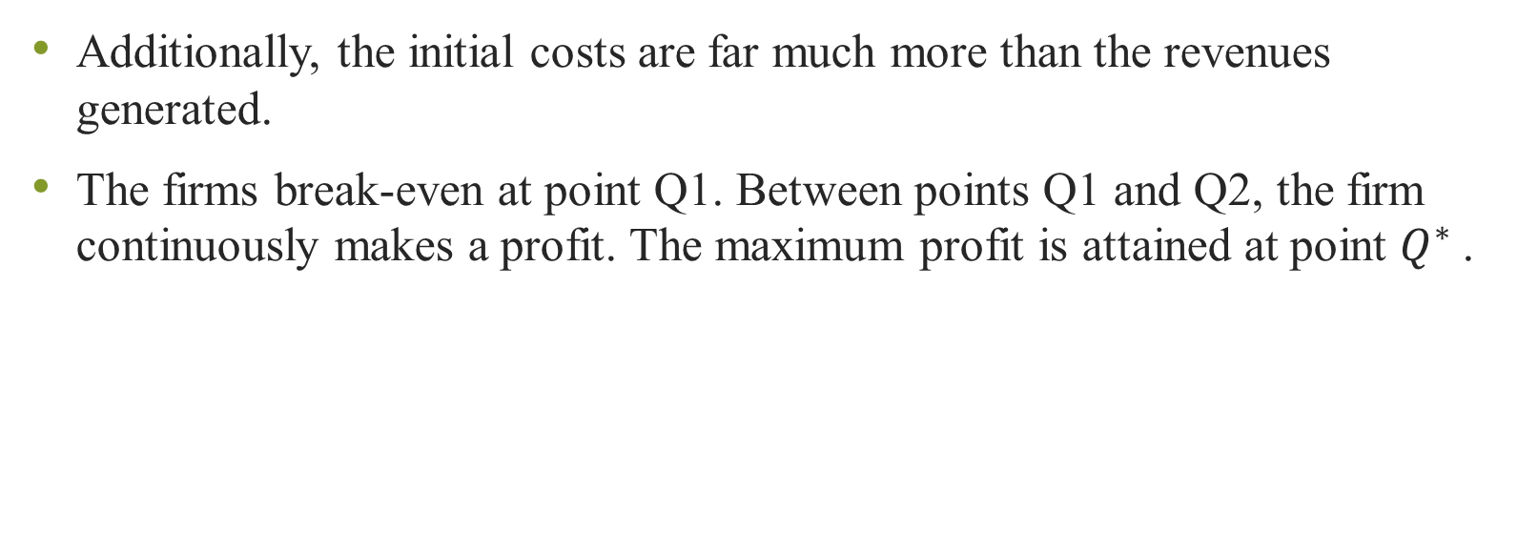
Revenue, Cost and Profit Curves
Additionally, the initial costs are far much more than the revenues generated.
The firms break-even at point Q1. Between points Q1 and Q2, the firm continuously makes a profit. The maximum profit is attained at point $Q^{∗}$.

Slide 38
Revenue, Cost and Profit Curves
Keeping in mind that the objective of every firm is to maximize profits, the relationship between revenues, cost and profit can be expressed algebraically as follows:

Slide 39
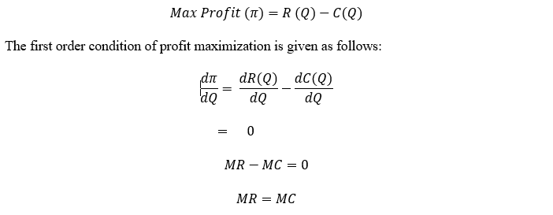
Revenue, Cost and Profit Curves

Slide 40
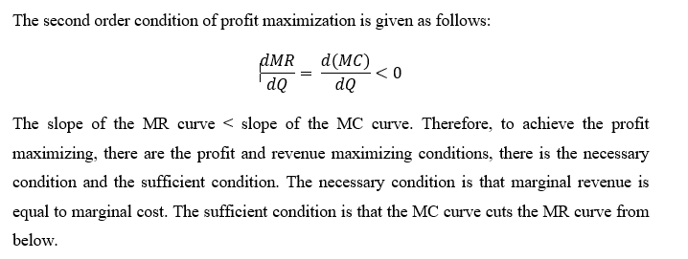
Revenue, Cost and Profit Curves

Slide 41
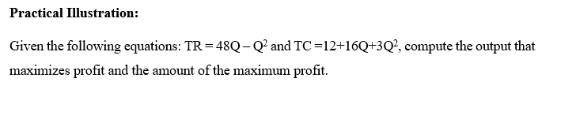
Revenue, Cost and Profit Curves: Practical Illustration.

Slide 42
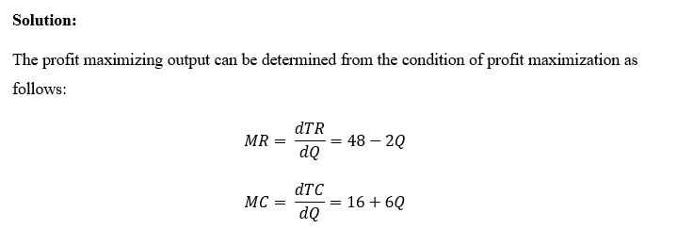
Revenue, Cost and Profit Curves: Practical Illustration

Slide 43
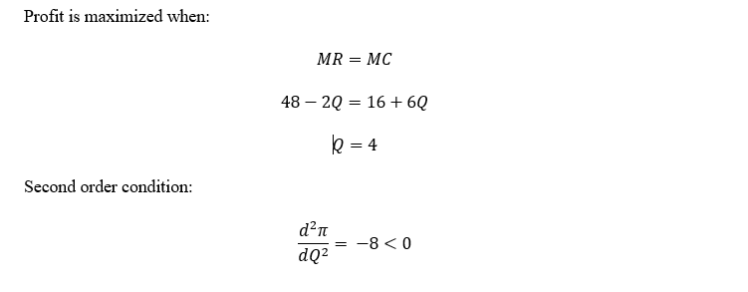
Revenue, Cost and Profit Curves: Practical Illustration

Slide 44
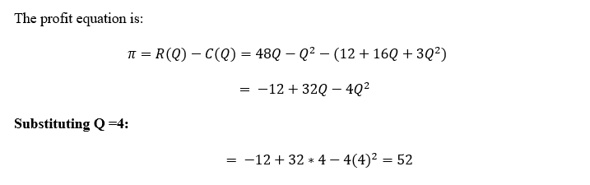
Revenue, Cost and Profit Curves: Practical Illustration

Slide 45
List of References
Brian T, ShorFroeb, L. M., McCann, M., & Ward, M. R. (2014). Managerial Economics; A Problem Solving Approach, Third Edition. In Angewandte Chemie International Edition, 6(11), 951–952.
Connelly, B. L., Certo, S. T., Ireland, R. D., & Reutzel, C. R. (2011). Signaling theory: A review and assessment. Journal of Management, 37(1), 39–67. https://doi.org/10.1177/0149206310388419
Thomas, C. R., Maurice, S. C., Viera Valencia, L. F., & Garcia Giraldo, D. (2016). Managerial economics : foundations of business analysis and strategy. In Angewandte Chemie International Edition, 6(11), 951–952. (Vol. 2).

Slide 46
List of References
Calvet, L., de la Torre, R., Goyal, A., Marmol, M., & Juan, A. A. (2020). Modern optimization and simulation methods in managerial and business economics: a review. Administrative Sciences, 10(3), 47.
Balogh, A., Baranyi, D. M., & Trautmann, L. (2022). New Challenges in the Education of Managerial Economics. Köz-gazdaság-Review of Economic Theory and Policy, 17(3), 19-38.
Coles, J. L., & Li, Z. (2020). Managerial attributes, incentives, and performance. The Review of Corporate Finance Studies, 9(2), 256-301.s

Slide 47
Thank You
End of Lecture 7

