Slide 1
Managerial Economics
Lecture 8
Monopoly
Lecturer: Dr Daniel Kungu Njau

Slide 2
Lecture Learning Outcome
At the end of the lecture, you will be able to:
Understand the nature and types of forms of a monopoly market.
Develop an understanding of monopoly power and the focus on barriers to entry of the market.
Comprehend the pricing and output decisions of a monopolist in the short- and long-term time horizons.

Slide 3
Presentation Outline
Part I: Nature, Types of Monopolies and their Power.
Part II: Pricing and Output Decisions of a Monopolist.

Slide 4
Monopoly: An Introduction
A monopoly can be deemed to be a market in which is a single seller sells a product with no close substitutes.
A monopoly can be categorized into two types, pure monopoly and monopoly.

Slide 5
Monopoly: An Introduction
A pure monopoly is the one that a firm sells a good or a service with no substitute. However, in practice, it is difficult to find a pure monopoly and only normal monopolies exist.
Additionally, some monopolies are natural monopolies because of huge barriers to entry making it difficult for potential firms to compete.

Slide 6
Features of a Monopoly
These are the identifying characteristic that makes a firm to be a monopoly. They are:
Single Seller
Single Product
Intertwined Firm and Industry

Slide 7
Features of a Monopoly
Independent Decision Making
Market Entry Restrictions

Slide 8
Single Product
If a firm sells a commodity which is mostly considered critical with no alternatives or very few close ones, then the firm can be said to have a monopoly in the supply of that particular product. This gives the firm a lot of power to determine its pricing decisions.
For example, Google holds a lot of sway in the search engine industry globally. Even though there are other competing search engines, there are smaller and do not have the recognition that Google has in a large part of the world.

Slide 9
Firm and Industry are Intertwined
Since a firm is operating as a single player in the market, then the market for that good or service can be equated to the monopoly firm.
There is no distinction between the market demand curve and the demand curve facing the firm. In the exceptional case where a monopolist is facing losses and deciders to shut down, then the industry it operates in ceases to exist a whole.

Slide 10
Independent Decision Making
A monopoly is able to make decisions without consideration of the players or competitors in the industry for the simple reason that they do not exist.
The monopoly firm is therefore regarded as the price taker. It gets to decide its own price and output based on individual demand and cost conditions.

Slide 11
Entry Restrictions
One of the compelling reasons why a monopolist exists is the restricted entry into the market in which operates from potential competitors.
These entry barriers safeguard the monopoly as a going concern in the absence of potential rivals.

Slide 12
Reasons why Monopolies Exist
Since existence of a monopoly is a classic sign of market imperfections, the question is, why do they exist since we expect the markets to self-correct?
The answer lies in the barriers to entry of any potential firms. Naturally, monopolies are protected by barriers to entry which can be summed up as the expensive costs to enter a market usually borne by new players. These barriers are discussed as follows.

Slide 13
Restriction by Law
A government regulation can automatically create a monopoly. A good example is where regulations only license a single player in the industry.
Alternatively, entry regulations to new firms may be so stringent such that new firms face insurmountable difficulties to overcome them.

Slide 14
Control of Key Resources
Some monopolies exist because of the strategic control they have over key essential raw resources control.
For example, in the production of tech related products, manufacturers tend to strategize and control key inputs such as chip making, in order to have continuous control over the manufacturing process.

Slide 15
Economies of Scale
Once a firm grows to a large enough size, its starts enjoying economies of scale and its production cost is lower compared to its revenues.
If the firm is a monopoly, these economies of scale are similar to the market it operates in. These advantages create barriers for any firms wishing to join the industry.

Slide 16
Specialized Know How
If a firm has been operating for a considerable time in the industry, it acquires experience and takes advantage of its long-term learning curve in terms of research and information.
This subsequently makes it difficult for competing firms who still have to go through a similar process.

Slide 17
Small Market Size
If the market is small in size in terms of its participants, it becomes difficult for potential entrants to enter the market. The most efficient player thus attains monopoly status.

Slide 18
Types of Monopolies
Legal Monopoly
Economic Monopoly
Natural Monopoly

Slide 19
Economic Monopoly
An economic monopoly comes into existence when a firm continuously grows and it eliminates competition through acquisitions, buy outs and mergers.
The monopoly firm in question may be more efficient or may have more resources to outcompete or buy out smaller competing firms.

Slide 20
Economic Monopoly
For example, even though there exist other smaller phone makers in the world, Apple and Samsung are considered to be the leading phone manufacturers and have a monopolistic hold in the global mobile market.
Similarly, a company like Microsoft exercise lots of control over the personal computer software around the world.

Slide 21
Natural Monopoly
This is based on the size of the market. If the size is too small to only accommodate one player or firm, then a natural monopoly is created because potential competitors cannot enter the market unless the original firm leaves.
A good example would be a large retail outlet having its presence in a small town. Other retailers cannot join unless the first retailer winds up its operations in the town.

Slide 22
Regional Monopoly
A monopoly firm may exist in a particular region, town or country due to availability of certain raw materials or other similar unique advantages.

Slide 23
Demand and Marginal Revenue Curves for a Monopoly Firm
Since a monopoly is the only player in the market, its demand curve is similar to the market one.
A monopoly firm is able to independently determine an optimal combination of output and price.

Slide 24
Demand and Marginal Revenue Curves for a Monopoly Firm
Additionally, we can expect its demand curve to be negatively sloped because the monopoly has total control of the market and can only be able to sell more if it reduces its price.

Slide 25
Demand and Marginal Revenue Curves for a Monopoly Firm
Furthermore, the monopoly demand curve is highly price inelastic because there are no close substitutes and consumers naturally have little alternatives available.

Slide 26
Demand and Marginal Revenue Curves for a Monopoly Firm
The demand curve is also not perfectly inelastic because pure monopolies do not exist in practice.
In summary, the monopolist does not have 100% control over its market, it can only increase the price or the quantity sold but not both at the same time.

Slide 27
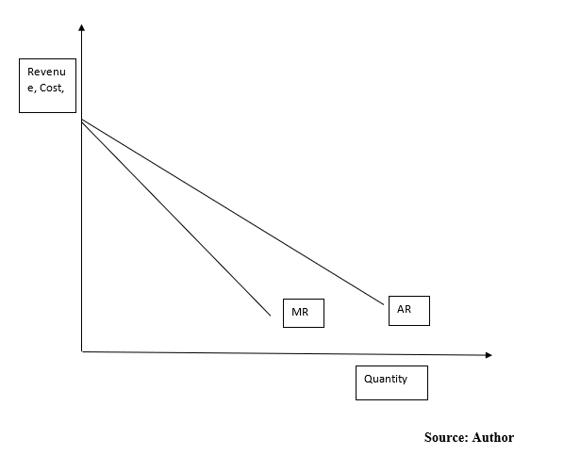
Figure 1: Illustration of a Demand and MR Curves of a Monopoly Firm

Slide 28
Figure 1: Illustration of a Demand and MR Curves of a Monopoly Firm
Figure 1 illustrates the average revenue (AR) and marginal revenue (MR) of the firm. The AR is also the demand curve of the firm and its slopes becomes the MR.
Both curves are downward sloping because a monopoly firm faces a normal demand curve which is highly inelastic.

Slide 29
Figure 1: Illustration of a Demand and MR Curves of a Monopoly Firm
The AR curve is downward sloping and the MR curve lies just below it. This is because if the monopoly wants to sell an additional unit of a product, it has to reduce its price.
The additional price derived from selling the additional unit is lower than the price received for the unit. Hence for the monopolist, MR is less than the price and MR curve just lies below the AR curve.

Slide 30
Illustration of a Demand and MR Curves of a Monopoly Firm
If the demand curve for the monopolist is linear, then the slope of the MR becomes twice of the AR and the MR curve lies half way between the AR and price axis.

Slide 31
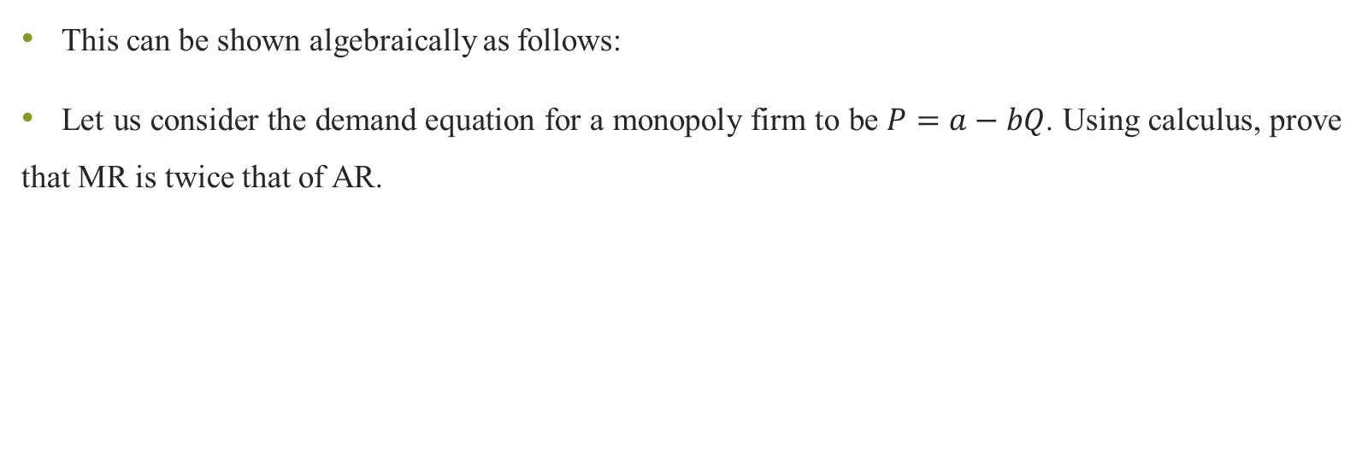
Illustration of a Demand and MR Curves of a Monopoly Firm
This can be shown algebraically as follows:
Let us consider the demand equation for a monopoly firm to be $P=a−bQ$. Using calculus, prove that MR is twice that of AR.

Slide 32
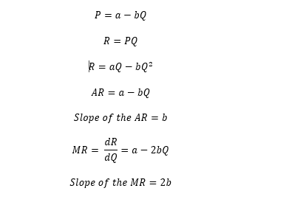
Illustration of a Demand and MR Curves of a Monopoly Firm

Slide 33
Price and Output Decisions in the Short Run
One of the underlying assumptions underpinning the study of monopolists is that a monopoly firm follows the rule of MR=MC when MC is rising.
A monopolist can therefore earn a supernormal profit, normal profit or subnormal profit in the short run.

Slide 34
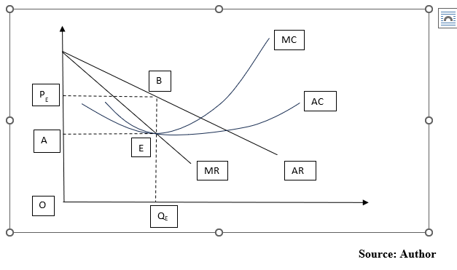
Monopolist Super Normal Profit

Slide 35
Monopolist Super Normal Profit
As illustrated in Figure 1, the supernormal profit is the most usual position for a monopolist. The equilibrium position and output are shown by letters E and Q_{E} respectively.
The monopolist is likely to charge the equilibrium price (P_{E}). Since AR is greater than AC, the firms earn supernormal profit.

Slide 36
Monopolist Super Normal Profit
The TR is given by the area under OQ_{E} and OP_{E} respectively. The TC is given by the area OAEQ_{E} and the total profit earned by the firm is shown by the region AP_{E}BE respectively.

Slide 37
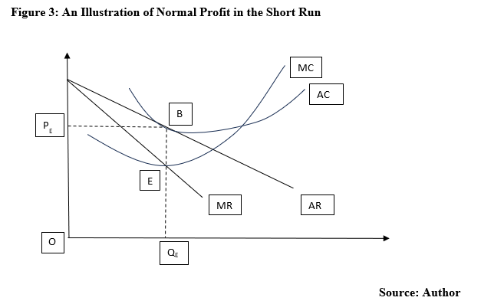
Monopolist Normal Profit

Slide 38
Monopolist Normal Profit
Figure 2 shows a case when a monopoly firm is earns just normal profits in the short run.
This usually happens in the initial years where there are high production and set up costs. AR is tangent to AC curve, and the equilibrium point is at E.

Slide 39
Monopolist Normal Profit
The output that maximizes profit is OQ_{E} and the equilibrium price is OP_{E}.
The TR earned is OP_{E}BQ_{E.} The TC is also OP_{E}BQ_{E} showing that TR=TC=AR= AC. Profit is therefore zero in this case.

Slide 40
List of References
Calvet, L., de la Torre, R., Goyal, A., Marmol, M., & Juan, A. A. (2020). Modern optimization and simulation methods in managerial and business economics: a review. Administrative Sciences, 10(3), 47.
Balogh, A., Baranyi, D. M., & Trautmann, L. (2022). New Challenges in the Education of Managerial Economics. Köz-gazdaság-Review of Economic Theory and Policy, 17(3), 19-38.
Coles, J. L., & Li, Z. (2020). Managerial attributes, incentives, and performance. The Review of Corporate Finance Studies, 9(2), 256-301.s

Slide 41
REFERENCES
Brian T, ShorFroeb, L. M., McCann, M., & Ward, M. R. (2014). Managerial Economics; A Problem Solving Approach, Third Edition. In Angewandte Chemie International Edition, 6(11), 951–952.
Connelly, B. L., Certo, S. T., Ireland, R. D., & Reutzel, C. R. (2011). Signaling theory: A review and assessment. Journal of Management, 37(1), 39–67. https://doi.org/10.1177/0149206310388419
Thomas, C. R., Maurice, S. C., Viera Valencia, L. F., & Garcia Giraldo, D. (2016). Managerial economics : foundations of business analysis and strategy. In Angewandte Chemie International Edition, 6(11), 951–952. (Vol. 2).

Slide 42
Thank You
End of Lecture 8

