Slide 1
Managerial Economics
Lecture 9
Oligopoly
Lecturer: Dr Daniel Kungu Njau

Slide 2
Lecture Learning Outcome
At the end of the lecture, you will be able to:
Understand the nature of an oligopoly market
Develop an understanding of the demand curve for a firm under oligopoly and examine the models of price and output under oligopoly.

Slide 3
Lecture Learning Outcome
Develop a grasp of collusive oligopoly and its various forms.

Slide 4
Presentation Outline
Part I: Understand the nature of an oligopoly market and its demand curve

Slide 5
Presentation Outline
Part II: Understand the models of price and output under oligopoly and collusive oligopoly and its various forms.

Slide 6
Introduction to Oligopoly
An oligopoly is a market dominated by a few sellers who sell differentiated or similar goods and services while watching closely the action of their rivals.
A key characteristic of this market is the interdependence of firms. No firm can single handedly make a decision without considering the action (reaction) of its rivals.

Slide 7
Introduction to Oligopoly
Being always cognizant of the rivals’ action is a key defining characteristic of the oligopoly. A classic example is the airplane manufacturing industry.
Although there are some few smaller airplane manufacturers like the Bombardier and Embraer companies, the civil aircraft market is largely dominated by the oligopoly/duopoly competition between Boeing and Airbus aircraft manufacturers.

Slide 8
Salient Features of an Oligopoly
Few Sellers
Product Differentiation
Entry Barriers
Interdependent Decision Making

Slide 9
Salient Features of an Oligopoly
Non Price Competition
Indeterminate Demand Curve

Slide 10
Salient Features of an Oligopoly:
Few Sellers
Although there may be a number of sellers, the general attribute of a monopoly is a few dominant sellers who possess an outsized control of the market.
A good example would be the global oligopoly in the phone manufacturing industry between Samsung and Apple.

Slide 11
Salient Features of an Oligopoly:
Few Sellers
Also, the global car industry is also dominated by a few car companies based from countries like Japan such as the Honda, Toyota, Mazda, Germany; Volkswagen and Mercedes and the US; Ford.
If there are only two strong established players, the market can be regarded as a duopoly. A good example is the Boeing, Airbus duopoly.

Slide 12
Salient Features of an Oligopoly:
Product Differentiation
Generally, oligopolies tend to differentiate their products. For example, Japanese cars take pride in simplicity and affordability while for German cars, they have a strong brand in exceptional engineering.
Even though the companies in an oligopoly are competing, they are doing so on the basis of differentiated products.

Slide 13
Salient Features of an Oligopoly:
Entry Barriers
Generally, there exist few or any legal hurdles to entry in the market.
However, for potential competitors, it is not easy to enter the oligopoly market due to a number of reasons. Many of these are similar to the barriers faced in a monopolistic competition.

Slide 14
Salient Features of an Oligopoly:
Entry Barriers
They include; huge amounts of investment requirements, strong consumer preferences for existing brands, advanced economies of scale and specialized technology acquired over time.

Slide 15
Salient Features of an Oligopoly:
Interdependent Decision Making
One of the overarching characteristics of a duopoly is firms have to take a lot of consideration what the rivals’ actions and reactions will possibly be.
For example, in the airplane manufacturing, Boeing and Airbus have been in regular competition over each other to produce planes that are fuel efficient and to build their order books from potential airplane buyers.

Slide 16
Salient Features of an Oligopoly:
Interdependent Decision Making
When Boeing launched its successful A320 new engine option, Boeing decided to act quickly and produced the Boeing 737 Max family of jets which unfortunately had a design flaw and were subsequently grounded.
Generally, a firm can only ignore rivals at its own peril.

Slide 17
Salient Features of an Oligopoly:
Non Price Competition
Firms in an oligopoly go to great strengths to avoid bidding and price wars.
They seek to outcompete each other on innovation and product differentiation rather than price.
Why? You may ask. It is because a competition based on price is almost a race to the bottom and both firms stand to lose if they undercut each other based on price.

Slide 18
Salient Features of an Oligopoly:
Non Price Competition
Additionally, the prevailing price is usually fixed after a long period of price competition and neither firm is interested in rocking this delicate price equilibrium.
To compete with each other, they pursue other lower risk competing strategies such as aggressive advertising, product bundling, influencing value perception of customers and innovative products to outcompete their rivals.

Slide 19
Salient Features of an Oligopoly:
Indeterminate Demand Curve
The demand curve of a firm operating in an oligopoly cannot be easily determined since the firm is unaware how rival firms in the industry will react.
If a firm for example decides to reduce its price, expecting to increase its demand for its good or service, if the rival firm also decides to counter this by reducing the price, then it’s a net zero effect and the demand curve is expected to be price inelastic.

Slide 20
Salient Features of an Oligopoly:
Indeterminate Demand Curve
Alternatively, if the rival’s product offering is better, then the price reduction will have minimal effect on quantity demanded. Therefore, the demand curve for the firm can either be elastic or inelastic.

Slide 21
Duopoly
Duopoly is a special case of oligopoly where only two dominant players firms exist in the market.
This is created by the domino effect of smaller inefficient firms falling out of the market and only the strong firms which can outcompete the smaller firms remain.

Slide 22
Duopoly
Additionally, there may be smaller firms but only two major ones are able to compete on an almost equal footing. A number of industries do exhibit these characteristics.
These include phone manufacturers, telecom industries, car manufacturers, airplane manufactures, heavy mining, chip making etc. In summary, a duopoly is an oligopoly where only two main competitors dominate the market.

Slide 23
Price and Output Decisions in an Oligopoly
Due to the difficulties of determining equilibrium price and output in an oligopoly, it is difficult to estimate an accurate demand for an oligopolist.
Various models have been postulated that attempt to explain the equilibrium of a firm under conditions of oligopoly.

Slide 24
Price and Output Decisions in an Oligopoly
The models are unable to predict the quantity and the price.
However, they attempt to show the impact of interdependence among firms and how their decisions influence output and pricing. One of the most common models employed in understanding oligopoly is the Cournot’s model.

Slide 25
Cournot’s Model
In this model, two competing firms decide to ignore their interdependence and take independent decisions as if they are only ones in the market (act like a monopoly).
One firm makes the first decision of entering a market and the other follows. The model is underpinned by various assumptions. The firms are engaged in the packaging of mineral water.

Slide 26
Assumptions of Cournot’s Problem
Each firm has the main goal of maximizing its profit and attaining an equilibrium point where the MC = MR.
Cost of production is zero because the water is packaged from springs available freely in nature. Therefore, the MC=0.

Slide 27
Assumptions of Cournot’s Model
The market demand curve is linear and the curve is a downward sloping straight line.
Each firm decides on its price assuming the other firms’ output is given.
Firms are able to sell their entire profit maximizing output at the price determined by their demand curves.

Slide 28
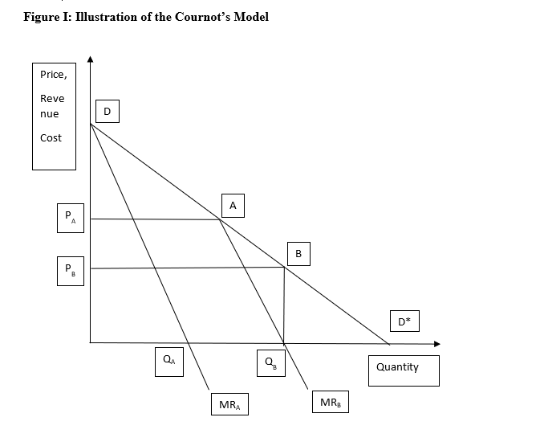
Figure I: Illustration of the Cournot’s Model

Slide 29
Explanation to Figure 1: Firm A
In figure I, firm A is the first entrant to the market of packaged water. The firm attempts to maximize its output and continuous to produce until MR=MC.
Its demand is given by D* and the MR_{A} becomes its marginal revenue curve.

Slide 30
Explanation to Figure 1: Firm A
Because the firm is rational and it intends to maximize its revenue and profit, firm A will produce where MC=MR. Since MC=0, and at equilibrium MR = MC = 0.
The firm will therefore produce OQ_{A} output and levy a price of OP_{A} as per the demand curve AR.

Slide 31
Explanation to Figure 1: Firm B
Still in figure I, firm B will now enter the market after firm A and find that firm A has already taken control over half of the market.
It reasonably expects thar firm A will continue to produce OQ_{A} and therefore decides to consider Q_{A}D as the market available to it and AD* as its demand curve.

Slide 32
Explanation to Figure 1: Firm B
Its MR curve becomes MR_{B.} Firm B will continue attempting to maximize its profit and will produce until its MC=MR, which is Q_{B}.
At this point, its cost of production is zero because MR =MC = 0. Firm B will therefore produce Q_{A}Q_{B} and sell it at a price of OP_{B}. Firm A therefore supplies half of the market and firm B the other half.

Slide 33
Practical Example: Question
Suppose the demand function of an industry is given by P = 100 – 0.5X and there are only two firms; A and B in it. Let also assume that firm A has a constant function C_{A} = 5X_{A} and firm B has an increasing cost function C_{B} = 5X²_{B.} Compute their profit maximizing levels of output.

Slide 34
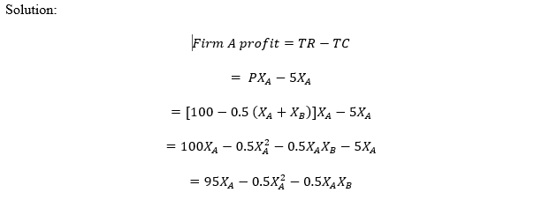
Practical Example: Solution

Slide 35
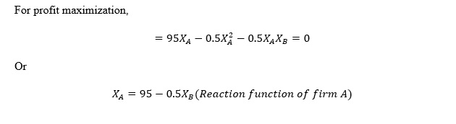

Practical Example: Solution

Slide 36
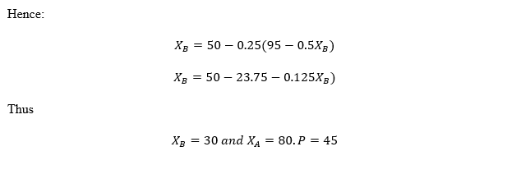
Practical Example: Solution

Slide 37
Collusive Oligopoly
Firms in an oligopoly in some cases may decide to work together, formally or informally, for a mutually beneficially interest.
They may enter into an agreement to work together on various aspects of trade such as price, market share, quantity etc.

Slide 38
Collusive Oligopoly
These agreements may be open or subtle, in order to attract the attention of antitrust laws enforcement.
Cases where a number of firms enter into an arrangement to collaborate on certain aspects is known as collusion. This collusion may be open or tacit. If the collusion is open and formal, it is known as a cartel.

Slide 39
Cartel
A cartel is an open and formal agreement among competing firms. They occur when firms are selling homogenous products and the oligopoly market provides a great avenue for collusion.
Cartel may decide to set a common price, agree on a certain quantity or even subdivide the market between themselves. Cartel may also be centralized or market sharing in nature.

Slide 40
Cartel
A centralized cartel makes decision about a common pricing while a market sharing cartel may divide the market between the participating firms and each firm gets its assigned territory.

Slide 41
List of References
Brian T, ShorFroeb, L. M., McCann, M., & Ward, M. R. (2014). Managerial Economics; A Problem Solving Approach, Third Edition. In Angewandte Chemie International Edition, 6(11), 951–952.
Connelly, B. L., Certo, S. T., Ireland, R. D., & Reutzel, C. R. (2011). Signaling theory: A review and assessment. Journal of Management, 37(1), 39–67. https://doi.org/10.1177/0149206310388419
Thomas, C. R., Maurice, S. C., Viera Valencia, L. F., & Garcia Giraldo, D. (2016). Managerial economics : foundations of business analysis and strategy. In Angewandte Chemie International Edition, 6(11), 951–952. (Vol. 2).

Slide 42
List of References
Calvet, L., de la Torre, R., Goyal, A., Marmol, M., & Juan, A. A. (2020). Modern optimization and simulation methods in managerial and business economics: a review. Administrative Sciences, 10(3), 47.
Balogh, A., Baranyi, D. M., & Trautmann, L. (2022). New Challenges in the Education of Managerial Economics. Köz-gazdaság-Review of Economic Theory and Policy, 17(3), 19-38.
Coles, J. L., & Li, Z. (2020). Managerial attributes, incentives, and performance. The Review of Corporate Finance Studies, 9(2), 256-301.s

Slide 43
REFERENCES
Brian T, ShorFroeb, L. M., McCann, M., & Ward, M. R. (2014). Managerial Economics; A Problem Solving Approach, Third Edition. In Angewandte Chemie International Edition, 6(11), 951–952.
Connelly, B. L., Certo, S. T., Ireland, R. D., & Reutzel, C. R. (2011). Signaling theory: A review and assessment. Journal of Management, 37(1), 39–67. https://doi.org/10.1177/0149206310388419
Thomas, C. R., Maurice, S. C., Viera Valencia, L. F., & Garcia Giraldo, D. (2016). Managerial economics : foundations of business analysis and strategy. In Angewandte Chemie International Edition, 6(11), 951–952. (Vol. 2).

Slide 44
Thank You
End of Lecture 9

