Slide 1
Managerial Economics
Lecture 10
Demand Forecasting
Lecturer: Dr Daniel Kungu Njau

Slide 2
Lecture Learning Outcomes
At the end of the lecture, you will be able to:
Understand the relevance of demand forecasting in business.
Understand the types of demand forecasting

Slide 3
Lecture Learning Outcomes
Explore qualitative techniques of forecasting demand.
Grasp the intricacies of quantitative and econometric methods of demand forecasting and its limitations.

Slide 4
Introduction to Demand Forecasting
Managers have to try and attempt to forecast what will happen in the future.
Although the future is generally unknown, based on past activities, managers can forecast with a degree of certainty what they reasonably expect to happen in the future.

Slide 5
Introduction to Demand Forecasting
Demand forecasting is therefore a scientific estimation of probable demand for a product in the future.
It may involve estimating the level of demand, extend and magnitude of demand, elasticity of demand, impact of proposed changes on price, income of the consumer and other possible determinants.

Slide 6
Demand Forecasting by Level of Forecasting
Demand forecasting is usually done on the firm level, industry level and also macro level. Each of the three levels is critical as it usually has an impact on the value of the firm.
At the firm or micro level, the demand forecast is done for a product the firm produces at the individual firm level.

Slide 7
Demand Forecasting by Level of Forecasting
At the industry level, the firm aims to forecast demand for its products in the industry as a whole.
This forecasting provides insight into the growth patterns of the industry and is helpful in identifying the lifecycle of the product.

Slide 8
Demand Forecasting by Level of Forecasting
At the macro level, demand forecasting of aggregate demand in the entire economy is performed.
If a company is selling its products nationally, then a forecast of the demand of its products at the macro level will be similar to the national demand.

Slide 9
Demand Forecasting by Time Period
Time period forecasting can be categorized into two. Short term forecasting and long-term forecasting.
Short term forecasting refers to the forecasting of demand for a period not exceeding one year. In the short run, the manager has to determine the most important valuable of input to combine with the fixed input in order to maximize production levels.

Slide 10
Demand Forecasting by Time Period
The main reason for this forecasting is to avoid possible costs associated with over or under production.
Forecasting aids managers to make the most optimal decisions regarding inventories, variable factors, sales target and pricing decisions.

Slide 11
Demand Forecasting by Time Period
Long term forecasting facilitates long term decisions such as expansion, installation of new plants, expansion of product offering etc.
The time horizon is usually longer averaging four years to seven years and may even extend longer for capital projects with a large cost outlay.

Slide 12
Demand Forecasting by Nature of Goods
The type of goods also determines the most suitable method of demand forecasting.
For long term goods like electronics or furniture, demand forecasting will be primarily based on the replacement demand. For non-durable goods, demand may vary with income level, status, age, gender, education levels, price of the product etc.

Slide 13
Subjective Method of Forecasting
Managers have a key role of establishing what the market wants and desires, so that they can comply with the needs of the market.
In order to do this, subjective methods of forecasting usually address two main questions.

Slide 14
Subjective Method of Forecasting
What do people say and what they do.
These methods are critical in forecasting new products and markets where no historical data is available. The main subjective methods are as follows.

Slide 15
Consumer Opinion Survey
Consumer surveys of buyers’ intentions are anchored on the belief that the most suitable way to determine demand for a good or service is to ask for the opinion of the users of the products.
In these surveys, buyers are asked about their future buying intentions, brand preferences and what amount they are likely to order.

Slide 16
Consumer Opinion Survey
The surveys also seek to know possible reactions due to a change in price of a product, product features or competitors’ products.
There are two main ways of conducting surveys. The census method and the sample method. The census involves surveying each and every buyer and their preferences.

Slide 17
Consumer Opinion Survey
This is not preferable because it is logistically impossible and also a very expensive exercise.
The sample method involves using a sample of buyers in the economy who act as a representative of the market.
Sampling is the most desirable method as it reduces the survey cost while promoting data validity. The main task in sampling is to ensure that data is a good representative of the population.

Slide 18
Consumer Opinion Survey
To enhance sampling, stratified sampling can also be employed.
The users to surveyed are subsequently stratified on various criteria to come up with a more accurate picture.
For example, if we are interested in surveying a certain demographic of people on their car user preference, we can stratify the potential respondents on the basis of age, gender, income levels and commuting distance to come up with a more accurate polling method.

Slide 19
Consumer Opinion Survey
The buyer’s intention may be collected through questionnaires or interviews which depend on the sample size and objective of carrying out the study.

Slide 20
Salesforce Composite Method
The salesforce of any firm usually has the first contact with consumers and hence are in a better position to forecast demand for the firm’s product.
Using the salesforce composite method, the salesforce is asked about its estimated sales target in their respective territories during a given period.

Slide 21
Salesforce Composite Method
Their responses summed up are used to predict demand.
The whole value chain in the sales team may be consulted. These include sales representatives, managers, dealers, distributors etc.

Slide 22
Expert Opinion Method
The expert opinion method is based on the opinion of experts both internal and external to the firm.
The demand forecast is thus derived from group discussions, the Delphi technique, market simulation and test marketing.

Slide 23
Expert Opinion Method
In group discussions, expert meet as a group and their deliberations through brainstorming are taken as forecasts.
The deliberations are structured to ensure all possible scenarios are mapped out and considered. Meetings are usually in person or virtual.

Slide 24
Expert Opinion Method
In the Delphi technique, the opinion of expert is considered without them having a face-to-face interaction.
This technique is considered to be an improvement of the group discussion technique. A carefully selected expert panel gets to answer questionnaires and at the end, a summary of each expert opinion is provided.

Slide 25
Expert Opinion Method
For market simulation, firms create a sample hypothetical market in which customers are requested to shop with some money given.
This test hypothetical market is useful in examining possible buyers’ preferences and reactions towards certain products in the market. The experiment is also modified to model the scenarios as much as possible.

Slide 26
Expert Opinion Method
For test marketing, a firm may launch a product in small scale and test it different segments of the market.
The buyers are unaware that a pilot test is going on in their test market. The actual sales made are used to forecast the demand of the products in question.

Slide 27
Expert Opinion Method
In summary, subjective methods do have an element of bias, time and cost. Additionally, there may be inaccuracies in collecting information.
These methods ideally should be employed in absence of historical data or for new product launches. If past data is available, the use of quantitative methods and statistics is considered to be more superior.

Slide 28
Quantitative Methods of Forecasting
There are forecast methods that employ statistical tools. They mostly rely on historical data to estimate a forecast of expected demand.
One of the best and commonly used is the trend projection. The method employs the use of time series data to predict future value of sales.

Slide 29
Quantitative Methods of Forecasting
The underlying assumption is that a trend will continue in the near future with regards to data on sales.
Key methods of trend analysis include graphical method and least squares method.

Slide 30
Graphical Method.
The graphical method is one of the simplest and intuitive method of forecasting sales.
Past historical data is plotted on a graph and using graphical estimation, the data is extrapolated to predict what the demand will be at a future date. The method largely provides a direction of the future forecast while taking into account previous historical data.

Slide 31
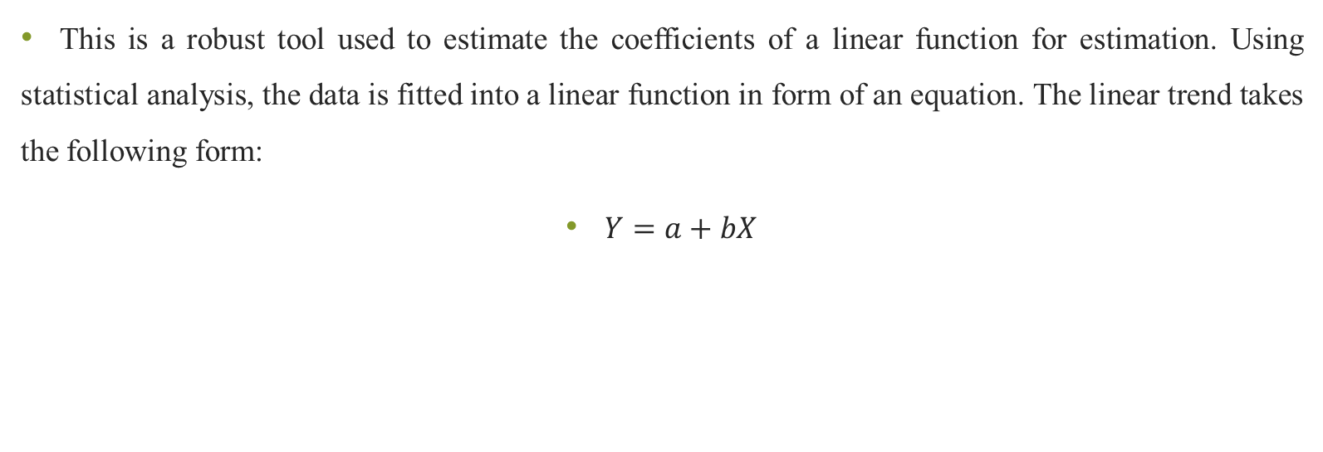
Ordinary Least Squares Method.
This is a robust tool used to estimate the coefficients of a linear function for estimation. Using statistical analysis, the data is fitted into a linear function in form of an equation. The linear trend takes the following form:
$Y=a+bX$

Slide 32
Ordinary Least Squares Method.
Where a is the constant oy Y axis intercept, b is the slope of the curve and X is the deviation from the mean of the predictor or independent variable.
The LINEST function in Microsoft Excel can be employed to predict the coefficients and a future estimate based on historical data.

Slide 33
Smoothing Techniques
In a number of cases where the data does not show a continuous trend, smoothing techniques can be employed.
This is mostly used for data which is seasonal or cyclical in nature with upwards and downwards movements.

Slide 34
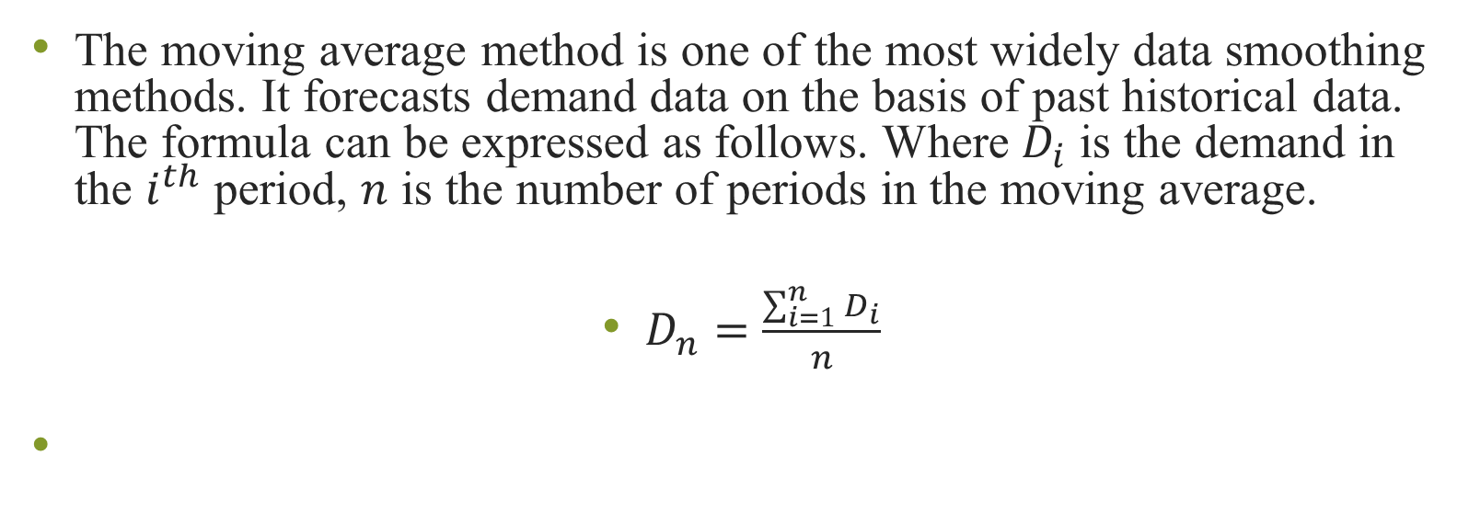
Moving Averages
The moving average method is one of the most widely data smoothing methods. It forecasts demand data on the basis of past historical data. The formula can be expressed as follows. Where $D_{i}$ is the demand in the $i^{th}$ period, $n$ is the number of periods in the moving average.
$D_{n}=\frac{\sum_{i=1}^{n}{D_{i}}}{n}$

Slide 35

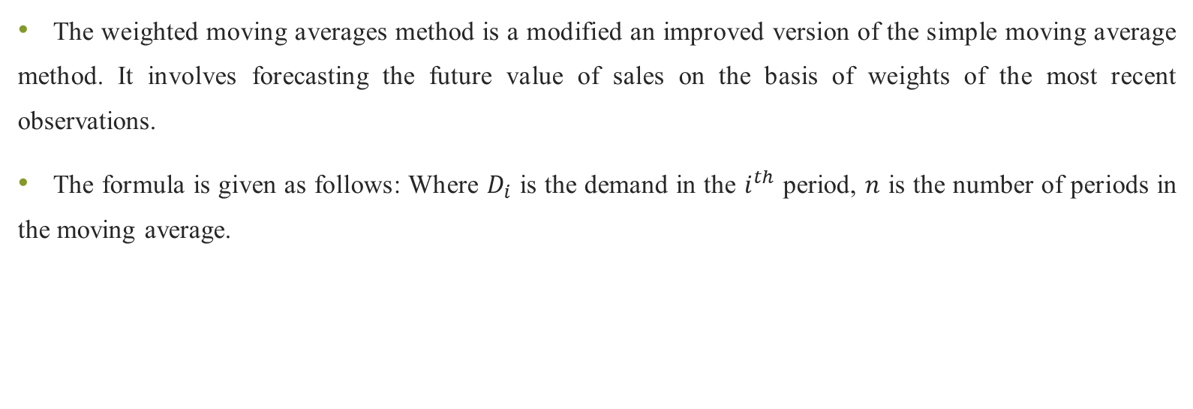
Weighted Average Method
The weighted moving averages method is a modified an improved version of the simple moving average method. It involves forecasting the future value of sales on the basis of weights of the most recent observations.
The formula is given as follows: Where $D_{i}$ is the demand in the $i^{th}$ period, $n$ is the number of periods in the moving average.

Slide 36
Exponential Smoothing
This method assigns the greatest weight to the most recent data in order to have a more realistic estimate of the data fluctuations.
Weights usually lie between zero and one and as we approach a large number of observations, the weights usually sum up to one.

Slide 37
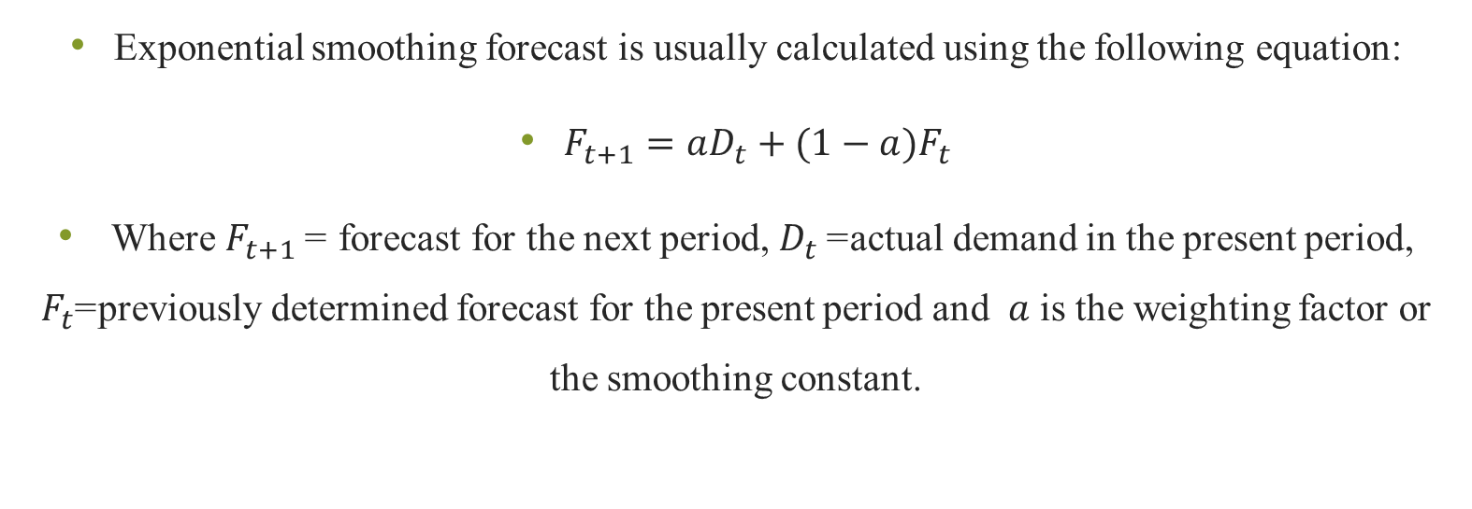
Exponential Smoothing
Exponential smoothing forecast is usually calculated using the following equation:
$F_{t+1}=aD_{t}+(1−a)F_{t}$
Where $F_{t+1}$ = forecast for the next period, $D_{t}$= actual demand in the present period, $F_{t}$=previously determined forecast for the present period and $a$ is the weighting factor or the smoothing constant.

Slide 38
Econometrics Methods
Econometrics is the application of statistical tools on economic theories, statistical and mathematical inference to estimate economic variables.
The model usually consists of a system of equations from past data that is used to forecast economic and business variables.

Slide 39
Econometrics Methods
These models largely examine causal relationship between the variables and hence they are considered to be reliable in forecasting demand compared to other methods.
Econometric models also utilize multiple regression techniques and multiple equation model in demand forecasting.

Slide 40
Econometrics Methods
The most commonly used econometric modelling is regression analysis.
A typical regression model consists of a set of independent variables which are considered to influence the dependent variable. For example, we may have a model that seeks to determine the influence of each variable of demand on the quantity demanded.

Slide 41
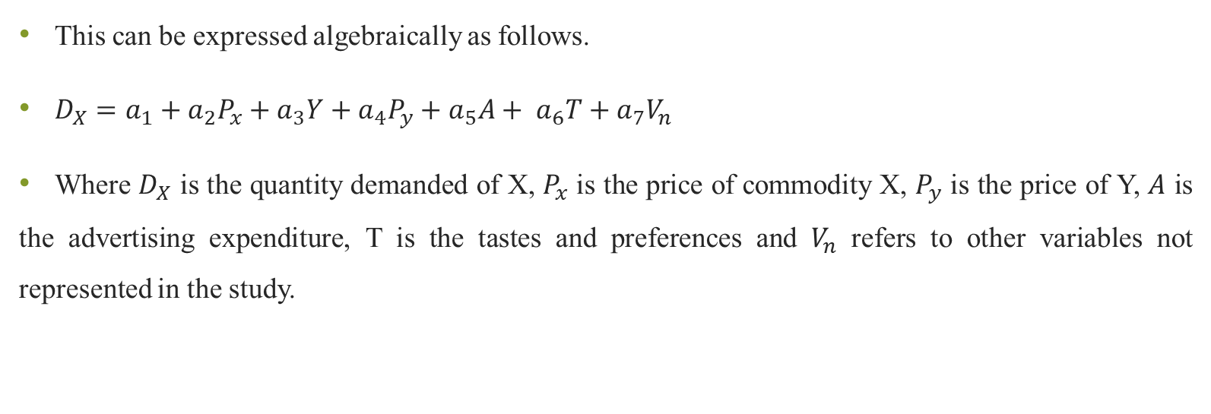
Econometrics Methods
This can be expressed algebraically as follows.
$D_{X}=a_{1}+a_{2}P_{x}+a_{3}Y+a_{4}P_{y}+a_{5}A+ a_{6}T+a_{7}V_{n}$
Where $D_{X}$ is the quantity demanded of X, $P_{x}$ is the price of commodity X, $P_{y}$ is the price of Y, $A$ is the advertising expenditure, T is the tastes and preferences and $V_{n}$ refers to other variables not represented in the study.

Slide 42
Econometric Models Tests
The precision of a regression model generated has to be ascertained. There are a number of measures used to test whether the estimation is possibly accurate.
These measures are the R static, F statistic and standard error of regression.

Slide 43
R Statistic
The R statistics measure the proportion of variation in the independent variable that is explained by the regression line.

Slide 44
F Test
The F test is an alternate measure to the R statistic and is used to measure a regression line goodness of fit.

Slide 45
Standard Error
The standard error provides an estimation of the unexplained or residual variation in the independent variable. It is particularly important in construction of confidence intervals and for forecasting purposes.

Slide 46
Problems with Econometric Models Tests
Additionally, there are some problems associated with regression such as multicollinearity, auto correlation, heteroscedasticity and specification errors.

Slide 47
Multicollinearity
Multicollinearity refers to case where two or more explanatory variables in the regression are found to be highly correlated.
This impairs accurate determination of the model.

Slide 48
Autocorrelation
. For autocorrelation (also referred to as serial correlation), the error term tends to show the same pattern.
The Durbin Watson test is used to detect autocorrelation.

Slide 49
Heteroscedasticity
Heteroscedasticity refers to a case where the variance of terms is constant for all values of the independent variables in the model.
Its violation means that the variables have different variables and are heteroscedastic. These disturbances lead to a biased estimator of the true variance.

Slide 50
Specification Errors
A specification error occurs when we omit one of the independent variables in a regression model or when the function itself is wrongly constructed

Slide 51
Limitation of Demand Forecasting
Some of the limitation include, access to accurate historical data. Estimation relies on past accurate data which can be sometimes difficult to obtain.
Additionally, the past is not always an accurate estimator of the future. Also, estimation requires use of models and data experts whose expertise may not always be available or affordable.

Slide 52
REFERENCES
Calvet, L., de la Torre, R., Goyal, A., Marmol, M., & Juan, A. A. (2020). Modern optimization and simulation methods in managerial and business economics: a review. Administrative Sciences, 10(3), 47.
Balogh, A., Baranyi, D. M., & Trautmann, L. (2022). New Challenges in the Education of Managerial Economics. Köz-gazdaság-Review of Economic Theory and Policy, 17(3), 19-38.
Coles, J. L., & Li, Z. (2020). Managerial attributes, incentives, and performance. The Review of Corporate Finance Studies, 9(2), 256-301.s

Slide 53
REFERENCES
Brian T, ShorFroeb, L. M., McCann, M., & Ward, M. R. (2014). Managerial Economics; A Problem Solving Approach, Third Edition. In Angewandte Chemie International Edition, 6(11), 951–952.
Connelly, B. L., Certo, S. T., Ireland, R. D., & Reutzel, C. R. (2011). Signaling theory: A review and assessment. Journal of Management, 37(1), 39–67. https://doi.org/10.1177/0149206310388419
Thomas, C. R., Maurice, S. C., Viera Valencia, L. F., & Garcia Giraldo, D. (2016). Managerial economics : foundations of business analysis and strategy. In Angewandte Chemie International Edition, 6(11), 951–952. (Vol. 2).

Slide 54
Thank You
End of Lecture 10

