Slide 1
Managerial Economics
Lecture 12
Financial Evaluation of Long Term Projects
Lecturer: Dr Daniel Kungu Njau

Slide 2
Lecture Learning Outcomes
At the end of the lecture, you will be able to:
Understand the projects which an organization has to undertake.
Understand the importance of project evaluation in achieving a firm’s objectives.

Slide 3
Lecture Learning Outcomes
Grasp the methods of project evaluation.
Grasp the intricacies of time value of money and the necessity of capital rationing.

Slide 4
Introduction to Projects
Every firm that desires to be a going concern in the near- and long-term future must be able to plan well for its long-term projects.
Long term projects include investments such as mergers and acquisitions, new plant expansions, business processes reengineering, launching of new products and services etc.

Slide 5
Introduction to Projects
All this is done to maximize the shareholders’ value in the firm. Therefore, it is critical to understand the decision-making process of the firm with regards to long term projects.

Slide 6
Importance of Project Evaluation
Failing to plan is planning to fail.
It is critical that projects be evaluated fully. Why, we will explain in subsequent slides.

Slide 7
Long term projects impact on the value of the company.
A company continues to be a going concern because of the benefits derived from the profits of its long-term investments.
Additionally, if a long-term investment such as research results in improved efficiency, then the investment lowers the cost of production to the company and can be considered worthwhile.

Slide 8
Irreversibility of Projects
Some projects are irreversible once funds are committed to them and they get started.
For example, funds spent on a new building or product cannot be reversed, hence the need to carry out adequate prior research and project evaluation to optimize future decisions.

Slide 9
Limited Firms Resources
Firms’ resources are usually finite and the management has to allocate them in the most optimal way that will yield the highest possible returns.
Project evaluation therefore becomes essential in deciding which projects to prioritize in allocating these scarce resources.

Slide 10
Cost Benefit Analysis
The main reason for conducting long term project evaluation is to consider the cost and benefit of these projects.
The management is keen to establish if a project is viable before committing resources and time to it.

Slide 11
Cost Benefit Analysis
The costs are considered against the payoffs and the net benefit is used to decide whether to establish the project or not.

Slide 12
Estimation of the project lifespan.
The expected time horizon if the project is also an important consideration because it will determine a host of other decisions.
For example, if a project takes too long, the cost consideration in terms of time may be too high due to rapidly changing technology.

Slide 13
Approximate estimation of cash flows.
It is critical to estimate the value of cashflows to be received from the project.
Cash outflows refer to the cost of initiating and continuing with the project and cash onflows are the returns from the project.

Slide 14
Approximate estimation of cash flows.
The initial cash flow, operational cashflows and terminal value of cashflow are all critical in estimating the true value of a project.

Slide 15
Capturing the time value of money.
Money changes value over time and usually, money today is worth more than tomorrow for a set amount of value.
Inflation makes money to lose value over time and this needs to be factored in when computing the project value.

Slide 16
Capturing the time value of money.
This is usually done through the application of the concepts of compounding and discounting.

Slide 17
Salient Characteristics of Project Evaluation
Long term projects posses unique characteristics that warrants special attention from the management. We will examine these in the next couple of slides.

Slide 18
Long term investment.
The funds invested in long term investments are usually locked in for an extended duration and are not usually available for meeting short term obligations.

Slide 19
Long term benefits.
It is expected that long term projects will yield returns for a longer time duration in the future.
The upfront costs are usually substantial; however, this is compensated by long term returns in the future.

Slide 20
Sacrificing short term funds for long term benefits.
The management decides to forego short term benefits for long term benefits in the future.
However, the future benefits have to be substantially larger than the short term benefits the firm would have obtained if it decided to use the benefits in the present moment.

Slide 21
Irreversible Investment
Once a project has been engaged in, it is difficult to get back the resources as these are usually tied up in the project.
Due to these high fixed costs, due diligence is necessary to ensure funds are only tied up in viable projects.

Slide 22
Project Evaluation Techniques
Project evaluation methods can be categorized using the traditional techniques or those that use discounted techniques.
The main technique that does not use discounting is the payback period. The discounting techniques are; the net present value, the internal rate of return and the profitability index.

Slide 23
Project Evaluation Techniques
Once projects are evaluated, them management decision usually fall into the falling decision criteria.
The management can either accept or reject a proposed project. This is done on the basis of the minimum return requirement.

Slide 24
Project Evaluation Techniques
Additionally, the management can rank projects from the most viable to the least viable.
Furthermore, the management may decide to allocate funds between various projects through rationing. The projects are usually scaled down to accommodate the lower levels of funds allocation.

Slide 25
Payback Period
This refers to the period it takes before a project can recover back the initial cost of investment from the proposed cash inflows.
Generally, the shorter period it takes to recoup back the cost of investment, the more the project will be considered viable.

Slide 26

Payback Period
It can be expressed as follows:

Slide 27
Payback Period
Generally, the method factors in uncertainty in future cash inflows and also favors projects with substantial cash flows in the initial years.
It is also simple and does not involve complex computations.

Slide 28
Payback Period
On the flipside, the method ignores cash flows occurring after the investment cost has been recouped.
It also ignores the time value of money and does not evaluate the projects on discounted future cash inflows.

Slide 29
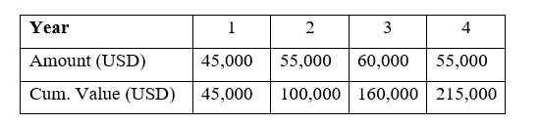
Payback Period:
Practical Example I
Horizons Ltd is considering investing in a new packaging machine that has an initial cost of USD 125,000. The estimated revenues to be earned if this machine is deployed as follows.

Slide 30
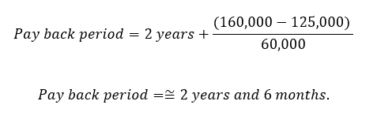
Payback Period:
Practical Example I- Solution
The first step is to compute the cumulative value of future cash inflows. We can see that the initial cost of 125,000 is recovered during the course of year 3. The actual payback period will be computed as follows:

Slide 31
Net Present Value
The present value method evaluates projects on the basis of the net present value of all future cash inflows less all the cash outflows.
If a project has a higher NPV, then it is considered to be of better value compared to the one with a lower NPV.

Slide 32
NPV Formula
The discounting rate is a risk adjusted return that takes into account the future value of money, inflation costs and the cost of borrowing.
The rate can be the average cost of capital or bank interest of obtaining the funds. The formula can be calculated as follows (next slide):

Slide 33
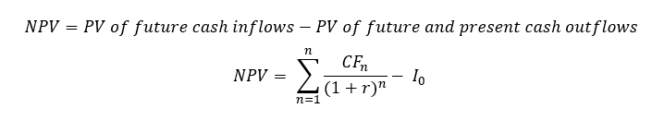
NPV Formula
Formula of NPV:

Slide 34
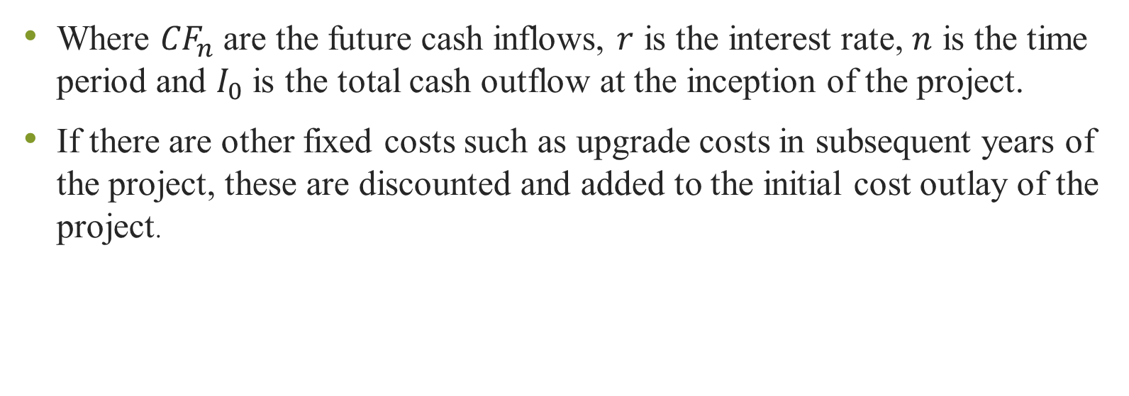
NPV Formula
Where ${CF}_{n}$ are the future cash inflows, $r$ is the interest rate, $n$ is the time period and $I_{0}$ is the total cash outflow at the inception of the project.
If there are other fixed costs such as upgrade costs in subsequent years of the project, these are discounted and added to the initial cost outlay of the project.

Slide 35
Steps in Calculating NPV
The first step in calculating NPV is to determine the cash onflows and outflows of the future project.
Then, the future cash inflows are discounted to the present value using the appropriate discounting rate.

Slide 36
Steps in Calculating NPV
This rate can be the prevailing interest rate, average cost of capital or expected rate of return. Once the total cost outlay (cash outflow) is determined, the cash outflows are subtracted from the cash inflows. If the amount is positive, the project is viable.
If it is negative, the project is rejected unless there are compelling reasons to accept.

Slide 37
Merits and Demerits of NPV
The method aligns with the shareholder goal of maximizing wealth because it assumes that a higher NPV is usually better.
It also takes into account the time value of money and considers the entire duration the project will be in existence.

Slide 38
Merits and Demerits of NPV
However, NPV does not adequately compare two mutually exclusive projects, it only examines one project at ago.

Slide 39
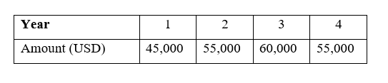
NPV: Practical Example II
Let us use the same example we used in practical example I; Horizons Ltd is considering investing in a new packaging machine that has an initial cost of USD 125,000.
The prevailing rate of interest is 14.5%. The estimated revenues to be earned if this machine is deployed as follows.

Slide 40
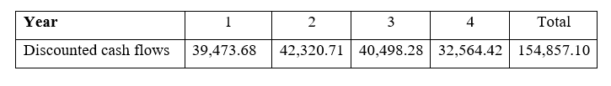
NPV: Practical Example II:
Solution
We need to discount the future cash onflows to the present value and then compare these to the initial cost and subtract to get the NPV. This is shown as follows:

Slide 41
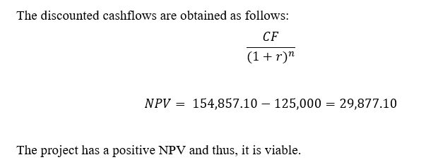
NPV: Practical Example II:
Solution

Slide 42
Profitability Index
The PI is an alternative more refined version of NPV and instead of subtracting, division is used.
It is also used to compare two projects on the basis of profitability. A rule of the thumb is, if the PI is higher or > 1, then the project is acceptable. A value of < 1 is a basis for rejecting the project.

Slide 43
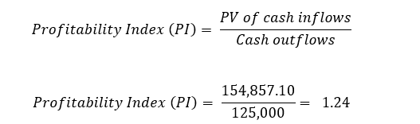
Profitability Index
If we use the same example we had in project II, the PI can be calculated as follows:
The PI > 1, hence the project is viable and should be considered.

Slide 44
Merits and Demerits of NPV
The PI technique is great evaluating mutually exclusive projects and also uses profits which is a far much greater tool.
However, it becomes only useful if it is employed together with NPV.

Slide 45
Internal Rate of Return (IRR)
The IRR is the value which matches the present value of future cash inflows with the cash outflow. The NPV at the IRR is equal to zero.
Therefore, this function below can be used to express the IRR.

Slide 46

Internal Rate of Return (IRR)
Generally, the rule for accepting or rejecting IRR is that the cost of capital should be lower than the project’s IRR. As a rule of the thumb, a project with a higher IRR is considered to be better than that with a lower IRR.

Slide 47
Capital Rationing
Since the projects and costs of long-term projects may be more than the funds available to the firm, capital rationing therefore becomes necessary.
The projects are prioritized based on those with the highest returns to those with the lowest.

Slide 48
REFERENCES
Calvet, L., de la Torre, R., Goyal, A., Marmol, M., & Juan, A. A. (2020). Modern optimization and simulation methods in managerial and business economics: a review. Administrative Sciences, 10(3), 47.
Balogh, A., Baranyi, D. M., & Trautmann, L. (2022). New Challenges in the Education of Managerial Economics. Köz-gazdaság-Review of Economic Theory and Policy, 17(3), 19-38.
Coles, J. L., & Li, Z. (2020). Managerial attributes, incentives, and performance. The Review of Corporate Finance Studies, 9(2), 256-301.s

Slide 49
REFERENCES
Brian T, ShorFroeb, L. M., McCann, M., & Ward, M. R. (2014). Managerial Economics; A Problem Solving Approach, Third Edition. In Angewandte Chemie International Edition, 6(11), 951–952.
Connelly, B. L., Certo, S. T., Ireland, R. D., & Reutzel, C. R. (2011). Signaling theory: A review and assessment. Journal of Management, 37(1), 39–67. https://doi.org/10.1177/0149206310388419
Thomas, C. R., Maurice, S. C., Viera Valencia, L. F., & Garcia Giraldo, D. (2016). Managerial economics : foundations of business analysis and strategy. In Angewandte Chemie International Edition, 6(11), 951–952. (Vol. 2).

Slide 50
Thank You
End of Lecture 12

