Slide 1
Disaster Management & Social Work
LECTURE 1
INTRODUCTION TO DISASTER
LECTURER: Victor J B Rana

Slide 2
Course Outline
The Course SW 575 A- Disaster Management & Social Work at Master of Arts in Social Studies is to provide knowledge on various types of natural & manmade disasters & its impacts, hazard & vulnerability analysis, national & international policies & structure for disaster management, disaster management cycle, development/disaster nexus, social worker's role, & public awareness & education

Slide 3
Course Outline
Objectives
To understand the scope & definition of disaster, types of disaster, & the impact of disasters.
To have an in-depth knowledge on the initiatives taken by the global community to reduce the risk of disaster.
Understand hazards, exposure, vulnerability, & risk analysis
To analyze Disaster Risk Management Continuum.
Notes:
1. Three- fourth of human occupying ¼ of global land mass facing unprecedented disaster risks/ hazards increasing but impacts exacerbated by process like population growth, poverty & marginalization, enviornm, poor planning, & Preparedness. & impacts of Climate change.
2. Topic Objectives
Meaning & scope of disaster
Understanding of natural & technical disaster.
Knowledge of global future trends & its impact.
3.Question for Discussion
What is the definition & concept of disaster?
What is the classification of disaster & how are they related?
What are the charecteristics of disaster?
What could be the future trends in global disaster related incidents & the impact it could have in the nations & society.

Slide 4
Course Outline
Objectives
To develop an understanding about community-based disaster risk management and awareness.
Identify the politics of disaster & key gender issues
Acquaint with the psychological impact of disaster
Learn & apply School Disaster Management Plan

Slide 5
Introduction to Disaster
Lesson Contents
Disaster Definition
Disaster Threshold
Characteristics/Classification of Natural Disasters
Global Trends
Manmade Disaster Definition, Causes, Nature, and Classification
Extensive & Intensive Risk

Slide 6
Expected Learning Outcomes
Introduction to Disaster
Lecture 1
Meaning & scope of disaster
Understanding of natural & man-made disaster.
Knowledge of current/future global trends in disasters.

Slide 7
Ground Realities Disaster- 2023
Natural Disasters-399
Deaths- 86,473
Affected Population- 93.1 Million
Economic Losses- US $ 202.7 Billion
18.8 Million people impacted by Drought in Indonesia
Earthquake in Turkey & Syria, 7.8 M- 56,683 deaths/9.2 Million affected/US $ 42.9 Billion economic damage
Storm Daniel, Libya-12,352 deaths/US $ 6.2 Billion economic damage

Slide 8
Ground Realities Disaster-2023
Extreme Temperatures in Europe- 47 Degrees C- 16305 deaths
Cyclone Freddy passed through Madagascar, Mozambique, and Malawi- 1,209 deaths/2.3 Million affected
Flooding in India due to Cyclone Michaung-affecting 4.4 million people.

Slide 9
Disaster Definition
What- Event that causes large scale disruption to the functioning of a normal community, local level or nation that exceeds its coping capacity.
How: Exposure to hazard, vulnerability, & insufficient capacity
Effects- Loss of lives & property, injuries, loss of livelihood, psychological trauma, non functioning services, economic loss, & environmental damage.

Slide 10
Disaster Definition
“Disasters can be defined as any event, human-made or natural, sudden or progressive, causing widespread human material or environmental losses, which exceed the ability of the affected community to cope using its own resources.
Judy Oehler-Stinnett, Ph.D GOVT E-1027/W: Preventive Measures: the Politics of Disaster http://www.vranet.com/govt1027)

Slide 11
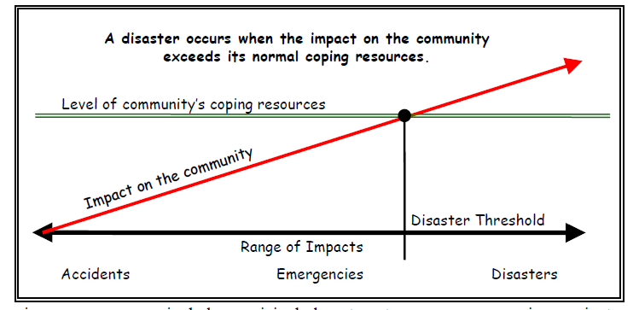
Disaster Threshold

Slide 12
Disaster Threshold

Slide 13
Disaster Threshold

Slide 14
Characteristics of Natural Disasters
Geographic location
Frequency
Predictability
Suddenness & Warning time
Severity/Intensity-size, speed
Duration
Destruction method
Sights, sounds
Injury, damage, deaths
Aftermath
Prevention
Preparedness

Slide 15
Classification of Disaster
Disaster
Natural
Geophysical
Metrological
Hydrological
Climatological
Biological
Extra-Terrestrial
Manmade
Transport
Technological
Social
Hostile

Slide 16
Geophysical
Events Originating from Solid Earth
Disaster Main-Type | Disaster Sub-Type | Disaster Sub-sub Type
Earthquake | Ground Shaking
 | Tsunami
Volcano | Volcanic Eruption
Mass Movement (Dry) | Rockfall
 | Avalanche | Snow Avalanche
 |  | Debris Avalanche
 | Landslide | Mudslide Lahar Debris Flow
 | Subsidence | Sudden Subsidence
 |  | Long-Lasting Subsidence
Source: Emergency Events Database(EM-DAT) CRED, 2009

Slide 17
Meteorological
Events caused by short‐lived/small to meso- scale
atmospheric processes (in the spectrum from
minutes to days)
Disaster Main-Type | Disaster Sub-Type | Disaster Sub-sub Type
Storm | Tropical Storm
 | Extra-Tropical Cyclone(Winter –Storm)
 | Local/Convective Storm | Thunderstorm/Lightning
 |  | Snowstorm/Blizzard
 |  | Sandstorm/ Duststorm
 |  | Tornado
 |  | Orographic Storm(Strong Winds)
Source: Emergency Events Database(EM-DAT) CRED, 2009

Slide 18
Hydrological
Events caused by deviations in the normal water
cycle and/or overflow of bodies of water caused by
wind set‐up)
Disaster Main-Type | Disaster Sub-Type | Disaster Sub-sub Type
Flood | General (River) Flood
 | Flash Flood
 | Storm Surge/Coastal Flood
Mass Movement (Wet) | Rockfall
 | Landslide | Debris Flow
 | Avalanche | Snow Avalanche
 |  | Debris Avalanche
 | Subsidence | Sudden/Long-Lasting
Source: Emergency Events Database(EM-DAT) CRED, 2009

Slide 19
Climatological
Events caused by long-lived/meso to macro scale process(intra-seasonal to multi decade climate variability)
Disaster Main-Type | Disaster Sub-Type | Disaster Sub-sub Type
Extreme Temperature | Heat Wave
 | Cold Wave | Frost
 | Extreme Winter Conditions | Snow Pressure
 |  | Icing
 |  | Freezing Rain
 |  | Debris Avalanche
 | Drought | Drought
 | Wild Fire | Forest/Land (Scrub, Bushes)
Source: Emergency Events Database(EM-DAT) CRED, 2009

Slide 20
Biological
Disaster caused by the exposure of living organisms
to germs and toxic substances
Disaster Main-Type | Disaster Sub-Type | Disaster Sub-sub Type
Biological | Epidemic | Viral Infectious Diseases
 |  | Bacterial Infectious Diseases
 |  | Parasite Infectious Diseases
 |  | Fungal Infectious Diseases
 |  | Prion Infectious Diseases
 | Insect Infestation | Grasshopper/Locust/Worms
 | Animal Stampede
Source: Emergency Events Database(EM-DAT) CRED, 2009
Notes:
Prion- Animal, Birds, Human

Slide 21
Extra-Terrestrial
Events Originating from Outside Earth’s Atmosphere
Disaster Main-Type | Disaster Sub-Type | Disaster Sub-sub Type
Extra-Terrestrial | Meteorite/Asteroid
Source: Emergency Events Database(EM-DAT) CRED, 2009

Slide 22
Source: Emergency Events Database(EM-DAT) CRED, 2024

Slide 23
- 399
03-22- 369
Source: Emergency Events Database(EM-DAT) CRED, 2024

Slide 24
63445
21304
1527
162
35
- 86473
03-22- 64148
Source: Emergency Events Database(EM-DAT) CRED, 2024

Slide 25
66.4 M
12.5 M
10.9 M
2.2 M
1 M
- 93.5 M
03-22- 175.5 M
Source: Emergency Events Database(EM-DAT) CRED, 2024

Slide 26
75.9 B
88.9 B
13.7 B
15.1 B
9 B
- $ 202.7 B
03-22- $ 96.3 B
Source: Emergency Events Database(EM-DAT) CRED, 2024

Slide 27
Source: Emergency Events Database(EM-DAT) CRED, 2024

Slide 28
Man- Made Disaster Definition
A man-made disaster is an event that causes significant harm to people, property, or the environment, and is caused by human activity, whether deliberate or not.
Man-made disasters have an element of human intent, negligence, or error involving a failure of a man-made system, as opposed to natural disasters resulting from natural hazards. Such man-made disasters are crime, arson, civil disorder, terrorism, war, biological/chemical threat, cyber-attacks, etc.

Slide 29
Causes of Man-Made Disaster
Indiscriminate Industrialization
Over Population & Increased Consumerism
Accidents
Use & Transportation of Hazardous Materials
Poor maintenance, Low Quality Work, or Human Error
Willful, Deliberate & Intentional Activity
System or Process Malfunctioning

Slide 30
Nature of Man-Made Disaster
Predictability Almost Nil
No System is Fail-Safe
Point Zero Plus Effect
Technical/Human Error
Increase in Number & Magnitude
Awareness Minimal
Preparedness Minimal

Slide 31
Man-Made Disasters
Hazard Sub-Family | Hazard Type | Hazard Sub-Type
Technological | Structural Collapse | Standing Structure
 |  | Underground Structure
 | Utility Failure
 | Fire
 | Explosion
 | Contamination | Chemical
 |  | Hydrocarbon
 |  | Radiation
Transport | Crash/Collision | Road
 |  | Rail
 |  | Water
 |  | Air
 |  | Space
Social | Social | Riot
 |  | Ethnic Strife
 | Economic | Embargos/Sanctions
 |  | Currency Devaluation
 |  | Mass Bank/Corporate Failures
Hostile | Conflict | Terrorism
 |  | Insurgency
 |  | Revolution
 |  | Regional War

Slide 32
Man Made Disasters 2018
Event | # of Incidents | Deaths | Insured Losses US $ Million
Major Fire/Explosions | 45 | 477 | 5439
Oil/Gas | 15 | 36 | 3056
Industry /Warehouse | 14 | 73 | 1845
Other Buildings | 11 | 308 | 382
Other Fires/Explosions | 3 | 22 | 81
Department Stores | 2 | 38 | 76
Aviation Disasters | 7 | 165 | 410
Space | 2 | 0 | 188
Crashes | 3 | 165 | 131
Damage on Ground | 2 | 0 | 90

Slide 33
Man Made Disasters 2018
Event | # of Incidents | Deaths | Insured Losses US $ Million
Miscellaneous | 21 | 925 | 200
Social Unrest | 1 | 0 | 200
Terrorism | 13 | 731 | 0
Others | 7 | 194 | 0
Maritime Disasters | 33 | 1163 | 197
Drilling Platforms | 1 | 0 | 90
Freighters | 2 | 22 | 75
Tankers | 1 | 0 | 32
Passenger Ships | 27 | 1087
Others | 2 | 54 | 0
Rail Disasters/Cableway | 10 | 140 | 0
Mining Accidents | 2 | 64 | 0
Grand Total | 118 | 2934 | 6246

Slide 34
Major Man- Made Disasters
Date | Place | Disaster | Deaths | Effects
1984 | Bhopal, India | Gas Leak | 8000 | Air Contamination
1986 | Chernobyl, Ukraine | Nuclear Power Plant Explosion | 31 | Radiation
1989 | California, USA | Exxon Valder Oil Spill |  | Ocean Contaminated, 119,000 Cubic Meters of Crude Oil Spill
2000 | Boniitaza Maire, Romania | Cyanide Spill |  | 100 Tons of Cyanide spill in river killing 80% of marine life
2001 | New York, USA | Terrorism | 2996 | Twin Towers destroyed
2003 | Persian Gulf | Oil Spill |  | Ocean Contaminated
2005 | Jillu, China | Petro Chemical Plant Explosion | 6 | Water Source Contaminated
2010 | Gulf of Mexico | Oil Spill in Rig |  | Ocean Contaminated, 780,000 Cubic Meters of Oil Spill

Slide 35
Extensive vs Intensive Risk
Extensive risk is more closely linked to drivers such as inequality and poverty. Extensive risk is constructed through development-related drivers, it is both manageable and avoidable with appropriate investments in disaster risk reduction.
Extensive risk is responsible for most damage and it represents an ongoing erosion of development assets, such as houses, schools, health facilities, roads and local infrastructure, particularly in low and middle-income countries
Intensive are sudden & Produce High Disaster Mortality Events

Slide 36
Damage by Extensive/ Intensive Risk Since 1990
United Nations office for Disaster Risk Reduction, 2015, Percentage of damage and loss from extensive and intensive disaster events (65 countries, 2 states, https://reliefweb.int/report/world/global-assessment-report-disaster-risk-reduction-2015

Slide 37
Mortality from Few Disasters Concentrated in Few Intensive Events
Earthquake
Turkey & Syria
Earthquake
Nepal
2015
2023
United Nations office for Disaster Risk Reduction, 2015, Mortality from Few Disasters Concentrated in Few Intensive Events), https://reliefweb.int/report/world/global-assessment-report-disaster-risk-reduction-2015

Slide 38
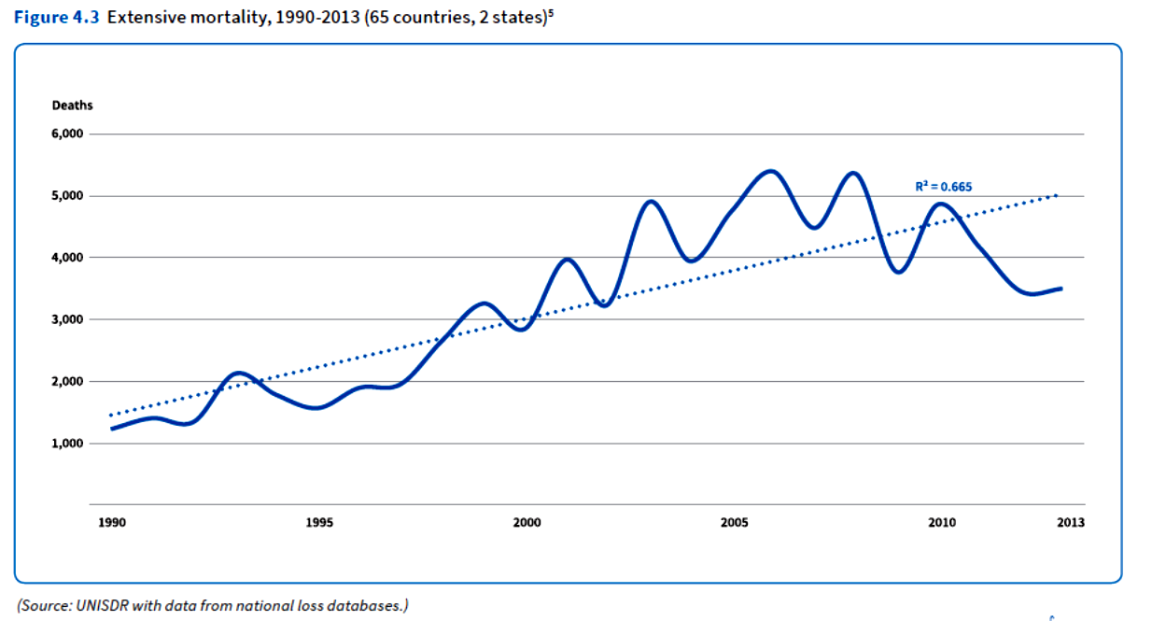
Extensive Mortality, 1990-2013(65 Countries, 2 States
United Nations office for Disaster Risk Reduction, 2015, Extensive Mortality, 1990-2013(65 Countries, 2 States, https://reliefweb.int/report/world/global-assessment-report-disaster-risk-reduction-2015

Slide 39
Reference Materials
Disaster Category Classification (CRED), Pg 1-19
2023 EDMAT Report Pg 1-8
Sigma 1-2024, Pg 1-3
CRED 2023 Disasters in Numbers, Pg 1-8
Disaster Types & Impacts, Pg 1-7
Judy Oehler-Stinnett, Ph.D GOVT E-1027/W: Preventive Measures: the Politics of Disaster http://www.vranet.com/govt1027)

Slide 40
THANK YOU

