Slide 1
STRATEGIC MARKETING MANAGEMENT
Betting In Your Most Priced Asset: The Customer
Week 4
Lecturer:
Fidela Reyes Balajadia
Associate Professor 2
University of the Assumption, Philippines

Slide 2
Lecture Learning Objectives:
At the end of the lecture, you will be able to:
1. Discuss the factors affecting the purchasing behavior of consumers
2. Apply the total quality concept in understanding the customer and thereby creating a positive influence on consumer decision process
3. Develop a personal plan for a particular local store with the aim of improving their customers in-store shopping experience
2

Slide 3
Lecture Learning Objectives:
At the end of the lecture, you will be able to:
4. Integrate the use of total quality concept in understanding the customer
5. Explain the consumer decision process
6. Explain what research can do in understanding the customers
2

Slide 4
There is a constant need to study and understand them- the customer's needs, wants, tastes, preferences, biases, idiosyncrasies and many others.

Slide 5
Overview of Customer Operation

Slide 6
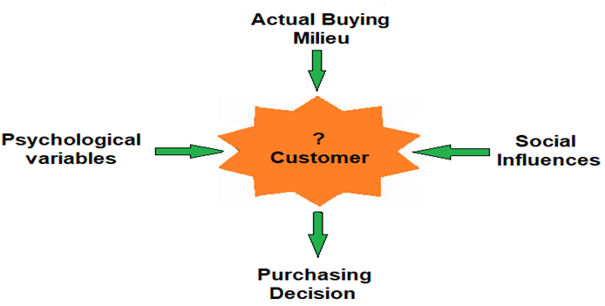
Naval (2021)

Slide 7
the factors affecting the purchasing decision of a consumer
psychological variables | social influences | the actual buying milieu

Slide 8
Psychological variables. These psychological variables are manifested in an individual's motive.
Motives are within every person drive the individual to seek satisfaction of his goal-oriented behavior.

Slide 9
1
Psychological variables have different dimensions as follow:

Slide 10
1
(A) Motivation. This is just one of the starting points in understanding what, how and why consumers buy or not buy a product or brand despite the product's effort of enticing consumers-the bottom line is motive.

Slide 11
Table 2.1 15 Fundamental Human Motives
Source: Etzel M., Walker, B. and Stanton, W. (2001)
Curiosity | Food | Honor
Rejection | Sex | Physical Exercise
Order | Independence | Power
Citizenship | Pain Avoidance | Prestige
Family | Social Contact | Vengeance

Slide 12
1
(B) Perception, the process by which people select, organize, interpret, retrieve, and respond to information from the world around them. Perception is a way of forming impressions about oneself, other people, and daily life experiences. It also serves as a screen or filter through which information passes before it has an effect on people.

Slide 13
1
Information is then interpreted and comprehended selectively depending on his beliefs and attitudes (selective attention and comprehension); and the person may opt to retain and remember only information in conformity with other psychological variables like his motives (selective retention).

Slide 14
Factors influencing perception
Perceiver | Setting | Perceived

Slide 15
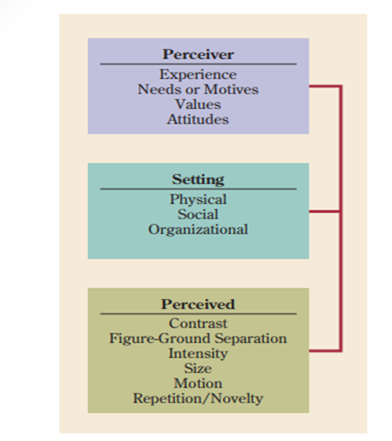
Schermerhorn et al. (2010)

Slide 16
The Perceiver: A person’s past experiences, needs or motives, personality, values, and attitudes may all influence the perceptual process.

Slide 17
The Setting: The physical, social, and organizational context of the setting also can influence the perceptual process.

Slide 18
The Perceived: Characteristics of the perceived person, object, or event— such as contrast, intensity, figure-ground separation, size, motion, and repetition or novelty—are also important in the perceptual process.

Slide 19

Schermerhorn et al. (2010)

Slide 20




Stages of the Perception Process
attention and selection
organization
interpretation
retrieval

Slide 21

1.) Attention and Selection
Our senses are constantly bombarded with so much information that if we don’t screen it, we quickly become incapacitated with information overload. Selective screening lets in only a tiny proportion of all the information available. Some of the selectivity comes from controlled processing— consciously deciding what information to pay attention to and what to ignore.

Slide 22
2.) Organization
Even though selective screening takes place in the attention stage, it is still necessary to find ways to organize the information efficiently. Schemas help us do this.

Slide 23
Stages of the Perception Process
Script schema
Self-schema
Person schema
Person-in-situation schema

Slide 24
A script schema is defined as a knowledge framework that describes the appropriate sequence of events in a given situation.
A self-schema contains information about a person’s own appearance, behavior, and personality.

Slide 25
Person schemas refer to the way individuals sort others into categories, such as types or groups, in terms of similar perceived features.
Person-in-situation schemas combine schemas built around persons (self and person schemas) and events (script schemas).

Slide 26
3.) Interpretation
Once your attention has been drawn to certain stimuli and you have grouped or organized this information, the next step is to uncover the reasons behind the actions.

Slide 27
4.) Retrieval
The information stored in our memory must be retrieved if it is to be used. All of us at times have trouble retrieving information stored in our memories. More commonly, memory decays, so that only some of the information is retrieved. Schemas play an important role in this area and make it difficult for people to remember things not included in them.

Slide 28
Perception and Impression Management
Richard Branson, CEO of the Virgin Group, may be one of the richest and most famous executives in the world. One of his early business accomplishments was the successful startup of Virgin Airlines, now a major competitor of British Airways (BA). In a memoir, the former head of BA, Lord King, said: “If Richard Branson had worn a shirt and tie instead of a goatee and jumper, I would not have underestimated him.”

Slide 29
Social Networks
Most of us have heard the advice: “Don’t forget to make a good first impression.” And, no doubt, first impressions do count in how others perceive us. In fact, we practice a lot of impression management as a matter of routine in everyday life. We dress, talk, act, and surround ourselves with things that reinforce a desirable self-image and help to convey that same image to other persons.

Slide 30
(C) Learning. Every part of the buying-decision process is influenced by learning. A person who buys a brand of cosmetics but experiences skin itching, or irritation may definitely withdraw the idea of picking the same brand of cosmetics ever again.

Slide 31
(D) Attitude is permanent in nature, and it would entail large effort and much money to change it. If change is possible, the remnant will still be there though in a controllable level.
An attitude is a predisposition to respond in a positive or negative way to someone or something in one’s environment.

Slide 32
Components of Attitudes
Cognitive component | Affective component | Behavioral component

Slide 33
The cognitive component
reflects underlying beliefs, opinions, knowledge, or information a person possesses. It represents a person’s ideas about someone or something and the conclusions drawn about them.

Slide 34
The affective component
a specific feeling regarding the personal impact of the antecedent conditions evidenced in the cognitive component.

Slide 35
The behavioral component
an intention to behave in a certain way based on the affect in one’s attitude. It is a predisposition to act, but one that may or may not be implemented.

Slide 36
Attitudes and Behavior
The link between attitudes and behavior is tentative. An attitude expresses an intended behavior that may or may not be carried out. In general, we can say that the more specific attitudes are, the stronger the relationship with eventual behavior.

Slide 37
Attitudes and Cognitive Consistency
An important issue in the attitude-behavior linkage is consistency. Leon Festinger, a noted social psychologist, uses the term cognitive dissonance to describe a state of inconsistency between an individual’s attitudes and/or between attitudes and behavior.

Slide 38
This can be done in one of three ways:
1. changing the underlying attitude,
2. changing future behavior, or
3. developing new ways of explaining or rationalizing the inconsistency.

Slide 39
Types of Attitude
GOOD ATTITUDE
BAD ATTITUDE

Slide 40
The term “morale” used when describing the feelings of a workforce toward their employer. It relates to the more specific notion of job satisfaction, an attitude reflecting a person’s positive and negative feelings toward a job, co-workers, and the work environment.

Slide 41
Job involvement, which is defined as the extent to which an individual is dedicated to a job.

Slide 42
Organizational commitment, or the degree of loyalty an individual feels toward the organization. Individuals with a high organizational commitment identify strongly with the organization and take pride in considering themselves members.

Slide 43
Employee engagement—a positive work attitude that Gallup defines as working with “passion” and feeling “a profound connection” with one’s employer.

Slide 44
(E) Personality. This refers to any distinguishing characteristics of a person influenced by different situations and experiences.

Slide 45
(F) Lifestyle. Individual's mode of living affects the spending habit and purchasing decision. A person's lifestyle may be attributed by his profession, activities, interests and beliefs in life.

Slide 46
2.) Social influences. Man is by nature a social animal. He has to enter into relationships with his fellow men to live a meaningful life, stated by the legendary Greek philosopher Aristotle.

Slide 47
The variables that cause complexities in his viewpoints may come from:
Culture
Social class
Reference group
Family

Slide 48
Culture also includes symbols and even artifacts that could depict the prolificacy of a place over a period of time.
Culture comprises the totality of an individual or a group of individuals' beliefs, traditions, values, language and attitudes within a given time context passed from one generation to another generation.

Slide 49
Social classes may be divided into upper, middle and lower classes.
Social Class. This refers to the ranking of members of a society which can be directly linked to their spending habits and buying behavior

Slide 50
Reference Group. The strength of the stimulus coming from the formal or informal group formed within a society is beyond question when it comes to influencing the minds of the members.

Slide 51
Family. It is structured by a group of individual living together in a household either related by blood, by marriage or any adoption process. Basically, people living in one roof consume and use the same product item at a certain period of time. They influence each other's references on food, clothing and other discretionary items.

Slide 52
3.) Actual Buying Milieu. The last factor that affects purchasing decision is the actual buying milieu wherein the consumer before finally making the actual purchase deliberately considers the store's atmospheric attributes.

Slide 53
Physical environment. It only takes few seconds to attract customers to get inside the store and once it happens, the store must be able to elicit a positive ambiance in order for the customer to stay longer inside.

Slide 54
Social environment. Ranges of product brands from one store to another may have slight differences or, in short, different stores may offer homogenous products which will make the competition indeed harder. But the good thing is, each store can leverage on the kind of services they would like to deliver to their customers. This makes the story different among stores alike.

Slide 55
The Use Total Quality Concept in Understanding the Customer
Contemporary managers and marketers are those who have the nose about the nature of the new generation of customers. They respond quickly to changes and they have deeper understanding about how these breeds of customers think and take actions.

Slide 56
The three important elements such as people, processes and measures

Slide 57
The first leg pertains to the first element-- the "measures" which imply that quality can be measured hence organization must exert efforts to improve their assessment and control mechanism.
The second element is the "people" leg which serves as a reminder to organization to prioritize people empowerment in the workplace to as this leads to better productivity level of workers towards the creation of product or services that will fit into the requirements of the customers.
The last leg is the element pertaining to "processes". This means that every organization embodies a defined system or program of works that should be enhanced or improved continually since total quality concept holds on to the quality principle that good enough is never good enough.

Slide 58
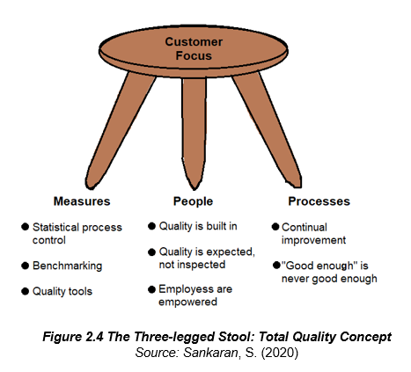

Slide 59
Consumer Decision Process
Consumers become quite unpredictable at times. Consumers may postpone their buying actions when various stimuli are causing disruptions and that these tend to baffle their decision-making process; and there are also times that consumers tend to become impulsive in their buying decisions; meaning they resort to unplanned buying actions.

Slide 60
1. Need Recognition. We can look at this process in two different perspectives. One is that consumer's problems or needs are most of the time explicit or evident; yet there are also times that their needs are latent, or they may not consider it a real need until a real problem has occurred.

Slide 61
2. Information Search. Once needs were identified and recognized, a strong motivation will begin to set into the consumer's mind. This motivation will cause the person to make attempts to conduct an information search.

Slide 62
3. Evaluation of Alternatives. Every manufacturer has their right to claim that their product is the best, all natural, no preservatives and so on.

Slide 63
4. Decision. The consumer has finally made the decision based on the alternatives he has gathered with the influence, of course, by the factors mentioned at the beginning of this lecture: the psychological and social variables and the actual buying milieu.

Slide 64
5. Post-purchase behavior. Getting a pool of reliable customers is what all marketers wanted to collect because this means the company has not only satisfied their customers but delighted them as well; and this is what real business is all about.

Slide 65
What Research can do in Understanding the Customers
Managers and marketers alike should learn how to listen to the active voices of the consumers, and they must also learn how to develop a heart that understands how consumers operate because the organizations who have mastered this craft are most likely the organization who will capture the attention of the target market. These are the wonders of marketing research which form part of the organization's marketing intelligence.

Slide 66
These processes are as follows:

Slide 67
1. Situation Analysis. Guided by the general objective of the firm as this also indicates to the identified problem that has to be solved, they could start vending ideas through analysis of the present situation. They need to scan the environment both internal and external for possible factors that may impede the intended objectives.

Slide 68
2. Gathering Primary Data. From the analysis of the company's present environment, reports, office documents, product literature, annual reviews and other related papers had helped them came up with an understanding about their present concern.

Slide 69
3. Analysis and Interpretation of Data. Data collected require an expert's analysis and a deeper scrutiny that will serve as guide in drawing conclusions.

Slide 70
4. Solution and Recommendation. The sound judgment of the researcher after the actual gathering of relevant facts should result to solving the identified problem; and therefore, meeting the general objective stated prior to the conduct of actual research study.

Slide 71
Strategic Marketing Management, Naval, Girly H. Mindshapers Co, Inc. 2021
Organizational Behavior (11th Edition) John R. Schermerhorn, Jr., James G. Hunt, Richard N. Osborn, Mary Uhl-Bien Copyright © 2010, 2007 by John Wiley & Sons, Inc.
Textbooks

Slide 72

Thanks!

Slide 73

Free templates for all your presentation needs
For PowerPoint and Google Slides
100% free for personal or commercial use
Ready to use, professional and customizable
Blow your audience away with attractive visuals

