Slide 1
STRATEGIC MARKETING MANAGEMENT
Segmenting, Targeting and Positioning
Week 5
Lecturer:
Fidela Reyes Balajadia
Associate Professor 2
University of the Assumption, Philippines

Slide 2
Lecture Learning Objectives:
At the end of the lecture, you will be able to:
1. Describe the Segmenting, Targeting and Positioning Model
2. Apply the four segmentations in interpreting different consumer behaviors before constructing product characterization to determine the homogeneity of the needs of the target market segment
3. Develop a selling proposition or statement that would appeal to a particular market segment
4. Explain the benefits of market segmentation
5. Discuss the variables of market segmentation

Slide 3
Large portion of marketing concepts is concerned with segmentation. It is the same as saying that the marketing programs your team has just crafted will guarantee success or the newly composed advertising jingle your team has just conceived will perfectly matter and strike a certain group of people.

Slide 4
Take for example, our regular use of a toothpaste. Everyone uses toothpaste but to some varying purposes and reasons. There are those who prefer to select a brand of toothpaste that will give them therapeutic benefits like maintaining healthy gums, protecting from tooth decays or cavities; yet there are particular group of buyers that demands another benefit from toothpaste other than its therapeutic benefit because for them the latter is just secondary.

Slide 5
Market segmentation can be defined as the process of identifying and dividing target markets into smaller groups who share similar characteristics. This strategy holds various advantages, one of which is that market segmentation allows companies to leverage over their marketing, advertising and sales efforts since they have the idea to whom their products will appeal the most.

Slide 6
Segmentation is the term given to the grouping of customers with similar needs by a number of different variables. Once this has been done, segments can be targeted by a number of targeting strategies. The stage that then follows is known as positioning which is the place that products or services occupy in the marketplace in relation to the competition, as perceived by the target market.

Slide 7
Benefits of Market Segmentation

Slide 8
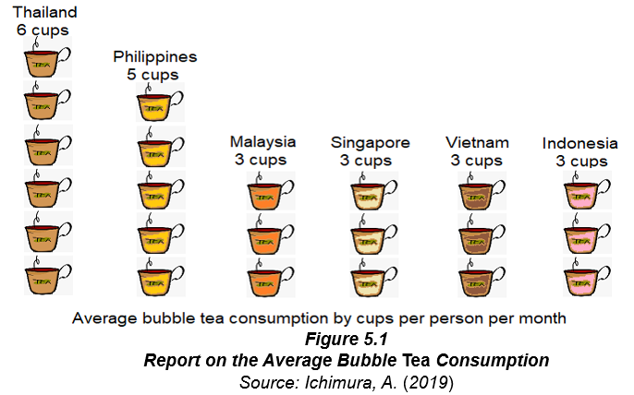
Six advantages of segmentation:
It allows the company to maintain a solid view of how marketing plans and activities will be carried out for the purpose of winning the preference of the target market.

Slide 9
Six advantages of segmentation:
Segmentation generates a customer-centric marketing program that allows organizations to increase the rate of their competitiveness.

Slide 10
Six advantages of segmentation:
As segmentation provides refinement of product messaging and deployment of the company's optimal offer to target market, customer retention becomes the end view.
Segmentation offers possibility of market expansion on the basis of geography. After leveraging the company's product or service to a particular territory on the basis of the segment's relative needs and wants, the organization is now capable to increase the range of their territorial coverage.

Slide 11
Six advantages of segmentation:
Clear product messaging is only possible if the company knows their targets; hence, one of the benefits of segmentation is improvement in their communication
Increase in competitiveness, brand equity and increased rate in customer retention are the by-product of segmentation, therefore, profitability takes the center stage.

Slide 12
Variables of Market Segmentation
01
02
03
04
Demographic
Geographic
Psychographics
Behavioral

Slide 13

Demographic Segmentation. This is considered the most common approach in segmentation wherein markets are divided into units on the basis of different variables such as age, sex, family life cycle, income and occupation.

Slide 14
Geographic Segmentation. Buying preferences are sometimes defined by the geographic locations. Hence, marketers use geographic segmentation in making strategies that are most appealing to a specific location. Geographic segmentation is another approach of dividing prospective buyers based on geographic units like nations, regions, municipalities, cities or neighborhoods.

Slide 15

Another good example to look into is the aspect of "urbanicity" that is attributable to the density of the population. Highly urbanized areas have distinct buying needs than people in the semi-urban areas and rural areas.

Slide 16
There are two reasons why people who live in the same area may share similar characteristics. First, some areas have more expensive properties than others and so people with similar socioeconomic characteristics may cluster together. Second, they have similar transport and shopping options.

Slide 17
Psychographic Segmentation. Personality traits and characteristics including person's interests, hobbies and lifestyles are the aspects that marketers consider when dividing markets using the psychographic segmentation.

Slide 18
Personality, attitudes, opinions and lifestyles are often used a segmentation bases.
These characteristics have some relationship to behavior and provide insight into how communicate with chosen segments.

Slide 19
Behavioral Segmentation. This approach is shaped by the person's buying behavior on the basis of his or her buying patterns evidenced by usage frequency, loyalty to the brand, benefits needed, purpose and urgency of use; thus, marketers clubbed them together as one segment with homogenous preference.

Slide 20
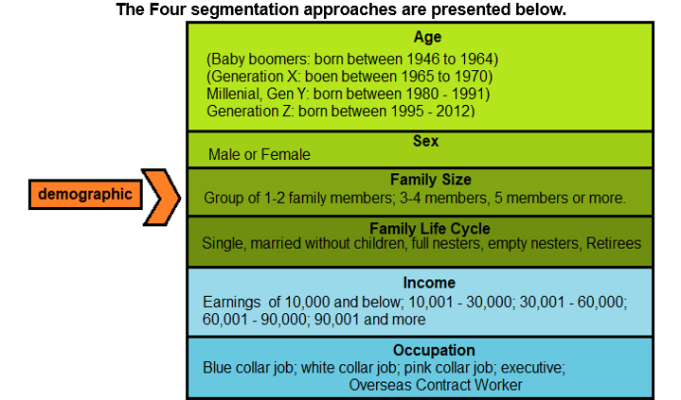
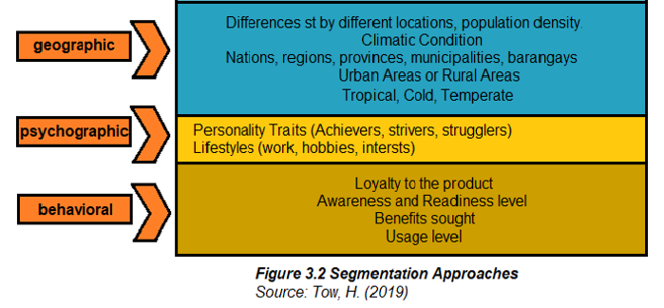

Slide 22
Requirements of an Effective Segmentation
01
03
Measurable
Substantial
02
04
Accessible
Actionable

Slide 23
Segmentation, Targeting and Positioning: A Modern Marketing Model

Slide 24
Market segmenting
Targeting
Positioning
01
02
03

Slide 25
Market Segmenting. Becoming acquainted with the profile of target markets in order to group them according to the homogeneity of their needs and wants enables one to present various options on what segment will the company be able to sustain the accomplishment of their objectives as to growth rate and profit margin.

Slide 26
(2) Targeting. Once market segmentation has been completed, the company should now select or target one or few market segments that they would like to serve on the basis of some factors such as the:

Slide 27



Some Factors in Targeting:
Financial and non-financial capacity of the company to cater such markets
The type of product or service you would want to specifically offer to your market
Competition

Slide 28

Targeting as a Marketing Concept

Slide 29
Targeting is the process of identifying customers for whom the company will optimize its offering. Simply put, targeting reflects the company’s choice of which customers it will prioritize and which customers it will ignore when designing, communicating, and delivering its offering.

Slide 30
Targeting is the next step in the sequential process involves a business making choices about segments on which resources are focused.

Slide 31
The Logic of Targeting
One approach is to develop the same offering for both customers (one for all strategy) and the other is to develop different offerings based on the needs of each customer (one for each strategy).

Slide 32
The one-for-all strategy of developing a single offering for the entire market is not very effective for satisfying customers with different needs because the offering will not create value for at least one of the customers (and perhaps even both).

Slide 33
The one-for-each strategy of developing a separate offering for each customer might not be effective because the company might not have the resources to develop offerings that meet the needs of both customers.

Slide 34
Grouping customers into segments enables a company to improve the cost efficiency of its marketing activities by not having to customize the offering for individual customers, usually with minimal sacrifice to the effectiveness of the offering.

Slide 35
Two types of targeting:

Slide 36
Strategic targeting calls for a conscious decision to ignore some potential customers in order to better serve others by tailoring the offering to their specific needs. Tactical targeting, on the other hand, does not aim to exclude any potential customers.

Slide 37
Strategic targeting focuses on the value that the company can create for and capture from target customers. In contrast, tactical targeting focuses on the means by which the company can reach these customers.

Slide 38
Strategic targeting is concerned with customer needs and preferences and their resources Tactical targeting, on the other hand, is concerned with the customer profile, which reflects customer’s readily observable characteristics such age, gender, income, social status, geographic location and buying behavior.

Slide 39
Two Principles of Strategic Targeting:
01
target compatibility
02
target attractiveness

Slide 40
The Key Resources:
01
03
business infrastructure
skilled employees
02
04
access to scarce resources
collaborator networks

Slide 41
The Key Resources:
05
07
know-how
established ecosystem
06
08
strong brands
access to capital

Slide 42

Two types of value for a company under Target attractiveness:
Monetary Value
Strategic Value

Slide 43
Two types of value for a company under Target attractiveness:
Monetary Value
CUSTOMERS REVENUE
COSTS OF SERVING TARGET CUSTOMERS

Slide 44
Two types of value for a company under Target attractiveness:
B. Strategic Value
SOCIAL VALUE
SCALE VALUE
INFORMATION VALUE

Slide 45
(3) Positioning follows on logically from the segmentation and targeting stages. Customer perceptions are central to the product position especially in relation to the competition’s offering. The product or service has to satisfy key customer requirements, and this has to be clearly communicated to customers.

Slide 46
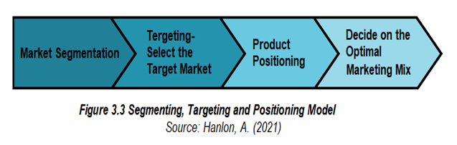

Slide 47
KEY SEGMENTATION PRINCIPLES:
01
03
COMPREHENSIVENESS
RELEVANCE
SIMILARITY
02

Slide 48
IN SUMMARY:

Slide 49
IN SUMMARY:
Careful strokes for a relatively diversified market are still the best deal in maximizing the resources of a company. Crafting a nice- sounding advertising message or spending a bigger chunk from your marketing budget on consumer promotion activities do not guarantee success nor guarantee an assurance that company resources were indeed maximized. Being able to resonate the message to an intended, potential group of people creates the difference. This is the advantage created by market segmentation, target marketing and product positioning.

Slide 50
IN SUMMARY:
Market segmentation is the process of identifying dividing target markets into smaller groups who share similar characteristics. It offers a lot benefit such as allowing the company to maintain a solid view of how marketing plans and activities should be carried out; increasing the rate of competitiveness through a customer- centric marketing program; leveraging company's product or service to a variety of geographical territories; refining product messaging and companies optimal offer to target market; improving company's communication towards its target audience; and increasing company's opportunities to earn higher profit.

Slide 51
Textbooks:
Strategic Marketing Management, Naval, Girly H. Mindshapers Co, Inc. 2021
Strategic Marketing Management, Butler, Dane ED-TECH Press 2019
Strategic Marketing Management: The Framework, Chernev, Alexander Cerebellum Press 2019

Slide 52
Thanks!
Please keep this slide for attribution

