Slide 1
STRATEGIC MARKETING MANAGEMENT
Marketing Information Systems (MkIS)
Week 6
Lecturer:
Fidela Reyes Balajadia
Associate Professor 2
University of the Assumption, Philippines

Slide 2
Lecture Learning Objectives:
At the end of the lecture, you will be able to:
1. Explain the basics about marketing information system
(MkIS)
2. Discuss the strategic role of the marketing information
system (MkIS)
3. Apply the role of the internet in the business
4. Differentiate the benefits of the marketing
information system (MkIS)

Slide 3
Lecture Learning Objectives:
At the end of the lecture, you will be able to:
5. Explain the marketing information system functional
components
6. Write an analysis of the marketing decision support system
7. Discuss the customer management systems
8. Explain privacy and marketing information system

Slide 4
An Overview

Slide 5
The Internet is rapidly changing the way business views marketing information systems. New business models present challenges and opportunities as organizations seek to adopt "e business" methodologies in the search for competitive advantage. Organizations of all sizes are feeling the "ripple effect" of Internet-enabled customers, supply chains and competitors.

Slide 6
Modern marketing organizations, with their focus on the Internet, exhibit different characteristics than their "old economy" brethren. They create and manage the customer interface where interactions are more virtual than face-to-face. They leverage IT technology to integrate and coordinate with customers and business partners to rapidly achieve measurable business results.

Slide 7
DEFINITION-MARKETING INFORMATION SYSTEM

Slide 8
MKIS is a computerized system that is designed to provide an organized flow of information to enable and support the marketing activities of an organization. The MKIS serves collaborative, analytical and operational needs. In the collaborative mode, the MKIS enables managers to share information and work together virtually. In addition, the MKIS can enable marketers to collaborate with customers on product designs and customer requirements.

Slide 9
STRATEGIC ROLE OF THE MARKETING INFORMATION SYSTEMS

Slide 10
Historically, the role of the marketing function has been to support "make and sell" business strategies that emphasized increases in market share over the creation of long- term customer value. This view started to change after World War II with the recognition that satisfying the customer's needs and wants should be the focus of a firm's business activities. The emphasis on the customer elevated the importance of marketing as a core business function on a par with research and development and production.

Slide 11
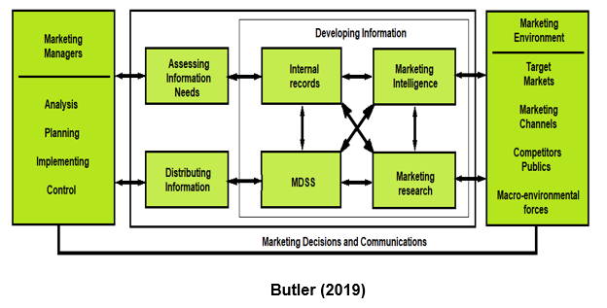
illustration

Slide 12

ROLE OF THE INTERNET
Information technology has transformed how firms conduct business.
The term "cybermarketing" is often used to describe the Internet's convergence of computers, information systems, telecommunications and the customer with the marketing process. Internet marketing is characterized by interactivity, graphical user interfaces, multimedia content, and one-to-one connectivity. Internet technologies are not only providing new ways to reach the customer, but also to enable the reengineering of the entire marketing process and, indeed, the entire enterprise.

Slide 13
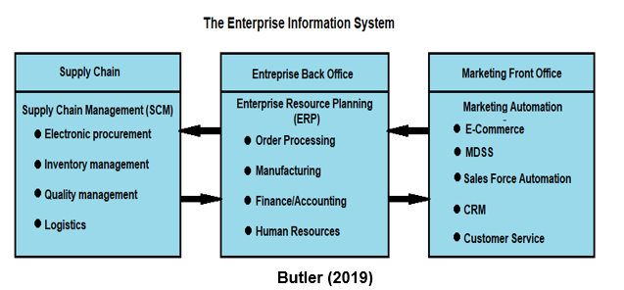
illustration

Slide 14
BENEFITS OF THE MARKETING INFORMATION SYSTEM
1
2
3
4
Market Monitoring
Strategy Implementation
Functional integration
Strategy Development

Slide 15
MARKETING INFORMATION SYSTEM (MkIS) FUNCTIONAL COMPONENTS

Slide 16
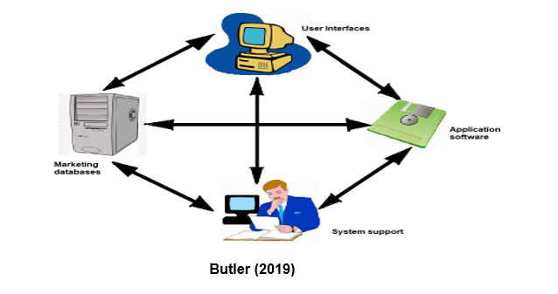
illustration

Slide 17
01
02
03
04
User Interfaces
System Support
Applications Software
Marketing Databases

Slide 18

Marketing decision support systems (MDSS) constitute a set of core applications of the MKIS. The MDSS provides computer-based tools, models, and techniques to support the marketing manager's decision process. In the general case, MDSS is optimized for queries of historical data.

Slide 19
Typical MDSS functions include models and tools for:
01
02
03
Sensitivity analysis
What-if analysis
Goal setting

Slide 20
Typical MDSS functions include models and tools for:
04
05
06
Forecasting models
Exception reporting
Pareto analysis

Slide 21
Typical MDSS functions include models and tools for:
08
07
Scorecards and dashboards
Simulation models

Slide 22
Common types of issues targeted by MDSS analyses
Market segment analysis
Pricing analysis
Market share analysis
Cost analysis

Slide 23
Common types of issues targeted by MDSS analyses
Sales analysis
Sales force productivity
Sales forecasting
Advertising analysis

Slide 24
Common types of issues targeted by MDSS analyses
Distribution
Customer satisfaction
Simulation

Slide 25
DATA WAREHOUSING

Slide 26
IBM defines a data warehouse as a place that stores enterprise data designed to facilitate management decisions. In essence, a data warehouse provides the basis for an analytical system where periodic data points are collected and stored at specified times for future analysis. Data warehousing enables marketers to capture, organize, and store potentially useful data about customers and markets for decision-making purposes.

Slide 27
Data Warehouse Processes
Data Collection
Data Management
Data Access

Slide 28
Data warehouses are an integral part of the MDSS. They provide the ability to access data for creating marketing operations reports, analyze sales results over time, identifying and mapping patterns, trends, that may be emerging in the market, and enabling the development of new products, pricing, market segmentation strategies, marketing communications campaigns, and distribution channels.

Slide 29
DATA MARTS
A data mart is a scaled-down version of a data warehouse. It is more focused, less complex, and holds a subset of the entire data, often in summary form. It is usually designed for a smaller number of users. They provide fast, specialized access and applications. They are sometimes call departmental data warehouses.

Slide 30
Data Mining
Data mining is the computer-based exploration and analysis of large quantities of data in order to discover meaningful patterns and rules for the purpose of improving marketing, sales, and customer support operations.

Slide 31
3
Data Mining Process

Slide 32
The first step in the process is to collect data on what the customer does. Online transaction processing (OLTP) systems do precisely that. Virtually everything a customer does when purchasing a product or service generates a string of transaction records. If the customer calls an "800" number to order a product, the phone company will capture data on the time of the call, the number dialed and the duration of the call. The marketing company will generate similar data in addition to that on products and services purchased, catalogue referenced, special offers, credit card number, order size, and time since last purchase.

Slide 33
Further transactions are generated by the order entry, billing, and shipping systems. The bank and the shipping company will log further transactions. The customer may need to call customer service to solve post-purchase problems. Internet transactions can generate even more data as the customer's purchase behavior can be linked to web- browsing behavior within a site and throughout the web. This data can then be linked to purchase histories, financial history and other personal-identity information.

Slide 34
Typical data mining tasks include

Slide 35
Classification
Estimation
Affinity grouping
01
02
03

Slide 36
Description
Clustering
Prediction
04
05
06

Slide 37
Data Mining Techniques
Market Basket Analysis
Cluster Analysis

Slide 38
Data Mining Techniques
Decision Trees
Query Tools

Slide 39
Data Mining Techniques
Neural Networks

Slide 40
OLAP is a family of analysis and report generating tools that are used to access large databases. It enables partially aggregated data or full reports to be stored in a multidimensional format for fast, convenient access and analysis. OLAP methods are based on databases that allow multidimensional views of business data. OLAP is useful for visualization of relationships between pre-designated variables.

Slide 41
OLAP applications are used achieve a higher view of the data such as total sales or profitability by product line, sales territory, or market segment. The OLAP database is usually updated in batch mode from multiple sources. OLAP is optimized for analysis and reporting. In contrast, users of online transaction processing (OLTP) applications are involved with creating, updating, or retrieving individual customer records. OLTP databases are optimized for updating transactions.

Slide 42
GEOGRAPHICAL INFORMATION SYSTEMS

Slide 43
GIS systems enable marketers to geographically map their customers, competitors, suppliers, sales concentrations, prospects, suppliers and partners. Site selection, trade- area analysis, environmental analysis, territory design, network planning, risk analysis are common applications.

Slide 44
Geographical Information System Marketing Applications
Customer Location
Geographic Market Information
Marketing Activity Location
01
02
03

Slide 45
Geographical Information System Marketing Applications
Business Location
Marketing Resource Location
04
05

Slide 46
CUSTOMER MANAGEMENT SYSTEMS
Companies need a method for viewing all customer and marketing-related information in an integrated way. Often marketing organizations maintain multiple databases for each business and marketing activity with data that is not easily integrated for strategic or operational purposes.

Slide 47
SALES FORCE AUTOMATION
The fastest growing elements of the MKIS. SFA applications are often integrated with the CRM system. SFA involves the application of information technology to the sales function or, more appropriately, to the activities leading to a sale. These activities include acquiring sales leads, managing the sales opportunity, closing the sale and managing the customer relationship.

Slide 48
THE SALES PROCESS:
01
LEAD GENERATION
02
SALES PROCESS MANAGEMENT
03
ACCOUNT MANAGEMENT

Slide 49
SALES PROCESS MANAGEMENT
01
02
03
04
VERIFICATION OF THE OPPORTUNITY
THE SALES CALL
OPPORTUNITY MANAGEMENT
CLOSING THE SALES

Slide 50
SALESFORCE AUTOMATION TOOLS:
01
DOCUMENT MANAGEMENT TOOLS
02
PERSONAL MANAGEMENT TOOLS
03
PROCESS MANAGEMENT TOOLS

Slide 51
CUSTOMER RELATIONSHIP MANAGEMENT
The Internet has facilitated a fundamental shift in market power from sellers to buyers. Customers, newly endowed with the power of market information, have much different expectations than before. Customers can easily move their business to another vendor with the click of a mouse. They have access to the same cost data as their suppliers and they demand 24x7 customer service.

Slide 52
CUSTOMER RELATIONSHIP MANAGEMENT
Customers now have almost unlimited ability for interactions with organizations through the Web in addition to the traditional phone and mail methods. Company web sites facilitate information search, shopping and customer support. E-mail communication can target specific offers on a one-to-one basis. Understanding and meeting demanding expectations has placed a renewed emphasis on managing customer relationships.

Slide 53
Customer Relationship Management Design Principles
The CRM system should offer the customer multiple channels for communication
The CRM system integrates the customer throughout the firm's value chain
Each CRM interaction should deliver value to the customer
Knowledge is captured during each CRM interaction

Slide 54
CRM functionality includes:
· E-commerce support
· Sales force automation
· Telesales and call center automation
· Direct mail and catalog sales
· Email and e-newsletter response
· Web sales and personalization
· Analysis of Web generated data
· Traditional customer support and service
· On-line support and customer service
· Mobile support through laptops, handheld devices.
· Training.

Slide 55
PRIVACY AND THE MARKETING INFORMATION SYSTEM
Privacy in the Internet Age has become a major concern for customers and marketers alike. Web enabled marketing information systems have the potential to collect highly sensitive and voluminous information on customers, competitors, suppliers and channel members. The speed in which this information can be collected, analyzed and acted upon can provide real competitive advantage to the user. This information can be used to better serve customers, streamline a company's operations, and develop better strategy. Some marketers use the data to better target advertising and marketing plans

Slide 56
TRACKING INTERNET USERS
It is axiomatic that no one is anonymous on the Web. At the current state of technology, marketers are able to develop customer profiles and track their behavior over the Web. Soon marketers will be able to track the locations and behaviors of Web-enabled cell phone and other wireless device users. The public uproar over such capabilities has caused several Web advertising networks to abandon efforts to link Web-use profiles to personal information.

Slide 57
Infrastructure elements are essential to the information model of the Internet:
01
02
03
04
ADVERTISING NETWORKS
COOKIES
IP ADDRESS
ONLINE
PROFILING

Slide 58
SALES PROCESS MANAGEMENT
05
06
07
PERSONAL INFORMATION
REFERERS
REGISTRATIONS

Slide 59
DEVELOPING A PRIVACY POLICY:
01
DISCLOSURE OF PRIVACY PRACTICES
02
ALLOW ACCESS
03
ESTABLISH INDUSTRY-WIDE PRIVACY RULES

Slide 60
Textbooks:
Strategic Marketing Management, Butler, Dane ED-TECH Press 2019
Strategic Marketing Management: The Framework, Chernev, Alexander Cerebellum Press 2019

Slide 61
THANKS!
Please keep this slide for attribution.

