Slide 1
STRATEGIC MARKETING MANAGEMENT
Marketing Plan Preparation
Week 7
Lecturer:
Fidela Reyes Balajadia
Associate Professor 2
University of the Assumption, Philippines

Slide 2
Lecture Learning Objectives:
At the end of the lecture, you will be able to:
1. Explain the important steps in the preparation of a marketing plan
with consideration of some enabling strategies that would
strengthen brand's performance.
2. Construct implementation strategies with analysis as to how
internal marketing efforts could become the strong
foundation of an effective marketing plan

Slide 3
Lecture Learning Objectives:
At the end of the lecture, you will be able to:
3. Integrate the knowledge acquired in making a marketing plan with
clear perception that this is the best tool to push products on their
competitive stand.
4. Explain the 4 “F's” of marketing plan
5. Prepare your own marketing plan based on the lecture presented
6. Discuss how internal marketing builds effective
implementation strategies

Slide 4
your marketing efforts should be grounded on facts
has efficient, goal- oriented team
a clear-cut marketing plan

Slide 5



Marketing plan is a detailed, systematically arranged proposal consisting of market-related activities that depict firm's intention to gain better directions in their decisions and quick guide on how to outsmart competitors

Slide 6
Marketing plan brings together the elements of marketing product, price, promotion and placement strategies that an organization has for its brand.

Slide 7



Marketing Plan's Primary Objective
product-based marketing plan
strategic-based marketing plan

Slide 8


Product should not only be good product, but it should be one kind of a product that is hard to resist in which customers will be compelled to get into their way of responding to your marketing efforts.

Slide 9
The 4’ “F's” of Marketing Plan
01
FACTUAL
02
FOCUSED
03
FINANCIALLY -SET
04
FLEXIBLE

Slide 10


Preparing the Marketing Plan
A marketing executive or team is responsible for preparing the marketing plan.
As strategic plan may be formulated in a long-term basis, say a 3-year strategic or 5-year strategic plan while a marketing plan is formulated annually to facilitate the efficient implementation of marketing activities during the year.
The marketing executive or product manager formulates the plan with the inputs from advertising, marketing and sales, finance, production team and other specialists in the organization.

Slide 11
Steps Undertaken in the Preparation of the Marketing Plan
Brief Summary
(3) Fact-Finding
(2) Describe the Target Market
(4) Setting of Verifiable Marketing Objectives

Slide 12
Steps Undertaken in the Preparation of the Marketing Plan
(5) Plan of Actions
b.) Multiplier Effect
a.) Concentration
c.) Comparison of Alternatives

Slide 13
Steps Undertaken in the Preparation of the Marketing Plan
(6) Numbering the Plans
b.) Focus on Controllable Costs
a.) Flexibility
c.) Ensure that the Activity is a Non-punitive one

Slide 14
steps undertaken in the preparation of the marketing plan
(7) Monitoring and Control

Slide 15

How Internal Marketing Builds Effective Implementation Strategies
What good will it bring to "an almost perfectly designed product", if the role of a clever craftsman will be removed in the picture or even the assistance of a persistent salesperson? The same as other junks, it will relish its lost glory for a time, unless that gifted craftsman or that persistent salesperson will again get into the picture.

Slide 16
Internal Marketing
Is among various business approaches that can enrich employees' attitude at work.
Ensures that every strategy and undertaking of the organization receives the active support and commitment of their employees thus, resulting to the efficient implementation of the external strategies.

Slide 17
Internal Marketing
Is done by examining the internal marketplace by aligning managerial behaviors to the behavior of the employees and studying whether internal capabilities are enough to attain external market objectives.

Slide 18
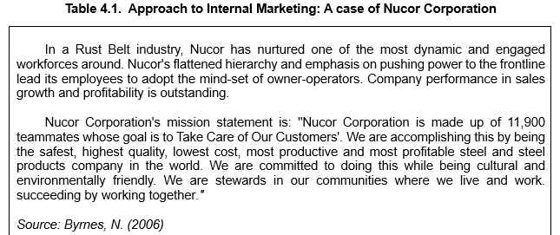

Slide 19
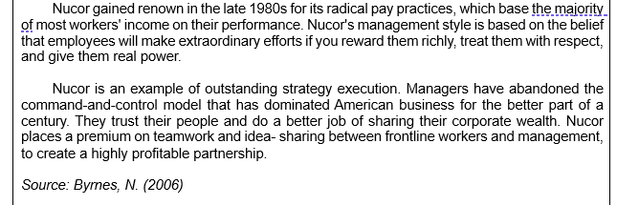

Slide 20
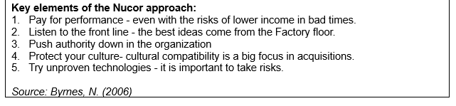

Slide 21

Factors in the Efficient Implementation of Marketing Plan
organizational design
incentives are deemed necessary
rapid and accurate movement of information
careful examination of the internal marketing strategies

Slide 22


The content of marketing plans

Slide 23
An executive summary
Situation analysis
The company's mission statement or long-term strategic vision
A statement of the company's key objectives

Slide 24
The marketing strategy
Implementation choices

Slide 25
MARKETING PLANNING
The area of marketing planning involves forging a plan for a firm's marketing activities. A marketing plan can also pertain to a specific product, as well as to an organization's overall marketing strategy.

Slide 26


MARKETING STRATEGY
Plans and Planning
Plans are needed to clarify what kinds of strategic objectives an organization would like to achieve and how this is to be done. Such plans must consider the amount of resources available. One critical resource is capital.

Slide 27
Factors that Affect a Firm
Trademarks/brand names
People
1
3
2
4
Patents
Distribution

Slide 28
Plans are subject to the choices and policies that the organization has made. Some firms have goals of social responsibility.
Strategic marketing is best seen as an ongoing and never-ending process.

Slide 29
Typically:
01
The organization will identify the objectives it wishes to achieve.
02
An analysis is made
03
Based on this analysis, a plan is made based on tradeoffs

Slide 30
Typically:
04
This strategy is then carried out
05
After implementation, the results or outcome are evaluated

Slide 31

Levels of Planning and Strategies
Corporate Level
Business unit Level
Functional Level

Slide 32


The Boston Consulting Group matrix provides a firm with an opportunity to assess how well its business units work together. Each business unit is evaluated in terms of two factors: market share and the growth prospects in the market.

Slide 33
Four Combination Emerge:
STAR
CASH COW
1
3
2
4
QUESTION MARK
DOG

Slide 34
A SWOT analysis is used to help the firm identify effective strategies. Successful firms such as Microsoft have certain strengths.
SWOT analysis should suggest how the firm may use its strengths and opportunities to overcome weaknesses and threats. Decisions should also be made as to how resources should be allocated.

Slide 35

Criteria for Effective Marketing Plans

Slide 36
01
The plan must be specific enough
02
The plan must be measurable

Slide 37
03
The goal must be achievable or realistic
04
The goals must be consistent

Slide 38
In Summary
This lecture must have placed you on top of your excitement to sell your product to your target market segment and get the profit margin that you earnestly desire. However, you need to do it one step at a time as you are dealing with limited resources and a number of competitors who also have the same excitement as yours. Hence, you need industry-tested methods of executing your marketing plan.

Slide 39
In Summary
Indeed, each company is driven by profit. Yet the only way to attain this is to remain committed to making their target market not only satisfied but also delighted. Hence, marketing efforts should be relevant, engaging and translated into a clear-cut marketing plan. Marketing plan is a detailed, systematically arranged proposal consisting of market-related activities that depict firm's intention to gain better directions in their decisions and quick guide on how to outsmart competitors.

Slide 40
In Summary
An effective marketing plan possesses 4 Fs characterized by being:
1. factual, which means that all information which will be used in the preparation of a marketing plan should be based on reliable facts that were logically gathered, facts that are allowed to incubate and to be verified prior to execution.
2. focused, which guarantees that the plan is designed to address a specific problem in response to the objectives of the company.

Slide 41
In Summary
3. financially-set, which signifies management's strong support and generous provision in order to effectively carry out the marketing plan; and,
4. flexible which means that the marketing plan, upon evaluation and monitoring activities, allows intervention and enhancement whenever deemed appropriate.

Slide 42
In Summary
There are important steps in the preparation of a marketing plan. These include:
1) brief summary on the preliminaries of the marketing plan with focus on the general objectives of the organization vis-à-vis the preparation of the marketing plan.
2) description of the target market in connection to market segmentation for a much clearer product targeting and positioning.
3) fact-finding that includes careful environmental scanning for possible threats and opportunities that may beset the preparation of the plan as well as the execution at a later stage.

Slide 43
In Summary
There are important steps in the preparation of a marketing plan. These include:
4) setting of verifiable marketing objectives which will help the marketing team assess the direction they are taking as well as the interventions when deemed necessary.
5) plan of actions that pertain to the marketing plan's specific program of activities with consideration to the principle of concentration, multiplier effect and comparison of alternatives.
6) numbering of plans which is about the management's support to the plan in consonance to the overall objectives of the firm.
7) monitoring and control for a timely assessment of actual results in connection to the desired results of the management.

Slide 44
In Summary
Upon your thorough consideration of these logical steps, also be cognizant about the idea that behind an effective marketing plan is the commitment and dedication of the people inside your organization. They are referred to as the organization's internal marketing. Internal marketing ensures that every strategy and undertaking of the organization receives the active support and commitment of their employees thus resulting to the efficient implementation of the external strategies.

Slide 45
Thanks!
Any questions?
You can find me at:
fidela.balajadia@ua.edu.ph
fidelabalajadia24@gmail.com

Slide 46
Textbooks:
Strategic Marketing Management, Naval, Girly H. Mindshapers Co, Inc. 2021
Strategic Marketing Management, Butler, Dane ED-TECH Press 2019
✋👆👉👍👤👦👧👨👩👪💃🏃💑❤😂😉😋😒😭👶😸🐟🍒🍔💣📌📖🔨🎃🎈🎨🏈🏰🌏🔌🔑

Slide 47

Credits
Special thanks to all the people who made and released these awesome resources for free:
Presentation template by SlidesCarnival
Photographs by Unsplash
Please keep this slide for attribution

