Slide 1
STRATEGIC MARKETING MANAGEMENT
Product and Brand Strategy with Pricing Techniques
Week 8
Lecturer:
Fidela Reyes Balajadia
Associate Professor 2
University of the Assumption, Philippines

Slide 2
Lecture Learning Objectives:
At the end of the lecture, you will be able to:
1. Explain the nature of a product in consideration to its degree of
tangibility and intangibility and the difference between product mix
and product line.
2. Apply the New Product Planning and Development process to
improve the brand equity of the newly introduced product/service
3. Associate branding strategies in crafting new products and services
that deliver great buying or shopping experience.

Slide 3
Lecture Learning Objectives:
At the end of the lecture, you will be able to:
4. Discuss on how to manage product mix and product line
5. Distinguish between product life cycle and product life cycle
management
6. Explain the categories of new product strategy

Slide 4
Nature and Definition of Product. Product may take into various forms and the kind of reception that the company has for the latter has parallel implications to its continued existence and profitability.

Slide 5
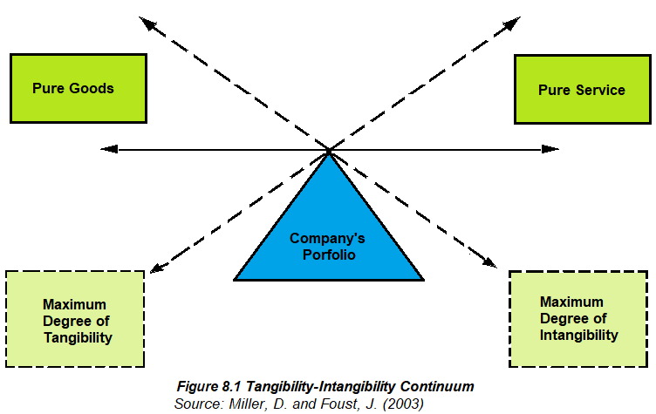

Slide 6
A product, either goods or services, is a total set of physical and non-physical attributes in which the targeted buyer intends to acquire, alongside with his/her satisfaction criteria, in exchange of a specified amount.

Slide 7

The noun product is defined as a “thing produced by labor or effort” or the “result of an act or a process”, and from the verb produce, from the Latin produce (re) (to) lead or bring forth. Since 1575, the word “product” has referred to anything produced. Since 1965, the word has referred to “thing or things produced”.

Slide 8
In marketing, a product is anything that can be offered to a market that might satisfy a want or need. In retailing, products are called merchandise. In manufacturing, products are purchased as raw materials and sold as finished goods. Commodities are usually raw materials such as metals and agricultural products, but a commodity can also be anything widely available in the open market. In general, product may refer to a single item or unit, a group of equivalent products, a grouping of goods and services, or an industrial classification for the goods or services.

Slide 9
Classification of Products
01
02
Consumer Goods
Industrial Goods

Slide 10
Classification of Consumer Goods
01
02
03
04
Convenience Goods
Shopping Goods
Specialty Goods
Unsought Goods

Slide 11
Classification of Producer Goods
01
02
03
Raw Materials
Fabricating/Component Parts & Materials
Installations

Slide 12
Classification of Producer Goods
04
05
Accessory Equipment
Operating Supplies

Slide 13

Managing Product Mix and Product Line
Product mix is a group of everything a company sells. It consists of a wide range or a mixture of product lines that a multi-brand organization wishes to offer their target customers. Needless to say, then, a product line refers to a unique product category or brand within the company's product mix.

Slide 14
Addition of new items to a company's product lines is referred to as product line extension. This marketing strategy being used by many companies allows them to experiment plunging into new market segments which may range from their current market going to a bunch of young urbans, or a group of middle-class professionals or perhaps to even mature markets like the aging populace".

Slide 15
The Product Life Cycle and Product Life Cycle Management
Products are biological organisms. When they are introduced in the market, they grow, mature and eventually decline. This life cycle concept could be sudden to a number of products but could also be gradual to some depending on the amount of company support and strategy given to each product.
The term “life cycle” implies a well-defined life cycle as observed in living organisms, but products do not have such a predictable life, and the specific life cycle curves followed by different products vary substantially.

Slide 16

Product Life Cycle or PLC

Slide 17
Growth Stage
Decline Stage
01
02
03
04
Introduction Stage
Maturity Stage

Slide 18
Three Options during the Decline Phase:
01
02
03
Maintain the product in hopes that competitors will exit.
Harvest it
Discontinue the product

Slide 19
Product life cycle management represents an all-encompassing vision for managing all data relating to the design, production, support and ultimate disposal of manufactured goods.
PLM concepts were first introduced where safety and control have been extremely important, notably the aerospace, medical device, military and nuclear industries.

Slide 20
Market-driven Product Planning and Development Process
First, it is a competitive weapon in boosting the company's growth rate
Second, it serves as a starting point of marketing planning
Third, it is indeed a strong indicator of the company managers' managerial
prowess
Fourth, product planning is an important way to fulfil the social
responsibilities of the business.

Slide 21
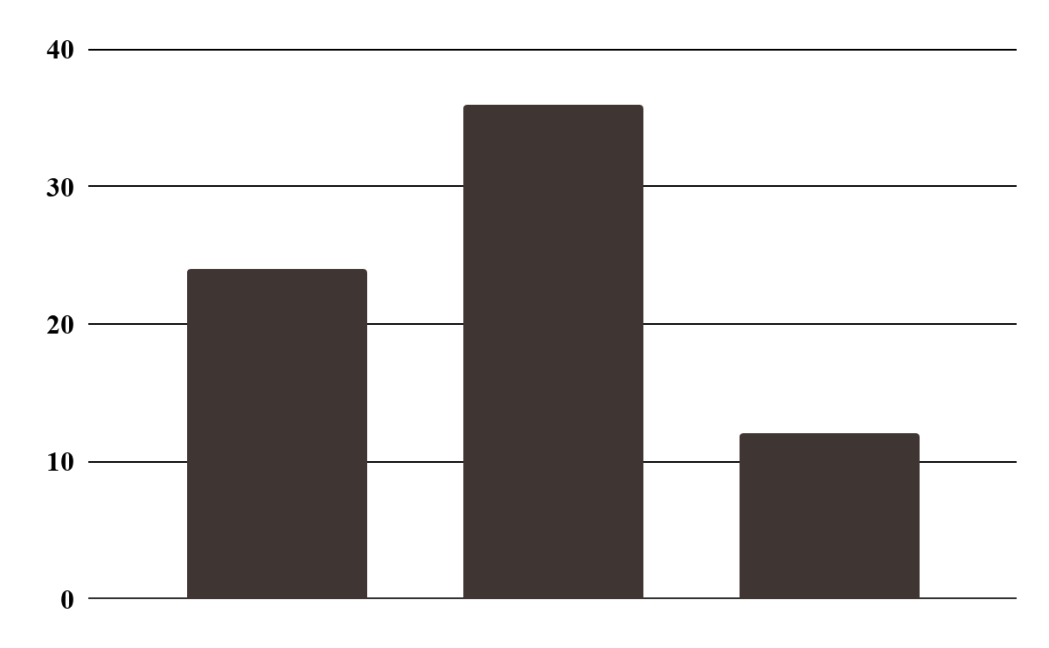
Categories of New Product Strategy
01
New-to-the-world products
02
New-to-the-firm products
03
Additions to existing product lines

Slide 22
Categories of New Product Strategy
04
Improvements & revisions of existing products
05
Repositioning
06
Cost Reductions

Slide 23
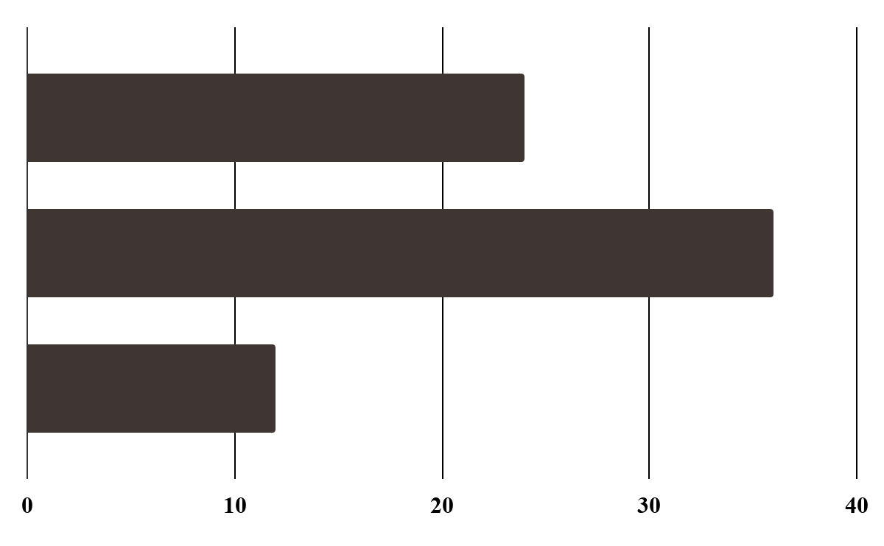
New Product Planning and Development Process
01
02
03
Customer needs analysis
Idea generation
Screening ideas

Slide 24
Screening Ideas risk:
Strategic Risk
Market Risk
Internal Risk

Slide 25
New Product Planning and Development Process
04
05
06
Evaluation of Prototype
Business Analysis
Product Development

Slide 26
New Product Planning and Development Process
07
08
Market Tests
Commercialization

Slide 27
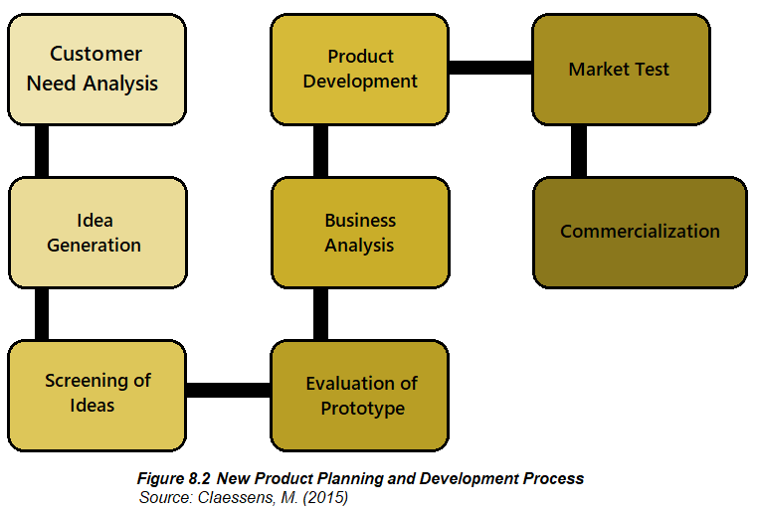

Slide 28
Why New Product Fails?
01
02
The product offers no point-of-difference at all
Limited Retailer Support

Slide 29
New Product Planning and Development Process
03
04
Poor Product Design
Weak or poorly executed new product launch

Slide 30
New Product Planning and Development Process
05
06
Aggressive competitors' actions
Small target market

Slide 31
A brand is a product, service or concept that is publicly distinguished from amongst in the industry.
A brand is a name, term, sign, symbol, design or combination thereof used to identify and differentiate a company’s products from competitors. Brand name is the element of the brand that can be vocalized. The brand mark is the element of the brand that cannot be vocalized, and the trademark is a brand that is registered with the US Patent and Trademark Office.

Slide 32
Brand extension strategy occurs when a company decides to stretch the use of their current brand name to label any newly introduced and related products in their product mix.

Slide 33
Another approach is family branding, also known as umbrella branding, which is common for organizations that attach their corporate name to a product introduced as either a new market segment or a different product class. Family branding aims to classify numerous products under the name of its parent brand.
This differs from branding individual products, which involves giving each product its own name and image.

Slide 34
Packaging is the science, art and technology of enclosing or protecting products for distribution, storage, sale and use. Packaging also refers to the process of design, evaluation and production of packages. Packaging can be described as a coordinated system of preparing goods for transport, warehousing, logistics, sales and end-use. Packaging contains, protects, preserves, transports, informs, and sells.

Slide 35
Package labeling or labelling is any written, electronic, or graphic communications on the packaging or on a separate but associated label.

Slide 36

Features of good packaging
1. Unique and handsome design that has the influence of pulling customers towards buying the product; it is advised that constant redesigning of packaging be observed to make the product more appealing and relevant despite changes in the business environment.
2. Provides convenience to users, not too heavy nor too big for its size; easy opening is another consideration.
3. Security of the products from dust, light, spoilage, damage, evaporation, etc.

Slide 37
Features of good packaging
4. Adaptability to be stored or kept in various places such as cabinets, shelves etc.
5. Dependability of the packaging as it is associated to the customers' impression about the company; and
6. Status or prestige as reflected in the customers' sense of confidence in every purchasing act.

Slide 38
The Purposes of Packaging and Package Label
01
03
PHYSICAL PROTECTION
Containment or agglomeration
02
04
BARRIER PROTECTION
Information transmission

Slide 39
The Purposes of Packaging and Package Label
05
07
MARKETING
CONVENIENCE
06
08
SECURITY
PORTION CONTROL

Slide 40
PACKAGING TYPES:

Slide 41
PRIMARY PACKAGING
SECONDARY PACKAGING
TERTIARY PACKAGING
01
02
03

Slide 42
Pricing and its Objectives
Achieve the financial goals of the company specifically their target return on investment in order to support all plans of the organization
Match the expectations or requirements of the target market in a specific product line
01
02

Slide 43
Pricing and its Objectives
Achieve the desired market share
Stabilize the growth rate of the product
03
04

Slide 44
Pricing and its Objectives
Induce more purchasing activities from target customers
Help recover the high costs of research and development incurred during the development stage of the product; and
05
06

Slide 45
Considerations in Pricing your Product Effectively:
COST-PLUS PRICING
Price Skimming Strategy
01
02
Psychological Pricing Strategy
Penetration Pricing Strategy
03
04

Slide 46
Considerations in Pricing your Product Effectively:
Price bundling Strategy
Follow-the-leader Pricing Strategy
05
06
Product line Pricing
07

Slide 47


Influences in Pricing Decisions:
INTERNAL FACTORS
EXTERNAL FACTORS
01

Slide 48
INTERNAL FACTORS INCLUDE:
01
03
COMPANY OBJECTIVES
MARKETING MIX
02
COMPANY STRUCTURE

Slide 49
EXTERNAL FACTORS INCLUDE:
01
03
DEMAND
POLITICAL & LEGAL
02
COMPETITION

Slide 50
A market-driven approach uses business decisions based on market facts. It is when the management is serious about committing all business functions work in harmony towards building great consumer experiences that result to customer satisfaction.

Slide 51
TECHNIQUES USED:
01
03
PERSONALIZED
RANDOM ACTS OF KINDNESS
02
EXCLUSIVE EVENTS

Slide 52
In Summary
To realize the company's objectives, products and services with strong brand equity must be established first. Products or services' sales are the vehicles in which the company enjoys a strong market foothold. Therefore, organizations should have vivid understanding on the kind of perceptions they would like to convey to their target markets by offering relevant line of products in their product mix Before understanding the relevance of your product to your target market segment, your team should have a clearer view of the product's nature and characteristics. Your company may decide the level of your product's tangibility and intangibility.

Slide 53
In Summary
But regardless of their nature, characteristics and classification, it is undeniable that every product is a biological organism which means that they have birth and may eventually suffer death of natural form. This refers to the product life cycle that includes the introduction stage, growth stage, maturity and decline stage. Hence, proper product life cycle management should be in place in order to safeguard and sustain the life of each product in our product mix.

Slide 54
In Summary
Packaging is deemed to be the silent salesman on the shelf. Therefore, your team must be able to take heed of the following essential features of a good packaging such as: unique and handsome design that could pull customers to buy the product; convenient to users; security of the products against damage, spoilage, etc.; adaptability to various storage areas; dependability of the packaging to gain good impression from customers; and prestige.

Slide 55
In Summary
Further, pricing is another critical factor to be decided upon by the management as it is believed that price could make or even break a product. Pricing is considered to be the only element among the elements in the marketing mix that is revenue-generating and the rest being cost centers. As the pricing decision is deemed a crucial managerial task, it is imperative that the price should not cause confusion to customers vis-à-vis giving focus to the real value of the brand. Hence, a market-driven concept is the best antidote during this time of hyper- competition and customer empowerment.

Slide 56
Thanks
Do you have any questions?
fidela.balajadia@ua.edu.ph
fidelabalajadia24@gmail.com
Please keep this slide for attribution

Slide 57
Textbooks:
Strategic Marketing Management, Naval, Girly H. Mindshapers Co, Inc. 2021
Strategic Marketing Management, Butler, Dane ED-TECH Press 2019

