Slide 1
STRATEGIC MARKETING MANAGEMENT
Distribution Strategy & Sales Management
Week 10
Lecturer:
Fidela Reyes Balajadia
Associate Professor 2
University of the Assumption, Philippines

Slide 2
Lecture Learning Objectives:
At the end of the lecture, you will be able to:
1. Discuss the significance of marketing intermediaries in the strategic placement strategies of an organization.
2. Write analysis on the classification of marketing intermediaries and the specific functions they are performing; and
3. Justify the importance of providing good Sales Performance Compensation Package for a group of sales representatives
to promote productivity and quality performance.

Slide 3
Lecture Learning Objectives:
At the end of the lecture, you will be able to:
4. Discuss how to select and manage channels of distribution
5. Explain the major arteries in the distribution system: wholesaling and retailing
6. Explain the rationale of sales management

Slide 4
Distribution strategy is a strategy connecting to the rest of the elements of the marketing mix. It is a comprehensive system of the company where they ensure that their products are strategically positioned near the target market any time and all the time. This principle of product availability may be associated to the well-known adage which says, "Absence make the heart grow fonder".

Slide 5
Sales management concerns in the development of individual who will make up the sales force, that is part in the achievement of the organization's sales and profit objectives. The nature of distribution strategy that is to bring products in places where consumers could avail them time and all the time is the same as the nature of sales management. Organizations develop their sales team in order that they could help in the placements and sales of the company's products to target buyers.

Slide 6
Significance of Marketing Intermediaries

Slide 7
Setting up an efficient channel that will link various intermediaries or institution that will work together in moving products to their strategic selling places, is critical to the success of a company. It is imperative that producers or manufacturers are able to develop and manage a strong and reliable network of product distributors which will ensure that the ultimate consumer or organizational buyer will enjoy maximum benefit of the time, place and possession
utility that every intermediary offers.

Slide 8
Other than the essential role intermediaries play in serving their buyers, they also offer huge advantage at the producers' end, without the intermediaries that will collect and disperse assortments of goods directly to intended buyers at a minimum total cost, the system would be in total inefficiency notwithstanding the tremendous costs the producers will incur after becoming a producer and a distributor in one.

Slide 9
Classification of Marketing Intermediaries and their Functions

Slide 10
Broadly speaking, there are two classes of middlemen that both assist in the transfer of title of goods from the producer or manufacturer to the buyer though they differ on the manner whether transfer is done directly or indirectly.

Slide 11
Two Classes of Middlemen:
functional middlemen or functional wholesalers
01
marketing or merchant middlemen
02

Slide 12
Common Types of Functional Middlemen:
AGENTS
BROKERS
COMMISSION MERCHANT

Slide 13
FUNCTIONS OF MARKETING INTERMEDIARIES:
TRANSPORTATION
ASSORTING & SORTING
STORING
TRANSACTIONS
PROMOTION & ANY MARKETING RELATED ACTIVITY
INFORMATION PROVIDER

Slide 14
Channels of Distribution

Slide 15
Doing business in a dynamic market offers a lot of great possibilities and opportunities for growth. You may be a baker specializing in making cakes and pastries who directly sells your product in the neighborhood. Yet, upon favorable acceptance of your baked products by your customers, you were enthused to widen your market reach. Going into a much bigger scale, you need to set up your own distribution channel where marketing intermediaries- some dealers or retailers, could assist you in reaching sales target and desired profit margin. Therefore, channel of distribution refers to the chain of businesses that products pass through before reaching their retailing point.

Slide 16
Distribution channels involves designing and streamlining the process of delivering a company's offering in a way that creates value for target customers, the company, and its collaborators. The key aspects of managing distribution channels are the focus of this lecture.

Slide 17





Distribution as a Value-Creation Process
Pana
Amico
Bro
Rafiki
Cuate

Slide 18
THREE MAIN TYPES OF ENTITIES:
A
B
C
MERCHANTS
AGENTS
FACILITATORS

Slide 19
Distribution Channel Functions
1
2
3
4
5
6
Product Delivery
Service Delivery
Brand Building
Delivering Incentives
Delivering Information
Collecting payments

Slide 20
Distribution Channel Design
1
2
3
Channel Structure
Value Added by the Channel
Distribution Coverage

Slide 21
AWESOME WORDS
Defining the Channel Structure

Slide 22
01
02
03
Direct
Indirect
Hybrid

Slide 23
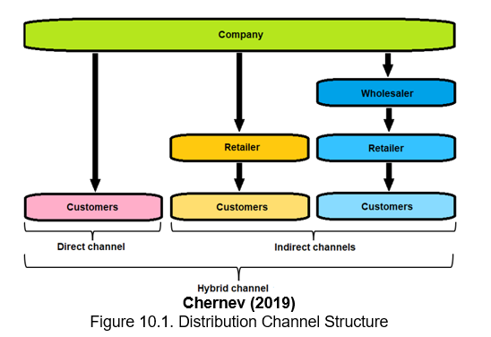

Slide 24
Key Aspects of Company’s Offering:
 |  | 1 | 2 | 3 | 4 | 5 | 6 | 7
1 | product
2 | service
3 | brand
4 | price

Slide 25
Key Aspects of Company’s Offering:
 |  | 1 | 2 | 3 | 4 | 5 | 6 | 7
5 | incentives
6 | communication

Slide 26
DIFFERENT ENTITIES:
COMPANY
INTERMEDIARIES
CUSTOMERS

Slide 27
Key Considerations in Channel Design

Slide 28
The Pros of Using Intermediaries
EFFECTIVENESS | SCALE
COST EFFICIENCY | SPEED
FLEXIBILITY

Slide 29
The Cons of Using Intermediaries
LOSS OF CONTROL | CHANNEL CONFLICTS
LIMITED INFORMATION | COMPLEX STRUCTURE

Slide 30
Managing Channel Relationships

Slide 31

Channel power refers to the ability of one channel member to exert influence over another member of the same distribution channel. This influence often leads to an imbalance in the value exchange in favor of the more powerful entity.

Slide 32
Channel power depends on a number of factors:
1 | Customer Demand
2 | Availability of alternative options
3 | Strategic Importance

Slide 33

Channel Conflicts
As with most business relationships, channel collaboration is not without conflicts. Channel conflicts are tensions among entities occupying different levels of the value-delivery chain.

Slide 34
TWO TYPES OF CHANNEL CONFLICTS:
VERTICAL
HORIZONTAL

Slide 35
$4.300,00
Channel Dynamics
Once created, distribution channels do not stay static; they evolve over time. Changes in technology and market structure often lead to reallocation of the functions performed by the different channel members.

Slide 36
TWO TYPES OF CHANNEL INTEGRATION:
VERTICAL INTEGRATION
HORIZONTAL INTEGRATION

Slide 37
Selecting and Managing Channels of Distribution
01
Nature of the Market
02
Product Consideration
Middlemen Consideration
03

Slide 38
Selecting and Managing Channels of Distribution
04
Company Consideration
05
Government Rules
06
Nature of Competition

Slide 39
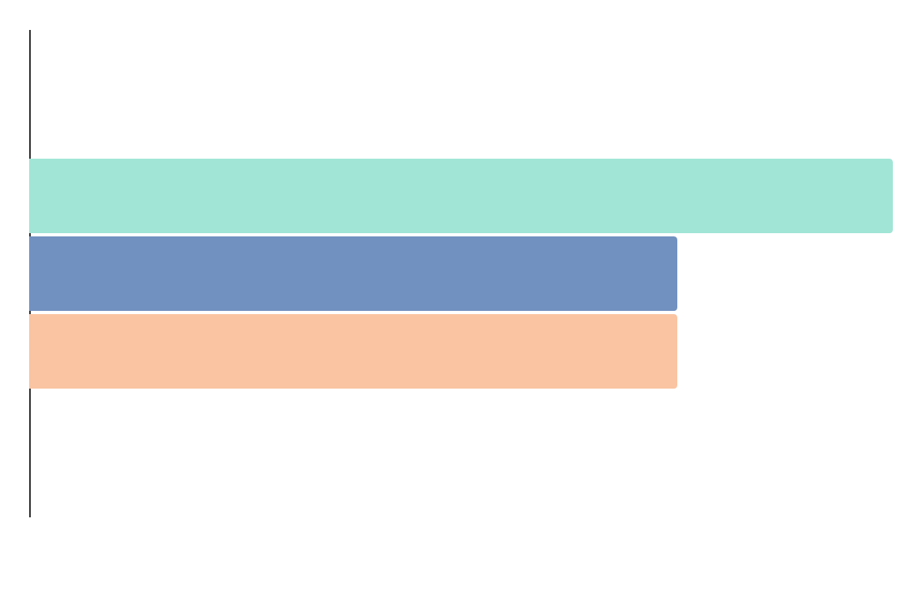
three degrees of market exposure:
01
02
03
INTENSIVE
SELECTIVE
EXCLUSIVE

Slide 40
Having a clear policy for relationship marketing in channels may be enhanced under vertical marketing system. Peter and Donnelly (2013) defined vertical marketing systems (VMS) as channels in which members are more dependent on one another and develop long- term working relationship in order to improve the efficiency and effectiveness of the system.

Slide 41
THREE MAJOR TYPES OF VMS:
1
2
3
ADMINISTERED VERTICAL MARKETING SYSTEM
CONTRACTUAL VERTICAL MARKETING SYSTEM
CORPORATE VERTICAL MARKETING SYSTEM

Slide 42
Major Arteries in the Distribution System: Wholesaling and Retailing

Slide 43
Wholesaling and retailing play a very essential role in the marketing process in which being the part of the chain of distribution, these intermediaries settle the gap between producers and consumers through the performance of undiscounted expert services that include efficient system in carrying out the physical movement of goods to convenient locations, assuming risks of managing large inventories of diverse products and delivering products as needed to replenish retail shelves.

Slide 44

TYPES OF RETAILING:
STORE RETAILING
01
NON-STORE RETAILING
02

Slide 45
Sales Management: Rationale

Slide 46
Hyper-competition contributes to the fluidity of the state or condition of a business. The dynamic nature of the business environment enables organizations to adapt growth strategies just to sustain competitive advantage. One of the business growth strategies that an organization could exploit is the knowledge or expertise on the principle of Product Life Cycle (PLC). Each stage in the PLC has complementary strategy deemed appropriate in timing and execution.

Slide 47
Sales management is an important segment of the organization's marketing mix mostly responsible in setting up varied sales strategies that also include the development, supervision, motivation and control of sales personnel. Other than achieving company's sales objectives, good sales management could make people of mediocre ability into people with extraordinary ability. Perhaps, it can be justified that personal selling is one of the rich sources of company revenue and profits and it anticipates meeting different company objectives such as: provision of vital product information; persuasion especially to undecided buyers; delivery of after-sales services in order to build better customer relationship.

Slide 48
Controlling the Sales Force

Slide 49
Various Devices that sales managers could use
01
02
03
SALES REPORT
QUOTA ANALYSIS
SALES COMPENSATION

Slide 50
Guide in order to Objectively Evaluate the Functions of the Sales Personnel
01
02
Effort -oriented parameters
Result-oriented parameters

Slide 51
Motivating and Compensating Sales Performance

Slide 52
Motivation in the workplace is a process of providing an environment that allows every member of the organization to remain focused and enthusiastic about their job. Motivation has three essential elements - need, drive and goal. In the motivation theory of Maslow, human needs have different hierarchical level in which the basic needs are the physiological needs while the ultimate needs is the need to be self-fulfilled commonly driven by the person's passion, hopes and aspirations. Accordingly, motivation ceases when an individual has attained a particular level hence will start aiming for the next hierarchal need.

Slide 53
TWO TYPES OF COMPENSATION:
1
2
MONETARY
NON-MONETARY

Slide 54
TYPES OF MONETARY COMPENSATION:
01
Straight Salary Plan
02
Commission Only Plan
03
Combination of Salary and Commission Plan

Slide 55
IN SUMMARY:
Any dynamic business entity aiming for sustained competitive advantage must ensure a comprehensive system that will position their products near the target market to ensure that all store shelves never run out of stocks and that products are available at the time of purchase. The significant role of channel members or the marketing intermediaries for an effective and efficient production system is something that every producer should consider in their quest for a sustainable competitive advantage. Both merchant middlemen and functional middlemen offer varied essential functions ranging from transportation, assorting, sorting, storing, transactions, promotions and other related activities. With the comprehensiveness of their services, producers could now fully allocate their resources in product development and innovation, part of their business and growth strategies.

Slide 56
IN SUMMARY:
The dynamic state of the business industry due to the occurrence of hyper-competition induced by technology and innovation urges producers to maintain their own distribution system apart from the support of their external distributors. This condition has prompted producers to establish a direct communication system with their target market thru the present sales force. Leading a diverse sales force requires a reliable system of sales management.

Slide 57
IN SUMMARY:
As performance is directly affected by the amount of motivation that the management gives to their sales personnel, it is but imperative, that in order to make them goal-directed, motivation scheme should be intensified in the organization. Compensation may be given in two types: monetary and non-monetary. Under the monetary compensation, the company may offer the following: 1) straight salary plan; 2) commission only plan; 3) combination of salary and commission plan. The non- monetary benefits include some perks such as: attractive retirement package, medical benefits including immediate family members, travel allowances, leave credits, children's education allowance, recognition and commendations and many others.

Slide 58
THANKS!
THANKS!
Please keep this slide for attribution

Slide 59

Textbooks:
Strategic Marketing Management, Naval, Girly H. Mindshapers Co, Inc. 2021
Strategic Marketing Management: The Framework, Chernev, Alexander Cerebellum Press 2019

