Slide 1
STRATEGIC MARKETING MANAGEMENT
Managing Global Operations
Week 11
Lecturer:
Fidela Reyes Balajadia
Associate Professor 2
University of the Assumption, Philippines

Slide 2





Lecture Learning Objectives:
At the end of the lecture, you will be able to:
1. Discuss the theory of comparative advantage which has infused
motivation for internationalization.
2. Draw risks and opportunities plan that organization may opt to use
as guide prior to their entry in the foreign market; and
3. Understand the essential elements in marketing products or
services in a global scale.
4. Explain what motivates a person to engage in internationalization
or foreign market
5. Discuss the risks in entering a foreign market

Slide 3
Theory of Comparative Advantage
Comparative advantage is a condition when a country is experiencing superiority in their production of goods or services than other countries.
Their superiority may be brought by too many factors such as economies of scale, technology, innovation and the like leading to a much lower opportunity cost. This is when trade off becomes the smartest and strategic decision by other countries.

Slide 4
Theory of Comparative Advantage
The scenarios cited above indeed could stimulate the trade-off. In the real sense, countries that enjoy the state of being comparatively advantageous over other countries in one particular economic aspect may not experience superiority in all aspects of their economic being.

Slide 5

Motivations for Internationalization

Slide 6






Diversifying in a much bigger geographical area for a company is a very challenging attempt. But since the advent of globalization, freer trade, commercial agreements in various forms involving different countries, zero to less tariff rates, better labor agreements and many more have encouraged several businesses to test the water and widen their horizons.

Slide 7
Several Motivating Factors for Internationalization.
First, they are motivated because of the lucrative market that the foreign land offers.
Second, when companies expand geographically outside their homeland, they have the advantage of economies of scale allowing the firm to economize various administrative costs such as labor, other resources, logistics, distribution networks and the like.

Slide 8
Several Motivating Factors for Internationalization.
Third motivation to internationalize the firm's operation is the firm's chance of gaining access to technological innovations that are being developed in other countries.
Lastly, entering into global operations allows the company to diversify, not only their products or services, but also to diversify possible market risks which may include market saturation in the home market, rapid changes in consumer buying behavior which disturbs market trends, economic and environmental condition, legal challenges and a lot more.

Slide 9
Risks in Entering Foreign Market
Crossing different geographical borders may cause organization to face various uncertainties and higher degree of risks-considering the political, economic, social, technology, environmental and legal aspects.

Slide 10


Some Problems that could be Expected when Entering Foreign Markets:
Cultural Differences. This concern may appear simpler yet may pose serious problem as cultural values and priorities are strong determinants in the purchasing behavior and decision of consumer.
Political Uncertainties. Public order and equitable trade legislation are to be reckoned by the management before getting into a new market.

Slide 11
Some Problems that could be Expected when Entering Foreign Markets:
Trade Restrictions. Tariff, being levied on commodities that enter and leave their home market; and quantitative restrictions in the form of quota which is imposed by a country on the volume and kind of goods that are allowed to enter and leave their country
Economic Conditions. An in-depth analysis about the economic development of a particular state should be the primary agenda of managers

Slide 12






Essential Elements in the Marketing Mix
Marketing research. Marketing intelligence is an important asset of a firm. It is composed of various data sets which a firm could use in analyzing the market before starting with any investment endeavor.
Product Strategy. The characteristics of the foreign market are not as predictable as it is like that of a domestic market. Companies most likely have to attend to the complexities of their demands center around cultural diversities.

Slide 13
Essential Elements in the Marketing Mix
Distribution Strategy. In the domestic market, companies rely heavily in the services of independent intermediaries where some of them take ownership and title of the goods they carry while others merely assist in the physical storage and distribution of products to other major distributive arteries without taking ownership and title thereof.
Pricing Strategy. This is another determinant not only for consumer acceptance but also the amount of resiliency that companies are willing to yield without hurting much their profit projections.

Slide 14
Essential Elements in the Marketing Mix
Advertising and Sales Promotion Strategy. According to the report of Forbes Business Development Council, the most innovative marketing strategies that companies may pursue during this recent time are guerrilla marketing, holistic marketing agencies and social media marketing and influencers. Guerilla marketing is the audacious approach to low-cost or zero advertising or promotion expense through the use of unconventional consumer interactions.

Slide 15
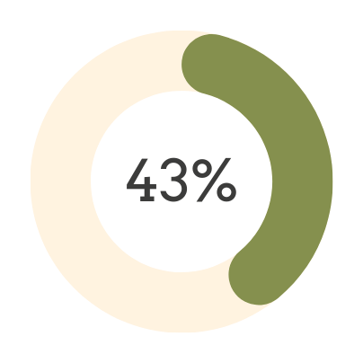
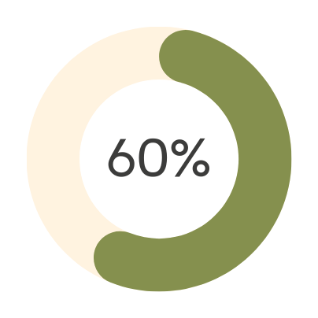
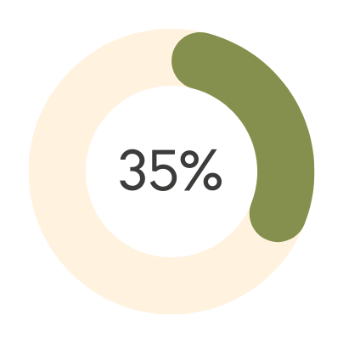

Common Pricing Approaches:
COST-BASED
DEMAND-ORIENTED
VALUE-BASED

Slide 16




Four Key Aspects:
01
03
identifying value
communicating value
02
04
designing value
delivering value

Slide 17






Three Main Types of Markets:
Business-to-Business (B2B) markets are similar to B2C markets, with the key difference that customers are business entities rather than consumers.
Consumer-to-Consumer (C2C) markets are those in which a company facilitates interactions between individual customers.
Business-to-Consumer (B2C) markets involve offerings aimed at individuals who are typically the end users of these offerings.

Slide 18



Two Key Components:

Slide 19
The term strategy comes from the Greek strategia - meaning "generalship" - used in reference to maneuvering troops into position before a battle. In marketing, strategy outlines a company's choice of the market in which it will compete and the value it intends to create in this market. Consequently, marketing strategy involves two key components: the target market in which it will compete and the value proposition for the relevant market entities- the company, its target customers, and its collaborators.

Slide 20
The term tactics comes from the Greek taktikń-meaning "arrangement" - used in reference to the deployment of troops during battle from their initial strategic position. In marketing, tactics refer to a set of specific activities, also known as the marketing mix, employed to execute a given strategy. The market tactics define the key aspects of the offering that the company introduces and manages in a given market, from the benefits this offering creates and how much it costs to how customers will hear about and buy it.

Slide 21



Target customers are the entities (individuals or organizations) whose needs the company aims to fulfill.
In business-to-consumer markets, target customers are the individuals who are typically the end users of the company's offerings. In business-to-business markets, target customers are other businesses that use the company's offerings. Target customers are defined by two factors: needs and profile.

Slide 22
Customer needs reflect the specific problem(s) faced by customers that the company aims to address.
Customer profile reflects customers' observable characteristics: demographics, geolocation, psychographics and behavior

Slide 23
Both factors-needs and profile - are important in defining target customers. Customer needs determine the value the company must create for these customers, and the customer profile identifies effective and cost-efficient ways in which the company can reach customers with these needs to communicate and deliver its offering.

Slide 24
Three entities in the target customers:
1. Competitors
2. Collaborators
3. Company

Slide 25
Competitors are entities that aim to fulfill the same need of the same customers as the company.
When defining their rivals, companies often fall prey to the myopic view of competition by defining it in traditional category and industry terms.
Many companies do not realize that competitors are defined relative to customer needs, rather than the industry within which they operate.

Slide 26
Collaborators are entities that work with the company to create value for target customers.
The choice of collaborators is driven by the complementarity of the resources needed to fulfill customer needs. Collaboration involves outsourcing the resources that the company lacks and that are required to fulfill the needs of target customers.

Slide 27
The company is the entity that develops and manages a given market offering.
The company can be a manufacturer that produces the actual goods being sold
Two Main Factors: goals and resources
Goals reflect the end result that the company aims to achieve with a particular offering.
Resources reflect the company's characteristics, including the resources that determine its ability to create market value and a sustainable competitive advantage.

Slide 28
Context describes the environment in which the company operates.
Five Factors:
1. Sociocultural context
2. Technological context
3. Regulatory context
4. Economic context
5. Physical context

Slide 29



This is the market value principle that encapsulates the company's value proposition:
The offering must create superior value for its target customers and collaborators in a way that enables the company to achieve its goals

Slide 30


Three Types of Value:
01
02
03
Customer value
Collaborator value
Company value

Slide 31
Three Main Factors of Customer Value:
01
02
03
the benefits and costs of the company's offering
the benefits and costs of the alternative means (competitive offerings) target customers can use to fulfill their needs.
the needs of these customers

Slide 32




The Seven Attributes Defining the Market Offering

Slide 33
The product aspect of an offering reflects the benefits of the good with which the company aims to create market value. Products can be both tangible and intangible.
The service aspect of an offering reflects the benefits of the good with which the company aims to create value for its customers without entitling them to permanent ownership of this good. The service aspect of the offering is closely related to its product aspect such that some offerings might be positioned as either a product or a service.
The brand is a marketing tool that aims to inform customers about the source of the products and services associated with the brand. The brand helps identify the company's products and services, differentiate them from those of the competition, and create unique value beyond the product and service aspects of the offering.

Slide 34
The price is the amount of money the company charges its customers and collaborators for the benefits provided by the offering.
Incentives are tools that enhance the value of the offering by reducing its costs and/or by increasing its benefits.
Communication informs the relevant market entities- target customers, collaborators, and the company's employees and stakeholders-about the specifics of the offering.
Distribution defines the channel(s) used to deliver the offering to target customers and the company's collaborators.

Slide 35
The market value map is a schematic presentation of the business model, enabling managers to clearly articulate the key aspects of the company’s strategy and tactics. Thus, the primary purpose of the value map is to visually outline the key aspects of the business model and serve as a guide that lays out the company’s strategy and tactics. The market value map follows the structure of the business model and comprises the three key components – the target market, the value proposition, and the market offering – that define the offering’s strategy and tactics. Accordingly, the market value map is visually represented as the key elements of the company’s strategy the target market (customers, collaborators, company, competitors, and context) and the value proposition (customer value, and company value) – and the market offering defined by its seven key attributes (product, service, brand, price, incentives, communication, and distribution.)

Slide 36
In Summary
No single nation produces everything that its people need nor inhabit in an economic vacuum. To improve a country's economic state, its leaders should learn to accept its limitation and start to open its borders for the bountiful opportunities that the global industry offers for everyone. Thinking through about the welfare and common good of every citizen, globalization and freer trade were intensified. Another reason that has heightened global trade is the concept on comparative advantage. It is a condition when a country is experiencing superiority in their production of goods or services than other countries. Their superiority may be brought by too many factors such as economies of scale, technology, innovation and the like leading to a much lower opportunity cost. This is when trade off becomes the smartest and strategic decision by other countries.

Slide 37
In Summary
Globalization and the agreement of world leaders for a freer trade amongst had resulted to a more stiffened competitive environment. This had prompted many businesses to diversify not only in their product offerings but also in their geographical reach. Entering in the global marketing offer companies' lucrative opportunities to improve their revenue and market position though the venture is quite risky and challenging triggered by factors like political, economic, legal, social, technology and environmental aspects that may hamper the efficient flow of global business operation. Yet the marketing mix, applied in the domestic market by experts and business specialists is also the same strategic mix that can be adapted in the international arena though more enhanced or modified because of a more complex market segment. The essential marketing mix elements for any global venture include: 1) marketing research; 2) product strategy; 3) distribution strategy; 4) pricing strategy; and 5) advertising and sales promotion strategy.

Slide 38
In Summary
A company's success is defined by its ability to create value in the chosen market. To create value, a company must clearly identify the target market in which it will compete, develop a meaningful value proposition that enables it to create and capture value in this market, and design a viable market offering. These key activities form the two building blocks of a company's business model: strategy and tactics.
Strategy identifies the market in which the company competes and the value the company intends to create in this market. Marketing strategy involves two components: the target market and the value proposition.
The target market is defined by five factors that form the 5-C framework: customers whose needs the company aims to fulfill, competitors that aim to fulfill the same needs of the same target customers, collaborators that work with the company to fulfill customers' needs, the company managing the offering, and the context in which the company operates. The choice of target customers determines all other aspects of the target market: the scope of the competition, potential collaborators, company resources necessary to fulfill customer needs, and the context in which the company will create market value.

Slide 39
In Summary
The value proposition defines the value that an offering aims to create for target customers, collaborators, and the company. An offering value proposition must provide a clear answer to three questions: Why would target customers choose the company's offering instead of the available alternatives? Why would collaborators choose the company's offering instead of the alternative options? Why would the company choose this offering instead of the alternative options? The market value principle states that to succeed in a given market the company must create superior value for its target customers and collaborators in a way that enables it to achieve its goals.
Tactics are the specific activities employed to execute the offering's strategy; they are the means that managers have at their disposal to create market value. Tactics outline the seven key attributes of the offering (also referred to as the marketing mix) that the company deploys in the target market: product, service, brand, price, incentives, communication, and distribution. Tactics can be viewed as a process of designing, communicating, and delivering value, where product, service, brand, price, and incentives compose the value-design aspect of the offering that defines its attractiveness for target customers; communication captures the value-communication aspect that aims to create awareness of the offering among target customers; and distribution reflects the value-delivery aspect of the offering that ensures the availability of the offering to target customers.

Slide 40
In Summary
The value-based approach to developing a business model and crafting the strategy and tactics of a market offering guides the development of a market value map that outlines the specific ways in which an offering creates value for its target customers, collaborators, and the company. The market value map follows the structure of the business model and comprises three key components the target market, the value proposition, and the market offering-that outline the offering's strategy and tactics.

Slide 41




Textbooks:
Strategic Marketing Management, Naval, Girly H. Mindshapers Co, Inc. 2021
Strategic Marketing Management: The Framework, Chernev, Alexander Cerebellum Press 2019

Slide 42



CREDITS
This presentation template is free for everyone to use thanks to the following:
SlidesCarnival for the presentation template
Pexels for the photos
HAPPY DESIGNING!

