Slide 1
COURSE: CONSRUCTION OF MEASURING INSTRUMENTS
Week 8. Temperature and pressure sensors.
Lecturer: PhD. B.Khamdamov (Andijan Machine Building Institute)
1

Slide 2
O’LCHASH ASBOBLARINI KONSTRUKSIYALASH
8-Ma’ruza. Temperatura va bosim datchiklari.
Ma’ruzachi: PhD. B.Xamdamov (Andijon Mashinasozlik Instituti)
2

Slide 3
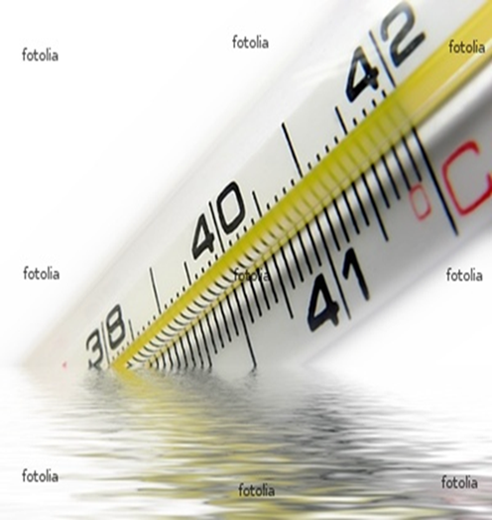
8-Mavzu: Temperatura va bosim datchiklari.
Reja:
8.1 Temperatura datchigi va uning turlari
8.2 Bosim datchigi va uning turlari
3

Slide 4
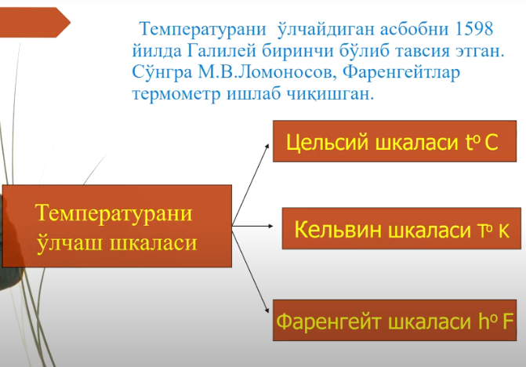
4

Slide 5
Sanoatda qo`llaniladigan temperatura o`lchash vositalari
Termometrik xususiyatlar | O`lchash vositasining nomlanishi | O`lchash diapazoni ⁰С quyi yuqori
Issiqlikdan kengayish | Suyuqlikli shisha termometrlar Dilatometrik va bimetal termometrlar | —200 —150 | 600 700
O`zgarmas hajmida bosimining o`zgarishi | Manometrik termometrlar: Gazli Suyuqlikli Bug`—suyuqlikli (kondensatsion) | —150(-267) —150 —50 | 600 600 350
Termoelektrik effekt (TEYuK) | Termoelektrik termometrlar | —200 | 2500
Elektr qarshiligi o`zgarishi | Metalli qarshilik termometrlari Yarim o`tkazgichli qarshilik termometrlari | —260 —272 | 1100 600
Issiqlikdan nurlanish | Pirometrlar: Kvazimonoxromatik pirometrlar Spektral nisbatli pirometrlar To`liq nurlanish pirometrlari | 700 300 50 | 6000 2800 3500
5

Slide 6
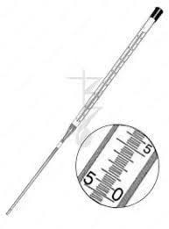
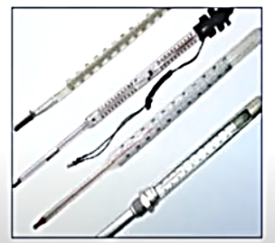
Чизикли кенгайиш термометрлари
[3]
[2]
6

Slide 7
Shishali suyuqlikli termometrlarda qo`llaniladigan termoelektrik moddalar
Nomi | Hajmiy kengayish koeff. β, grad^{—1} | O`rtacha temperatura ⁰С |  | Qo`llanish chegarasi ⁰С
 |  | qotishi | qaynashi | quyi | yuqori
Metil spirti | 0,00115 | —95,8 | 65,6 | —80 | 80
Etil spirti | 0,00103 | —114,5 | 78,0 | —80 | 80
Kerosin | 0,00093 | — | — | 0 | 300
Petroley efiri | 0,00140 | — | — | —120 | 20
Pentan | 0,00170 | —200 | — | —190 | 20
Toluol | 0,00107 | —97,2 | 109,8 | —80 | 100
Galliy | — | 29,8 | 2070 | — | 1200
Simob | 0,00016 | —38,9 | 356,6 | —35 | 600
7

Slide 8
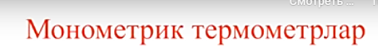
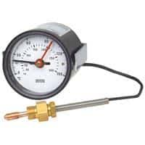
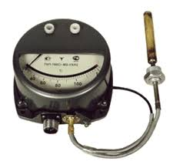
[4]
[5]
8

Slide 9
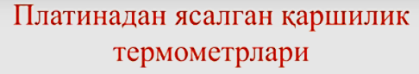
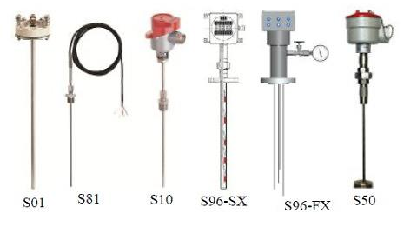
[6]
9

Slide 10
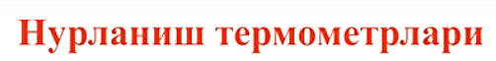
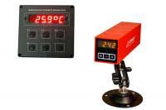
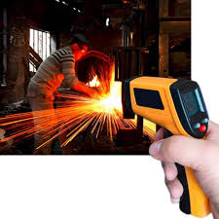
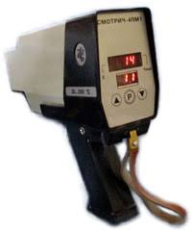
[8]
[7]
[9]
10

Slide 11
Temperaturani o'lchash usullari
Issiqlikning bir jismdan ikkinchisiga o'tishi temperaturaning tashuvchisi bo'lgan modda molekulalarining ichki energiya miqdoriga bog'liqligini ko'rsatadi. Shuning uchun temperaturani aniqlash ishchi moddaning fizik xususiyatlarining o'zgarishini kuzatish orqali amalga oshiriladi. Bunday o'lchash usuli o'lchanadigan muhit temperaturaining mutlaq qiymatini bermaydi, ammo ishchi moddaning shartli ravishda nol deb qabul qilingan boshlang'ich temperaturasiga nisbatan farqni beradi.
Temperaturani o'lchash uchun:
hajmning kengayishi,
bosimning yopiq tizimdagi o'zgarishi,
elektr qarshiligining o'zgarishi,
EYuKning paydo bo'lishi,
nurlanish intensivligi
kabi fizik hodisalar qo'llaniladi.
11

Slide 12
Hozirgi kunda harorat datchiklarning eng keng tarqalgan turlari:
Rezistiv
Termoelektrik
yarim o’tkazgichli
Optik
pyezoelektrik detektorlar
Haroratni o’lchash har doim energiyaning unchalik katta bo’lmagan porsiyasini ob’yektdan bu energiyani elektr signaliga aylantirishi lozim bo’lgan datchikka uzatishdan iborat bo’ladi.
12

Slide 13
Kontaktli detektor (zond) ob’yektning ichiga yoki tashqarisiga joylashtirilganda ob’yekt bilan zond o’rtasida issiqlik o’tkazuvchanlik hisobiga issiqlik uzatilishi sodir bo’ladi. Bunda zondning tarkibiga kiradigan sezgir element qiziydi yoki sovuydi.
Issiqlik nurlanish yordamida uzatilganda issiqlik energiyasi IQ nurlanish ko’rinishida ob’yektning harorati va optik bog’lanishining tipiga bog’liq holda datchik tomonidan yutiladi yoki undan ajralib chiqadi.
13

Slide 14
Haroratni o’lchashning ikkita asosiy uslubi mavjud:
muvozanatli
bashorat qilinadigan (prognozli)
Haroratni o’lchash o’lchanadigan yuza bilan zondda joylashgan sezgir element o’rtasida issiqlik muvozanati boshlanganda, ya’ni datchik bilan o’lchanadigan ob’yekt o‘rtasida sezilarli harorat farqi bo’lmaganda o’tkaziladi.
Bashorat qilish uslubida o’lchashlarni o’tkazish jarayonida issiqlik muvozanati boshlanmaydi, joriy haroratning qiymati datchik haroratining o‘zgarish tezligi bo'yicha aniqlanadi
14

Slide 15
Termorezistiv datchiklar
Termorezistiv datchiklarning afzalliklari yuqori sezgirligi, interfeysli sxemalarni yaratishning oddiyligi va uzoq muddatli barqarorlik bo‘lib hisoblanadi.
guruh
rezistiv harorat datchiklari (RHD)
p-n o’tishli detektorlar
termistorlar
15

Slide 16
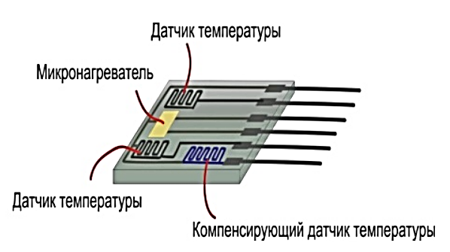
Температура датчиги
[10]
16

Slide 17
Barcha metallar va qotishmalarning solishtirma qarshiligi haroratga bog’liq bo’lganligi sababli ular asosida haroratni o’lchaydigan sezgir element sifatida ishlatish mumkin. Harorat detektorlarini tayyorlash uchun barcha metallar to‘gri kelsada, ushbu maqsadlar uchun asosan faqat platinadan foydalaniladi.
600°C dan yuqori haroratlarni o’lchash uchun volframli rezistiv datchiklar qo'llaniladi
17

Slide 18
RHD lar bir nechta tipda ishlab chiqariladi:
mos keluvchi taglikka, masalan, kremniy mikromembranaga qoplangan platina yoki uning qotishmalarining yupqa qatlamidan ishlanadi.
Yupqa plyonkali RHD
ularda platina sim keramik trubkaning ichiga o‘ralgan va yuqori haroratbardosh yelim yordamida unga mahkamlangan bo’ladi. Bunday konstruksiya juda yuqori barqarorlikka ega bo’lgan datchiklarni tayyorlash imkonini beradi.
Simli RHD
18

Slide 19
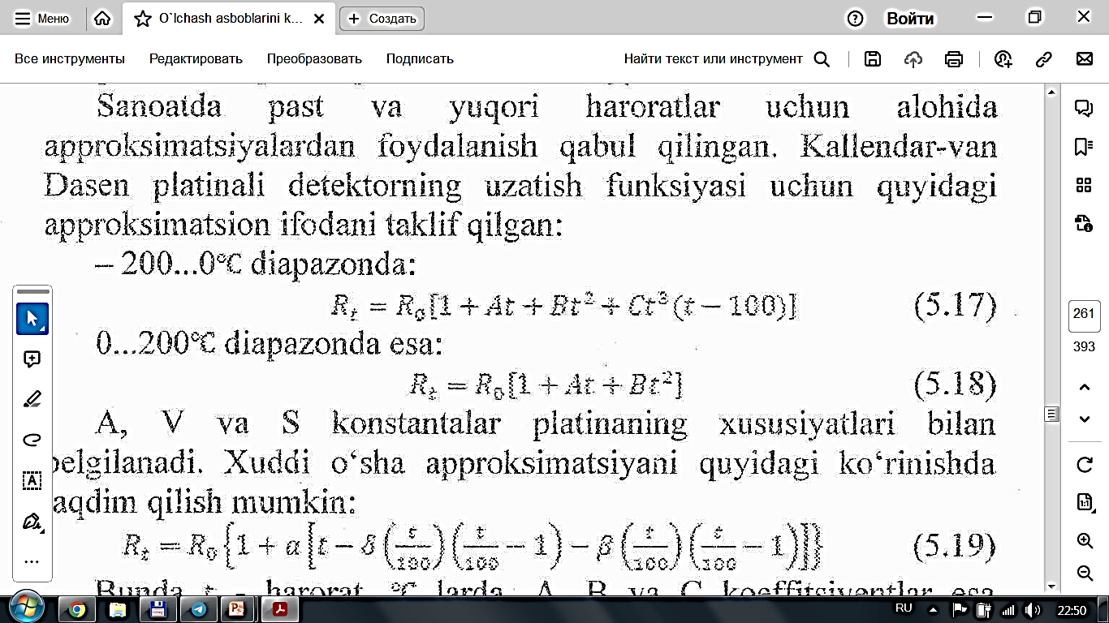
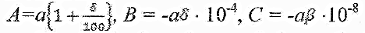
Sanoatda past va yuqori haroratlar uchun alohida
approksimatsiyalardan foydalanish qabul qilingan.
Kallendar-Van Dasen platinali detektorning uzatish funksiyasi uchun quyidagi ifodani taklif qilgan:
- 200...0 °C diapazonda:
0...200 °C diapazonda:
A, B va C konstantalar platinaning xususiyatlari bilan belgilanadi. Xuddi o‘sha approksimatsiyani quyidagi ko‘rinishda taqdim qilish mumkin:
19

Slide 20
Standart termoelektr termometrlar
Termoelektrik termometrlarda termoparalarning turlari | O’lchash chegarasi, °C | Yuqori o’lchash chegarasi, °C
 |  | Uzoq vaqt qo’llanishda | Qisqa vaqt qo’llanishda
Mis – kopelli | -200 | 100 | 600
Mis-mis-nikelli | -200 | 400 | 600
Temis-mis-nikelli | -200 | 700 | 900
Xromel-kopelli | -50 | 600 | 800
Nikel-xrom-mis-nikelli | -100 | 700 | 900
Nikel-xrom-nikelli-alyuminiyli | -200 | 1000 | 1300
Platinarodiy (10% li) | 0 | 1300 | 1600
Platinarodiy (30% li) | -300 | 1600 | 1800
Volframreniy (5% li) | 0 | 2200 | 2500
Volframreniy (20% li)
20

Slide 21
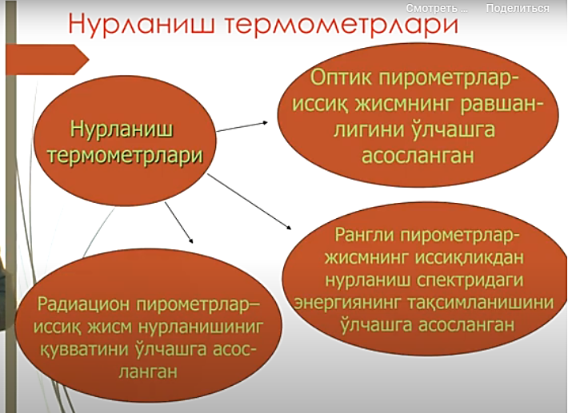
21

Slide 22
Nurlanish pirometrlarining turlari | O’lchash chegarasi | Xatolik darajasi
Optik pirometrlar | 800 °C dan 10 000 °C gacha | 1,5 %
Rangli pirometrlar | 800 °C dan 2 000 °C gacha | 1,0 %
Radiatsion pirometrlar | - 50 °C dan 3 500 °C gacha | 2,5 %
22

Slide 23
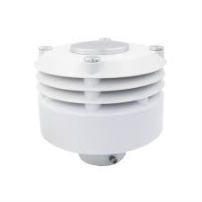
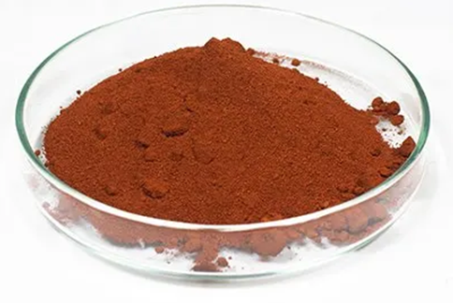
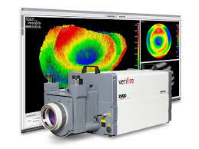
Temperatura optik datchiklari
Flouressent datchiklar
Interferometrik datchiklar
Haroratdan rangini o‘zgartiradigan eritmalar asosidagi datchiklar
[11]
[12]
[13]
23

Slide 24
Flouressent datchiklar
Bunday datchiklar spektrning ko’rinadigan diapazoni nurlari bilan qo‘zg‘atishga javob tariqasida ba’zi bir fosforli tarkibiy qismlarning shu’la taratish xususiyati asosida amalga oshiriladi. Flouressent datchiklarda sezgir element sifatida to’rt valentli marganets bilan faollashtirilgan magniy ftormagnetit qo’llaniladi.
24

Slide 25
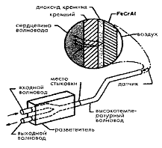

Interferometrik datchiklar
Interferometrik harorat datchigining sezgir elementi sifatida ko‘pincha yupqa kremniy qatlamidan foydalaniladi, chunki uning sindirish koeffitsiyenti haroratga bog‘liq bo’ladi, bu nur yo’lining uzunligini o‘zgarishiga olib keladi.
[14]
25

Slide 26
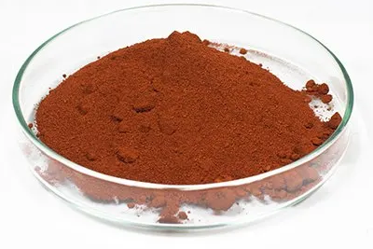
Haroratdan rangini o‘zgartiradigan eritmalar asosidagi datchiklar
Bunday datchiklar biotibbiyot tizimlarida qo’llaniladi. Xromatik eritma sifatida ko‘pincha CoCl26H2O (kobalt xlorid eritmasi) qo’llaniladi. Bunday datchiklarning harakat tamoyili ba’zi bir xromatik eritmalar uchun xarakterli bo’lgan spektrning ko‘rinadigan diapazonidagi nurlanishlarning (400...800 nm) yutilish koeffitsiyentlarining haroratga bog’lanishiga asoslanadi
[13]
26

Slide 27
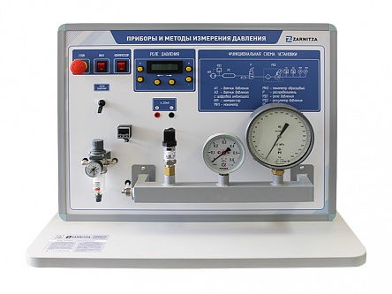
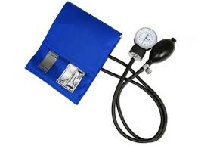
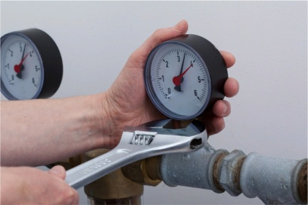
Bosim datchiklari
BOSIM
bir jism tomonidan boshqa jismning yuza birligiga ta’sir qiladigan normal taqsimlangan kuchni tavsiflaydi.
Agar ta’sir ko`rsatuvchi muhit gaz yoki suyuqlik bo'lsa, unda bosim ichki energiyani aks ettiradi va asosiy holat parametrlaridan biri bo`lib hisoblanadi
[15]
[16]
[17]
27

Slide 28
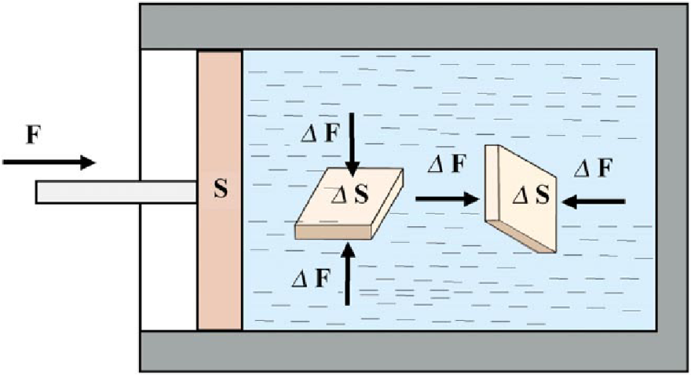
[18]
F – tashqi kuch,
S – muxitning erkin yuzasi (maydon),
ΔF – ichki yuza S ga tushayotgan bosim.
28

Slide 29
Bosimni o`lchash printsipi bo`yicha O`V lari tasnifi
Suyuqlikli
Yuk-porshenli
Deformatsion
Elektrik
29

Slide 30
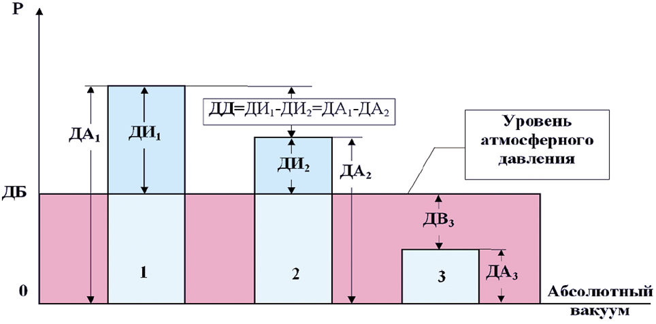
Bosim o'lchash asboblari
Fizik jarayonning 1, 2, 3 nuqtalarida o`lchanayotgan bosim turlari
[19]
Shartli belgilar:
        Р - bosim,
        ДБ – barometric bosim,
        ДА – absolyut bosim,
        ДИ – ortiqcha bosim,
        ДВ – vakuummetrik bosim,
        ДД – differentsial bosim.
30

Slide 31
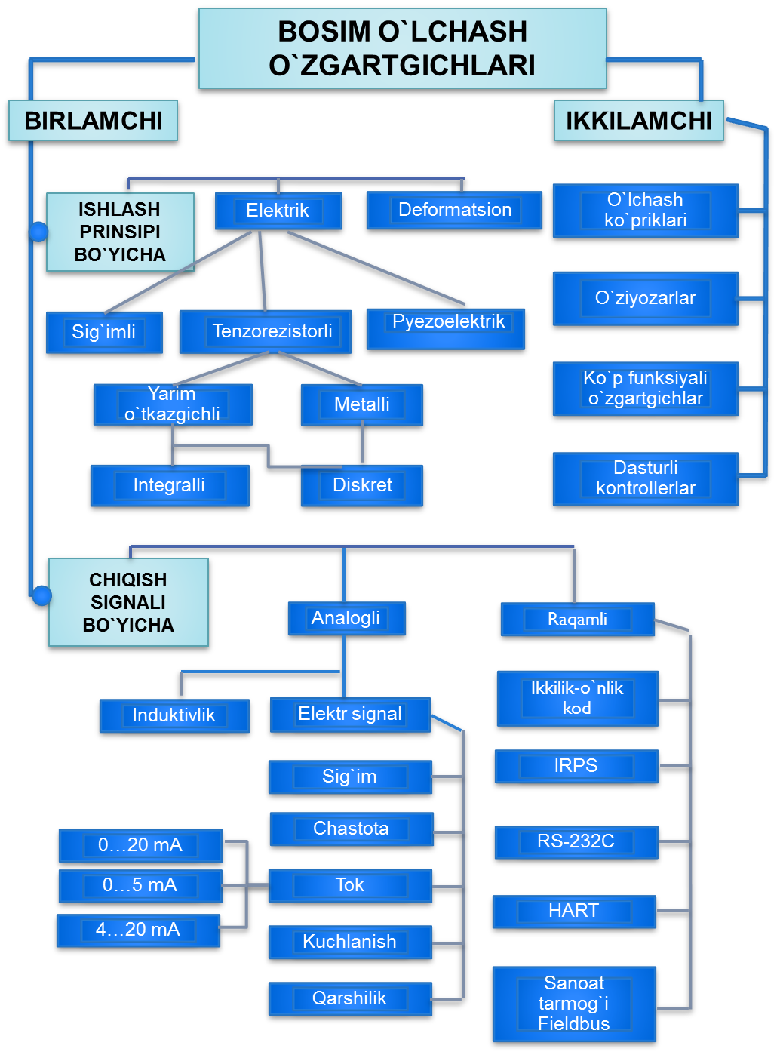
31

Slide 32
O’lchanayotgan bosim kattaligining turiga ko‘ra o’lchash asboblari quyidagi turlarga bo’linadi:
manometr — mutlaq va ortiqcha bosimni o’lchaydi
barometr — atmosfera bosimini o’lchaydi
vakuummetr — berk idish ichidagi suyuqlik va gaz bosimining siyraklanishini o’lchaydi
manovakuummetr — ortiqcha bosim va siyraklanishlarni o’lchaydi
naporomer — kichik qiymatli ortiqcha bosimni o’lchaydi
tyagomer — kichik qiymatli siyraklanishni o’lchaydi
differensial manometr — ikki bosim ayirmasini (bosimlar farqini) o’lchaydi
32

Slide 33
Bosim datchiklari
– bu kirish miqdorini kompensatsiyalashga asoslanib suyuqlik va gaz bosimini elektrik, pnevmatik va boshqa turli signallarga aylantirib beruvchi o‘zgartgichdir.
Bosim datchiklari tarkibiga kiradigan sezgir elementlar tashqi kuchlanish ta’siri ostida deformatsiyalanadigan mexanik qurilmalardir
Suyuqlikli
prujinali
elektrik
33

Slide 34
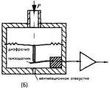

Bosimni chiziqli ko’chishga aylantirish uchun qo’llaniladigan gofrilangan metall diafragma
[20]
[21]
34

Slide 35
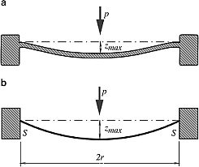
[22]
A-rasm. Bosim ostida yupka plastinkaning deformatsiyalanishi
B-rasm. Membrananing deformatsiyalanishi
35

Slide 36
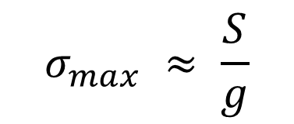
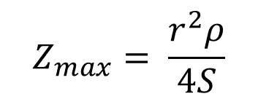
r bosimning past qiymatlarida membrana rnarkazining zm chetlashishi va uning σm mexanik kuchlanganligi bosimning kvazichiziqli funksiyalari bo’lib hisoblanadi (kuchlanish N/m2 da o’lchanadi):
$$Z_{max}= \frac{r^{2}ρ}{4S}$$
$$σ_{max} ≈ \frac{S}{g}$$
r – memrananing radiusi
g – memrananing qalinligi
S – radial cho’zilish
36

Slide 37
Foydalanilgan adabiyotlar
1.B.A.Nazarbayeva. O’lchash vositalarini konstruksiyalash. O’quv qo’llanma. Toshkent “Tafakkur avlodi” 2020 y.
2. Temperature sensors. [Online images]. https://encrypted-tbn2.gstatic.com/images?q=tbn:ANd9GcTxQqME6lOU959oVfCJsRzRPlUHa4cvm1F6wU42-2f7QcrsYyUN
3. Temperature sensors. Online images https://encrypted-tbn3.gstatic.com/images?q=tbn:ANd9GcTahJ5f0QTSpFn9dSZJtYSJPbHy-f7vSa5r1N0Cbq-vAF7iPw1p
4. Temperature instruments. PPT-online. [Accessed in 2020]. https://encrypted-tbn3.gstatic.com/images?q=tbn:ANd9GcS0ZkkvBIw-UJN7Q2Nqa2RwQ33ya96A2ha3vgox9-hQJQPJaFnO
5. Temperature instruments. PPT-online. [Accessed in 2020]. https://encrypted-tbn1.gstatic.com/images?q=tbn:ANd9GcSdyk3k3fOwVcNDWvej-xUymloncD-Lk3CbFVTFHw-LyDW7Hl2d
6. Temperature instruments. PPT-online. [Accessed in 2020]. https://encrypted-tbn0.gstatic.com/images?q=tbn:ANd9GcRhokWFP0zt74C7Ij4IE9UmGtf8oJ4-ca5ooTh40iGqbto93kAo
7. Temperature instruments. PPT-online. [Accessed in 2022]. https://encrypted-tbn2.gstatic.com/images?q=tbn:ANd9GcRgrUCZpPkKbMVSnNwv9WWCvrd3OYibBphEKGe8yAOKVs1LtUiQ
8. Temperature instruments. PPT-online. [Accessed in 2022]. https://encrypted-tbn1.gstatic.com/images?q=tbn:ANd9GcRYJ62RpKq1BFmkh4-AkFy6ezT4aWAX643LMHbZQ2kPpbJnVoW7
9. Temperature instruments. PPT-online. [Accessed in 2022]. https://encrypted-tbn0.gstatic.com/images?q=tbn:ANd9GcStXWfFnpKQ3HdaOxMRETnjTmIQSk_xqqSCg9ZoEct52YlzHjuQ
10. Temperature sensors. [Online images]. https://encrypted-tbn0.gstatic.com/images?q=tbn:ANd9GcRocBdRgwdk3yoKLZPdpLtTIRIHqmuHFNLyi1hwG_4z-MgzELgp
11. Optical temperature sensors. [ppt-online]. https://encrypted-tbn2.gstatic.com/images?q=tbn:ANd9GcQrQG81FuNZXe2OzCV7wpf1p16gXAEyFQSsKZWZLpitG8kzAc-j
37

Slide 38
12. Optical temperature sensors. [ppt-online]. https://encrypted-tbn2.gstatic.com/images?q=tbn:ANd9GcQwE16RGRBsutXNvoNB3ZAlQjI9_7qbLYgOTSCw-0uTwGNOW_M5
13. Optical temperature sensors. [ppt-online]. https://encrypted-tbn2.gstatic.com/images?q=tbn:ANd9GcRnV3QFQLfAh6A1oWgorQkyjcvsYFIOEf8KbGMuStKqJR4lcLLv
14. Interferometric sensors. [ppt-online]. [Accessed in 2015] https://encrypted-tbn2.gstatic.com/images?q=tbn:ANd9GcQXIDeEuF0A6wvkLZ-48G02NDGPsFbd-sTwIgvPRZfHhv5uU-6a
15. Pressure measuring devices. [ppt-online]. https://encrypted-tbn2.gstatic.com/images?q=tbn:ANd9GcTtPzqeLNDpaYBLG2jaFC2dGzTgy2aykFl5-dV1bNc2npp7NdJR
16. Pressure measuring devices. [ppt-online]. https://encrypted-tbn2.gstatic.com/images?q=tbn:ANd9GcTaAjAQd0UWQjdwBP-ZLj7nD_r70YpJE1Que_hC2aZ32Ya6hsd1
17. Pressure measuring devices. [ppt-online]. https://encrypted-tbn0.gstatic.com/images?q=tbn:ANd9GcQOefh-XeIp4IeuMggN5kPlCvKDTNGru20JJlEV5oSum1GzVtCm
18. Pressure and its measurements [online images]. [Accessed in 2017] https://encrypted-tbn3.gstatic.com/images?q=tbn:ANd9GcTRL_mZtQz9JidpbOQtOosXJqVcng5OXQ3uTGdWyYvtB0Q8nPbI
19. Pressure and its measurements [online images]. [Accessed in 2017] https://encrypted-tbn0.gstatic.com/images?q=tbn:ANd9GcRdRXmI3qdDe9b1dy8r0ch8Kma6Ai8jjh2r2VRmVEwyNzRMMbD_
20. Pressure measuring devices. [ppt-online]. https://encrypted-tbn0.gstatic.com/images?q=tbn:ANd9GcRXtMhwgJ9IYOqPhwq6N1QISot0AGVTRhHBTqsAAnLOx6DSGZJ5
21. Pressure measuring devices. [ppt-online]. https://encrypted-tbn1.gstatic.com/images?q=tbn:ANd9GcRNil7MtgNf2aQZhcBjYbMc899TdZpxj4PP5IFsw7m7XkV7gbgX
22. Pressure measuring devices. [ppt-online]. https://encrypted-tbn0.gstatic.com/images?q=tbn:ANd9GcRzA-AeKYVQFUZXUBMIr95Y4ChdQyBLs5Obj_9WFJcTHCgsE0Ry
38

Slide 39
E’tiboringiz
uchun rahmat !!!
39

