Slide 1
COURSE: FUNDAMENTALS OF MARKETING
LECTURE 11: PROMOTION
LECTURER: DR LUCY KARIMI KIRIMA
LECTURE 11: PROMOTION
LECTURER: DR LUCY KARIMI KIRIMA
Lecture learning outcomes:
At the end of the lecture, you will be able to:
Understand the concept of promotion
Examine the aspects of promotion mix

Slide 2
Concept of promotion
According to Arunima Rudra , the term 'Promotion ' is originated from the Latin word 'promovere' which means to move forward. Marketers use the word 'promotion' as a communicative activity, the purpose of which is to move forward a product, service or idea in a channel of distribution
Promotion is concerned with effectively communicating the results of the marketing strategy to target audiences. Promotion is an active explicit form of marketing communication. Promotion highlights the marketing elements in order to increase the odds that consumers will buy and become committed to a product.

Slide 3
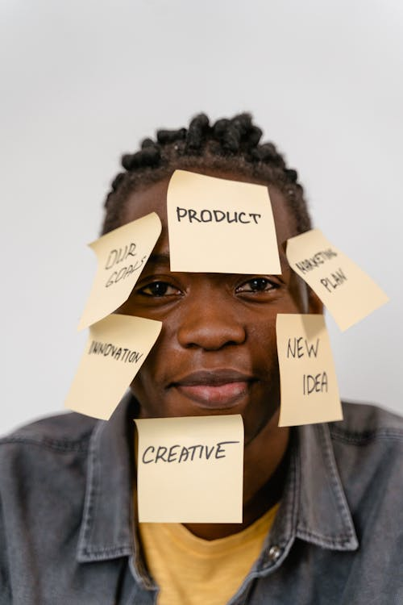
Promotion
Thus promotion can be defined as "the marketing function concerned with persuasively communicating to target audiences the components of the marketing program inorder to facilitate exchange between the marketer and the consumer and to help satisfy the objectives of both"'
https://www.pexels.com/photo/man-in-blue-denim-jacket-with-sticky-notes-on-the-face-7550317/

Slide 4
Promotion
According to Mc. Carthy, “promotion is concerned with any method that communicates to the target market about the right product to be sold in the right place at the right price, promotion encompasses sales promotion, advertising and personal selling.”
According to Philip Kotler, “promotion compasses all the tools in the marketing mix, whose major role is persuasive communication.”

Slide 5

Need for Promotion
Promotion is essential to persuade consumers who have established product loyalties. As there are so many product choices consumers often settle on a particular 'satisfactory brand' and purchase it repeatedly to reduce the effort involved in choosing another product
https://www.pexels.com/photo/a-person-holding-a-clothes-hanger-with-orange-shirt-8148577/

Slide 6
Need for Promotion
A second reason for the rising importance of promotion is the widening physical and emotional distance between producers and consumers. Once marketing intermediaries are involved it is not enough for a producer to communicate only with the ultimate consumers. Marketing intermediaries must also be informed about products. Wholesalers must promote products to retailers, and retailers must promote products to consumers.

Slide 7
Need for Promotion
Consumers are beyond the need to fulfil1 their basic physiological requirements and are moving toward fulfilling their desires. As they allocate their limited resources to the purchase of desires rather than basic needs, they become more selective in their choices. A good promotional program helps consumers make these choices in a more satisfying way.
Intense competition within and between industries has placed pressure on the promotional programs of individual sellers.

Slide 8
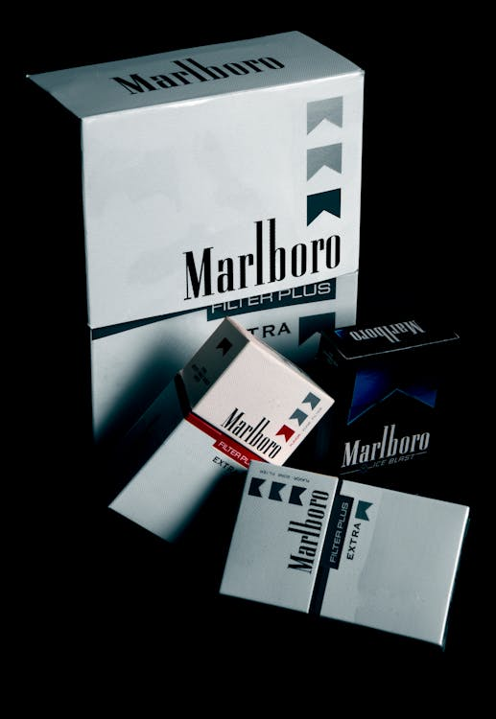
Need for Promotion
Finally, during times of economic decline, product planning, distribution channels, and pricing structure change. Promotion is needed inorder to maintain the level of sales and profit required for a firm's survival.
https://www.pexels.com/photo/marlboro-cigarette-boxes-57528/

Slide 9
Role of promotion
Increase Brand Awareness
Provide Information
Increase customer traffic
More employment
Effective sales support: Promotion helps in the sales support of the product. Sales promotion makes the salesman’s effort more productive
Increase speed of product acceptance: Most of the sales promotion devices such as contests, premium coupons

Slide 10
The Promotional Mix
The concept of promotional mix assumes that there is variety of means for communicating with consumers and the final selection of them will depend on the jobs assigned to promotion and the environment in which these jobs are to be performed. The concept further assumes that while certain promotional types may be better suited for some task than others all promotional types are compatible and interchangeable.

Slide 11
Advertising
“Any paid form of non-personal presentation and promotion of ideas, goods or services by an identified sponsor
Advertising is any paid form of non-personal communication and promotion of ideas, goods or services by an identified sponsor. Although some advertising (such as direct mail) is directed at specific individuals, most advertising massages are tailored to a group and use mass media such as radio, television, newspapers, magazines and outdoor

Slide 12
Objectives of advertising
Attention: Using highly readable print, color, diagrams and pictures can also attract the attention of users.
Building sales and profits: Advertising is designed to increase sales and build profits gradually. People will try the products and they become repeat users and also they tell their family and friends, which is additional advertising for a company
Switching back: This objective is for the companies who have switched to their previous customers back. They attract the customers back like discount sale, new advertise, some reworking done on packaging

Slide 13
Objectives of advertising
Brand switch: The purpose of advertisement is to attract the customers of competitors. Here the advertisers try to convince the customers to switch from the existing brand.
Building brand awareness: Companies advertise to build brand awareness, which is when people know a particular brand
Prompting immediate action: Different forms of advertising may also prompt people to act immediately. Including a coupon, deadlines, free trail etc will attract buyers to make purchase in a short period.

Slide 14
Advantages/merits of advertising
Expansion of market: It enables the manufacturer to expand his market
Increased sales: Advertisement facilitates mass production to goods and increase the volume of sales
Fights competition: Advertising is greatly helpful in fighting the forces of competition prevalent in the market
Better quality products: Different goods are advertised under different brands names. A branded product assures a standard quality to the consumers
Educates the consumers: Advertising is educational and dynamic in nature
Elimination of middlemen: It aims at establishing a direct link between the manufacturer and the consumer, thereby eliminating the marketing intermediaries

Slide 15
Disadvantages/demerits of advertising
Add to costs: It is a medium for many advertisers to incur high cost compared to others
An online annoyance: Trying to stay absorbed in an online article when ads are popping up left, right and center can be very difficult.
A security risk: Sometimes accessing web pages or websites may also rise of “Adware”. Malicious software that plants risky ads in the user computers.
Confuses buyers: Many a time distorted version of reality is shown in the advertising

Slide 16
Personal Selling
Personal Selling : Personal selling, as contrasted to advertising, lends itself to the promotion of complex and expensive products. This type of promotion is unique, in as its name suggests, it is presented on a personal basis
According to Herbert N Casson, personal selling “is the art of understanding,
appreciating and influencing other people for mutual benefits.”
In other words, it is a process of persuading and assisting a prospective customer tobuy a commodity or service.

Slide 17
Importance of personal selling
It provides feedback: It involves two-way flow of communication between the buyer and the seller. It is a useful method of understanding and getting the knowledge about the needs and behavior of customers, attitude, tastes, habbits of customers.
Selling complex products: Companies that sell complex products must be able to demonstrate or explain products to potential customers and deal with questions or queries
Focus on prospective customers: Personal selling method focuses on prospective customers
Channel of communication: communicates information about features, quality, utility, price etc of the products to customers.
Social relations: Sellers establish social and living relationship with customers

Slide 18
Sales Promotion
SaIes promotion is the term used in the business world to refer to any promotion, other than advertisement, personal selling and publicity, that supports and enhances advertising and personal selling activities.
Sales promotion activities
Consumer Sales promotion : A good example of consumer sales promotion is sampling, ie., placing a sample of a product in the hands of potential consumers at no charge
Dealer Sales Promotion : Producers rely on sales promotion to make selling and advertising to their middlemen more effective. Good retailers are often given premiums, for example, for each case of goods they buy.

Slide 19

Sales promotion activities
Sales force : A significant amount of a company's sales promotional efforts often are aimed at the company's own sales force. The idea behind such activity is of course, to make the salesmen's efforts more effective
https://www.pexels.com/photo/a-man-in-a-black-long-sleeved-shirt-holding-a-sign-7641996/

Slide 20
Tools of sales promotion
Coupons
This involves offering price reduction or saving to customers on the purchase of a specific product. The coupons may be mailed or enclosed along with other products, or inserted in a magazine or newspaper advertisement.
Consumer-oriented
The consumer-oriented promotion tools are aimed at increasing the sales to existing consumers, and to attract new customers to the firms. It is also called as pull strategy
Free samples: Small units of free samples are delivered door to door, sent through direct mail, attached to another product

Slide 21
Tools of sales promotion
Exchange scheme: In this case, the customer exchanges the old product for a new one
Discounts: It refers to reduction in price on a particular item during a particular period
Premium offers: These can be extra quantities of the same product at the regular price. For instance, Colgate offered 125g in a tube for the price of 100g.
Personality promotions: This type of promotion is used to attract the greater number of customers in a store and to promote sale of a particular item. For instance, a famous sports personality may be hired to provide autographs to customers visiting a sports shop.
Installment sales: In this case, consumers initially pay smaller amount of the price and the balance amount in monthly installments over a period of time

Slide 22
Sales Promotion
According to A.H.R Delen, Sales promotion means “any steps that are taken for the purpose of obtaining or increasing sales. Often, this term refers specially to selling efforts that are designed to supplement personal selling and advertising and by coordination, help them to become more effective.”
In other words, sales promotion refers to those specialized activities other than personal selling and advertising that are taken by a firm for promoting its sales.

Slide 23
Trade-oriented
Cash bonuses: Can be in the form of one extra case for every five cases ordered, cash discounts or straight cash payments to encourage volume sales
Credit terms: Special credit terms may provide to encourage bulk orders from retailers or dealers.
Trade-oriented sales promotion programmes are directed at the dealer network of the company to motivate them to sell more of the company’s brand than other brands. It is also known as push strategy.
Stock return: Some firms take back partly or wholly the unsold stocks lying with the retailers,

Slide 24

Trade-oriented
Dealer trophies
Some firms may institute a special trophy to the highest-performing dealer in a particular period of time.
Along with the trophy, the dealer may get a special gift such as a sponsored tour within or outside the country.
https://www.pexels.com/photo/hands-of-a-man-receiving-a-gold-trophy-7005070/

Slide 25
Public Relations
Public Relations Often the terms 'Public Relations' and 'Publicity' are used interchangeably.
Publicity is a function of public relations. Public Relations is the broader term that "connotes the entire being of an organization with respect to its self expression to the world“.' Public relations is concerned with creating and maintaining a favourable public attitude towards a company, its products, ideas, and personnel.

Slide 26
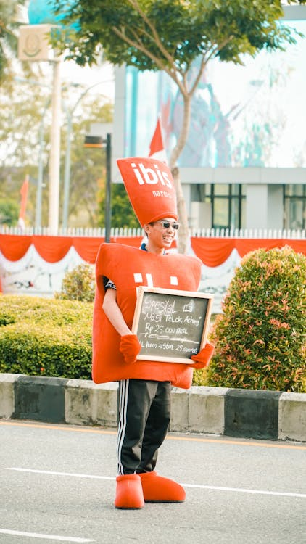
Publicity
Publicity is information about a company and its products that appears as a news article in such media as newspapers, magazines and radio and T.V. broadcasts.
Publicity is gaining public visibility or awareness for a product, service or company name through media.
https://www.pexels.com/photo/a-man-dressed-as-a-robot-holding-a-sign-27405491/

Slide 27
Types of publicity
News releases: An organization may issue news releases to mass media so that the media people can prepare interesting report on the new developments in the organizations and publish or broadcast them to general public.
Feature articles: An organization may use the service of an expert or a journalist to write interesting feature on the organization and its products
Press conferences: An organization may request business reporters from important media to attend special press conferences where the new developments are communicated to the mass media.

Slide 28
Types of publicity
Feature articles
An organization may use the service of an expert or a journalist to write interesting feature on the organization and its products. Once the feature article is ready it is forwarded to a specific media for publication.
Sponsorship of social events: An organization may receive a very good publicity if it sponsors social events like cultural gatherings, sporting events, seminars and many more.

Slide 29
Types of publicity
Press conferences
An organization may request business reporters from important media to attend special press conferences where the new developments are communicated to the mass media.
Sponsorship of social events
An organization may receive a very good publicity if it sponsors social events like cultural gatherings, sporting events, seminars and many more.

Slide 30
Importance of publicity
To announce new products: Publicity is a major tool to build public awareness about a new product
To announce new policies: The organization may introduce new bonuses or incentives to resellers and communicate it through the mass media. Such communication helps the organization to build its image as a good caretaker of its partners in the market.
To counter negative rumors
Competitors often spread negative rumors about the organization’s financial health, management problems or product defects. Publicity is a very effective tool to counter those negative rumors.

Slide 31
Importance of publicity
To announce technological breakthrough
When an organization adopts a new technology, it may announce it to the general public through the mass media. Such communication helps the organization to establish itself as a technological leader in the industry.
To report performance
An organization may communicate its performance to the stockholders through the mass media. Such communication may be based on current problems, future prospects, future plans, financial situation, profits etc.

Slide 32
References
Fundamentals of marketing, Marilyn, A, S, John, D, Routledge (Taylor and Francis) London New York,2007
Principles of marketing. Rashmi. R. Das. https://ddceutkal.ac.in/Downloads/UG_SLM/Commerce/Principle_Marketing.pdf
Marketing Fundamentals, University of New South Wales, Spoonfeedme

Slide 33
References
Principles of Marketing, Pearson. 17th edition, Kotler P. and Armstrong G,2017
Essentials of Marketing 17th Edition, William Perreault, Joseph Cannon, E. Jerome McCarthy , McGraw-Hill Education,2021
Role of packaging in marketing product and organization. Dileep Kumar (2006). Hensard University Toru Orua

Slide 34
References
Packing and Packaging .S Natarajan, M. Govindarajan,V Kumar. Government Arts College, Coimbatore
Marketing, Polese, Francesco, and Evert Gummesson, ProQuest Ebook Central, http://ebookcentral.proquest.com/lib/aunke -ebooks / detail. action? docID =4856363,2017
Rashmi R Das .Principles of Management (http://ddceutkal.ac.in/Dowload/UG.SLM/Commerce/Principle-Marketing.pdf
Chahat Azam .Concept of products.

Slide 35
References
https://dspmuranchi.ac.in/pdf/Blog/1)%20PRODUCT%20CONCEPT.pdf.Faculty of Commerce DSPMU.
Baglandesh Open University .New Product Development . http://www.ebookbou.edu.bd/Books/Text/SOB/MBA/mba_3313/Unit-06.pdf
Brand Management .Madhu S Kamar (2015)Knowledge Management and Research Organization .

Slide 36
References
Mart Production (2021). https://www.pexels.com/photo/man-in-blue-denim-jacket-with-sticky-notes-on-the-face-7550317/
Vie Studio (2021). https://www.pexels.com/photo/a-person-holding-a-clothes-hanger-with-orange-shirt-8148577/
Nima Ashkbari (2016). https://www.pexels.com/photo/marlboro-cigarette-boxes-57528/
https://www.pexels.com/photo/a-man-in-a-black-long-sleeved-shirt-holding-a-sign-7641996/

Slide 37
References
Alena Darma (2021). https://www.pexels.com/photo/a-man-in-a-black-long-sleeved-shirt-holding-a-sign-7641996/
REDNE Stock Project (2012). https://www.pexels.com/photo/hands-of-a-man-receiving-a-gold-trophy-7005070/
Rendi Id (2024).https://www.pexels.com/photo/a-man-dressed-as-a-robot-holding-a-sign-27405491/

