Slide 1
Engineering Thermodynamics I
Lecture 1
Basic Concepts and Definition
Lecturer: Dr. Melaku Desta

Slide 2
Lecture learning outcomes:
At the end of this lecture, you will be able to:
Understand the fundamental principles and scope of thermodynamics.
Identify real-world application areas of Engineering Thermodynamics.
Define and classify thermodynamic systems (open, closed, and isolated).
Understand the concept of system boundaries and surroundings.
Analyze energy interactions across system boundaries.
Distinguish between intensive and extensive properties.

Slide 3
Content
Definition of Thermodynamics
Approaches in the study of Thermodynamics
Application areas of Thermodynamics
Thermodynamic system, boundary and surroundings
Thermodynamic properties
Thermodynamic equilibrium
Dimensions and Units
Summary
References

Slide 4
1. Definition of Thermodynamics
The name Thermodynamics originates from the Greek words:
    Therme – Heat, and
    Dynamics – Power
    which is most descriptive of the early efforts to convert heat into power
Thermodynamics – ‘Science of energy’ [1]
Engineering thermodynamics is a branch of applied science that focuses on the principles of energy, heat, and work, as well as their interactions and transformations.

Slide 5
1. Definition of Thermodynamics Cont…
Thermodynamics – built on four laws governing the phenomena of energy transfer, heat flow, work, and entropy within physical systems.
  The Zero Law – Defines Temperature (T)
  1st Law – Defines Energy (U)
    Simply an expression of the conservation of energy principle.
  2nd Law – Defines Entropy (S)
    Energy has quality as well as quantity – actual processes occur in the direction of decreasing quality of energy (Eg. Cup of Coffee)
  3rd Law – Gives numerical value to Entropy

Slide 6
2. Approaches in the study of Thermodynamics
  1. Microscopic or Statistical Approach
    Structure of matter is considered and a large number of variables are needed to describe the state of matter
    This perspective considers the behavior of individual particles (atoms or molecules) in a system.
    It focuses on the properties of these particles, such as velocity, energy, and position, to analyze the system's overall behavior.
    Explains phenomena such as phase transitions and entropy at a molecular level.
    Example: Examining the distribution of velocities of gas molecules in a container.

Slide 7
2. Approaches in the study of Thermodynamics Cont…
  2. Macroscopic or Classical Approach
    Structure of matter is not considered and only few number of variables are used to describe the state of matter.
    This perspective looks at the system as a whole, focusing on observable properties like pressure, temperature, and volume, without delving into the behavior of individual particles.
    It relies on experimental observations and established thermodynamic laws (e.g., the First and Second Laws of Thermodynamics).
    Example: Calculating the work done by an engine or the heat transfer between two bodies.

Slide 8
3. Application of Thermodynamics
Thermodynamics has vast applications in fields like designing engines, power plants, refrigeration systems, and various other systems where energy efficiency and conversion are critical [2].
Some application areas of thermodynamics include:
  The human body – the body converts chemical energy from food into mechanical energy (movement) and thermal energy (heat)
  Air-conditioning systems – enabling the transfer of heat, efficient energy use, and control of indoor climate.
  Air planes – Design and operation of airplanes, influencing propulsion, heat management, environmental control, and fuel efficiency.
  Car radiators – Maintains the engine temperature by dissipating excess heat generated during combustion

Slide 9
3. Application of Thermodynamics Cont…
  4. Heat Engines – Understanding how engines convert heat into work
  e.g. Car engines, steam turbines
  5. Refrigeration and heat pump systems – These devices transfer heat from a cooler to a warmer place using work as an input
  6. Power plants – Designing systems to efficiently convert thermal energy into electrical energy

Slide 10
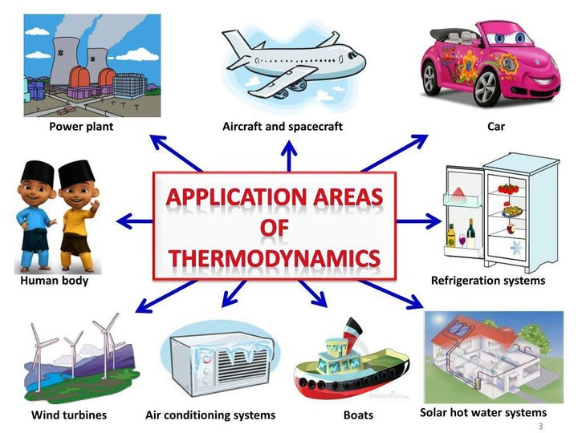
3. Application of Thermodynamics Cont…
Figure 1. Some application areas of Thermodynamics [3]
url: https://assets.isu.pub/document-structure/230615083338-bf56db075d59cf5037c7bdfb91ce68e1/v1/02d1eb996bee0d62399da4c8b0af5fab.jpeg?width=720&quality=85%2C50

Slide 11
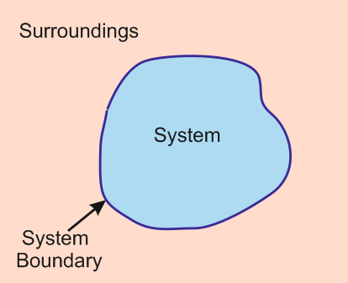
4. Thermodynamic system, boundary and surroundings
Thermodynamic System
A quantity of matter or a region in space chosen for study.
It can include matter, energy, or both.
Surroundings
Everything external to the system.
Boundary
the real or imaginary surface that separates the system from its surroundings.
It may be fixed or movable
Figure 2. Thermodynamic system, boundary and surroundings [4].
url: https://www.mechanicalfunda.com/2017/01/what-is-thermodynamic-system.html

Slide 12
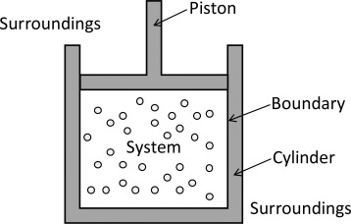
Boundary
The boundary is the contact surface shared by both the system and the surroundings.
It plays a crucial role in analyzing energy and mass interactions
Types of Boundaries
Fixed Boundary – The boundary does not change shape or volume. e.g. A rigid container
Movable Boundary – The boundary can expand or contract. e.g. A piston-cylinder arrangement
Real Boundary – A physical barrier, such as the walls of a container
Imaginary Boundary – A conceptual surface, such as the edge of a gas cloud in space
Figure 3. Boundary of a thermodynamic system [5]
https://ars.els-cdn.com/content/image/3-s2.0-B9780128207338000030-f03-01-9780128207338.jpg

Slide 13
Thermodynamic System
The objective of a thermodynamic system is to provide a framework for analyzing and understanding energy, heat, and work exchanges between a defined system and its surroundings [1].
It is simply a cornerstone of energy analysis.
Thermodynamic systems are categorized based on the interactions they allow between the system and its surroundings.
  Closed Systems
  Open System
  Isolated System

Slide 14
Thermodynamic System Cont.…
Closed System
  In a closed system, only energy in the form of heat and work can be exchanged with the surroundings, but matter remains contained within the system.
  No mass can cross its boundary
  Volume may also change
  Also known as Control Mass
e.g. sealed piston-cylinder device

Slide 15
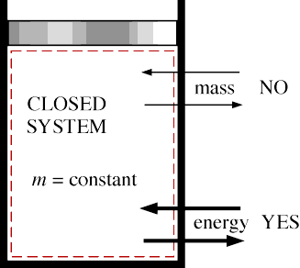
Thermodynamic System Cont.…
Closed System
Figure 4. Mass cannot cross the boundaries of a closed system, but energy can.
url: https://engineeringcheatsheet.com/wp-content/uploads/2025/02/image-14.png

Slide 16
Thermodynamic System Cont.…
2. Open System
  In an open system, both matter and energy can be exchanged with the surroundings.
  Volume may also change
  Also known as Control Volume
  e.g. water heater, car radiator, turbine, nozzle.

Slide 17
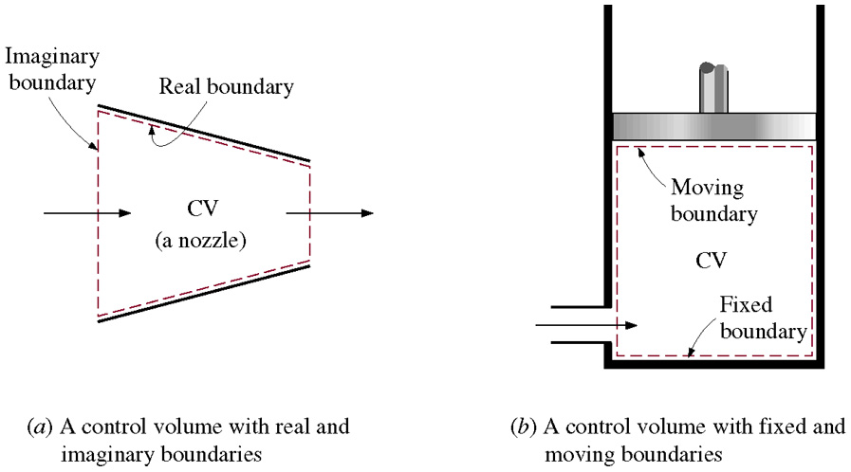
Thermodynamic System Cont.…
Open System
Figure 5. A control volume with fixed and moving boundaries
url: https://glossaread-contain.s3.ap-south-1.amazonaws.com/epub/1649289938_3838542.png

Slide 18
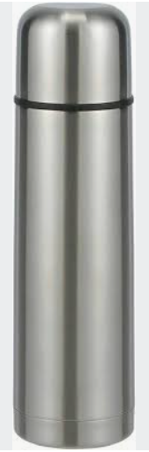
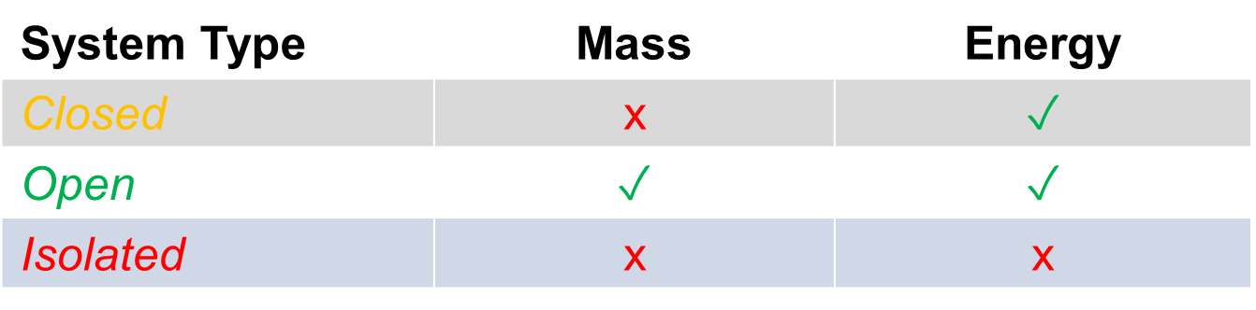
Thermodynamic System Cont.…
3. Isolated System
  In an isolated system, neither matter nor energy can be exchanged with the surroundings.
  This type is an idealization, as perfect isolation is rarely achievable in practice.
  e.g. A highly insulated thermos bottle attempting to maintain the temperature of its contents.

Slide 19
How do we describe a system?
A thermodynamic system can be described by its:
  Properties - pressure, volume, temperature, and internal energy
  Phase - identifying whether the system is homogeneous or heterogeneous
  State - its the condition of the system at which it exists
  Equilibrium - Thermal equilibrium, mechanical equilibrium, chemical equilibrium
  Process - any change from one state to another

Slide 20
5. Thermodynamic Properties
A thermodynamic property is a measurable or calculable characteristic of a thermodynamic system that helps describe its physical condition or state.
These properties are used in thermodynamics to analyze and predict the behavior of systems.
They are also used to analyze and predict energy changes, equilibrium, and phase transitions in thermodynamic systems.
Thermodynamic properties are independent of the path used to arrive at the system condition.

Slide 21
5. Thermodynamic Properties Cont…
The most common thermodynamic properties, often used in analysis and calculations, include:
  Temperature (T): Measures the thermal energy of a system and determines heat flow between systems.
  Pressure (P): Represents the force exerted per unit area within or on the boundaries of a system.
  Volume (V): Refers to the space occupied by the system, often linked to pressure and temperature through equations like the Ideal Gas Law.
  Internal Energy (U): The total energy contained within a system, including kinetic and potential energy of particles.

Slide 22
5. Thermodynamic Properties Cont…
  Enthalpy (H): Combines internal energy with the work done by the system due to pressure and volume changes, commonly used in processes involving heat transfer at constant pressure.
  Entropy (S): A measure of disorder or randomness in a system, crucial for determining spontaneity of processes.

Slide 23
5. Thermodynamic Properties Cont…
Thermodynamic properties are generally classified into two main categories:
1. Intensive Properties:
Its value remains the same whether one considers the whole system or only a part of it.
These do not depend on the size or mass of the system.
They are characterized by:
  Independence from system size
  Uniformity throughout the system
  Retain their values during division
  Determination of state
Examples: Temperature, pressure, density

Slide 24
5. Thermodynamic Properties Cont…
2. Extensive Properties:
These depend on the size or mass of the system.
The property value changes based on the size of the portion of the system being considered.
They are characterized by:
  Dependence on system size
  Additive in nature
  Change with division
  Depend on extensive quantities
  Can become intensive properties
Examples: Volume, internal energy, enthalpy, entropy, mass

Slide 25
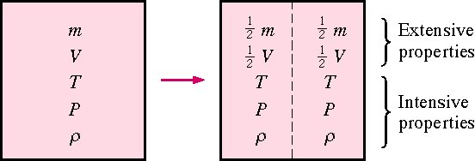
5. Thermodynamic Properties Cont…
Illustration of Intensive and Extensive Properties:
Figure 6. Criterion to differentiate intensive and extensive properties
url: https://encrypted-tbn0.gstatic.com/images?q=tbn:ANd9GcREF8KJJ17nld0s3k4ejFccMw-evJrVSFQk0w&s

Slide 26
5. Thermodynamic Properties Cont…
Another useful property is the Specific Property:
It is an intensive property that is expressed on a per-unit basis, typically with respect to mass.
allow us to describe the state of a system without needing to know its total size or mass
Some Examples:
  Specific Volume: Volume per unit mass (e.g., cubic meters per kilogram, m³/kg).
  Specific Energy: Energy per unit mass (e.g., joules per kilogram, J/kg).
  Specific Heat: Heat capacity per unit mass (e.g., J/kg·K).
Capital letters will denote extensive properties and small letters will be used to represent the specific properties. For Example:
Specific volume (v) = V/m

Slide 27
5. Thermodynamic Properties Cont…
Examples: Identify which of the following are extensive properties and which are intensive properties:
  a 8 m³ volume (Extensive Property)
  20 J of kinetic energy, (Extensive Property)
  a pressure of 100 kPa, (Intensive Property)
  a stress of 800 kPa, (Intensive Property)
  a mass of 10 kg, and (Extensive Property)
  a velocity of 50 m/s. (Intensive Property)
  Convert all extensive properties to intensive properties assuming m = 50 kg.

Slide 28
6. Thermodynamic Equilibrium
Thermodynamic equilibrium is a state in which a system's properties remain constant over time because it has achieved balance in all forms of equilibrium, without any external influence causing change.
A system is said to be in thermodynamic equilibrium when:
  there is no change in any properties of the system when it is isolated from its surroundings.
  all intensive properties have same value throughout the system.
Or, a system should satisfy the following equilibrium conditions:
  Thermal Equilibrium
  Mechanical Equilibrium
  Chemical Equilibrium

Slide 29
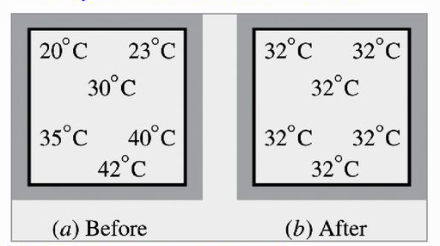
6. Thermodynamic Equilibrium Cont…
Thermal Equilibrium: There are no temperature differences within the system or with its surroundings, so no heat flows occur.
- Also known as equality of temperature.
Figure 7. A closed system reaching thermal equilibrium
url: https://slideplayer.com/slide/14494085/90/images/15/STATE+AND+EQUILIBRIUM+Thermodynamics+deals+with+equilibrium+states..jpg
.

Slide 30
6. Thermodynamic Equilibrium Cont…
Mechanical Equilibrium: There are no unbalanced forces or pressure differences within the system or between the system and its surroundings.
- Also known as equality of pressure
Chemical Equilibrium: There are no net chemical reactions or phase changes, and the composition of the system remains constant over time.
- Also known as equality of chemical potential

Slide 31
7. Dimensions and Units
Dimensions and units play a critical role in Engineering Thermodynamics for several important reasons:
  Consistency and Accuracy
  Standardization
  Physical Understanding
  Problem-Solving and Conversions
  Validation of Equations
  Design and Application

Slide 32
7. Dimensions and Units Cont…
1. Dimensions
Dimensions represent the physical nature of a quantity (e.g., length, mass, time).
Dimensions can be:
a. Fundamental Dimensions:
    Length - Meter (m)
    Mass – kilogram (kg)
    Time - seconds (s)
    Quantity - mole

Slide 33
7. Dimensions and Units Cont…
b. Derived Dimensions:
Formed by combining fundamental dimensions
        Force = mass x acceleration (Newtons)
        Work = force x distance (Joule or Nm)
        Velocity = displacement/ time (m/s)

Slide 34
7. Dimensions and Units Cont…
2. Units
Units are specific magnitudes assigned to dimensions (e.g., meters, kilograms, seconds).
Unit Systems:
    SI Units (International System): The most widely used system (e.g., meter, kilogram, second, kelvin).
    Imperial Units: Common in certain regions (e.g., foot, pound, BTU).
  Common Units in Thermodynamics: Energy (joules, BTU), pressure (pascals, psi), volume (m³, ft³).

Slide 35
7. Dimensions and Units Cont…
Note that: In engineering, all equations must be dimensionally homogeneous.

Slide 36
Summary
The basic concepts of thermodynamics are introduced and discussed.
Thermodynamics is the science that primarily deals with energy.
A system of fixed mass is called a closed system, or control mass, and a system that involves mass transfer across its boundaries is called an open system, or control volume.
The mass-dependent properties of a system are called extensive properties and the others intensive properties.
A system is said to be in thermodynamic equilibrium if it maintains thermal, mechanical, and chemical equilibrium.
The importance of dimensions and units are discussed and noted that in engineering, all equations must be dimensionally homogeneous

Slide 37
References
[1]. Thermodynamics – An Engineering Approach, Cengel Y A.,Bole M A., McGraw-Hill Education, 8th edition 2015.
[2]. Lecture Notes on Thermodynamics, Joseph M. Powers, Department of Aerospace and Mechanical Engineering University of Notre Dame Notre Dame, Indiana 46556-5637 USA, updated 06 March 2025.
[3]. Wonders of Thermodynamics: Energy, Heat, Physics Formula and Entropy, Gaurav Mehra, vocal.media/education,2023,https://issuu.com/gauravm1612/docs/wonders_of_thermodynamics_energy_heat_physics_f/1,(Viewed March 2025)
[4]. Introduction to Engineering Thermodynamics, Claire Yu Yan, University of British Columbia, Okanagan, Open Education Resource (OER) LibreTexts Project (https://LibreTexts.org), 2025.
[5]. Energy and thermodynamics, David Ting, Thermofluids, Academic Press, Pages 19-33, 2022. https://doi.org/10.1016/B978-0-323-90626-5.00018-5.

Slide 38
Thank you !

