Slide 1
Engineering Thermodynamics I
Lecture 2
Basic Concepts and Definition
Lecturer: Dr. Melaku Desta

Slide 2
Lecture learning outcomes:
At the end of this lecture, you will be able to:
Understand the concept of a system's thermodynamic state.
Explain the concept of paths between thermodynamic states and analyze different processes.
Differentiate the concepts of reversible and irreversible processes
Explain the significance of pressure, temperature, and other system properties.
Use the zeroth law of thermodynamics to explain thermal equilibrium
Build a solid understanding that serves as a basis for exploring more complex thermodynamic laws and applications.

Slide 3
Content
Thermodynamic State
Thermodynamic Path and Processes
Quasi-Static and Non-Quasi-Static Processes
Reversible and Irreversible Processes
Common Thermodynamic Properties
Zeroth Law of Thermodynamics
Summary
References

Slide 4
1. Thermodynamic State
A thermodynamic state refers to the condition of a system at a specific point in time, described by its state properties, such as pressure, temperature, volume, and composition [1].
These properties are macroscopic in nature and act as coordinates to describe the system.
These properties uniquely define the state of the system when it's in equilibrium.
The differences in thermodynamic states often depend on variations in the following properties.
  Temperature difference
  Pressure difference
  Volume difference
  Phase difference

Slide 5
1. Thermodynamic state Cont…
A substance can be at various pressures & temperatures or in various states.
In a given state each property has one value.
Thermodynamic state helps to illustrate changes or processes a system undergoes.
Understanding thermodynamic states and how systems transition between them (thermodynamic processes) is essential in:
  Engineering Design
  Refrigeration and Heating
  Material Science
  Energy Systems
  Chemical Reactions
  Environmental Science

Slide 6
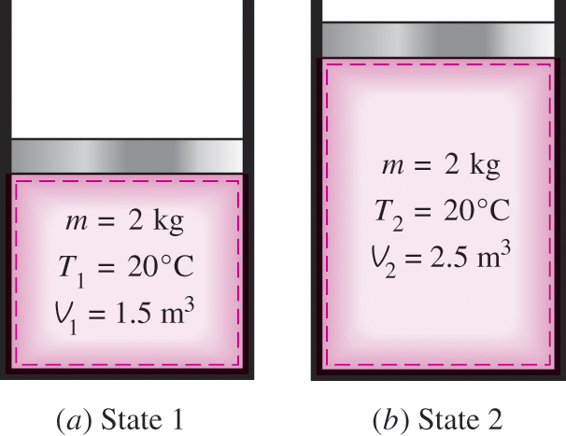
1. Thermodynamic state Cont…
  A thermodynamic state is a point function. This means that the state of a system is defined by specific properties.
  Point functions are path-independent, focusing solely on the current conditions of the system rather than the process or path taken to arrive at that condition.
Figure 1: A system at two different states
url: https://encrypted-tbn0.gstatic.com/images?q=tbn:ANd9GcTd2RGkn94j9qBVfFVCUoXi80Zkxwam92Yfvg&s

Slide 7
1. Thermodynamic state Cont…
  The State Postulate
  The state postulate is a fundamental principle in thermodynamics, which states that the state of a thermodynamic system can be fully defined using a sufficient number of independent properties.
  For a single-phase system (such as a liquid or gas), typically two independent properties are enough to determine all other properties of the system, assuming the composition remains constant [2].

Slide 8
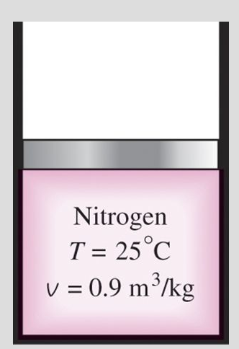
1. Thermodynamic state Cont…
The state of a simple compressible system in equilibrium is completely specified by 2 independent intensive properties [2].
The state postulate is also known as the two-property rule. The state postulate requires that the two properties specified be independent to fix the state.
Figure 2: The state of Nitrogen is fixed by two independent intensive properties
url:https://slideplayer.com/slide/9191840/27/images/16/The+State+Postulate+The+number+of+properties+required+to+fix+the+state+of+a+system+is+given+by+the+state+postulate%3A.jpg

Slide 9
2. Thermodynamics Path and Processes
  A thermodynamic path refers to the series of states that a thermodynamic system passes through during a process as it transitions from an initial state to a final state or from one equilibrium state to another [3].
  It describes how the system changes its properties, such as pressure, temperature, and volume, over time.
  A thermodynamic path is often represented visually on diagrams, like Pressure-Volume (P-V) or Temperature-Entropy (T-S) plots, to show the relationship between properties during the process.

Slide 10
2. Thermodynamics Path and Processes Cont…
  Path Function
  A thermodynamic path function is a property that depends on the specific path or process taken by a system during its transition from one state to another.
  Unlike state functions, which are independent of the path and depend solely on the system's current state, path functions are concerned with the process itself.
Key Characteristics of Path Functions:
    They are not properties of the system's state, so they cannot be represented by a single point on a state diagram.
    Their values are calculated by integrating along the path taken during the process.
    They are process-dependent and are expressed as inexact differentials (denoted by symbols like δQ and δW).

Slide 11
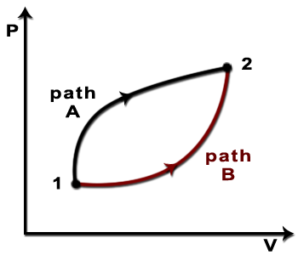
2. Thermodynamics Path and Processes Cont…
Examples of Path Functions
Work (W): The amount of work done by or on a system depends on the path taken (e.g., isothermal, adiabatic processes).
Heat (Q): The heat transferred into or out of a system depends on how the process occurs.
Figure 3. Thermodynamic Path
  url: https://i.sstatic.net/ywvyt.png

Slide 12
2. Thermodynamics Path and Processes Cont…
Thermodynamic Process
It is the transformation of a system from one state to another state through a succession of states.
A thermodynamic process refers to the sequence of changes that a system undergoes in its thermodynamic properties, such as temperature, pressure, volume, and internal energy.
These changes result from interactions between the system and its surroundings, typically involving the transfer of energy as heat or work.

Slide 13
2. Thermodynamics Path and Processes Cont…
Thermodynamic Process
State 1
State 2
Process
Figure 4: A system at two different states
url: https://encrypted-tbn0.gstatic.com/images?q=tbn:ANd9GcTd2RGkn94j9qBVfFVCUoXi80Zkxwam92Yfvg&s

Slide 14
2. Thermodynamics Path and Processes Cont…
Types of Thermodynamic Processes:
The common types of thermodynamic processes include:
Isothermal Process:
  The temperature remains constant throughout the path.
  Heat is exchanged with the surroundings to maintain the temperature.
Example: Expansion or compression of a gas in contact with a heat reservoir.
2. Adiabatic Process:
  No heat is transferred to or from the system during the path.
  Changes in the system occur due to work done on or by the system.
Example: Rapid compression or expansion of gas.

Slide 15
2. Thermodynamics Path and Processes Cont…
3. Isochoric Process:
  The volume remains constant (no change in volume).
  Heat transfer leads to changes in pressure and temperature.
Example: Heating a gas inside a rigid container.
4. Isobaric Process:
  The pressure remains constant throughout the process.
  Heat transfer causes changes in the system's volume and temperature.
Example: Heating water in an open container.

Slide 16
2. Thermodynamics Path and Processes Cont…
There are also specific types of thermodynamic processes:
5. Isentropic Process:
  Entropy remains constant (no entropy change).
  It is a special type of adiabatic process where there is no heat transfer and no entropy generation.
  Often idealized for efficiency analysis in systems like turbines and compressors.
6. Isenthalpic Process:
  Enthalpy remains constant.
  Commonly associated with processes like throttling, where fluid expands through a valve or a porous plug without heat transfer or work.

Slide 17
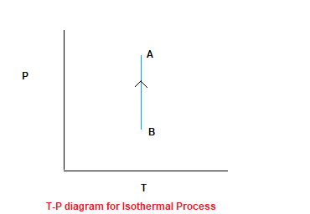
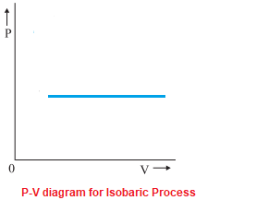
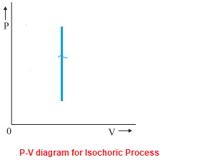
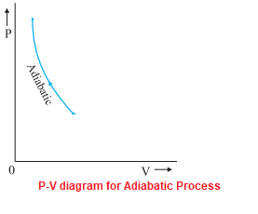
2. Thermodynamics Path and Processes Cont…
Figure 5: Common types of thermodynamic processes
url: https://physicscatalyst.com/heat/thermodynamic-processess.php

Slide 18
3. Quasi-Static and Non-Quasi-Static Processes
Quasi-Static Processes
A quasi-static process is a theoretical thermodynamic process that occurs infinitely slowly, allowing the system to remain in equilibrium at every step.
Each state during the process is well-defined and can be described using thermodynamic variables like pressure, temperature, and volume.
Some of the key characteristics are:
Infinitely Slow: The process occurs so slowly that the system has enough time to adjust and maintain equilibrium.
Reversible: Because the system is always in equilibrium, the process is reversible, meaning it can return to its original state without energy losses.
Idealized: Quasi-static processes are not practically achievable but serve as a useful approximation in theoretical thermodynamics.

Slide 19
3. Quasi-Static and Non-Quasi-Static Processes Cont...
Quasi-Static Processes
Examples:
Compression or expansion of gas in a piston, done extremely slowly.
Idealized heat transfer where the temperature gradient between system and surroundings is negligible.

Slide 20
3. Quasi-Static and Non-Quasi-Static Processes Cont...
Non-Quasi-Static Processes
A non-quasi-static process occurs at a finite rate, meaning the system does not have enough time to maintain equilibrium during the transitions.
As a result, thermodynamic variables like pressure and temperature may not be uniform throughout the system.
Some of the Key Characteristics are:
  Finite Rate: The process happens quickly, leading to deviations from equilibrium.
  Irreversible: Since equilibrium is not maintained, the process is irreversible, involving energy losses due to factors like friction or turbulence.
  Realistic: Non-quasi-static processes are common in real-world applications.

Slide 21
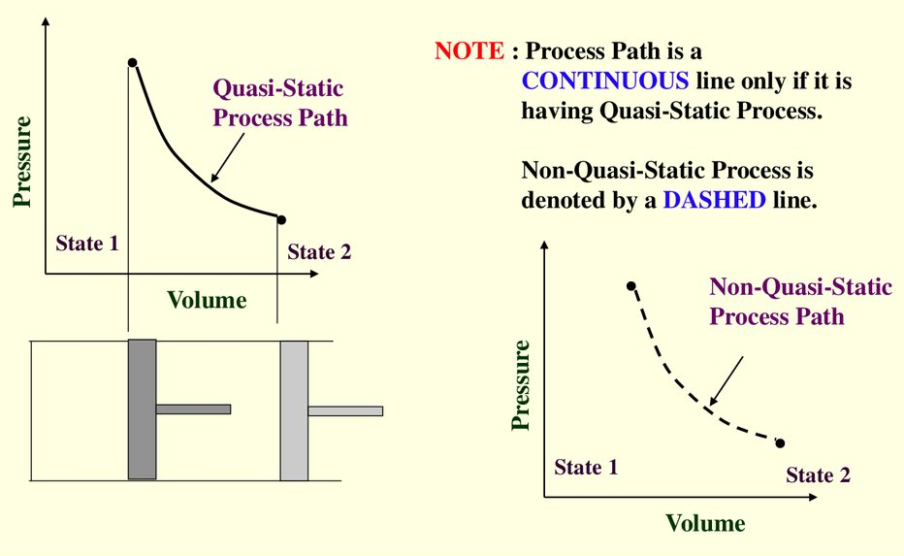
3. Quasi-Static and Non-Quasi-Static Processes Cont...
Non-Quasi-Static Processes
Examples:
  Rapid compression or expansion of gas (like in engines).
  Sudden heat transfer where the temperature difference is significant.
Figure 6: Quasi-static and Non-quasi-static processes
url: https://cf.ppt-online.org/files/slide/q/QKfceBZqTp7ojsXwG1W5O2IvNLSYnk68D0tdPM/slide-12.jpg

Slide 22
3. Quasi-Static and Non-Quasi-Static Processes Cont...
  Comparison of Quasi-Static and Non-Quasi-Static Processes
  Quasi-static processes are essential for understanding theoretical concepts like maximum efficiency in heat engines, while non-quasi-static processes help in modeling real-life scenarios.
Aspect | Quasi-Static | Non-Quasi-Static
Rate of Change | Infinitely slow | Finite/fast
Equilibrium Maintenance | Always in equilibrium | Deviates from equilibrium
Practicality | Theoretical (idealized) | Realistic

Slide 23
4. Reversible and Irreversible Processes
In thermodynamics, reversible and irreversible processes represent two different ways a system can change its state while interacting with its surroundings.
Reversible Processes
A reversible process is an idealized process that occurs infinitely slowly and is perfectly efficient, allowing the system to return to its initial state without any net loss of energy.
That is, both the system and the surroundings are returned to their initial states at the end of the reverse process.

Slide 24
4. Reversible and Irreversible Processes Cont…
Reversible Processes
Reversible processes actually do not occur in nature. They are merely idealizations of actual processes [4].
Reversible processes can be approximated by actual devices, but they can never be achieved.
That is, all the processes occurring in nature are irreversible.
Why we are bothering with such fictitious processes. There are two reasons.
  they are easy to analyze.
  they serve as idealized models to which actual processes can be compared and can be viewed as theoretical limits for the corresponding irreversible ones.

Slide 25
4. Reversible and Irreversible Processes Cont…
Reversible Processes
A thermodynamic process is said to be a reversible process if:
  The system remains in equilibrium at all times during the process.
  There is no entropy generation or entropy stays constant, as there are no inefficiencies or losses.
  The process happens extremely slowly to avoid deviations from equilibrium.
  The process is perfectly efficient and has no friction, turbulence, or other factors causing energy loss.

Slide 26
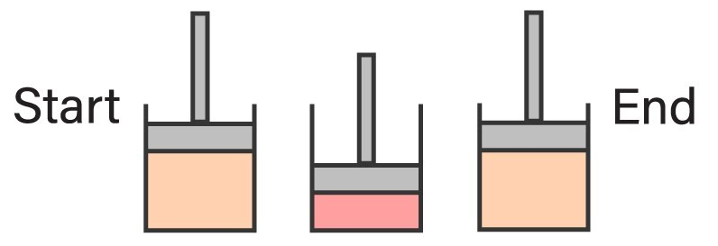
4. Reversible and Irreversible Processes Cont…
Reversible Processes
Example:
Slow compression or expansion of a gas in a frictionless piston-cylinder setup.
Idealized heat exchange where the temperature difference between the system and surroundings is negligible.
Figure 7: Reversible process
url: https://i.ytimg.com/vi/v97DLR1Plb0/maxresdefault.jpg

Slide 27
4. Reversible and Irreversible Processes Cont…
Irreversible Processes
An irreversible process is a real-world process that occurs at a finite rate and involves inefficiencies, leading to a net loss of energy that cannot be recovered [4].
A thermodynamic process is said to be an irreversible process if:
  The system is not in equilibrium during the process.
  Entropy increases (entropy generation) due to inefficiencies like friction, heat loss, and turbulence.
  The process happens quickly, making it impossible to return to the original state without external intervention.
  The processes are realistic or they are common in everyday applications.

Slide 28
4. Reversible and Irreversible Processes Cont…
Irreversible Processes
The factors that cause a process to be irreversible are called irreversibilities.
They include friction, unrestrained expansion, mixing of two fluids, heat transfer across a finite temperature difference, electric resistance, inelastic deformation of solids, and chemical reactions.
Examples:
  Rapid expansion or compression of gas in engines.
  Heat transfer with a significant temperature difference.
  Mixing of fluids or chemical reactions.

Slide 29
4. Reversible and Irreversible Processes Cont…
Internally and Externally Reversible Processes
A process is called internally reversible if no irreversibilities occur within the boundaries of the system during the process.
A process is called externally reversible if no irreversibilities occur outside the system boundaries during the process.
A process is called totally reversible, or simply reversible, if it involves no irreversibilities within the system or its surroundings.

Slide 30

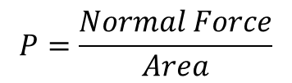

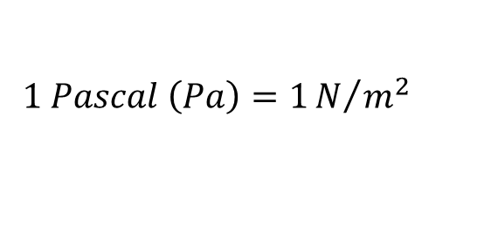
5. Common Thermodynamic Properties
1. Pressure
Pressure is the force exerted per unit area on a surface by an object, substance, or fluid (such as a gas or liquid).
It’s a measure of how concentrated a force is over a specific area, and it plays a crucial role in physics, engineering, and everyday life [5].
$$Units$$
$$P=\frac{Normal Force}{Area}$$
$$1 Pascal \left(Pa\right)=1N/{m^{2}}$$
$$1 bar={10}^{5}Pa=0.1 MPa$$
$$1 atm=101325Pa=101.325 kPa$$

Slide 31
5. Common Thermodynamic Properties Cont…
Types of Pressure
1. Absolute Pressure (P_{absolute} or, P)
  Measured relative to a perfect vacuum (absolute zero)
  Includes atmospheric pressure as a reference.
Example: Pressure inside a sealed gas cylinder.
2. Gauge Pressure (P_{gauge} or, P_{g})
  Measured relative to the atmospheric pressure.
  Positive for pressures above atmospheric pressure and negative for below.
Example: Tire pressure measurements.

Slide 32

5. Common Thermodynamic Properties Cont…
Types of Pressure
3. Atmospheric Pressure (P_{atm} or, P_{o} )
  Pressure exerted by the Earth's atmosphere.
  Decreases with altitude because of lower air density.
`
Pressure
P_{absolute} – measured relative to
evacuated box (absolute zero)
P_{gauge} – measured relative to local
atmoshpheric pressure
$$P=P_{atm}+P_{g}$$
$$P_{atm}=P_{o}=101.325 kPa at sea level$$

Slide 33
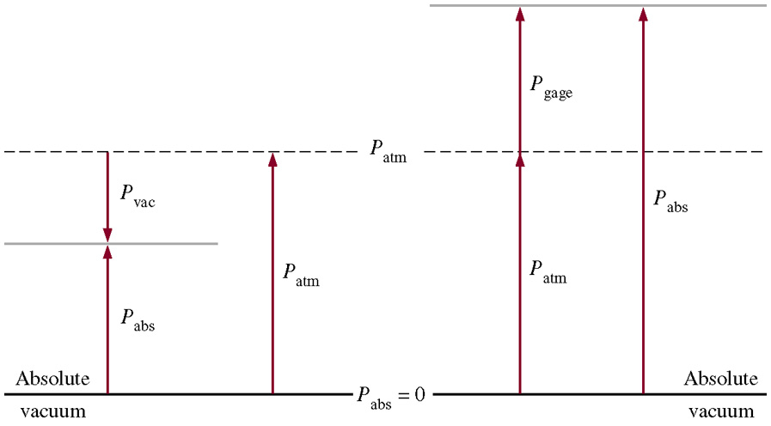

5. Common Thermodynamic Properties Cont…
Types of Pressure
Pressures below atmospheric pressure are called vacuum pressures and are measured by vacuum gages that indicate the difference between the atmospheric pressure and the absolute pressure.
$$P_{vac}=P_{atm}−P_{abs}$$
Figure 8: Absolute, gauge and atmospheric pressures
url: https://image.slideserve.com/1356564/absolute-gage-and-vacuum-pressures-l.jpg

Slide 34
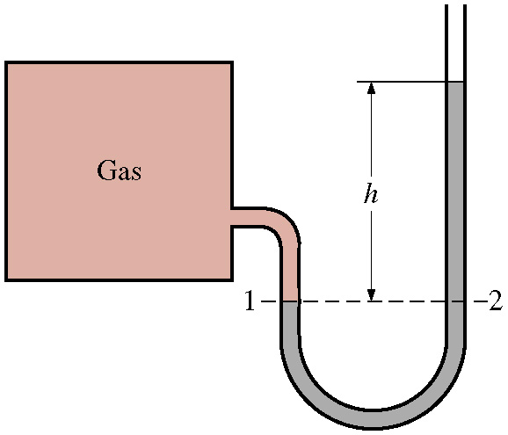

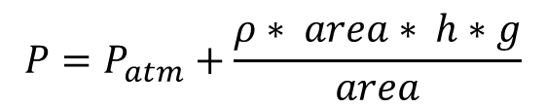
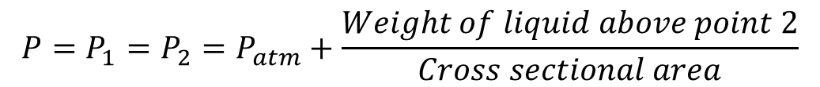

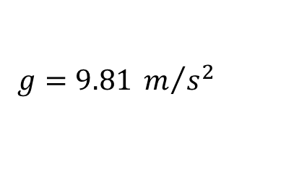


5. Common Thermodynamic Properties Cont…
Methods of Measuring Pressure
Manometer: used to measure gauge pressure
Points 1 and 2 at the same height and connected by the same liquid have the same pressure. i.e.
$$P_{1}=P_{2}$$
or $\frac{F_{1}}{A_{1}}=\frac{F_{2}}{A_{2}}$
Figure 9: The basic manometer
https://images.theengineeringprojects.com/image/webp/2022/10/pressure-and-fluid-statics-4.jpg.webp?ssl=1
$$P=P_{1}=P_{2}=P_{atm}+\frac{Weight of liquid above point 2}{Cross sectional area}$$
$$P=P_{atm}+\frac{ρ∗ area∗ h∗g}{area}$$
$$ρ=density of measuring liquid$$
$$g=9.81 m/{s^{2}}$$
$$P=P_{atm}+ρhg$$

Slide 35
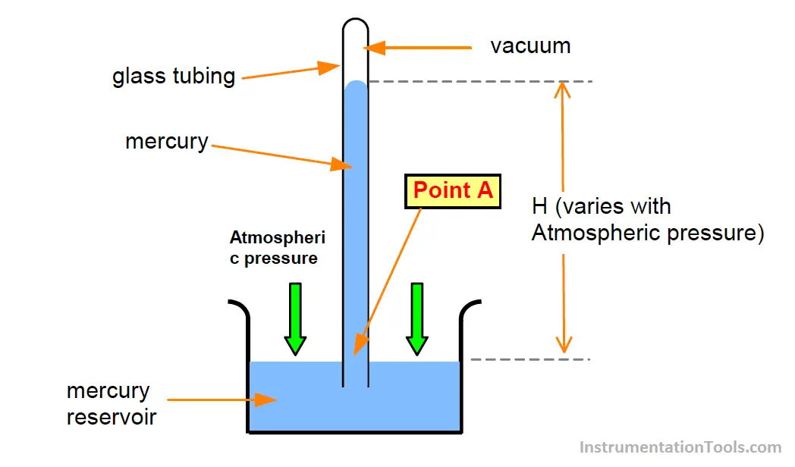
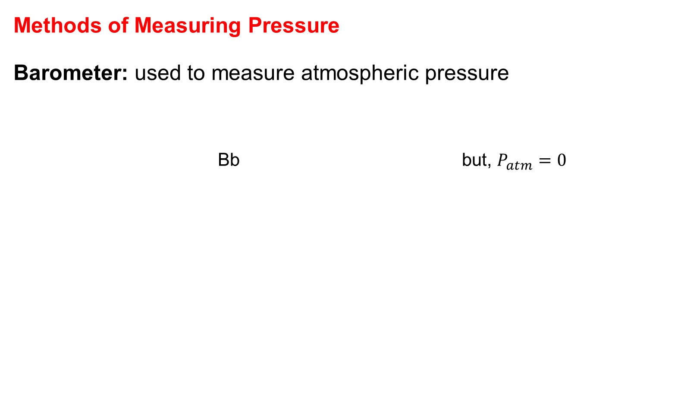


5. Common Thermodynamic Properties
Methods of Measuring Pressure
Barometer: used to measure atmospheric pressure
Bb but, $P_{atm}=0$
$$P=P_{atm}+ρhg$$
$$P=ρhg$$
Figure 10: The basic manometer
url: https://instrumentationtools.com/wp-content/uploads/2017/09/instrumentationtools.com_barometer-principle.png

Slide 36
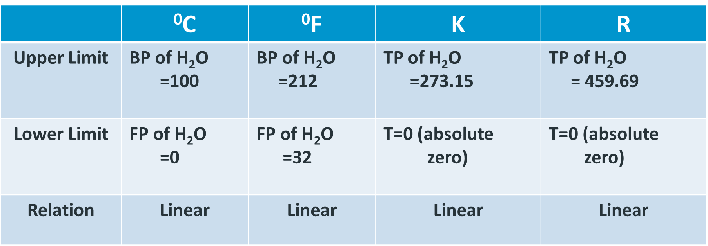
5. Common Thermodynamic Properties
2. Temperature
Temperature is a measure of the average kinetic energy of the particles in a substance.
Degree of hotness or coldness
Temperature is measured using thermometers
Scales of Temperature:
  Degree Celsius (°C)
  Degree Fahrenheit (°F)
  Kelvin (K)

Slide 37
6. Zeroth Law of Thermodynamics
The Zeroth Law of Thermodynamics is a fundamental principle that establishes the concept of thermal equilibrium and provides the basis for temperature measurement.
It states that:
"If two systems are each in thermal equilibrium with a third system, then they are in thermal equilibrium with each other.“ [5]
If T_{A} = T_{C} and T_{B} = T_{C} then
T_{A} = T_{B}
The Zeroth Law is deceptively simple but foundational to the study of thermodynamics.

Slide 38
Summary
A concise summary of the lecture are:
Thermodynamic state: The condition of a system described by its properties, such as temperature, pressure, volume, and internal energy.
Thermodynamic path and processes: The sequence of states a system goes through during a process, which can be isothermal, adiabatic, isobaric, or isochoric.
Quasi-static and non-quasi-static processes: Quasi-static processes occur slowly, maintaining equilibrium, while non-quasi-static processes happen rapidly, disrupting equilibrium.

Slide 39
Summary Cont…
A concise summary of the lecture are:
Reversible and irreversible processes: Reversible processes occur infinitely slowly and can be undone without affecting the surroundings, while irreversible processes cause permanent changes.
Common thermodynamic properties: Includes temperature, pressure, which define the state and behavior of a thermodynamic system.
Zeroth law of thermodynamics: If two systems are in thermal equilibrium with a third system, they are also in thermal equilibrium with each other, forming the basis for temperature measurement.

Slide 40
References
[1]. Fundamentals of Engineering Thermodynamics”, Moran, Michael J.5th ed.2017.
[2]. Thermodynamics – An Engineering Approach, Cengel Y A.,Bole M A., McGraw-Hill Education, 8th edition 2015.
[3]. Wonders of Thermodynamics: Energy, Heat, Physics Formula and Entropy, Gaurav Mehra, vocal.media/education,2023,https://issuu.com/gauravm1612/docs/wonders_of_thermodynamics_energy_heat_physics_f/1,(Viewed March 2025)
[4]. Fundamentals of Engineering Thermodynamics, Michael J. Moran, Howard N. Shapiro, Daisie D. Boettner, Margaret B. Bailey - (2010, Wiley) - libgen.lc
[5]. A New Approach to Engineering Thermodynamics, Renaud Gicquel - Energy Systems_ (2021, CRC Press) - libgen.li

Slide 41
Thank you !

