Slide 1
Engineering Thermodynamics I
Lecture 3
First Law of Thermodynamics and Energy
Lecturer: Dr. Melaku Desta

Slide 2
Lecture learning outcomes:
At the end of this lecture, you will be able to:
Understand the principle of energy conservation and express it using thermodynamic equations.
Define internal energy, kinetic energy, and potential energy and understand their roles in a system's total energy.
Explain the mechanisms of energy transfer such as heat, work, and mass flow
Differentiate between conduction, convection, and radiation as heat transfer mechanisms.
Calculate and interpret boundary work for different processes
Analyze closed systems with no mass transfer, applying
the energy balance equation

Slide 3
Content
First Law of Thermodynamics
Energy of a System
Mechanisms of Energy Transfer
Energy Transfer by Heat and Work
Boundary Work
Some Typical Processes
The First Law for a Closed System
Summary
References

Slide 4
1. The First Law of Thermodynamics
The First Law of Thermodynamics is the law that relates the various forms of energies for system of different types.
It is simply the expression of the conservation of energy principle.
It states that energy cannot be created or destroyed; it can only change forms or be transferred from one system to another [1].
During an interaction between a system and its surroundings, the amount of energy gained by the system must be exactly equal to the amount of energy lost by the surroundings.
First law of thermodynamics is based on experimental observations.
It is a cornerstone in understanding energy systems.

Slide 5
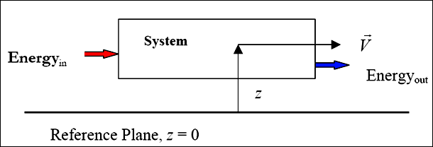
1. The First Law of Thermodynamics Cont…
Figure 1: Energy of a system
url: https://slideplayer.com/slide/15788401/88/images/30/System+CM.+Energyin.+Energyout.+z.+Reference+Plane%2C+z+%3D+0..jpg
The first law of thermodynamics is expressed as [2]
$\left({Total Energy \atop Entering the System}\right)$-$\left({Total Energy \atop Leaving the System}\right)=\left({The Change in Total \atop Energy of the System}\right)$

Slide 6



1. The First Law of Thermodynamics Cont…
The total energy of the system, E_{system}, is given as
$$E_{in}−E_{out}=ΔE_{system}$$
$$E_{system}=Internal Energy+Kinetic Energy+Potential Energy$$
$$E_{system}=U+KE+PE$$
$$E_{in}−E_{out}=ΔU+ΔKE+ΔPE$$

Slide 7
2. Energy of a System
Energy can be viewed as the ability to cause change.
Energy can exist in numerous forms such as:
    Thermal,
    Kinetic,
    Potential,
    Mechanical,
    Electric,
    Magnetic,
    Chemical, and
    Nuclear
Their sum constitutes the total energy E of a system.

Slide 8
2. Energy of a System Cont…
In thermodynamic analysis, energy can be grouped in to two forms:
    Microscopic
    Macroscopic
Microscopic forms of energy are those related to the molecular structure of a system and the degree of the molecular activity, and they are independent of outside reference frames.
The sum of all the microscopic forms of energy is called the internal energy of a system and is denoted by U.
Example:- Latent energy
Chemical energy
Nuclear energy

Slide 9
2. Energy of a System Cont…
Macroscopic forms of energy are those a system possesses as a whole with respect to some outside reference frame,
Example:- Kinetic Energy
Potential Energy
The macroscopic energy of a system is related to motion and the influence of some external effects such as gravity, magnetism, electricity, and surface tension.

Slide 10
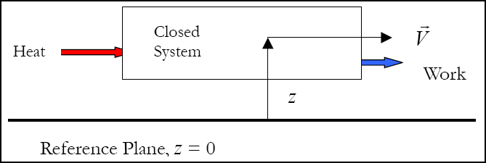
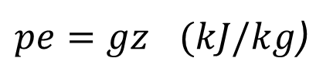

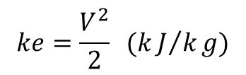
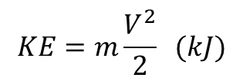
2. Energy of a System Cont…
When all parts of a system move with the same velocity, the kinetic energy (KE) is expressed as:
  Or on a unit mass basis,
  The energy that a system possesses as a result of its elevation in a gravitational field is called potential energy (PE) and is expressed as
where : g - the gravitational acceleration and
z -the elevation of the centre of gravity of a system
$$KE=m\frac{V^{2}}{2} (kJ)$$
$$ke=\frac{V^{2}}{2} (kJ/kg)$$
Figure 2: Energy balance for closed system
url: https://image.slideserve.com/1413503/slide3-l.jpg
$$PE=mgz$$
$pe=gz$ $(kJ/kg$)

Slide 11
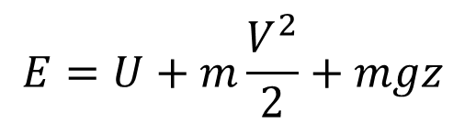


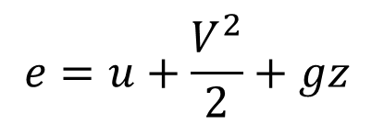
2. Energy of a System Cont…
The magnetic, electric, and surface tension effects are significant in some specialized cases only and are usually ignored.
The total energy of a system consists of the kinetic, potential, and internal energies and is expressed as
  on a unit mass basis,
$$E=U+KE+PE$$
$$E=U+m\frac{V^{2}}{2}+mgz$$
$$e=u+\frac{V^{2}}{2}+gz$$
$$e=u+ke+pe$$

Slide 12

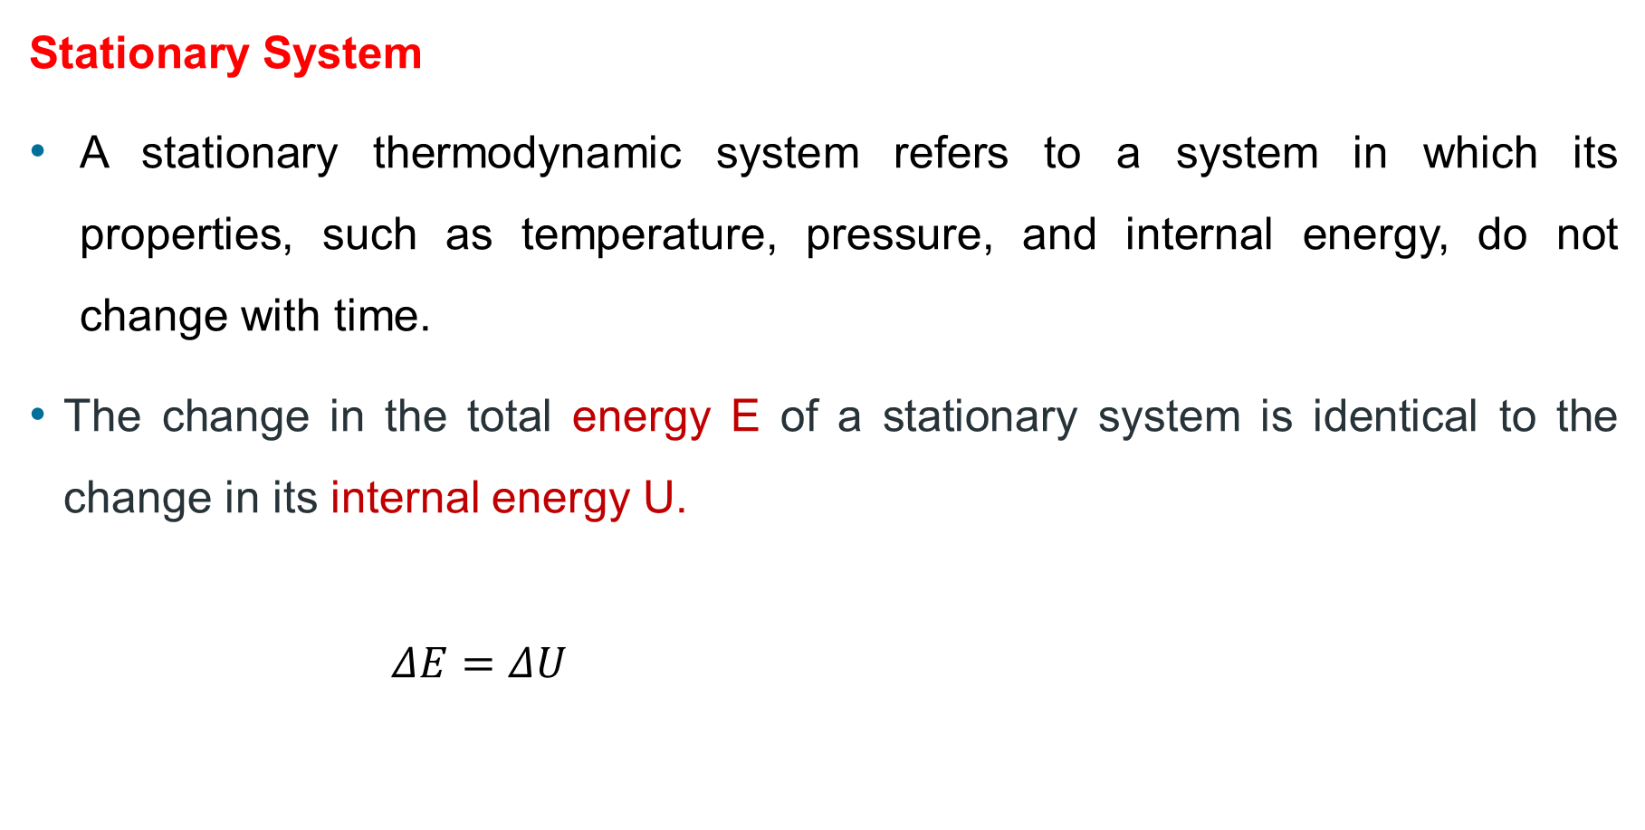
2. Energy of a System Cont…
Stationary System
A stationary thermodynamic system refers to a system in which its properties, such as temperature, pressure, and internal energy, do not change with time.
The change in the total energy E of a stationary system is identical to the change in its internal energy U.
$ΔE=ΔU$
$$E_{in}−E_{out}=ΔU+ΔKE+ΔPE$$

Slide 13
3. Mechanisms of Energy Transfer
Heat Transfer (Q):
  Heat transfer to a system - increases the internal energy of the system
  Heat transfer from a system – decreases the internal energy of the system
Work Transfer (W):
  Work done on a system - increases the energy of the system
  Work done by the system - decreases the energy of the system
Mass Flow (m):
  Mass enters a system - increases the energy of the system
  Mass leaves the system - decreases the energy in the system

Slide 14
3. Mechanisms of Energy Transfer
In thermodynamics, energy transfer for:
  Closed systems - Two primary mechanisms
    heat transfer and
    work
  Open Systems - Three primary mechanisms
    heat transfer,
    work, and
    mass transfer

Slide 15
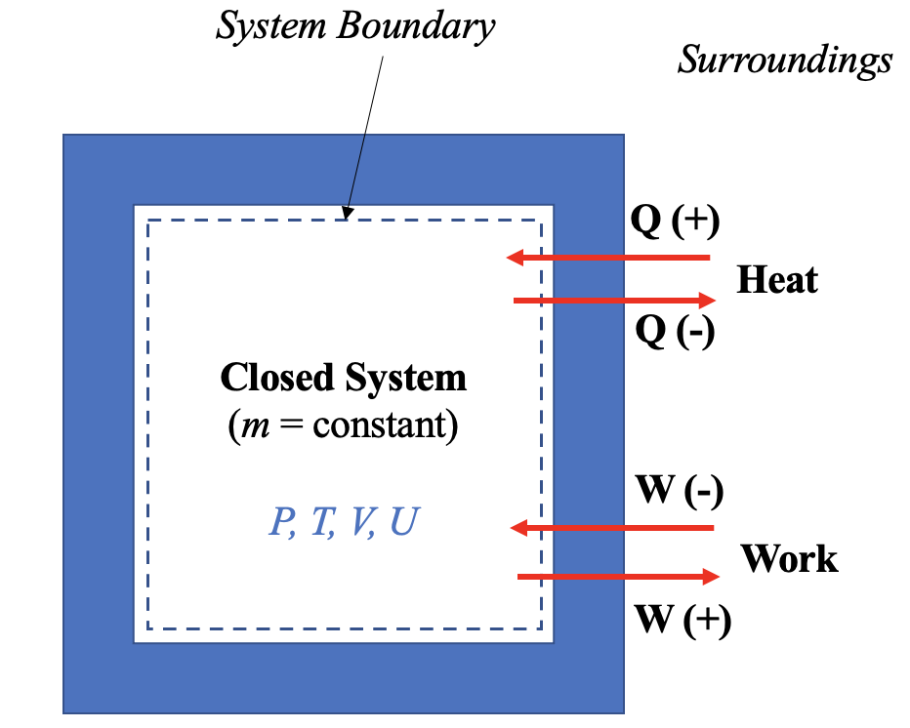
3. Mechanisms of Energy Transfer Cont…
Energy transfer for Closed Systems
Energy can cross the boundary of a closed system in two distinct forms: heat and work.
Figure 3: Energy transfer by heat and work
url: https://pressbooks.bccampus.ca/thermo1/wp-content/uploads/sites/499/2021/07/Heat-and-work-to-closed-systems.png

Slide 16
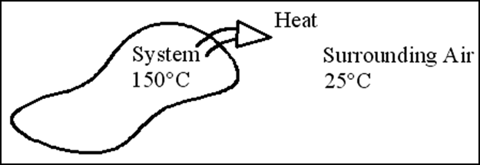
4. Energy Transfer by Heat and Work
i. Energy transport by heat
Heat is defined as the form of energy that is transferred between two systems (or a system and its surroundings) by virtue of a temperature difference [2].
This transfer occurs naturally and is governed by three main mechanisms: conduction, convection, and radiation.

Slide 17
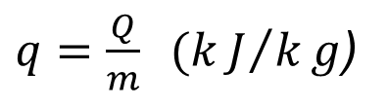
4. Energy Transfer by Heat and Work Cont…
i. Energy transport by heat
As a form of energy, heat has energy units, kJ
The amount of heat transferred during the process between two states (states 1 and 2) is denoted by Q₁₂, or just Q
Sometimes it is desirable to know the rate of heat transfer (the amount of heat transferred per unit time)
Heat transfer per unit mass of a system is denoted by q and is determined from:
$q=\frac{Q}{m} (kJ/kg$)

Slide 18
4. Energy Transfer by Heat and Work Cont…
Heat Transfer Mechanisms:
Heat transfer by Conduction: it is the process of transferring thermal energy through a solid material or between objects in direct physical contact.
Heat transfer by Convection: Heat convection occurs in fluids (liquids or gases) and involves the movement of particles to transfer heat. It is the combined effects of conduction and fluid motion.
3. Heat transfer by Radiation: the transfer of energy due to the emission of electromagnetic waves (or photons).

Slide 19
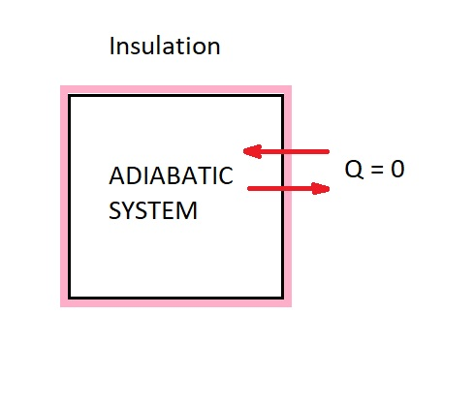
4. Energy Transfer by Heat and Work Cont…
A process during which there is no heat transfer is called an adiabatic process.
There are two ways a process can be adiabatic:
  Well insulated
  Both the system and the surroundings are at the same temperature
  Figure 2: An adiabatic system
  url: https://sbainvent.com/wp-content/uploads/2019/11/ADIABATIC-SYSTEM.jpg

Slide 20
4. Energy Transfer by Heat and Work Cont…
ii. Energy transport by Work
If the energy crossing the boundary of a closed system is not heat, it must be work.
An energy interaction that is not caused by a temperature difference between a system and its surroundings is work.
It is the energy transfer associated with a force acting through a distance.
Example:- A rising piston,
A rotating shaft

Slide 21
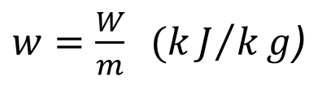
4. Energy Transfer by Heat and Work Cont…
ii. Energy transport by Work
Work is also a form of energy transferred like heat and, therefore, has energy units kJ.
The work done during a process between states 1 and 2 is denoted by W₁₂, or simply W.
The work done per unit time is called power and is denoted by .The unit of power is kJ/s, or kW.
The work done per unit mass of a system is denoted by w and is expressed as
$w=\frac{W}{m} (kJ/kg$)

Slide 22
4. Energy Transfer by Heat and Work Cont…
The similarities between Heat and Work
  Both are recognized at the boundaries of a system as they cross the boundaries.
  Both are associated with a process, not a state. Unlike thermodynamic properties, both heat and work has no meaning at a state.
  Both are path functions – their magnitude depends on the path followed during a process.

Slide 23
4. Energy Transfer by Heat and Work Cont…
Sign convention for energy transported by heat and work
In thermodynamics, understanding how heat and work are quantified and their directions of flow is vital for energy systems.
Since heat and work are directional quantities, the specification of both the magnitude and direction is required for complete analysis.
The sign convention for heat and work interactions is as follows [3]:
    heat transfer to a system: +ve
    heat transfer from a system: -ve
    work done by a system: +ve
    work done on a system: -ve

Slide 24
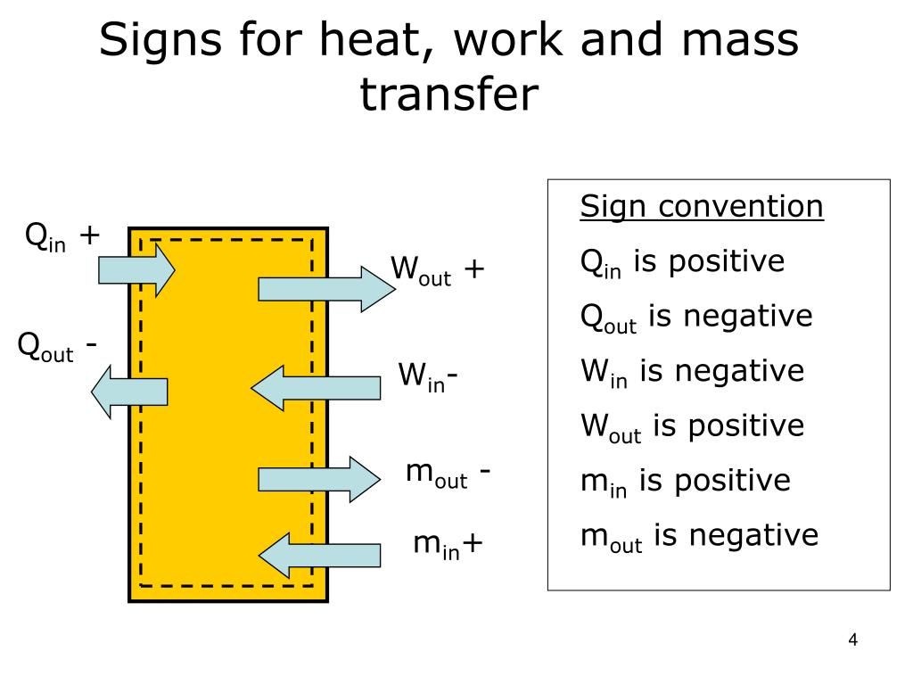
4. Energy Transfer by Heat and Work Cont…
Sign convention for energy transported by heat, work and mass
Figure 3: Sign convention for heat, work and mass transfer
url: https://image3.slideserve.com/6788916/slide4-l.jpg

Slide 25
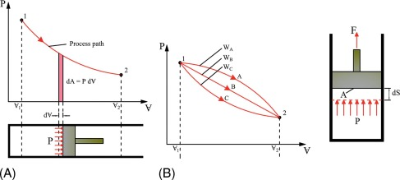
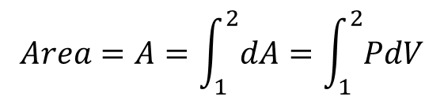
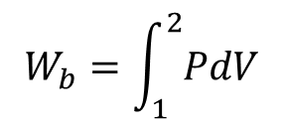

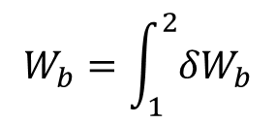
5. Boundary Work
  Boundary work is the work done by a system as its boundary expands or contracts due to pressure. Or, The work associated with a moving boundary.
  It's most commonly associated with processes involving gases in a piston-cylinder assembly, where the system's volume changes.
$$W_{b}=\int_{1}^{2}{{δW}_{b}}$$
${δW}_{b}=Fds$= $\frac{F}{A}Ads$=$PdV$
$$W_{b}=\int_{1}^{2}{PdV}$$
$$Area=A=\int_{1}^{2}{dA}=\int_{1}^{2}{PdV}$$
Figure 4: Boundary work [4]
Url:https://ars.els-cdn.com/content/image/3-s2.0-B9780323906265000197-f06-04-9780323906265.jpg

Slide 26
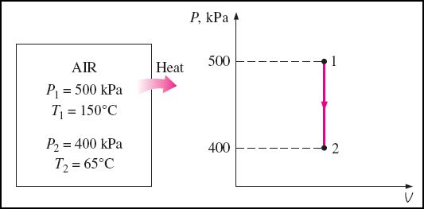
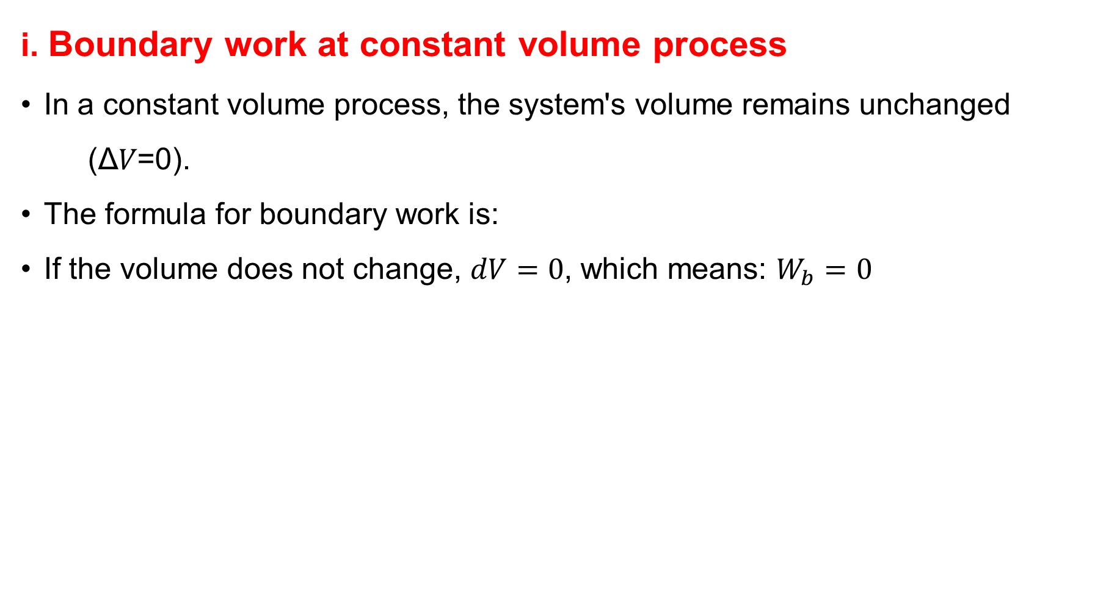
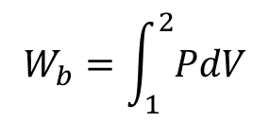
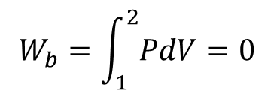
6. Some Typical Processes
i. Boundary work at constant volume process
In a constant volume process, the system's volume remains unchanged
(Δ𝑉=0).
The formula for boundary work is:
If the volume does not change, $dV=0$, which means: $W_{b}=0$
$$W_{b}=\int_{1}^{2}{PdV}$$
$$W_{b}=\int_{1}^{2}{PdV}=0$$
Figure 5: Boundary work at constant volume
url: https://slideplayer.com/slide/15258439/92/images/5/Some+Typical+Processes+Constant+volume.jpg

Slide 27
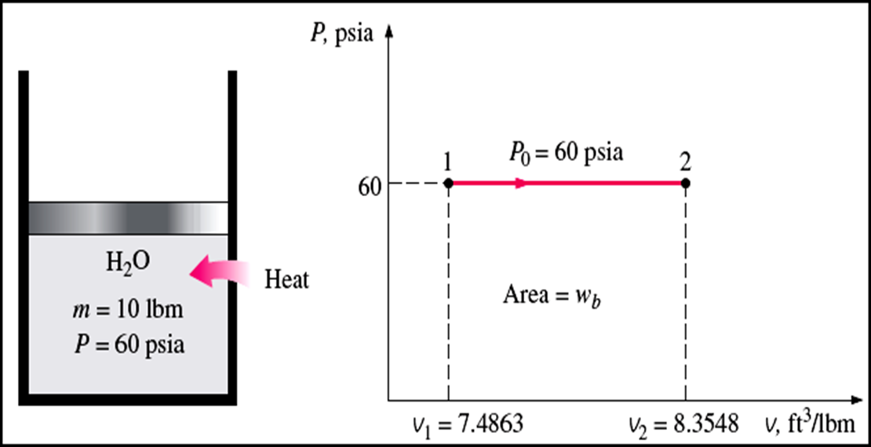
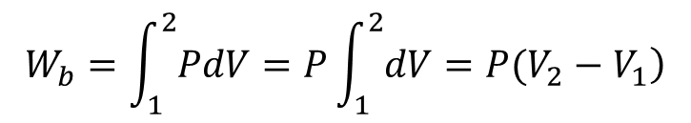
6. Some Typical Processes Cont…
ii. Boundary work at constant pressure
In a constant pressure process, the pressure (P) remains unchanged while the system's volume changes.
This is a common scenario in thermodynamic processes, such as the expansion or compression of a gas under constant atmospheric pressure.
$$W_{b}=\int_{1}^{2}{PdV}=P\int_{1}^{2}{\left.dV=P(V_{2}−V_{1}\right)}$$
Figure 6: Boundary work at constant pressure
url:https://slideplayer.com/slide/15258439/92/images/6/Constant+pressure+If+the+pressure+is+held+constant%2C+the+boundary+work+equation+becomes..jpg

Slide 28
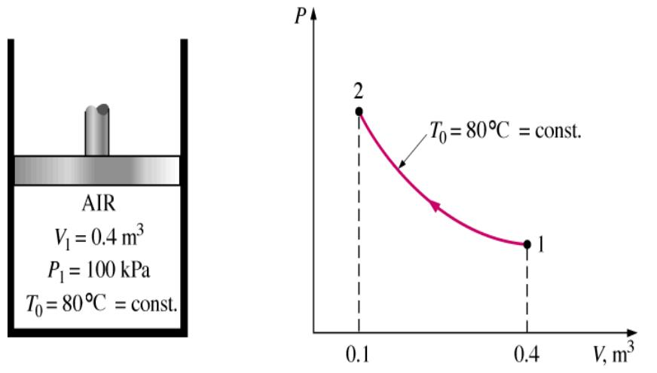
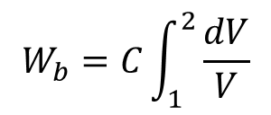

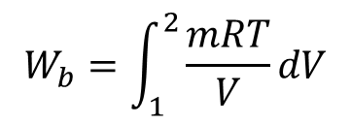
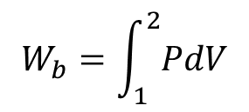
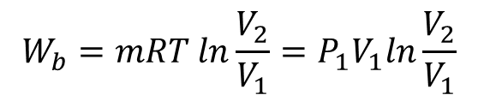
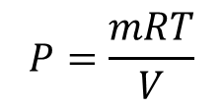
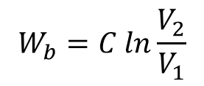
6. Some Typical Processes Cont…
iii. Boundary work at constant Temperature
If the temperature of an ideal gas system held constant, then the equation of state provides the pressure volume relation.
$$P=\frac{mRT}{V}$$
$$W_{b}=\int_{1}^{2}{PdV}$$
$$W_{b}=\int_{1}^{2}{\frac{mRT}{V}dV}$$
$$mRT=C=PV$$
$$W_{b}=C\int_{1}^{2}{\frac{dV}{V}}$$
$$W_{b}=C ln\frac{V_{2}}{V_{1}}$$
$$W_{b}=mRT ln\frac{V_{2}}{V_{1}}=P_{1}V_{1}ln\frac{V_{2}}{V_{1}}$$
Figure 7: Boundary work at constant temperature
url: https://slideplayer.com/slide/15258439/92/images/7/Constant+temperature%2C+ideal+gas.jpg

Slide 29
6. Some Typical Processes Cont…
iv. Polytropic Process
During actual expansion and compression processes of gases, pressure and volume are often related by PV^{n} = C. where n and C are constants.
This equation describes a wide range of thermodynamic processes by varying the value of n.
It’s used to analyze real-world systems like gas compressors, turbines, and engines.
The polytropic process encompasses other familiar processes as specific case [4]:
    𝑛=0: Constant pressure process (𝑃=constant).
    𝑛=1: Isothermal process (𝑇=constant).
    𝑛=∞: Constant volume process (𝑉=constant).
    𝑛=𝛾 (ratio of specific heats): Adiabatic process

Slide 30

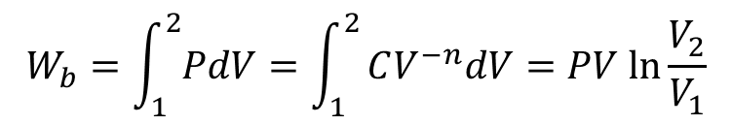
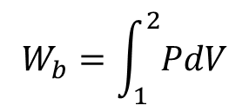
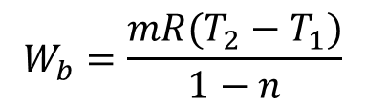
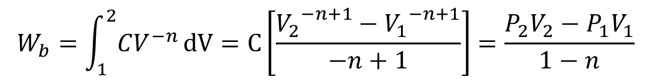

6. Some Typical Processes Cont…
Polytropic Process
$$W_{b}=\int_{1}^{2}{PdV}$$
, and,
For the special case of n = 1, the system is isothermal process and the boundary work becomes
$${PV}^{n}=C$$
$$P=CV^{−n}$$
$$W_{b}=\int_{1}^{2}{CV^{−n}}dV=C\left[\frac{{V_{2}}^{−n+1}−{V_{1}}^{−n+1}}{−n+1}\right]=\frac{P_{2}V_{2}−P_{1}V_{1}}{1−n}$$
$$W_{b}=\frac{mR(T_{2}−T_{1})}{1−n}$$
$$W_{b}=\int_{1}^{2}{PdV}=\int_{1}^{2}{CV^{−n}dV=PV ln\frac{V_{2}}{V_{1}}}$$

Slide 31
6. Some Typical Processes Cont…
v. Spring Work
Spring work refers to the work done when a spring is either stretched or compressed from its equilibrium position.
If the spring is stretched or compressed, the work is stored as potential energy in the spring.
The direction of the force determines whether the work is positive or negative:
  Positive work: External force stretches or compresses the spring.
  Negative work: The spring itself does work while returning to its equilibrium position.

Slide 32
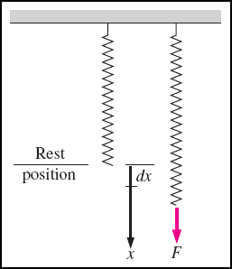
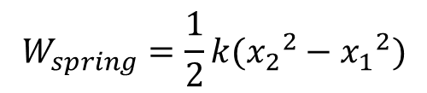

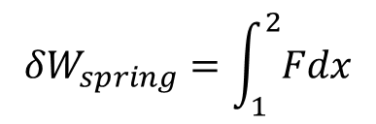
6. Some Typical Processes Cont…
Spring Work
Springs follow Hooke's Law, which states that the force required to stretch or compress a spring is proportional to the displacement (x) [5].
When the length of the spring changes by a differential amount dx under the influence of a force F, the work done is
$${δW}_{spring}=\int_{1}^{2}{Fdx}$$
$$F=kx$$
$$W_{spring}=\frac{1}{2}k({x_{2}}^{2}−{x_{1}}^{2})$$
  Figure 8: Spring work
  url: https://slideplayer.com/slide/14310633/89/images/32/When+the+length+of+the+spring+changes+by+a+differential+amount+dx+under+the+influence+of+a+force+F%2C+the+work+done+is.jpg

Slide 33
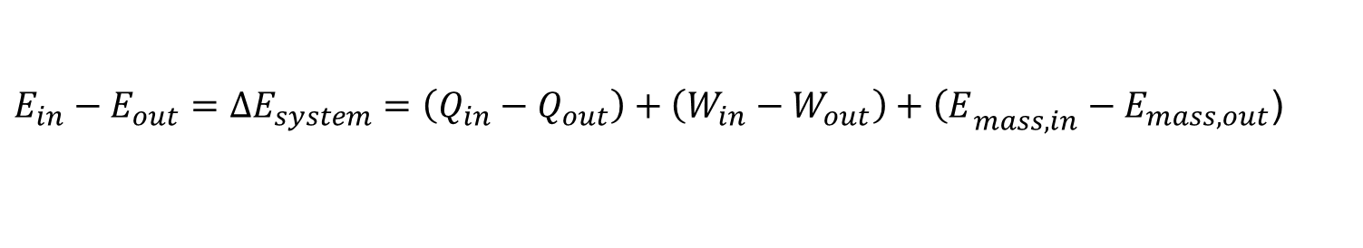

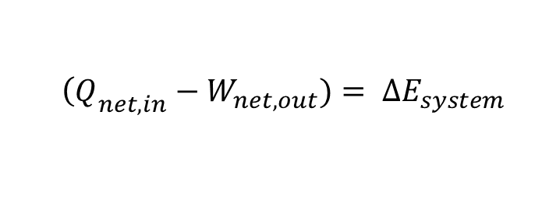
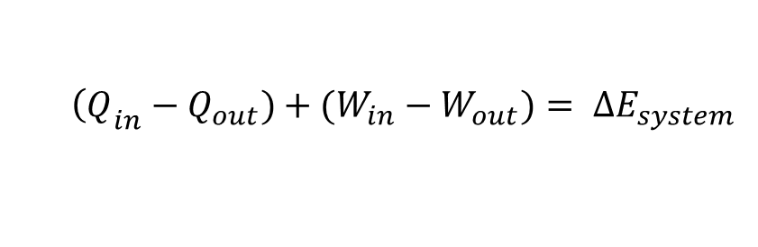
7. The First Law for a Closed System
The general energy balance equation
It can be more explicitly expressed as:
Therefore, for a closed system where mass never crosses the boundary of the system, the energy balance reduces to:
Where,
$$E_{in}−E_{out}=ΔU+ΔKE+ΔPE$$
$E_{in}−E_{out}=∆E_{system}=\left(Q_{in}−Q_{out}\right)+\left(W_{in}−W_{out}\right)+{\left(E\right.}_{mass,in}−E_{mass,out}$)
$$E_{in}−E_{out}=∆E_{system}=\left(Q_{in}−Q_{out}\right)+\left(W_{in}−W_{out}\right)$$
$${\left(Q\right.}_{in}−Q_{out})+(W_{in}−W_{out})= ∆E_{system}$$
$${\left(Q\right.}_{net,in}−W_{net,out})= ∆E_{system }$$
$$Q_{net,in}={Q_{in}−Q_{out} and, W}_{net,out}=W_{out}−W_{in}$$

Slide 34
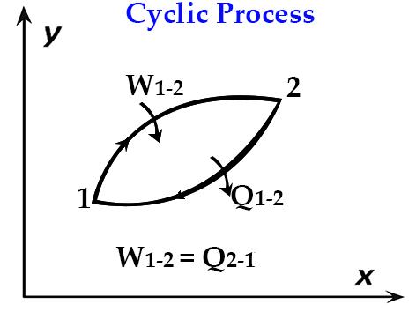




7. The First Law for a Closed System Cont…
For closed systems undergoing cyclic processes, the initial and final states are identical and the energy balance equation becomes:
$$∆E_{system}=E_{2}−E_{1}=0$$
$$E_{in}−E_{out}=0$$
$$E_{in}=E_{out}$$
${W_{net,out}=Q}_{net,in}=Q_{in}{−Q}_{out}$
  Figure 9: Cyclic Process
  url:https://blogger.googleusercontent.com/img/b/R29vZ2xl/AVvXsEhkh5h8_t8lo_f4j_WBmTC1TWJCDr2_JSaslO-y1ZK2Qque9pwvFAJZ7AVH64sO9h1BmGLb1oug3pwLls615ylbsTLu9tswyhbt_M7onIfrEvto2rSjoR7nQxqnTp2vZBvYhIB0eqr-LrU/s1600/Cyclic+process.png

Slide 35
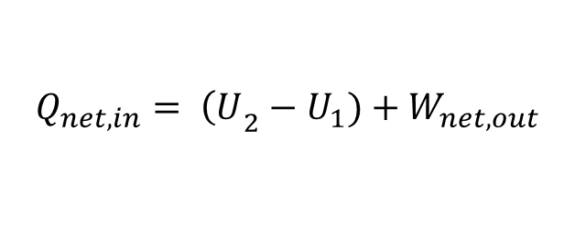
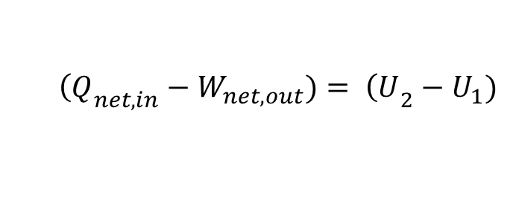

7. The First Law for a Closed System Cont…
If the closed system consists of internal energy, kinetic energy and potential energy, the total energy of the system becomes:
If the change in kinetic and potential energies are negligible,
or,
$$E_{in}−E_{out}=ΔU+ΔKE+ΔPE$$
$$E_{in}−E_{out}=∆E_{system}=\left(Q_{in}−Q_{out}\right)+\left(W_{in}−W_{out}\right)$$
$${\left(Q\right.}_{net,in}−W_{net,out})= {\left(U\right.}_{2}−U_{1})+(m\frac{{V_{2}}^{2}−{V_{1}}^{2}}{2})+mg(z_{2}−z_{1})$$
$${\left(Q\right.}_{net,in}−W_{net,out})= {\left(U\right.}_{2}−U_{1})$$
$$Q_{net,in}= {\left(U\right.}_{2}−U_{1})+W_{net,out}$$

Slide 36
Summary
The First Law of Thermodynamics is introduced and its significance in energy conservation is explained.
Energy of a system can be grouped into microscopic and macroscopic forms.
In thermodynamics, energy transfer mechanisms for closed systems are heat transfer and work, and for open systems, in addition to heat transfer and work, there is a mass transfer.
Boundary work is the work associated with a moving boundary.
Typical processes of boundary work are at constant volume, constant pressure, constant temperature, polytropic process and spring work.
Application of energy conservation equations to closed systems without mass transfer, with examples like piston-cylinder devices.

Slide 37
References
[1]. Thermodynamics – An Engineering Approach, Cengel Y A.,Bole M A., McGraw-Hill Education, 8th edition 2015.
[2]. First Law of Thermodynamics, Bahman Zohuri, Physics of Cryogenics, 2018, Pages 119-163, https://doi.org/10.1016/B978-0-12-814519-7.00005-7.
[3]. Advanced Thermodynamics for Engineers, Winterbone, Ali Turan, Butterworth-Heinemann, 2015, Pages 1-12, https://doi.org/10.1016/B978-0-444-63373-6.00001-0.
[4]. Wonders of Thermodynamics: Energy, Heat, Physics Formula and Entropy, Gaurav Mehra,vocal.media/education,2023,https://issuu.com/gauravm1612/docs/wonders_of_thermodynamics_energy_heat_physics_f/1,(Viewed March 2025)
[5]. Fundamentals of Thermal and Nuclear Power Generation, Tomio Okawa, Hitoshi Asano, JSME Series in Thermal and Nuclear Power Generation, Volume 1, 2021, Pages 77-226, https://doi.org/10.1016/B978-0-12-820733-8.00003-0.

Slide 38
Thank you !

