Slide 1
Engineering Thermodynamics I
Lecture 4
First Law of Thermodynamics and Energy
Lecturer: Dr. Melaku Desta

Slide 2
Lecture learning outcomes:
At the end of this lecture, you will be able to:
Understand the first law of thermodynamics and its implications for energy conservation.
Define specific heats, internal energy, and enthalpy, and explain their significance in thermodynamic systems.
Distinguish between specific heats of ideal gases, solids, and liquids, including their practical applications.
Apply the first law of thermodynamics to control volumes in different engineering scenarios.
Solve thermodynamic problems using formulas and concepts introduced in this lecture.

Slide 3
Content
Internal Energy and Enthalpy
Specific Heats
Internal Energy, Enthalpy, and Specific Heats of Ideal Gases
Internal Energy, Enthalpy, and Specific Heats of Solids and Liquids
The First Law and the Control Volume
Flow Work and the Energy of a Flowing Fluid
Some Steady-Flow Engineering Devices
Summary
References

Slide 4
1. Internal Energy and Enthalpy
Internal Energy
Internal energy (U) represents the total microscopic energy contained within a system due to the motion and interactions of its molecules. It includes:
  Kinetic energy: from the movement of molecules and atoms, such as their vibrations, rotations, and translations.
  Potential energy: arising from the interactions between particles, like chemical bonds and intermolecular forces.
Internal energy is a state function, meaning it depends only on the current state of the system (temperature, pressure, phase, etc.), not on the path taken to reach that state.

Slide 5
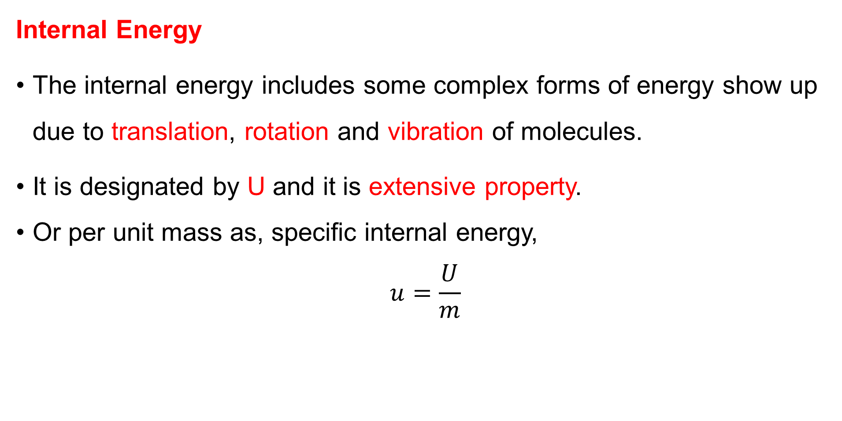
1. Internal Energy and Enthalpy Cont…
Internal Energy
The internal energy includes some complex forms of energy show up due to translation, rotation and vibration of molecules.
It is designated by U and it is extensive property.
Or per unit mass as, specific internal energy,
$$u=\frac{U}{m}$$

Slide 6
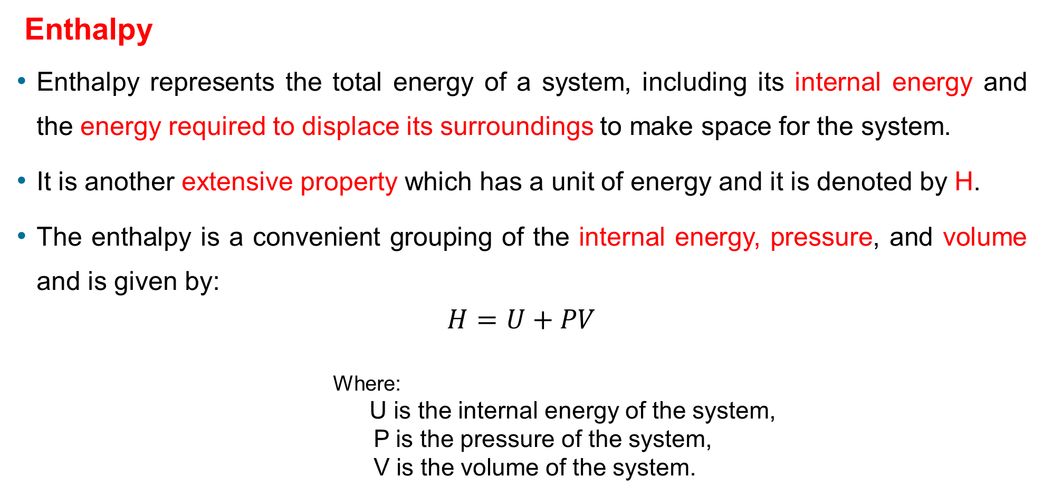
1. Internal Energy and Enthalpy Cont…
Enthalpy
Enthalpy represents the total energy of a system, including its internal energy and the energy required to displace its surroundings to make space for the system.
It is another extensive property which has a unit of energy and it is denoted by H.
The enthalpy is a convenient grouping of the internal energy, pressure, and volume and is given by:
$$H=U+PV$$
                Where:
                U is the internal energy of the system,
                P is the pressure of the system,
                V is the volume of the system.

Slide 7
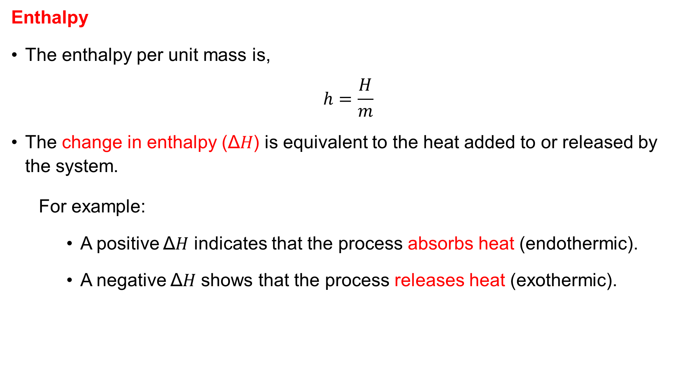
1. Internal Energy and Enthalpy Cont…
Enthalpy
The enthalpy per unit mass is,
$$h=\frac{H}{m}$$
The change in enthalpy (Δ𝐻) is equivalent to the heat added to or released by the system.
  For example:
    A positive Δ𝐻 indicates that the process absorbs heat (endothermic).
    A negative Δ𝐻 shows that the process releases heat (exothermic).

Slide 8
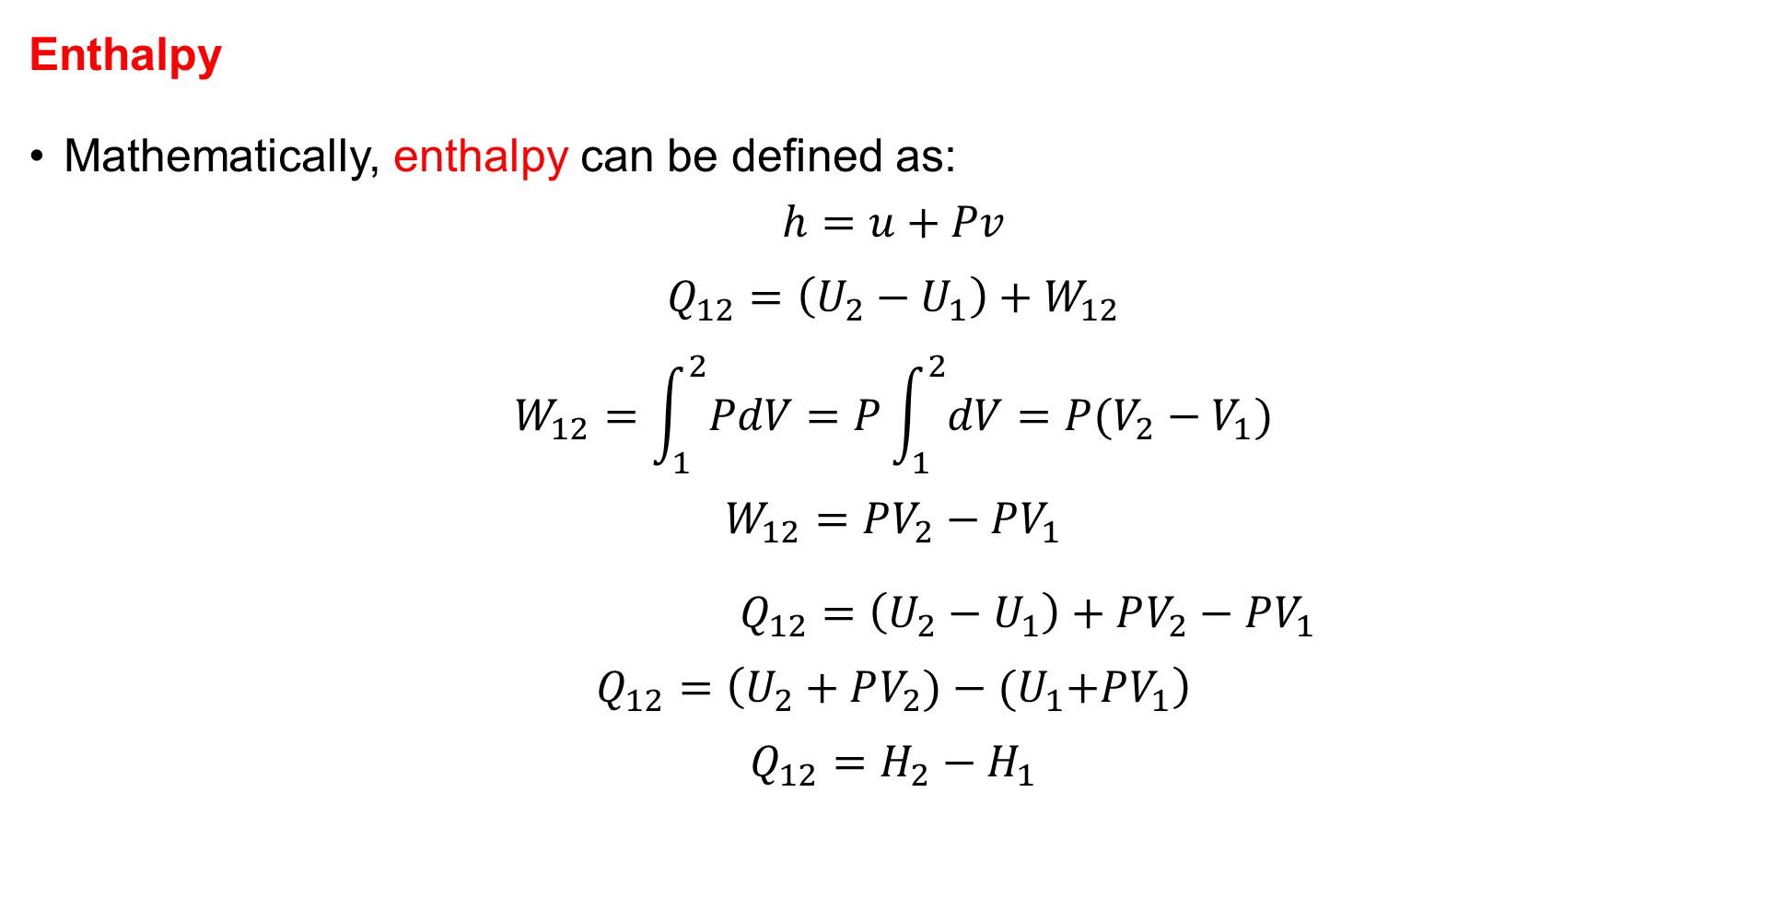
1. Internal Energy and Enthalpy Cont…
Enthalpy
Mathematically, enthalpy can be defined as:
$$h=u+Pv$$
$$Q_{12}=\left(U_{2}−U_{1}\right)+W_{12}$$
$$W_{12}=\int_{1}^{2}{PdV}=P\int_{1}^{2}{dV=P(V_{2}−V_{1})}$$
$$W_{12}=PV_{2}−PV_{1}$$
$Q_{12}=\left(U_{2}−U_{1}\right)+PV_{2}−PV_{1}$
$$Q_{12}=\left(U_{2}+PV_{2})−{(U}_{1}+PV_{1}\right)$$
$$Q_{12}=H_{2}−H_{1}$$

Slide 9
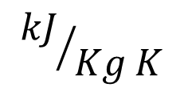
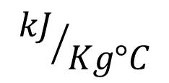
2. Specific Heat
Specific heat is defined as; the energy required to raise the temperature of a unit mass of a substance by one degree [1].
It is an intensive property of a substance that will enable us to compare the energy storage capability of various substances. The unit is:
or
In thermodynamics, we are interested in two kinds of specific heats:
  specific heat at constant volume, and
  specific heat at constant pressure
$${kJ}/{Kg°C}$$
$${kJ}/{Kg K}$$

Slide 10
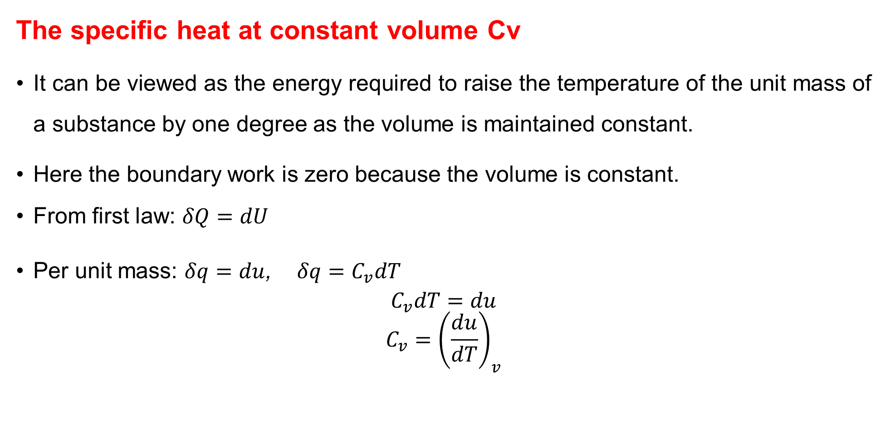
2. Specific Heat Cont…
The specific heat at constant volume Cv
It can be viewed as the energy required to raise the temperature of the unit mass of a substance by one degree as the volume is maintained constant.
Here the boundary work is zero because the volume is constant.
From first law: $δQ=dU$
Per unit mass: $δq=du$, $δq=C_{v}dT$
$$C_{v}dT=du$$
$$C_{v}={\left(\frac{du}{dT}\right)}_{v}$$

Slide 11
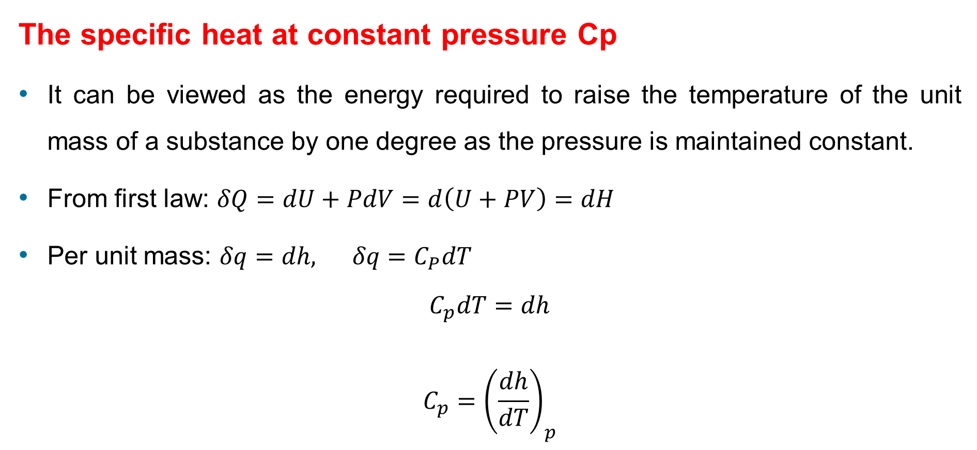
2. Specific Heat Cont…
The specific heat at constant pressure Cp
It can be viewed as the energy required to raise the temperature of the unit mass of a substance by one degree as the pressure is maintained constant.
From first law: $δQ=dU+PdV=d\left(U+PV\right)=dH$
Per unit mass: $δq=dh, δq=C_{P}dT$
$$C_{p}dT=dh$$
$$C_{p}={\left(\frac{dh}{dT}\right)}_{p}$$

Slide 12
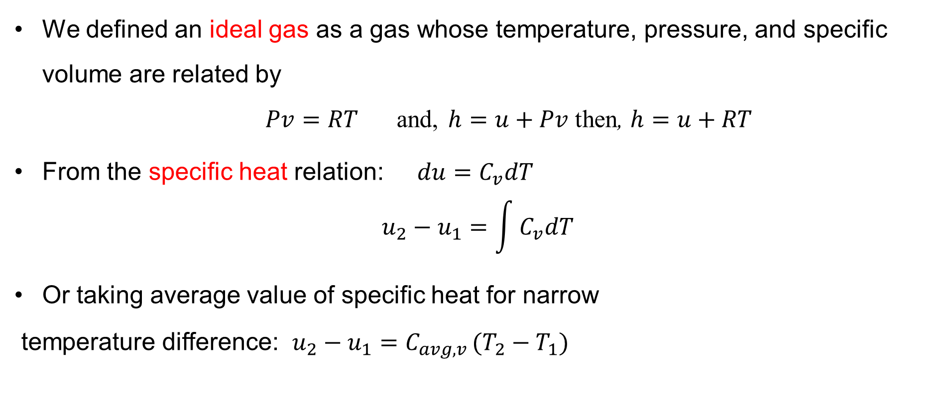
3. Internal Energy, Enthalpy, and Specific Heats of Ideal Gases
We defined an ideal gas as a gas whose temperature, pressure, and specific volume are related by
$Pv=RT$and, $h=u+Pv$ then, $h=u+RT$
From the specific heat relation: $du=C_{v}dT$
$$u_{2}−u_{1}=\int{C_{v}dT}$$
Or taking average value of specific heat for narrow
temperature difference: $u_{2}−u_{1}=C_{avg,v }(T_{2}−T_{1})$

Slide 13
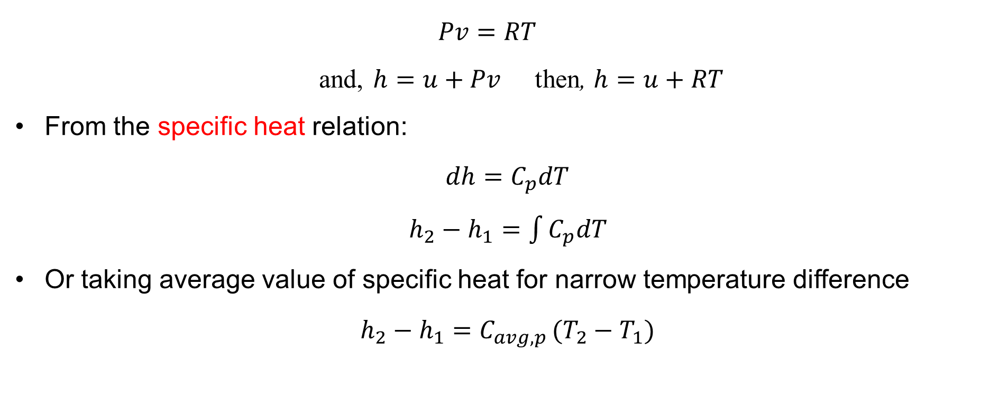
3. Internal Energy, Enthalpy, and Specific Heats of Ideal Gases Cont…
$$Pv=RT$$
and, $h=u+Pv$ then, $h=u+RT$
From the specific heat relation:
$${dh=C}_{p}dT$$
$h_{2}−h_{1}=\int{C_{p}dT}$
Or taking average value of specific heat for narrow temperature difference
$$h_{2}−h_{1}=C_{avg,p }(T_{2}−T_{1})$$

Slide 14
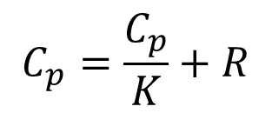
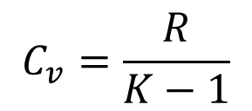


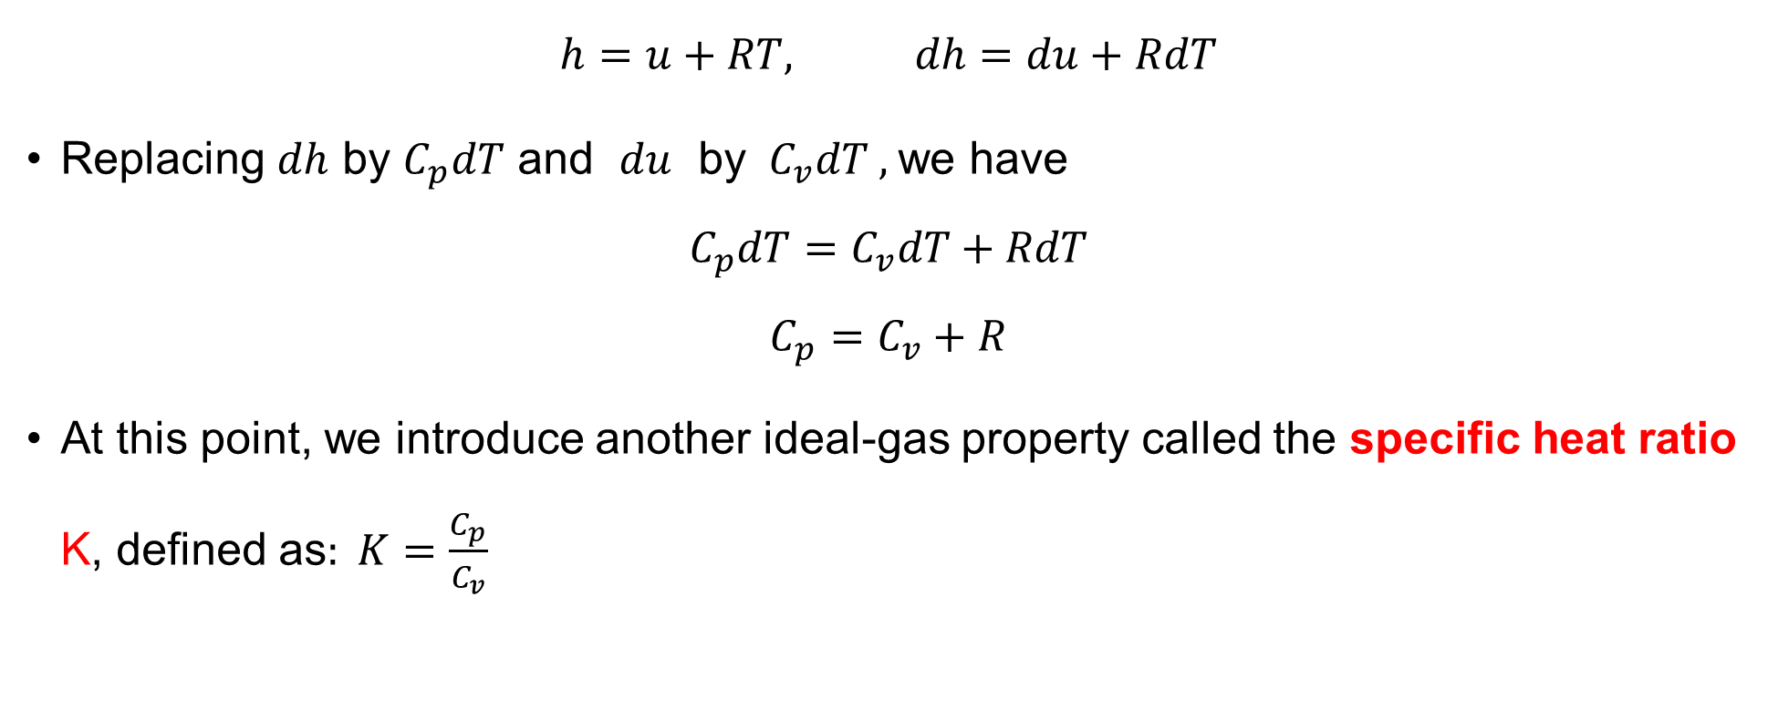
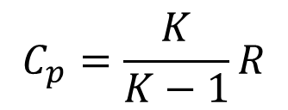
3. Internal Energy, Enthalpy, and Specific Heats of Ideal Gases Cont…
Relation between C_{P} and C_{V} for Ideal Gases
$$h=u+RT, dh=du+RdT$$
Replacing $dh$ by $C_{p}dT$ and $du$ by $C_{v}dT ,$we have
$$C_{p}dT=C_{v}dT+RdT$$
$$C_{p}=C_{v}+R$$
At this point, we introduce another ideal-gas property called the specific heat ratio K, defined as$: K=\frac{C_{p}}{C_{v}}$
$$C_{p}=KC_{v}$$
$${KC}_{v}=C_{v}+R$$
$$C_{v}=\frac{R}{K−1}$$
$$C_{p}=\frac{C_{p}}{K}+R$$
$$C_{p}=\frac{K}{K−1}R$$

Slide 15
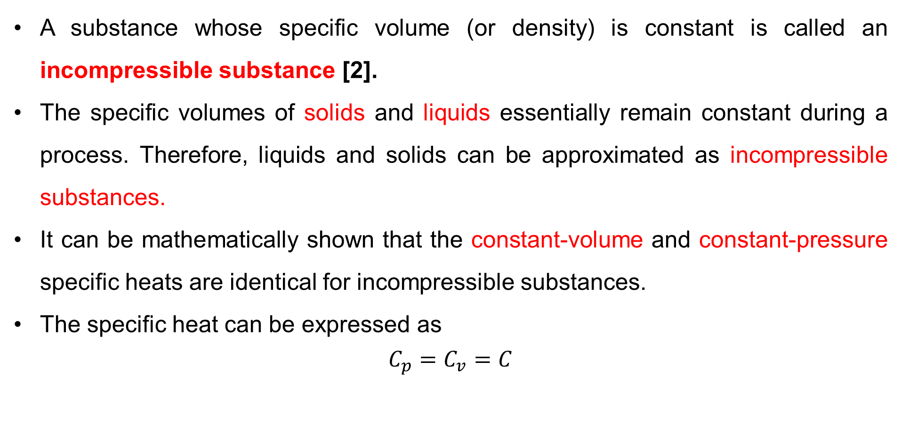
4. Internal Energy, Enthalpy, and Specific Heats of Solids and Liquids
A substance whose specific volume (or density) is constant is called an incompressible substance [2].
The specific volumes of solids and liquids essentially remain constant during a process. Therefore, liquids and solids can be approximated as incompressible substances.
It can be mathematically shown that the constant-volume and constant-pressure specific heats are identical for incompressible substances.
The specific heat can be expressed as
$$C_{p}=C_{v}=C$$

Slide 16
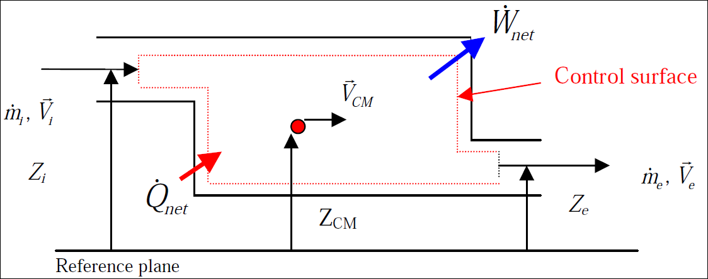
5. The First Law and the Control Volume
The conservation of mass and the conservation of energy principles for open systems or control volumes apply to systems having mass crossing the system boundary or control surface.

Slide 17
5. The First Law and the Control Volume Cont…
In addition to the heat transfer and work crossing the system boundaries, mass carries energy with it as it crosses the system boundaries.
Hence the conservation of mass principle can be used to relate mass which entering and leaving a system.
The net mass transfer to or from a control volume during a process (at time interval t) is equal to the net change (increase or decrease) in the total mass within the control volume during that process (t) [1]. That is,
$\left(\begin{aligned}Total mass Entering \\ the CV during Δt\end{aligned}\right)$- $\left(\begin{aligned}Total mass Leaving \\ the CV during Δt\end{aligned}\right)=\left(\begin{aligned}Net Change in mass \\ within the CV during Δt\end{aligned}\right)$

Slide 18
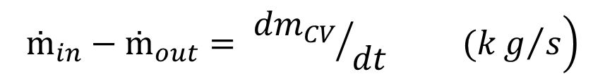
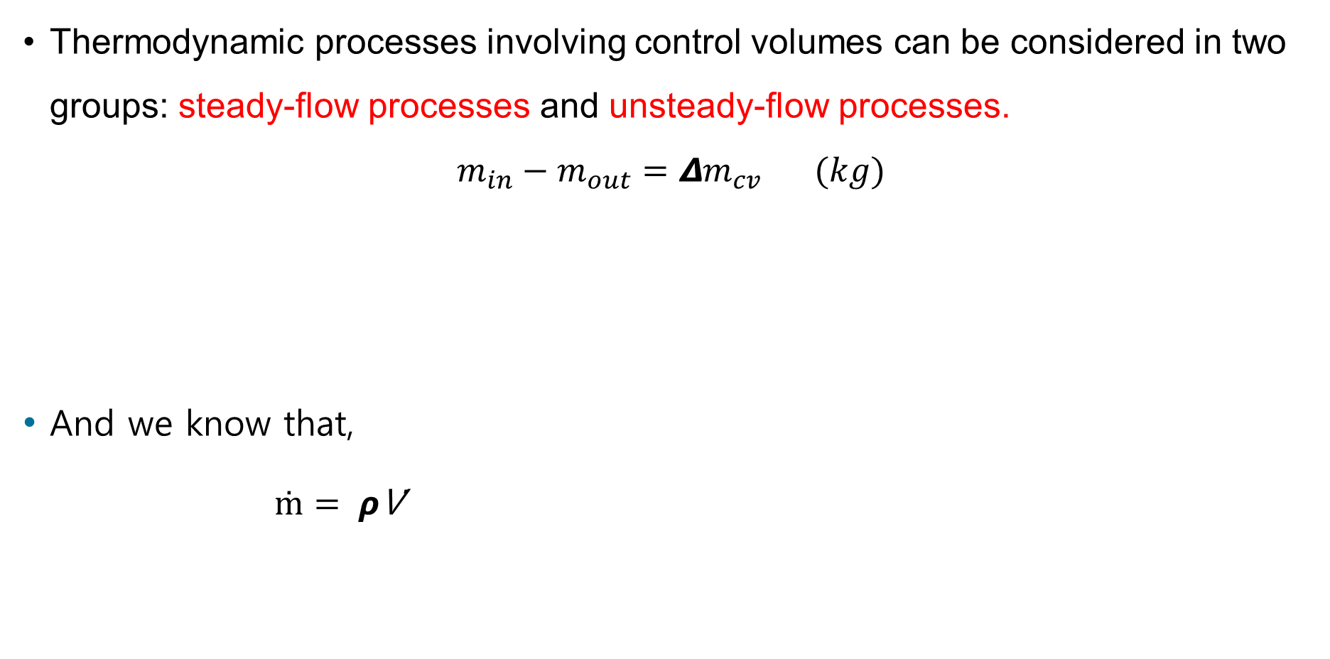
5. The First Law and the Control Volume Cont…
Thermodynamic processes involving control volumes can be considered in two groups: steady-flow processes and unsteady-flow processes.
$$m_{in}−m_{out}=Δm_{cv }(kg)$$
And we know that,
$ṁ= ρ$V̇
$$\left.ṁ_{in}−ṁ_{out}= {{dm}_{CV}}/{dt} (kg/s\right)$$

Slide 19
5. The First Law and the Control Volume Cont…
Steady State Processes
The flow through a control volume is at steady state if, “the property of the substance at a given position within or at the boundaries of the control volume do not change with time” [3].
During a steady-flow process, the total amount of mass contained within a control volume does not change with time (m_{CV}= constant).
Although energy and mass may flow into and out of the system, the rates of inflow and outflow are balanced, and the system's state remains constant.

Slide 20
5. The First Law and the Control Volume Cont…
Steady State Processes
Key characteristics of steady state processes include:
  No accumulation: There is no net change in mass, energy, or other properties within the control volume.
  Time invariance: The system's properties (pressure, temperature, velocity, etc.) at a given point remain constant over time.
  Mass and energy conservation: The incoming and outgoing flows of mass and energy are equal, ensuring equilibrium.

Slide 21

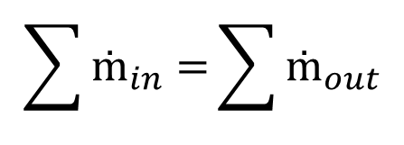
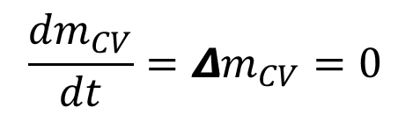

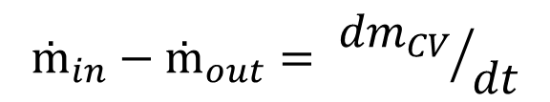

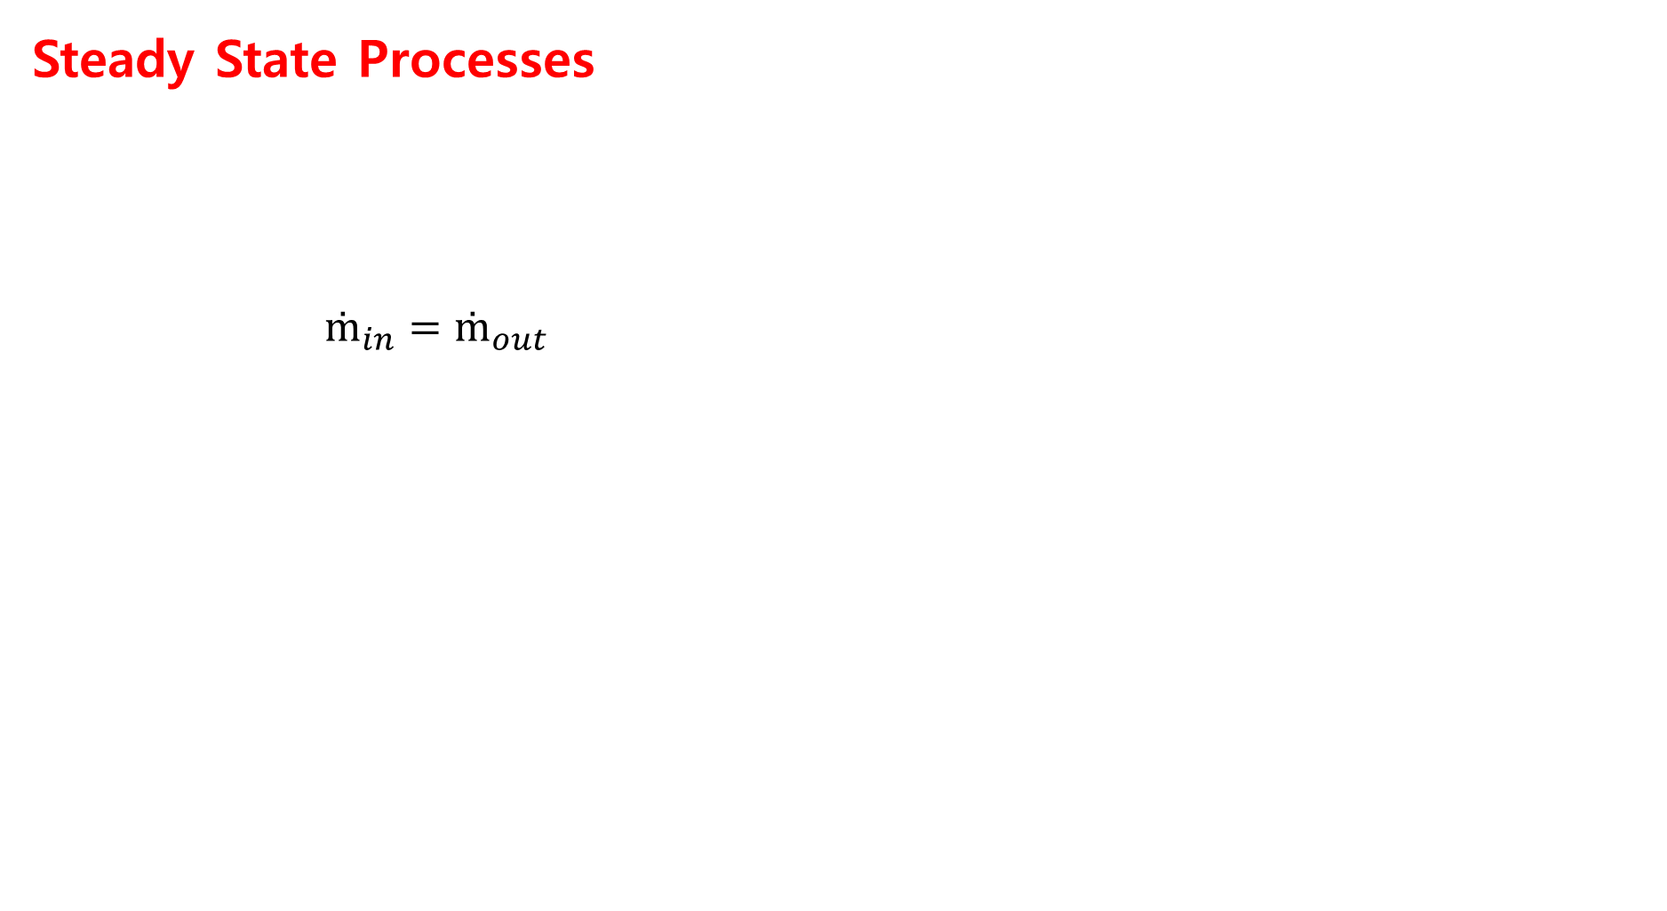

5. The First Law and the Control Volume Cont…
Steady State Processes
$ṁ_{in}=ṁ_{out}$
$$ṁ_{in}−ṁ_{out}= {{dm}_{CV}}/{dt}$$
$$\frac{{dm}_{CV}}{dt}=Δm_{CV}=0$$
$$\sum{ṁ_{in}=}\sum{ṁ_{out}}$$
$$ρ_{in}{V̇}_{in}=ρ_{out}{V̇}_{out}$$
$$ρ_{in}=ρ_{out}, incompressible assumption$$
$$V_{in}=V_{out}$$
$${v⃗}_{in}A_{in}={v⃗}_{out}A_{out}$$

Slide 22
5. The First Law and the Control Volume Cont…
Unsteady State Process
Unsteady state processes, also known as transient processes, are those in which the properties of a system change with time.
The properties within the control volume change with time but remain uniform at any instant of time.
Unlike steady state processes, the system is not in equilibrium, and the variables such as temperature, pressure, mass flow, or energy vary until the system reaches a new equilibrium or steady state.

Slide 23
5. The First Law and the Control Volume Cont…
Key Features of Unsteady State Processes
  Time Dependence: The properties and behavior of the system are functions of time.
  Dynamic Changes: Mass, energy, or momentum can accumulate or deplete in the system.
  Control Volume: The first law of thermodynamics (energy balance) must consider changes over time. For example:
Example:- filling and empting processes where most of the cases average value of properties must be used

Slide 24
6. Flow Work and The Energy of a Flowing Fluid
Flow work, also known as flow energy, is the work required to move a fluid into or out of a control volume in thermodynamic systems [4].
Unlike closed systems, control volumes involve mass flow across their boundaries, and some work is required to push the mass into or out of the control volume.
This concept is especially important when analyzing systems with mass transfer, such as turbines, compressors, and pipes.

Slide 25
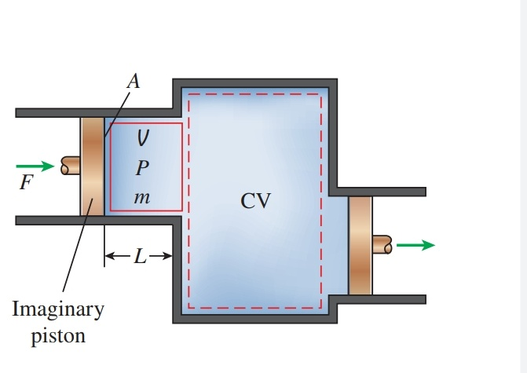
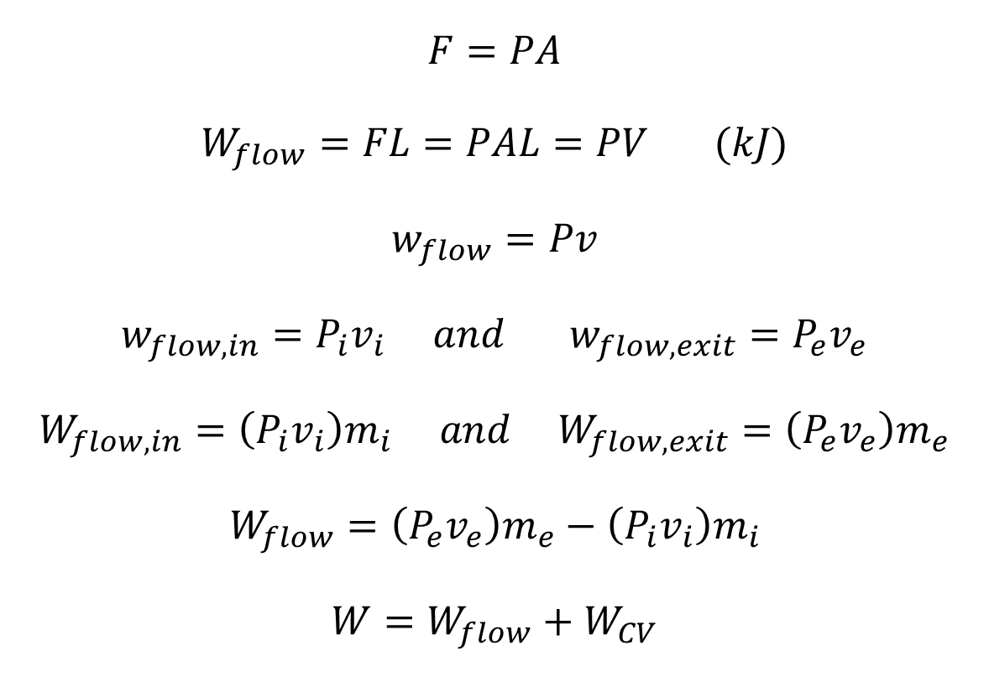
6. Flow Work and The Energy of a Flowing Fluid Cont…
$$F=PA$$
$$W_{flow}=FL=PAL=PV (kJ)$$
$$w_{flow}=Pv$$
$$w_{flow,in}=P_{i}v_{i} and w_{flow,exit}=P_{e}v_{e}$$
$$W_{flow,in}=\left(P_{i}v_{i}\right)m_{i} and W_{flow,exit}=\left(P_{e}v_{e}\right)m_{e}$$
$$W_{flow}=\left(P_{e}v_{e}\right)m_{e}−\left(P_{i}v_{i}\right)m_{i}$$
$$W=W_{flow}+W_{CV}$$
Figure 1: Schematic for Flow work
url: https://i.sstatic.net/1vwGW.jpg

Slide 26
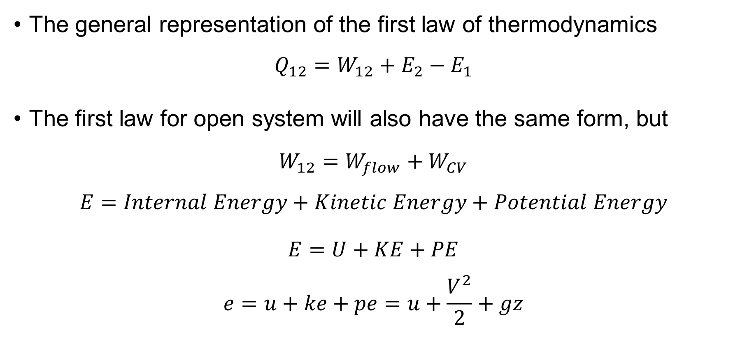
6. Flow Work and The Energy of a Flowing Fluid Cont…
  Development of energy balance
The general representation of the first law of thermodynamics
$$Q_{12}=W_{12}+E_{2}−E_{1}$$
The first law for open system will also have the same form, but
$$W_{12}=W_{flow}+W_{CV}$$
$$E=Internal Energy+Kinetic Energy+Potential Energy$$
$$E=U+KE+PE$$
$$e=u+ke+pe=u+\frac{V^{2}}{2}+gz$$

Slide 27
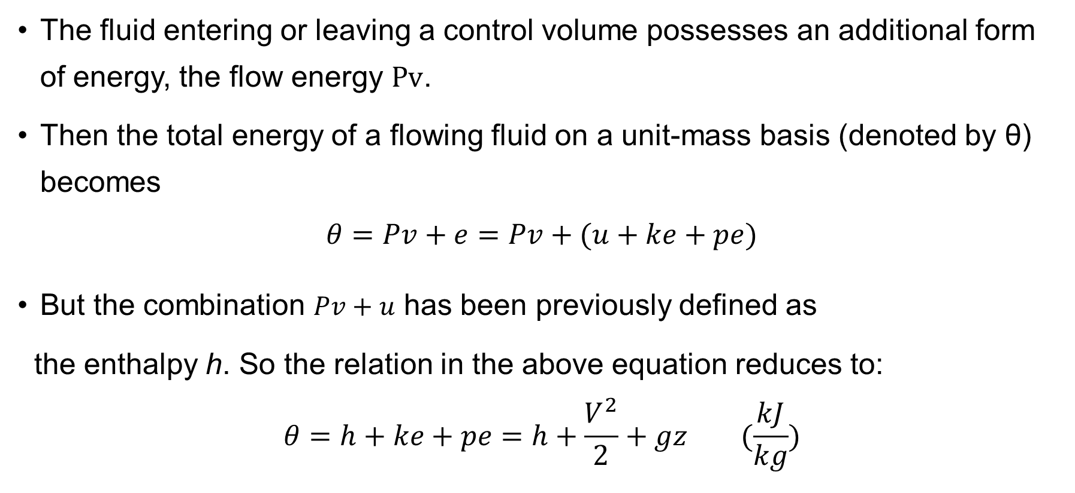
6. Flow Work and The Energy of a Flowing Fluid Cont…
  Development of energy balance
The fluid entering or leaving a control volume possesses an additional form of energy, the flow energy $Pv$.
Then the total energy of a flowing fluid on a unit-mass basis (denoted by θ) becomes
$$θ=Pv+e=Pv+(u+ke+pe)$$
But the combination $Pv+u$ has been previously defined as
the enthalpy h. So the relation in the above equation reduces to:
$$θ=h+ke+pe=h+\frac{V^{2}}{2}+gz (\frac{kJ}{kg})$$

Slide 28
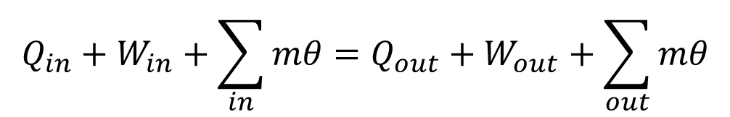
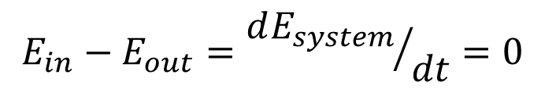
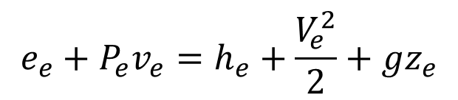
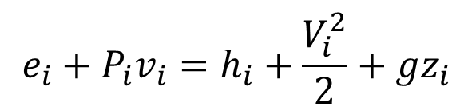
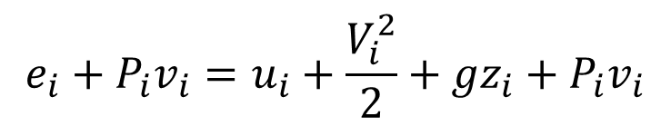
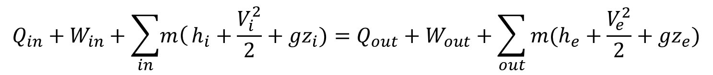
6. Flow Work and The Energy of a Flowing Fluid Cont…
For inlet
For outlet
General equation
$$e_{i}+P_{i}v_{i}=u_{i}+\frac{V_{i}^{2}}{2}+{gz}_{i}+P_{i}v_{i}$$
$$e_{i}+P_{i}v_{i}=h_{i}+\frac{V_{i}^{2}}{2}+{gz}_{i}$$
$$e_{e}+P_{e}v_{e}=h_{e}+\frac{V_{e}^{2}}{2}+{gz}_{e}$$
$$E_{in}−E_{out}={dE_{system}}/{dt}=0$$
$$Q_{in}+W_{in}+\sum_{in}{mθ}=Q_{out}+W_{out}+\sum_{out}{mθ}$$
$$Q_{in}+W_{in}+\sum_{in}{\left.m\right(}h_{i}+\frac{V_{i}^{2}}{2}+{gz}_{i})=Q_{out}+W_{out}+\sum_{out}{m(h_{e}+\frac{V_{e}^{2}}{2}+{gz}_{e})}$$

Slide 29
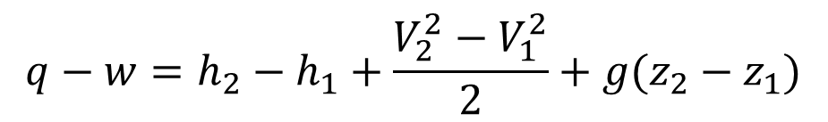
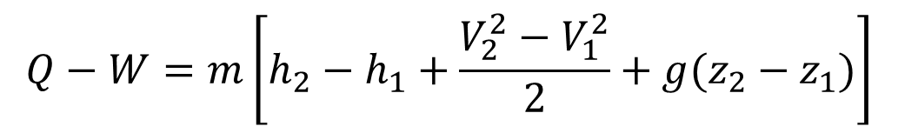
6. Flow Work and The Energy of a Flowing Fluid Cont…
In such cases, it is common practice to assume heat to be transferred into the system (heat input) at a rate of Q, and work produced by the system (work output) at a rate of W, and then solve the problem.
The first-law or energy balance relation in that case for a general steady-flow system becomes:
$$Q−W=m\left[h_{2}−h_{1}+\frac{V_{2}^{2}−V_{1}^{2}}{2}+g(z_{2}−z_{1})\right]$$
$$q−w=h_{2}−h_{1}+\frac{V_{2}^{2}−V_{1}^{2}}{2}+g(z_{2}−z_{1})$$

Slide 30



6. Flow Work and The Energy of a Flowing Fluid Cont…
When the fluid experiences negligible changes in its kinetic and potential energies:
That is, , and
,
the energy balance equation is reduced further to:
$$ke=0$$
$$pe=0$$
$$q−w=h_{2}−h_{1}$$

Slide 31
7. Some Steady-Flow Engineering Devices
i. Nozzles and Diffusers
Nozzles and diffusers are commonly utilized in jet engines, rockets, spacecraft, and even garden hoses.
  A nozzle is a device that increases the velocity of a fluid at the expense of pressure.
  A diffuser is a device that increases the pressure of a fluid by slowing it down.

Slide 32
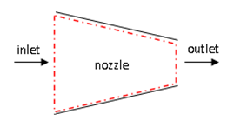
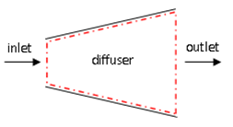



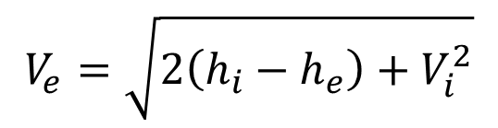
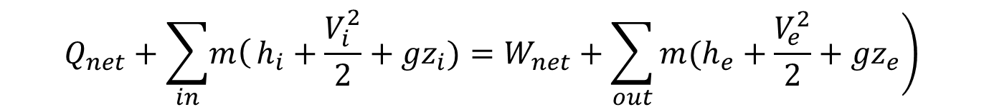
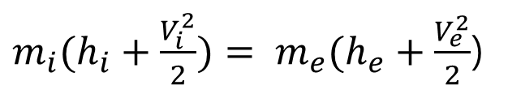
7. Some Steady-Flow Engineering Devices Cont…
i. Nozzles and Diffusers
$$ṁ_{in}=ṁ_{out}$$
$$ṁ_{1}=ṁ_{2}=ṁ$$
$$E_{in}=E_{out}$$
$$Q_{net}+\sum_{in}{\left.m\right(}h_{i}+\frac{V_{i}^{2}}{2}+{gz}_{i})=W_{net}+\sum_{out}{\left.m(h_{e}+\frac{V_{e}^{2}}{2}+{gz}_{e}\right)}$$
$m_{i}(h_{i}+\frac{V_{i}^{2}}{2})= m_{e}(h_{e}+\frac{V_{e}^{2}}{2}$)
Figure 2: Nozzle and Diffuser
url: https://qph.cf2.quoracdn.net/main-qimg-c58eea4e44590bb35e57d9081ae10470
$$V_{e}=\sqrt{2\left(h_{i}−h_{e}\right)+V_{i}^{2}}$$

Slide 33
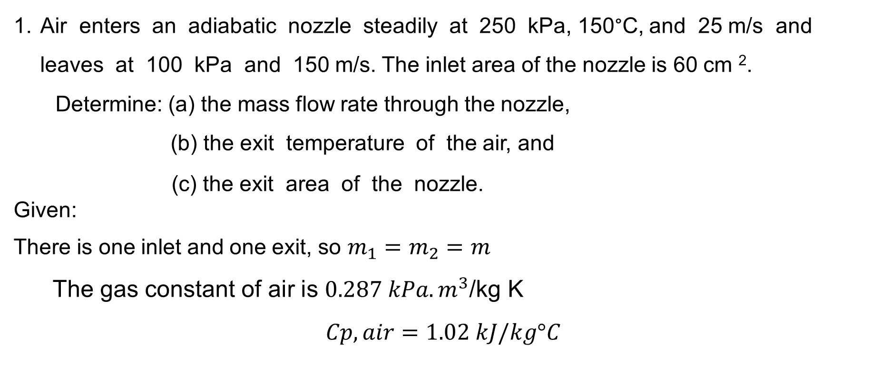
7. Some Steady-Flow Engineering Devices Cont…
Example:
Air enters an adiabatic nozzle steadily at 250 kPa, 150°C, and 25 m/s and leaves at 100 kPa and 150 m/s. The inlet area of the nozzle is 60 cm ².
Determine: (a) the mass flow rate through the nozzle,
(b) the exit temperature of the air, and
(c) the exit area of the nozzle.
Given:
There is one inlet and one exit, so $m_{1}=m_{2}=m$
The gas constant of air is $0.287 kPa.m^{3}$/kg K
$$Cp,air=1.02 kJ/kg°C$$

Slide 34
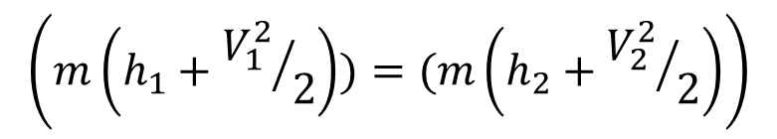
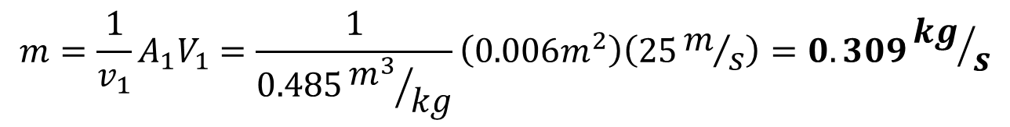
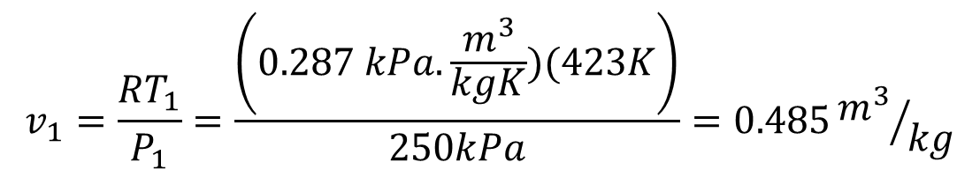

7. Some Steady-Flow Engineering Devices Cont…
Solution:
Using the ideal gas relation: $P_{1}v_{1}=RT_{1}$
$$v_{1}=\frac{RT_{1}}{P_{1}}=\frac{\left(0.287 kPa.\frac{m^{3}}{kgK})(423K\right)}{250kPa}=0.485{m^{3}}/{kg}$$
$$m=\frac{1}{v_{1}}A_{1}V_{1}=\frac{1}{0.485{m^{3}}/{kg}}\left(0.006m^{2}\right)\left(25m/s\right)=0.309{kg}/s$$
$$m=0.309{kg}/s$$
From the energy balance of nozzles,
$$\left(m\left(h_{1}+{V_{1}^{2}}/2\right))=(m\left(h_{2}+{V_{2}^{2}}/2\right)\right)$$

Slide 35

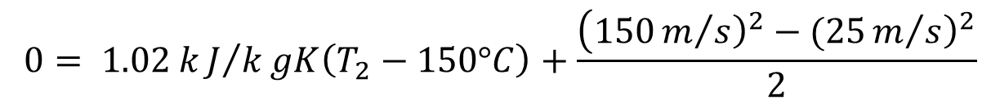
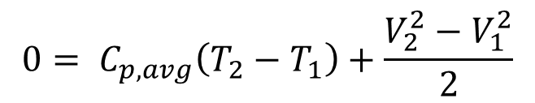
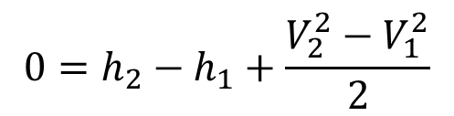
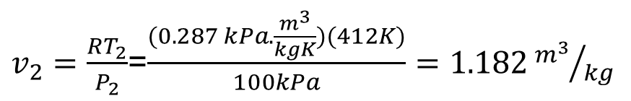
7. Some Steady-Flow Engineering Devices Cont…
S$ince Q=W=0,$
$$0=h_{2}−h_{1}+\frac{V_{2}^{2}−V_{1}^{2}}{2}$$
$$0= C_{p,avg}\left(T_{2}−T_{1}\right)+\frac{V_{2}^{2}−V_{1}^{2}}{2}$$
$$0= 1.02 kJ/kgK\left(T_{2}−150°C\right)+\frac{\left({\left.150m/s\right)}^{2}−({\left.25m/s\right)}^{2}\right.}{2}$$
Therefore, $T_{2}=139.3°C$
The specific volume of the air at the nozzle exit is
$v_{2}=\frac{RT_{2}}{P_{2}}$=$\frac{(0.287 kPa.\frac{m^{3}}{kgK})(412K)}{100kPa}=1.182{m^{3}}/{kg}$

Slide 36
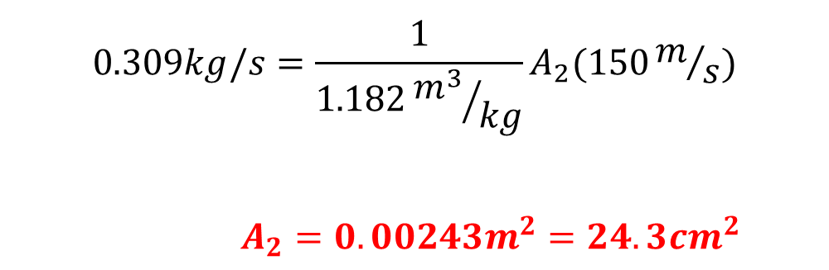

7. Some Steady-Flow Engineering Devices Cont…
Therefore, $m=\frac{1}{v_{2}}A_{2}V_{2}$
$$0.309kg/s=\frac{1}{1.182{m^{3}}/{kg}}A_{2}(150m/s)$$
$A_{2}=0.00243m^{2}=24.3{cm}^{2}$

Slide 37
7. Some Steady-Flow Engineering Devices Cont…
ii. Turbines
In steam, gas, or hydroelectric power plants, the device that drives the electric generator is the turbine.
As the fluid passes through the turbine, work is done against the blades, which are attached to the shaft. As a result, the shaft rotates, and the turbine produces work.

Slide 38
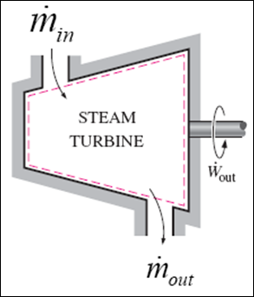
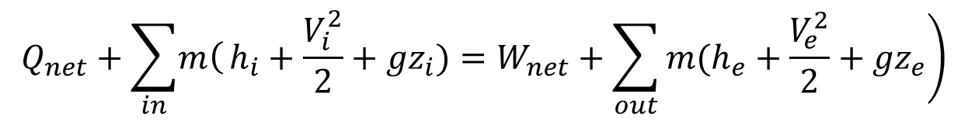





7. Some Steady-Flow Engineering Devices Cont…
ii. Turbines
$$E_{in}=E_{out}$$
$$Q_{net}+\sum_{in}{\left.m\right(}h_{i}+\frac{V_{i}^{2}}{2}+{gz}_{i})=W_{net}+\sum_{out}{\left.m(h_{e}+\frac{V_{e}^{2}}{2}+{gz}_{e}\right)}$$
$$ṁ_{in}=ṁ_{out}$$
$$m_{i}h_{i}= m_{e}h_{e}+W_{out}$$
$$ṁ_{1}=ṁ_{2}=ṁ$$
$$\left.W_{out}=m(h_{i}−h_{e}\right)$$
  Figure 3: A Steam Turbine [1]

Slide 39
7. Some Steady-Flow Engineering Devices Cont…
iii. Compressors
Compressors, as well as fans, are devices used to increase the pressure of a fluid.
Work is supplied to these devices from an external source through a rotating shaft.

Slide 40






7. Some Steady-Flow Engineering Devices Cont…
iii. Compressors
$$Q_{net}+\sum_{in}{\left.m\right(}h_{i}+\frac{V_{i}^{2}}{2}+{gz}_{i})=W_{net}+\sum_{out}{\left.m(h_{e}+\frac{V_{e}^{2}}{2}+{gz}_{e}\right)}$$
$$ṁ_{in}=ṁ_{out}$$
$$ṁ_{1}=ṁ_{2}=ṁ$$
$$\left.{−W}_{net}=m(h_{e}−h_{i}\right)$$
$$W_{net}=m(h_{i}−h_{e})$$
  Figure 4: An Adiabatic Compressor [1]

Slide 41

7. Some Steady-Flow Engineering Devices Cont…
iv. Pumps
The work required when pumping an incompressible liquid in an adiabatic steady-state, steady-flow process is given by
The enthalpy difference can be written as
$$Q−W=m\left[h_{2}−h_{1}+\frac{V_{2}^{2}−V_{1}^{2}}{2}+g(z_{2}−z_{1})\right]$$
$$h_{2}−h_{1}=\left(u_{2}−u_{1}\right)+\left[\left({\left.Pv\right)}_{2}−({\left.Pv\right)}_{1}\right.\right]$$

Slide 42




7. Some Steady-Flow Engineering Devices Cont…
iv. Pumps
The pumping process for an incompressible liquid is essentially isothermal, and the internal energy change is approximately zero.
Since $v_{2}=v_{1}=v$the work input to the pump becomes:
$$−W=m\left[{v(P}_{2}−P_{1})+\frac{V_{2}^{2}−V_{1}^{2}}{2}+g(z_{2}−z_{1}\right]$$
$$−W=m\left[\left.{v(P}_{2}−P_{1}\right)\right]$$
$$w_{in, pump}=m\left[\left.{v(P}_{2}−P_{1}\right)\right]$$

Slide 43
7. Some Steady-Flow Engineering Devices Cont…
v. Throttling Valves
Throttling valves are any kind of flow-restricting devices that cause a significant pressure drop in the fluid.
The pressure drop in the fluid is often accompanied by a large drop in temperature, and for that reason throttling devices are commonly used in refrigeration and air-conditioning applications [5].

Slide 44





7. Some Steady-Flow Engineering Devices Cont…
v. Throttling Valves
$$Q_{net}+\sum_{in}{\left.m\right(}h_{i}+\frac{V_{i}^{2}}{2}+{gz}_{i})=W_{net}+\sum_{out}{\left.m(h_{e}+\frac{V_{e}^{2}}{2}+{gz}_{e}\right)}$$
$$ṁ_{in}=ṁ_{out}$$
$$m_{i}h_{i}=m_{e}h_{e}$$
  Figure 5: Throttling Valve
  url: https://i.ytimg.com/vi/bhsTyRyCEf0/maxresdefault.jpg
$$h_{i}=h_{e}$$

Slide 45







7. Some Steady-Flow Engineering Devices Cont…
vi. Mixing Chambers
The mixing of two fluids occurs frequently in engineering applications. The section where the mixing process takes place is called a mixing chamber.
The ordinary shower is an example of a mixing chamber.
$$\sum{m_{in}=}\sum{m_{out}}$$
$$E_{in}=E_{out}$$
$$Q_{net}+\sum_{in}{\left.m\right(}h_{i}+\frac{V_{i}^{2}}{2}+{gz}_{i})=W_{net}+\sum_{out}{\left.m(h_{e}+\frac{V_{e}^{2}}{2}+{gz}_{e}\right)}$$
$$m_{1}+m_{2}=m_{3}$$
$$m_{2}=m_{3}−m_{1}$$
$$m_{1}h_{1}+m_{2}h_{2}=m_{3}h_{3}$$
$$m_{1}h_{1}+{(m}_{3}{−m}_{1})h_{2}=m_{3}h_{3}$$
$$m_{1}{(h}_{1−}h_{2})=m_{3}{(h}_{3}−h_{2})$$
$$m_{1}=m_{3}\frac{{(h}_{3}−h_{2})}{{(h}_{1−}h_{2})}$$
  Figure 6: Mixing Chamber [1]

Slide 46
Summary
Internal energy (𝑈) is the energy due to molecular motion, while enthalpy (𝐻=𝑈+𝑃V) represents the total heat content in a system.
Specific Heats: Specific heat at constant volume (𝐶𝑣) and constant pressure (𝐶𝑝); for ideal gases, they are related by 𝐶𝑝−𝐶𝑣=𝑅,
For Ideal Gases: Internal energy and enthalpy are temperature-dependent only; changes in these properties are calculated using specific heats.
For Liquids and Solids: Internal energy and enthalpy are less sensitive to temperature changes compared to gases, and specific heat values often remain approximately constant.
The first law of thermodynamics applies to control volumes, accounting for energy transfer via heat, work, and mass flow, including flow work (𝑃𝑉) and kinetic and potential energy contributions.
Key steady flow devices include nozzles, turbines, compressors, heat exchangers, and pumps, each serving specific purposes like energy transfer, pressure control, or velocity alteration.

Slide 47
References
,
,
,
,
[1]. Thermodynamics – An Engineering Approach, Cengel Y A.,Bole M A., McGraw-Hill Education, 8th edition 2015.
[2]. Energy and Exergy Efficiencies, Ibrahim Dincer, Comprehensive Energy Systems, 2018, Pages 263-339, https://doi.org/10.1016/B978-0-12-809597-3.00123-1
[3]. First Law of Thermodynamics, Bahman Zohuri, Physics of Cryogenics, 2018, Pages 119-163, https://doi.org/10.1016/B978-0-12-814519-7.00005-7.
[4]. Thermodynamics of Multiphase Systems, Amir Faghri, Yuwen Zhang, Transport Phenomena in Multiphase Systems, 2006, Pages 107-176, https://doi.org/10.1016/B978-0-12-370610-2.50007-6
[5]. Fundamentals of Engineering Thermodynamics, Michael J. Moran, Howard N. Shapiro, Daisie D. Boettner, Margaret B. Bailey - (2010, Wiley) - libgen.lc

Slide 48
Thank you !

