Slide 1
Engineering Thermodynamics I
Lecture 5
Properties of Pure Substances
Lecturer: Dr. Melaku Desta

Slide 2
Lecture learning outcomes:
At the end of this lecture, you will be able to:
Understand the definition and characteristics of pure substances and differentiate them from mixtures.
Describe the distinct phases (solid, liquid, gas) and the conditions under which phase transitions occur.
Explain phase-change processes and understand the mechanisms and energy implications of phase changes
Interpret property diagrams and read and analyze Pressure-Volume (P-v), Temperature-Volume (T-v), and Pressure-Temperature (P-T) diagrams.
Apply concepts of phase-change processes and property
diagrams to solve thermodynamic problems in real-world
systems.

Slide 3
Content
Pure Substance
Phases of Pure Substances
Phase-Change Processes of Pure Substances
Property Diagrams for Phase-Change Processes
The Temperature-Volume Diagram
The Pressure-Volume Diagram
The P-v-T Surface
Summary
References

Slide 4
1. Pure Substance
A pure substance is a material that has a uniform and consistent composition throughout and is made up of only one type of particle [1].
A substance that has a fixed chemical composition throughout is called a pure substance.
This could be a single chemical element, like oxygen (O₂), or a single compound, like water (H₂O).
The key characteristic of a pure substance is its homogeneity-
it doesn't contain any mixtures or impurities.

Slide 5
1. Pure Substance Cont…
Pure substances have well-defined physical and chemical properties, such as melting points, boiling points, and densities.
For example, pure water boils at 100°C at standard atmospheric pressure, whereas water mixed with other substances would have altered properties.
Pure substance may exist in different phases, but the chemical compositions is the same.
Water made up of two atoms of hydrogen and one atom of oxygen,
will have the same composition when in ice, liquid and vapor
forms.

Slide 6
2. Phases of Pure Substances
Phases of pure substances refer to the distinct forms a substance can take, based on its molecular structure and energy state.
Under different conditions a substance may appear in different phases. The three principal phases are solid, liquid and gas.
    Considering water, it can exist as
        Pure solid phase (ice)
        Pure liquid phase
        Pure vapor phase (steam)
    It can also exist as an equilibrium mixture of different phases.

Slide 7
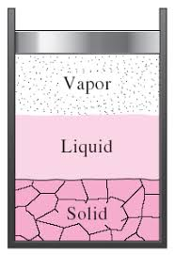
2. Phases of Pure Substances Cont…
Figure 1: Phases of Water
url: https://encrypted-tbn2.gstatic.com/images?q=tbn:ANd9GcQBUO4Pl1HJ2HiP7tng62DkSiQhyBo_ylb6Cc5VLm-dbfGauOwG

Slide 8
2. Phases of Pure Substances Cont…
Phase Changes
These transitions between phases occur at specific conditions of temperature and pressure:
Melting: Solid → Liquid (e.g., ice melting into water).
Freezing: Liquid → Solid (e.g., water freezing into ice).
Evaporation/Boiling: Liquid → Gas (e.g., water boiling to become steam).
Condensation: Gas → Liquid (e.g., steam cooling to become water).
Sublimation: Solid → Gas (e.g., dry ice turning into carbon
dioxide gas without becoming liquid).
Deposition: Gas → Solid (e.g., frost formation on a cold surface).

Slide 9
3. Phase-Change Processes of Pure Substances
The phase-change processes of pure substances occur when the substance transitions between solid, liquid, and gaseous states due to changes in temperature and pressure [2].
Let us consider a piston-cylinder device containing liquid water at different temperatures and pressures for different phase changes.

Slide 10
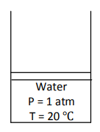


3. Phase-Change Processes of Pure Substances Cont…
i. Compressed Liquid/ Sub-cooled Liquid
Consider the piston-cylinder device containing liquid water at 20ºC and 1atm.
Under these conditions, water exists in the liquid phase, and it is called a compressed liquid, or a sub cooled liquid.
As the temperature rises, the liquid water expands slightly, and so its specific volume increases.
$$State 1$$
$$Liquid$$

Slide 11
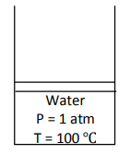



3. Phase-Change Processes of Pure Substances Cont…
ii. Saturated Liquid
At this point water is still a liquid, but any heat addition will cause some of the liquid to vaporize.
That is, a phase change process from liquid to vapor is about to take place.
A liquid about to vaporize is called saturated liquid.
$$State 2$$
$$Liquid$$

Slide 12
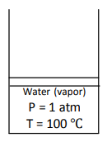


3. Phase-Change Processes of Pure Substances Cont…
iii. Saturated Liquid-Vapor Mixture
Once boiling starts, the temperature stops rising until the liquid is completely vaporized (it is a constant phase- change process at p-constant).
During this process the only thing is change in volume.
At this stage liquid and vapor phase coexist in equilibrium and it is called
saturated liquid-vapor mixture.
$$State 3$$
$$Mixture$$

Slide 13


3. Phase-Change Processes of Pure Substances Cont…
iv. Saturated Vapor
At this point, the entire cylinder is filled with vapor that is on the borderline of the liquid phase.
Any heat loss from this vapor will cause some of the vapor to condense (phase change from vapor to liquid).
The vapor that is about to condense is called a saturated vapor.
$$State 4$$
$$Vapor$$

Slide 14
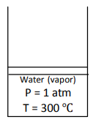

3. Phase-Change Processes of Pure Substances Cont…
v. Superheated vapor
At this stage the phase-change process is complete, we back to a single-phase region (vapor).
Further transfer of heat will result in an increase in both the temperature and the specific volume.
A vapor that is not about to condense (i.e. not a saturated vapor) is called a superheated vapor.
$$State 5$$
$$Vapor$$

Slide 15
3. Phase-Change Processes of Pure Substances Cont…
T
T-v Diagram
Saturated Liquid
5
Super Heated
3
Saturated Liquid-Vapor Mixture
2
4
Saturated Vapor
Compressed Liquid
1
V
Figure 2: Phase change processes of pure substance

Slide 16
3. Phase-Change Processes of Pure Substances Cont…
Saturation Temperature and Saturation Pressure
At a given pressure, the temperature at which a pure substance changes phase is called the saturation temperature T_{sat.}
At a given temperature, the pressure at which a pure substance changes phase is called the saturation pressure P_{sat}.
At a pressure of 101.325 kPa, T_{sat} is 99.97°C.
At a temperature of 99.97°C, P_{sat} is 101.325 kPa.

Slide 17
3. Phase-Change Processes of Pure Substances Cont…
Saturation (boiling) pressure of water at various temperatures
Table 1: Boiling pressure of water at various temperatures [1]

Slide 18
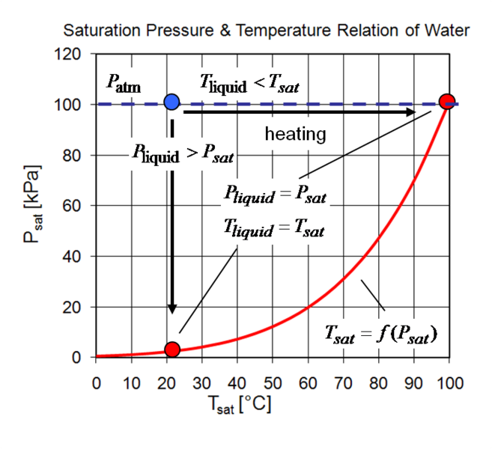
3. Phase-Change Processes of Pure Substances Cont…
During a phase-change process, pressure and temperature are obviously dependent properties
  Figure 3: Saturation Pressure and Temperature Relation of Water
  url: https://upload.wikimedia.org/wikiversity/en/thumb/f/f2/Boiling_cavitation.png/657px-Boiling_cavitation.png

Slide 19
3. Phase-Change Processes of Pure Substances Cont…
Latent Heat
The amount of energy absorbed or released during a phase-change process is called the latent heat.
The amount of energy absorbed during vaporization is called the latent heat of vaporization and it is equivalent to the energy released during condensation.
The amount of energy absorbed during melting is called the latent heat of fusion and it is equivalent to the amount of energy released during freezing.

Slide 20
4. Property Diagrams for Phase Change Processes
Property diagrams for phase change processes visually represent the behavior of substances as they transition between different phases (like solid, liquid, and gas).
These diagrams are incredibly useful for understanding thermodynamic principles and analyzing phase transitions such as melting, boiling, and sublimation.
The common types of property diagrams are:
  The Temperature-Volume (T-v) Diagram
  The Pressure-Volume (P-v) Diagram
  The Pressure-Temperature (P-T) Diagram

Slide 21
5. Temperature-Volume (T-v) Diagram
A Temperature-Volume (T-v) diagram shows the relationship between temperature and specific volume of a substance during phase change processes, offering insights into how volume changes with temperature for different phases.
Experimental result tells us, as the pressure is increased further, the saturation line of the process will continue to get shorter and it will become a point [3].
This point is called the critical point of the substance and it may be defined as the point at which the saturated liquid and saturated vapor states are identical.
At pressures above the critical pressure, there is not
a distinct phase-change process.
We can never tell when the change has occurred.

Slide 22
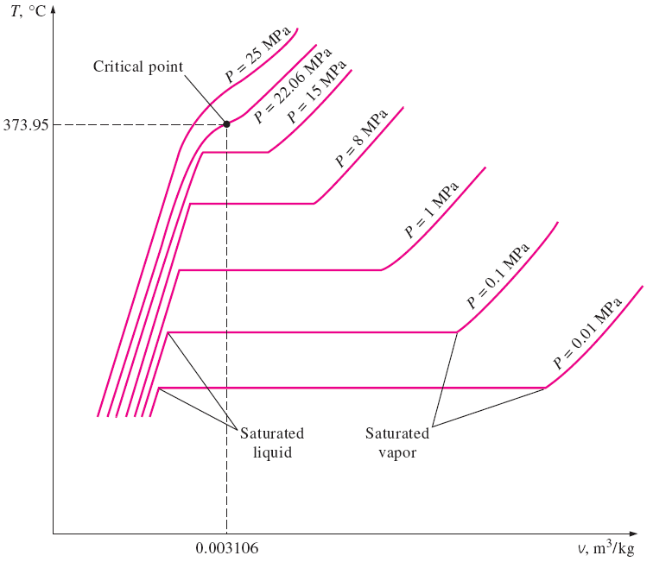
5. Temperature-Volume (T-v) Diagram Cont…
  Figure 4: T-v Diagram of Water
  url:https://encrypted-tbn0.gstatic.com/images?q=tbn:ANd9GcSK24DHk2HFRwAyazofrFNugW82DckEPtgYBA&s

Slide 23
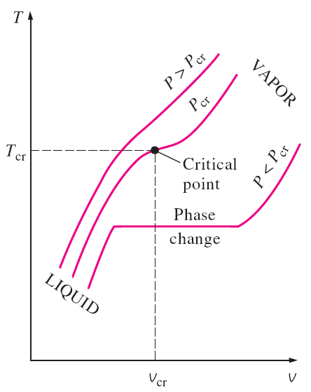
5. Temperature-Volume (T-v) Diagram Cont…
  Figure 5: T-v Diagram of Water (critical point)
  url: https://slideplayer.com/slide/14832318/90/images/12/saturated+liquid+line+saturated+vapor+line.+compressed+liquid+region.+superheated+vapor+region.+saturated+liquid%E2%80%93vapor+mixture+region+%28wet+region%29.jpg

Slide 24
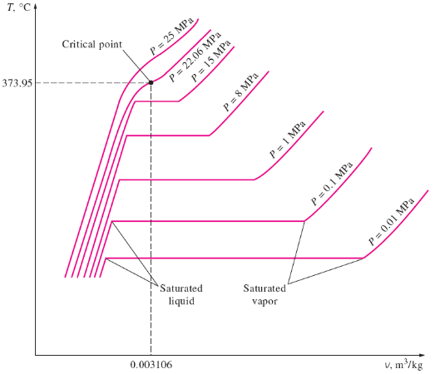
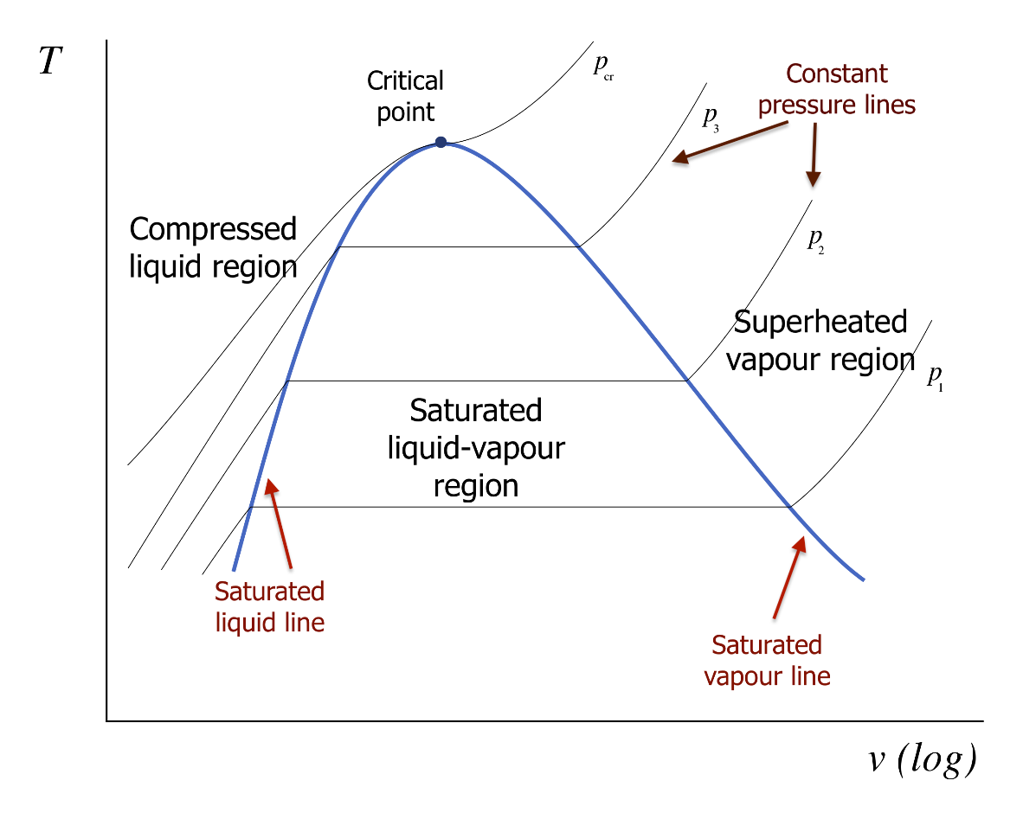
5. Temperature-Volume (T-v) Diagram Cont…
  Figure 6: T-v Diagram of a Pure Substance
  url:https://pressbooks.bccampus.ca/thermo1/wp-content/uploads/sites/499/2021/06/Fig.-2-8_T-v_diagram_for_a_liquid_vapor-copy.svg_.png

Slide 25
6. Pressure-Volume (P-v) Diagram
  A Pressure-Volume (P-V) diagram illustrates the relationship between pressure and volume for a substance, providing insights into its behavior during various thermodynamic processes, including phase changes.
  The general shape of the P-v diagram of a pure substance is very much like the T-v diagram, but the T constant lines on this diagram have a downward trend.

Slide 26
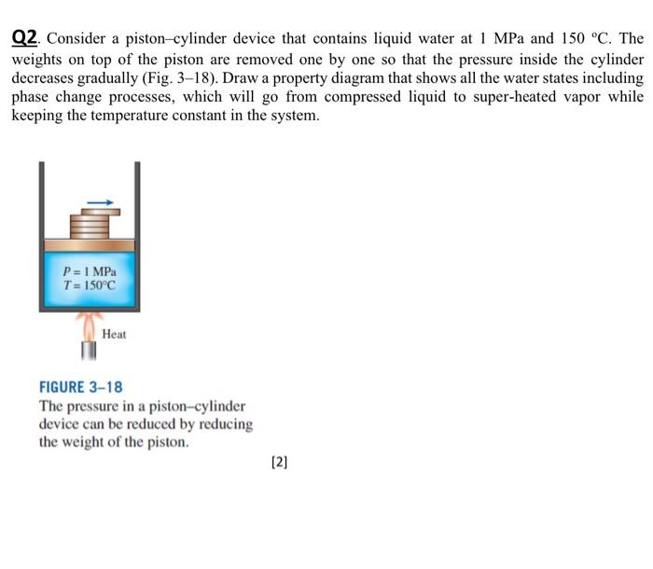
6. Pressure-Volume (P-v) Diagram Cont...
Consider again a piston–cylinder device that contains liquid water at 1MPa and 150°C. Water at this state exists as a compressed liquid.
  Figure 7: T-v Diagram of a Pure Substance
url: https://media.cheggcdn.com/study/215/2150a462-bc16-4448-b673-d198d8d23067/image

Slide 27
6. Pressure-Volume (P-v) Diagram Cont...
Now the weights on top of the piston are removed one by one so that the pressure inside the cylinder decreases gradually.
The water is allowed to exchange heat with the surroundings so its temperature remains constant.
As the pressure decreases, the volume of the water increases slightly.

Slide 28
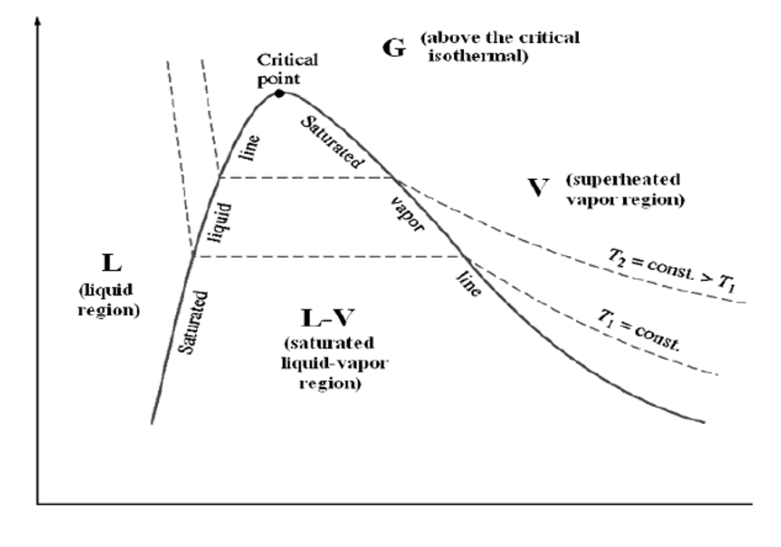
6. Pressure-Volume (P-v) Diagram Cont...
P-v Diagram
Figure 8: P-v Diagram of Pure Substances
url:https://www.researchgate.net/publication/50893732/figure/fig2/AS:305707564978182@1449897771117/p-v-diagram-for-a-pure-substance.png

Slide 29
6. Pressure-Volume (P-v) Diagram Cont...
P-v Diagram
P-V diagrams are especially useful for understanding work done by or on a system, such as in engines and refrigeration cycles.
This type of diagram is a cornerstone of thermodynamics and helps analyze energy transfer, system efficiency, and phase transitions.

Slide 30
6. Pressure-Temperature (P-T) Diagram Cont...
A Pressure-Temperature (P-T) diagram, commonly referred to as a phase diagram, illustrates the equilibrium relationships between the pressure and temperature of a substance as it transitions among its solid, liquid, and vapor (gas) phases [4].
The diagram is crucial for understanding phase transitions and predicting the conditions under which they occur.
It's widely used in fields like material science, engineering, and chemistry.

Slide 31
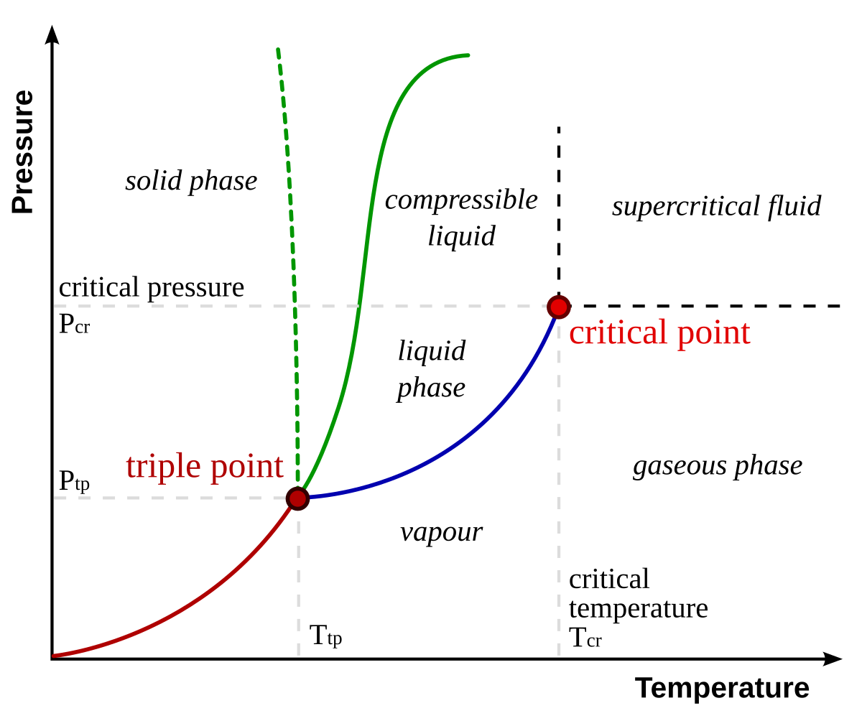
6. Pressure-Temperature (P-T) Diagram Cont...
The sublimation line: separates the solid and vapour regions,
The vaporization line: separates the liquid and vapour regions, and
The melting (or fusion) line: separates the solid and liquid regions.
All three phases are separated from each other by three lines.
Figure 9: P-T Diagram of Pure Substances
url:https://upload.wikimedia.org/wikipedia/commons/thumb/3/34/Phase-diag2.svg/1200px-Phase-diag2.svg.png

Slide 32
7. The P-v-T Surface
The P-v-T surface in thermodynamics refers to a three-dimensional graphical representation of the relationship among pressure (P), specific volume (v), and temperature (T) of a substance [5].
This surface helps to visualize how these properties interact and vary with each other in different phases of the substance (solid, liquid, and gas).
The P-v-T graph is particularly useful in understanding the thermodynamic behavior of materials under varying conditions.
It’s like a 3D "landscape" of thermodynamic states.

Slide 33
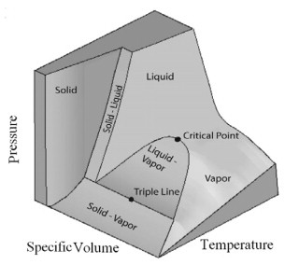
7. The P-v-T Surface
Figure 10: The P-v-T Surface of Pure Substances
url:https://ars.els-cdn.com/content/image/3-s2.0-B9780123706102500076-f02-05-9780123706102.jpg

Slide 34
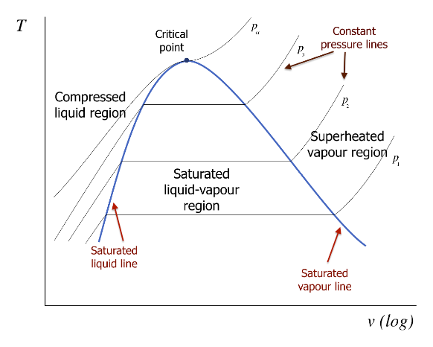

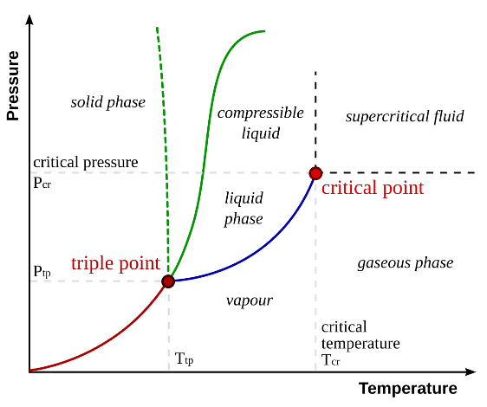
7. The P-v-T Surface Cont…

Slide 35
Summary
A pure substance is a material that has a consistent and uniform composition throughout.
Pure substances exist in three principal phases; solid, liquid, and gas with distinct properties based on molecular arrangements and energy levels.
Property diagrams (like P-v, T-v, and P-T diagrams) visually represent relationships between pressure, temperature, and specific volume during phase changes.
The T-v diagram depicts phase-change behaviors, showing isobars where boiling and condensation happen, including the critical and saturation points.
The P-v diagram portrays the transitions between phases under varying pressures, illustrating saturation states and boundary lines.
The P-v-T Surface is a 3D surface that combines pressure, specific
volume, and temperature, giving a comprehensive overview of
phase interactions and critical phenomena.

Slide 36
References
[1]. Thermodynamics – An Engineering Approach, Cengel Y A.,Bole M A., McGraw-Hill Education, 8th edition 2015.
[2]. Thermodynamics of Multiphase Systems, Amir Faghri, Yuwen Zhang, Transport Phenomena in Multiphase Systems, 2006, Pages 107-176, https://doi.org/10.1016/B978-0-12-370610-2.50007-6
[3]. Advanced Thermodynamics for Engineers, Winterbone, Ali Turan, Butterworth-Heinemann, 2015, Pages 1-12, https://doi.org/10.1016/B978-0-444-63373-6.00001-0.
[4]. Thermodynamic Properties, Modern Engineering Thermodynamics, 2011, Pages 57-98,
https://doi.org/10.1016/B978-0-12-374996-3.00003-8
[5]. The PVT surface of water, Ralph C. Dougherty, Chemical Physics, Volume 298, 2004, Pages 307-315, https://doi.org/10.1016/j.chemphys.2003.11.031

Slide 37
Thank you !

