Slide 1
Engineering Thermodynamics I
Lecture 6
Properties of Pure Substances
Lecturer: Dr. Melaku Desta

Slide 2
Lecture learning outcomes:
At the end of this lecture, you will be able to:
Explain the concept of vapor pressure and its role in phase equilibrium.
Utilize property tables to determine thermodynamic properties.
Apply the ideal gas equation to solve basic gas law problems.
Understand the compressibility factor and its significance in real gas behavior.
Solve practical problems using theoretical concepts
and tutorials.

Slide 3
Content
Vapor pressure and phase equilibrium
Property Tables
The Ideal Gas Equation of State
Compressibility Factor
Tutorials and solved problems
Summary
References

Slide 4
1. Vapor pressure and phase equilibrium
Vapor pressure and phase equilibrium concepts are fundamental in understanding boiling, condensation, and how substances behave at different pressures and temperatures
Vapor pressure is the pressure exerted by a vapor in equilibrium with its liquid (or solid) phase at a given temperature.
It represents the tendency of the liquid's molecules to escape into the vapor phase.
A substance with higher vapor pressure evaporates more
readily, indicating greater volatility.

Slide 5
1. Vapor pressure and phase equilibrium Cont…
Phase equilibrium refers to the state in which multiple phases (e.g., liquid, vapor, solid) of a substance coexist without a net change, as their rates of interconversion are equal.
At this point, the rate of molecules evaporating from the liquid equals the rate of molecules condensing back into the liquid.
This dynamic process maintains a constant vapor pressure as long as temperature and conditions remain steady.
For example, in a closed container with water, the rate at
which water evaporates equals the rate at which vapor
condenses, maintaining equilibrium.

Slide 6
2. Thermodynamics Tables
The relationship among thermodynamic properties are too complex to be expressed in simple equations and thus, properties are measured and/or calculated and then presented in a tabulated form.
Thermodynamic tables are reference materials that provide the thermodynamic properties of substances under various conditions of temperature and pressure. These properties include, but are not limited to:
  Pressure (P) Internal Energy (u)
  Temperature (T) Enthalpy (h)
  Specific Volume (v) Entropy (s)

Slide 7
2. Thermodynamics Tables Cont…
In single-phase regions, any two properties will fix the state.
In two phase regions, any two properties (except P and T) will fix the state.
P and T are dependent on each other.
  Figure 1: P-v Diagram of a Pure Substance
  url: https://image.slideserve.com/485693/regions-on-a-pv-diagram-l.jpg

Slide 8


2. Thermodynamics Tables Cont…
Enthalpy − A Combination Property
In the analysis of certain types of processes, particularly in power generation and refrigeration, we frequently encounter the combination of internal energy U, and pressure-volume product PV. That is
Before 1930, h was referred to as heat content or total heat.
After 1930, it is referred to as enthalpy (from the Greek word
enthalpien which means to heat)
$$H=U+PV$$
$$h=u+Pv$$

Slide 9
2. Thermodynamics Tables Cont…
Saturated Liquid and Saturated Vapor States
Both saturated liquid and saturated vapor states are crucial in thermodynamics for understanding phase transitions, energy transfer during boiling or condensation, and the behavior of substances at varying pressures and temperatures.
Saturated liquid state refers to a liquid at its boiling point.
At this state, the liquid is in equilibrium with its vapor.
Any small addition of heat will begin converting the liquid into
vapor without raising its temperature.
It's the precise threshold before a phase change begins.

Slide 10
2. Thermodynamics Tables Cont…
Saturated vapor state describes a vapor at its condensation point. Here, the vapor is in equilibrium with its liquid counterpart.
If heat is removed, condensation will begin, but the temperature remains constant during the process.
Saturated liquid-vapor mixture falls under the P-v (or T-v) dome.
Its properties can be obtained from Water Tables A-4 and A-5

Slide 11
2. Thermodynamics Tables Cont…
Table A-4
Temperature is listed in the left column as the independent variable.

Slide 12
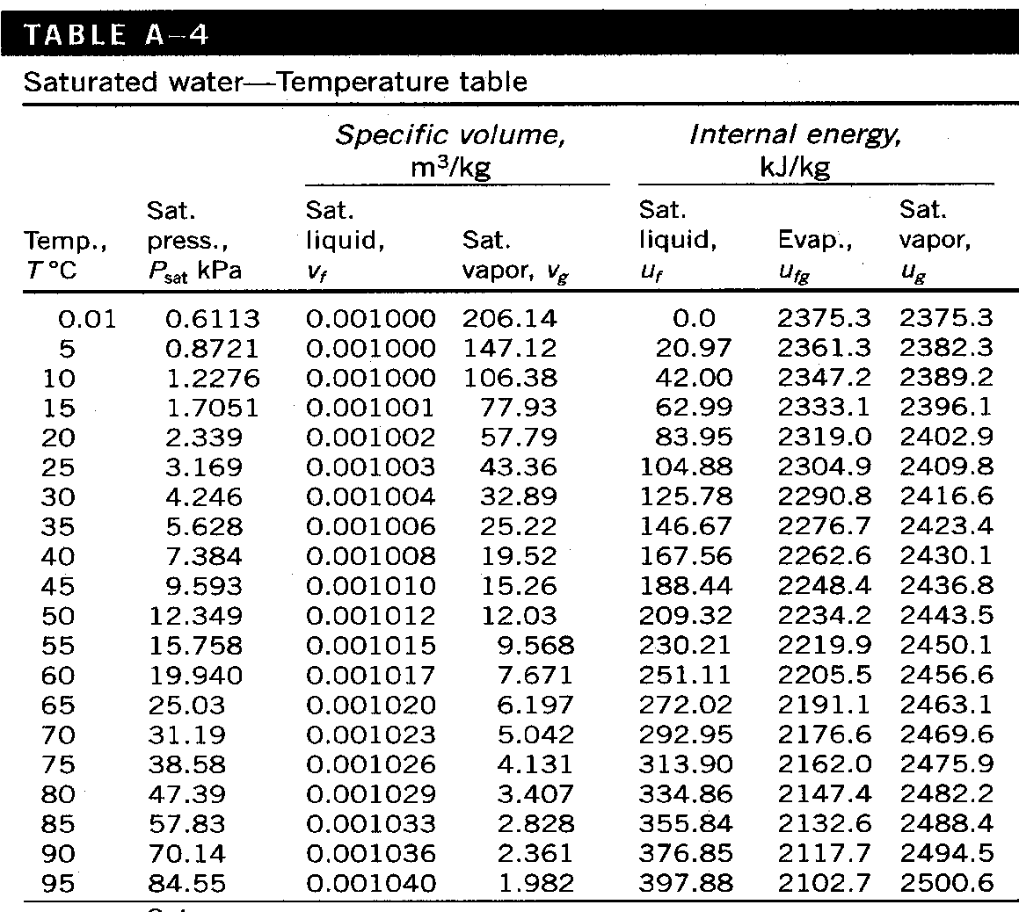
2. Thermodynamics Tables Cont…
Saturated Water Table A-4 [2]

Slide 13


2. Thermodynamics Tables Cont…
Table A-5
Pressure is listed in the left column as the independent variable.
Use whichever table is convenient
Enthalpy of vaporization or latent heat - the amount of energy needed to vaporize a unit mass of saturated liquid at a given temperature or pressure
$$v_{fg}=v_{g}−v_{f}$$
$$h_{fg}=h_{g}−h_{f}$$

Slide 14
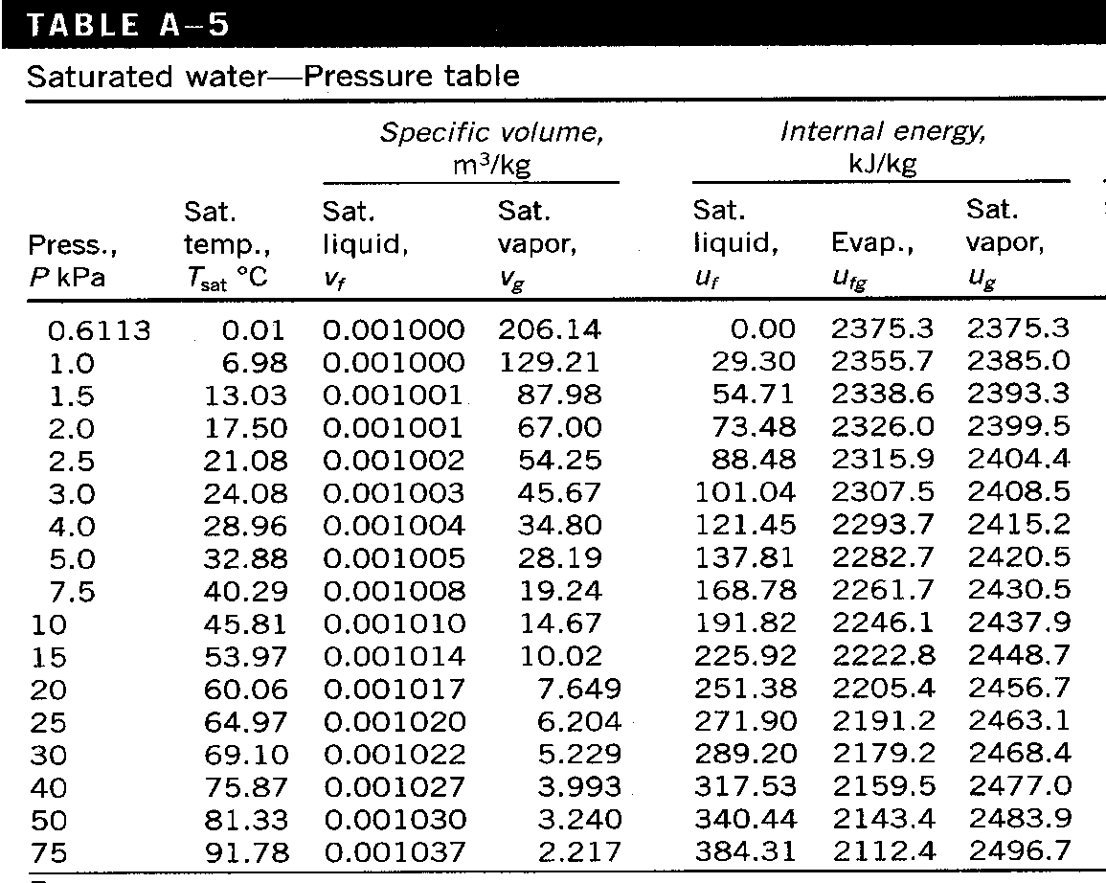
2. Thermodynamics Tables Cont…
Saturated Water Table A-5 [2]

Slide 15
2. Thermodynamics Tables Cont…
Saturated Liquid-Vapor Mixture
A saturated liquid-vapor mixture refers to a thermodynamic state where both liquid and vapor phases coexist in equilibrium at a given pressure and temperature.
  The liquid is at its saturated liquid condition (ready to evaporate if heat is added).
  The vapor is at its saturated vapor condition (ready to condense if heat is removed).
This mixture represents an intermediate state during phase transition.

Slide 16
2. Thermodynamics Tables Cont…
Saturated Liquid-Vapor Mixture
For example:
When a saturated liquid starts boiling, it forms a saturated liquid-vapor mixture until all the liquid becomes vapor.
Similarly, when a saturated vapor starts condensing, the mixture forms until the entire vapor turns into liquid.

Slide 17
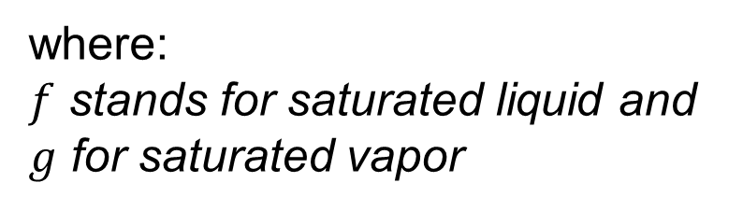
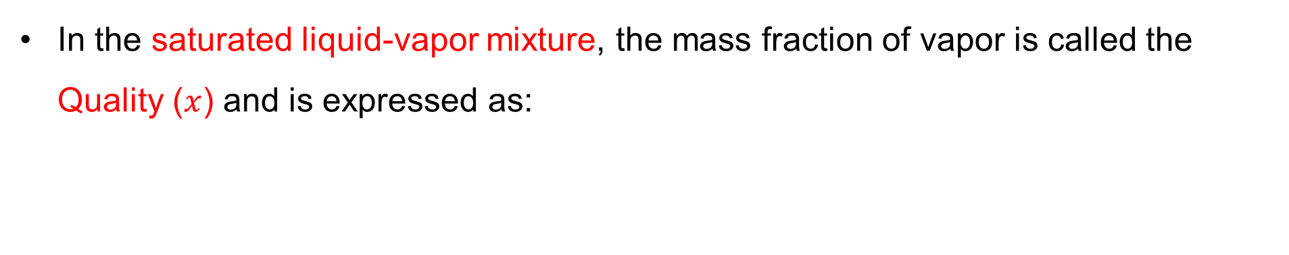
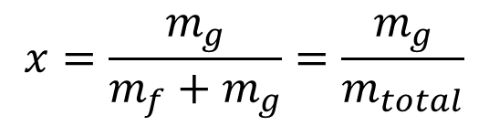
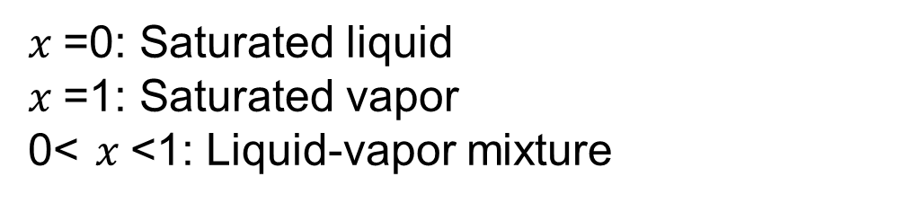
2. Thermodynamics Tables Cont…
In the saturated liquid-vapor mixture, the mass fraction of vapor is called the Quality ($x$) and is expressed as:
where:
$f$ stands for saturated liquid and $g$ for saturated vapor
$$x=\frac{m_{g}}{m_{f}+m_{g}}=\frac{m_{g}}{m_{total}}$$
$x$=0: Saturated liquid
$x$=1: Saturated vapor
0< $x$<1: Liquid-vapor mixture

Slide 18
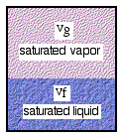
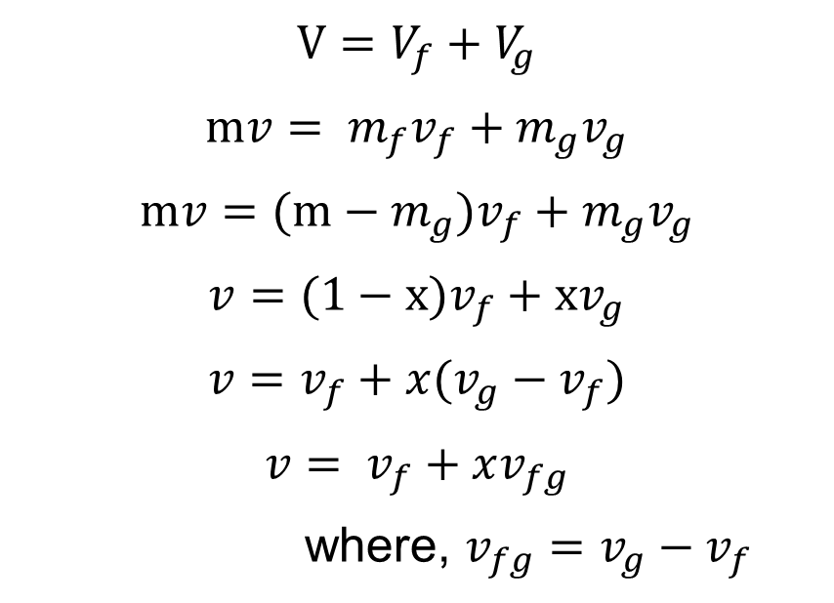
2. Thermodynamics Tables Cont…
Derivation
$$V=V_{f}+V_{g}$$
$$mv= m_{f}v_{f}+m_{g}v_{g}$$
$$mv=(m−m_{g})v_{f}+m_{g}v_{g}$$
$$v=(1−x)v_{f}+xv_{g}$$
$$v=v_{f}+x(v_{g}−v_{f})$$
$$v= v_{f}+xv_{fg}$$
where, $v_{fg}=v_{g}−v_{f}$
  Figure 2: Saturated Liquid-Vapor Mixture
url:https://people.ohio.edu/trembly/mechanical/thermo/Intro/Chapt.1_6/pure_fluid/quality_eqns.gif

Slide 19

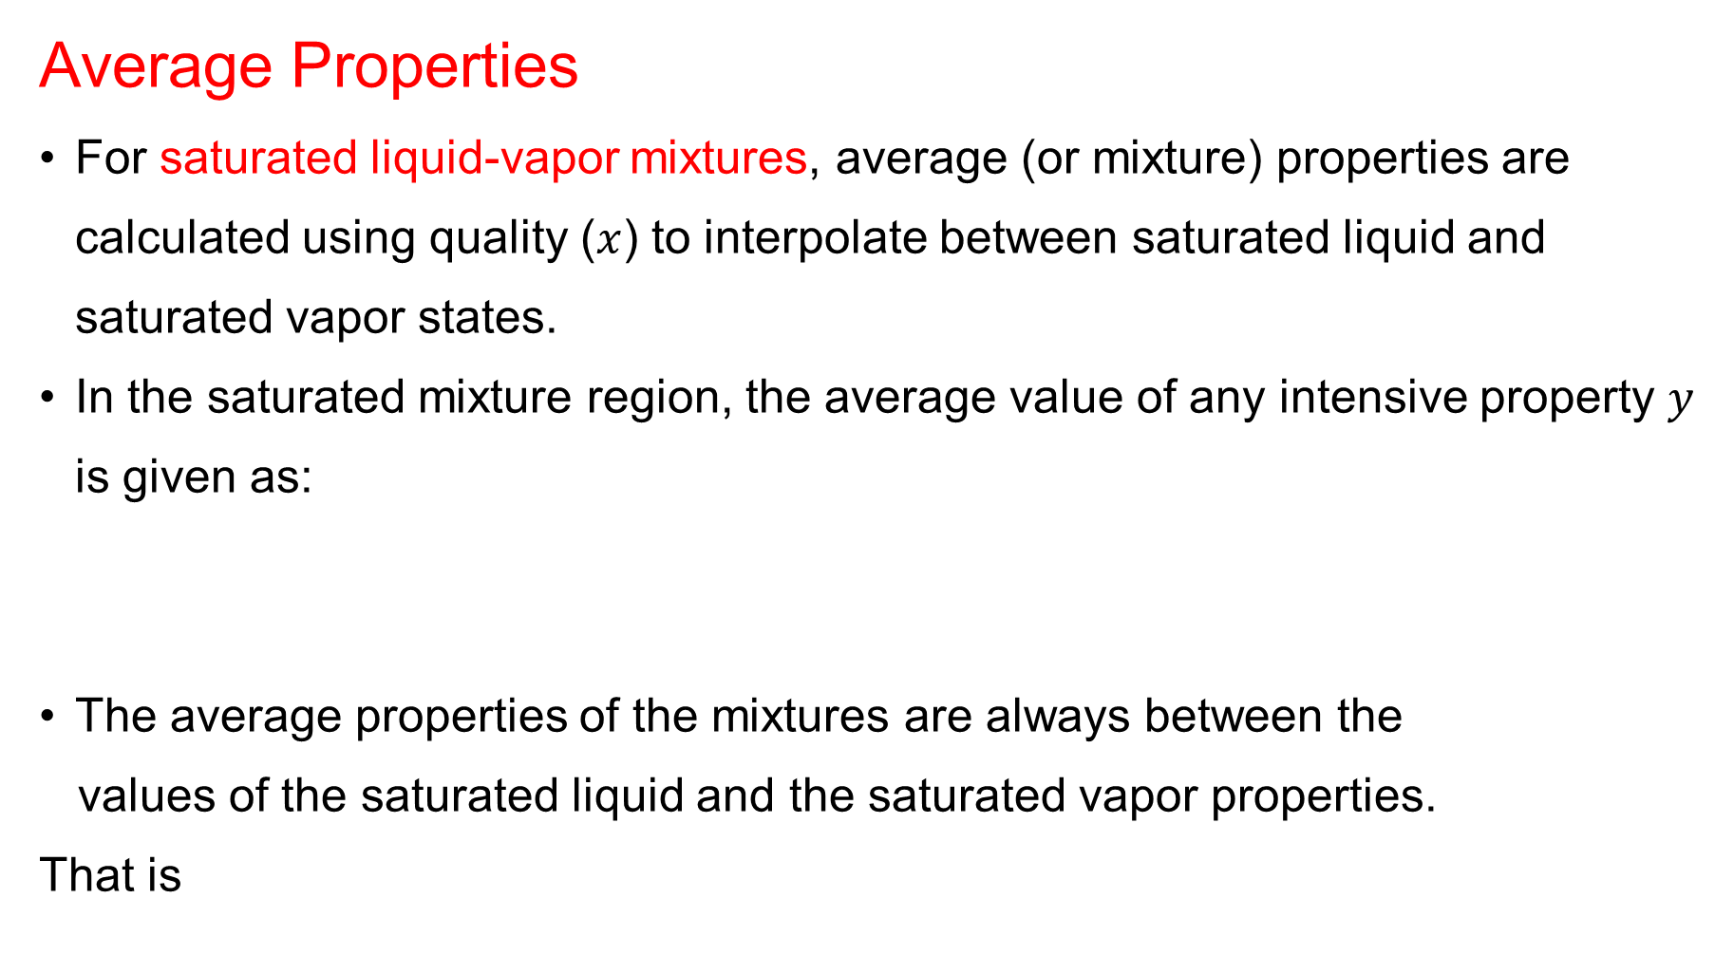


2. Thermodynamics Tables Cont…
Average Properties
For saturated liquid-vapor mixtures, average (or mixture) properties are calculated using quality ($x$) to interpolate between saturated liquid and saturated vapor states.
In the saturated mixture region, the average value of any intensive property $y$ is given as:
The average properties of the mixtures are always between the
values of the saturated liquid and the saturated vapor properties.
That is
$$\left.y=y_{f}+x(y_{g}−y_{f}\right)$$
$$y= y_{f}+xy_{fg}$$
$$y_{f}≤y_{avg}=y_{g}$$

Slide 20

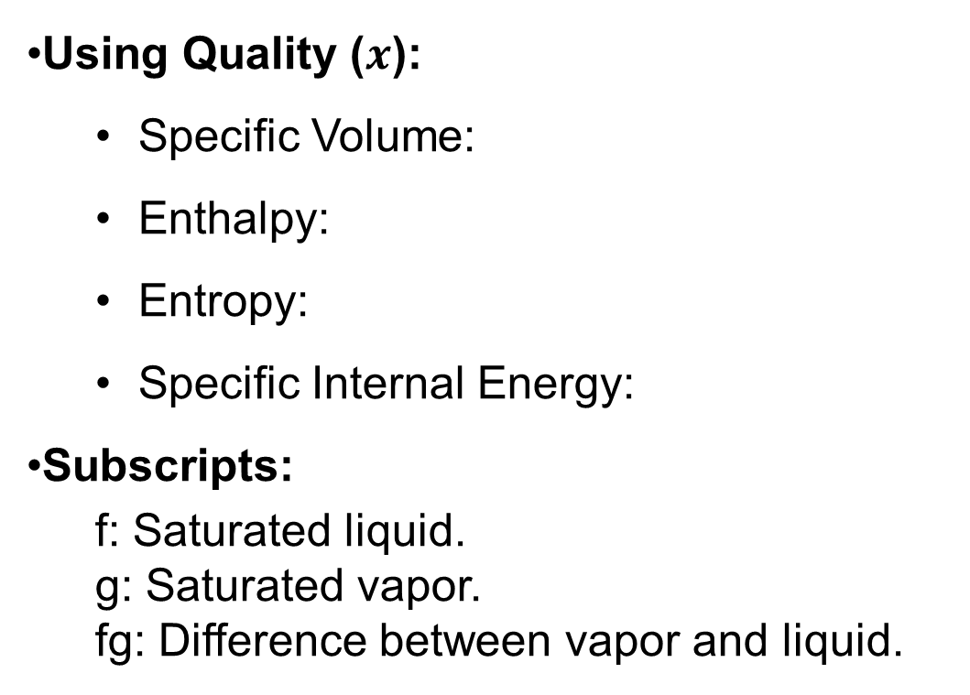



2. Thermodynamics Tables Cont…
Average Properties
For saturated liquid-vapor mixtures,
Using Quality ($x$):
  Specific Volume:
  Enthalpy:
  Entropy:
  Specific Internal Energy:
Subscripts:
  f: Saturated liquid.
  g: Saturated vapor.
  fg: Difference between vapor and liquid.
$$v= v_{f}+xv_{fg}$$
$$h= h_{f}+xh_{fg}$$
$$s= s_{f}+xs_{fg}$$
$$u= u_{f}+xu_{fg}$$

Slide 21
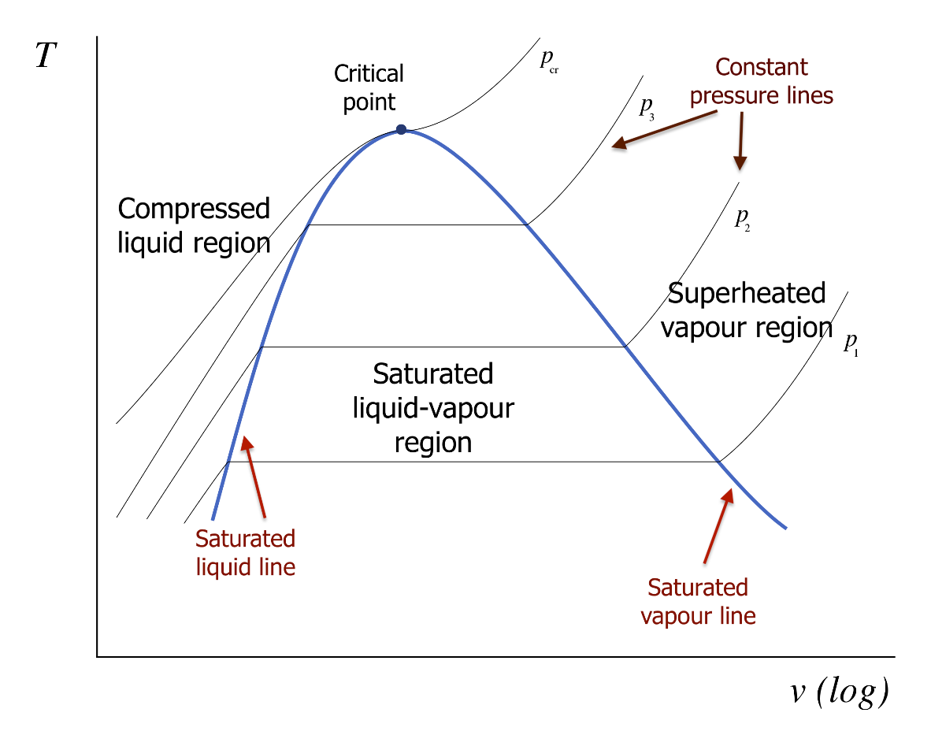
2. Thermodynamics Tables Cont…
The T-v diagram
  Figure 3: T-v Diagram of a Pure Substance
  url:https://pressbooks.bccampus.ca/thermo1/wp-content/uploads/sites/499/2021/06/Fig.-2-8_T-v_diagram_for_a_liquid_vapor-copy.svg_.png

Slide 22
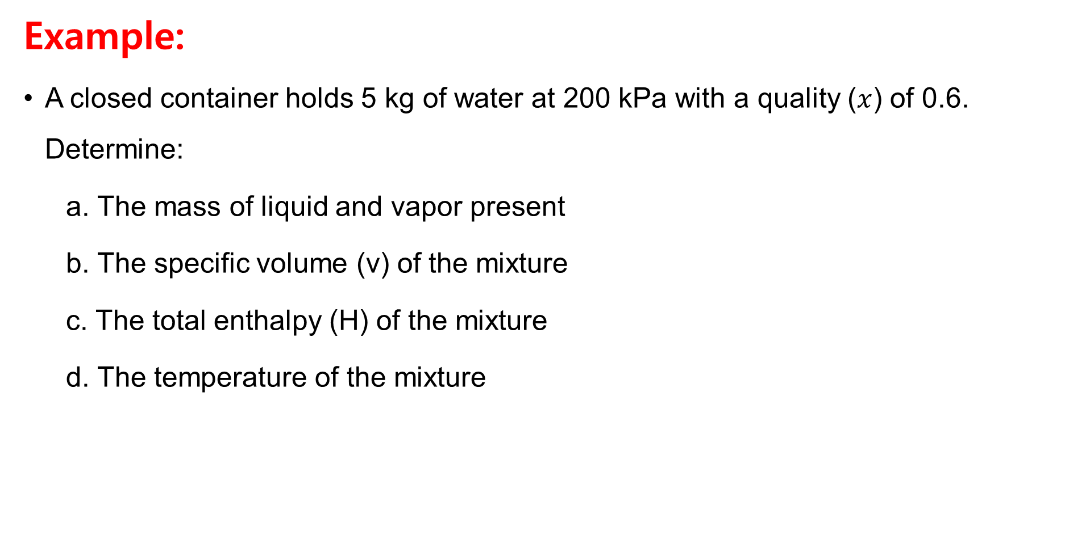
2. Thermodynamics Tables Cont…
Example:
A closed container holds 5 kg of water at 200 kPa with a quality ($x$) of 0.6. Determine:
  a. The mass of liquid and vapor present
  b. The specific volume (v) of the mixture
  c. The total enthalpy (H) of the mixture
  d. The temperature of the mixture

Slide 23
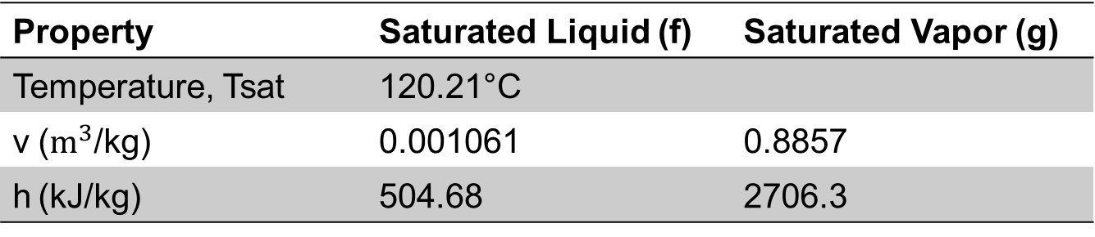
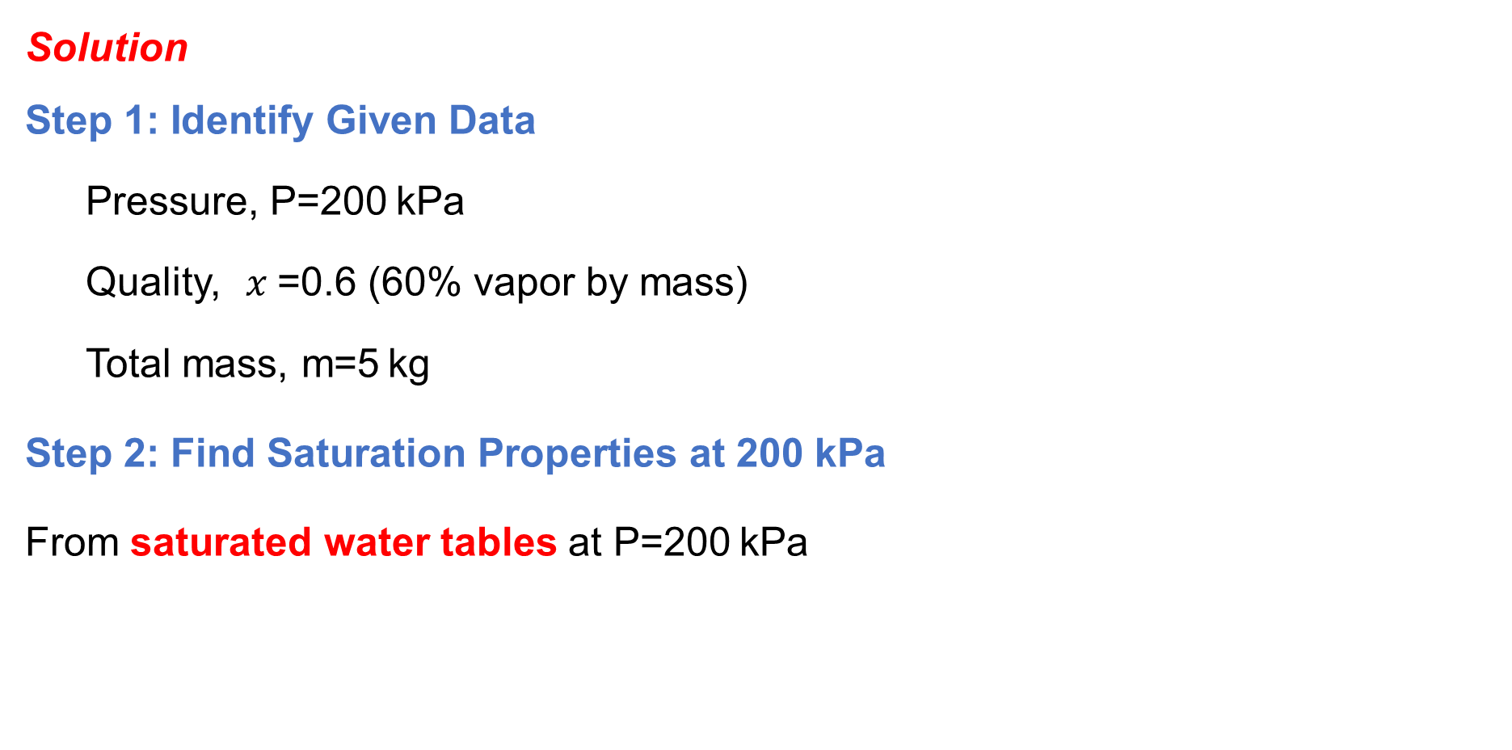
2. Thermodynamics Tables Cont…
Solution
Step 1: Identify Given Data
  Pressure, P=200 kPa
  Quality, $x$=0.6 (60% vapor by mass)
  Total mass, m=5 kg
Step 2: Find Saturation Properties at 200 kPa
From saturated water tables at P=200 kPa
Property | Saturated Liquid (f) | Saturated Vapor (g)
Temperature, Tsat | 120.21°C
v ($m^{3}$/kg) | 0.001061 | 0.8857
h (kJ/kg) | 504.68 | 2706.3

Slide 24
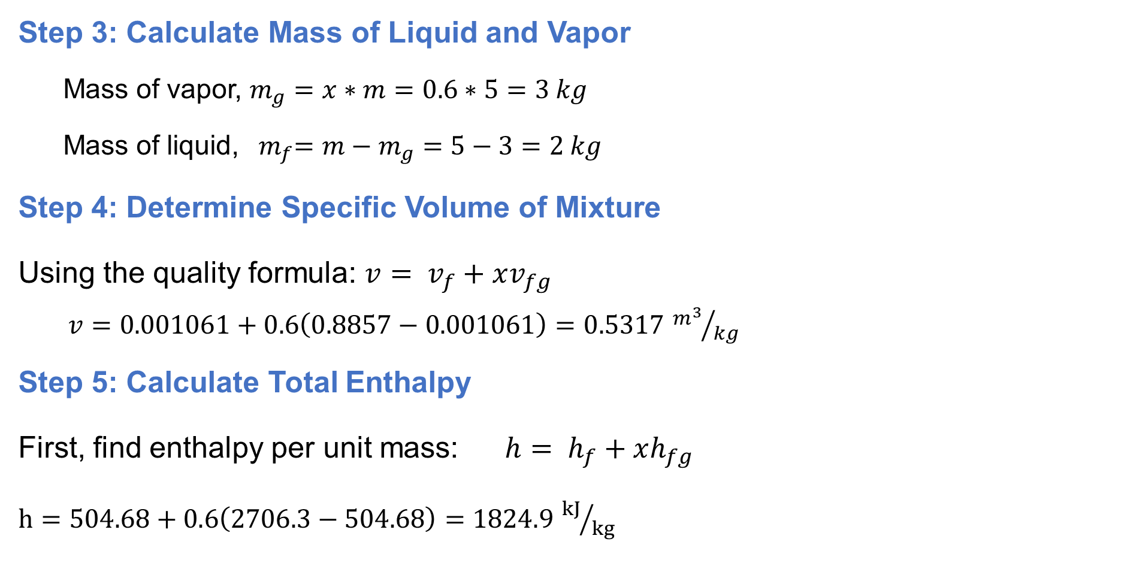
2. Thermodynamics Tables Cont…
Step 3: Calculate Mass of Liquid and Vapor
  Mass of vapor, $m_{g}=x∗m=0.6∗5=3 kg$
  Mass of liquid, ${ m}_{f}=m−m_{g}=5−3=2 kg$
Step 4: Determine Specific Volume of Mixture
Using the quality formula: $v= v_{f}+xv_{fg}$
$v=0.001061+0.6\left(0.8857−0.001061\right)=0.5317$ ${m^{3}}/{kg}$
Step 5: Calculate Total Enthalpy
First, find enthalpy per unit mass:$h= h_{f}+xh_{fg}$
$h=504.68+0.6\left(2706.3−504.68\right)=1824.9$ ${kJ}/{kg}$

Slide 25
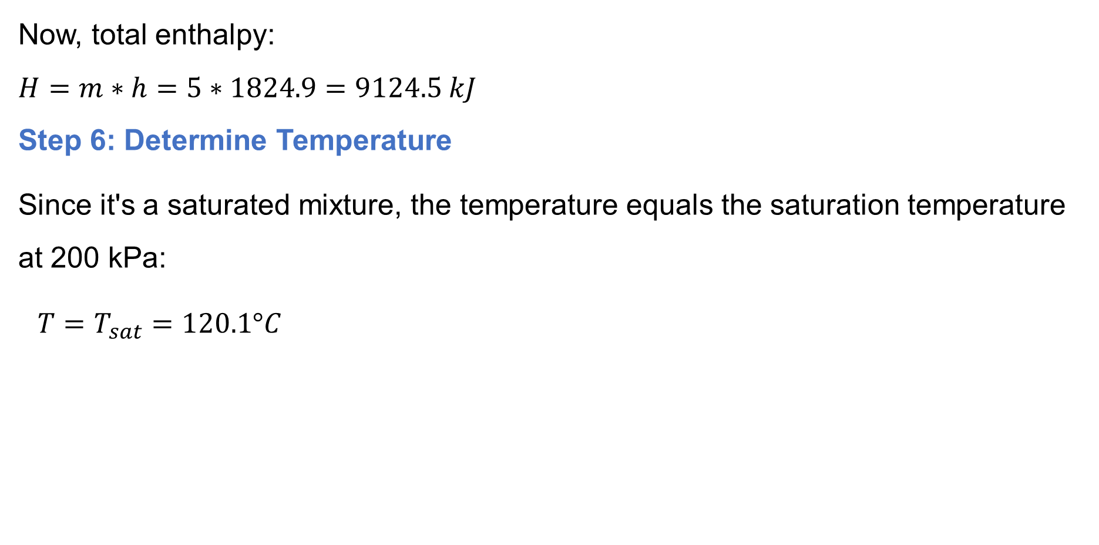
2. Thermodynamics Tables Cont…
Now, total enthalpy:
$H=m∗h=5∗1824.9=9124.5 kJ$
Step 6: Determine Temperature
Since it's a saturated mixture, the temperature equals the saturation temperature at 200 kPa:
$T=T_{sat}=120.1°C$

Slide 26
2. Thermodynamics Tables Cont…
Superheated Vapor
A superheated vapor is a pure gaseous phase that exists at a temperature higher than the saturation temperature (T>Tsat) for a given pressure.
Unlike saturated vapor (which is at the boiling point), superheated vapor has no liquid phase present and behaves more like an ideal gas.
To identify superheated vapor in thermodynamic tables, check if T>Tsa​t for a given P.

Slide 27
2. Thermodynamics Tables Cont…
In the region to the right of the saturated vapor line, a substance exists as superheated vapor (single phase).

Slide 28
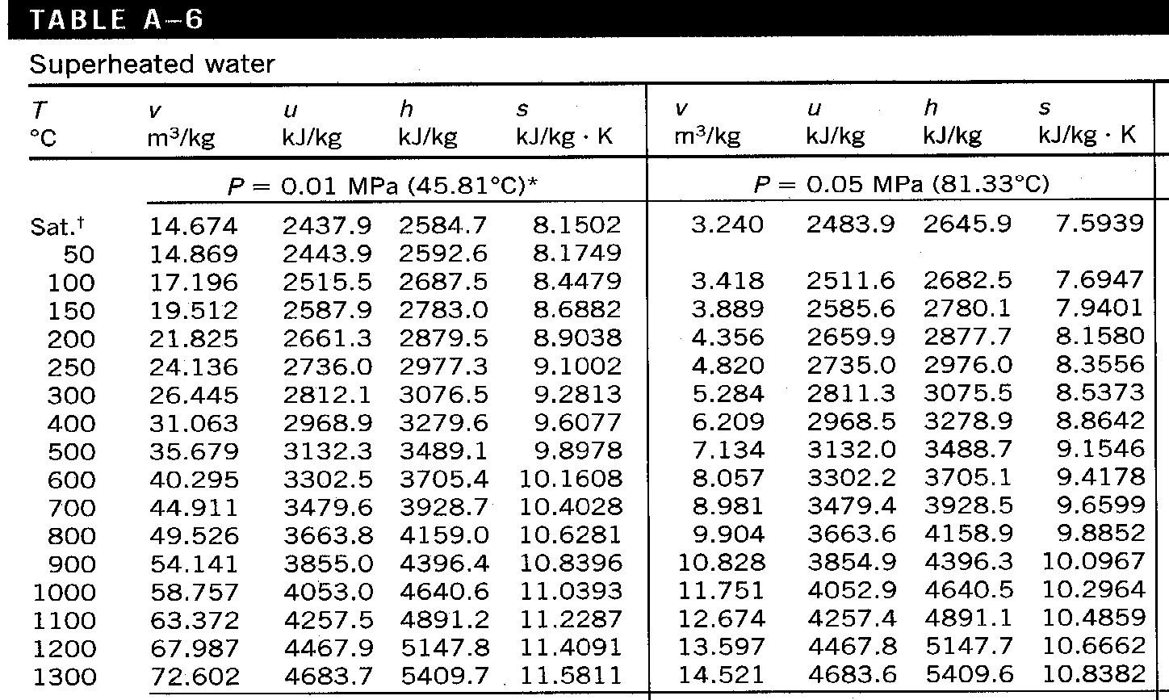
2. Thermodynamics Tables Cont…
Superheated Vapor Table: A-6 [2]

Slide 29
2. Thermodynamics Tables Cont…
Compressed Liquid
A compressed liquid (also called subcooled liquid) refers to water (or any liquid) that is not about to vaporize
It is at a higher pressure than its saturation pressure (P>Psat) for a given temperature, or at a lower temperature than its saturation temperature (T<Tsat) for a given pressure.
Unlike saturated liquid (which is at boiling point), compressed liquid is fully liquid with no bubbles.

Slide 30
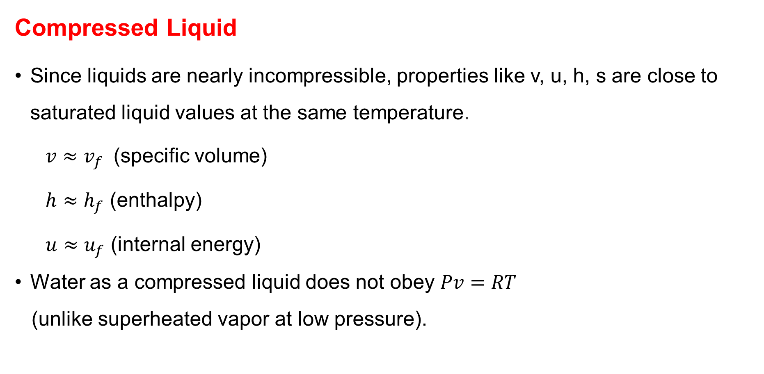
2. Thermodynamics Tables Cont…
Compressed Liquid
Since liquids are nearly incompressible, properties like v, u, h, s are close to saturated liquid values at the same temperature.
  $v≈v_{f}$​ (specific volume)
  $h≈h_{f}$ (enthalpy)
  $u≈u_{f}$ (internal energy)
Water as a compressed liquid does not obey $Pv=RT$
(unlike superheated vapor at low pressure).

Slide 31
2. Thermodynamics Tables Cont…
Compressed Liquid
In the region to the left of the saturated liquid line, a substance exists as compressed liquid.

Slide 32
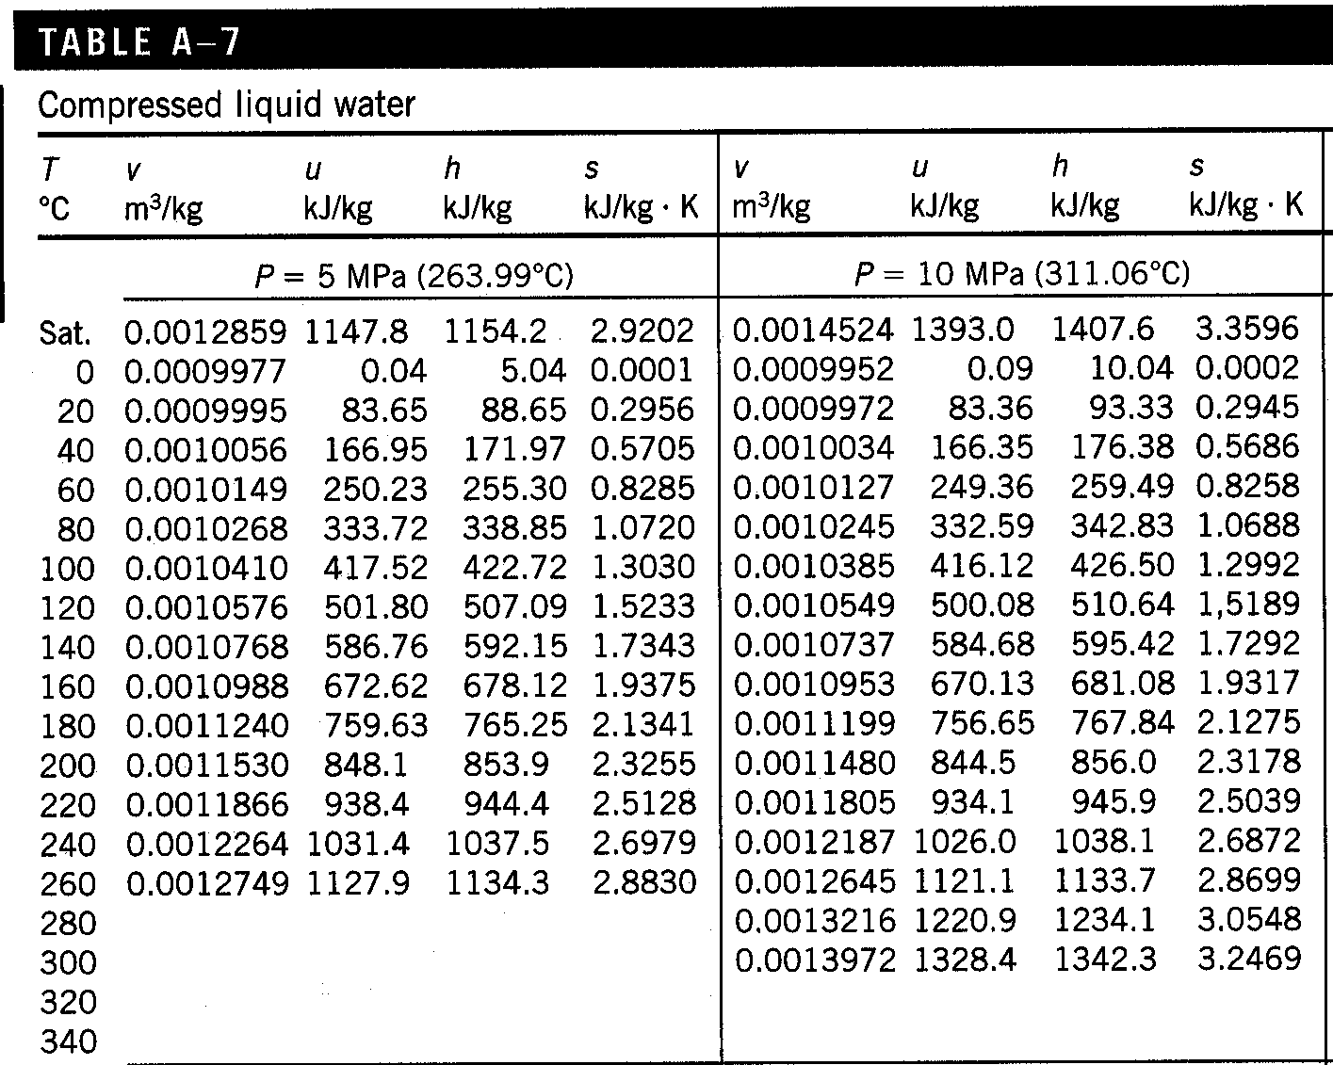
2. Thermodynamics Tables Cont…
Compressed Liquid Water Table A-7 [2]

Slide 33
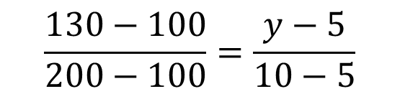
2. Thermodynamics Tables Cont…
  Linear Interpolation
  Linear interpolation is a mathematical technique used to estimate unknown property values (like v, h, s, u) between two known data points in thermodynamic tables.
  Since tables provide discrete values, interpolation helps find precise values at intermediate states.
A | B
100 | 5
130 | y
200 | 10
$$\frac{130−100}{200−100}=\frac{y−5}{10−5}$$

Slide 34
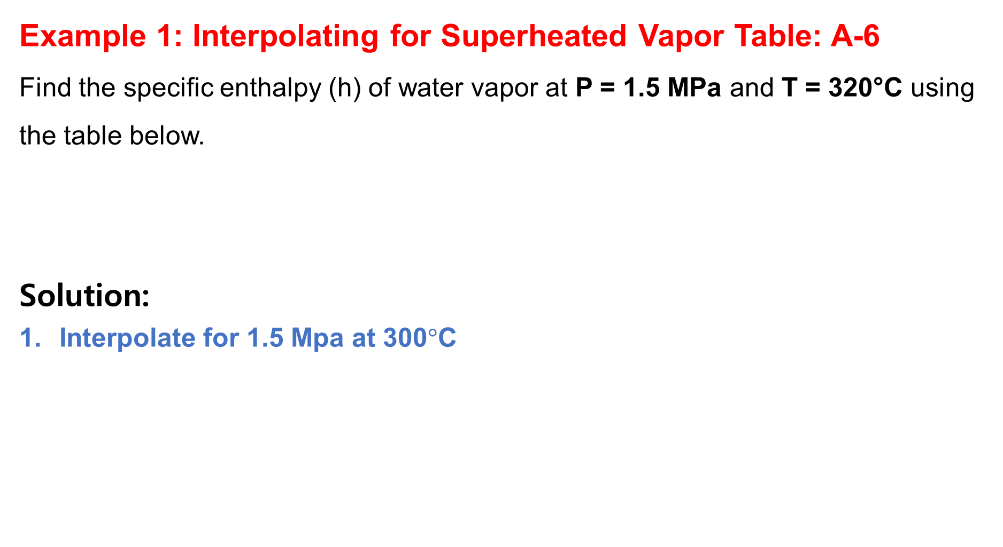
2. Thermodynamics Tables Cont…
Example 1: Interpolating for Superheated Vapor Table: A-6
Find the specific enthalpy (h) of water vapor at P = 1.5 MPa and T = 320°C using the table below.
Solution:
Interpolate for 1.5 Mpa at 300$°$C
Temp. (°C) | h (kJ/kg) at 1.0 MPa | h (kJ/kg) at 2.0 MPa
300 | 3051.2 | 3024.2
350 | 3157.7 | 3137.0
$$h_{300°C,1.5MPa}=3024.2+\left(\frac{1.5−1.0}{2.0−1.0}\right)\left(3051.2−3024.2\right)=3037.7{kJ}/{kg}$$

Slide 35
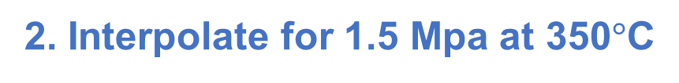
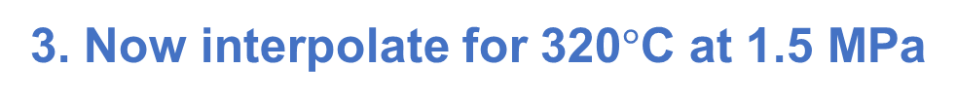
2. Thermodynamics Tables Cont…
2. Interpolate for 1.5 Mpa at 350$°$C
$$h_{350°C,1.5MPa}=3137.0+\left(\frac{1.5−2.0}{1.0−2.0}\right)\left(3157.7−3137.0\right)=3147.35{kJ}/{kg}$$
3. Now interpolate for 320$°$C at 1.5 MPa
$$h_{320°C}=3037.7+\left(\frac{320−300}{350−300}\right)\left(3147.35−3037.7\right)=3081.5{kJ}/{kg}$$

Slide 36
2. Thermodynamics Tables Cont…
Example 2:
A piston-cylinder device contains 1 kg of water at 200°C and 500 kPa. The water is heated until its temperature reaches 400°C.
Determine:
  a. The initial state (saturated, superheated, or compressed liquid).
  b. The specific volume (v) and enthalpy (h) at the initial state.
  c. The final specific volume (v) and enthalpy (h) after heating.
  d. The total work done (W) if the pressure remains constant.

Slide 37

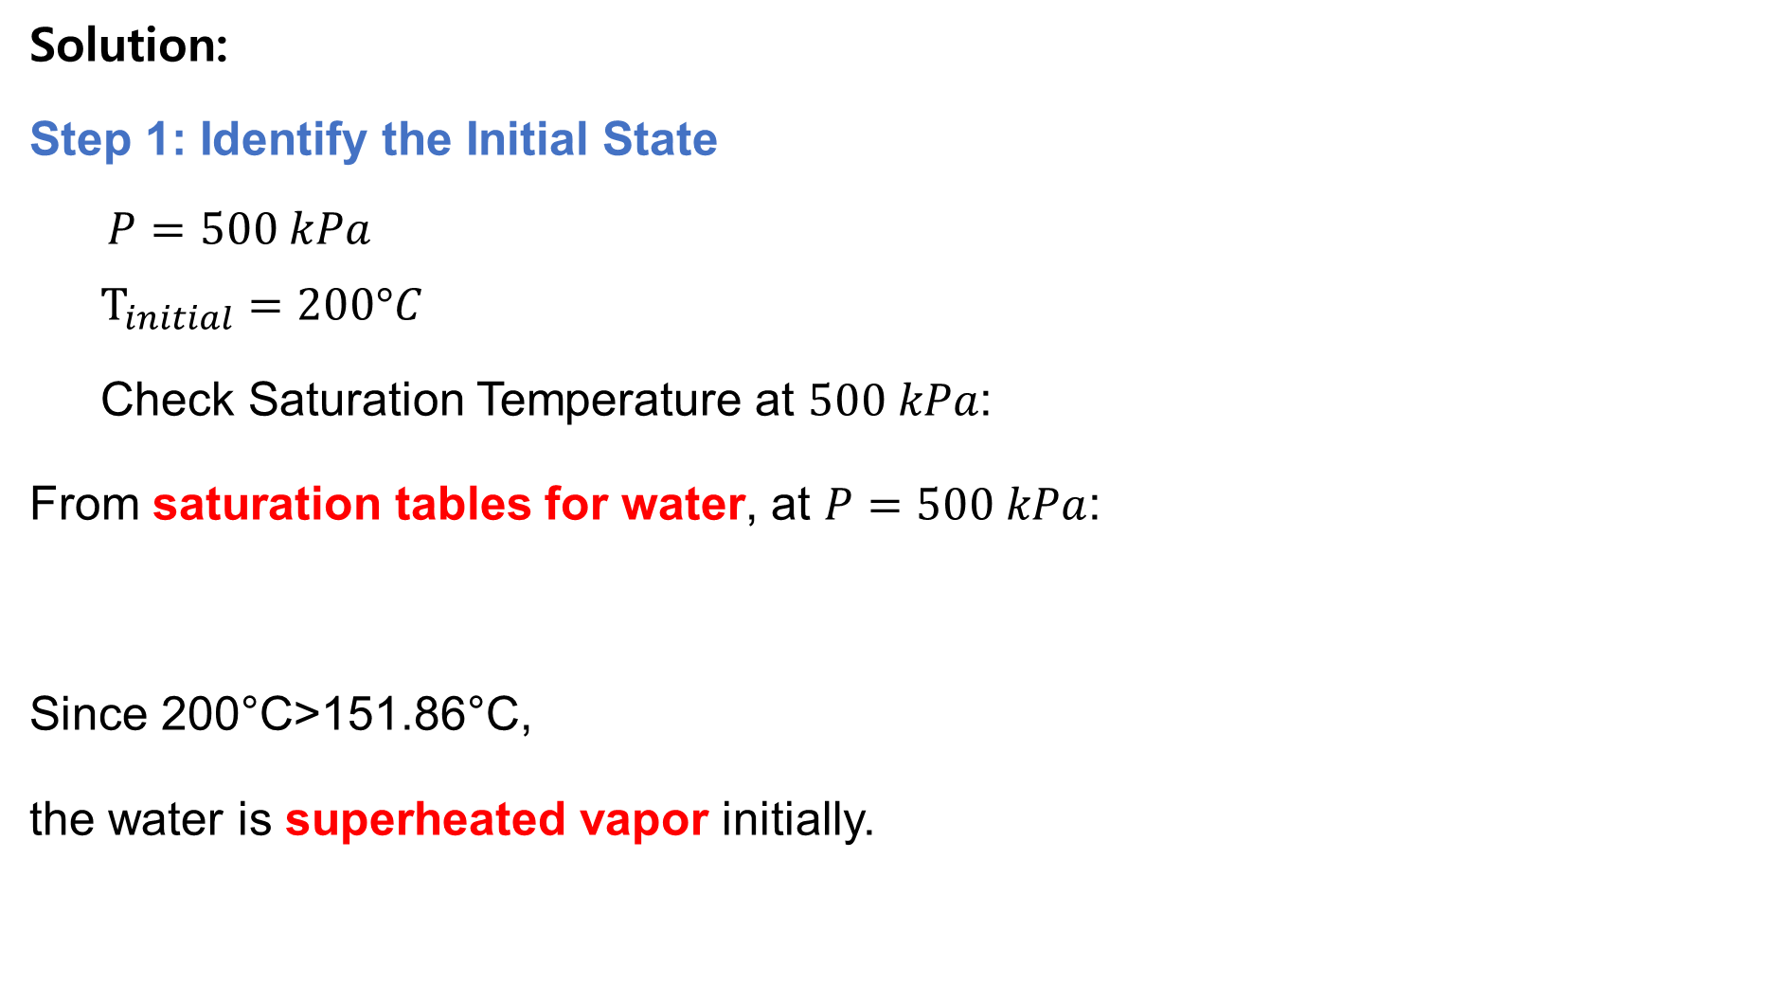
2. Thermodynamics Tables Cont…
Solution:
Step 1: Identify the Initial State
$P=500 kPa$
  $$T_{initial}=200°C$$
  Check Saturation Temperature at $500 kPa$:
From saturation tables for water, at $P=500 kPa$:
Since 200°C>151.86°C,
the water is superheated vapor initially.
$$T_{sat}=151.86°C$$

Slide 38
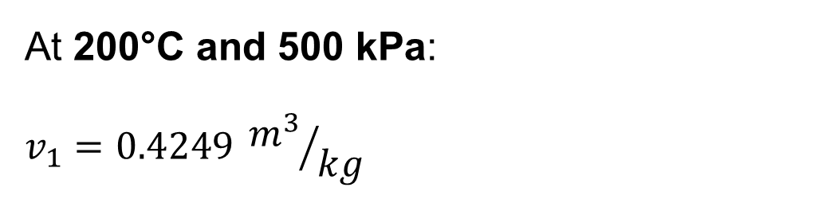
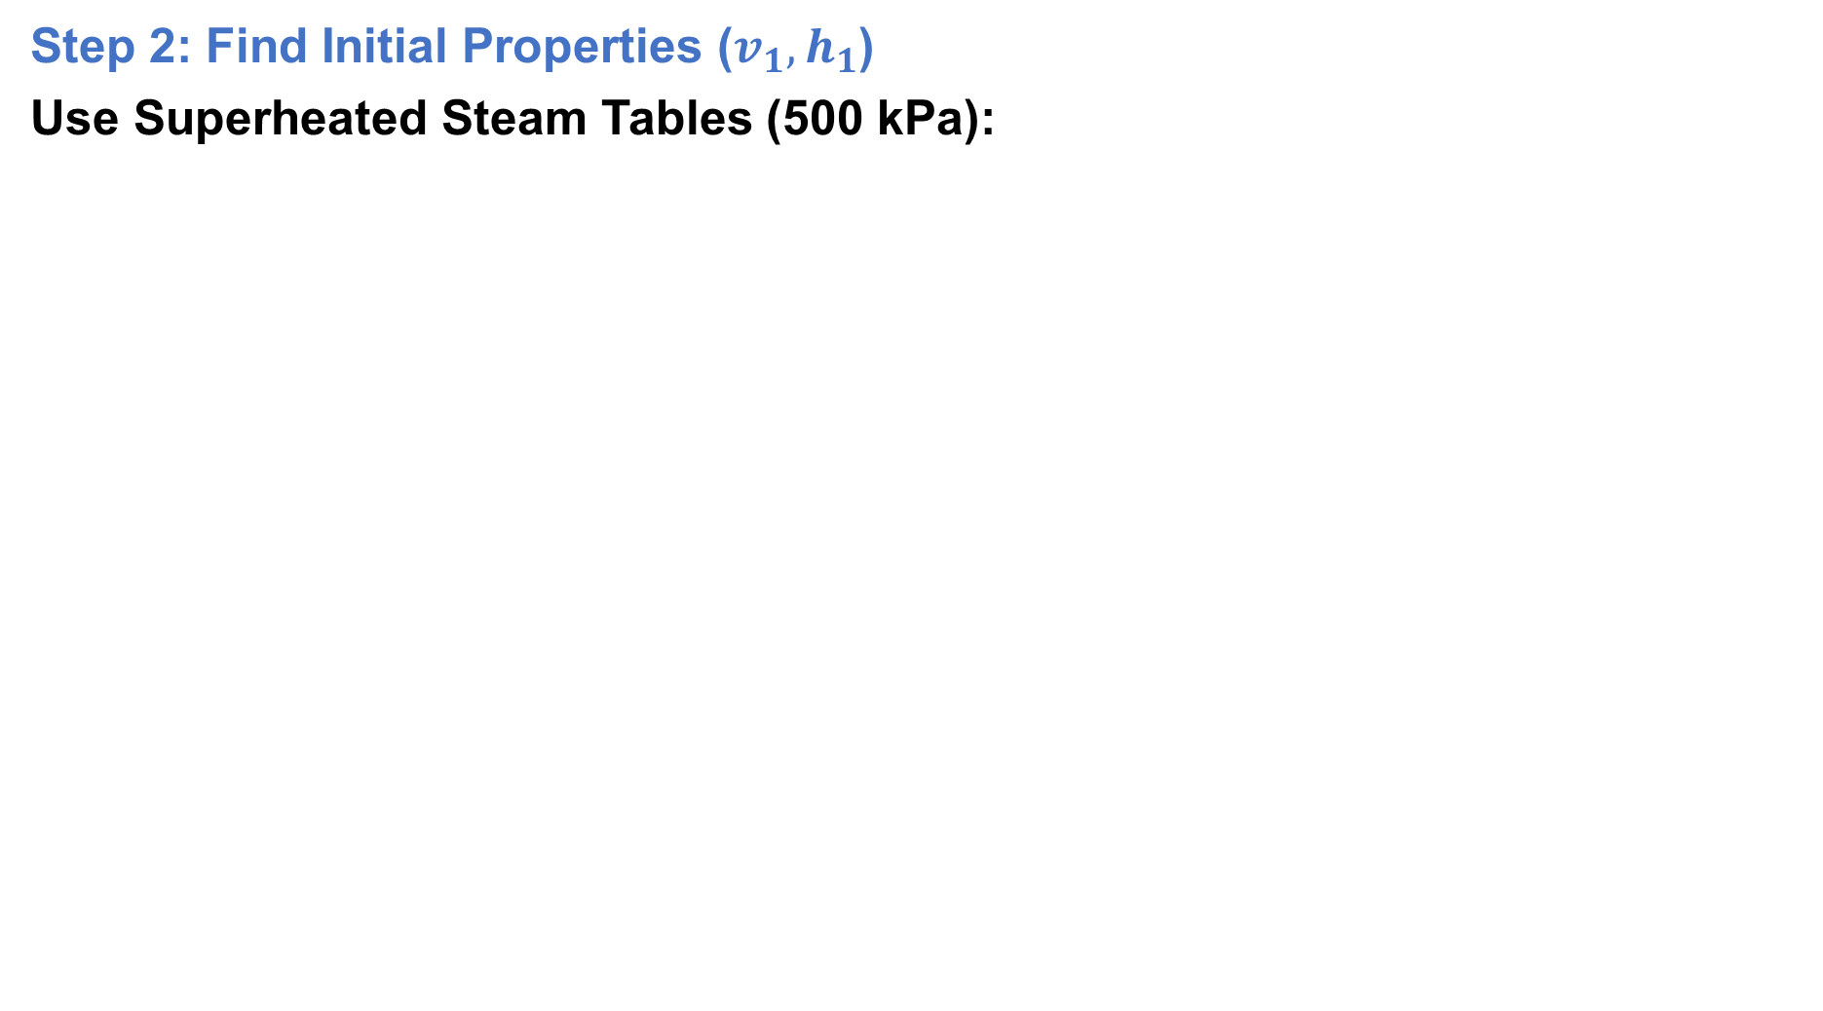
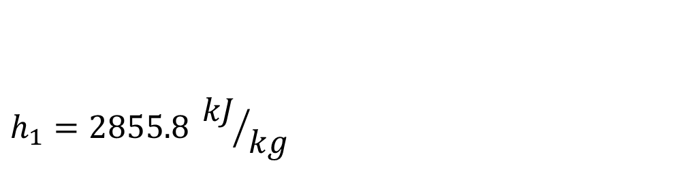
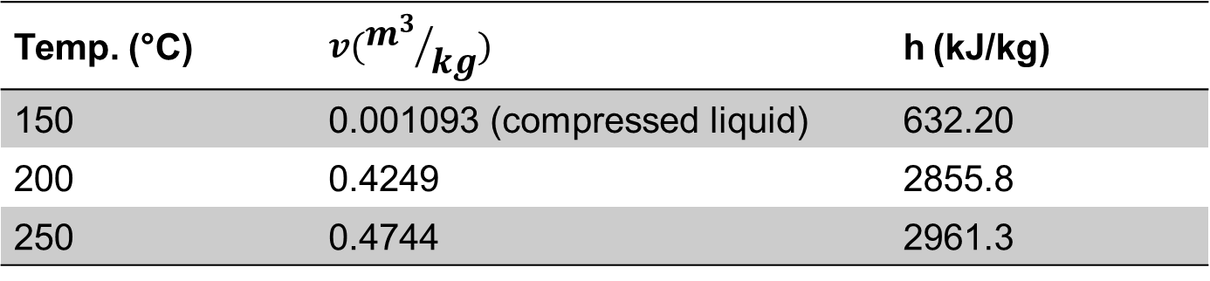
2. Thermodynamics Tables Cont…
Step 2: Find Initial Properties ($v_{1},h_{1}$​)
Use Superheated Steam Tables (500 kPa):
Temp. (°C) | $$v({m^{3}}/{kg})$$ | h (kJ/kg)
150 | 0.001093 (compressed liquid) | 632.20
200 | 0.4249 | 2855.8
250 | 0.4744 | 2961.3
At 200°C and 500 kPa:
$$v_{1}=0.4249 {m^{3}}/{kg}$$
$$h_{1}=2855.8 {kJ}/{kg}$$

Slide 39
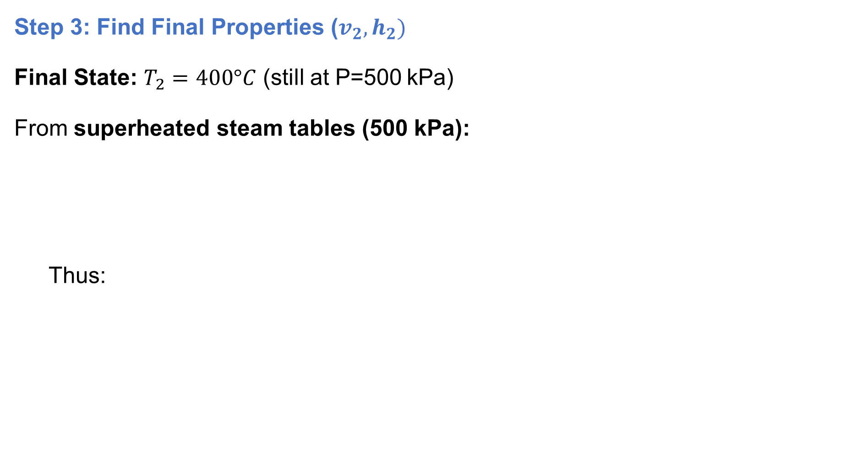
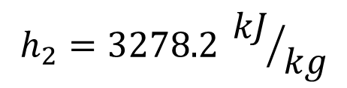
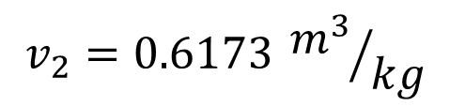
2. Thermodynamics Tables Cont…
Step 3: Find Final Properties ($v_{2},h_{2})$
Final State: $T_{2}=400°C$ (still at P=500 kPa)
From superheated steam tables (500 kPa):
  Thus:
Temp. (°C) | v (m3/kg) | h (kJ/kg)
400 | 0.6173 | 3278.2
$$v_{2}=0.6173 {m^{3}}/{kg}$$
$$h_{2}=3278.2 {kJ}/{kg}$$

Slide 40
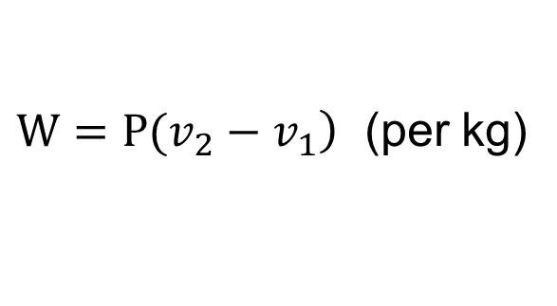
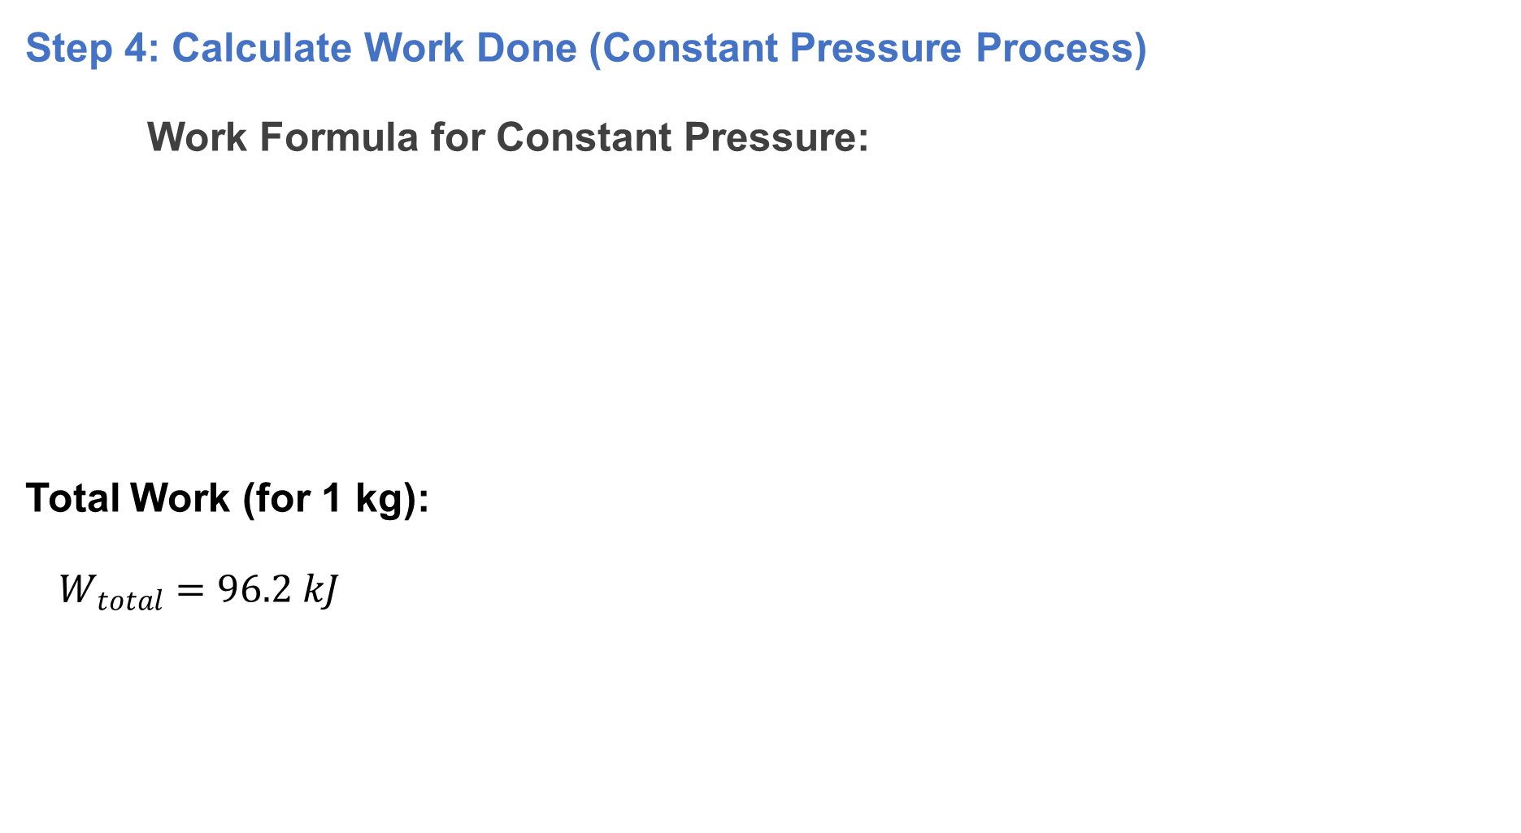
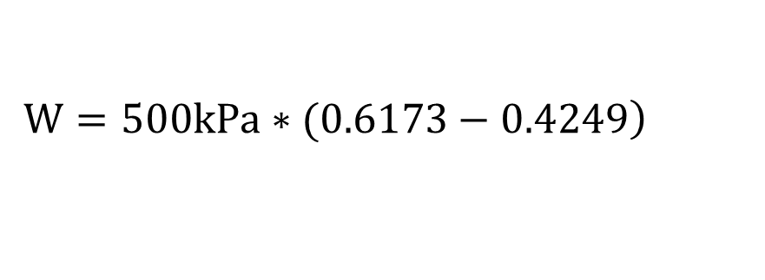
2. Thermodynamics Tables Cont…
Step 4: Calculate Work Done (Constant Pressure Process)
Work Formula for Constant Pressure:
Total Work (for 1 kg):
$W_{total}=96.2 kJ$
$\left.W=P(v_{2}−v_{1}\right)$ (per kg)
$$\left.W=500kPa∗(0.6173−0.4249\right)$$
W = 500*0.1924 =96.2 Kj/kg

Slide 41
2. Thermodynamics Tables Cont…
Reference State and Reference Values
In thermodynamics, a reference state (or reference condition) is a standardized baseline used to define zero values for properties like enthalpy (h), entropy (s), and internal energy (u).
These reference values simplify calculations by providing a consistent starting point for measuring changes in a system.
The values of u, h, and s cannot be measured directly, and they are calculated from measurable properties using the relations between thermodynamic properties.
However, those relations give the changes in properties, not the values of properties at specified state.

Slide 42
2. Thermodynamics Tables Cont…
Reference State and Reference Values
In thermodynamics we are concerned with the changes in properties, and the reference chosen has no consequences in the calculations [3].
For water, the state saturated liquid at 0.01ºC is taken as the reference state, and the internal energy and entropy are assigned zero values at that sate.
For refrigerant 134a, the state saturated liquid at -40ºC is taken as the reference state, and the enthalpy and entropy are assigned zero values at that state.
Always check the reference state in your thermodynamic
tables before solving problems!

Slide 43
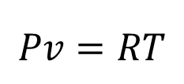
3. The Ideal Gas Equation of State
Property tables provide very accurate information about the properties. But,
They are bulky and vulnerable (exposed) to typographical errors.
A more practical and desirable approach would be to have some simple relations among the properties that are sufficiently general and accurate.
Any equation that relates P-v-T is called Equation of state.
The ideal gas equation of state is a fundamental relationship in thermodynamics that describes the behavior of an ideal gas. It is expressed as:
It is the simplest and best known equation of state
$$Pv=RT$$

Slide 44
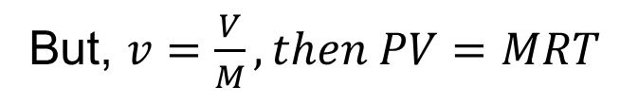

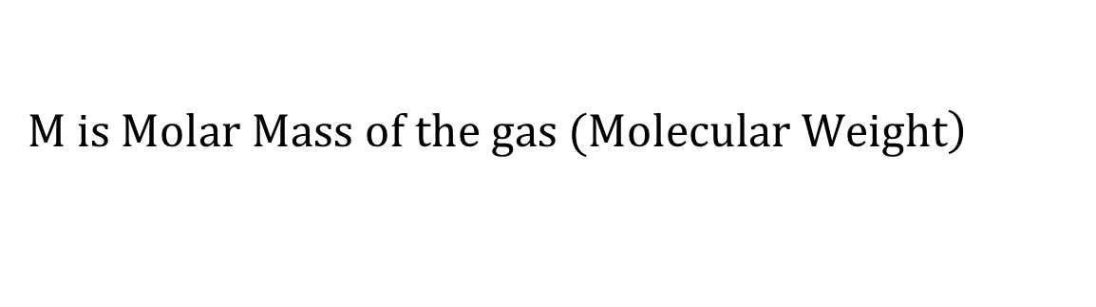
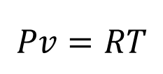
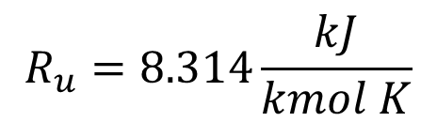

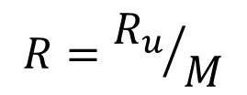
3. The Ideal Gas Equation of State Cont…
The vapor phase of a substance is called gas when it is above the critical temperature.
Vapor implies a gas that is not far from a state of condensation.
$$Pv=RT$$
$$R is the Gas Constant$$
$$R={R_{u}}/M$$
$$R_{u }the universal gas constant$$
$$R_{u}=8.314\frac{kJ}{kmol K}$$
$$\left.M is Molar Mass of the gas (Molecular Weight\right)$$
But, $v=\frac{V}{M}, then PV=MRT$

Slide 45

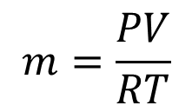
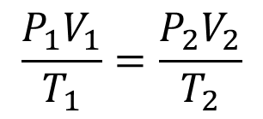
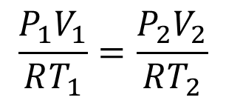
3. The Ideal Gas Equation of State Cont…
The properties of an ideal gas for a fixed mass at two different states are related to each other by:
An ideal gas is an imaginary substance that obeys the P-v-T relation.
An ideal gas is a hypothetical gas whose molecules occupy negligible space and have no interactions, and which consequently obeys the gas laws exactly [4].
At low pressure and high temperature, the density of a
gas decreases, and the gas behaves like an ideal gas.
$$m=\frac{PV}{RT}$$
$$\frac{P_{1}V_{1}}{RT_{1}}=\frac{P_{2}V_{2}}{RT_{2}}$$
$$\frac{P_{1}V_{1}}{T_{1}}=\frac{P_{2}V_{2}}{T_{2}}$$
$$m_{1}=m_{2}$$

Slide 46
3. The Ideal Gas Equation of State Cont…
Many familiar gases such as Air, Nitrogen, Oxygen, Hydrogen, Helium, Argon, Neon, Krypton, and even heavier gases such as Carbon dioxide can be treated as ideal gases with negligible error.
However, dense gases such as water vapor in steam power plants and refrigerant vapor in refrigerators, however, should not be treated as ideal gases.
At pressure below 10 KPa, water vapor can be treated as an ideal gas, regardless of its temperature, with negligible error (less than 0.1%).
At higher pressures, however, the ideal-gas assumption
yields unacceptable errors.

Slide 47
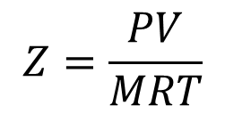
4. Compressibility Factor
Real gases deviate from ideal-gas behavior significantly at state near the saturation region and the critical point.
This deviation at a given temperature and pressure can accurately accounted for by introducing a correction factor called the compressibility factor.
The compressibility factor, often denoted by Z, is a dimensionless number that measures how much a real gas deviates from ideal gas behavior [5].
It is defined as:
$$Z=\frac{PV}{MRT}$$

Slide 48
4. Compressibility Factor
The compressibility factor is a correction factor applied to the ideal gas law to account for deviations from ideal behavior in real gases.
For real gases Z can be greater than or less than unity.
The farther away Z is from unity, the more the gas deviates from ideal-gas behaviour.
Real Gas
Z > 1
Z < 1
Ideal Gas
Z = 1

Slide 49
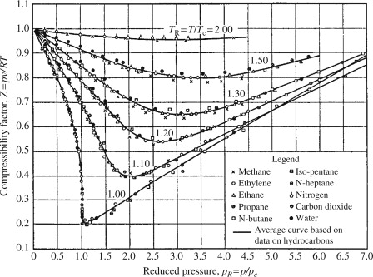
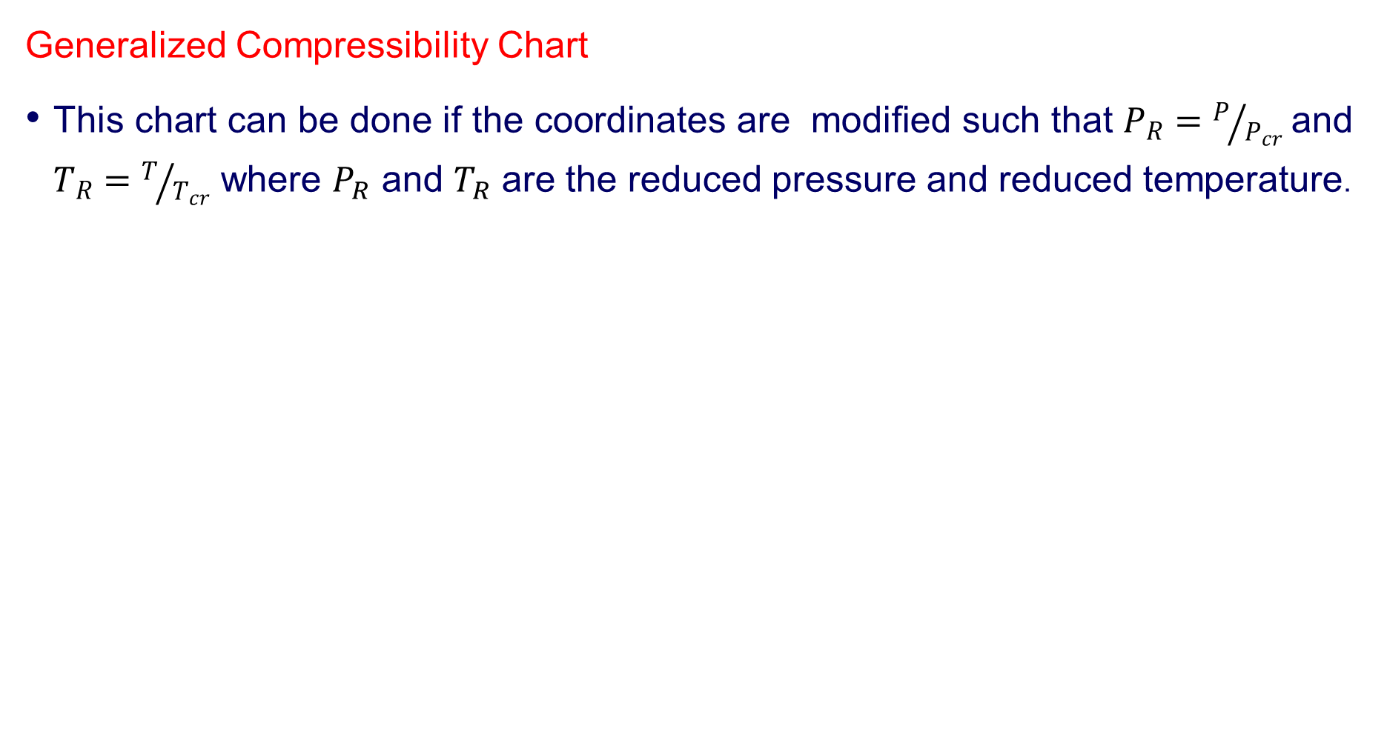
4. Compressibility Factor
Generalized Compressibility Chart
This chart can be done if the coordinates are modified such that $P_{R}=P/{P_{cr}}$and $T_{R}=T/{T_{cr}}$ where $P_{R}$ and $T_{R}$ are the reduced pressure and reduced temperature.
  Figure 4: Generalized Compressibility Chart
  url:https://ars.els-cdn.com/content/image/3-s2.0-B9780123749963000117-f11-02-9780123749963.jpg
The Z factor is the same for all gases at the same reduced pressure and temperature.
This is called the principle of corresponding states.

Slide 50
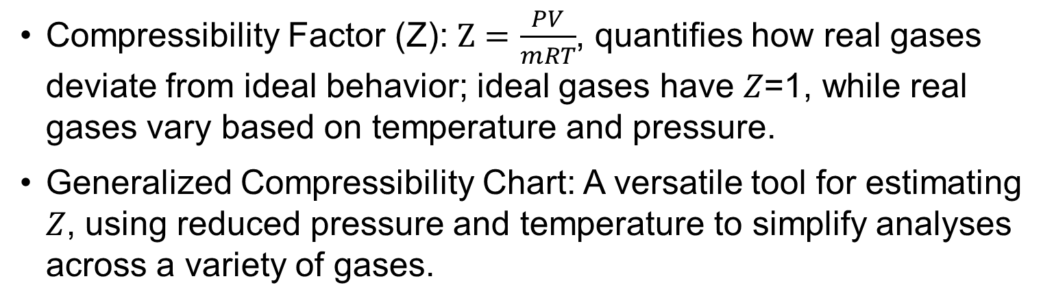
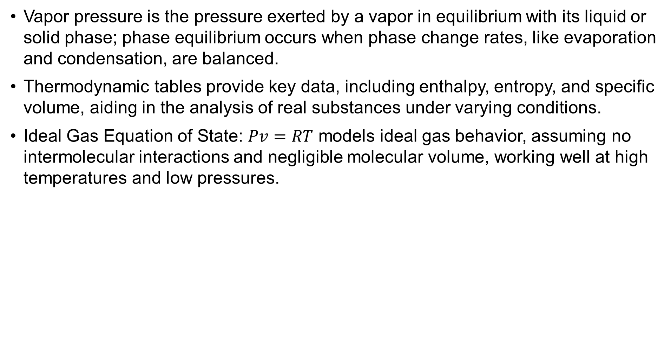
Summary
Vapor pressure is the pressure exerted by a vapor in equilibrium with its liquid or solid phase; phase equilibrium occurs when phase change rates, like evaporation and condensation, are balanced.
Thermodynamic tables provide key data, including enthalpy, entropy, and specific volume, aiding in the analysis of real substances under varying conditions.
Ideal Gas Equation of State: $Pv=RT$ models ideal gas behavior, assuming no intermolecular interactions and negligible molecular volume, working well at high temperatures and low pressures.
Compressibility Factor (Z): $Z=\frac{PV}{mRT}$, quantifies how real gases deviate from ideal behavior; ideal gases have 𝑍=1, while real gases vary based on temperature and pressure.
Generalized Compressibility Chart: A versatile tool for estimating 𝑍, using reduced pressure and temperature to simplify analyses across a variety of gases.

Slide 51
References
,
[1]. Thermodynamics – An Engineering Approach, Cengel Y A.,Bole M A., McGraw-Hill Education, 8th edition 2015.
[2]. Introduction to Thermodynamics and Heat Transfer, Cengel, McGraw-Hill Education, Second edition, 2008.
[3]. Thermodynamic Aspects of Energy, Ibrahim Dincer, Calin Zamifirescu, 2018, Pages 153-211, https://doi.org/10.1016/B978-0-12-809597-3.00105-X.
[4]. Fundamentals of Thermal and Nuclear Power Generation, Tomio Okawa, Hitoshi Asano, JSME Series in Thermal and Nuclear Power Generation, Volume 1, 2021, Pages 77-226, https://doi.org/10.1016/B978-0-12-820733-8.00003-0.
[5]. Gas Turbine Engineering Handbook, Meherwan P. Boyce, 2012, Pages 139-176, https://doi.org/10.1016/B978-0-12-383842-1.00003-2.

Slide 52
Thank you !

