Slide 1
Engineering Thermodynamics I
Lecture 7
Second Law of Thermodynamics
Lecturer: Dr. Melaku Desta

Slide 2
Lecture learning outcomes:
At the end of this lecture, you will be able to:
Understand the second law of thermodynamics and recognize the limitations of energy conversion.
Understand the role of thermal reservoirs in storing and transferring heat.
Analyze how heat engines operate and their efficiency limitations.
Assess the impact of the second law on real-world applications like power generation.
Apply thermodynamic concepts to improve
energy efficiency in engineering systems.

Slide 3
Content
Second Law of Thermodynamics
Thermal Energy Reservoirs
Thermodynamic Cycles
Heat Engines
Efficiency and Performance of Heat Engines
Summary
References

Slide 4
1. Second Law of Thermodynamics
The Second Law of Thermodynamics states that in any energy transfer or transformation, the total entropy (disorder) of a system and its surroundings always increases [1].
In other words, it states that processes occur in a certain direction, not in just any direction.
For example:
  Water flows down a waterfall.
  Gases expand from a region of high pressure to a lower
  pressure.
  Heat moves from an area of elevated temperature to one with
  a lower temperature.

Slide 5
1. Second Law of Thermodynamics Cont…
It implies that natural processes tend to move towards greater randomness and lower efficiency in energy conversion.
Physical processes in nature can proceed toward equilibrium spontaneously.
Once a spontaneous process occurs, it can be reversed, but not without external energy input.
This law is fundamental in understanding energy limitations, thermodynamic efficiency, and the behavior of heat engines.

Slide 6
1. Second Law of Thermodynamics Cont…
In simpler terms:
  Heat naturally flows from hot objects to cold ones, never the reverse without external work.
  No engine or machine can be 100% efficient, as some energy is always lost as waste heat.
  Entropy is a measure of disorder, and the universe naturally evolves towards higher entropy.

Slide 7
1. Second Law of Thermodynamics Cont…
While a spontaneous process can theoretically be reversed, doing so requires an external energy source because nature doesn't automatically undo these changes.
For example:
    To move heat from a cold object back to a hot one, a heat pump or refrigerator is needed.
    To push water back up a waterfall, work must be done,
    such as pumping the water upward.
    To compress a gas that has expanded, external force
    must be applied.

Slide 8
1. Second Law of Thermodynamics Cont…
Differences between the First and the Second Laws of Thermodynamics
The first law of thermodynamics does not specify the direction of energy transfer.
It only asserts that energy cannot be created or destroyed, merely transformed from one form to another.
However,
The Second Law is about energy efficiency, heat energy
naturally spreads out, making some processes irreversible
due to entropy increase.

Slide 9
1. Second Law of Thermodynamics Cont…
The core differences are:
Aspect | First Law | Second Law
Focus | Energy conservation | Entropy and direction of processes
Limitation | Doesn’t restrict process direction | Defines permissible process directions
Mathematical Form | ΔU=Q−W | ΔS≥0 (for isolated systems)
Practical Implication | Energy accounting (e.g., engines) | Efficiency limits (e.g., heat engines)

Slide 10
2. Thermal Energy Reservoirs
A thermal energy reservoir is a hypothetical or real body with a very large thermal capacity that can supply or absorb finite amounts of heat without changing temperature [2].
A thermal energy reservoir acts as a source/sink in thermodynamic cycles (e.g., heat engines, refrigerators).
  Source (High-Temperature Reservoir):
    Supplies heat energy (e.g., the sun, furnace, nuclear reactor).
  Sink (Low-Temperature Reservoir):
    Absorbs waste heat (e.g., atmosphere, oceans, cooling water).

Slide 11
2. Thermal Energy Reservoirs Cont…
Thermal reservoirs are idealized but essential for thermodynamic cycles.
They dictate efficiency limits (Carnot efficiency).
Applications of thermal energy reservoirs are in:
  Power plants (steam turbines)
  Refrigeration and heat pumps
  Renewable energy systems (solar and geothermal energy)

Slide 12
2. Thermal Energy Reservoirs Cont…
Heat and Work Reservoirs
Heat and work reservoirs are essential concepts in thermodynamics, particularly in understanding energy transfer.
Heat Reservoir
A heat reservoir is a large system that can absorb or release heat without undergoing a significant change in temperature.
It can exchange heat without noticeable temperature fluctuations.
It serves as a source or sink for thermal energy.
A source in a thermal energy reservoir is a system that supplies heat energy to another system

Slide 13
2. Thermal Energy Reservoirs Cont…
A thermal energy source plays a vital role in processes like power generation, heating, and refrigeration.
Examples of thermal energy sources:
  Boilers
  Furnaces
  Sun
  Geothermal sources

Slide 14
2. Thermal Energy Reservoirs Cont…
A sink in a thermal energy reservoir is a system that absorbs heat energy from another system.
It has a large thermal capacity, meaning it can take in heat without undergoing a significant change in temperature.
A sink plays a crucial role in processes like cooling systems, heat dissipation, and maintaining thermal equilibrium in nature.
Examples of thermal energy sink:
  Oceans & Large Water Bodies
  Atmosphere
  Cooling Towers
  Radiators

Slide 15
2. Thermal Energy Reservoirs Cont…
2. Work Reservoir
A work reservoir is a system capable of performing or receiving work without significant change in its condition.
In other words, a work reservoir is a large system in stable equilibrium that can supply or absorb finite amounts of work adiabatically without undergoing any change in its properties (e.g., pressure, volume).
Unlike heat reservoirs, work reservoirs do not transfer energy via heat but through mechanical, electrical, or other work interactions.

Slide 16
2. Thermal Energy Reservoirs Cont…
Work reservoirs provide a steady source of work for engines, machines, and electrical systems.
Examples:
  A battery supplying electrical work,
  A hydraulic pump exerting mechanical work.
  Fly wheels
  Piston engines

Slide 17

3. Thermodynamic Cycles
A Thermodynamic Cycle is a series of processes that a working fluid undergoes to convert heat energy into work or vice versa, returning to its original state after completing the cycle.
These cycles are fundamental in power generation, refrigeration, and various industrial applications.
Thermodynamic cycles involve a working substance (such as steam, air, or gas).
They operate in a closed loop, where the fluid returns to its initial state.
$P_{f}=P_{i}, T_{f}=T_{i}, u_{f}=u_{i}, v_{f}=v_{i}…$

Slide 18
3. Thermodynamic Cycles Cont…
Thermodynamic cycles uses heat transfer and work interactions to drive the cycle.
They are governed by the laws of thermodynamics, particularly the First and Second Laws.
In thermodynamics, there are two types of cycles:
  Power Cycles
  Refrigeration Cycles

Slide 19
3. Thermodynamic Cycles Cont…
Power Cycles
Convert thermal energy into mechanical work.
Examples:
  Carnot Cycle – Theoretical maximum efficiency cycle.
  Rankine Cycle – Used in steam power plants.
  Brayton Cycle – Found in gas turbines and jet engines.
  Otto Cycle – Used in internal combustion engines (e.g., gasoline engines).
  Diesel Cycle – Used in diesel engines.

Slide 20
3. Thermodynamic Cycles Cont…
2. Refrigeration Cycles
Transfer heat from lower-temperature regions to higher-temperature regions using work input.
Examples:
  Carnot Refrigeration Cycle – Theoretical cooling system.
  Vapor Compression Refrigeration Cycle – Used in refrigerators and air conditioners.
  Absorption Refrigeration Cycle – Used in industrial cooling
  systems.

Slide 21
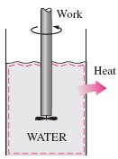
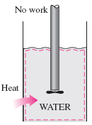
4. Heat Engines
Work can be readily transformed into various forms of energy, but converting other types of energy into work is significantly more challenging.
While work can be entirely and directly converted into heat, the reverse process, transforming heat into work, necessitates the use of some
specialized devices. These devices are called heat engines.
  Figure 1: Work and Heat Energy
url: https://slideplayer.com/slide/5370522/17/images/2/5-1+Work+Always+Converts+Directly+and+Completely+to+Heat,+But+not+the+Reverse..jpg

Slide 22
4. Heat Engines Cont…
A heat engine is a device that converts heat energy into mechanical work by exploiting temperature differences between a heat source and a heat sink.
A heat engine is a thermodynamic system operating in a thermodynamic cycle to which net heat is transferred and from which net work is delivered [3].
It operates in a cyclic process, absorbing heat from a high-temperature reservoir, converting part of it into work, and releasing the remaining energy to a low-temperature reservoir.
The working fluid within the system undergoes a sequence
of thermodynamic processes that collectively form the
heat engine cycle.

Slide 23
4. Heat Engines Cont…
The components of heat engine are:
  Heat source
  Working substance
  Mechanism for work output
  Heat sink
Examples:
  Steam Turbines
  Internal Combustion Engines
  Gas Turbines

Slide 24
4. Heat Engines Cont…
Types of Heat Engines
Heat engines can be broadly categorized into two main types:
  External Combustion Engines
  Internal Combustion Engines
These engines operate on different principles but serve the same fundamental purpose, converting thermal energy into mechanical work.

Slide 25
4. Heat Engines Cont…
  External Combustion Engines
In these engines, fuel combustion occurs externally, heating a working fluid such as steam or air, which then drives the engine.
  Steam Engine: Uses steam to produce motion; historically used in locomotives and early industrial machinery.
  Steam Turbine: Commonly used in power plants; steam spins a turbine to generate electricity.
  Stirling Engine: Uses cyclic compression and expansion of
  gas to generate power; known for high efficiency and low
  emissions.

Slide 26
4. Heat Engines Cont…
  2. Internal Combustion Engines
Internal combustion engines burn fuel directly inside the engine cylinder, generating power more efficiently and compactly.
Reciprocating Engines:
  Otto Cycle (Gasoline Engine): Used in cars and motorcycles, operates using spark ignition.
  Diesel Engine: Higher efficiency than gasoline engines;
  used in trucks, ships, and generators.
  Dual-Fuel Engine: Uses both gasoline and diesel
  for improved efficiency.

Slide 27
4. Heat Engines Cont…
  2. Internal Combustion Engines
Rotary Engines:
  Wankel Engine: Compact and smooth operation, used in some sports cars.
  Gas Turbine Engine: Used in jet aircraft and some power plants, operates at high speeds.
Internal combustion engines are lightweight and compact design, has higher power-to-weight ratio and faster response time [4], however,
They have more complex cooling and lubrication systems required
and produces more emissions compared to external combustion
engines.

Slide 28
4. Heat Engines Cont…
  3. Other Advanced Heat Engines
    Jet Engines: Used in aviation; generates thrust by expelling hot gases at high speed.
    Rocket Engines: Operate in space; expel gases to produce thrust based on Newton’s Third Law.
    Closed-Cycle Gas Turbines: Used for specialized high-efficiency applications.

Slide 29
4. Heat Engines Cont…
Application Areas of Heat Engines
1. Power Generation
  Steam turbines (coal, nuclear, geothermal).
  Gas turbines (peaking power plants).
2. Transportation
  Automotive: ICE (cars, trucks).
  Aerospace: Jet engines, rocket propulsion.
  Marine: Diesel engines, steam turbines (ships).
3. Industrial & Niche Uses
  Stirling engines: Solar dishes, space probes
  Micro-CHP: Combined heat and power for homes.

Slide 30
4. Heat Engines Cont…
While heat engines vary significantly in design and application, they all share the following four fundamental characteristics:
  Heat Input: They absorb thermal energy from a high-temperature source (e.g., solar radiation, fossil fuel combustion, or nuclear reactions).
  Work Output: They convert a portion of this heat into useful mechanical work (typically manifested as shaft rotation).
  Heat Rejection: They discharge the unconverted waste heat to a low-temperature sink (such as ambient air or bodies of water).
  Cyclic Operation: They function through a continuous
  thermodynamic cycle, enabling repeated energy
  conversion.

Slide 31
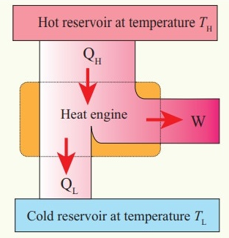
4. Heat Engines Cont…
Heat Engines
  Figure 1: Heat Engine
url: https://img.brainkart.com/imagebk43/bz6GJ20.jpg

Slide 32
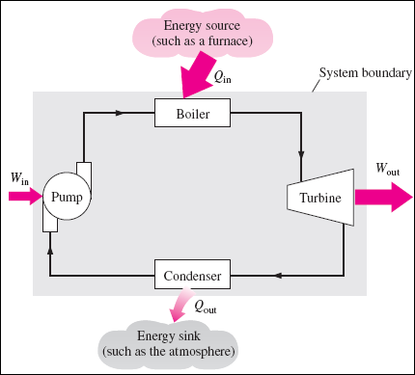
4. Heat Engines Cont…
Among work-producing devices, the steam power plant most closely exemplifies the fundamental principles of a heat engine.
  Figure 3: Steam Power Plant
url:https://slideplayer.com/slide/5370522/17/images/4/Schematic+of+Steam+Power+Plant.jpg

Slide 33
4. Heat Engines Cont…
  Q_{in} = amount of heat supplied to steam in boiler from a high-temperature source (furnace).
  Q_{out}= amount of heat rejected from steam in condenser to a low-temperature sink (the atmosphere, a river, etc.)
  W_{out} = amount of work delivered by steam as it expands in turbine
  W_{in} = amount of work required to compress water to boiler pressure

Slide 34




4. Heat Engines Cont…
Using the first law of thermodynamics for the system:
0 (Cyclic)
$$Q_{net,in}−W_{net,out}= ΔU$$
$$W_{net,out}= Q_{net,in}$$
$$W_{net,out}= Q_{in}−Q_{out}$$
$$W_{net,out}= Q_{H}−Q_{L}$$

Slide 35
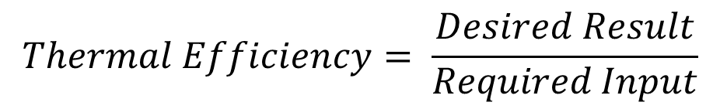
5. Efficiency and Performance of Heat Engines
To compare the output with the input, we define the Thermal Efficiency of the cycle.
Thermal efficiency measures the performance of a work-producing device or heat engine.
It is defined as the ratio of net work output (the useful result) to heat input (the energy required to achieve it)
$$Thermal Efficiency= \frac{Desired Result}{Required Input}$$

Slide 36
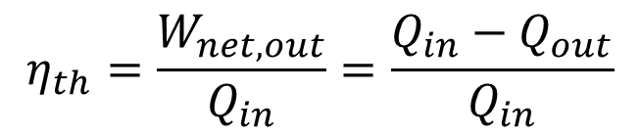
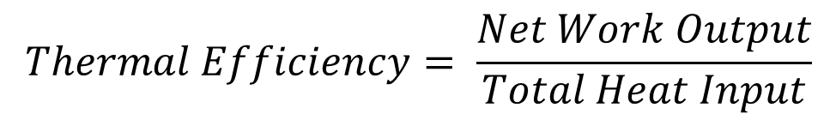
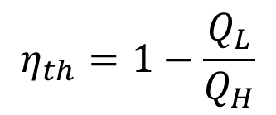
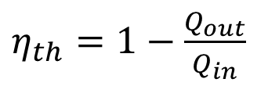
5. Efficiency and Performance of Heat Engines Cont…
The thermal efficiency is always less than 1 or less than 100 percent.
$$Thermal Efficiency= \frac{Net Work Output}{Total Heat Input}$$
$$η_{th}=\frac{W_{net,out}}{Q_{in}}=\frac{Q_{in}−Q_{out}}{Q_{in}}$$
$η_{th}=1−\frac{Q_{out}}{Q_{in}}$
$$η_{th}=1−\frac{Q_{L}}{Q_{H}}$$

Slide 37
5. Efficiency and Performance of Heat Engines Cont…
In an idealized reversible expansion with negligible friction, perfect insulation, and quasi-equilibrium conditions, the total heat transfer (Q) to the system is greater than the work performed (W), as a portion of Q contributes to increasing the internal energy (ΔU) of the gas.
From this discussion, we conclude that all heat engines inevitably lose some energy by transferring it to a lower-temperature reservoir, as this process is essential for completing the cycle.
‘No heat engine can convert all the heat it receives to useful work’ [5].

Slide 38


5. Efficiency and Performance of Heat Engines Cont…
Example 1:
A steam power plant receives 1800 MJ of heat energy from a high-temperature reservoir and rejects 1100 MJ to the low-temperature sink.
Determine:
  The work output of the plant.
  The thermal efficiency of the steam power plant.
  Given:
$$Q_{H}=1800 MJ$$
$$Q_{L}=1100 MJ$$

Slide 39



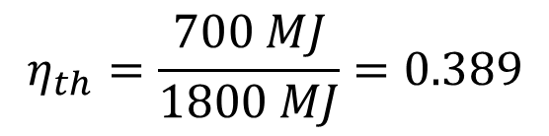
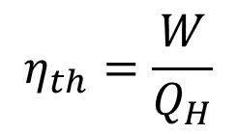

5. Efficiency and Performance of Heat Engines Cont…
Solution:
From the first law of thermodynamics:
The thermal efficiency is:
$$W_{out}=Q_{H}−Q_{L}$$
$$W_{out}=\left(1800−1100\right) MJ$$
$$W_{out}=700 MJ$$
$$η_{th}=\frac{W}{Q_{H}}$$
$$η_{th}=\frac{700 MJ}{1800 MJ}=0.389$$
$$η_{th}=38.9\%$$

Slide 40
5. Efficiency and Performance of Heat Engines Cont…
Example 2:
A coal-fired steam power plant has the following operating parameters:
  Net power output: 300 MW
  Overall thermal efficiency: 32%
  Air-fuel ratio: 12 kg air/kg coal
  Coal heating value: 28,000 kJ/kg
Determine:
  a. Daily coal consumption (24-hour operation)
  b. Mass flow rate of combustion air

Slide 41
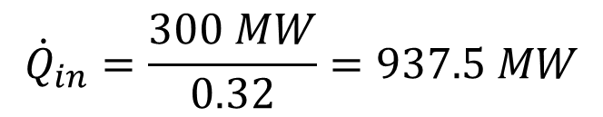
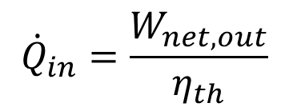
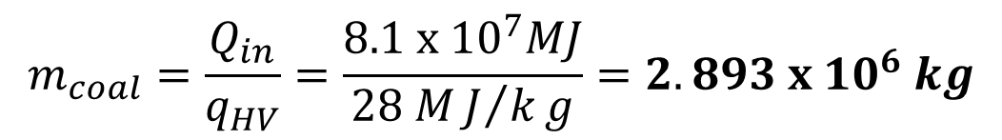

5. Efficiency and Performance of Heat Engines Cont…
Solution:
$${\dot{Q}}_{in}=\frac{W_{net,out}}{η_{th}}$$
$${\dot{Q}}_{in}=\frac{300 MW}{0.32}=937.5 MW$$
And we know that, $Q_{in}={(\dot{Q}}_{in}Δt)=(937.5{MJ}/s)(24 x 3600s)$
$$Q_{in}=8.1 x {10}^{7}MJ$$
The amount and rate of fuel consumed during 24 hours are:
$$m_{coal}=\frac{Q_{in}}{q_{HV}}=\frac{8.1 x {10}^{7}MJ}{28 MJ/kg}=2.893 x {10}^{6} kg$$

Slide 42
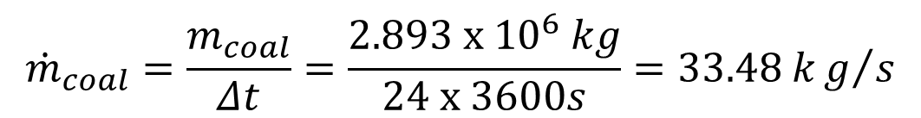
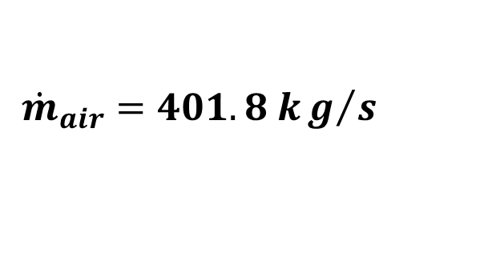
5. Efficiency and Performance of Heat Engines Cont…
Therefore,
$${\dot{m}}_{coal}=\frac{m_{coal}}{Δt}=\frac{2.893 x {10}^{6} kg}{24 x 3600s}=33.48 kg/s$$
The air-fuel ratio is 12, the mass flowrate of the combustion air is
$$\left.{\dot{m}}_{air}=\left(AF\right){\dot{m}}_{coal}=(12 {kg air}/{kg fuel})(33.48 kg/s\right)$$
$${\dot{m}}_{air}=401.8 kg/s$$

Slide 43
Summary
Second Law of Thermodynamics states that heat naturally flows from hot to cold and that entropy in an isolated system always increases.
Thermal energy reservoirs are large sources or sinks of heat that maintain a constant temperature while exchanging energy.
Thermodynamic cycles are repeated processes where systems return to their initial state, enabling continuous energy conversion.
Heat engines are devices that convert thermal energy into mechanical work using cyclic processes and heat transfer principles.
The performance of heat engines is evaluated using key metrics
that assess efficiency, work output, and operational limits.

Slide 44
References
,
[1]. Thermodynamics – An Engineering Approach, Cengel Y A.,Bole M A., McGraw-Hill Education, 8th edition 2015.
[2]. Exergy and Energy Analyses of Thermal Systems with Applications in Power Plants: A Review M. A. Ahmadi, M. H. Ahmadi, and F. Pourfayaz, Energy Reports, vol. 7, pp. 2598–2625, 2021.
[3]. Thermodynamic Aspects of Energy, Ibrahim Dincer, Calin Zamifirescu, 2018, Pages 153-211, https://doi.org/10.1016/B978-0-12-809597-3.00105-X.
[4]. Thermodynamic Optimization of Finite-Time Processes with Applications to Heat Engines R. S. Berry, V. Kazakov, S. Sieniutycz, Z. Szwast, and A. M. Tsirlin, Applied Thermal Engineering, vol. 18, no. 9-10, pp. 687-702, 1998.
[5]. George B, Arfken, David F, Griffing, Donald C, Kelly, Joseph Priest, The Second Law of Thermodynamics. 2012 International Edition University Physics, https://doi.org/10.1016/B978-0-12-059858-8.50029-7

Slide 45
Thank you !

