Slide 1
Engineering Thermodynamics I
Lecture 8
Second Law of Thermodynamics
Lecturer: Dr. Melaku Desta

Slide 2
Lecture learning outcomes:
At the end of this lecture, you will be able to:
Understand the fundamental principles behind refrigerators and heat pumps, including their working mechanisms and energy transfer processes.
Explore the key statements of the second law of thermodynamics
Examine the Carnot Cycle and the four stages of the Carnot cycle
Calculate the efficiency of a Carnot heat engine and understand its operational limitations
Investigate the function of Carnot refrigerators and
heat pumps

Slide 3
Content
Refrigerators and Heat Pumps
Statements of the Second Law of Thermodynamics
The Carnot Cycle
The Carnot Heat Engine
The Carnot Refrigerator and Heat Pumps
Summary
References

Slide 4
1. Refrigerators and Heat Pumps
A well-known observation from everyday experience is that heat flows from regions of higher temperature to those of lower temperature, or from warmer mediums to cooler ones.
The reverse process, however, cannot happen spontaneously.
Transferring heat from a colder medium to a hotter one requires specialized devices known as refrigerators.
Refrigerators and heat pumps are devices that transfer heat against
its natural flow, from a colder region to a hotter one, by consuming
external work [1].

Slide 5
1. Refrigerators and Heat Pumps Cont…
i. Refrigerators
Refrigerators, like heat engines, are cyclic devices.
The working fluid used in the refrigeration cycle is called a refrigerant.
The key components of a refrigerator includes:
  Evaporator: Absorbs heat from the cold space (low-pressure refrigerant).
  Compressor: Increases refrigerant pressure/temperature.
  Condenser: Releases heat to the surroundings.
  Expansion Valve: Lowers pressure, cooling the refrigerant.

Slide 6
1. Refrigerators and Heat Pumps Cont…
There are different types of refrigeration system:
  Vapor-Compression Refrigeration (most common).
  Vapor-Absorption Refrigeration (uses heat energy instead of mechanical work).
  Thermoelectric Cooling (Peltier effect for small-scale applications).
  Cryogenic Refrigeration System (Used for extremely low temperatures, often in scientific and medical applications)
  Magnetic Refrigeration (emerging technology).

Slide 7
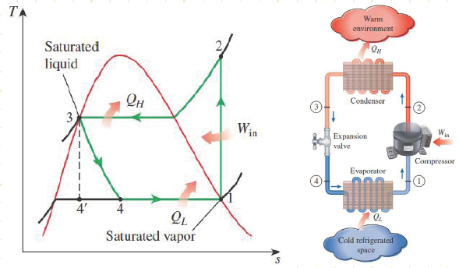
1. Refrigerators and Heat Pumps Cont…
Refrigerator Components
  Figure 1: Components of a Refrigerator
url: https://www.engineersedge.com/graphics/chap14-1.png

Slide 8
1. Refrigerators and Heat Pumps Cont…
ii. Heat Pumps
A heat pump is another device that moves heat from a low-temperature medium to a high-temperature one.
Uses external energy (electricity) to pump heat from low-temperature to high-temperature spaces.
It works similarly to a refrigerator but can also provide heating by absorbing heat from the outside (air, ground, or water) and releasing it indoors.

Slide 9
1. Refrigerators and Heat Pumps Cont…
Refrigerators and heat pumps operate on the same cycle but differ in their objectives.
    The objective of a refrigerator is to maintain the refrigerated space at a low temperature by removing heat from it.
    The objective of a heat pump, however, is to maintain a heated space at a high temperature.

Slide 10
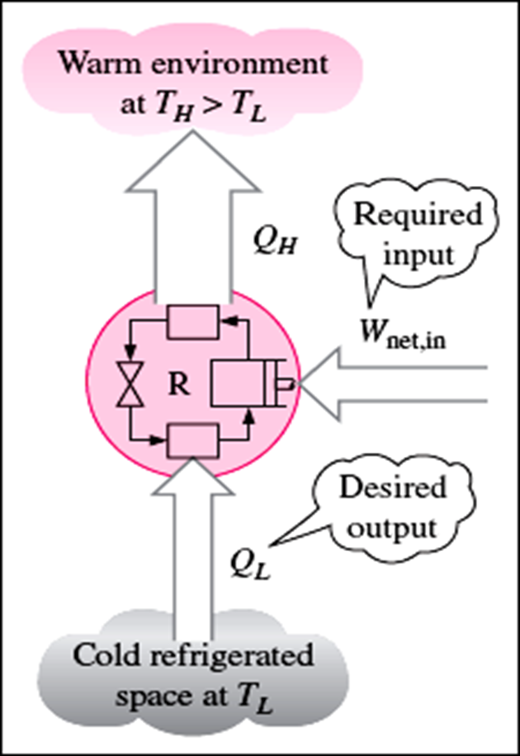
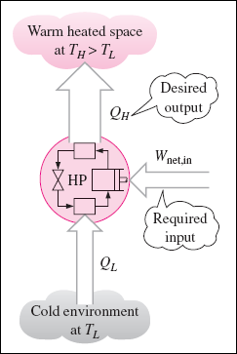
1. Refrigerators and Heat Pumps Cont…
Refrigerator and Heat Pump
  Figure 2: Refrigerator and Heat Pump
url: https://encrypted-tbn0.gstatic.com/images?q=tbn:ANd9GcSGEw6t1-9xp6m_afufb8i5YKUwEdhhLXOb8Vov3eVUTjORCVfaIthDpdHOcYY7XqdaINM&usqp=CAU

Slide 11
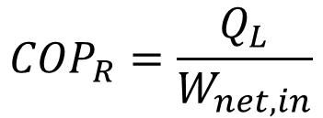
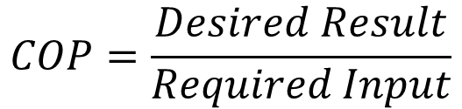
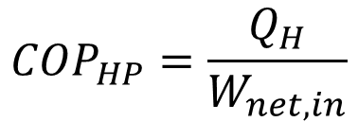
1. Refrigerators and Heat Pumps Cont…
The performance of a refrigerator or heat pump is quantified by its coefficient of performance (COP).
Coefficient of Performance (COP) is defined as the ratio of useful thermal energy transferred to the required work input.
            And,
$$COP=\frac{Desired Result}{Required Input}$$
$${COP}_{R}=\frac{Q_{L}}{W_{net,in}}$$
$${COP}_{HP}=\frac{Q_{H}}{W_{net,in}}$$

Slide 12
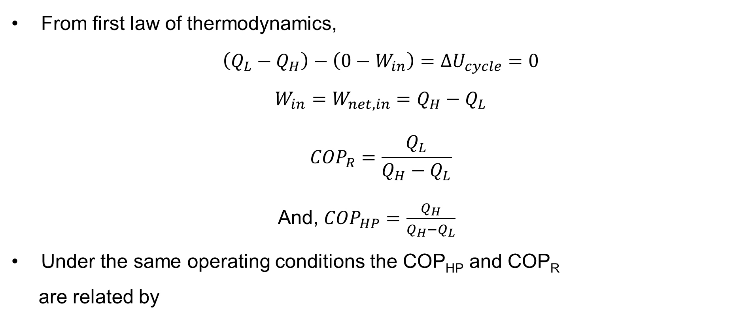

1. Refrigerators and Heat Pumps Cont…
From first law of thermodynamics,
$$\left(Q_{L}−Q_{H}\right)−\left(0−W_{in}\right)=ΔU_{cycle}=0$$
$$W_{in}=W_{net,in}=Q_{H}−Q_{L}$$
$${COP}_{R}=\frac{Q_{L}}{Q_{H}−Q_{L}}$$
And, ${COP}_{HP}=\frac{Q_{H}}{Q_{H}−Q_{L}}$
Under the same operating conditions the COP_{HP} and COP_{R}
are related by
$${COP}_{HP}={COP}_{R}+1$$

Slide 13
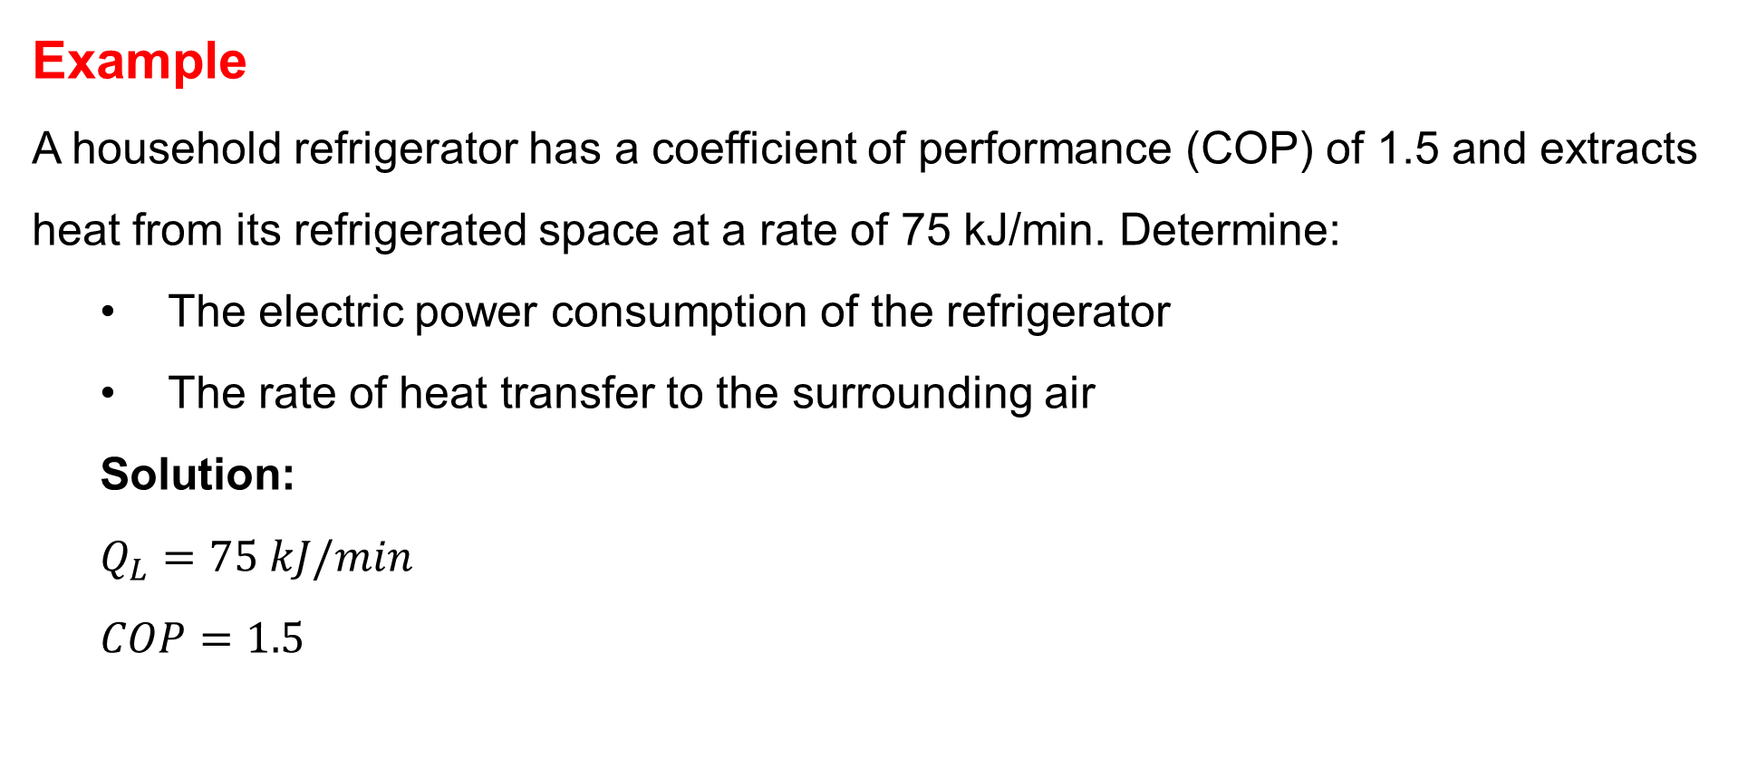
1. Refrigerators and Heat Pumps Cont…
Example
A household refrigerator has a coefficient of performance (COP) of 1.5 and extracts heat from its refrigerated space at a rate of 75 kJ/min. Determine:
  The electric power consumption of the refrigerator
  The rate of heat transfer to the surrounding air
  Solution:
  $$Q_{L}=75 kJ/min$$
  $$COP=1.5$$

Slide 14
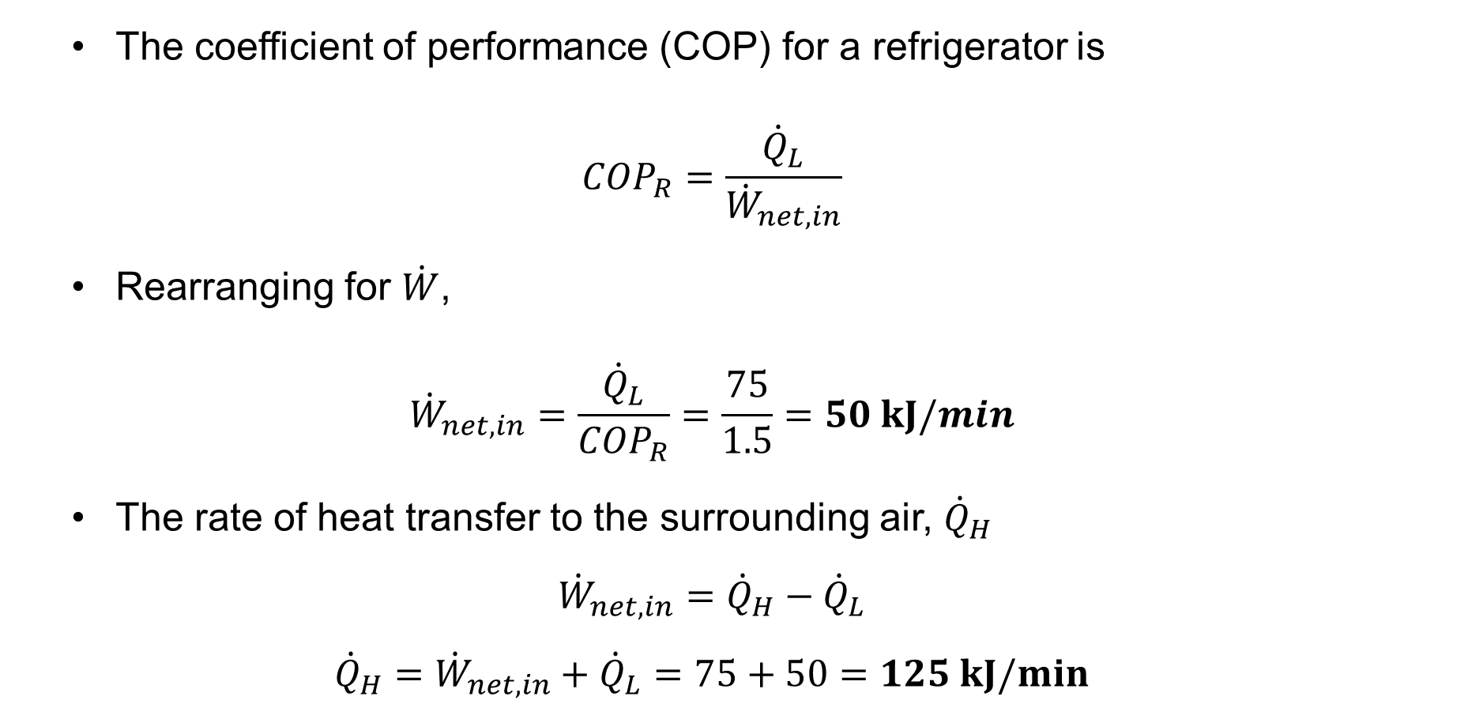
1. Refrigerators and Heat Pumps Cont…
  The coefficient of performance (COP) for a refrigerator is
  $${COP}_{R}=\frac{{\dot{Q}}_{L}}{{\dot{W}}_{net,in}}$$
  Rearranging for $\dot{W}$,
  $${\dot{W}}_{net,in}=\frac{{\dot{Q}}_{L}}{{COP}_{R}}=\frac{75}{1.5}=50 kJ/min$$
  The rate of heat transfer to the surrounding air, ${\dot{Q}}_{H}$
  $${\dot{W}}_{net,in}={\dot{Q}}_{H}−{\dot{Q}}_{L}$$
  $${\dot{Q}}_{H}={\dot{W}}_{net,in}+{\dot{Q}}_{L}=75+50=125 kJ/min$$

Slide 15
2. Statements of the Second Law of Thermodynamics
The second law of thermodynamics provides fundamental principles governing the direction of heat transfer and the limitations of energy conversion.
It is expressed through two main statements:
  Kelvin-Planck Statement (Heat Engine Perspective)
This statement defines the constraints of heat engines:
  It states that, ’A heat engine cannot operate in a cycle and produce work without rejecting some heat to a lower-temperature reservoir’ [2].
  That is, a heat engine must exchange heat with a low-temperature sink as well as a high-temperature source to keep operating.
  This means it is impossible to have a 100% efficient heat
  engine, some energy must always be lost to the surroundings.

Slide 16
2. Statements of the Second Law of Thermodynamics Cont…
  Clausius Statement (Refrigerator Perspective)
This statement applies to refrigerators and heat pumps:
  It states that, ‘Heat cannot spontaneously flow from a colder body to a hotter body without external work being applied’ [2].
  In other words, a refrigerator requires an input of work to transfer heat against its natural direction.
  Thus, the COP of a refrigerator or heat pump must be less than infinity. (COP < ∞)
Both statements are equivalent because violating one
would automatically violate the other.

Slide 17
3. The Carnot Cycle
The Carnot cycle, developed by Sadi Carnot, represents the first theoretical heat engine operating through four reversible processes:
  Two isothermal (constant temperature)
  Two adiabatic (no heat transfer) stages
The Carnot cycle is a theoretical thermodynamic cycle that represents the most efficient possible heat engine [1].
It is an idealized model that sets the upper limit of efficiency for real heat engines, based on the second law of thermodynamics.

Slide 18
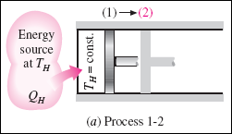
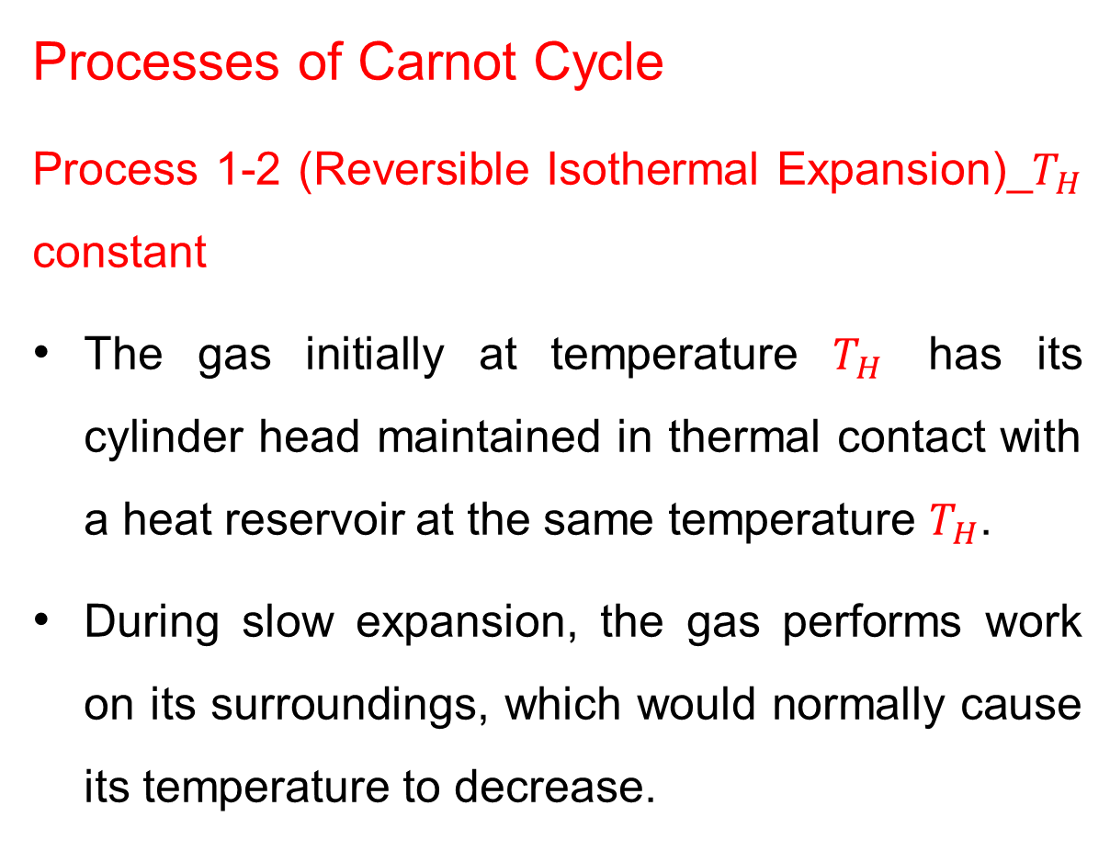
3. The Carnot Cycle Cont…
Processes of Carnot Cycle
Process 1-2 (Reversible Isothermal Expansion)_$T_{H}$ constant
The gas initially at temperature $T_{H}$ has its cylinder head maintained in thermal contact with a heat reservoir at the same temperature $T_{H}$.
During slow expansion, the gas performs work on its surroundings, which would normally cause its temperature to decrease.

Slide 19
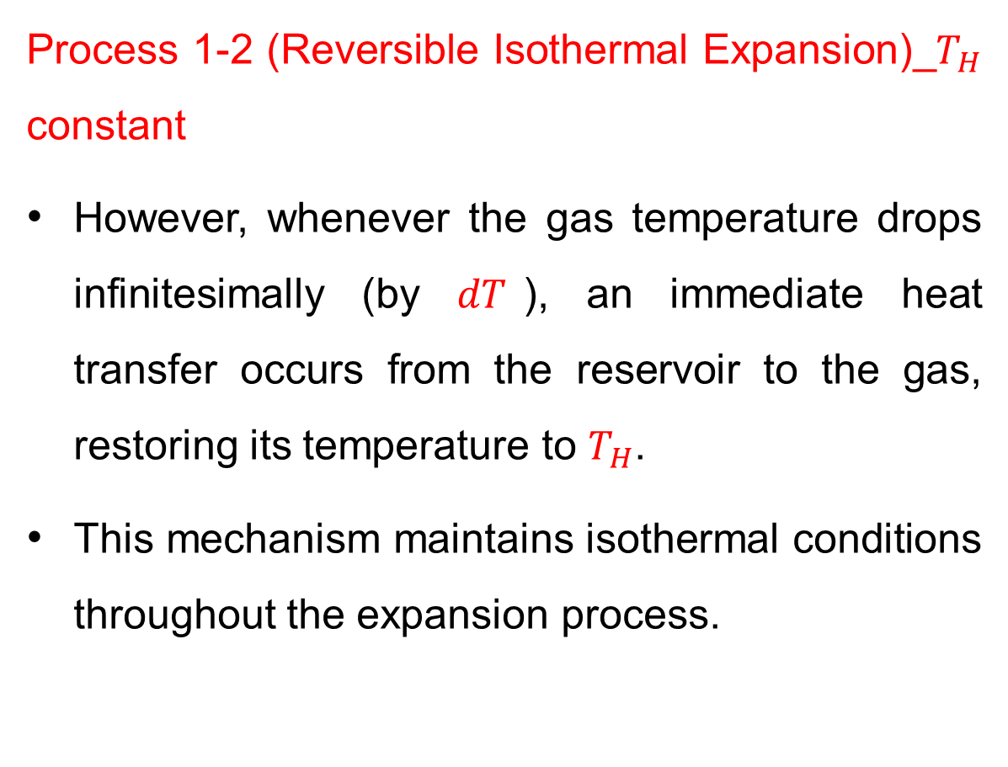
3. The Carnot Cycle Cont…
Process 1-2 (Reversible Isothermal Expansion)_$T_{H}$ constant
However, whenever the gas temperature drops infinitesimally (by $dT$), an immediate heat transfer occurs from the reservoir to the gas, restoring its temperature to $T_{H}$.
This mechanism maintains isothermal conditions throughout the expansion process.

Slide 20
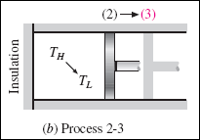
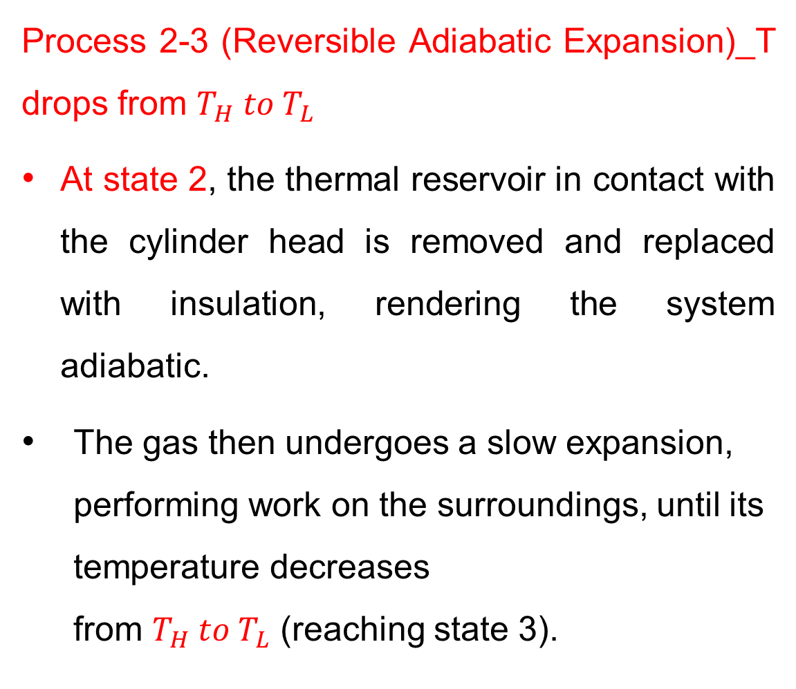
3. The Carnot Cycle Cont…
Process 2-3 (Reversible Adiabatic Expansion)_T drops from $T_{H}{ to T}_{L}$
At state 2, the thermal reservoir in contact with the cylinder head is removed and replaced with insulation, rendering the system adiabatic.
The gas then undergoes a slow expansion, performing work on the surroundings, until its temperature decreases from $T_{H}{ to T}_{L}$ (reaching state 3).

Slide 21
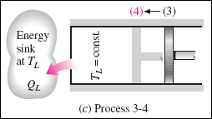
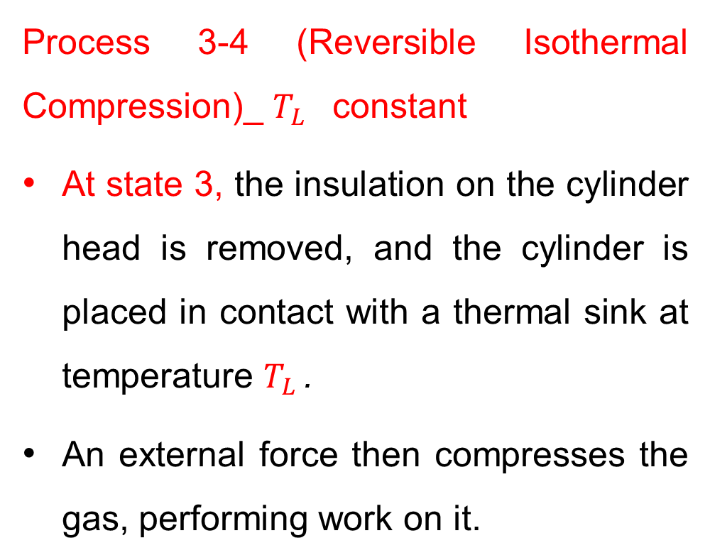
3. The Carnot Cycle Cont…
Process 3-4 (Reversible Isothermal Compression)_ $T_{L}$ constant
At state 3, the insulation on the cylinder head is removed, and the cylinder is placed in contact with a thermal sink at temperature $T_{L}$ .
An external force then compresses the gas, performing work on it.

Slide 22
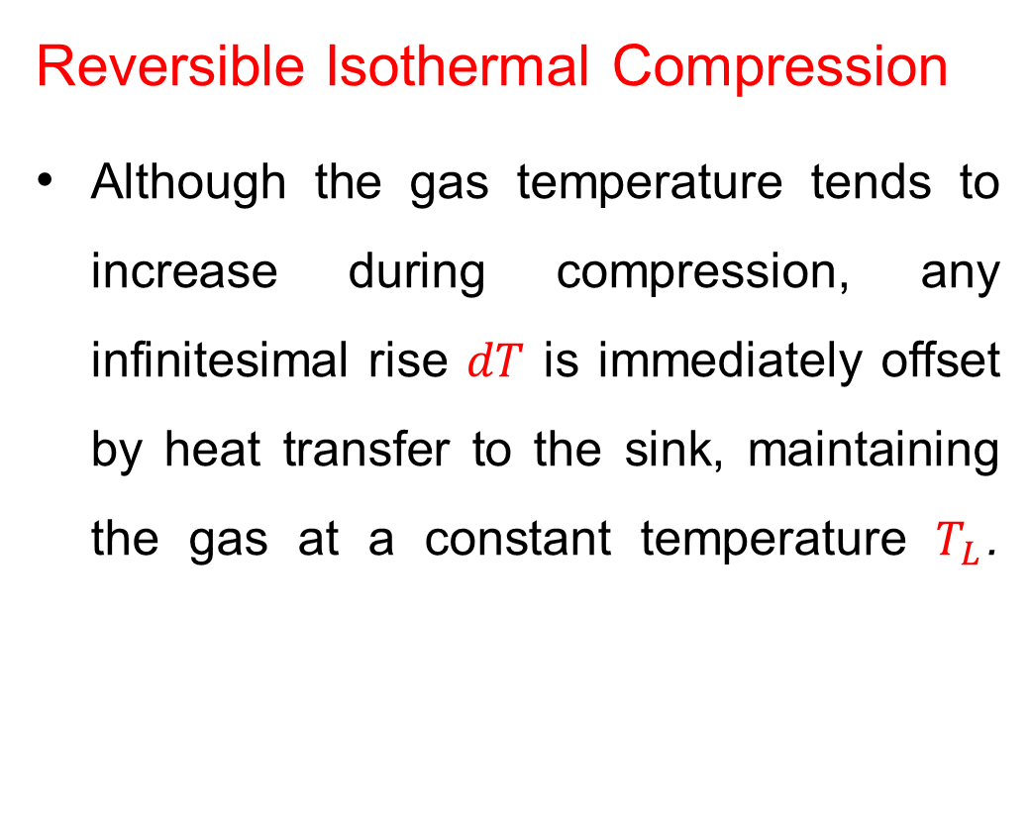
3. The Carnot Cycle Cont…
Reversible Isothermal Compression
Although the gas temperature tends to increase during compression, any infinitesimal rise $dT$ is immediately offset by heat transfer to the sink, maintaining the gas at a constant temperature $T_{L}$.

Slide 23
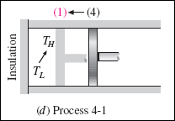
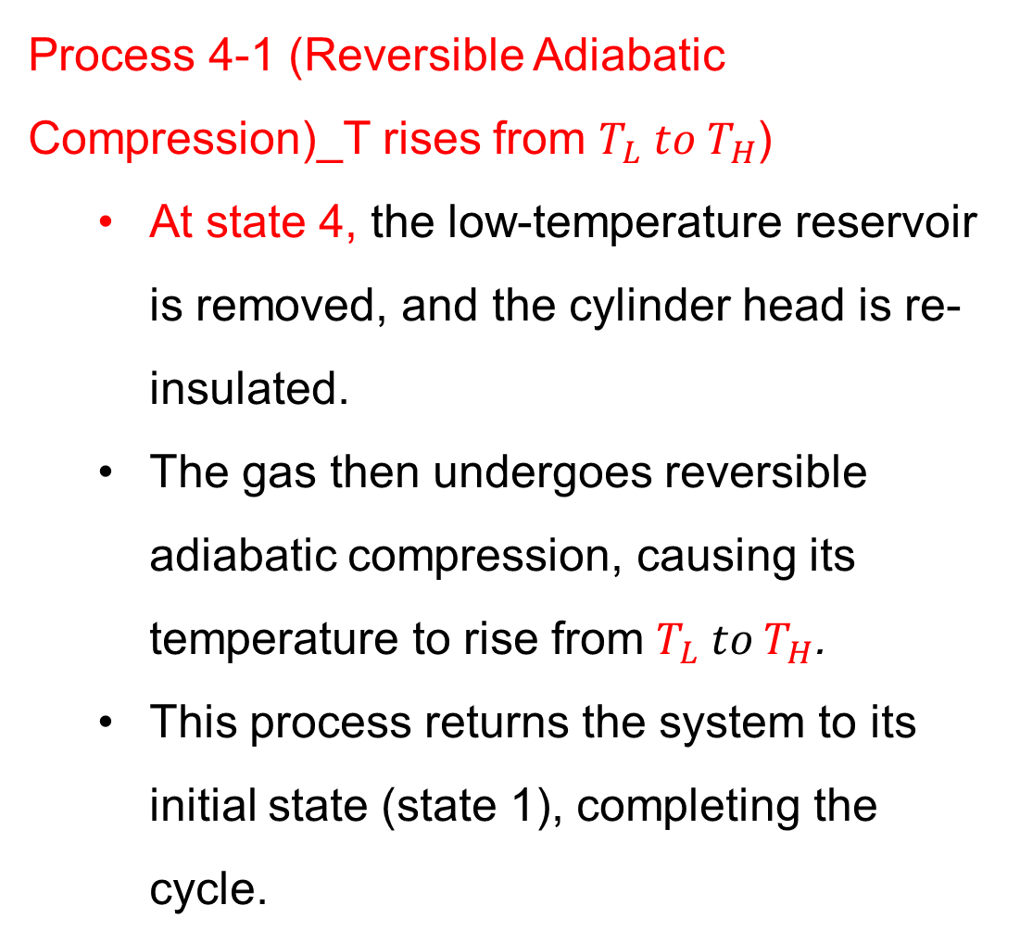
3. The Carnot Cycle Cont…
Process 4-1 (Reversible Adiabatic Compression)_T rises from $T_{L}{ to T}_{H}$)
  At state 4, the low-temperature reservoir is removed, and the cylinder head is re-insulated.
  The gas then undergoes reversible adiabatic compression, causing its temperature to rise from $T_{L}{ to T}_{H}$.
  This process returns the system to its initial state (state 1), completing the cycle.

Slide 24
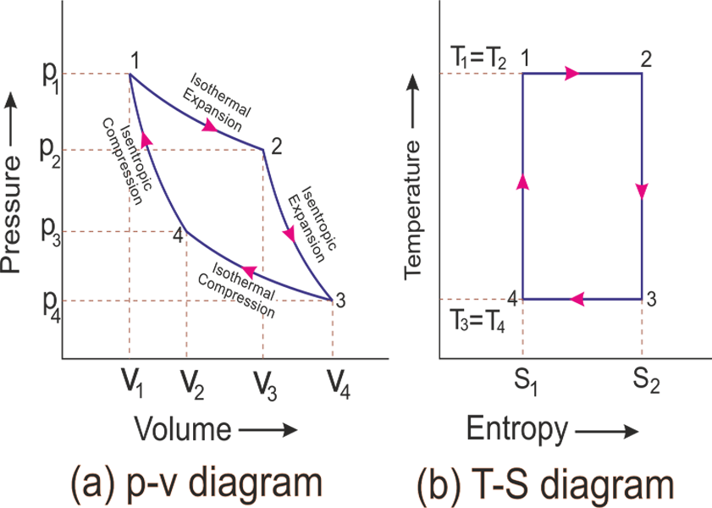
3. The Carnot Cycle Cont…
The P-v Diagram of a Carnot Cycle
  Figure 3: P-V diagram of a Carnot Cycle
url: https://www.mechanicaltutorial.com/pictures/content_picture/carnot_cycle/carnot_cycle_graph.png

Slide 25
3. The Carnot Cycle Cont…
On a P-V diagram, the area beneath a process curve corresponds to the boundary work for quasi-equilibrium (internally reversible) processes. In this cycle:
  The area under curve 1-2-3 represents the work output during expansion (done by the gas).
  The area under curve 3-4-1 represents the work input during compression (done on the gas).
  The enclosed area (1-2-3-4-1) equals the net work output of the cycle, the difference between work produced and work consumed.

Slide 26
4. The Carnot Heat Engines
  The Carnot heat engine is a theoretical model of an ideal heat engine that operates with the maximum possible efficiency engine possible between two given temperatures [3].
  It's based on reversible processes, and its efficiency is solely determined by the temperatures of the hot and cold reservoirs.
  Though no physical engine can ever be truly Carnot-perfect, engineers use its principles to improve the efficiency of real-world thermal engines, such as those in power plants and automobiles.

Slide 27
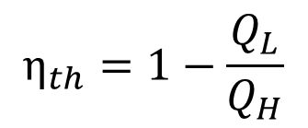
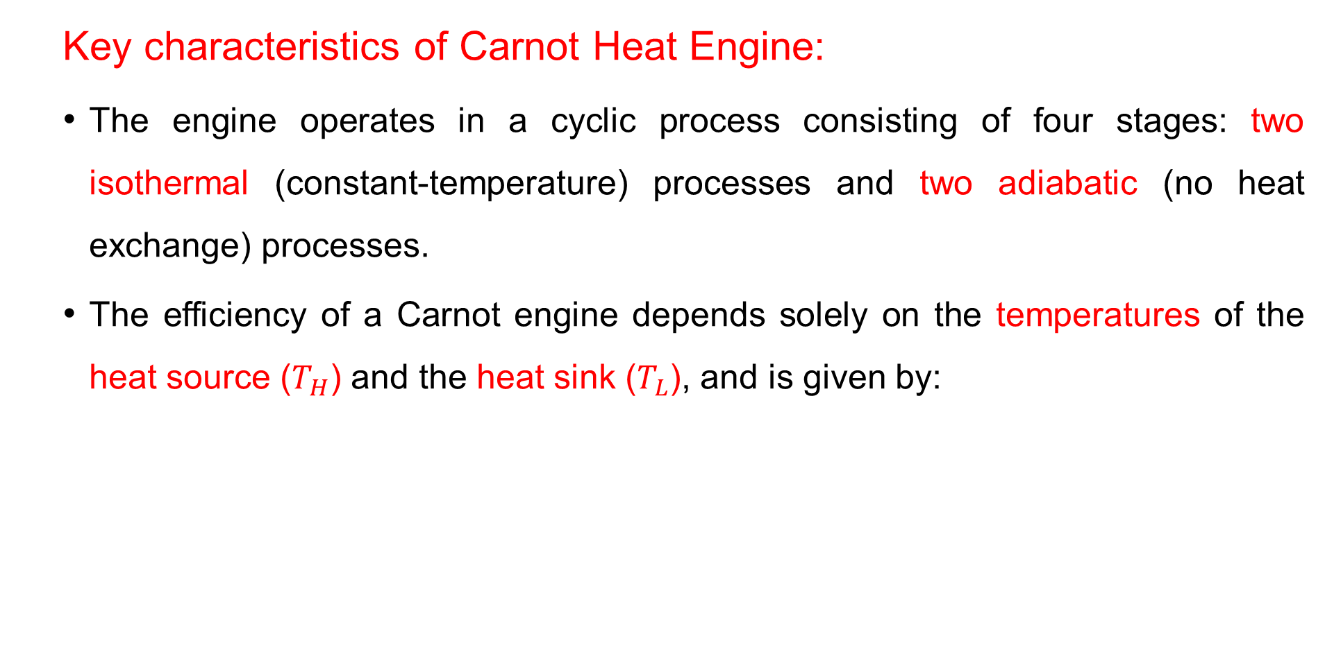

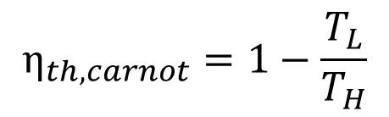
4. The Carnot Heat Engine Cont…
  Key characteristics of Carnot Heat Engine:
  The engine operates in a cyclic process consisting of four stages: two isothermal (constant-temperature) processes and two adiabatic (no heat exchange) processes.
  The efficiency of a Carnot engine depends solely on the temperatures of the heat source ($T_{H}$) and the heat sink ($T_{L}$), and is given by:
$$η_{th}=1−\frac{Q_{L}}{Q_{H}}$$
  And, $\frac{Q_{L}}{Q_{H}}=\frac{T_{L}}{T_{H}}$ Therefore,
$$η_{th,carnot}=1−\frac{T_{L}}{T_{H}}$$

Slide 28
4. The Carnot Heat Engine Cont…
  Key Characteristics of Carnot Heat Engines:
  The engine assumes perfect insulation and frictionless operation, which means no energy is lost due to inefficiencies like heat dissipation or mechanical friction.
  Since real heat engines always have inefficiencies, the Carnot engine represents the upper limit of efficiency that any engine can strive to achieve.

Slide 29
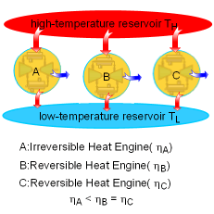
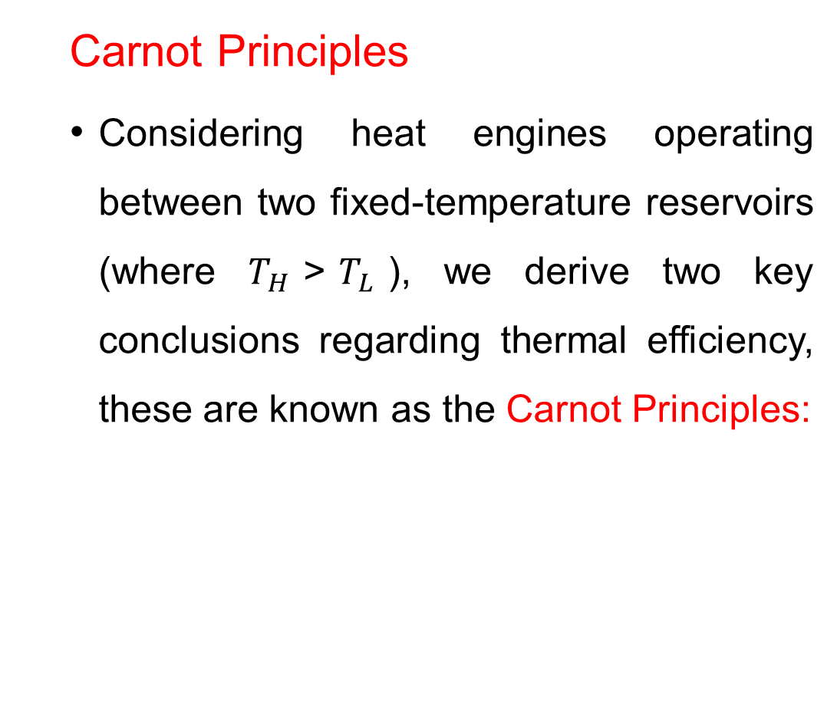
4. The Carnot Heat Engine Cont…
  Carnot Principles
  Considering heat engines operating between two fixed-temperature reservoirs (where $T_{H}$>$T_{L}$​), we derive two key conclusions regarding thermal efficiency, these are known as the Carnot Principles:
  Figure 4: Carnot principles
url: https://www.ecoursesbook.com/ebook/thermodynamics/ch05/sec054/media/th050401p.gif

Slide 30
4. The Carnot Heat Engine Cont…
Carnot Principles
Principle 1 (Irreversible vs. Reversible Efficiency):
"The efficiency of any irreversible heat engine is always less than that of a reversible engine operating between the same two temperature reservoirs [1]."
Principle 2 (Universality of Reversible Efficiency):
"All reversible heat engines operating between the same two constant-temperature reservoirs achieve identical efficiencies [1]."

Slide 31
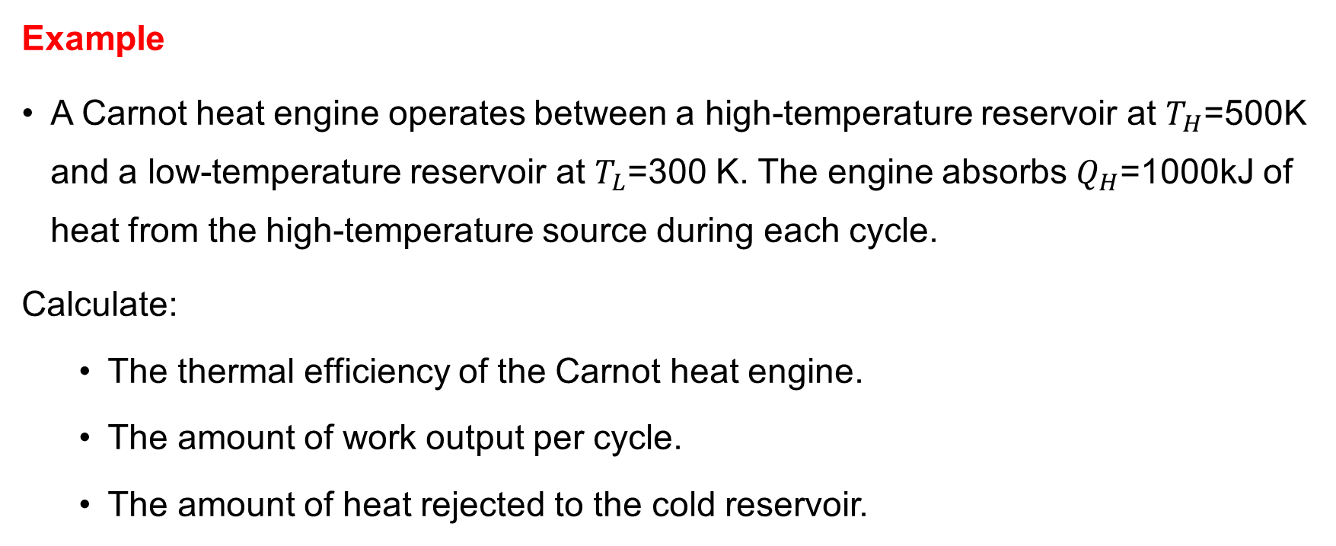
4. The Carnot Heat Engine Cont…
Example
A Carnot heat engine operates between a high-temperature reservoir at $T_{H}$=500K and a low-temperature reservoir at $T_{L}$=300 K. The engine absorbs $Q_{H}$=1000kJ of heat from the high-temperature source during each cycle.
Calculate:
  The thermal efficiency of the Carnot heat engine.
  The amount of work output per cycle.
  The amount of heat rejected to the cold reservoir.

Slide 32
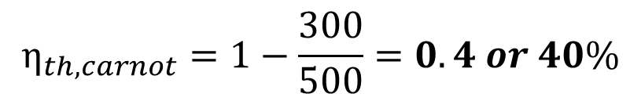
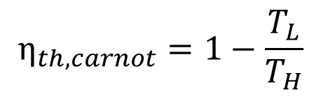


4. The Carnot Heat Engine Cont…
Solution:
The efficiency of a Carnot heat engine is given by:
The useful work output of the engine is:
The heat rejected to the cold reservoir,
$$η_{th,carnot}=1−\frac{T_{L}}{T_{H}}$$
$$η_{th,carnot}=1−\frac{300}{500}=0.4 or 40\%$$
$$W=η_{th} x Q_{H}$$
$$W=0.4 x 1000=400 kJ$$
$$Q_{L}=Q_{H}−W=1000−400=600 kJ$$

Slide 33
5. The Carnot Refrigerator and Heat Pump
A Carnot refrigerator and a Carnot heat pump are theoretical thermodynamic devices that operate on the reversed Carnot cycle, which consists of two isothermal and two adiabatic (isentropic) processes [4].
They are essentially the same device, differing only in their objective:
  refrigerators aim to remove heat from a cold reservoir, while
  heat pumps aim to transfer heat to a warm reservoir.
It's a theoretical model, and real-world refrigerators and heat pumps do not perfectly follow this cycle, but they can be designed to
operate close to it.

Slide 34
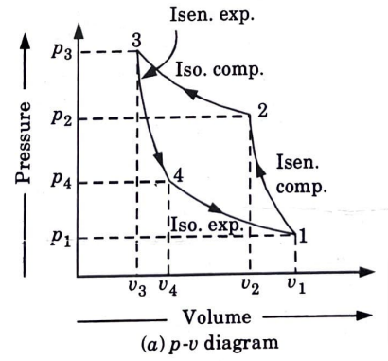
5. The Carnot Refrigerator and Heat Pump
The P-v diagram of a Carnot Refrigerator and Heat Pump
  Figure 4: P-v diagram of a Carnot Refrigerator
url: https://bachelorexam.com/wp-content/uploads/2023/03/image-89.png

Slide 35
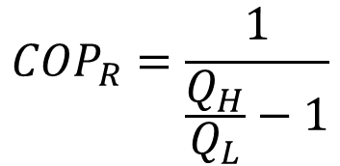
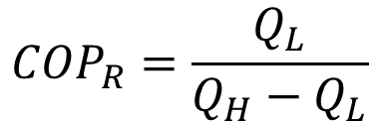
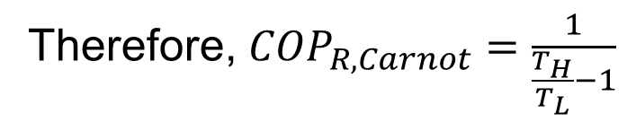
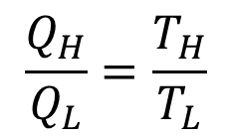
5. The Carnot Refrigerator and Heat Pump Cont…
The Carnot cycle represents the maximum possible efficiency for a refrigerator or heat pump operating between two given temperatures [5].
The Coefficient of Performance of Refrigerators can be determined:
For a Carnot Refrigerator,
$${COP}_{R}=\frac{Q_{L}}{Q_{H}−Q_{L}}$$
$${COP}_{R}=\frac{1}{\frac{Q_{H}}{Q_{L}}−1}$$
$$\frac{Q_{H}}{Q_{L}}=\frac{T_{H}}{T_{L}}$$
Therefore, ${COP}_{R,Carnot}=\frac{1}{\frac{T_{H}}{T_{L}}−1}$

Slide 36
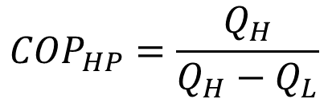
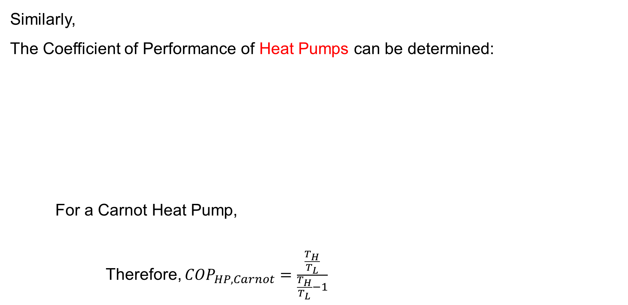
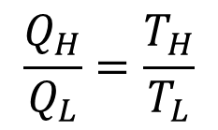
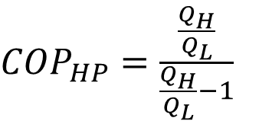
5. The Carnot Refrigerator and Heat Pump Cont…
Similarly,
The Coefficient of Performance of Heat Pumps can be determined:
For a Carnot Heat Pump,
Therefore, ${COP}_{HP,Carnot}=\frac{\frac{T_{H}}{T_{L}}}{\frac{T_{H}}{T_{L}}−1}$
$${COP}_{HP}=\frac{Q_{H}}{Q_{H}−Q_{L}}$$
${COP}_{HP}=\frac{\frac{Q_{H}}{Q_{L}}}{\frac{Q_{H}}{Q_{L}}−1}$
$$\frac{Q_{H}}{Q_{L}}=\frac{T_{H}}{T_{L}}$$

Slide 37
5. The Carnot Refrigerator and Heat Pump Cont…
You may have observed that the power cycle operates in the clockwise direction when plotted on a process diagram (a).
The Carnot cycle may be reversed, in which it operates as a refrigerator.
The refrigeration cycle operates in the counter clockwise direction (b).
(a) (b)

Slide 38
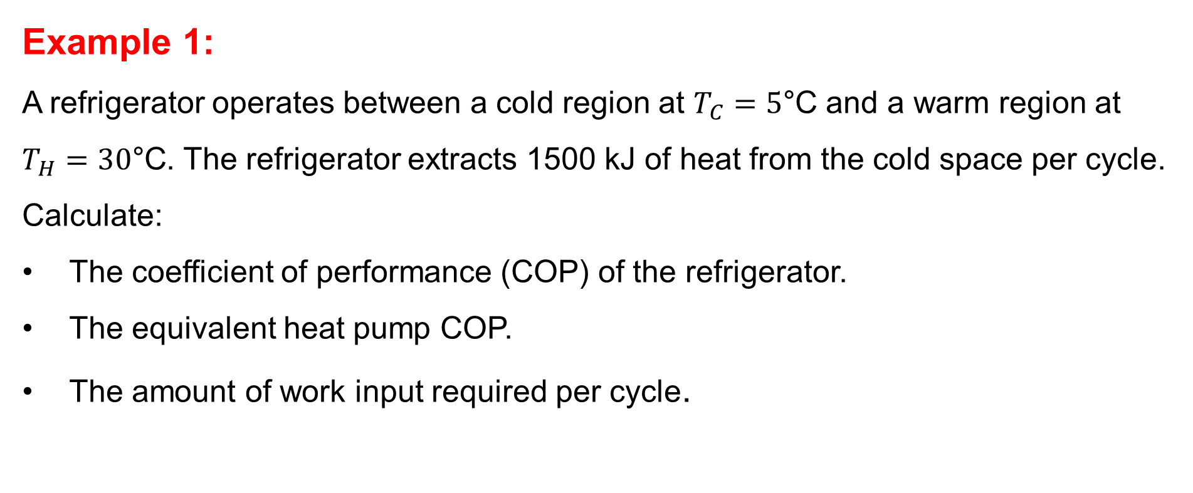
5. The Carnot Refrigerator and Heat Pump Cont…
Example 1:
A refrigerator operates between a cold region at $T_{C}=5\text{°}\text{C}$ and a warm region at $T_{H}=30\text{°}\text{C}$. The refrigerator extracts 1500 kJ of heat from the cold space per cycle.
Calculate:
The coefficient of performance (COP) of the refrigerator.
The equivalent heat pump COP.
The amount of work input required per cycle.

Slide 39
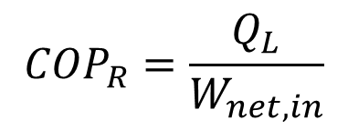
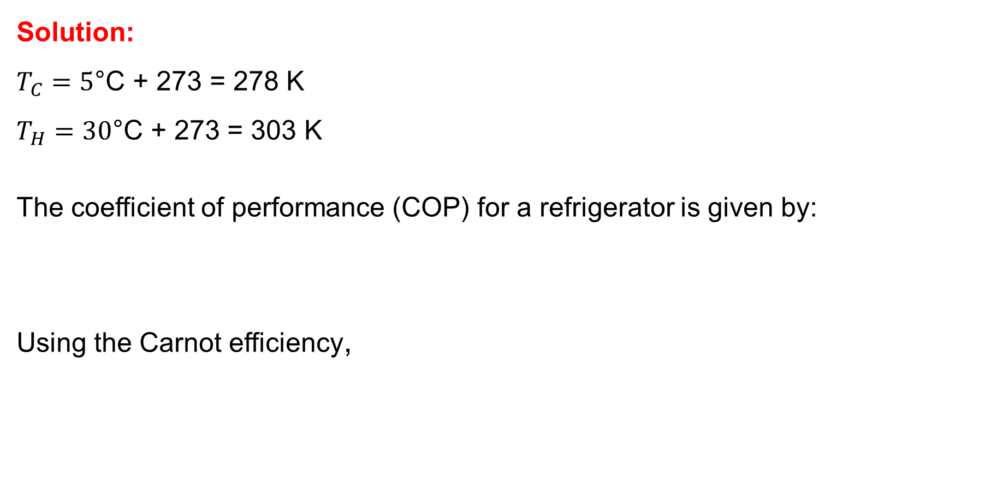
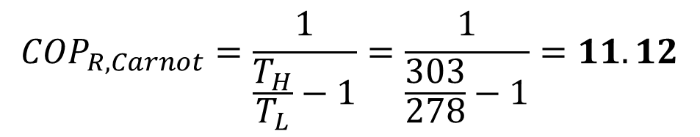
5. The Carnot Refrigerator and Heat Pump Cont…
Solution:
$T_{C}=5\text{°}\text{C}\text{ + 273 = 278}$ K
$T_{H}=30\text{°}\text{C}\text{ + 273 = 303 }\text{K}$
The coefficient of performance (COP) for a refrigerator is given by:
Using the Carnot efficiency,
$${COP}_{R}=\frac{Q_{L}}{W_{net,in}}$$
$${COP}_{R,Carnot}=\frac{1}{\frac{T_{H}}{T_{L}}−1}=\frac{1}{\frac{303}{278}−1}=11.12$$

Slide 40

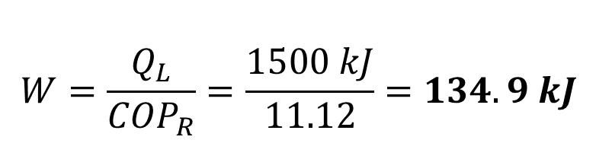



5. The Carnot Refrigerator and Heat Pump Cont…
The work input can be determined by rearranging the COP equation:
The COP of Heat Pump can be:
For the same amount of work input, the heat pump can deliver:
$$W=\frac{Q_{L}}{{COP}_{R}}=\frac{1500 kJ}{11.12}=134.9 kJ$$
$${COP}_{HP}={COP}_{R}+1$$
$${COP}_{HP}=11.12+1=12.12$$
$$Q_{H}={COP}_{HP} x W$$
$$Q_{H}=12,12 x 134.9=1635 kJ$$

Slide 41
5. The Carnot Refrigerator and Heat Pump Cont…
Example 2:
A Carnot heat engine receives heat from a high-temperature reservoir at 900°C, absorbing energy at a rate of 800 kJ per minute. It then releases waste heat to the surrounding air at 27°C. The engine’s entire work output is utilized to operate a Carnot refrigerator, which draws heat from a refrigerated space maintained at -5°C and transfers it to the same ambient air at 27°C.
Determine:
The maximum rate at which heat can be removed from the refrigerated space.
The total rate at which heat is rejected to the ambient air.

Slide 42
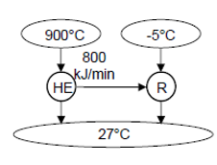
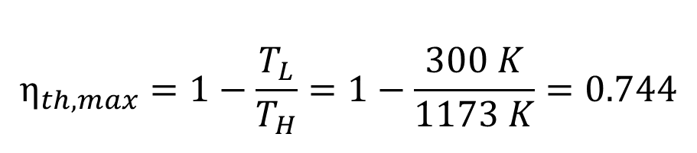
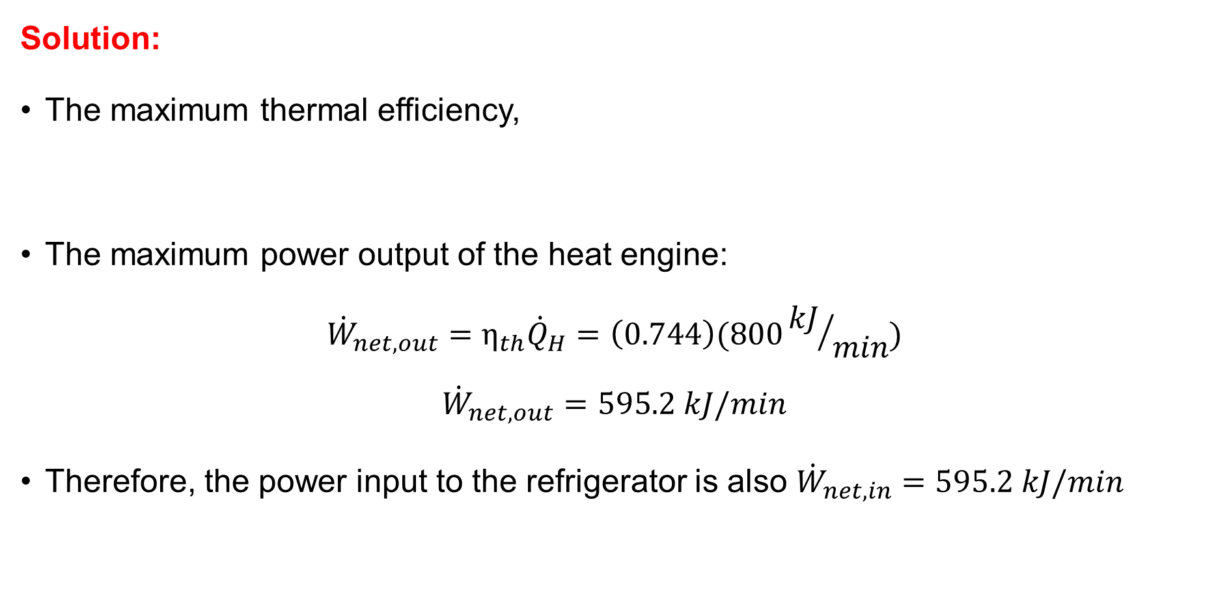
5. The Carnot Refrigerator and Heat Pump Cont…
Solution:
The maximum thermal efficiency,
The maximum power output of the heat engine:
$${\dot{W}}_{net,out}=η_{th}{\dot{Q}}_{H}=\left(0.744\right)(800{kJ}/{min})$$
$${\dot{W}}_{net,out}=595.2 kJ/min$$
Therefore, the power input to the refrigerator is also ${\dot{W}}_{net,in}=595.2 kJ/min$
$$η_{th,max}=1−\frac{T_{L}}{T_{H}}=1−\frac{300 K}{1173 K}=0.744$$

Slide 43
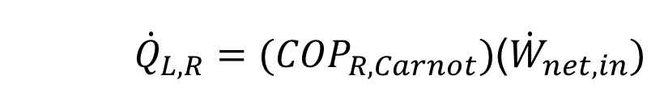
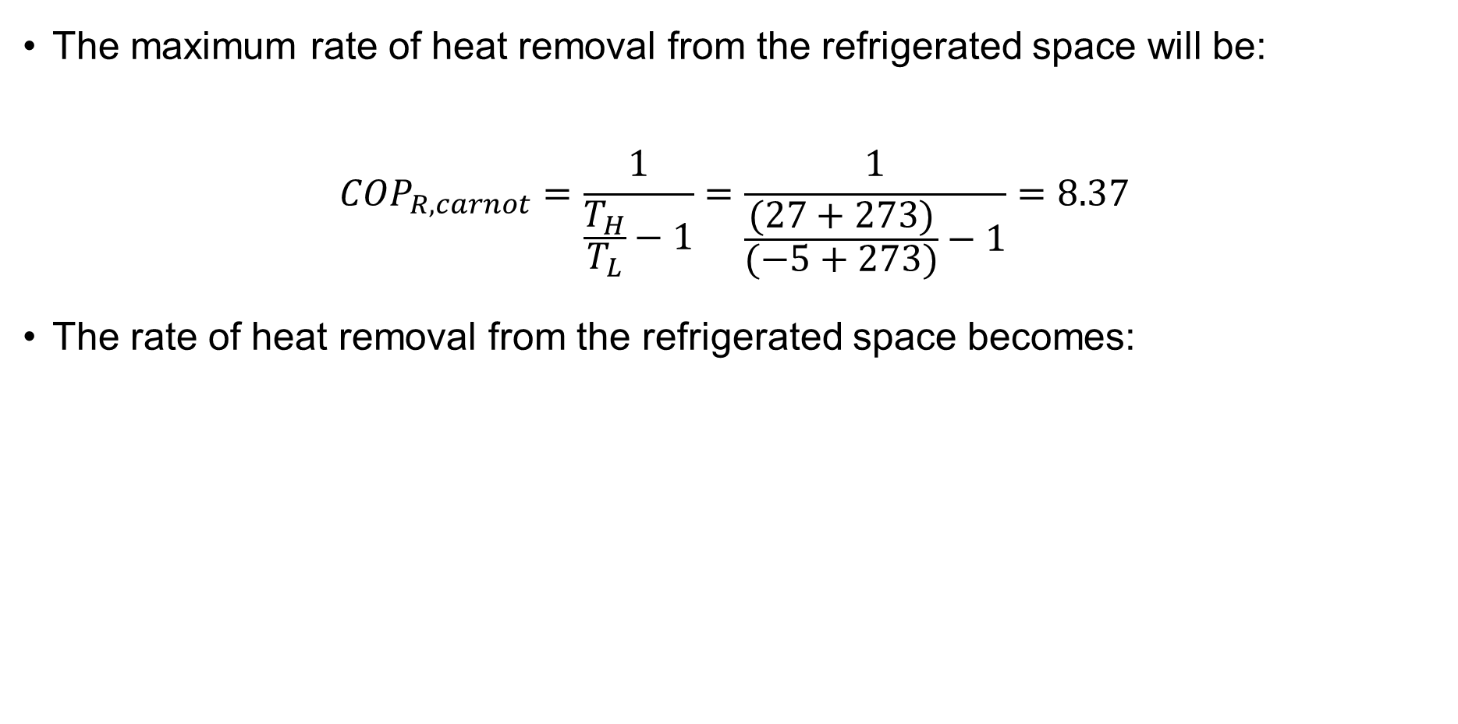
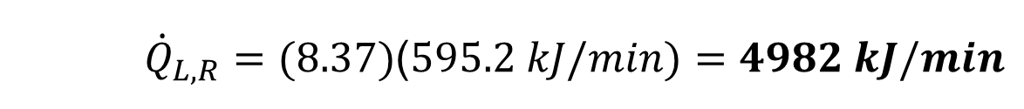
5. The Carnot Refrigerator and Heat Pump Cont…
The maximum rate of heat removal from the refrigerated space will be:
$${COP}_{R, carnot}=\frac{1}{\frac{T_{H}}{T_{L}}−1}=\frac{1}{\frac{(27+273)}{(−5+273)}−1}=8.37$$
The rate of heat removal from the refrigerated space becomes:
    ${\dot{Q}}_{L,R}={(COP}_{R,Carnot})$(${\dot{W}}_{net,in})$
    ${\dot{Q}}_{L,R}=(8.37)$($595.2 kJ/min)=4982 kJ/min$

Slide 44
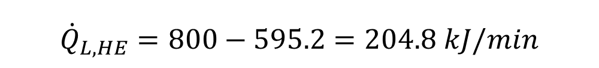

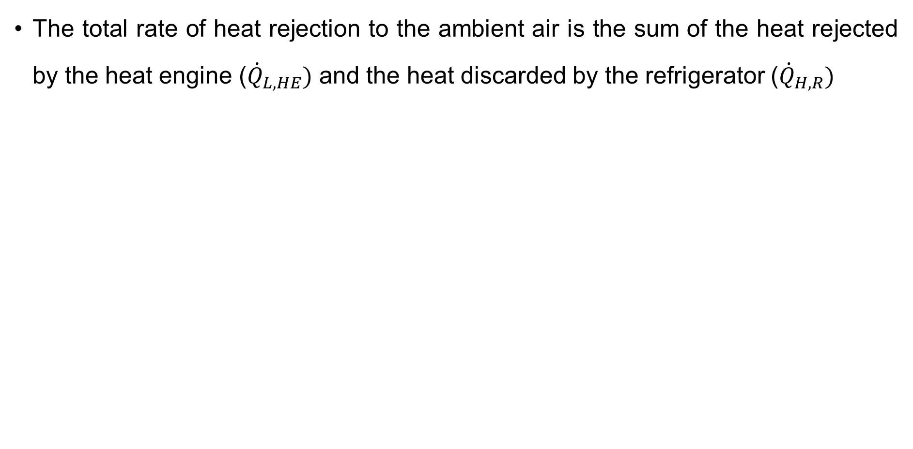



5. The Carnot Refrigerator and Heat Pump Cont…
The total rate of heat rejection to the ambient air is the sum of the heat rejected by the heat engine (${\dot{Q}}_{L,HE})$ and the heat discarded by the refrigerator (${\dot{Q}}_{H,R})$
$${\dot{Q}}_{L,HE}={\dot{Q}}_{H,HE}−{\dot{W}}_{net,out}$$
$${\dot{Q}}_{L,HE}=800−595.2=204.8 kJ/min$$
$${\dot{Q}}_{H,R}={\dot{Q}}_{L,R}+{\dot{W}}_{net,in}$$
$${\dot{Q}}_{H,R}=4982+595.2=5577.2 kJ/min$$
$${\dot{Q}}_{ambient}={\dot{Q}}_{L,HE}+{\dot{Q}}_{H,R}$$
$${\dot{Q}}_{ambient}=204.8+5577.2=5782 kJ/min$$

Slide 45
Summary
Refrigerators and Heat Pumps are devices that transfer heat against the natural flow, using work input to move heat from a colder region to a warmer one. Performance is measured using the coefficient of performance (COP).
Second Law of Thermodynamics states that energy transfers tend toward increasing entropy, and no process is 100% efficient in converting heat into work.
Carnot Cycle is an idealized cycle consisting of two isothermal and two adiabatic processes, providing the theoretical maximum efficiency for heat engines.
Carnot Heat Engine operates on the Carnot cycle, achieving the highest possible efficiency, with performance dependent solely on the temperature of the heat reservoirs.
Carnot Refrigerator and Heat Pump operate on the reversed
Carnot cycle; the Carnot refrigerator maximizes cooling efficiency,
while the Carnot heat pump maximizes heating efficiency.

Slide 46
References
,
[1]. Thermodynamics – An Engineering Approach, Cengel Y A.,Bole M A., McGraw-Hill Education, 8th edition 2015.
[2]. Thermodynamic Aspects of Energy, Ibrahim Dincer, Calin Zamifirescu, 2018, Pages 153-211, https://doi.org/10.1016/B978-0-12-809597-3.00105-X.
[3]. Exergy and Energy Analysis of a Novel Ejector-Enhanced Vapor Compression Refrigeration Cycle, A. M. Alklaibi, M. A. Al-Nimr, and S. Kiwan, International Journal of Refrigeration, vol. 118, pp. 1–11, Oct. 2020.
[4]. The Carnot Cycle and the Second Law of Thermodynamics: Historical Perspective and Modern Applications. A. Bejan and J. P. Meyer, Cambridge, UK: Cambridge University Press, 2023.
[5]. Exergy Analysis of Irreversible Carnot-like Heat Engines with Finite-Time Thermodynamics, M. H. Ahmadi et al., Energy Conversion and Management, vol. 291, p. 117271, August 2023.

Slide 47
Thank you !

