Slide 1
Engineering Thermodynamics I
Lecture 9
Entropy
Lecturer: Dr. Melaku Desta

Slide 2
Lecture learning outcomes:
At the end of this lecture, you will be able to:
Define entropy as a measure of disorder and explain its significance in thermodynamics.
Formulate and interpret the Clausius inequality as a fundamental statement of the second law of thermodynamics.
Analyze entropy changes in reversible and irreversible processes, recognizing their impact on energy efficiency.
Explain why entropy increases in natural processes and how this principle governs the direction of spontaneous change.
Discuss practical implications of entropy analysis in heat engines, refrigeration, and other thermodynamic systems.
Relate entropy to the degradation of energy quality,
highlighting its role in determining the efficiency of energy
conversion systems.

Slide 3
Content
Definition of Entropy
Entropy and the Clausius Inequality
The Increase of Entropy Principle
The T-S Diagram of a Carnot Cycle
Summary
References

Slide 4
1. Definition of Entropy
The second law of thermodynamics establishes the foundation for a fundamental thermodynamic property known as entropy, which quantifies the dispersal of energy and the degree of disorder within a system.
Entropy is a quantitative measure of microscopic disorder for a system [1]. (It is an abstract property and difficult to give a physical description of it)
The more disorganized a system, the higher the entropy.
Entropy is a function of a quantity of heat which shows the possibility
of conversion of heat into work.

Slide 5
1. Definition of Entropy Cont…
Examples
When a solid changes into a liquid, its entropy increases.
  This is because the molecules in a solid are tightly packed and have very limited movement, meaning they are in a highly ordered state.
  Since entropy is a measure of randomness or disorder in a system, the transition from solid to liquid leads to a rise in entropy.
  This is consistent with the second law of thermodynamics,
  which states that natural processes tend to move toward
  higher entropy.

Slide 6
1. Definition of Entropy Cont…
When a liquid transitions into a solid, its entropy decreases.
  This is because the molecules in a liquid move freely and have more randomness, whereas in a solid, the molecules are more tightly arranged in a fixed structure, reducing disorder.
  Since entropy is a measure of randomness or molecular disorder, the formation of a solid results in a lower entropy state.
When a gas transitions into a liquid, entropy decreases.
  Since entropy measures molecular disorder, the shift from
  a gas to a liquid leads to a more ordered state, reducing entropy.

Slide 7
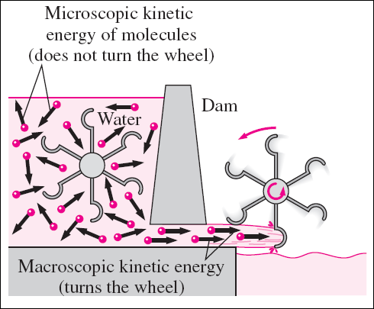
1. Definition of Entropy Cont…
Entropy is a measure of energy that is no longer available to perform useful work within the current environment [1].
  Figure 1: Useful kinetic energy of molecules of water
url: https://encrypted-tbn3.gstatic.com/images?q=tbn:ANd9GcT0rB0HiNwjICOM_PmRGfeI743vbPCZVADWajFoBbKJ6t2MkLSC

Slide 8
1. Definition of Entropy Cont…
Higher molecular disorder (entropy) reduces a system's ability to produce useful work, increasing the net power input required to sustain a process.
Dissipative forces, such as friction, generate entropy by increasing molecular randomness.
This demonstrates the governing influence of the Second Law of Thermodynamics, all real processes are constrained by entropy generation, which degrades energy quality and limits efficiency [2].

Slide 9
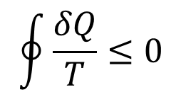
2. Entropy and the Clausius Inequality
The Clausius Inequality is a fundamental principle in thermodynamics that establishes a criterion for the direction and reversibility of processes based on entropy [3].
It is derived from the Second Law of Thermodynamics and mathematically formalizes the concept of irreversibility in cyclic processes.
For any thermodynamic cycle (closed-loop process), the Clausius inequality states:
$$\oint{\frac{δQ}{T}≤0}$$

Slide 10
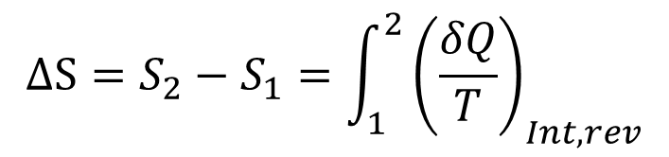
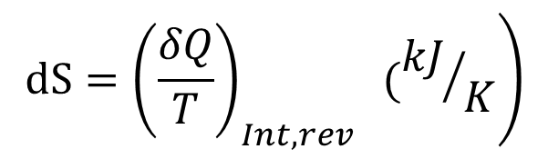
2. Entropy and the Clausius Inequality Cont…
Clausius realized in 1865 that he had discovered a new thermodynamic property, and he chose to name this property entropy.
It is designated S and is defined as
The entropy change of a system during a process can be determined by integrating:
$$\left.dS={\left(\frac{δQ}{T}\right)}_{Int,rev} ({kJ}/K\right)$$
$$∆S=S_{2}−S_{1}=\int_{1}^{2}{{\left(\frac{δQ}{T}\right)}_{Int,rev}}$$

Slide 11
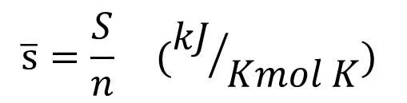
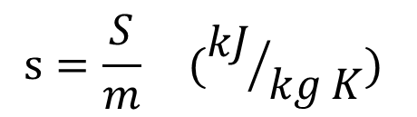
2. Entropy and the Clausius Inequality Cont…
Entropy is an extensive property of a system and sometimes is referred to as total entropy.
Entropy per unit mass, designated s, is an intensive property and has the unit kJ/kg · K.
$$s=\frac{S}{m} ({kJ}/{kg K})$$
$$\overline{s}=\frac{S}{n} ({kJ}/{Kmol K})$$

Slide 12
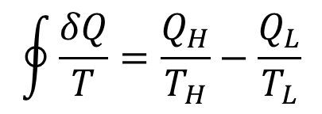
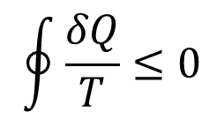
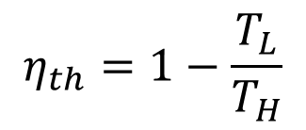
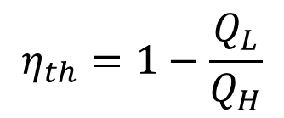
2. Entropy and the Clausius Inequality Cont…
The Clausius inequality,
This inequality is valid for all cycles, reversible and irreversible.
Consider a reversible Carnot cycle
From Carnot efficiency,
$$\oint{\frac{δQ}{T}≤0}$$
$$\oint{\frac{δQ}{T}=\frac{Q_{H}}{T_{H}}−\frac{Q_{L}}{T_{L}}}$$
$$η_{th}=1−\frac{Q_{L}}{Q_{H}}$$
$$η_{th}=1−\frac{T_{L}}{T_{H}}$$

Slide 13
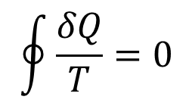
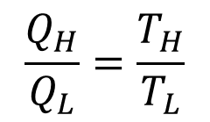
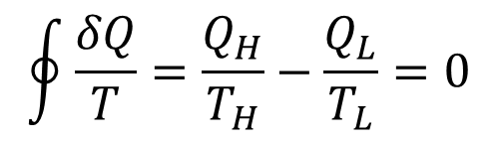
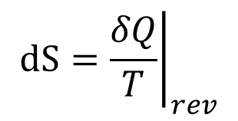
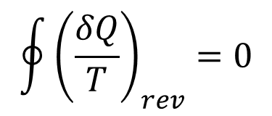
2. Entropy and the Clausius Inequality Cont…
Therefore,
Define a thermodynamic property entropy (S), such that
From Carnot principle,
$$\frac{Q_{H}}{Q_{L}}=\frac{T_{H}}{T_{L}}$$
$$\oint{\frac{δQ}{T}=\frac{Q_{H}}{T_{H}}−\frac{Q_{L}}{T_{L}}=0}$$
$$\oint{{\left(\frac{δQ}{T}\right)}_{rev}}=0$$
$$\oint{\frac{δQ}{T}=0}$$
$$dS={\left.\frac{δQ}{T}\right|}_{rev}$$

Slide 14

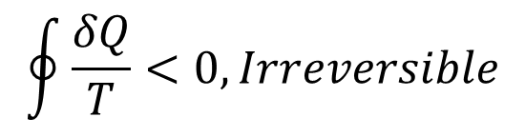

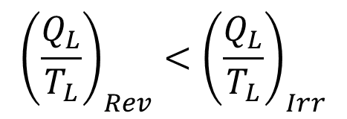
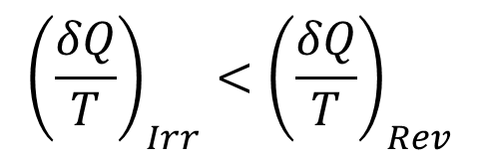

2. Entropy and the Clausius Inequality Cont…
$$W_{Irr}<W_{Rev}$$
$$Q_{H}−Q_{L, Irr}<Q_{H}−Q_{L,Rev}$$
T
Irreversible
process
2
$$Q_{L, Irr}>Q_{L,Rev}$$
1
Reversible
process
$${\left(\frac{δQ}{T}\right)}_{Irr}<{\left(\frac{δQ}{T}\right)}_{Rev}$$
S
$${\left(\frac{Q_{L}}{T_{L}}\right)}_{Rev}<{\left(\frac{Q_{L}}{T_{L}}\right)}_{Irr}$$
$$\oint{\frac{δQ}{T}<0, Irreversible}$$

Slide 15
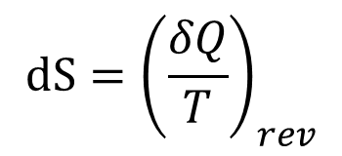
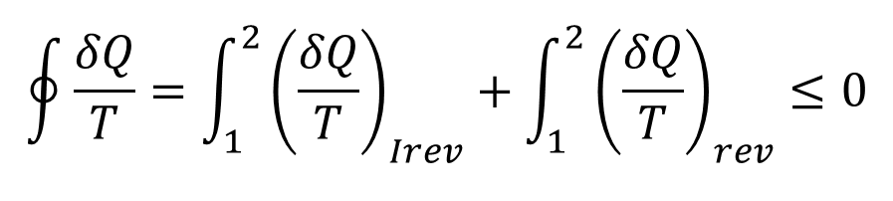
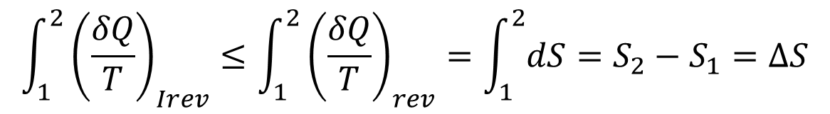
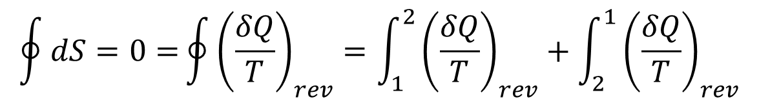
2. Entropy and the Clausius Inequality Cont…
$$\oint{\frac{δQ}{T}=\int_{1}^{2}{{\left(\frac{δQ}{T}\right)}_{Irev}}}+\int_{1}^{2}{{\left(\frac{δQ}{T}\right)}_{rev}}≤0$$
T
Irreversible
process
2
From entropy definition
$$dS={\left(\frac{δQ}{T}\right)}_{rev}$$
1
Reversible
process
$$\oint{dS=0=}\oint{{\left(\frac{δQ}{T}\right)}_{rev}}=\int_{1}^{2}{{\left(\frac{δQ}{T}\right)}_{rev}}+\int_{2}^{1}{{\left(\frac{δQ}{T}\right)}_{rev}}$$
S
Therefore,
$$\int_{1}^{2}{{\left(\frac{δQ}{T}\right)}_{Irev}}≤\int_{1}^{2}{{\left(\frac{δQ}{T}\right)}_{rev}}=\int_{1}^{2}{dS=S_{2}−S_{1}=∆S}$$

Slide 16
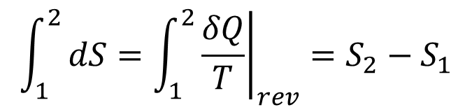
2. Entropy and the Clausius Inequality Cont…
For any reversible process,
The change of entropy can be defined based on a reversible process.
Since entropy is a thermodynamic property, it has fixed values at a fixed thermodynamic states.
The entropy change between two specified states is the same no matter what path, reversible or irreversible.
It’s because entropy is a state function.
$$\int_{1}^{2}{dS=\int_{1}^{2}{{\left.\frac{δQ}{T}\right|}_{rev}}}=S_{2}−S_{1}$$
T
Irreversible
process
2
1
Reversible
process
S

Slide 17
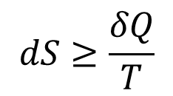
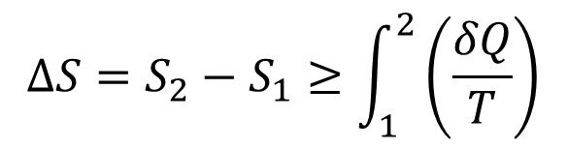
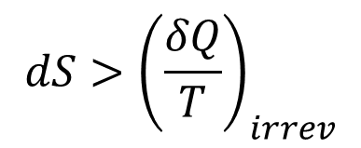
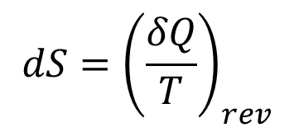
2. Entropy and the Clausius Inequality Cont…
  The change in entropy can be:
  This is valid for all processes.
  Since
$$∆S=S_{2}−S_{1}≥\int_{1}^{2}{\left(\frac{δQ}{T}\right)}$$
$$dS≥\frac{δQ}{T}$$
$$dS={\left(\frac{δQ}{T}\right)}_{rev}$$
$$dS>{\left(\frac{δQ}{T}\right)}_{irrev}$$

Slide 18
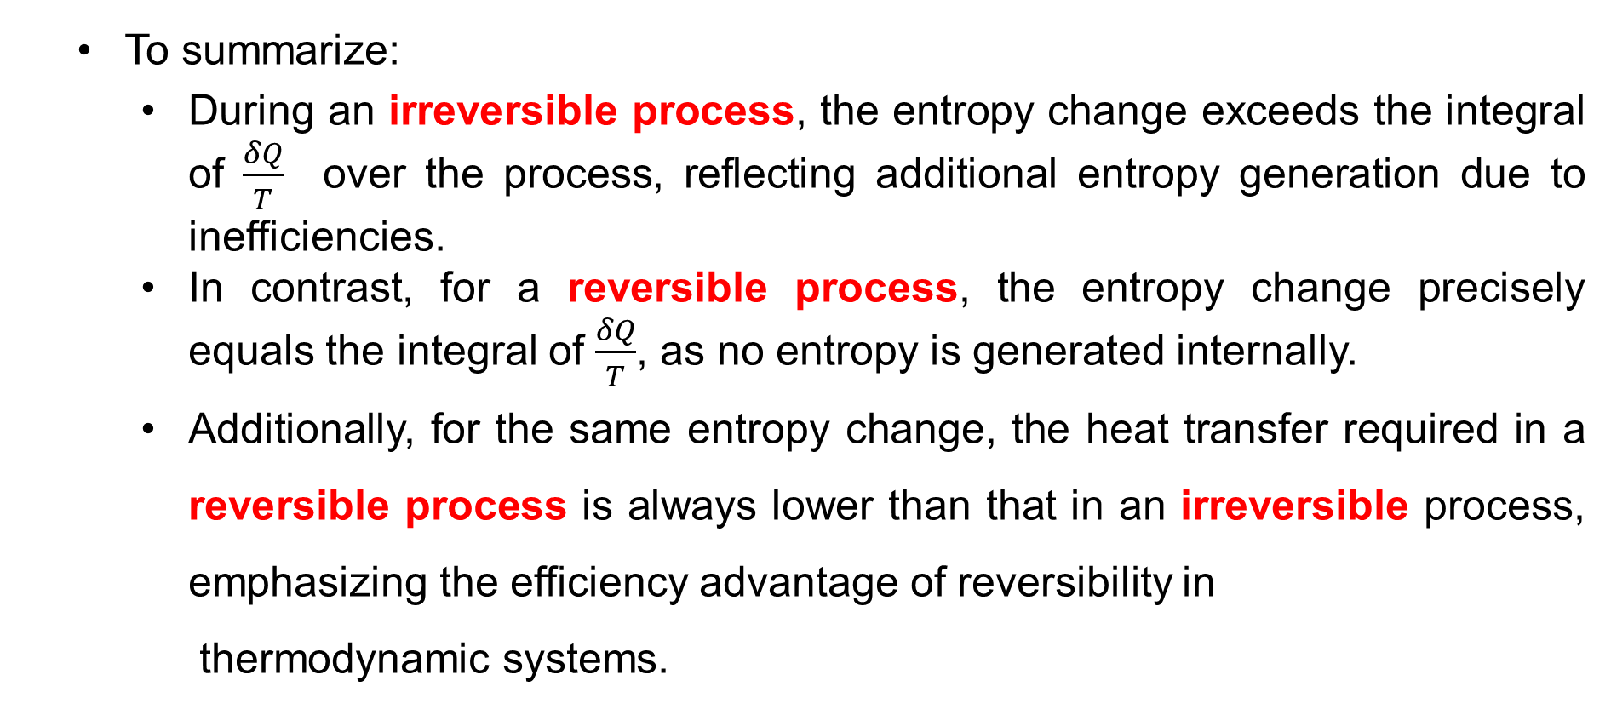
2. Entropy and the Clausius Inequality Cont…
  To summarize:
    During an irreversible process, the entropy change exceeds the integral of $\frac{δQ}{T}$ over the process, reflecting additional entropy generation due to inefficiencies.
    In contrast, for a reversible process, the entropy change precisely equals the integral of $\frac{δQ}{T}$, as no entropy is generated internally.
    Additionally, for the same entropy change, the heat transfer required in a reversible process is always lower than that in an irreversible process, emphasizing the efficiency advantage of reversibility in
    thermodynamic systems.

Slide 19
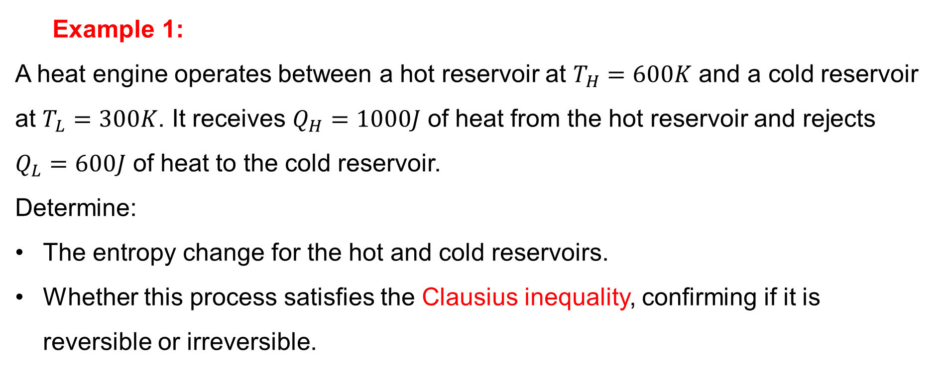
2. Entropy and the Clausius Inequality Cont…
  Example 1:
A heat engine operates between a hot reservoir at $T_{H}=600K$ and a cold reservoir at $T_{L}=300K$. It receives $Q_{H}=1000J$ of heat from the hot reservoir and rejects $Q_{L}=600J$ of heat to the cold reservoir.
Determine:
The entropy change for the hot and cold reservoirs.
Whether this process satisfies the Clausius inequality, confirming if it is reversible or irreversible.

Slide 20
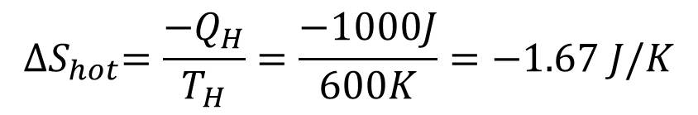
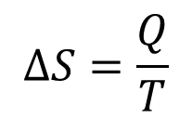
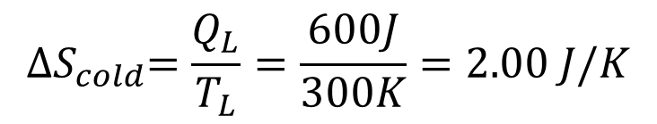
2. Entropy and the Clausius Inequality Cont…
  Solution:
  The entropy change for each reservoir:
  For the hot reservoir:
  For the cold reservoir:
$$∆S=\frac{Q}{T}$$
$${∆S}_{hot}=\frac{{−Q}_{H}}{T_{H}}=\frac{−1000J}{600K}=−1.67 J/K$$
$${∆S}_{cold}=\frac{Q_{L}}{T_{L}}=\frac{600J}{300K}=2.00 J/K$$

Slide 21

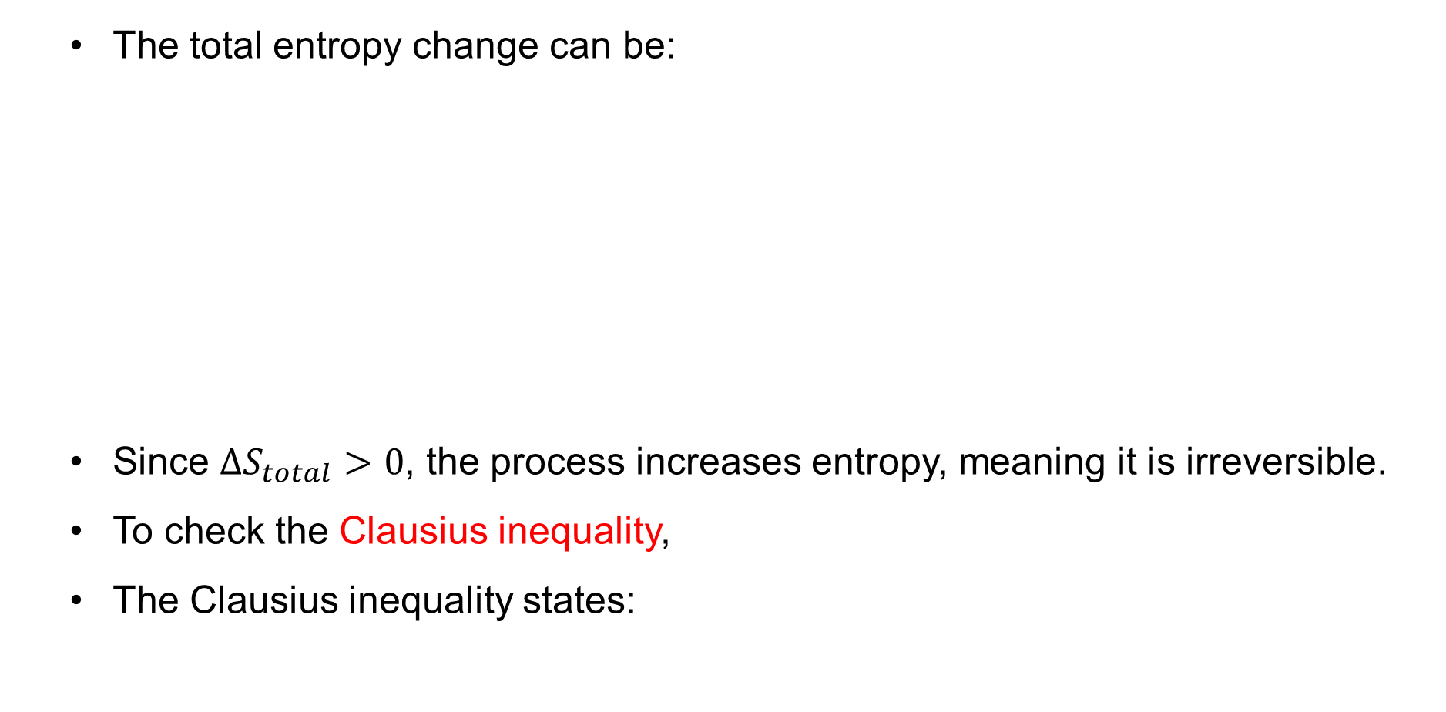
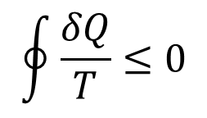
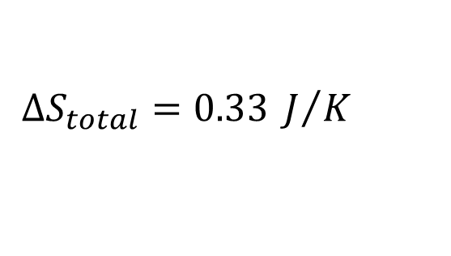
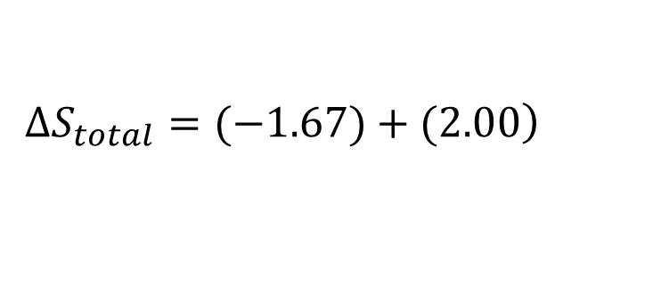
2. Entropy and the Clausius Inequality Cont…
  The total entropy change can be:
  Since $∆S_{total}>0$, the process increases entropy, meaning it is irreversible.
  To check the Clausius inequality,
  The Clausius inequality states:
$$∆S_{total}=∆S_{H}+∆S_{C}$$
$$\left.∆S_{total}=(−1.67)+(2.00\right)$$
$$∆S_{total}=0.33 J/K$$
$$\oint{\frac{δQ}{T}≤0}$$

Slide 22

2. Entropy and the Clausius Inequality Cont…
  For a reversible cycle,
  Since our calculation resulted in a positive entropy change, it confirms that this process is irreversible and obeys the Clausius inequality.
  Therefore, this heat engine increases entropy and operates irreversibly.
  The Clausius inequality holds, reinforcing that real-world heat engines always produce entropy due to irreversibilities.
$$∆S_{total}=0$$

Slide 23
3. The Increase of Entropy Principle
  In real-world systems, most processes involve irreversibilities (such as friction, heat loss, and mixing), leading to entropy generation and an overall increase in entropy.
  Only ideal, perfectly reversible processes maintain constant entropy without increasing it.
  Natural processes, like heat transfer from hot to cold or the mixing of gases, result in greater disorder and higher entropy [3].
  As entropy increases, the ability to convert energy into
  useful work decreases, affecting efficiency in
  thermodynamic systems.

Slide 24
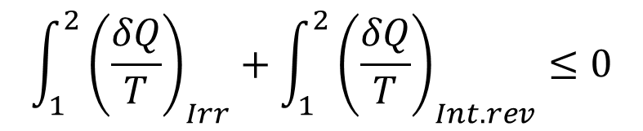
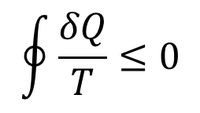
3. The Increase of Entropy Principle Cont…
The increase of entropy principle helps explain why some processes occur spontaneously while others do not and is crucial in understanding energy efficiency and resource utilization [4].
From the Clausius inequality,
$$\oint{\frac{δQ}{T}≤0}$$
$$\int_{1}^{2}{{\left(\frac{δQ}{T}\right)}_{Irr}}+\int_{1}^{2}{{\left(\frac{δQ}{T}\right)}_{Int.rev}}≤0$$

Slide 25
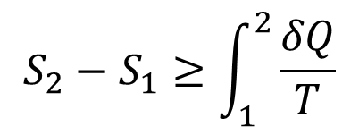
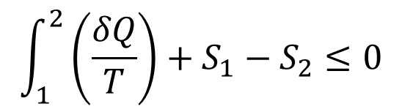
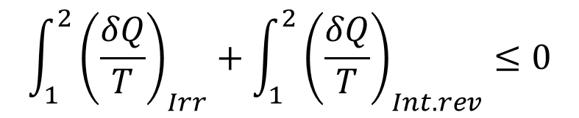
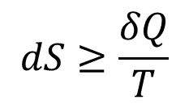
3. The Increase of Entropy Principle Cont…
Where:- the equality holds for an internally reversible process
and the inequality for an irreversible process.
$$\int_{1}^{2}{{\left(\frac{δQ}{T}\right)}_{Irr}}+\int_{1}^{2}{{\left(\frac{δQ}{T}\right)}_{Int.rev}}≤0$$
$$\int_{1}^{2}{\left(\frac{δQ}{T}\right)}+S_{1}−S_{2}≤0$$
$$S_{2}−S_{1}≥\int_{1}^{2}{\frac{δQ}{T}}$$
$$dS≥\frac{δQ}{T}$$

Slide 26
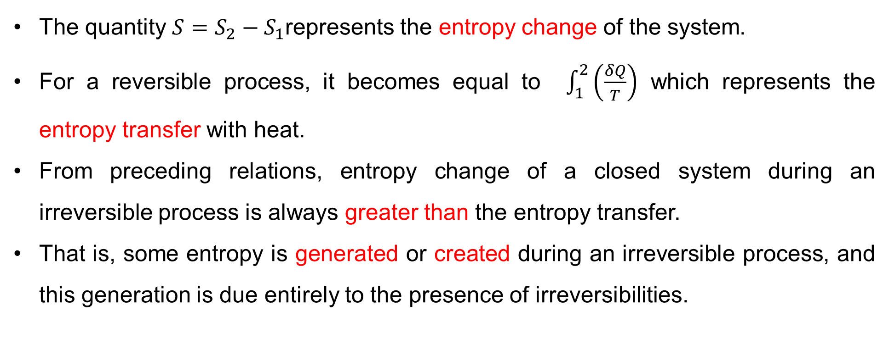
3. The Increase of Entropy Principle Cont…
The quantity $S=S_{2}−S_{1}$represents the entropy change of the system.
For a reversible process, it becomes equal to $\int_{1}^{2}{\left(\frac{δQ}{T}\right)}$ which represents the entropy transfer with heat.
From preceding relations, entropy change of a closed system during an irreversible process is always greater than the entropy transfer.
That is, some entropy is generated or created during an irreversible process, and this generation is due entirely to the presence of irreversibilities.

Slide 27
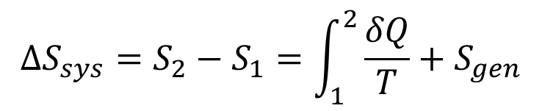
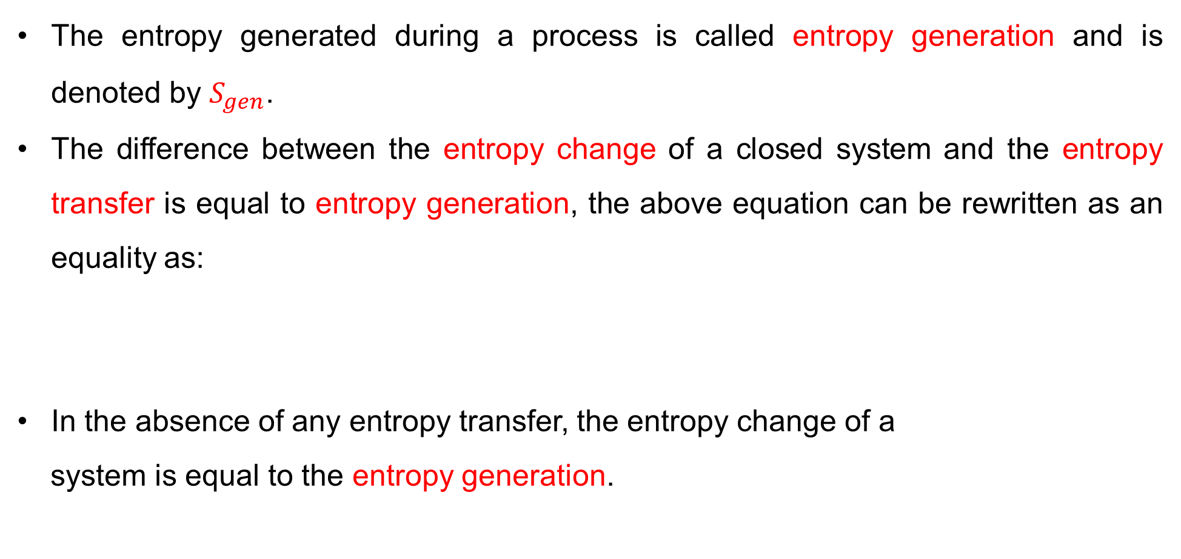
3. The Increase of Entropy Principle Cont…
The entropy generated during a process is called entropy generation and is denoted by $S_{gen}$.
The difference between the entropy change of a closed system and the entropy transfer is equal to entropy generation, the above equation can be rewritten as an equality as:
In the absence of any entropy transfer, the entropy change of a
system is equal to the entropy generation.
$$∆S_{sys}=S_{2}−S_{1}=\int_{1}^{2}{\frac{δQ}{T}+S_{gen}}$$

Slide 28

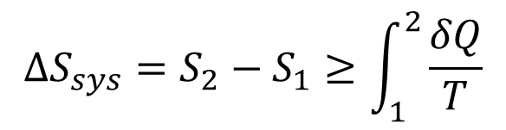
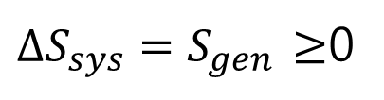
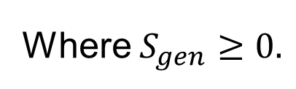
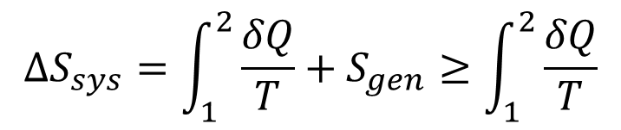
3. The Increase of Entropy Principle Cont…
$$∆S_{sys}=S_{2}−S_{1}≥\int_{1}^{2}{\frac{δQ}{T}}$$
$$∆S_{sys}=S_{2}−S_{1}$$
$$∆S_{sys}=\int_{1}^{2}{\frac{δQ}{T}+S_{gen}}≥\int_{1}^{2}{\frac{δQ}{T}}$$
Where $S_{gen}≥0.$
The entropy will still increase or stay the same but never decrease.
$∆S_{sys}=S_{gen}$ $≥$0
Entropy increase principle
A process can occur only in the direction that aligns with the increase of entropy principle, ensuring that the overall disorder of an isolated system never decreases [5].

Slide 29

3. The Increase of Entropy Principle Cont…
For an isolated system (or simply an adiabatic closed system), the heat transfer is zero, and the above equation reduces to:
This equation can be expressed as the entropy of an isolated system during a process always increases or, in the limiting case of a reversible process, remains constant.
In other words, it never decreases. This is known as the
increase of entropy principle.
$$∆S_{Isolated}≥0$$

Slide 30
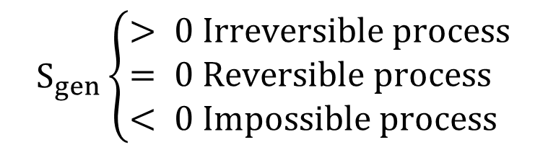
3. The Increase of Entropy Principle Cont…
The increase of entropy principle can be summarized:
It can be concluded as:
Entropy is non-conservative since it is always increasing.
The entropy of the universe is continuously increasing, in other words, it is more disorganized and is approaching chaotic.
The entropy generation is due to the existence of
irreversibilities.
$$S_{gen}\left\{\begin{aligned}&> 0 Irreversible process \\ &= 0 Reversible process \\ &< 0 Impossible process\end{aligned}\right.$$

Slide 31

3. The Increase of Entropy Principle Cont…
Therefore, the higher the entropy generation the higher the irreversibilities and, accordingly, the lower the efficiency of a device since a reversible system is the most efficient system.
To summarize the implications of the increase of entropy generation and the Clausius inequality,
  For Reversible Processes:
    No entropy is generated.
    Example: Carnot cycle.
  For Irreversible Processes:
    Entropy is generated ($S_{gen}>0$).
    Example: Real engines with friction.

Slide 32
3. The Increase of Entropy Principle Cont…
Example 1:
A heat engine operates between a source at 800 K and a sink at 300 K. During one cycle, it absorbs 1000 kJ of heat from the source and rejects 600 kJ of heat to the sink.
Determine:
The entropy change of the source, sink, and total.
The entropy generated during the cycle.
The efficiency of the engine and compare it to the Carnot efficiency.

Slide 33




3. The Increase of Entropy Principle Cont…
Solution:
Entropy Change of Source: (Loses 1000 kJ of heat, entropy decreases)
Entropy Change of Sink: (Gains 600 kJ of heat, entropy increases)
$$T_{H}=800K$$
$$∆S_{H}=\frac{−Q_{H}}{T_{H}}=\frac{−1000 kJ}{800 K}=−1.25 kJ/K$$
$$T_{L}=300K$$
$$∆S_{L}=\frac{+Q_{L}}{T_{L}}=\frac{600 kJ}{300 K}=+2.0 kJ/K$$

Slide 34




3. The Increase of Entropy Principle Cont…
The total entropy change is the sum of the entropy changes of the reservoirs:
Since $∆S_{total}>0,$ the process is irreversible (As expected for real engines)
The entropy generation ($S_{gen})$
Entropy generation quantifies irreversibilities
(friction or heat leakage)
$$∆S_{total}=∆S_{H}+∆S_{L}$$
$$∆S_{total}=−1.25+2.0=+0.75 kJ/K$$
$$S_{gen}=∆S_{total}=0.75 kJ/K$$

Slide 35



3. The Increase of Entropy Principle Cont…
The efficiency of the engine:
Actual efficiency:
Carnot efficiency:
Therefore, the actual efficiency is lower than the Carnot limit
due to entropy generation ($S_{gen}=0.75 kJ/K)$
$$η=1−\frac{Q_{L}}{Q_{H}}=1−\frac{600}{1000}=0.4 (40\%)$$
$$η_{rev}=1−\frac{T_{L}}{T_{H}}=1−\frac{300}{800}=0.625 (62.5\%)$$

Slide 36



3. The Increase of Entropy Principle Cont…
Example 2:
Show that the heat can not transfer from the low-temperature sink at 500K to the high-temperature source at 1000K based on the increase of entropy principle.
Assume 2000 kJ of heat is to be transferred from the sink to the source.
Solution:
$$ΔS_{source}=\frac{2000}{800}=2.5 kJ/K$$
$$ΔS_{sink}=\frac{−2000}{500}=−4 kJ/K$$
$$S_{gen}=∆S_{source}+∆S_{sink}=−1.5 kJ/K$$

Slide 37

3. The Increase of Entropy Principle Cont…
Therefore, since the $S_{gen}<0,$ it is impossible based on the entropy increase principle, i.e. $S_{gen}≥0$, therefore, the heat can not transfer from low temperature to high temperature without external work input.
However, if the process is reversed, 2000kJ of heat is transferred from the source to the sink, $S_{gen}=1.5 kJ/K>0$, and the process can occur according to the second law of thermodynamics.

Slide 38




3. The Increase of Entropy Principle Cont…
If the sink temperature is increased to 700 K, how about the entropy generation?
Entropy generation is less than when the sink temperature
is 500 K, less irreversibility.
Heat transfer between objects having large temperature
difference generates higher degree of irreversibilities.
$$ΔS_{source}=\frac{2000}{800}=2.5 kJ/K$$
$$ΔS_{sink}=\frac{−2000}{700}=−2.86 kJ/K$$
$$S_{gen}=∆S_{source}+∆S_{sink}=−0.36 kJ/K$$
$$0.36 kJ/K<1.5 kJ/K$$

Slide 39

4. The T-S Diagram of the Carnot Cycle
T-S diagrams visualize heat transfer and entropy changes.
Recall that a Carnot Cycle is based on an idealized heat engine with maximum possible efficiency.
Four Reversible Processes:
  Process 1-2: Reversible Isothermal Expansion (Heat addition at $T_{H}$).
  Process 2-3: Reversible Adiabatic Expansion (No heat transfer, temperature drops).
  Process 3-4: Reversible Isothermal Compression
  (Heat rejection at $T_{L}$).
  Process 4-1: Reversible Adiabatic Compression
  (Temperature rises back to $T_{H}$).

Slide 40

4. The T-S Diagram of the Carnot Cycle Cont…
Process 4-1 (Reversible Adiabatic
  Figure 2: T-S Diagram of a Carnot Cycle
url: https://preview.redd.it/understanding-t-s-in-a-carnot-cycle-v0-84owjd1oq71d1.jpeg?width=640&crop=smart&auto=webp&s=018be6840d63a2110cdf73a51b38d1acf89097a7

Slide 41

4. The T-S Diagram of the Carnot Cycle Cont…
The T-s diagram of internally reversible process
  Figure 3: T-S Diagram of a Carnot Cycle
url: https://lens.usercontent.google.com/image?vsrid=CPWD8bGPmvHeywEQAhgBIiRlMTZjODNkZS1hOTRiLTRjNDYtOTJhNS1hZWFlMzc0ODcyNTI&gsessionid=62zhPa2d4BP1YpYiqJSOKSgsD3CoIz84sI7XSbQskoOWxreV_ZXXpA

Slide 42
Summary
Entropy is a measure of the disorder or randomness in a system, closely linked to the second law of thermodynamics. It quantifies the amount of energy unavailable for useful work.
The Clausius inequality states that for a cyclic process, the sum of heat transfer divided by the temperature at which it is absorbed is always less than or equal to zero, reinforcing the irreversibility of natural processes.
Entropy always increases in an isolated system, meaning that natural processes tend to move towards greater disorder, making perfect efficiency impossible in real-world applications.
The Carnot cycle, when plotted on a Temperature-Entropy (T-S) diagram, visually represents the reversible heat exchange process, with isothermal
and adiabatic segments showing ideal energy

Slide 43
References
,
[1]. Thermodynamics – An Engineering Approach, Cengel Y A.,Bole M A., McGraw-Hill Education, 8th edition 2015.
[2]. Fundamentals of Engineering Thermodynamics, 9th ed. Hoboken, M. Moran et al., NJ: Wiley, 2022, Chapter 6: Entropy and the Clausius Inequality.
[3]. A Modern Interpretation of the Concept of Entropy, J. Kestin, Journal of Non-Equilibrium Thermodynamics, vol. 46, no. 3, pp. 229-243, 2021.
[4]. Understanding Thermodynamics. Mineola, H. C. Van Ness, NY: Dover Publications, 2021, Chapter 4: Entropy and the Second Law.
[5]. The Second Law of Thermodynamics: From Carnot to Clausius, J. Kestin, American Journal of Physics, vol. 90, no. 1, pp. 12-21, January 2022.

Slide 44
Thank you !

