Slide 1
Engineering Thermodynamics I
Lecture 10
Entropy
Lecturer: Dr. Melaku Desta

Slide 2
Lecture learning outcomes:
At the end of this lecture, you will be able to:
Learn how entropy varies in phase transitions (melting, vaporization) and how to calculate entropy changes using thermodynamic tables.
Gain insights into why entropy changes in liquid and solid phases are generally small and how they can be estimated using heat capacity relationships.
Explore the fundamental equations governing entropy change in ideal gases, considering isothermal and adiabatic processes.
Analyze real-world irreversible and reversible processes to determine whether a system obeys the Clausius inequality.
Develop problem-solving techniques for entropy calculations, including identifying system boundaries, choosing appropriate formulas, and interpreting results.
Apply entropy principles to real-world engineering processes,
such as power cycles, refrigeration cycles, and irreversible
heat transfer.

Slide 3
Content
Entropy Change of Pure Substances
Isentropic Processes
The Tds Relations
Entropy Change of Liquids and Solids
Entropy Change of Ideal Gases
Isentropic Processes of Ideal Gases
Isentropic Efficiencies of Steady-Flow Devices
Summary
References

Slide 4
1. Entropy Change of Pure Substances
For pure substances, entropy change occurs during phase transitions, heating, cooling, and expansion or compression processes.
For pure substances (e.g., water, ideal gases), entropy changes depend on:
  Temperature (T)
  Pressure (P)
  Phase (solid, liquid, vapor)
When a pure substance undergoes melting, vaporization,
or sublimation, its entropy increases due to greater molecular
disorder [1].

Slide 5
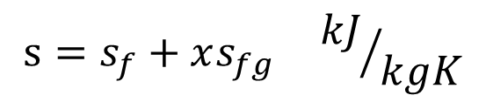
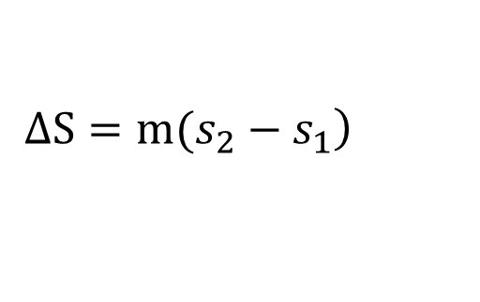

1. Entropy Change of Pure Substances Cont…
The value of entropy at a specified state is determined just like any other property.
In the compressed liquid and superheated vapor regions, the values can be directly retrieved from the thermodynamic tables corresponding to the specified state.
In the saturated mixture region, they are determined using interpolation based on quality and phase equilibrium data.
$$s=s_{f}+xs_{fg} {kJ}/{kgK}$$
$$s_{@T,P}≅s_{f@T}$$
$$\left.ΔS=m(s_{2}−s_{1}\right)$$

Slide 6
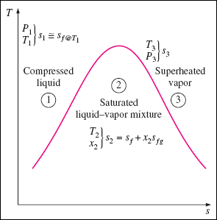
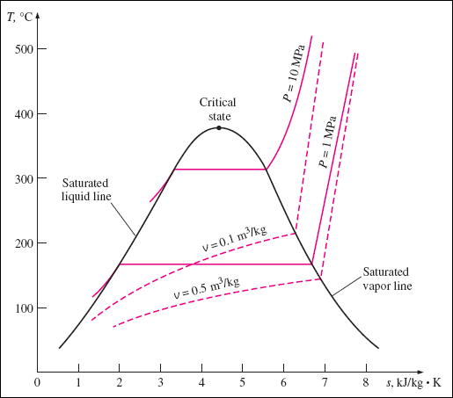
1. Entropy Change of Pure Substances Cont…
Entropy change for compressed liquid, saturated liquid-vapor mixture and superheated regions of pure substances:
Figure 1: Entropy change of pure substances
url: https://encrypted-tbn1.gstatic.com/images?q=tbn:ANd9GcSBgfbIh-gMNGsIGdr2-Q0Pl073_nY4iTZP5dKxm_5n6uNU3wsV

Slide 7
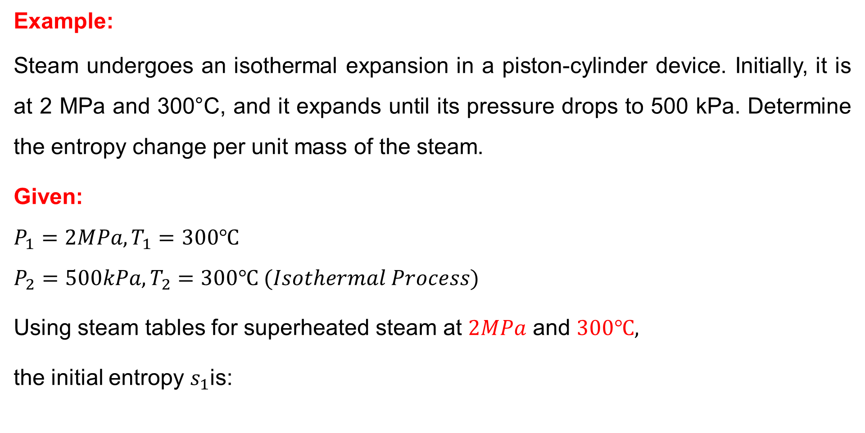
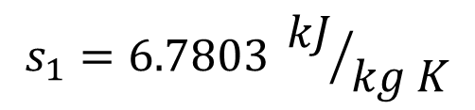
1. Entropy Change of Pure Substances Cont…
Example:
Steam undergoes an isothermal expansion in a piston-cylinder device. Initially, it is at 2 MPa and 300°C, and it expands until its pressure drops to 500 kPa. Determine the entropy change per unit mass of the steam.
Given:
$$P_{1}=2MPa, T_{1}=300℃$$
$$P_{2}=500kPa, T_{2}=300℃ (Isothermal Process)$$
Using steam tables for superheated steam at $2MPa$ and $300℃,$
the initial entropy $s_{1}$is:
$$s_{1}=6.7803 {kJ}/{kg K}$$

Slide 8
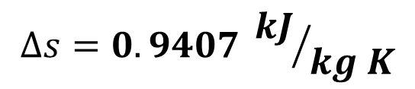

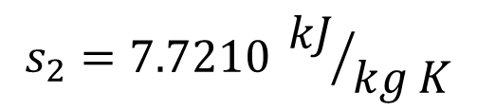
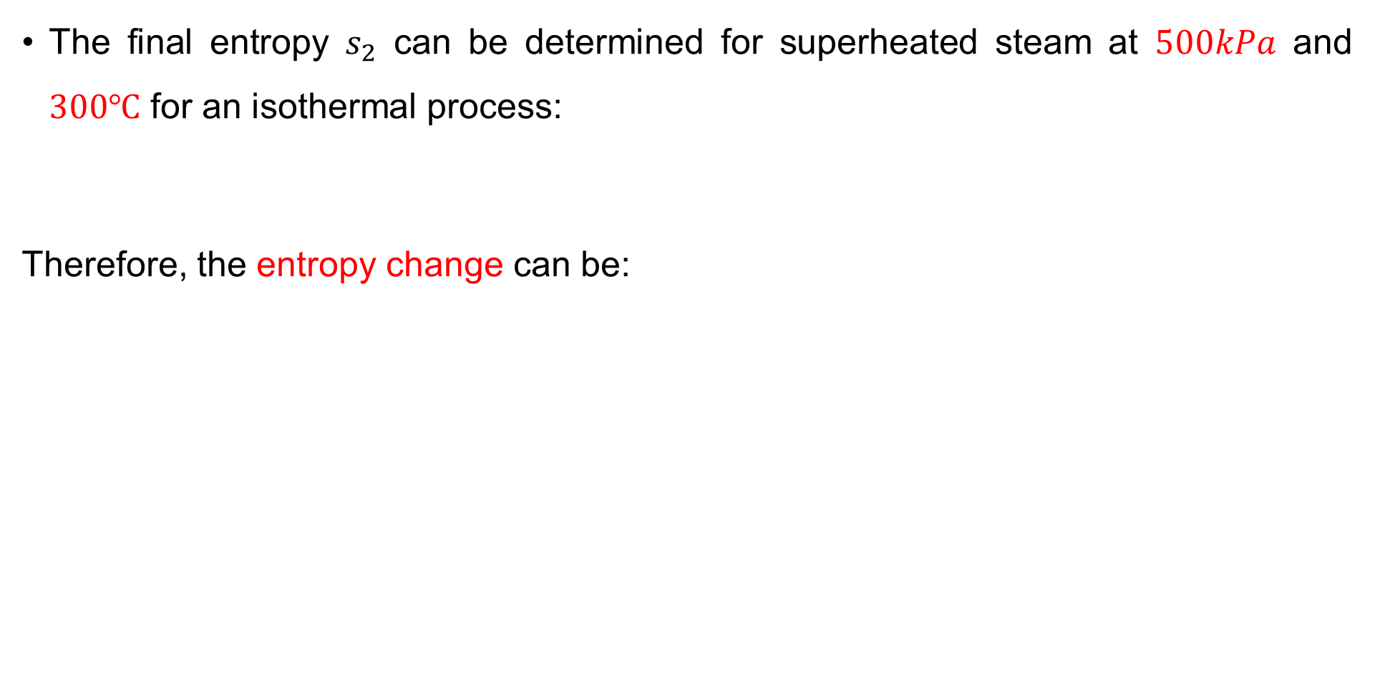

1. Entropy Change of Pure Substances Cont…
The final entropy $s_{2}$ can be determined for superheated steam at $500kPa$ and $300℃$ for an isothermal process:
Therefore, the entropy change can be:
$$s_{2}=7.7210 {kJ}/{kg K}$$
$$Δs=s_{2}−s_{1}$$
$$Δs=7.7210−6.7803$$
$$Δs=0.9407 {kJ}/{kg K}$$

Slide 9
2. Isentropic Processes
An isentropic process is a thermodynamic process in which entropy remains constant throughout.
This occurs when a system undergoes a process that is adiabatic (no heat transfer), and reversible (no friction or dissipation effects).
Characteristics of Isentropic Processes
    No Heat Transfer: The process is purely energy-based, with work interactions but no heat exchange.
    Reversible: The system experiences no irreversibilities
    such as friction, turbulence, or non-equilibrium effects.
    Constant Entropy: Since the process is reversible and
    adiabatic, entropy remains unchanged.

Slide 10


2. Isentropic Processes Cont…
Then it follows that the entropy of a fixed mass does not change during a process that is internally reversible and adiabatic.
Isentropic processes provide an essential foundation for studying idealized thermodynamic cycles, improving energy efficiency, and analyzing real-world engineering systems [2].
Though real processes contain some irreversibilities, the isentropic
assumption serves as a useful approximation for many applications.
$$ΔS=0$$
$$S_{2}=S_{1}$$

Slide 11
2. Isentropic Processes Cont…
Applications of Isentropic Processes
  Gas Turbines & Compressors: Idealized models for power generation and refrigeration cycles assume isentropic compression and expansion.
  Nozzles & Diffusers: High-speed gas flow through nozzles and diffusers is often modeled as isentropic to simplify calculations.
  Idealized Adiabatic Expansion: Used in thermodynamic cycles such as the Carnot cycle and Rankine cycle.

Slide 12
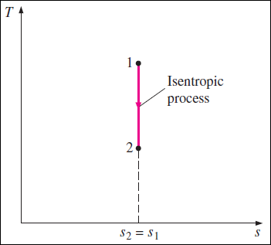
2. Isentropic Processes Cont…
The T-s diagram of isentropic processes

Slide 13

3. The Tds Relations
Tds (Temperature-Differential Entropy) relations are fundamental equations in thermodynamics that describe the relationship between temperature, entropy, and other properties such as pressure and volume [3].
These equations provide a way to express entropy changes in terms of measurable quantities.
The differential form of the conservation of energy equation for a closed stationary system containing a simple compressible substance can be
expressed for an internally reversible process as:
$$δQ_{Int,rev}−δW_{Int,rev}=dU$$

Slide 14


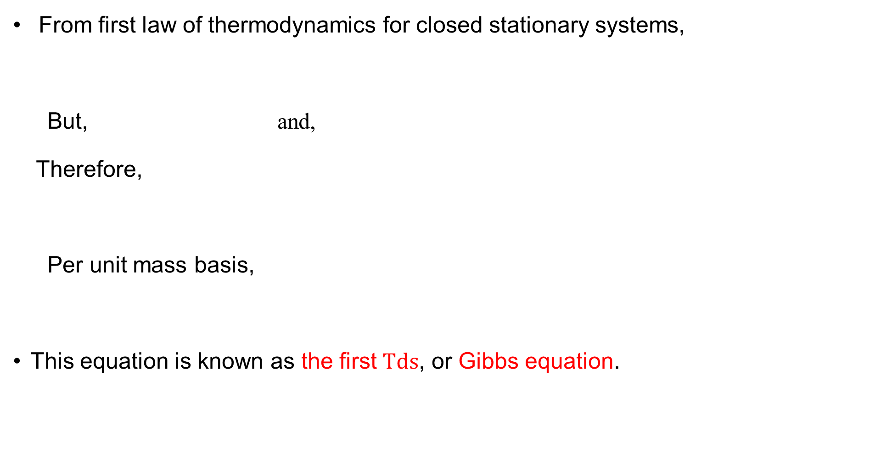


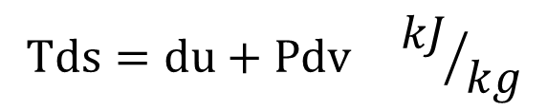
3. The Tds Relations
From first law of thermodynamics for closed stationary systems,
But, and,
Therefore,
Per unit mass basis,
This equation is known as the first $Tds$, or Gibbs equation.
$$δQ_{Int,rev}−δW_{Int,rev}=dU$$
$$δQ_{Int,rev}=TdS$$
$$δW_{Int,rev}=PdV$$
$$TdS=dU+PdV$$
$$Tds=du+Pdv {kJ}/{kg}$$

Slide 15

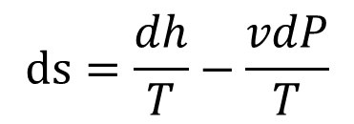

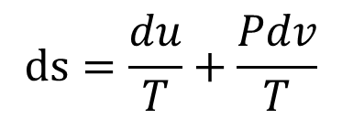


3. The Tds Relations
The second Tds equation is obtained by eliminating du from above equation by using the definition of enthalpy :
$$ds=\frac{du}{T}+\frac{Pdv}{T}$$
$$h=u+Pv$$
$$h=u+Pv$$
$$dh=du+Pdv+vdP$$
$$Tds=dh−vdP$$
$$ds=\frac{dh}{T}−\frac{vdP}{T}$$

Slide 16
4. Entropy Change of Liquids and Solids
Unlike gases, liquids and solids exhibit minimal volume changes when subjected to temperature variations or pressure changes.
They are often approximated as incompressible substances, meaning their specific volume remains nearly constant.
Because of their stable molecular arrangement, entropy change in liquids and solids is predominantly influenced by temperature variations rather than pressure.

Slide 17

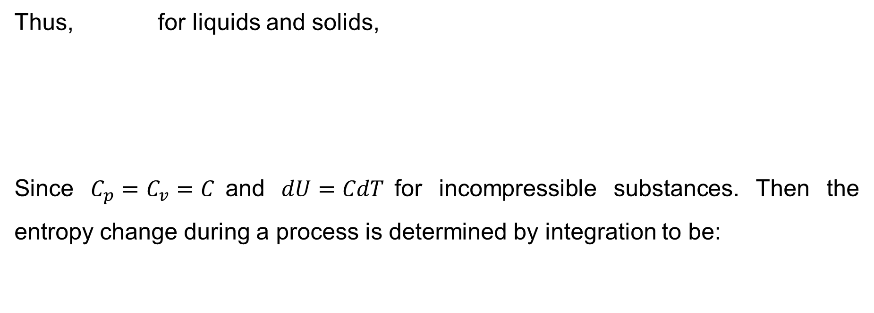
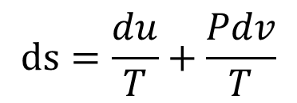
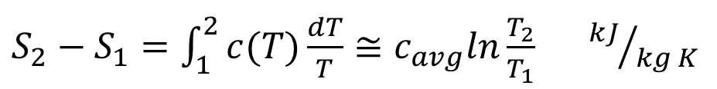
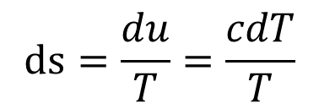
4. Entropy Change of Liquids and Solids Cont…
Thus, for liquids and solids,
Since $C_{p}=C_{v}=C$and $dU=CdT$for incompressible substances. Then the entropy change during a process is determined by integration to be:
$$dv≅0$$
$$ds=\frac{du}{T}+\frac{Pdv}{T}$$
$$ds=\frac{du}{T}=\frac{cdT}{T}$$
$S_{2}−S_{1}=\int_{1}^{2}{c(T)\frac{dT}{T}≅c_{avg}ln\frac{T_{2}}{T_{1}}}$ ${kJ}/{kg K}$

Slide 18
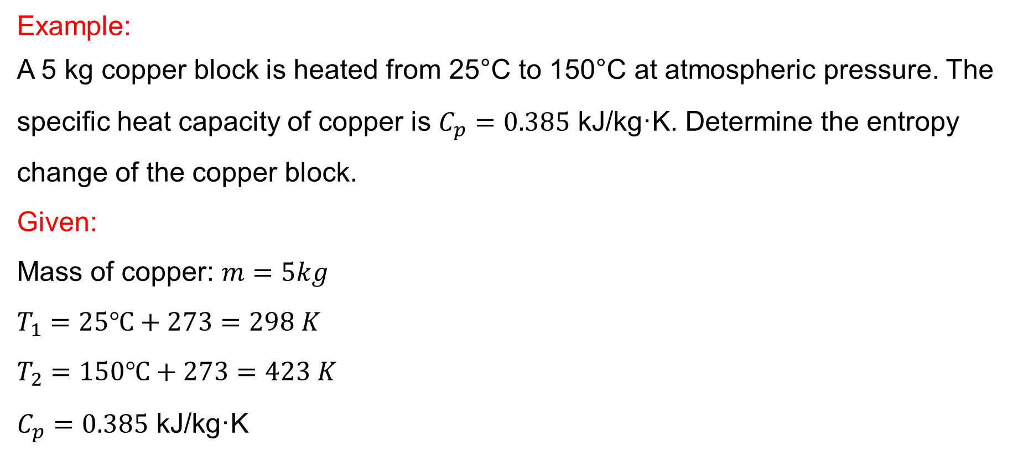
4. Entropy Change of Liquids and Solids Cont…
Example:
A 5 kg copper block is heated from 25°C to 150°C at atmospheric pressure. The specific heat capacity of copper is $C_{p}=0.385$ kJ/kg·K. Determine the entropy change of the copper block.
Given:
Mass of copper: $m=5kg$
$$T_{1}=25℃+273=298 K$$
$$T_{2}=150℃+273=423 K$$
$C_{p}=0.385$ kJ/kg·K

Slide 19
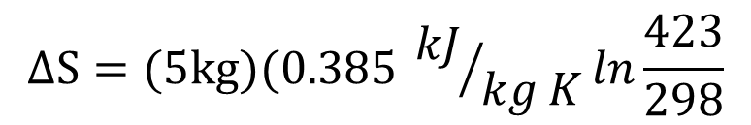
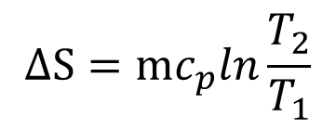



4. Entropy Change of Liquids and Solids Cont…
Solution:
For solids and liquids, the entropy change can be determined:
$$ΔS=mc_{p}ln\frac{T_{2}}{T_{1}}$$
$$ΔS=(5kg)(0.385 {kJ}/{kg K}ln\frac{423}{298}$$
$$ΔS=\left(1.925\right)ln⁡(1.419)$$
$$ΔS=\left(1.925\right)(0.350)$$
$$ΔS=0.674 kJ/K$$

Slide 20

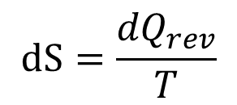

4. Entropy Change of Ideal Gases
For an ideal gas, entropy change is influenced by variations in temperature and volume or pressure. The general expression for entropy change is:
Using the first law of thermodynamics and the definition of specific heat capacity,
Or,
$$dS=\frac{{dQ}_{rev}}{T}$$
$$Tds=C_{v}dT+PdV$$
$$Tds=C_{P}dT−VdP$$

Slide 21
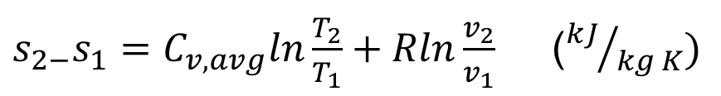
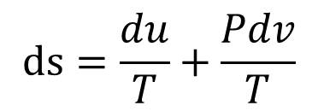
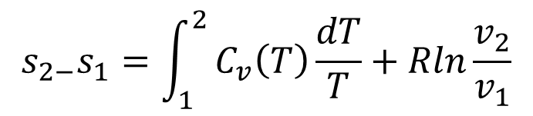

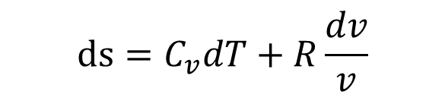


4. Entropy Change of Ideal Gases Cont…
From the first Tds relation (Gibbs equation),
$$Tds=du+PdV$$
$$ds=\frac{du}{T}+\frac{Pdv}{T}$$
$$du=C_{v}dT, and$$
$$P={RT}/v$$
$$ds=C_{v}dT+R\frac{dv}{v}$$
$$s_{2−}s_{1}=\int_{1}^{2}{C_{v}\left(T\right)\frac{dT}{T}+Rln\frac{v_{2}}{v_{1}}}$$
$s_{2−}s_{1}=C_{v,avg}ln\frac{T_{2}}{T_{1}}+Rln\frac{v_{2}}{v_{1}}$ (${kJ}/{kg K})$

Slide 22
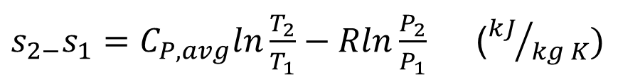
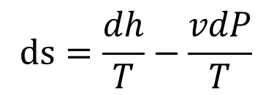
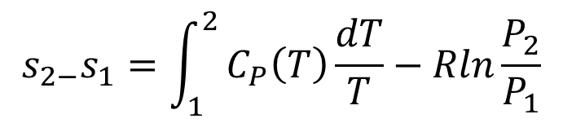

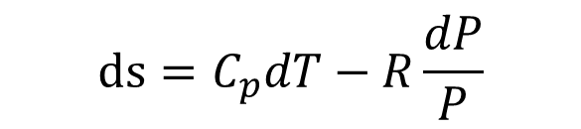


4. Entropy Change of Ideal Gases Cont…
From the second Tds relation,
$$Tds=dh−vdP$$
$$ds=\frac{dh}{T}−\frac{vdP}{T}$$
$$dh=C_{p}dT, and$$
$$v={RT}/P$$
$$ds=C_{p}dT−R\frac{dP}{P}$$
$$s_{2−}s_{1}=\int_{1}^{2}{C_{P}\left(T\right)\frac{dT}{T}−Rln\frac{P_{2}}{P_{1}}}$$
$s_{2−}s_{1}=C_{P,avg}ln\frac{T_{2}}{T_{1}}−Rln\frac{P_{2}}{P_{1}}$ (${kJ}/{kg K})$

Slide 23
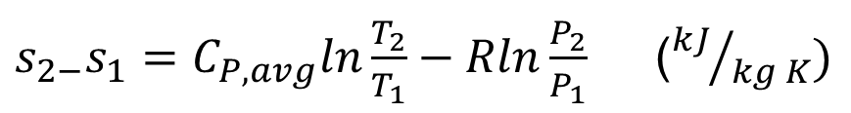

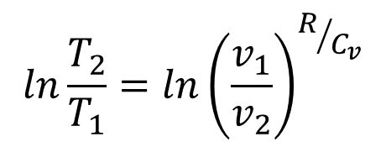
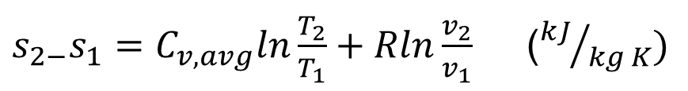
5. Isentropic Processes of Ideal Gases
  For ideal gases, the entropy change can be determined by:
$s_{2−}s_{1}=C_{v,avg}ln\frac{T_{2}}{T_{1}}+Rln\frac{v_{2}}{v_{1}}$ (${kJ}/{kg K})$
$s_{2−}s_{1}=C_{P,avg}ln\frac{T_{2}}{T_{1}}−Rln\frac{P_{2}}{P_{1}}$ (${kJ}/{kg K})$
For an isentropic process, $S_{2−}S_{1}=ΔS=0$
From the above relations,
$$ln\frac{T_{2}}{T_{1}}=ln{\left(\frac{v_{1}}{v_{2}}\right)}^{R/{C_{v}}}$$

Slide 24
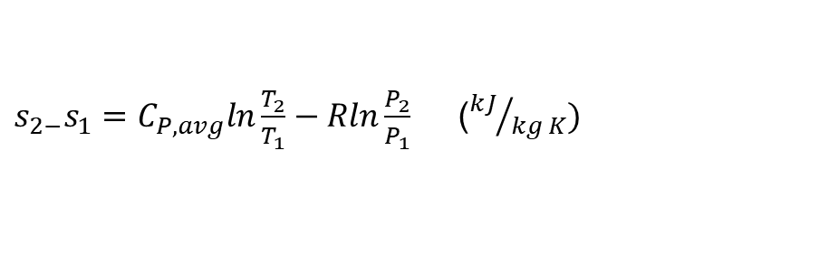
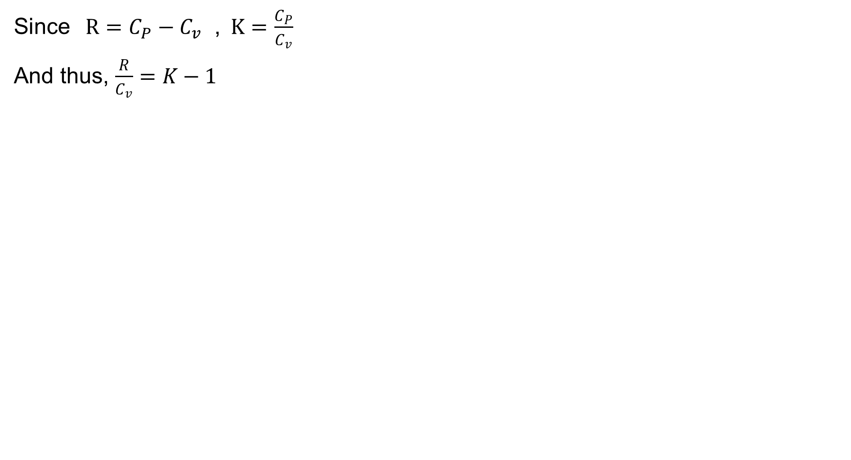
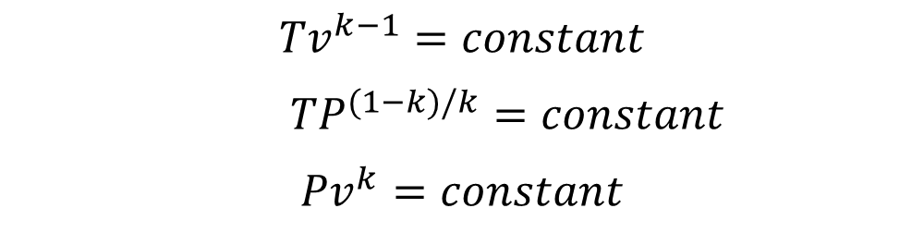
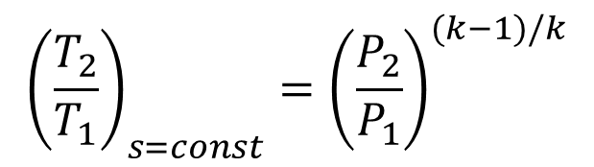
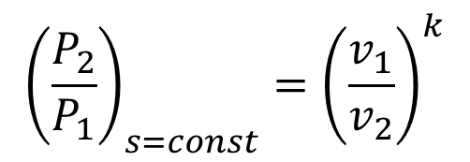
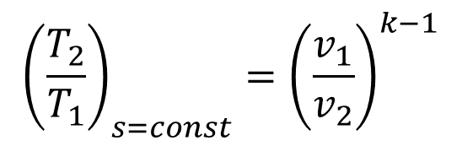
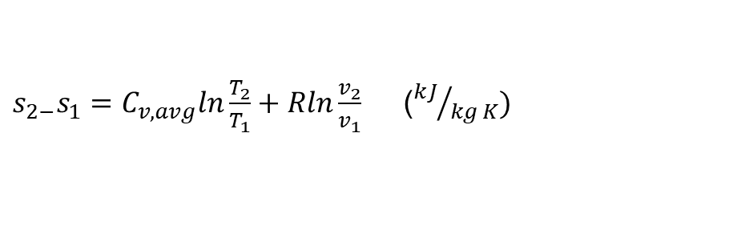
5. Isentropic Processes of Ideal Gases Cont…
Since$R=C_{P}−C_{v}$ ,$K=\frac{C_{P}}{C_{v}}$
And thus, $\frac{R}{C_{v}}=K−1$
$s_{2−}s_{1}=C_{v,avg}ln\frac{T_{2}}{T_{1}}+Rln\frac{v_{2}}{v_{1}}$ (${kJ}/{kg K})$
$s_{2−}s_{1}=C_{P,avg}ln\frac{T_{2}}{T_{1}}−Rln\frac{P_{2}}{P_{1}}$ (${kJ}/{kg K})$
$${\left(\frac{T_{2}}{T_{1}}\right)}_{s=const}={\left(\frac{v_{1}}{v_{2}}\right)}^{k−1}$$
$${\left(\frac{P_{2}}{P_{1}}\right)}_{s=const}={\left(\frac{v_{1}}{v_{2}}\right)}^{k}$$
$${\left(\frac{T_{2}}{T_{1}}\right)}_{s=const}={\left(\frac{P_{2}}{P_{1}}\right)}^{(k−1)/k}$$
$${Tv}^{k−1}=constant$$
${TP}^{(1−k)/k}=constant$
$${Pv}^{k}=constant$$

Slide 25
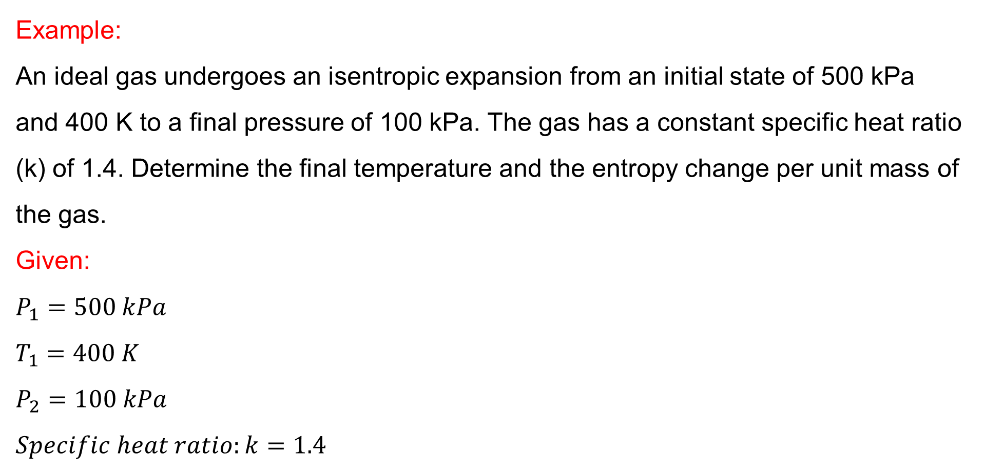
5. Isentropic Processes of Ideal Gases Cont…
Example:
An ideal gas undergoes an isentropic expansion from an initial state of 500 kPa and 400 K to a final pressure of 100 kPa. The gas has a constant specific heat ratio (k) of 1.4. Determine the final temperature and the entropy change per unit mass of the gas.
Given:
$$P_{1}=500 kPa$$
$$T_{1}=400 K$$
$$P_{2}=100 kPa$$
$$Specific heat ratio:k=1.4$$

Slide 26
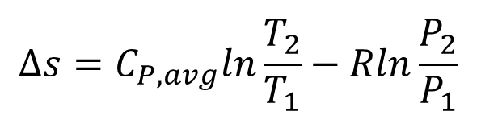
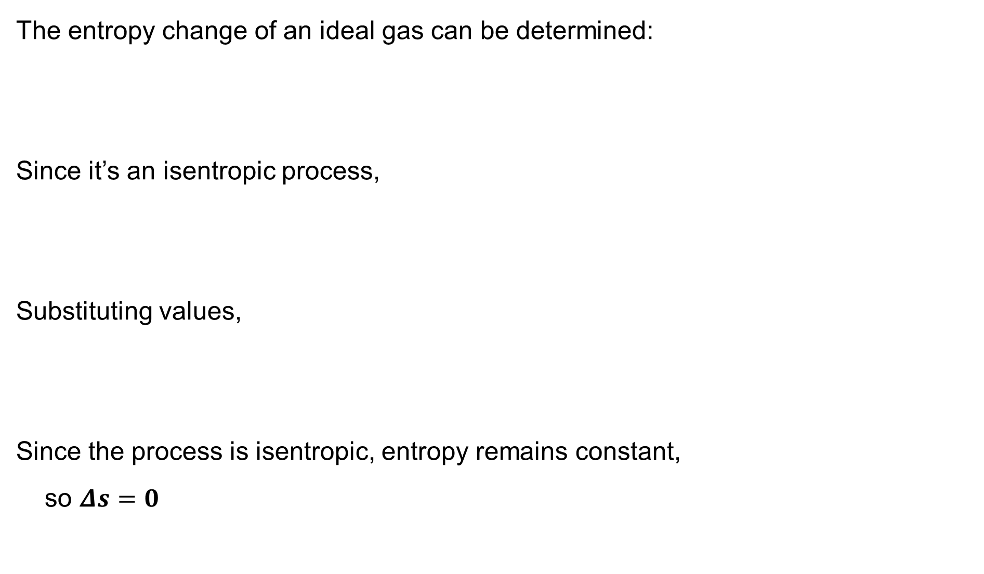
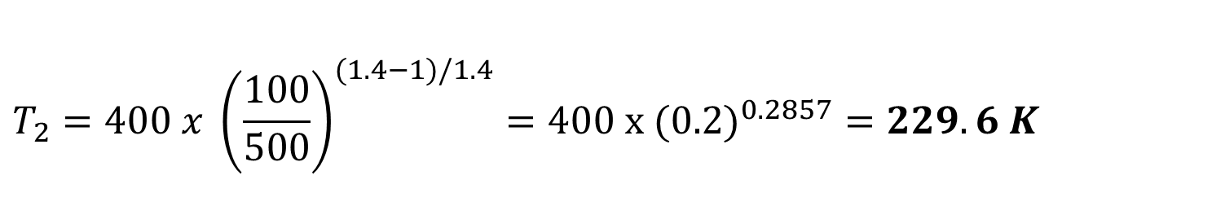
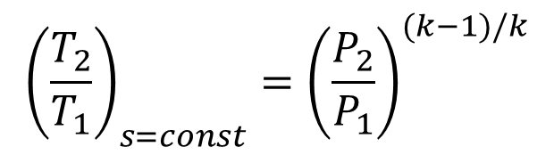
5. Isentropic Processes of Ideal Gases Cont…
The entropy change of an ideal gas can be determined:
Since it’s an isentropic process,
Substituting values,
Since the process is isentropic, entropy remains constant,
so $Δs=0$
$$Δs=C_{P,avg}ln\frac{T_{2}}{T_{1}}−Rln\frac{P_{2}}{P_{1}}$$
$${\left(\frac{T_{2}}{T_{1}}\right)}_{s=const}={\left(\frac{P_{2}}{P_{1}}\right)}^{(k−1)/k}$$
$$T_{2}=400 x {\left(\frac{100}{500}\right)}^{(1.4−1)/1.4}=400 x (0.2)^{0.2857}=229.6 K$$

Slide 27
6. Isentropic Efficiencies of Steady-Flow Devices
Now we extend the analysis to discrete engineering devices working under steady-flow conditions, such as turbines, compressors, and nozzles, and we examine the degree of degradation of energy in these devices as a result of irreversibilities.
However, first we need to define an ideal process that serves as a model for the actual processes.
Thus, the ideal process that can serve as a suitable model for adiabatic steady-flow devices is the isentropic process [4].

Slide 28
6. Isentropic Efficiencies of Steady-Flow Devices Cont…
The more closely the actual process approximates the idealized isentropic process, the better the device performs [5].
Thus, it would be desirable to have a parameter that expresses quantitatively how efficiently an actual device approximates an idealized one.
This parameter is the isentropic or adiabatic efficiency, which is a measure of the deviation of actual processes from the corresponding idealized ones.

Slide 29
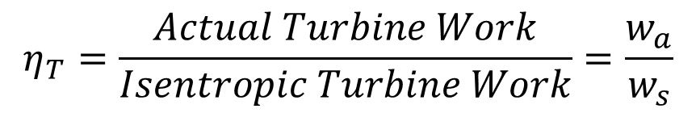
6. Isentropic Efficiencies of Steady-Flow Devices Cont…
1. Isentropic Efficiency of Turbines
The desired output of a turbine is the work produced, and the isentropic efficiency of a turbine is defined as the ratio of the actual work output of the turbine to the work output that would be achieved if the process between the inlet state and the exit pressure were isentropic [6]:
$$η_{T}=\frac{Actual Turbine Work}{Isentropic Turbine Work}=\frac{w_{a}}{w_{s}}$$

Slide 30
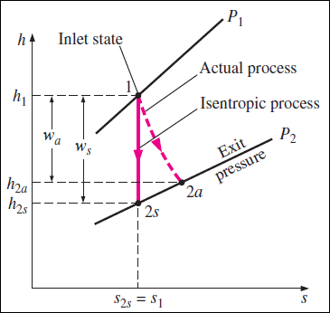
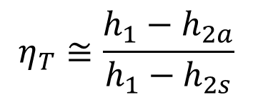
6. Isentropic Efficiencies of Steady-Flow Devices Cont…
Isentropic Efficiency of Turbines
$$η_{T}≅\frac{h_{1}−h_{2a}}{h_{1}−h_{2s}}$$
Well-designed, large turbines have isentropic efficiencies above 90 percent.
For small turbines, however, it may drop even below 70 percent.

Slide 31
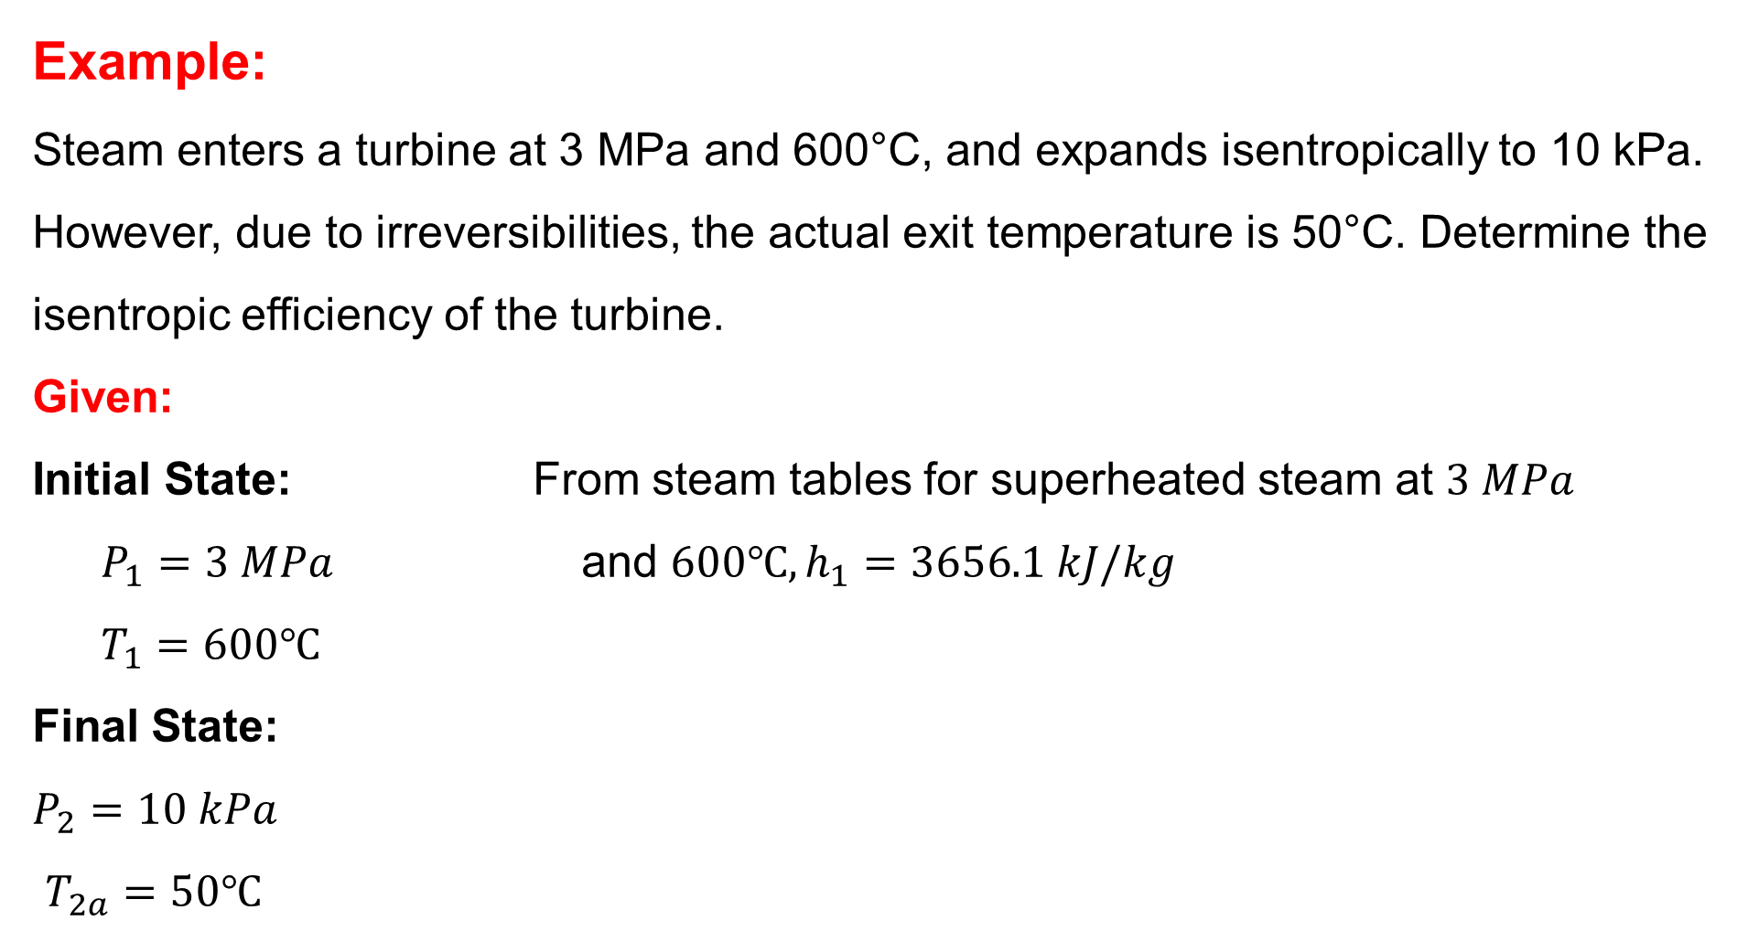
6. Isentropic Efficiencies of Steady-Flow Devices Cont…
Example:
Steam enters a turbine at 3 MPa and 600°C, and expands isentropically to 10 kPa. However, due to irreversibilities, the actual exit temperature is 50°C. Determine the isentropic efficiency of the turbine.
Given:
Initial State: From steam tables for superheated steam at $3 MPa$
  $P_{1}=3 MPa$ and $600℃, h_{1}=3656.1 kJ/kg$
  $$T_{1}=600℃$$
Final State:
$P_{2}=10 kPa$
$T_{2a}=50℃$

Slide 32
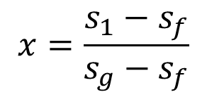

6. Isentropic Efficiencies of Steady-Flow Devices Cont…
For isentropic expansion, let’s check the entropy at state 1:
$$s_{1}=7.0227{kJ}/{kg K}$$
At 10 kPa, we use the saturated steam tables, the entropy for saturated vapor at 10kPa is:
$$s_{g}=7.3595 {kJ}/{kg K}$$
Since $s_{1}<s_{g},$ the steam is a mixture at the exit.
Therefore, the quality $x$is found from: $s_{1}=s_{f}+xs_{fg}$
$$x=\frac{s_{1}−s_{f}}{s_{g}−s_{f}}$$

Slide 33








6. Isentropic Efficiencies of Steady-Flow Devices Cont…
Where:
Therefore,
Now using enthalpy formula for a mixture:
Where,
$$s_{f@10kPa}=0.6492{kJ}/{kg K}$$
$$s_{g@10kPa}=7.3595{kJ}/{kg K}$$
$$x=\frac{7.0227−0.6492}{7.3595−0.6492}=0.95$$
$h_{2s}=h_{f}+x(h_{g}−h_{f}$)
$$h_{g@10kPa}=2556.3{kJ}/{kg }$$
$$h_{f@10kPa}=191.81{kJ}/{kg }$$
$h_{2s}=191.81+0.95(2556.3−191.81$)
$$h_{2s}=2438.08 kJ/kg$$

Slide 34



6. Isentropic Efficiencies of Steady-Flow Devices Cont…
To find the actual exit enthalpy,
From steam tables for saturated liquid at $50℃:$
$$h_{2a}=209.3 kJ/kg$$
To calculate the isentropic efficiency,
$$η_{T}=\frac{h_{1}−h_{2a}}{h_{1}−h_{2s}}=\frac{3656.1−209.3}{3656.1−2438.08}$$
$$η_{T}=0.92=92\%$$

Slide 35

6. Isentropic Efficiencies of Steady-Flow Devices Cont…
2. Isentropic Efficiencies of Compressors and Pumps
The isentropic efficiency of a compressor is defined as the ratio of the work input required to raise the pressure of a gas to a specified value in an isentropic manner to the actual work input [6]:
$$η_{C}=\frac{Isentropic Compressor Work}{Actual Compressor Work}=\frac{w_{s}}{w_{a}}$$

Slide 36



6. Isentropic Efficiencies of Steady-Flow Devices Cont…
Isentropic Efficiencies of Compressors and Pumps
$$η_{c}≅\frac{h_{2s}−h_{1}}{h_{2a}−h_{1}}$$
$$η_{P}=\frac{w_{s}}{w_{a}}=\frac{v(P_{2}−P_{1})}{h_{2a}−h_{1}}$$

Slide 37

6. Isentropic Efficiencies of Steady-Flow Devices Cont…
Example:
An air compressor takes in air at 100 kPa and 300 K and compresses it to 800 kPa. The process is adiabatic, and the exit temperature is 550 K. The specific heat ratio of air is 1.4, and the specific gas constant R is 0.287 kJ/kg·K. Determine the isentropic efficiency of the compressor.
Given:
Inlet state: Final State:
$P_{1}=100 kPa$ $P_{2}=800 kPa$
$T_{1}=300 K$ $T_{2a}=550 K$
Specific heat ratio: $k=1.4$
Gas constant, $R=0.287 kJ/kg K$

Slide 38





6. Isentropic Efficiencies of Steady-Flow Devices Cont…
The isentropic exit temperature, $T_{2s},$
For isentropic compression, we use the relation:
Substituting values,
The isentropic efficiency of the compressor is given by:
$$T_{2s}=T_{1}{\left(\frac{P_{2}}{P_{1}}\right)}^{(k−1)/k}$$
$$T_{2s}=300{\left(\frac{800}{100}\right)}^{(1.4−1)/1.4}=526.5 K$$
$$η_{c}=\frac{T_{2s}−T_{1}}{T_{2a}−T_{1}}=\frac{526.5−300}{550−300}$$
$$η_{c}=0.906=90.6\%$$

Slide 39

6. Isentropic Efficiencies of Steady-Flow Devices Cont…
3. Isentropic Efficiency of Nozzles
The isentropic efficiency of a nozzle is defined as the ratio of the actual kinetic energy of the fluid at the nozzle exit to the kinetic energy value at the exit of an isentropic nozzle for the same inlet state and exit pressure [6].
$$η_{N}=\frac{Actual KE at Nozzle Exit}{Isentropic KE at Nozzle Exit}=\frac{V_{2a}^{2}}{V_{2s}^{2}}$$

Slide 40



6. Isentropic Efficiencies of Steady-Flow Devices Cont…
Isentropic Efficiency of Nozzles
$$h_{1}=h_{2a}+\frac{V_{2a}^{2}}{2}$$
$$η_{N}≅\frac{h_{1}−h_{2a}}{h_{1}−h_{2s}}$$

Slide 41

6. Isentropic Efficiencies of Steady-Flow Devices Cont…
Example:
Air enters a nozzle at $600 kPa$and $450K$ with a velocity of $30m/s$. It expands isentropically to $100 kPa$. The actual exit velocity is $500 m/s$. Assuming ideal gas behavior with $C_{P}=1.005{kJ}/{kg K}$ and $k=1.4$, determine the isentropic efficiency of the nozzle.
Given:
Inlet state: Final state:
$P_{1}=600kPa$ $P_{2}=100kPa$ $C_{P}=1.005{kJ}/{kg K}$
$T_{1}=450 K$ ${\vec{V}}_{2a}=500m/s$ $k=1.4$
$${\vec{V}}_{1}=30m/s$$

Slide 42





6. Isentropic Efficiencies of Steady-Flow Devices Cont…
Solution:
The isentropic exit temperature, $T_{2s}$
For an isentropic expansion, we use the temperature relation:
To find the isentropic exit velocity,
Solving for ${\vec{V}}_{2},$
${\vec{V}}_{2s}=500.64 m/s$
$$T_{2s}=T_{1}{\left(\frac{P_{2}}{P_{1}}\right)}^{(k−1)/k}=$$
$$450{\left(\frac{100}{600}\right)}^{(1.4−1)/1.4}$$
$$T_{2s}=325.8K$$
$$\frac{V_{2s}^{2}}{2}=C_{P}(T_{1}−T_{2s})+\frac{V_{1}^{2}}{2}=\left(1.005 x{10}^{3}\right)\left(450−325.8\right)+\frac{{30}^{2}}{2}$$

Slide 43



6. Isentropic Efficiencies of Steady-Flow Devices Cont…
To calculate the isentropic efficiency of a nozzle,
Substituting values,
$$η_{N}=\frac{V_{2a}^{2}−V_{1}^{2}}{V_{2s}^{2}−V_{1}^{2}}$$
$$η_{N}=\frac{{500}^{2}−{30}^{2}}{{500.64}^{2}−{30}^{2}}$$
$$η_{N}=0.998=99.8\%$$

Slide 44
Summary
Entropy quantifies system disorder and phase changes involve significant entropy variations, with entropy increasing during vaporization and decreasing during condensation.
Isentropic Processes are idealized reversible adiabatic processes where entropy remains constant, commonly seen in turbines, compressors, and nozzles.
For incompressible substances, such as Liquids and Solids, entropy change depends primarily on temperature.
The entropy change in an ideal gas depends on variations in temperature and pressure.
Isentropic efficiencies of steady-flow devices measures how closely a real device approaches an ideal isentropic process, typically expressed as
a ratio of actual to isentropic performance.

Slide 45
References
,
[1]. Thermodynamics – An Engineering Approach, Cengel Y A.,Bole M A., McGraw-Hill Education, 8th edition 2015.
[2]. Fundamentals of Engineering Thermodynamics, 9th ed. Hoboken, M. Moran et al., NJ: Wiley, 2022, Chapter 6: Entropy and the Clausius Inequality.
[3]. Thermodynamics and an Introduction to Thermostatistics, H. B. Callen, 2nd ed. Hoboken, NJ, USA: Wiley, 1985..
[4]. Understanding Thermodynamics. Mineola, H. C. Van Ness, NY: Dover Publications, 2021, Chapter 4: Entropy and the Second Law.
[5]. Fundamentals of Thermodynamics, Sonntag, R. E., Borgnakke, C., & Van Wylen, G. J. 2003, (6th ed.). Wiley.
[6]. Fundamentals of Thermal-Fluid Sciences, Y. A. Cengel, J. M. Cimbala, and R. H. Turner, 6th ed. New York, NY, USA: McGraw-Hill, 2020.

Slide 46
Thank you !

