Slide 1
Engineering Thermodynamics I
Lecture 12
Vapor Power Cycles
Lecturer: Dr. Melaku Desta

Slide 2
Lecture learning outcomes:
At the end of this lecture, you will be able to:
Understand the Carnot Cycle and learn the principles of the idealized Carnot Cycle and its four reversible processes.
Analyze the Rankine Cycle and study the components and processes of the basic Rankine Cycle and its role in steam power plants.
Recognize how actual vapor power cycles differ from idealized ones due to irreversibilities (friction, heat losses, etc.) and practical limitations.
Explore how reheating steam between turbine stages improves efficiency and reduces moisture content in later turbine stages.
Examine the Regenerative Rankine Cycle and understand how feedwater heating improves cycle efficiency.
Assess and compare the advantages and limitations of
these cycles for practical engineering applications in power
generation.

Slide 3
Content
The Carnot Cycle
The Rankine Cycle
Deviation of Actual Vapor Power Cycles from Idealized Ones
The Ideal Reheat Rankine Cycle
The Ideal Regenerative Rankine Cycle
Summary
References

Slide 4
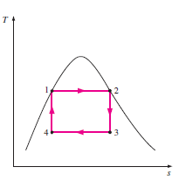
1. The Carnot Cycle
As emphasized repeatedly, the Carnot cycle represents the highest possible thermal efficiency for any heat engine operating between two fixed temperature limits.
Consider a steady-flow Carnot cycle executed within the saturation dome of a pure substance.
Figure 1: T-s Diagram of a Carnot Cycle
url: https://encrypted-tbn0.gstatic.com/images?q=tbn:ANd9GcS0_X5wMHSoHnfPEarrNqFfsWsfnG1V1W4XzorZ6Q3t8KTLTJbl8iXxV2LdNYmSxdDFSu0&usqp=CAU

Slide 5
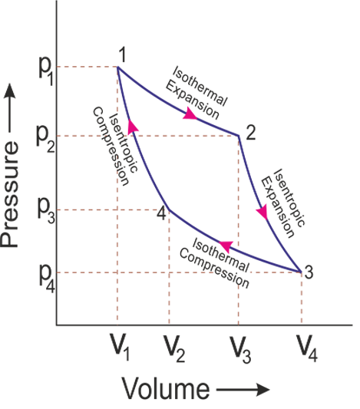
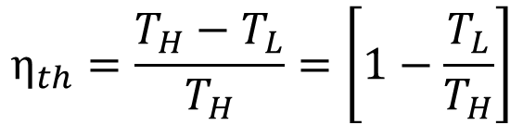
1. The Carnot Cycle Cont…
The fluid is heated reversibly and isothermally in a boiler (process 1-2), expanded isentropically in a turbine (process 2-3), condensed reversibly and isothermally in a condenser (process 3-4), and compressed isentropically by a compressor to the initial state (process 4-1).
Figure 2: P-v Diagram of a Carnot Cycle
url: https://www.mechanicaltutorial.com/pictures/content_picture/carnot_cycle/carnot_cycle_graph.png
$$η_{th}=\frac{T_{H}−T_{L}}{T_{H}}=\left[1−\frac{T_{L}}{T_{H}}\right]$$

Slide 6
1. The Carnot Cycle Cont…
Practical Limitations of the Carnot Cycle:
  Temperature Constraints: Heat transfer is restricted to two-phase systems, limiting the maximum temperature to below the critical point.
  Turbine Erosion: Liquid droplet formation damages turbine blades, leading to wear and inefficiency.
  Fluid Selection: A working fluid with a steep saturated vapor line could minimize two-phase flow in the turbine.

Slide 7
1. The Carnot Cycle Cont…
Practical Limitations of the Carnot Cycle:
  Control Challenges: Precise condensation control is difficult, making it hard to achieve the desired vapor quality at the cycle's end state.
  Compressor Issues: Handling two-phase flow in a compressor is mechanically impractical.

Slide 8
2. The Rankine Cycle
Many of the impracticalities associated with the Carnot cycle can be eliminated by superheating the steam in the boiler and condensing it completely in the condenser.
The cycle that results is the Rankine cycle, which is the ideal cycle for vapor power plants.
The Rankine Cycle is a thermodynamic cycle widely used in steam power plants to convert heat into mechanical work, which is then transformed into electricity [1].
It is the idealized model for vapor power cycles, serving as
the basis for real-world power generation systems.

Slide 9
2. The Rankine Cycle Cont…
The cycle consists of four main components:
  Pump – Compresses liquid water to high pressure (isentropic process).
  Boiler (Heat Addition) – Heats high-pressure water to produce steam (isobaric process).
  Turbine – Expands steam to produce work (isentropic expansion).
  Condenser – Condenses exhaust steam back into liquid (isobaric heat rejection).
  The Rankine cycle follows the following four processes
  on a T-s (Temperature-Entropy) diagram:

Slide 10
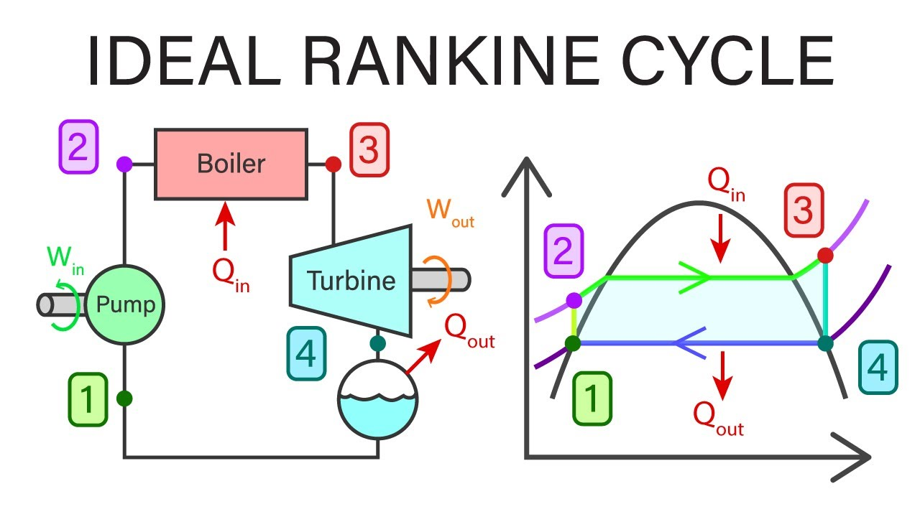
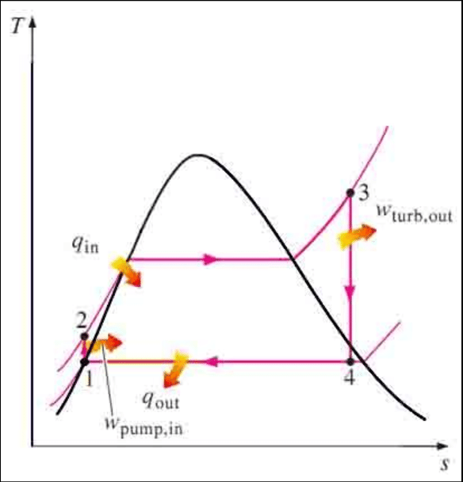
2. The Rankine Cycle Cont…
Four processes of a Rankine Cycle:
Process 1-2: Isentropic compression in a pump
Process 2-3: Constant pressure heat addition in a boiler
Process 3-4: Isentropic expansion in a turbine
Process 4-1: Constant pressure heat rejection in a condenser
Figure 3: Components of a Rankine Cycle
url: https://i.ytimg.com/vi/21XFZaxity8/maxresdefault.jpg
Figure 4: T-s diagram of a Rankine Cycle
url: https://www.researchgate.net/publication/336647595/figure/fig1/AS:815342993547265@1571404326643/deal-Rankine-Cycle.png

Slide 11
2. The Rankine Cycle Cont…
Comparison with Carnot Cycle
Rankine Cycle is more practical than the Carnot cycle because:
  It avoids two-phase compression (pump handles only liquid).
  It allows superheating steam to higher temperatures.
However, Carnot efficiency is higher for the same temperature limits.
(a) (b)
Figure 5: T-s diagram of (a) Carnot Cycle, (b) Rankine Cycle

Slide 12
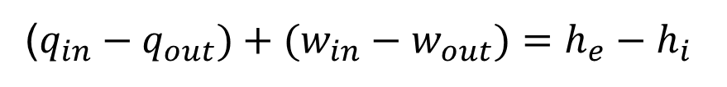
2. The Rankine Cycle Cont…
Energy Analysis of the Rankine Cycle
Rankine cycle can be analyzed as steady-flow processes.
Neglecting changes in kinetic and potential energies.
The steady-flow energy equation per unit mass of steam
Assumptions:
The boiler and the condenser do not involve any work.
the pump and the turbine are assumed to be isentropic.
($q_{in}−q_{out})+(w_{in}−w_{out})=h_{e}−h_{i}$

Slide 13
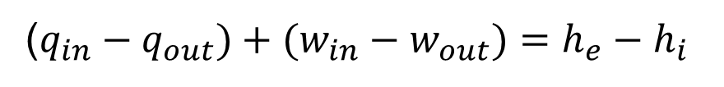
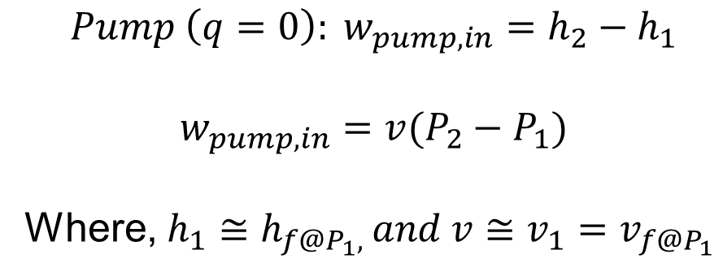
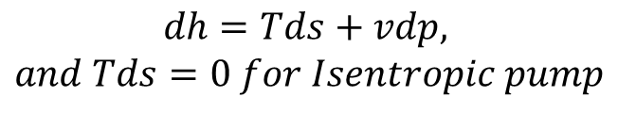
2. The Rankine Cycle Cont…
The conservation of energy relation for each device can be expressed as follows:
1. Isentropic Compression (Pump Work Input)
  Since this process is ideally isentropic, there is no entropy generation.
  The work input to the pump is given by:
($q_{in}−q_{out})+(w_{in}−w_{out})=h_{e}−h_{i}$
$$Pump \left(q=0\right): w_{pump,in}=h_{2}−h_{1}$$
$$w_{pump,in}=v(P_{2}−P_{1})$$
Where, $h_{1}≅h_{f@P_{1}, }and v≅v_{1}=v_{f@P_{1}}$
$$dh=Tds+vdp,$$
$$and Tds=0 for Isentropic pump$$

Slide 14
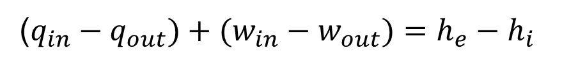

2. The Rankine Cycle Cont…
2. Isobaric Heat Addition (Boiler)
  The high-pressure liquid enters the boiler and absorbs heat, causing it to evaporate into steam.
  This process occurs at constant pressure.
  The heat energy added is:
($q_{in}−q_{out})+(w_{in}−w_{out})=h_{e}−h_{i}$
$$q_{in}=h_{3}−h_{2}$$

Slide 15

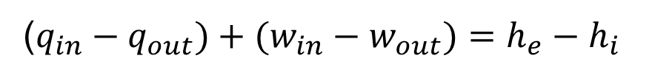
2. The Rankine Cycle Cont…
3. Isentropic Expansion (Turbine Work Output)
  The high-energy steam expands in the turbine, producing mechanical work.
  Since the process is ideally isentropic, no entropy is generated.
  The turbine work output is:
($q_{in}−q_{out})+(w_{in}−w_{out})=h_{e}−h_{i}$
$$w_{out}=h_{3}−h_{4}$$

Slide 16
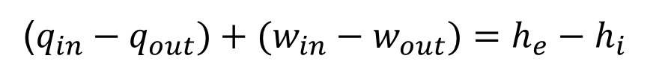
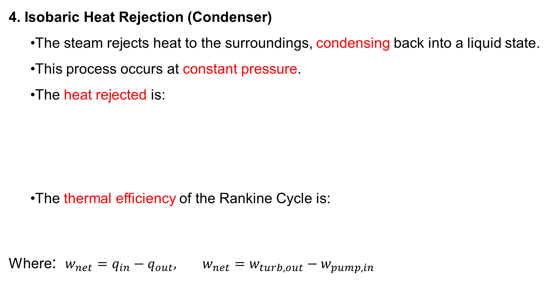
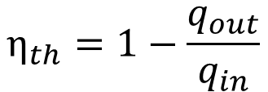

2. The Rankine Cycle Cont…
4. Isobaric Heat Rejection (Condenser)
  The steam rejects heat to the surroundings, condensing back into a liquid state.
  This process occurs at constant pressure.
  The heat rejected is:
  The thermal efficiency of the Rankine Cycle is:
Where: $w_{net}=q_{in}−q_{out}, w_{net}=w_{turb,out}−w_{pump,in}$
($q_{in}−q_{out})+(w_{in}−w_{out})=h_{e}−h_{i}$
$$q_{out}=h_{4}−h_{1}$$
$$η_{th}=1−\frac{q_{out}}{q_{in}}$$

Slide 17
2. The Rankine Cycle Cont…
Example 1:
A steam power plant operates on a simple ideal Rankine cycle with a net power output of 45 MW. Steam enters the turbine at 7 MPa and 500°C and is condensed in the condenser at 10 kPa. Cooling water from a lake flows through the condenser tubes at 2000 kg/s.
  Determine the thermal efficiency of the cycle.
  Find the mass flow rate of steam (ṁ).
  Calculate the temperature rise of the cooling water (ΔT).

Slide 18
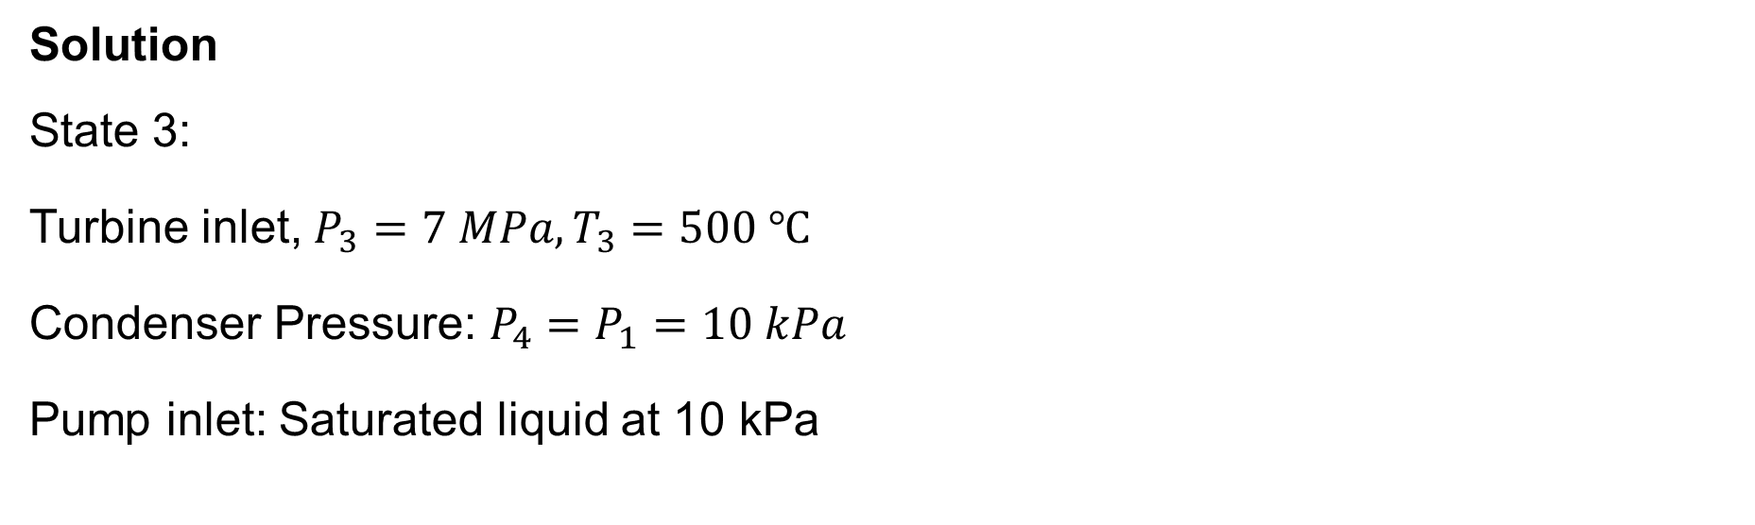
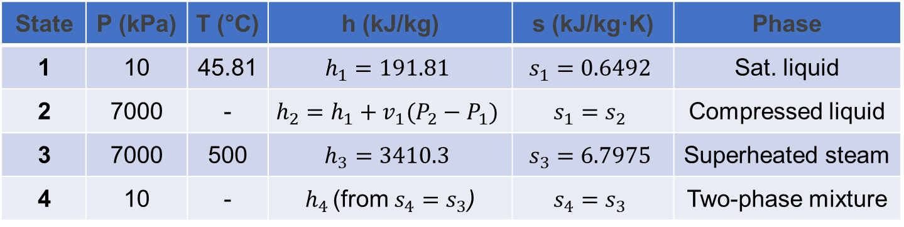
2. The Rankine Cycle Cont…
Solution
State 3:
Turbine inlet, $P_{3}=7 MPa, T_{3}=500 ℃$
Condenser Pressure: $P_{4}=P_{1}=10 kPa$
Pump inlet: Saturated liquid at 10 kPa
State | P (kPa) | T (°C) | h (kJ/kg) | s (kJ/kg·K) | Phase
1 | 10 | 45.81 | $$h_{1}=191.81$$ | $$s_{1}=0.6492$$ | Sat. liquid
2 | 7000 | - | $$h_{2}=h_{1}+v_{1}(P_{2}−P_{1})$$ | $$s_{1}=s_{2}$$ | Compressed liquid
3 | 7000 | 500 | $$h_{3}=3410.3$$ | $$s_{3}=6.7975$$ | Superheated steam
4 | 10 | - | $h_{4 }$(from $s_{4}=s_{3}$) | $$s_{4}=s_{3}$$ | Two-phase mixture

Slide 19

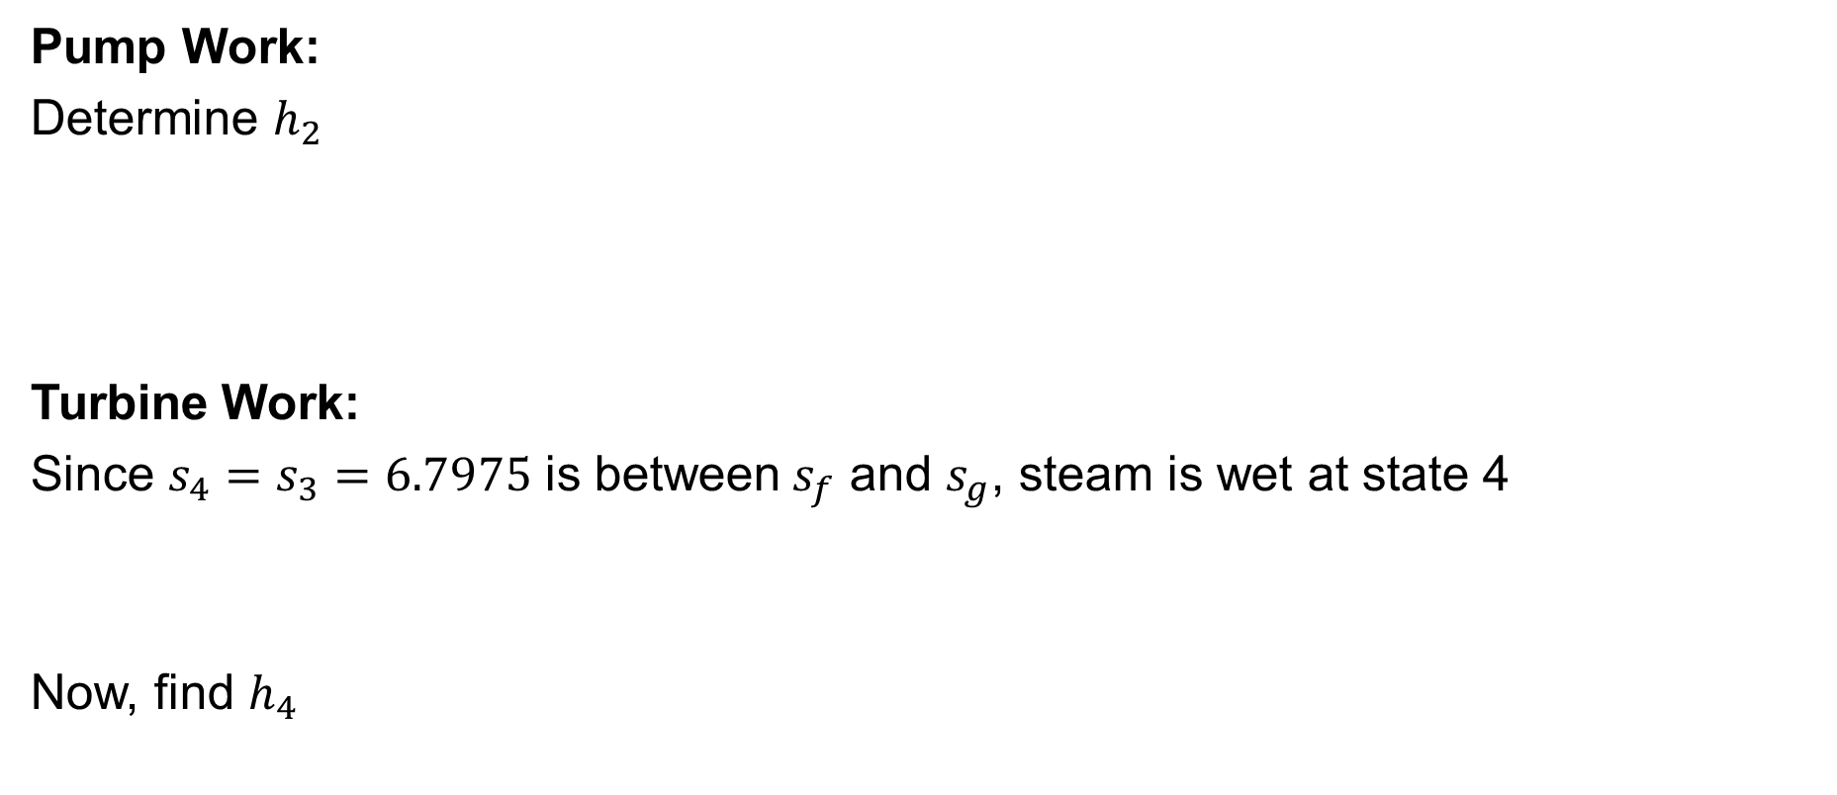
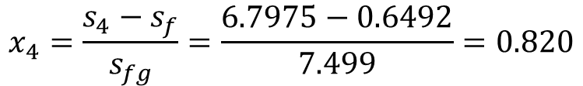



2. The Rankine Cycle Cont…
Pump Work:
Determine $h_{2}$
Turbine Work:
Since $s_{4}=s_{3}=6.7975$ is between${ s}_{f}$ and $s_{g}$, steam is wet at state 4
Now, find $h_{4}$
$$W_{P}=v\left(P_{2}−P_{1}\right)=0.001010\left(7000−10\right)=7.06 kPa$$
where $v_{1}=0.001010 m^{3}/kg$
$h_{2}=h_{1}+W_{P}$
$$h_{2}=191.81+0.001010(7000−10)$$
$$h_{2}=198.87 kJ/kg$$
$$x_{4}=\frac{s_{4}−s_{f}}{s_{fg}}=\frac{6.7975−0.6492}{7.499}=0.820$$
$$h_{4}=h_{f}+x_{4}h_{fg}=191.81+0.820 x 2392.1=2153.5 kJ/kg$$
$$W_{out}=h_{3}−h_{4}=3410.3−2153.5=1256.8 kJ/kg$$

Slide 20
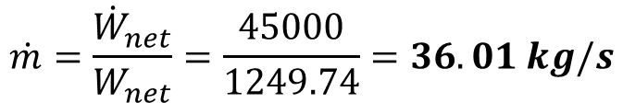
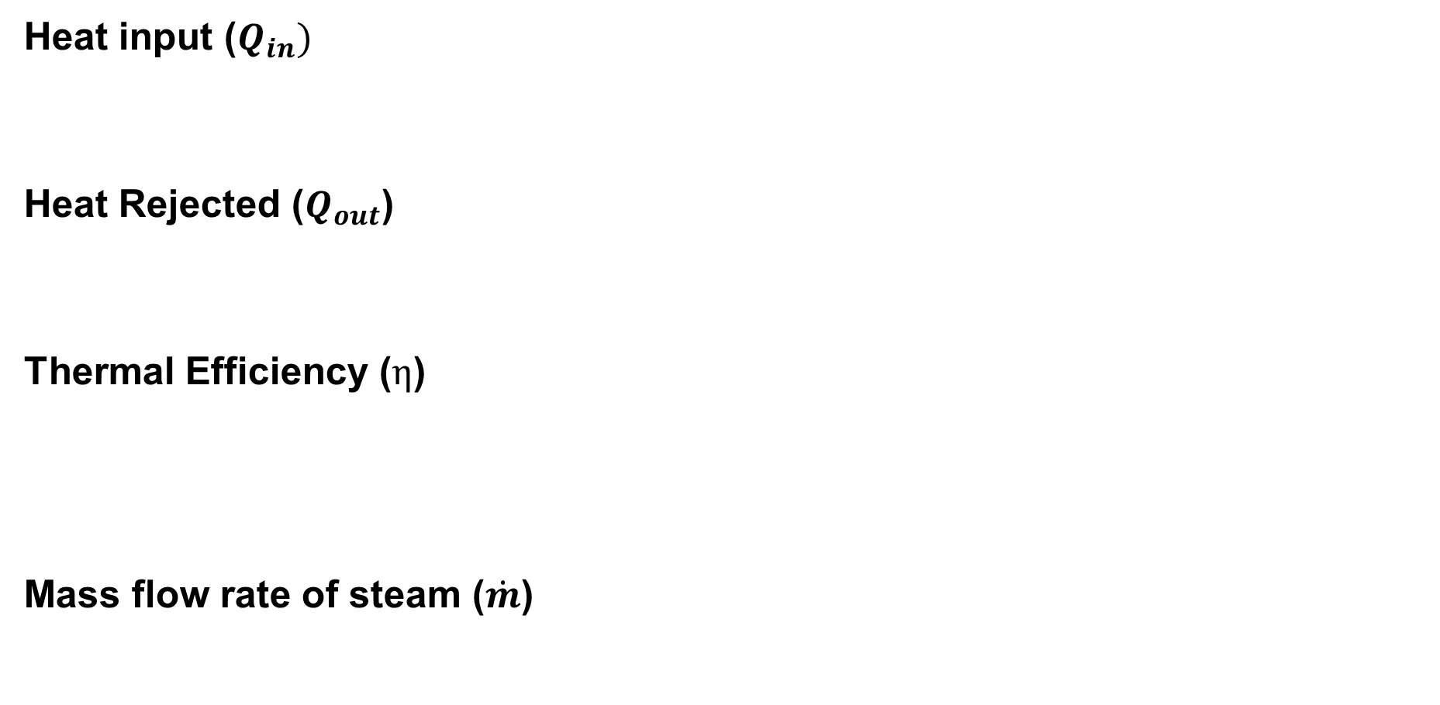
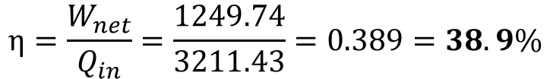
2. The Rankine Cycle Cont…
Heat input ($Q_{in})$
Heat Rejected ($Q_{out}$)
Thermal Efficiency ($η$)
Mass flow rate of steam ($\dot{m}$)
$$Q_{in}=h_{3}−h_{2}=3410.3−198.87=3211.43 kJ/kg$$
$$Q_{out}=h_{4}−h_{1}=2153.5−191.81=1961.69 kJ/kg$$
$$W_{net}=W_{out}−W_{pump}=1256.8−7.06=1249.74 kJ/kg$$
$$η=\frac{W_{net}}{Q_{in}}=\frac{1249.74}{3211.43}=0.389=38.9\%$$
$$\dot{m}=\frac{{\dot{W}}_{net}}{W_{net}}=\frac{45000}{1249.74}=36.01 kg/s$$

Slide 21
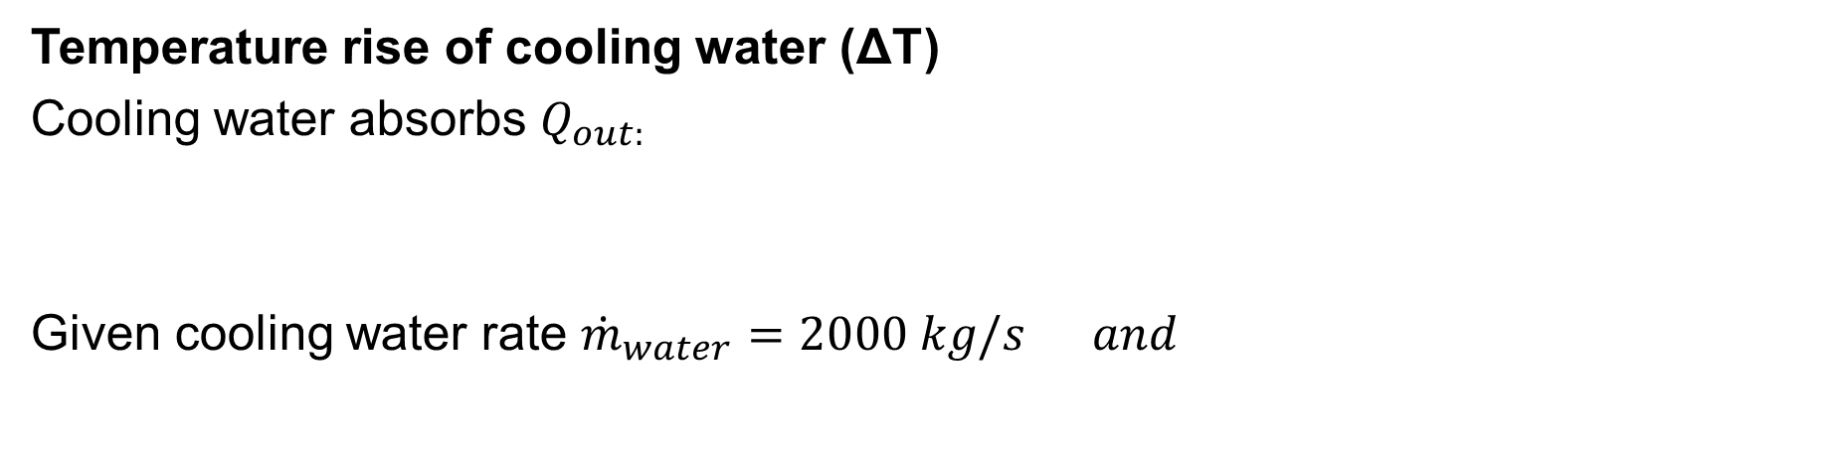

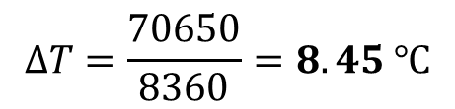

2. The Rankine Cycle Cont…
Temperature rise of cooling water (ΔT)
Cooling water absorbs $Q_{out:}$
Given cooling water rate ${\dot{m}}_{water}=2000 kg/s and$
$${\dot{Q}}_{out}={\dot{m}}_{steam} x Q_{out}=36.01 x 1961.69=70650 kJ/s$$
${\dot{Q}}_{out}={\dot{m}}_{water}$ $C_{p}ΔT$
$$C_{p}=4.18 kJ/kgK$$
$$ΔT=\frac{70650}{8360}=8.45 ℃$$

Slide 22
3. Deviation of Actual Vapor Power Cycles from Idealized Ones
In real-world power plants, actual vapor power cycles deviate from the ideal Rankine cycle due to various irreversibilities and practical limitations.
These deviations reduce efficiency and affect performance. Below are the key reasons for these differences:
  Turbine and pump irreversibilities (friction, turbulence, and heat losses)
  Pressure drops in pipes and heat exchangers
  Heat losses to the surroundings
  Incomplete condensation & subcooling
  Fluid property variations

Slide 23
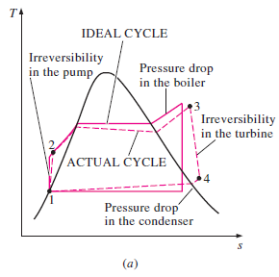
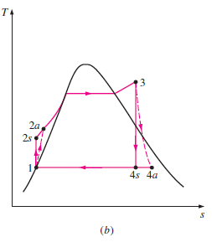
3. Deviation of Actual Vapor Power Cycles from Idealized Ones
The T-s Diagram of an Ideal and Actual Vapor Power Cycles
Figure 5: Deviation of Actual Vapor Power Cycles from Idealized One
url: https://sklc-tinymce-2021.s3.amazonaws.com/2020/11/mceclip5_1605032619.png

Slide 24
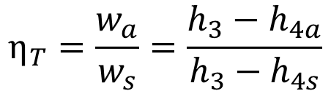
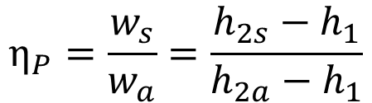
3. Deviation of Actual Vapor Power Cycles from Idealized Ones Cont…
A pump requires a greater work input, and a turbine produces a smaller work output as a result of irreversibilities.
Under ideal conditions, the flow through these devices is isentropic.
The deviation of actual pumps and turbines from the isentropic ones can be accurately accounted for, however, by utilizing adiabatic efficiencies, defined as:
$$η_{P}=\frac{w_{s}}{w_{a}}=\frac{h_{2s}−h_{1}}{h_{2a}−h_{1}}$$
$$η_{T}=\frac{w_{a}}{w_{s}}=\frac{h_{3}−h_{4a}}{h_{3}−h_{4s}}$$

Slide 25
3. Deviation of Actual Vapor Power Cycles from Idealized Ones Cont…
Example 2:
Repeat Example 1, assuming an adiabatic efficiency of 87 percent for both the turbine and the pump.
A steam power plant operates on a simple ideal Rankine cycle with a net power output of 45 MW. Steam enters the turbine at 7 MPa and 500°C and is condensed in the condenser at 10 kPa. Cooling water from a lake flows through the condenser tubes at 2000 kg/s.
  Determine the thermal efficiency of the cycle.
  Find the mass flow rate of steam (ṁ).
  Calculate the temperature rise of the cooling water (ΔT).

Slide 26

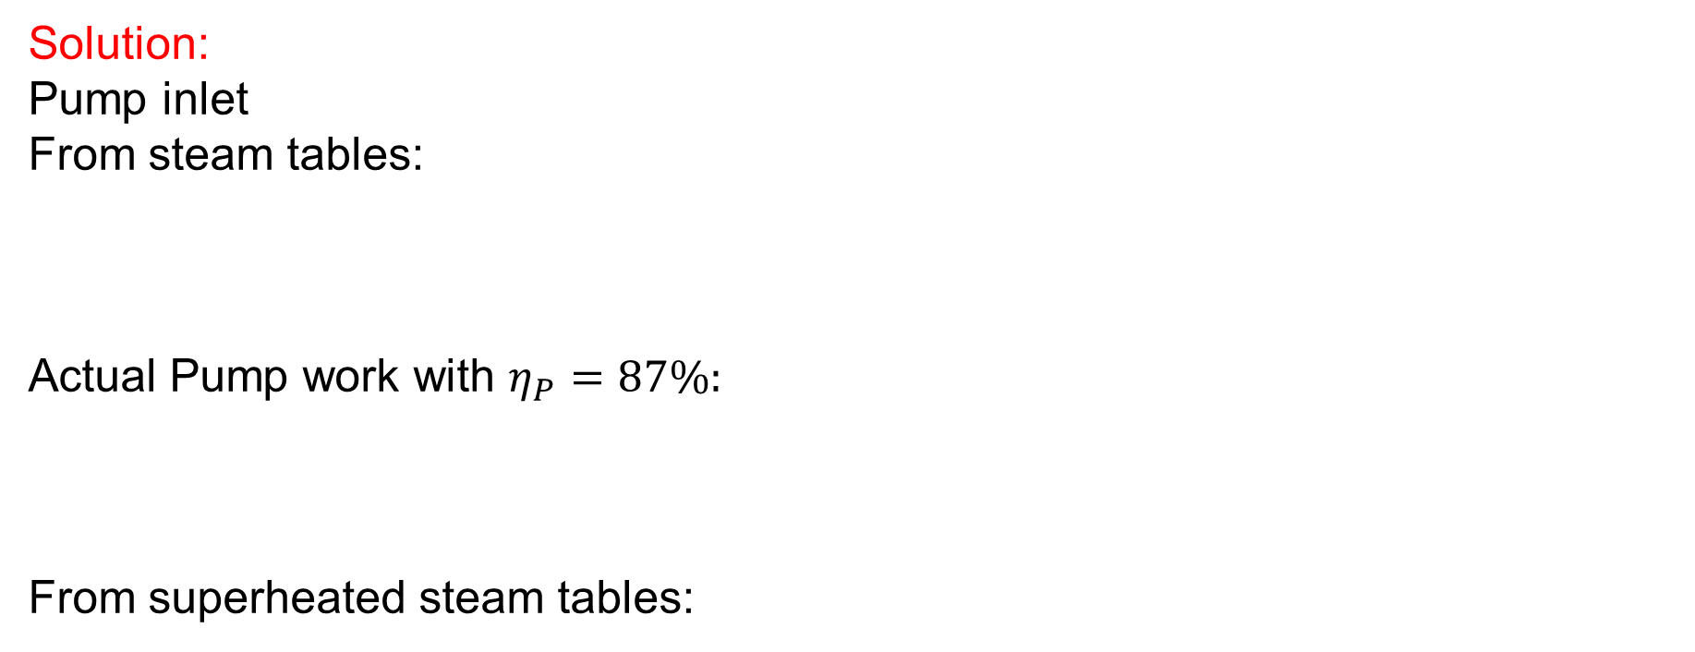

3. Deviation of Actual Vapor Power Cycles from Idealized Ones Cont…
Solution:
Pump inlet
From steam tables:
Actual Pump work with $η_{P}=87\%:$
From superheated steam tables:
$$h_{1}=191.81kJ/kg, { v}_{1}=0.001010 m^{3}/kg{ , s}_{1}=0.6492$$
$$h_{2s}=h_{1}+v_{1}\left(P_{2}−P_{1}\right)=191.81+0.001010 \left(7000−10\right)=198.87 kJ/kg$$
$$h_{2a}=h_{1}+\frac{h_{2s}−h_{1}}{η_{P}}=191.81+\frac{198.87−191.81}{0.87}=199.92 kJ/kg$$
$$h_{3}=3410.3 kJ/kg$$
$$s_{3}=6.7975$$

Slide 27
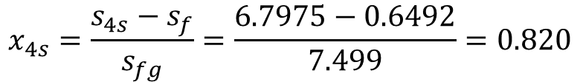
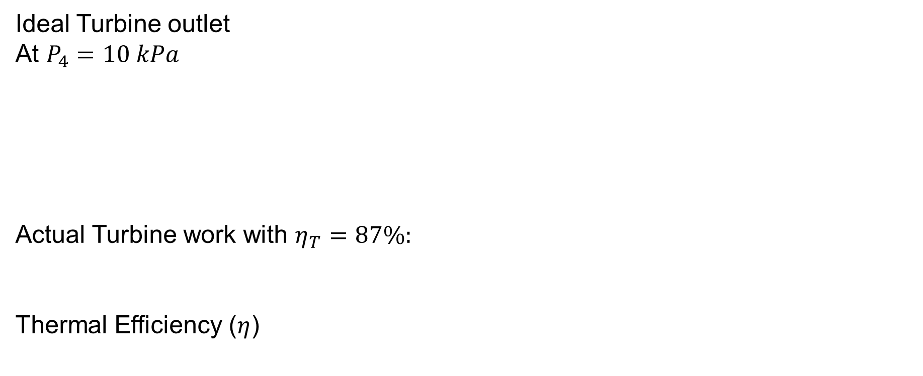
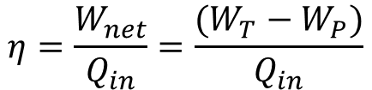
3. Deviation of Actual Vapor Power Cycles from Idealized Ones Cont…
Ideal Turbine outlet
At $P_{4}=10 kPa$
Actual Turbine work with $η_{T}=87\%:$
Thermal Efficiency ($η$)
$$x_{4s}=\frac{s_{4s}−s_{f}}{s_{fg}}=\frac{6.7975−0.6492}{7.499}=0.820$$
$$h_{4s}=h_{f}+x_{4s}h_{fg}=191.81+0.820 x 2392.1=2153.5 kJ/kg$$
$$h_{4}=h_{3}−η_{T }\left(h_{3}−h_{4s}\right)=3410.3−0.87\left(3410.3−2153.5\right)=2317.1 kJ/kg$$
$$η=\frac{W_{net}}{Q_{in}}=\frac{(W_{T}−W_{P})}{Q_{in}}$$

Slide 28
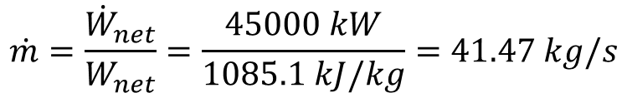
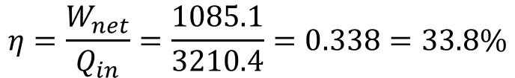
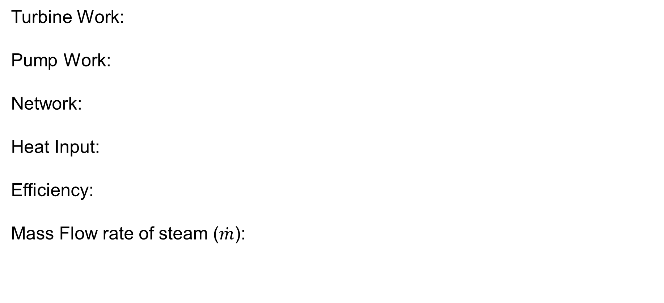
3. Deviation of Actual Vapor Power Cycles from Idealized Ones Cont…
Turbine Work:
Pump Work:
Network:
Heat Input:
Efficiency:
Mass Flow rate of steam ($\dot{m}$):
$$W_{T}=h_{3}−h_{4}=3410.3−2317.1=1093.2 kJ/kg$$
$$W_{P}=h_{2}−h_{1}=199.92−191.81=8.11 kJ/kg$$
$$W_{net}=W_{T}−W_{P}=1093.2−8.11=1085.1 kJ/kg$$
$$Q_{in}=h_{3}−h_{2}=3410.3−199.92=3210.4 kJ/kg$$
$$η=\frac{W_{net}}{Q_{in}}=\frac{1085.1}{3210.4}=0.338=33.8\%$$
$$\dot{m}=\frac{{\dot{W}}_{net}}{W_{net}}=\frac{45000 kW}{1085.1 kJ/kg}=41.47 kg/s$$

Slide 29
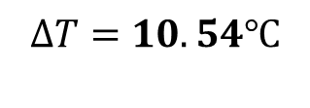
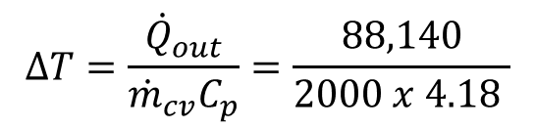

3. Deviation of Actual Vapor Power Cycles from Idealized Ones Cont…
Temperature Rise of Cooling Water:
Heat rejected in condenser
Cooling water temperature rise:
$$Q_{out}=h_{4}−h_{1}=2317.1−191.81=2125.3 kJ/kg$$
$${\dot{Q}}_{out}={\dot{m}Q}_{out}=41.47 x 2125.3=88,140 kW$$
$${\dot{Q}}_{out}={{\dot{m}}_{cv}C}_{p}ΔT$$
$$ΔT=\frac{{\dot{Q}}_{out}}{{{\dot{m}}_{cv}C}_{p}}=\frac{88,140}{2000 x 4.18 }$$
$$ΔT=10.54℃$$

Slide 30
3. Deviation of Actual Vapor Power Cycles from Idealized Ones Cont…
How can we increase the efficiency of the Rankine Cycle?
Improving the efficiency of the Rankine cycle-a widely used thermodynamic cycle in power plants-can lead to better energy output and lower operational costs [2].
The basic idea behind all the modifications to increase the thermal efficiency of a power cycle is the same:
  Increase the average temperature at which heat is transferred to the working fluid in the boiler, or
  decrease the average temperature at which heat is
  rejected from the working fluid in the condenser.

Slide 31
3. Deviation of Actual Vapor Power Cycles from Idealized Ones Cont…
Some of the ways to enhance the efficiency of a Rankine Cycle are [3]:
  Lowering the condenser pressure
  Superheating the steam to high temperatures
  Increasing the boiler pressure
  Using Reheat Cycles
  Regenerative Feedwater Heating
  Improved Turbine Design

Slide 32
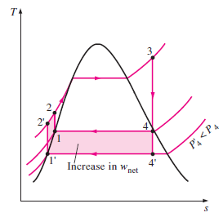
3. Deviation of Actual Vapor Power Cycles from Idealized Ones Cont…
Lowering the Condenser Pressure (Lowers T_{low,av})
Decreasing the pressure in the condenser reduces the temperature at which heat is rejected, increasing the thermal efficiency.
The colored area on this diagram represents the increase in net work output as a result of lowering the condenser pressure from P4 to P’4.
The heat input requirements also increase, but this increase is very small.
The overall effect of lowering the condenser pressure is an increase in the thermal efficiency of the cycle.
Figure 6: T-s diagram of a Rankine Cycle with Lowering Condenser Pressure
url: https://slideplayer.com/slide/5779348/19/images/10/Effect+of+Lowering+Condenser+Pressure+on+the+Ideal+Rankine+cycle.jpg

Slide 33
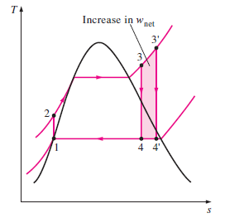
3. Deviation of Actual Vapor Power Cycles from Idealized Ones Cont…
Superheating the Steam to High Temperatures (Increases T_{high,av})
  Increasing the temperature of the steam beyond the saturation point (before entering the turbine) helps improve efficiency by reducing moisture content in the later turbine stages.
  The colored area on this diagram represents the increase in the net work.
  The total area under the process curve 3-3’ represents the increase in the heat input.
Figure 7: T-s diagram of a Rankine Cycle with Superheating the Steam
url: https://encrypted-tbn0.gstatic.com/images?q=tbn:ANd9GcSrnUU9zg3wGZAlY7SFpjSli-cxvRtLdIsMdA&s

Slide 34
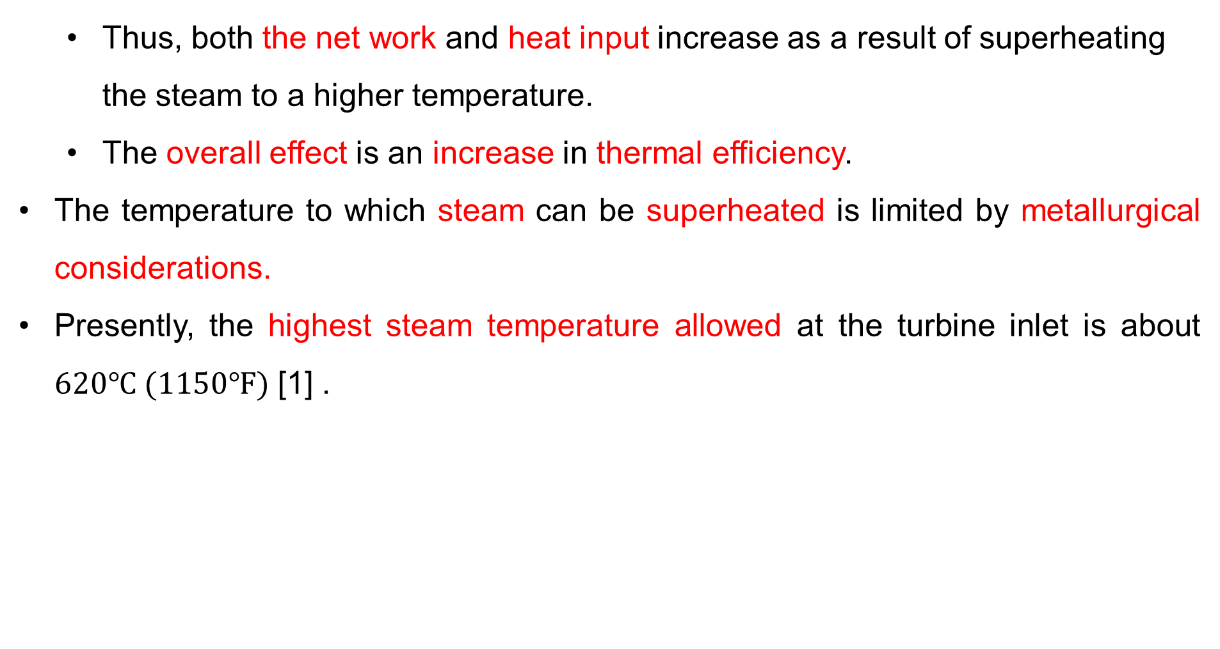
3. Deviation of Actual Vapor Power Cycles from Idealized Ones Cont…
  Thus, both the net work and heat input increase as a result of superheating the steam to a higher temperature.
  The overall effect is an increase in thermal efficiency.
The temperature to which steam can be superheated is limited by metallurgical considerations.
Presently, the highest steam temperature allowed at the turbine inlet is about $620℃ (1150℉)$ [1] .

Slide 35
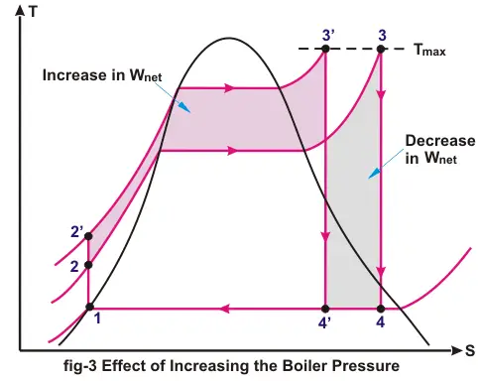
3. Deviation of Actual Vapor Power Cycles from Idealized Ones Cont…
Increasing the Boiler Pressure (Increase T_{high,av} )
Raising the steam pressure in the boiler increases the average temperature at which heat is added, boosting efficiency.
This, in turn, raises the average temperature at which heat is added to the steam and thus raises the thermal efficiency of the cycle.
However, this requires materials that can withstand higher pressures.
Figure 8: T-s diagram of a Rankine Cycle with Increasing the Boiler Pressure
url: https://www.electrical4u.com/images/september16/1474713085.png

Slide 36
4. The Ideal Reheat Rankine Cycle
Increasing the boiler pressure increases the thermal efficiency of the Rankine cycle, but it also increases the moisture content of the steam to unacceptable levels.
Then,
How can we harness the improved efficiencies of higher boiler pressures while mitigating the risk of excessive moisture in the turbine's final stages?

Slide 37
4. The Ideal Reheat Rankine Cycle Cont…
Two possibilities to mind:
1. Superheating the steam to very high temperatures before it enters the turbine.
  This would be the ideal solution because increasing the steam temperature raises the average heat addition temperature, thereby improving cycle efficiency.
  However, this approach is not feasible, as it would require steam temperatures beyond safe metallurgical limits for the turbine materials.

Slide 38
4. The Ideal Reheat Rankine Cycle Cont…
2. Expand the steam in the turbine in two stages, and reheat it in between.
The simple ideal Rankine cycle can be enhanced by incorporating a reheat process.
Reheating effectively addresses the issue of excessive moisture in turbine stages, making it a widely adopted solution in modern steam power plants [4].
Therefore, the Ideal Reheat Rankine Cycle is a modification of the simple Rankine cycle designed to improve efficiency and reduce moisture content in the later stages of the turbine.
This is achieved by expanding the steam in two turbine
stages and reheating it between expansions.

Slide 39
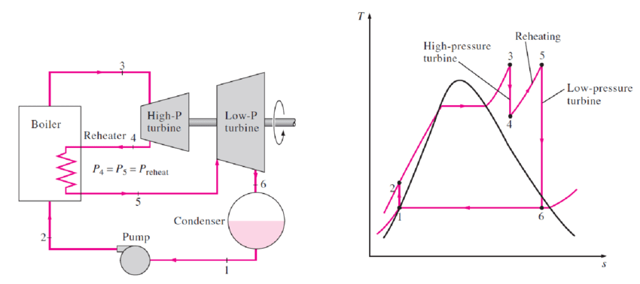
4. The Ideal Reheat Rankine Cycle Cont…
The T-s diagram of the ideal reheat Rankine cycle and the schematic of the power plant operating on this cycle are shown below:
Figure 9: Schematic and T-s diagram of an Ideal Rehaet Rankine Cycle
url: https://www.researchgate.net/profile/Zin-Eddine-Dadach/publication/348295259/figure/fig7/AS:977200316702723@1609994119970/deal-Reheat-Rankine-Cycle-18.png

Slide 40
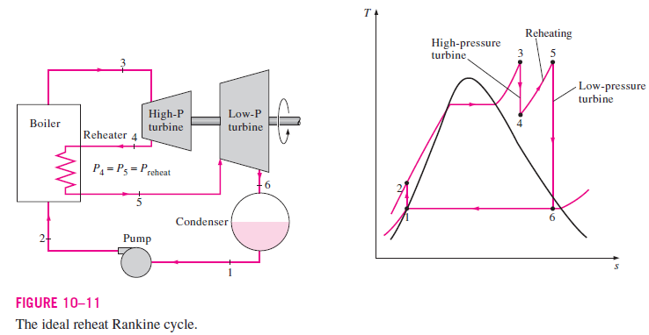
4. The Ideal Reheat Rankine Cycle Cont…
The ideal reheat Rankine cycle differs from the simple ideal Rankine cycle in that the expansion process takes place in two stages.
In the first stage (the high-pressure turbine), steam is expanded isentropically to an intermediate pressure and sent back to the boiler where it is reheated at constant pressure, usually to the inlet temperature of the first turbine stage.
Steam then expands isentropically in the second stage (low-pressure turbine) to the condenser pressure.

Slide 41
4. The Ideal Reheat Rankine Cycle Cont…
The total heat input and the total turbine work output for a reheat cycle become
$$q_{in}=q_{primary}+q_{reheat}=\left(h_{3}−h_{2}\right)+(h_{5}−h_{4})$$
$$w_{turb, out}=w_{turb I}+w_{turb II}=\left(h_{3}−h_{4}\right)+(h_{5}−h_{6})$$

Slide 42
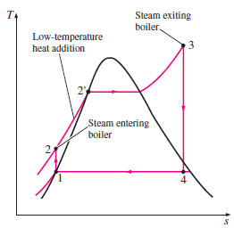
6. The Ideal Regenerative Rankine Cycle
A careful examination of the T-s diagram of the Rankine cycle shown reveals that heat is added to the working fluid during process 2-2’ at a relatively low temperature.
This lowers the average temperature at which heat is added and thus the cycle efficiency.
To remedy this shortcoming, we look for ways to raise the temperature of the liquid leaving the pump (called the feedwater) before it enters the boiler.

Slide 43
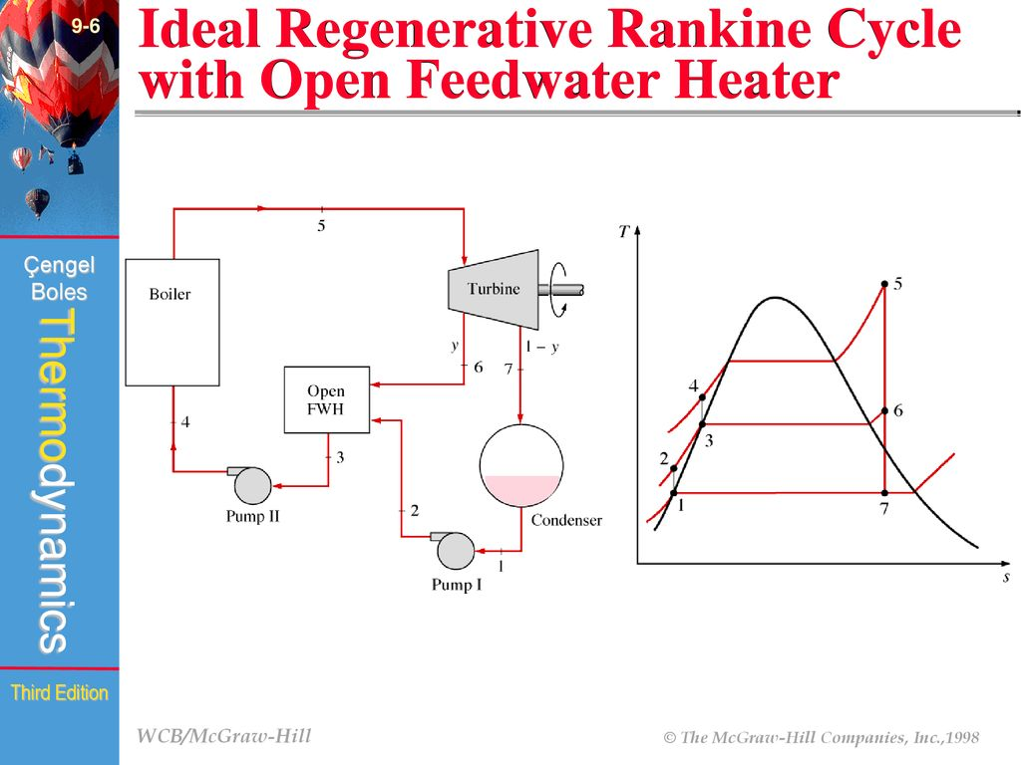
6. The Ideal Regenerative Rankine Cycle Cont…
A practical regeneration process in steam power plants is accomplished by extracting, or “bleeding,” steam from the turbine at various points [5].
This steam, which could have produced more work by expanding further in the turbine, is used to heat the feedwater instead.
Figure 10: Schematic and T-s diagram of an Ideal Regenerative Rankine Cycle
url: https://image4.slideserve.com/9116143/the-ideal-regenerative-rankine-cycle-with-an-open-l.jpg

Slide 44
6. The Ideal Regenerative Rankine Cycle Cont…
The device where the feedwater is heated by regeneration is called a regenerator.
A feedwater heater is basically a heat exchanger where heat is transferred from the steam to the feedwater either by mixing the two fluid streams (open feedwater heaters) or without mixing them (closed feedwater heaters).

Slide 45
Summary
The Rankine Cycle is the fundamental thermodynamic cycle used in steam power plants.
Real cycles experience inefficiencies due to irreversibilities such as friction, heat losses, and pressure drops, leading to lower actual efficiency compared to ideal cycles.
The ideal Reheat Rankine Cycle improves efficiency by reheating steam between turbine stages to reduce excessive moisture content and increase the work output of the cycle.
The Ideal Regenerative Rankine Cycle enhances efficiency by preheating the feedwater using extracted steam from the turbine, reducing the amount of fuel needed for heat addition in the boiler.
While these cycles guide power plant design, real-world
systems require engineering adaptations to optimize
performance while accounting for material limitations
and economic factors.

Slide 46
References
,
[1]. Thermodynamics – An Engineering Approach, Cengel Y A.,Bole M A., McGraw-Hill Education, 8th edition 2015.
[2]. Energy and exergy analyses of thermal power plants: A review. Kaushik, S. C., Reddy, V. S., & Tyagi, S. K. (2011). Renewable and Sustainable Energy Reviews, 15(4), 1857–1872. https://doi.org/10.1016/j.rser.2010.12.007
[3]. Thermodynamic analysis of reheat Rankine cycle. Dincer, I., & Al-Muslim, H. (2001). International Journal of Energy Research, 25(8), 727–739. https://doi.org/10.1002/er.713
[4]. Fundamentals of engineering thermodynamics, Moran, M. J., Shapiro, H. N., Boettner, D. D., & Bailey, M. B. (2018). (9th ed.). Wiley.
[5]. Thermodynamic Analysis of a Regenerative Rankine Cycle with Feedwater Heaters, Koroglu, Tahsin, and Osman S. Sogut. Energy Conversion and Management, vol. 174, 2018, pp. 382–394.

Slide 47
Thank you !

